Slide 1
Topic 3 Forces and Motion
Lesson 1
Describing motion and force

Slide 2
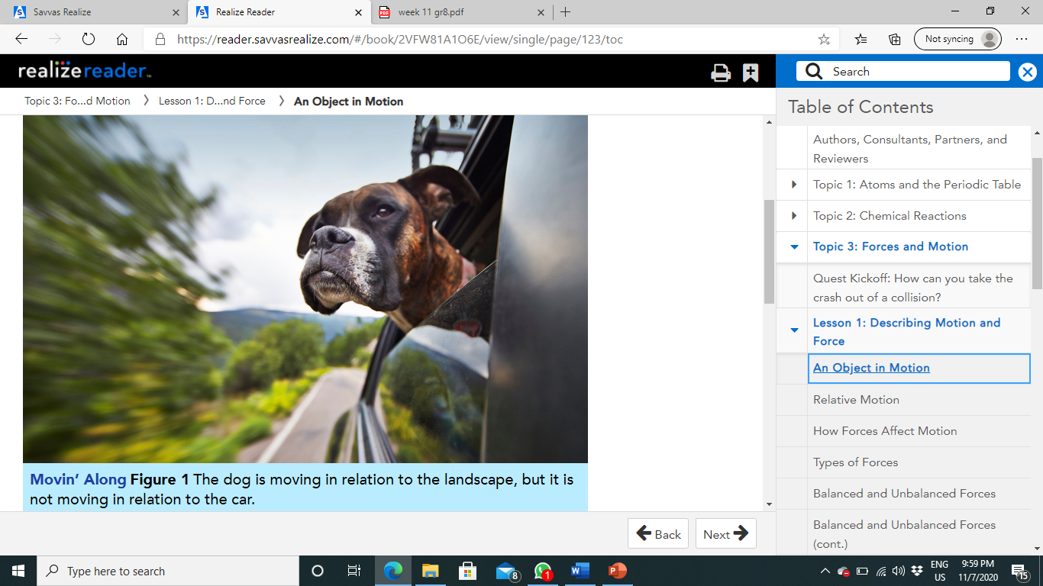
An Object in Motion:
How do you decide whether something is moving?
For example, if you were the photographer riding in the car in Figure 1, would you say the dog is moving?
Parts of it would seem to be.
Its eyes blink, and its ears flap in the wind.
But to you, the dog would appear to be staying in one position.
You know, however, that the dog is in a car that is speeding down the road, so it must be moving.
What determines whether the dog is moving or not?
Reference Points:
An object is in motion if its position changes when compared to another object.
To decide whether the dog is moving, you might use yourself as a reference point.
A reference point is a place or object used for comparison to determine whether something is in motion.

Slide 3
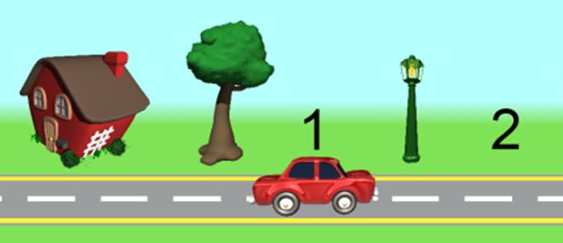
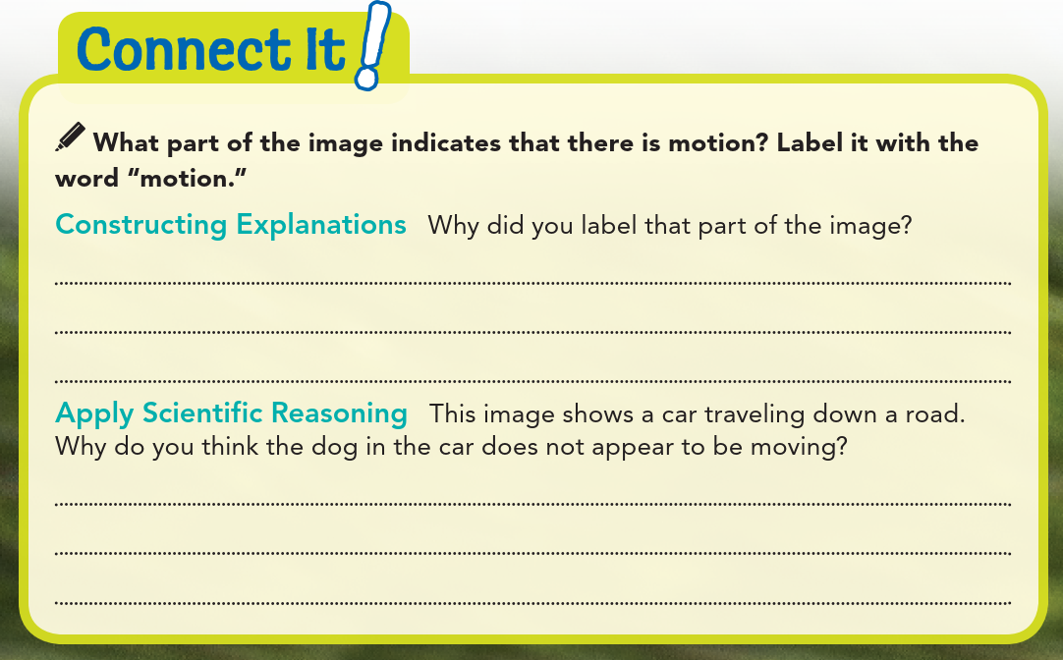
Objects that are fixed to Earth such as a tree, a stop sign, or a building make good reference points.
Suppose a tree along the road in Figure 1 is used as a reference point.
The car moves past the tree, as does the dog inside the car.
In relation to the tree, the dog changes position, and therefore is in motion.
However, if you are the photographer in Figure 1, and you are the reference point, your position relative to the dog does not change. You could say that, compared to you, the dog is not in motion.
motion

Slide 4
It was blurry, showing that something was moving.
The person taking the picture is in the car and is moving at the same speed as the dog.

Slide 5
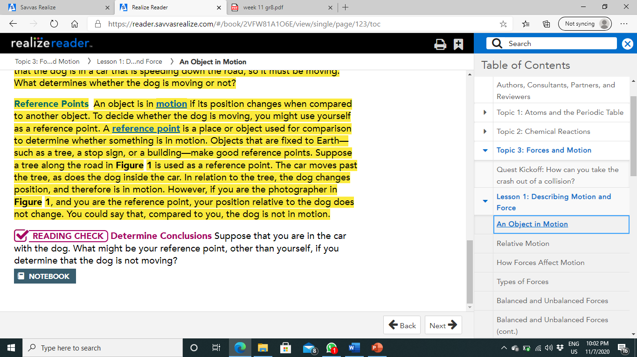
The car itself; another person in the car; an object in the car.

Slide 6
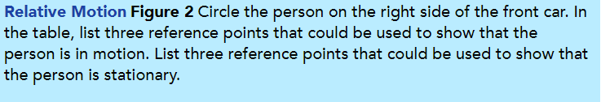
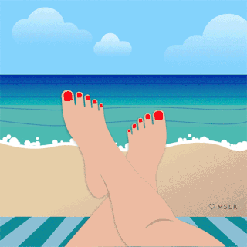
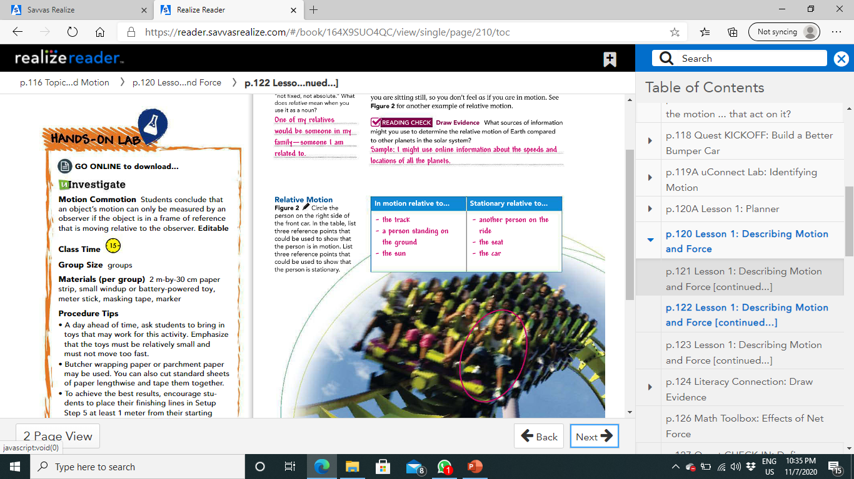
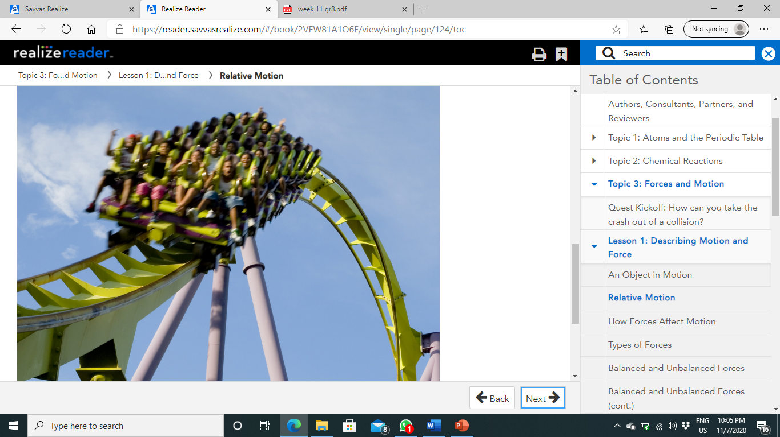
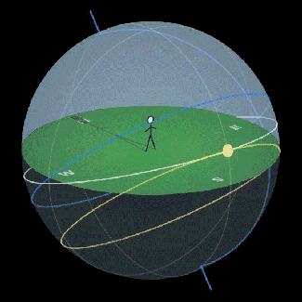
Relative Motion:
Because motion is determined by a reference point that can change, motion is relative.
Suppose you are relaxing on a beach. If you use your beach towel as your reference point, you are not moving. You and the beach towel are not changing positions relative to each other.
Suppose you use the sun as a reference point instead of your beach towel. If you compare your position to the sun, you are moving quite rapidly, because you are on Earth and Earth revolves around the sun.
Relative to the sun, you are moving, but relative to Earth, you are sitting still, so you don't feel as if you are in motion.
See Figure 2 for another example of relative motion.

Slide 7
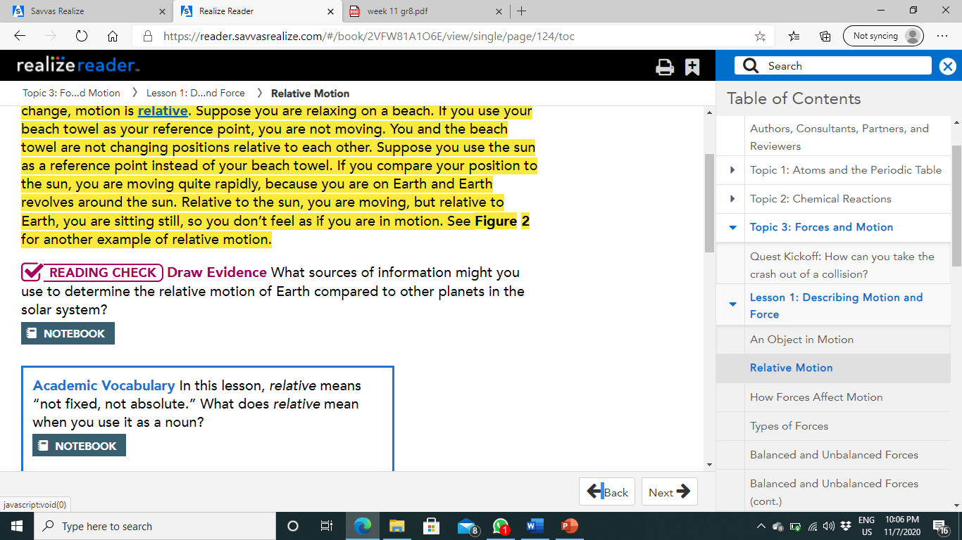
I might use online information about the speeds and locations of all the planets.

Slide 8
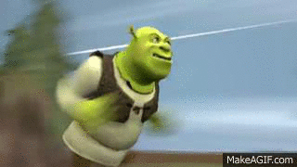
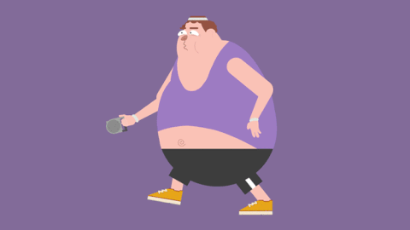
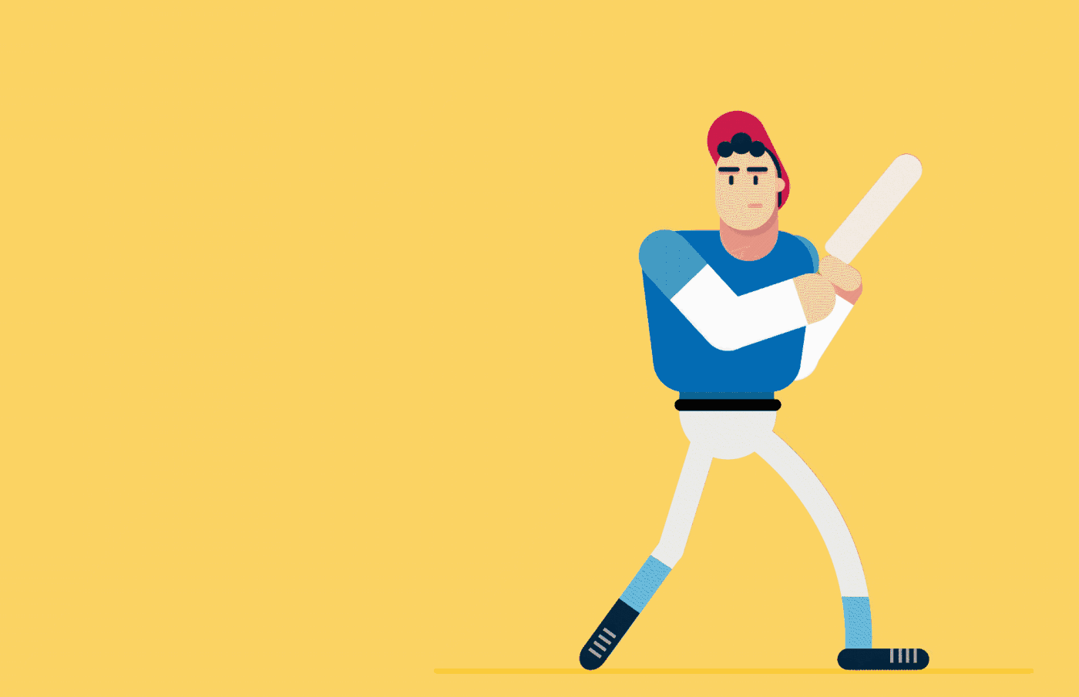
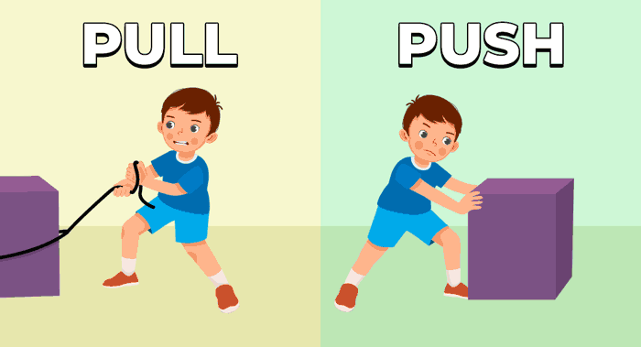
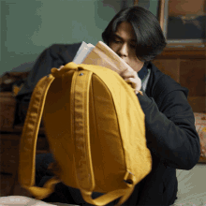
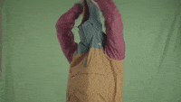
How Forces Affect Motion:
While objects move relative to one another, they can also speed up, slow down, and change direction.
The motion of an object can change when one or more forces act on the object.
A force is a push or a pull.
When one object pushes or pulls another object, the first object exerts a force on the second object.
You exert a force on a book when you push it into your book bag. You exert a force on the sleeve of your jacket when you pull it off your arm.

Slide 9
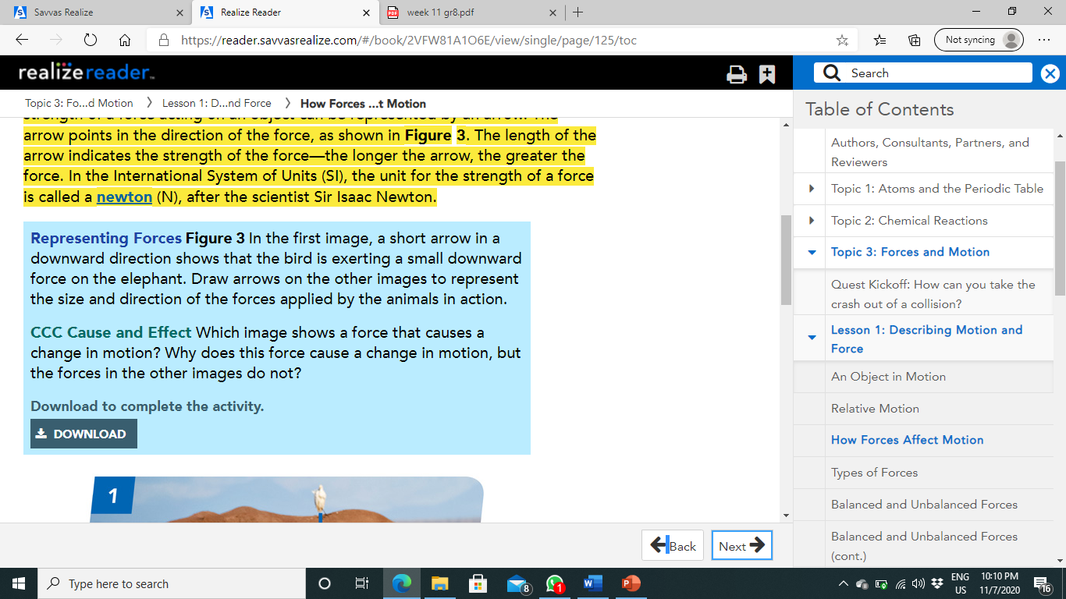
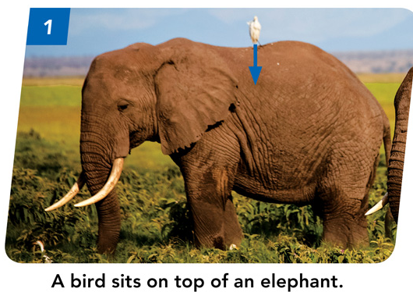
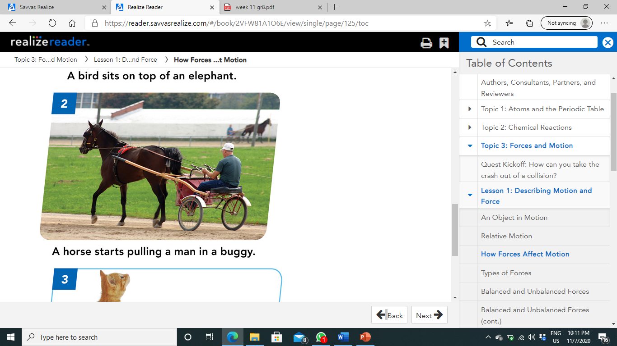
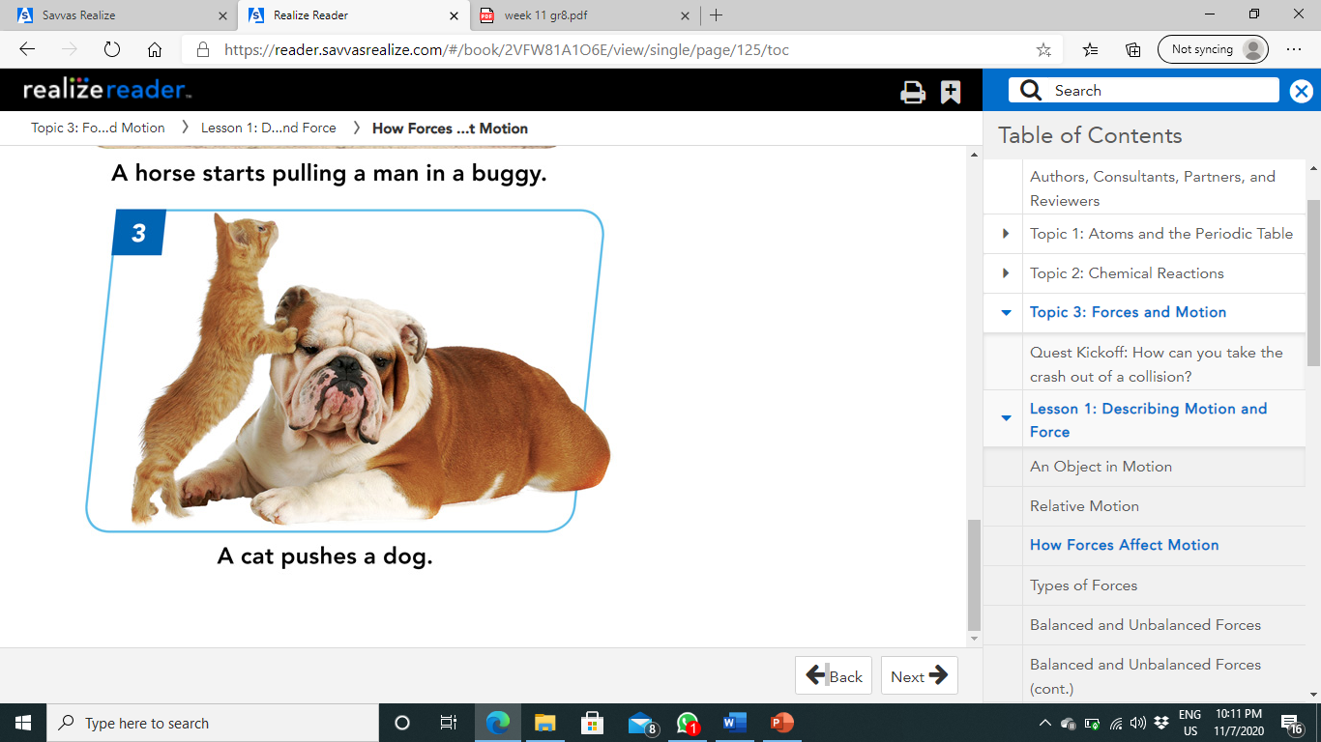
Describing Force:
A force is described by its strength and by the direction in which it acts.
The force needed to lift a dinner plate requires less strength than the force needed to push a refrigerator.
Pushing a faucet handle to the left is a different force from pushing it to the right.
In an image, the direction and strength of a force acting on an object can be represented by an arrow.
The arrow points in the direction of the force, as shown in Figure 3. The length of the arrow indicates the strength of the force ,the longer the arrow, the greater the force.
In the International System of Units (SI), the unit for the strength of a force is called a newton (N), after the scientist Sir Isaac Newton.
The horse is strong enough to pull the cart. The bird and cat are not strong enough to move the elephant and the dog.

Slide 10
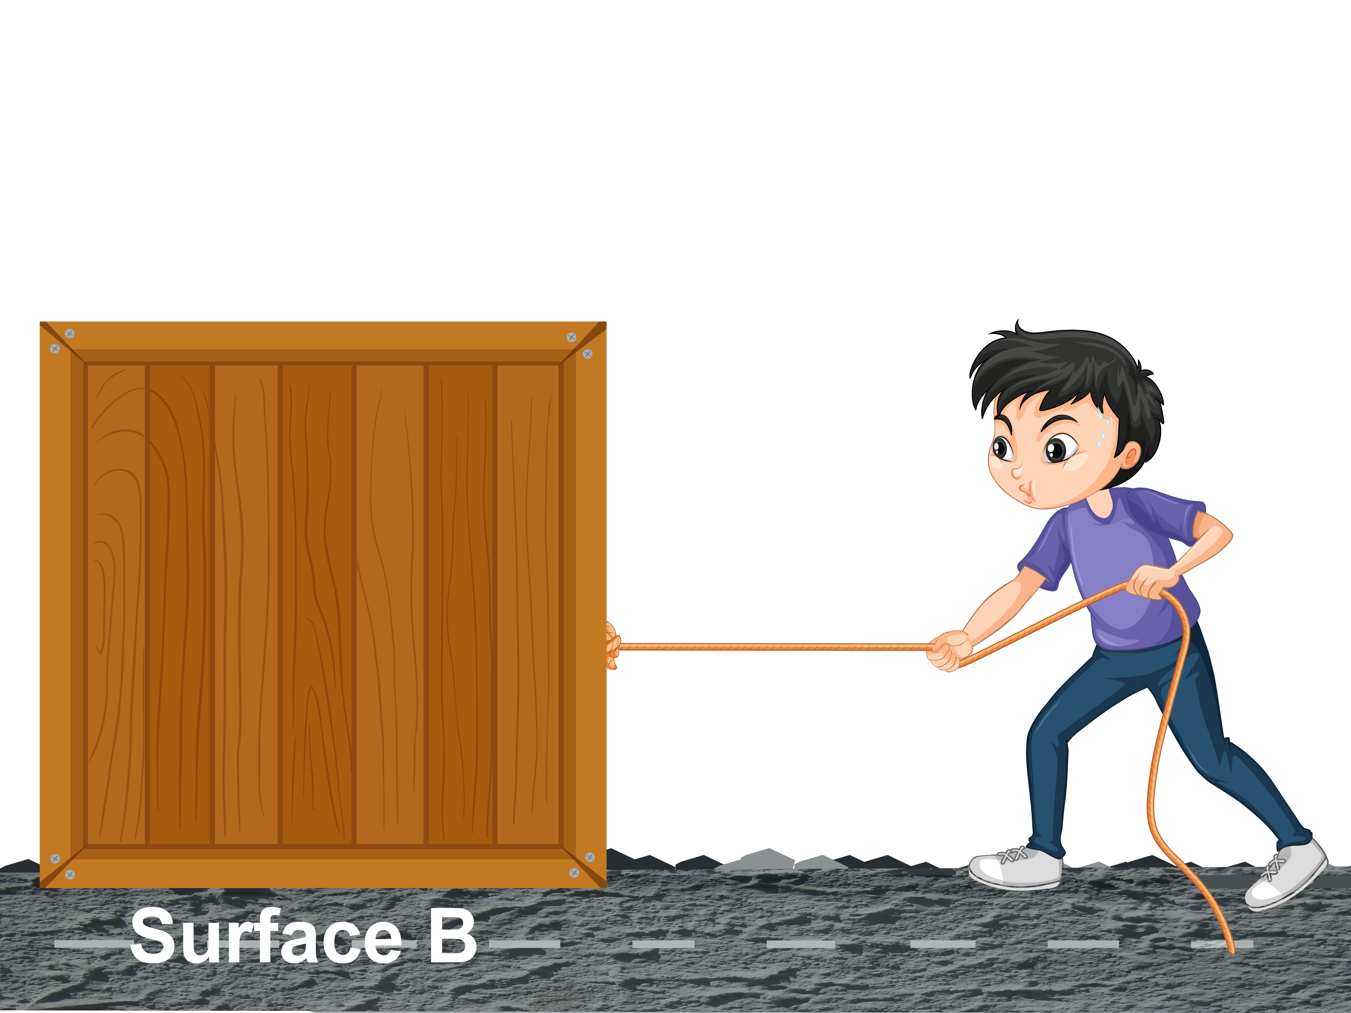
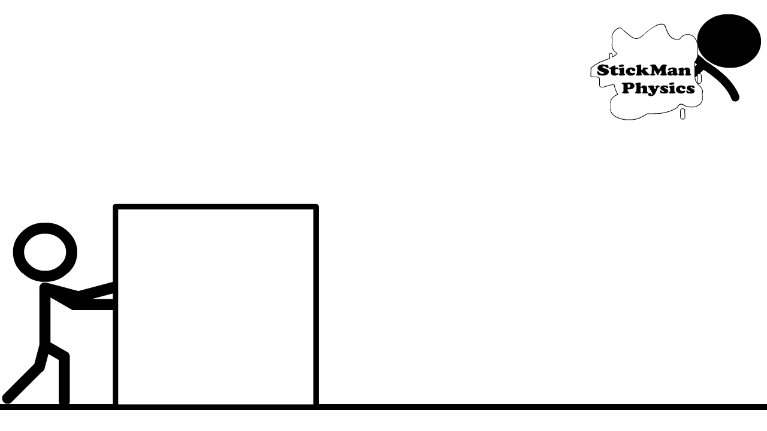
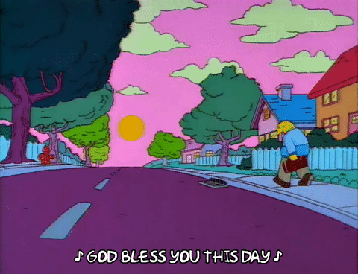
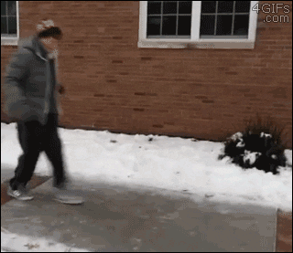
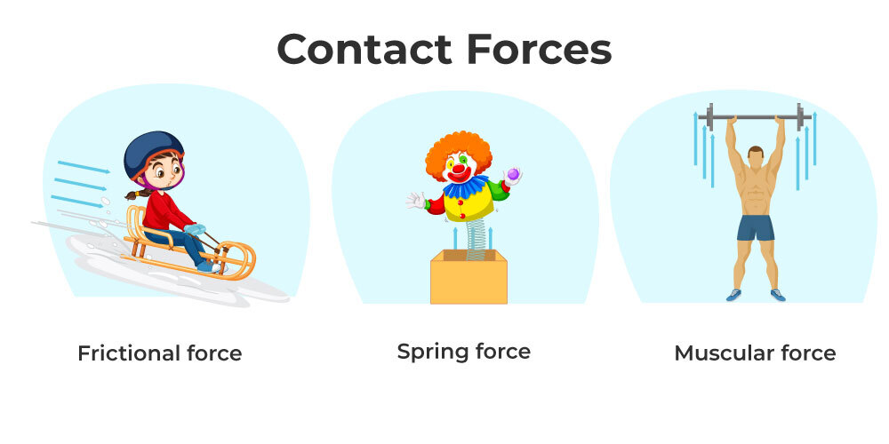
Types of Forces:
Forces can be classified as either
contact forces
noncontact forces
Contact forces are those applied only when one object actually touches another.
When you push a box across the floor, your push is a contact force because the force only exists while you touch the box.
The box may be difficult to push because there is another contact force acting on the box in the opposite direction of your push.
It is the force of friction between the box and the floor.
Friction is a contact force that two surfaces exert on each other when they rub against each other.
Friction between your feet and the sidewalk prevents you from slipping as you walk.
Ice on the sidewalk greatly reduces that friction.

Slide 11
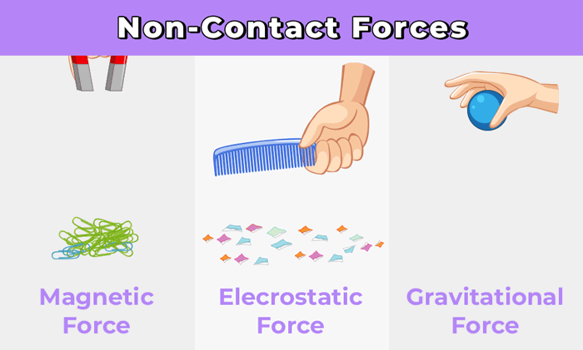
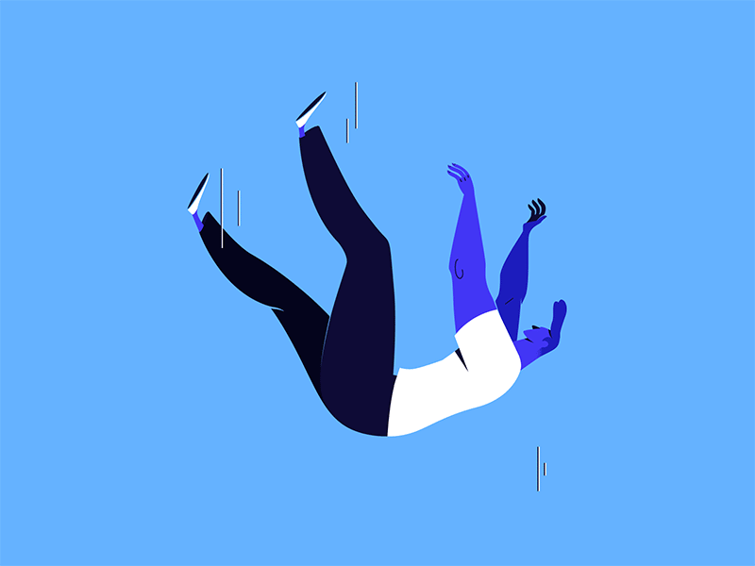
A noncontact force is a force applied to an object whether it touches the object or not.
One noncontact force that you experience every day is gravity, a force that pulls objects toward each other as a result of their masses.
The force of gravity pulls your body toward Earth.
Magnetism and electrical forces are also noncontact forces.

Slide 12
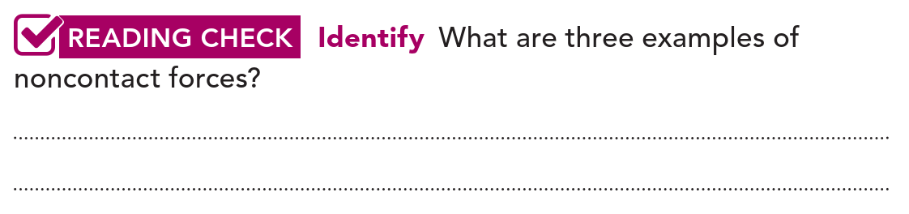
Gravity, magnetism, and electrical forces.

Slide 13
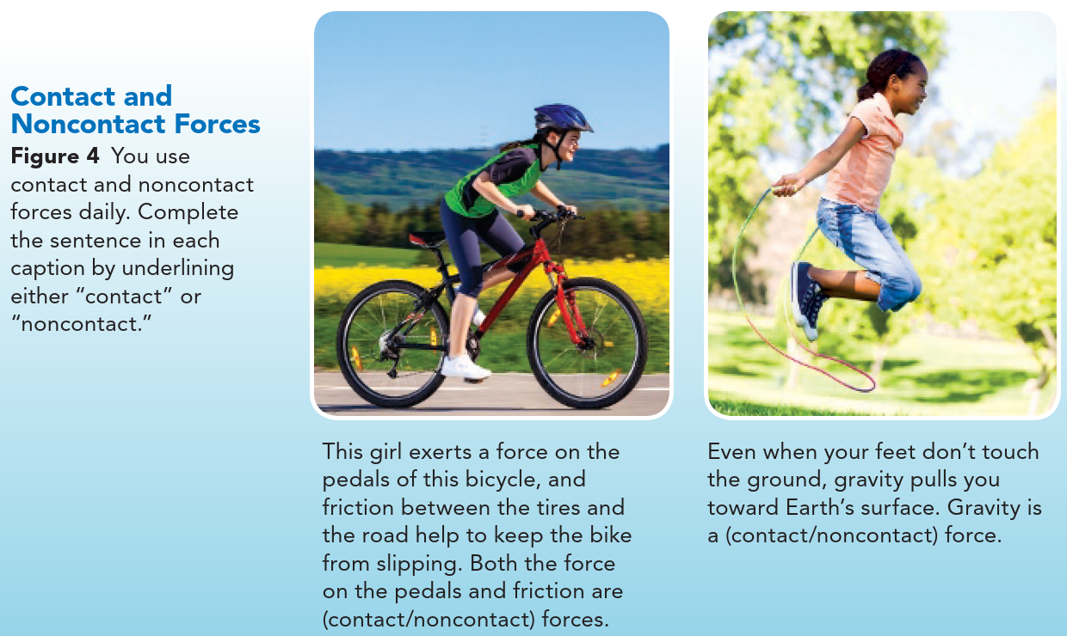

Slide 14
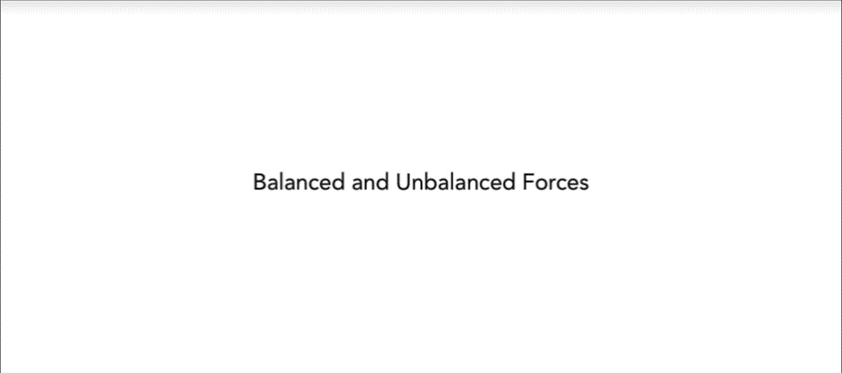
Balanced and Unbalanced Forces:
More than one force can act on an object.
If two forces acting on an object are equal in strength and opposite in direction, they are balanced forces.
A single book resting on a shelf has two forces acting on it.
The downward force of gravity is equal in strength and opposite in direction to the upward force of the shelf on the book.
The forces are balanced.
What happens when someone pulls the book off the shelf? The pull of the person removing the book and the friction between the shelf and the book also act in opposite directions.
These two forces, however are not equal in strength. The pull is stronger than the friction. These forces are unbalanced.

Slide 15
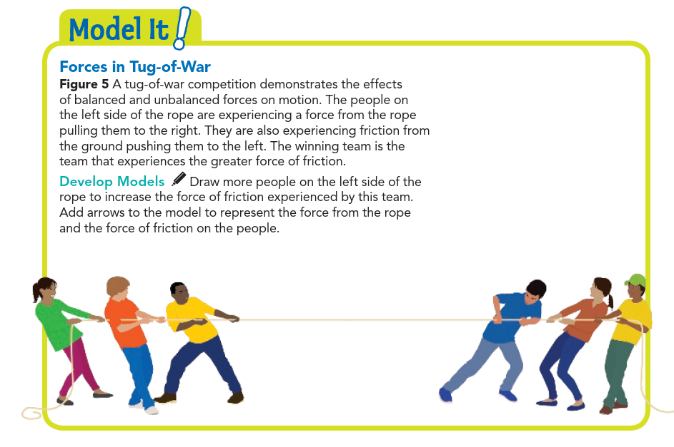
Friction
Force

Slide 16
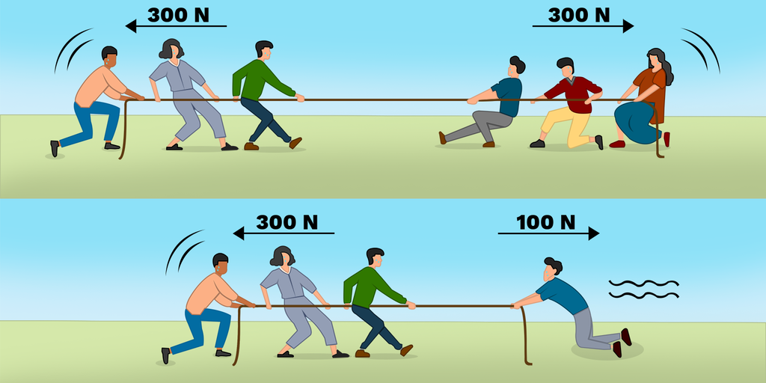
Balanced and Unbalanced Forces:
When the forces on an object are unbalanced, there is a nonzero net force acting on the object.
The net force on an object is the combination of all the forces acting on that object.
If the forces act in the same direction, the net force is the sum of the forces.
If the forces act in opposite directions, the net force is the difference in the strengths of those forces.
If the net force turns out to be zero, the forces are balanced.
Otherwise, the forces are unbalanced.
A nonzero net force acting on an object causes a change in the object's motion.
Choose which is the unbalanced force the first or the second one?

Slide 17
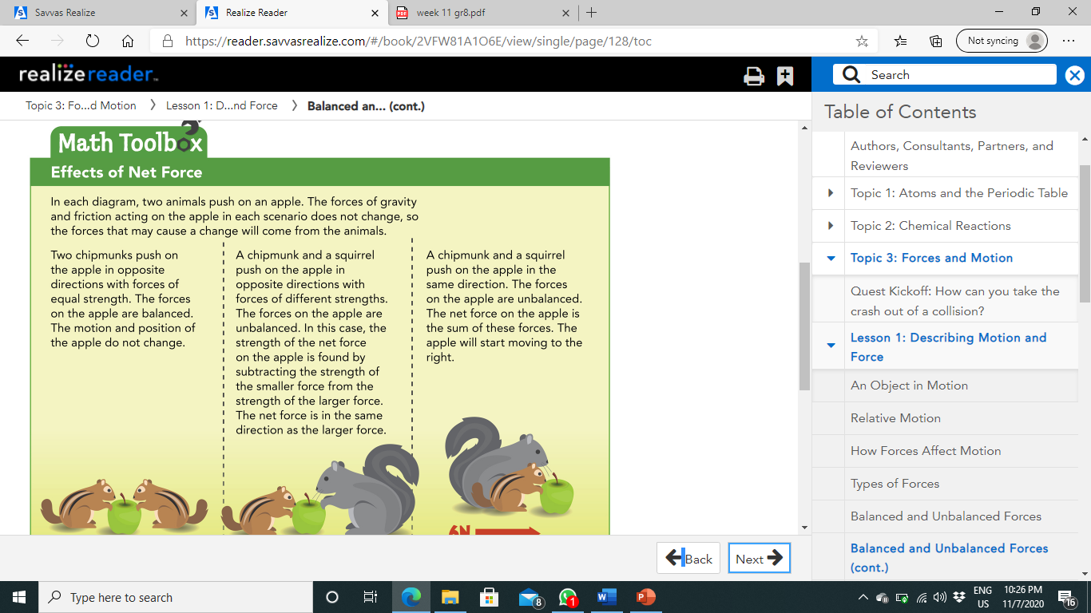
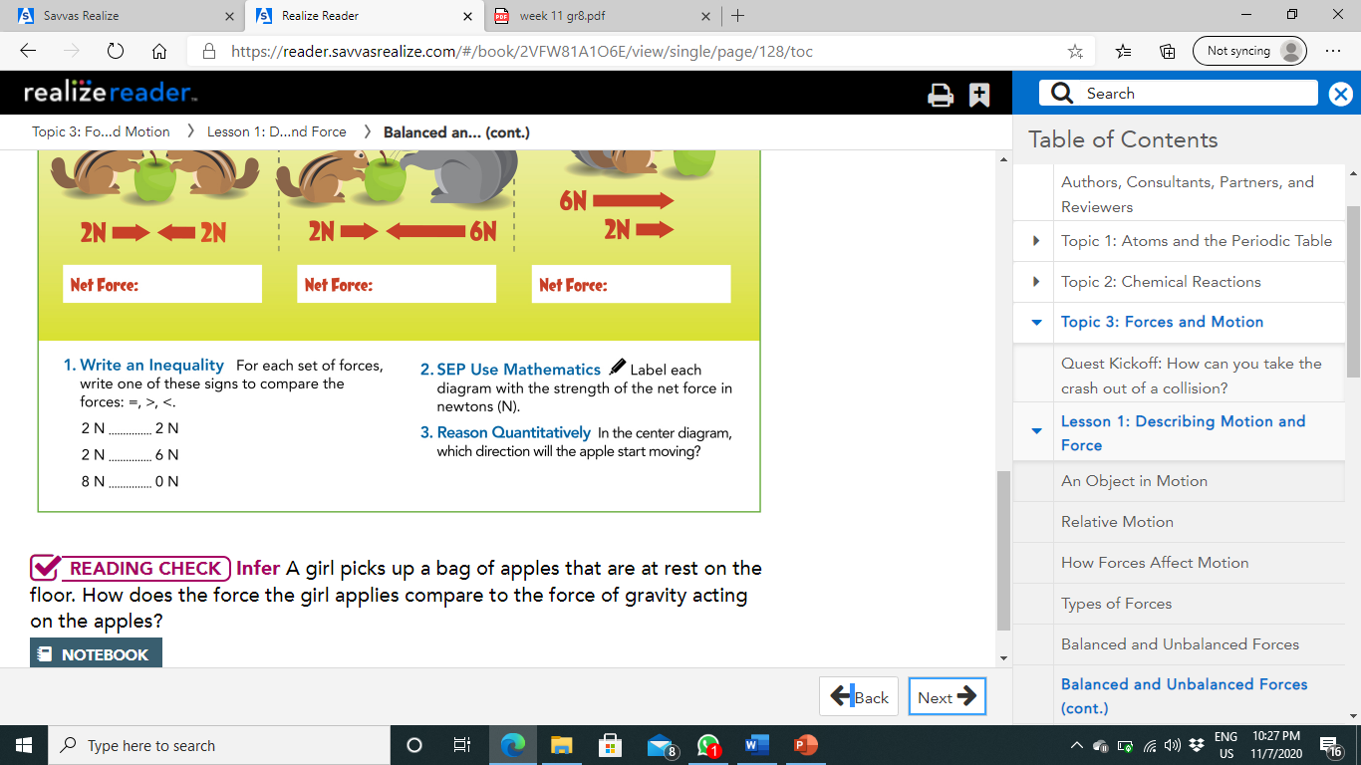
0 N
4 N
8 N
=
<
>
To the left

Slide 18
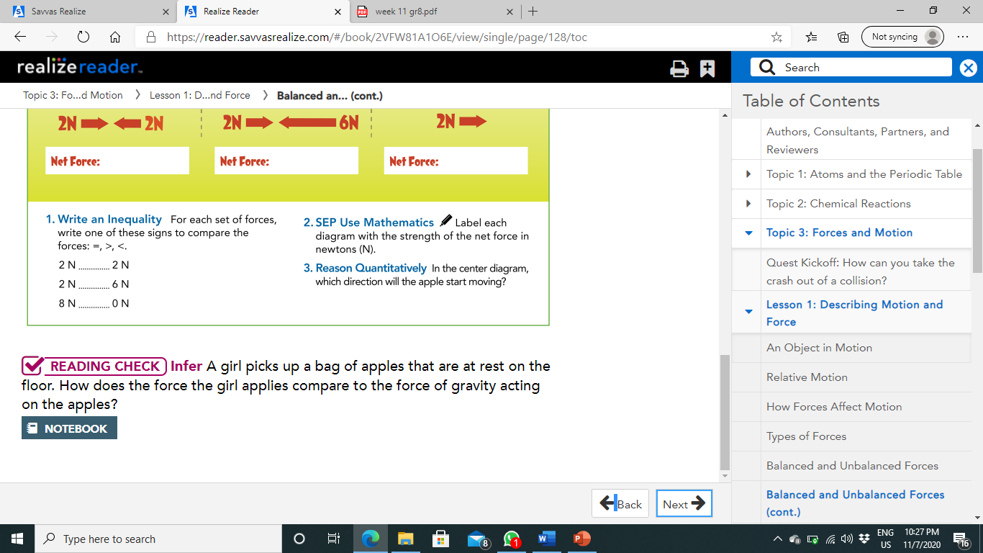
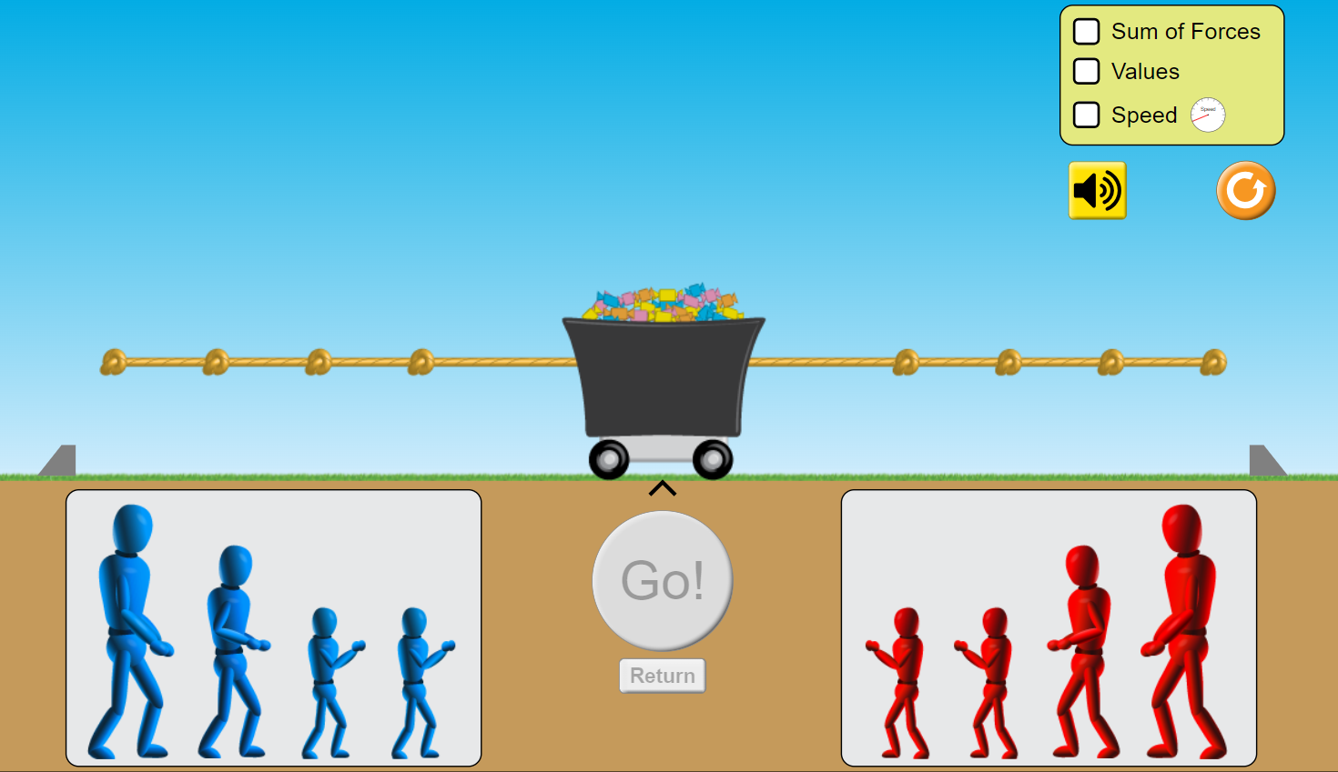
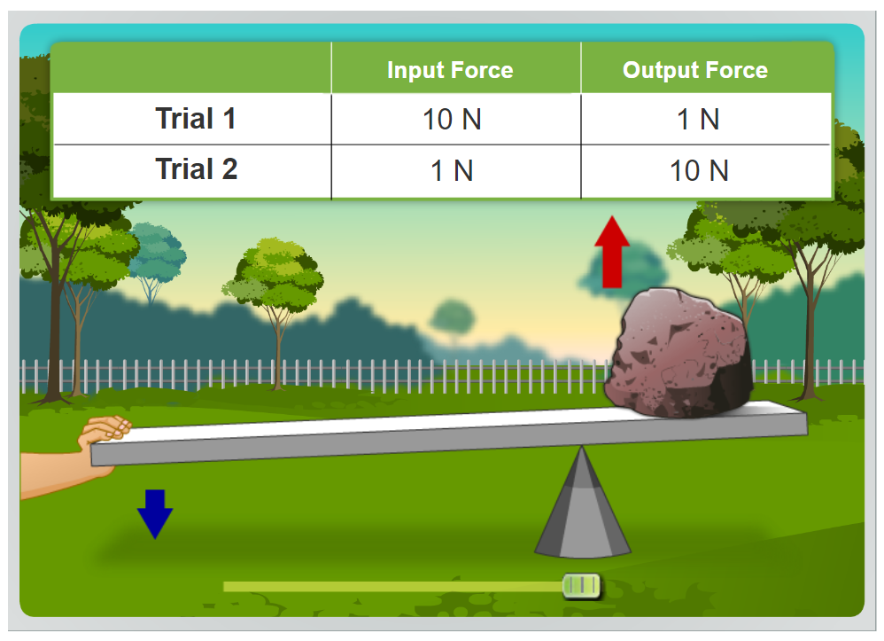
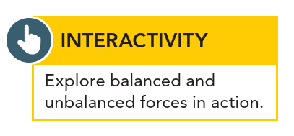
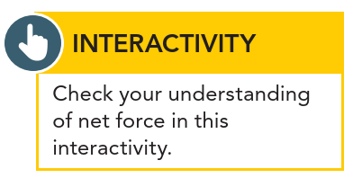
The lifting force is stronger than the force of gravity and acts in the opposite direction.

Slide 19
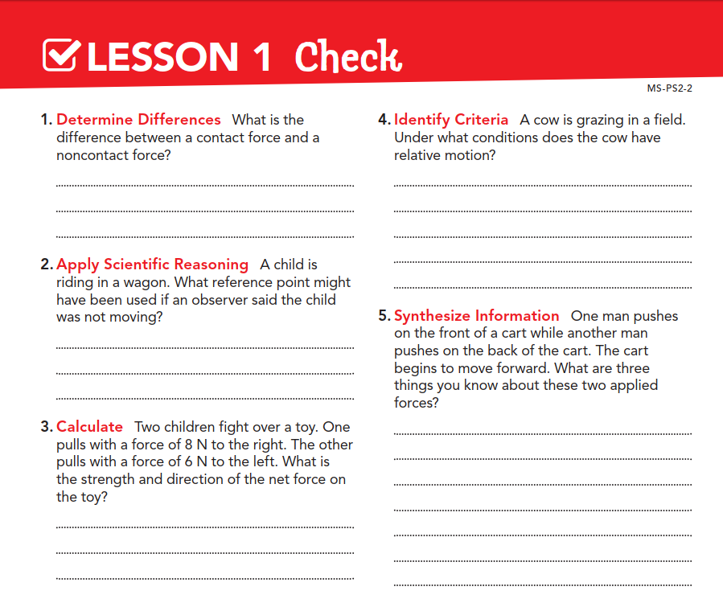
The object applying the force and another object must touch for the force to be a contact force.
The cow has relative motion when it is compared to a reference point that is moving in relation to the cow, such as a truck driving by.
The wagon itself
They are unbalanced, the net force is not zero, and the strength of the force on the back of the cart is greater than the force on the front.
8N – 6N = 2N to the right

Slide 20


