Slide 1
Lesson 2 Chemical Change

Slide 2
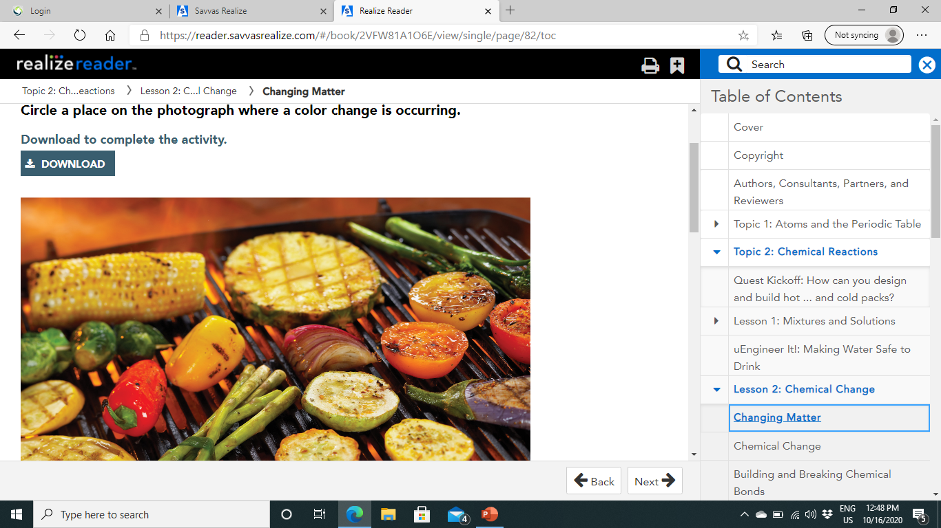
Changing Matter
Introduction:
Think about the steps in grilling veggies. You slice some of them into smaller pieces.
Then, you place them on the grill and turn on the heat.
As the veggies cook, they become charred, turning black in some areas.
The whole process involves both physical and chemical changes to matter.

Slide 3
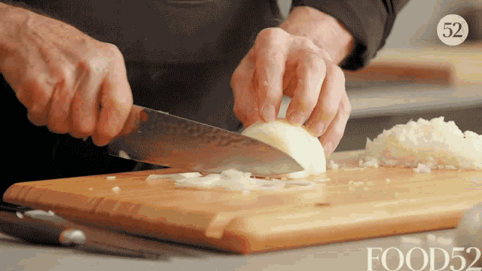
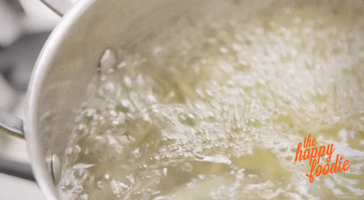
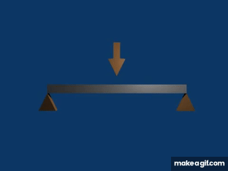
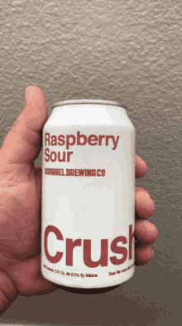


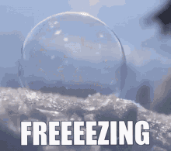
Physical Change:
Physical change: is a change that alters the form or appearance of a substance without changing it into a different substance.
Slicing an onion is an example of a physical change
The onion becomes smaller objects of different shape, but the onion pieces are made of the same matter as before.
Water boiling is also a physical change.
While the water may not be visible as vapor in the air, it is still water molecules of two hydrogen atoms bonded to an oxygen atom.
Bending, crushing, cutting, melting, freezing, and boiling are all physical changes.

Slide 4
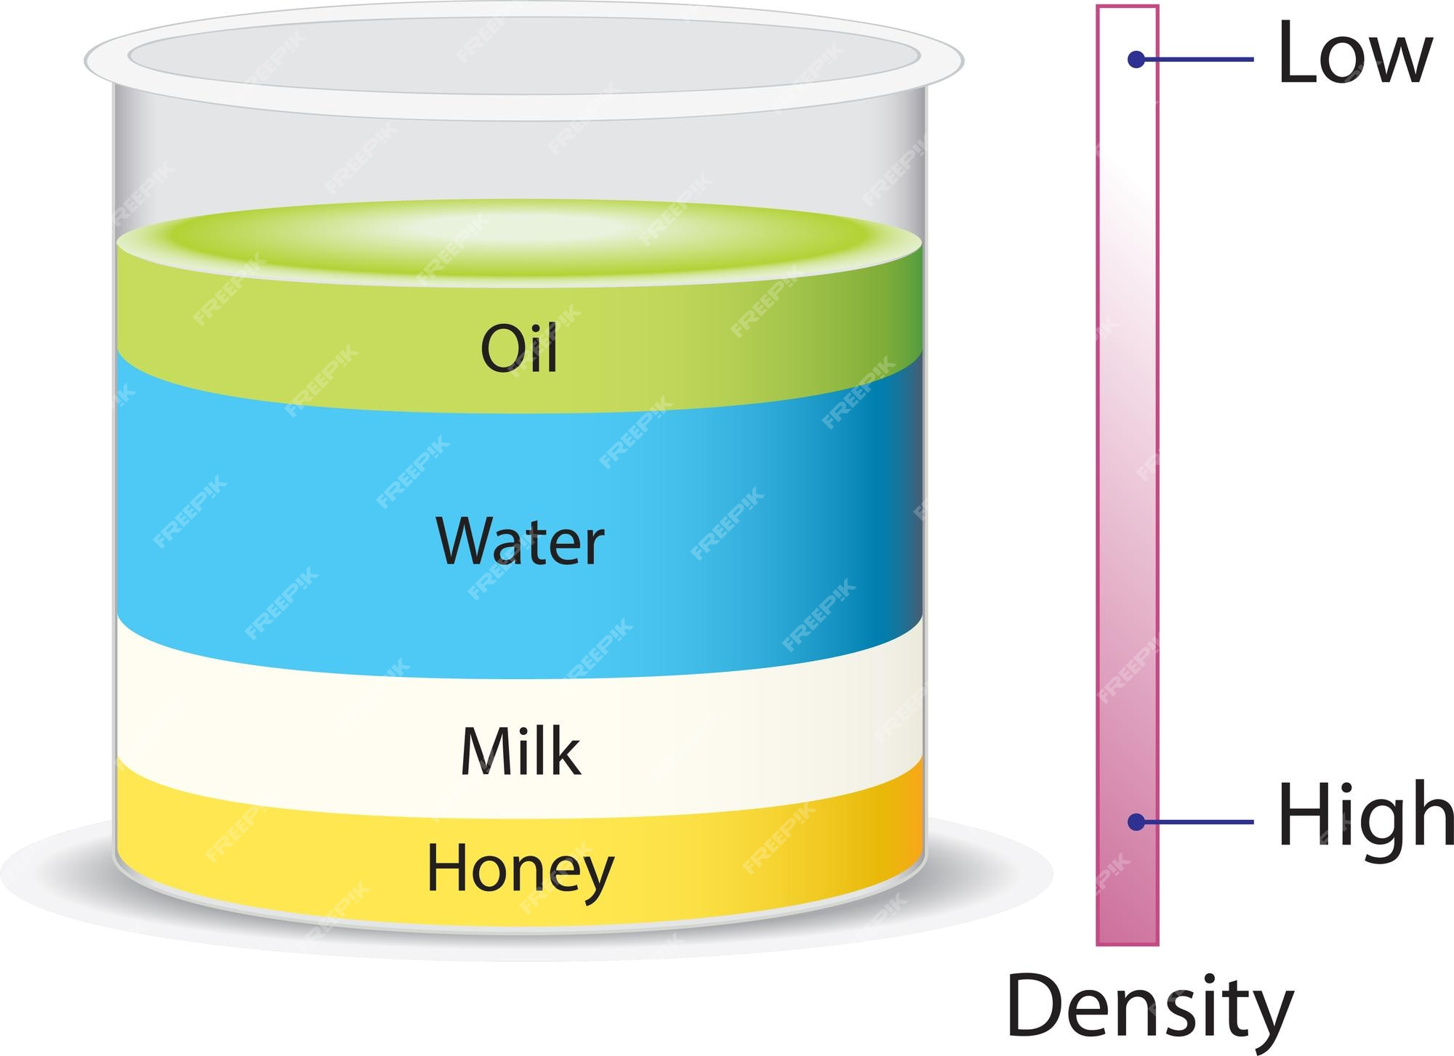
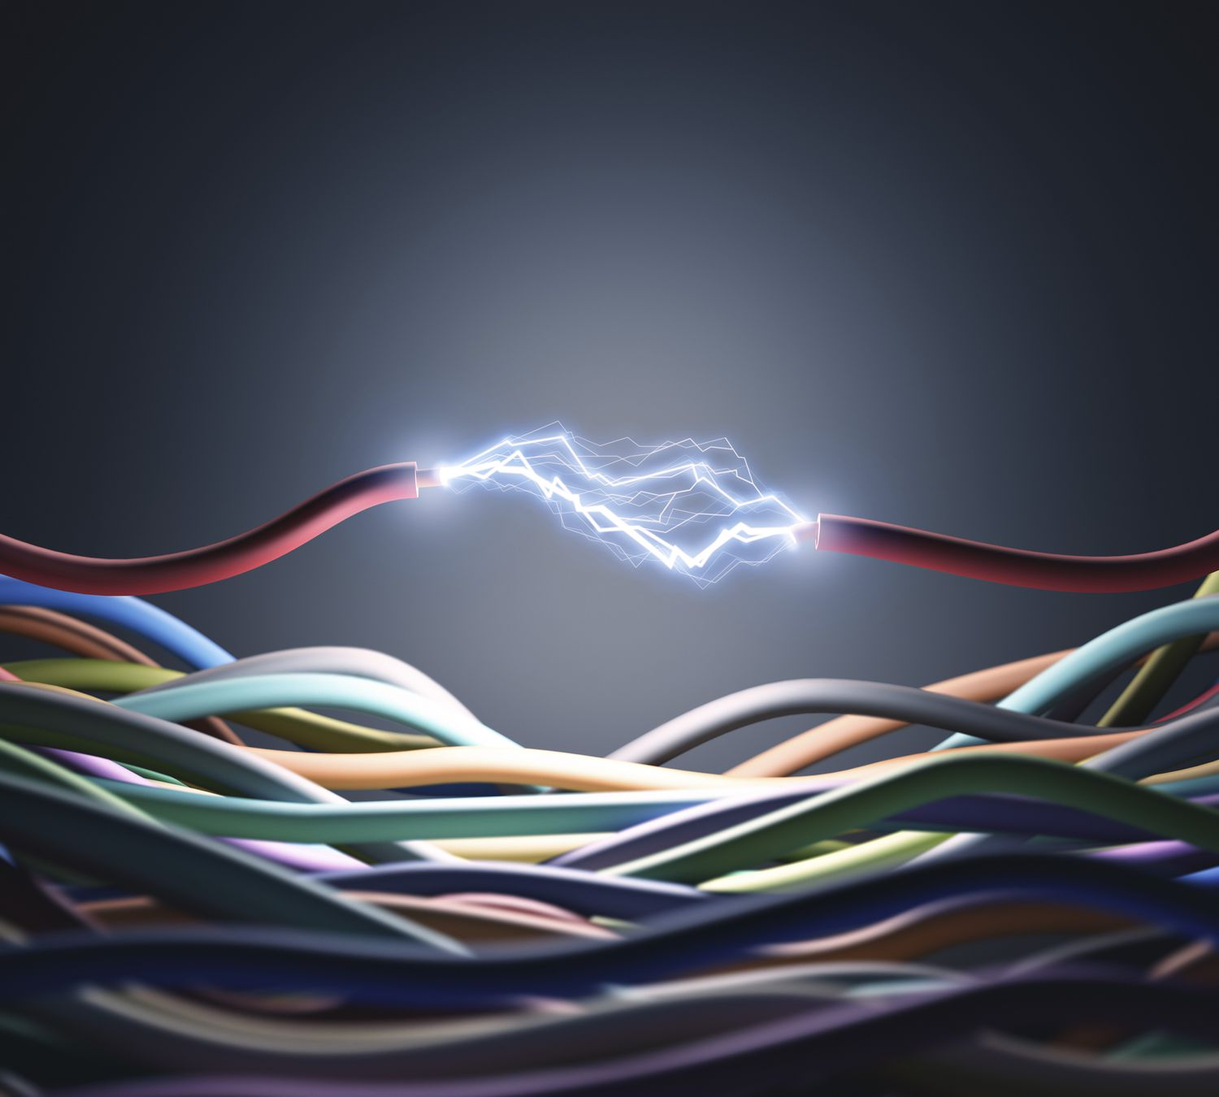
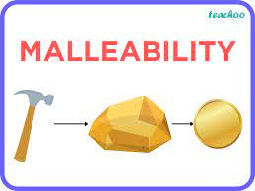
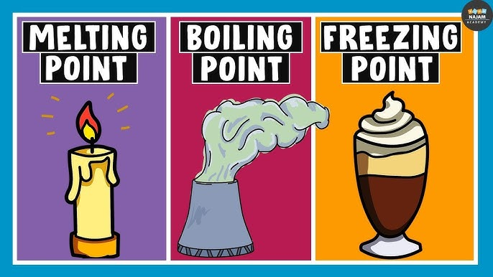
While physical changes may alter some physical properties of an object, the characteristic physical properties of the matter remain the same.
Some characteristic physical properties include density, conductivity, malleability, melting point, freezing point, and boiling point.
For instance, the boiling point of water is 100°C. One drop of water or one liter will both boil at this temperature.

Slide 5
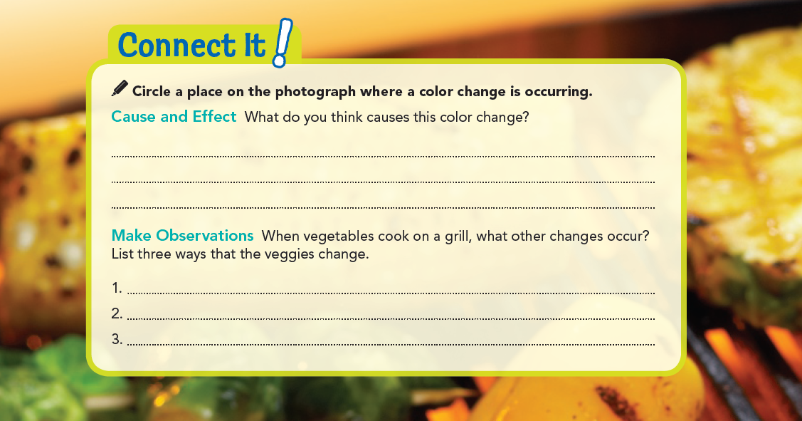
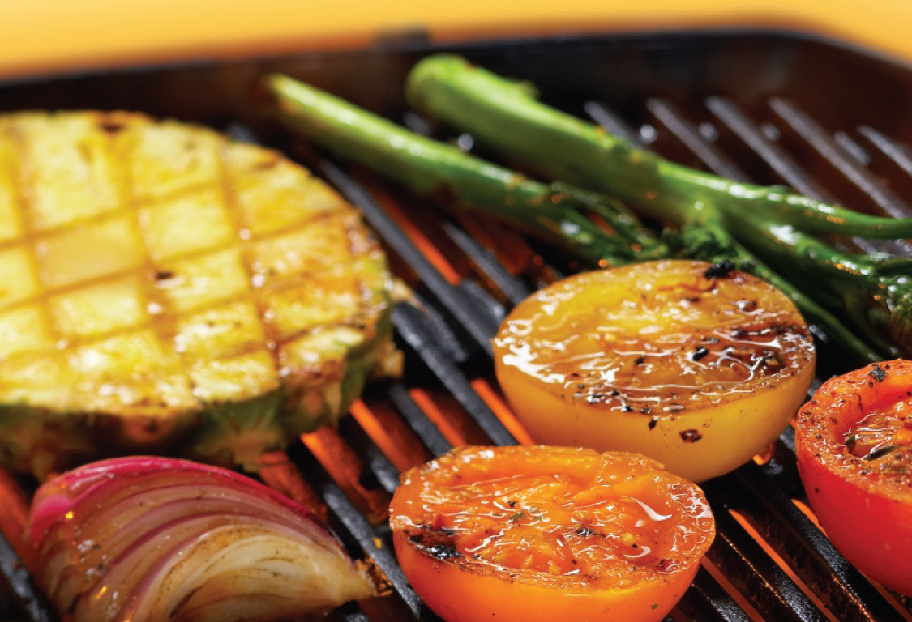
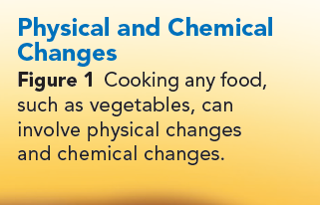
The tomato is turning black, heat from the grill causes the tomato to change color.
They become hotter.
Their shapes change slightly; some shrivel.
Their texture changes; some become less crisp.

Slide 6
chemical Change:
When veggies cook on the grill, they turn black in some places.
Heat causes a chemical reaction that forms new compounds, resulting in the black color.
A chemical reaction can also be called a chemical change which is a change in matter that produces one or more new substances.
In a chemical change, atoms and molecules rearrange to form new ones.
Substances that undergo chemical changes are called reactants, and what they form are called products.
Burning and rusting are both examples of chemical changes.
During these changes, characteristic chemical properties of the reactants can be observed. When a substance burns, you can observe the substance's flammability. When iron rusts, you can observe its reactivity with oxygen. During both of these chemical reactions, changes in color provide evidence that a chemical reaction has occurred.

Slide 7


Slide 8
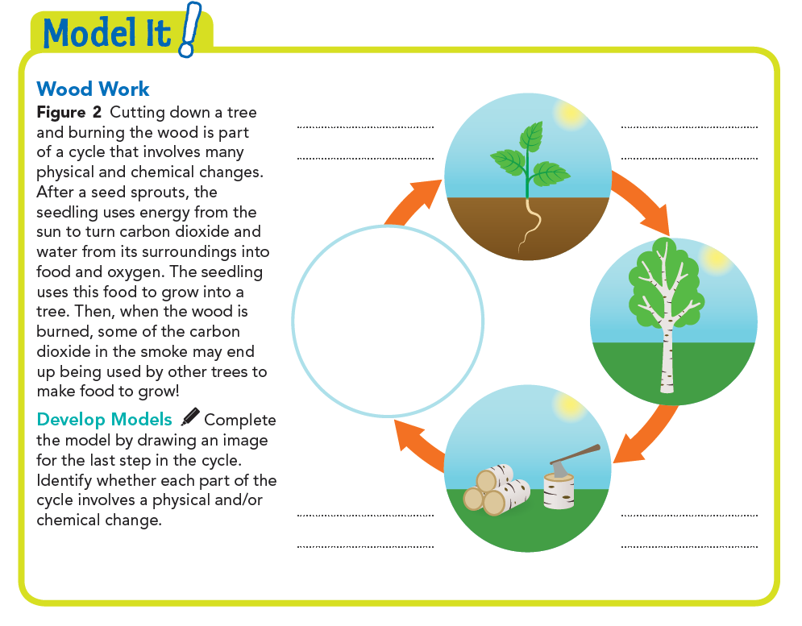

Physical change
Chemical change
Physical change
Chemical change
Physical change
Chemical change
Physical change

Slide 9
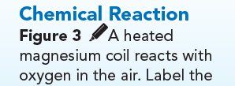
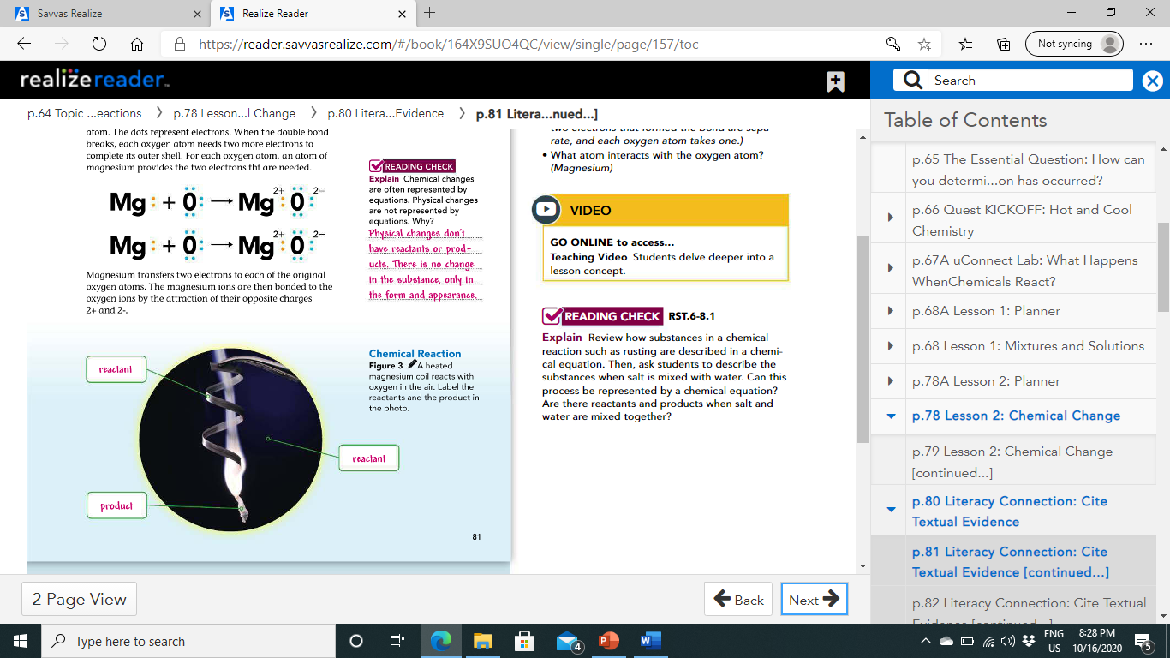
Building and Breaking Chemical Bonds:
Chemical changes occur when existing bonds break and new bonds form, as a result, new substances are made.
Atoms bond when they share or transfer electrons.
Figure 3 shows magnesium, a shiny metal, burning.

Slide 10
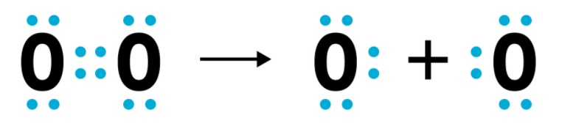
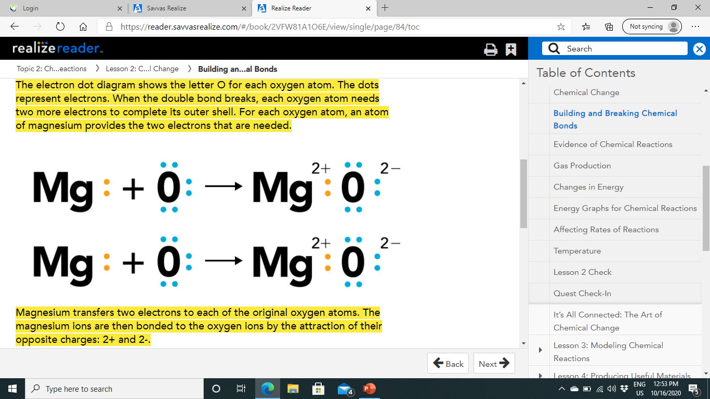
It reacts with oxygen in the air to produce magnesium oxide, a white solid.
Here is what happens to the atoms during the chemical reaction.
When the double bond breaks, each oxygen atom needs two more electrons to complete its outer shell.
For each oxygen atom, an atom of magnesium provides the two electrons that are needed.
Magnesium transfers two electrons to each of the original oxygen atoms. The magnesium ions are then bonded to the oxygen ions by the attraction of their opposite charges: 2+ and 2-.

Slide 11
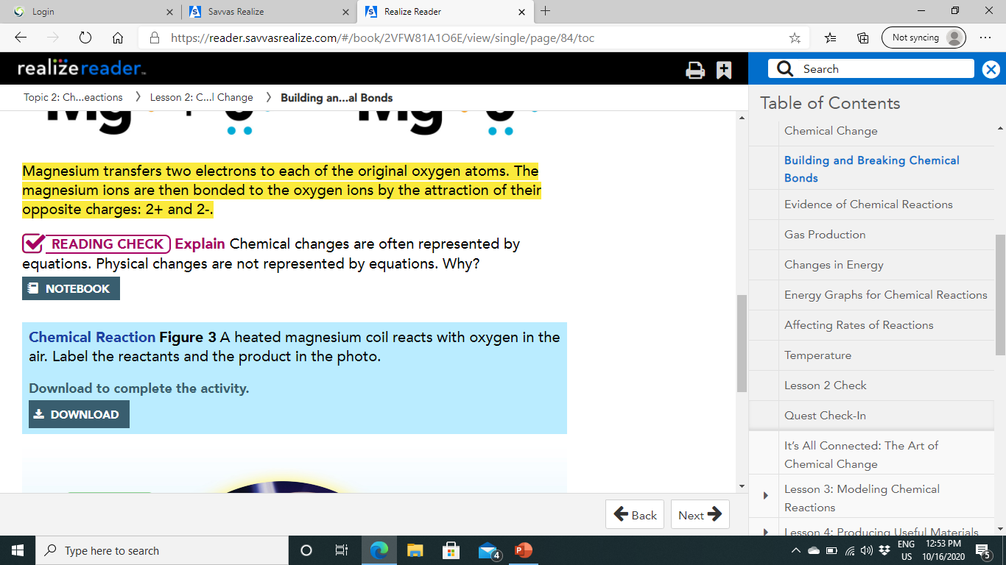
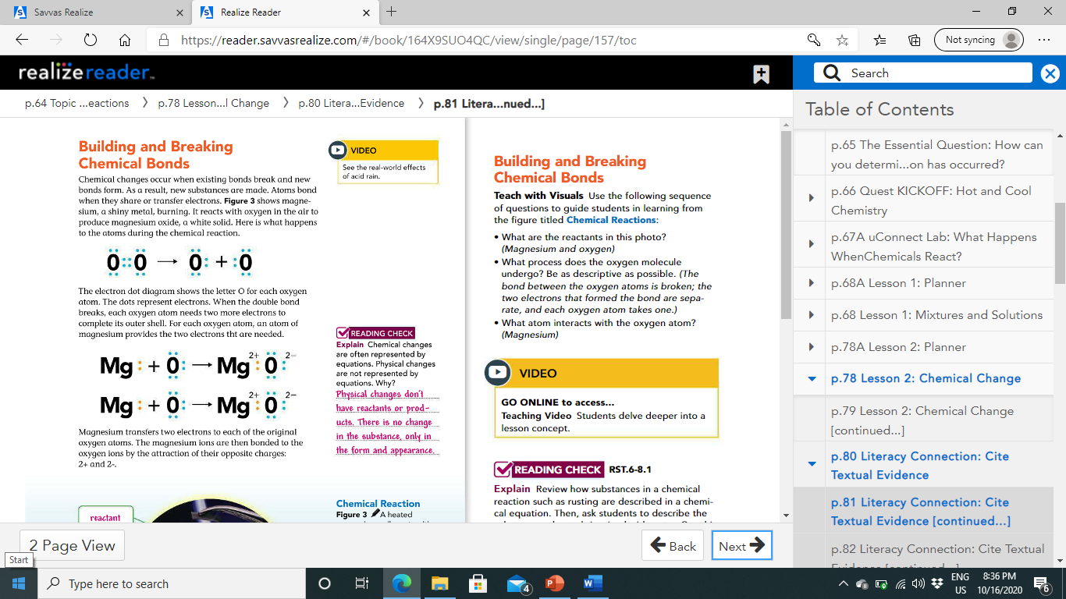

Slide 12
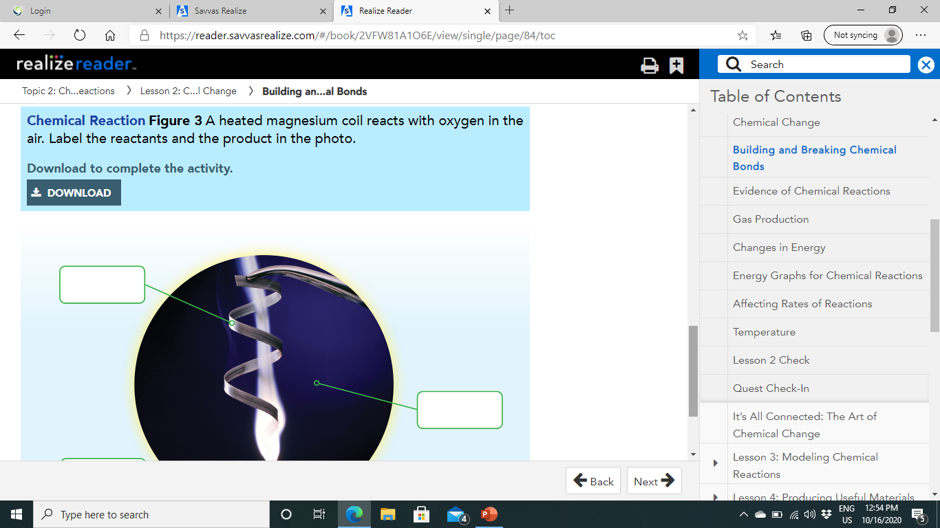
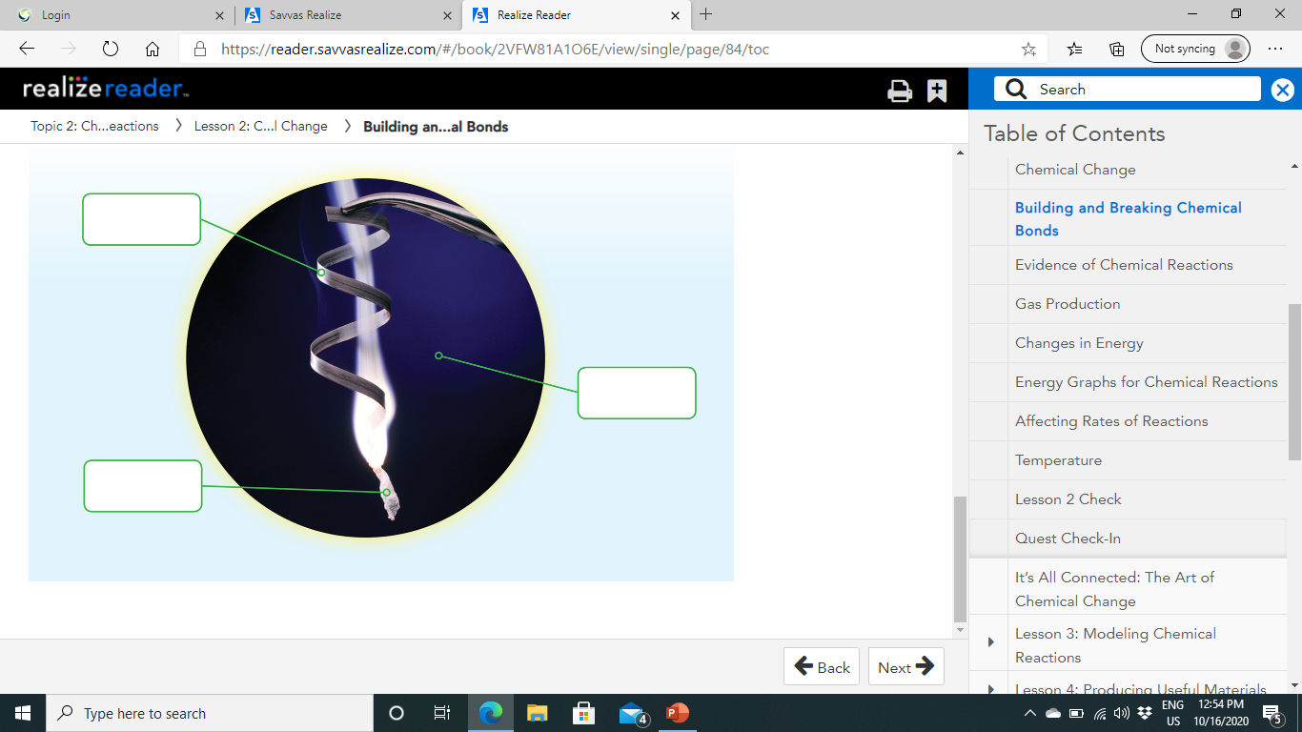
Reactant
Reactant
Product

Slide 13
Evidence of Chemical Reactions:
In the chemical changes you've just read about, there is some kind of movement of energy.
For example, the reaction of magnesium and oxygen requires energy from the flame to get started, and then the chemical reaction releases energy.
Changes in energy and changes in properties are both signs that a chemical reaction has occurred.
In general, the only way to be absolutely certain that a chemical reaction has occurred is to confirm that a new substance has been created.
However, there are other observable changes that can indicate that a chemical reaction has occurred.

Slide 14
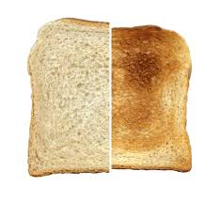
1-Color Change:
A color change may signal that a new substance has formed in an otherwise unchanged object.
A slice of bread that just popped up from a toaster is brown.
This is because heat energy burns sugars in the bread, producing different carbon compounds that taste slightly different than the untoasted bread would taste.

Slide 15
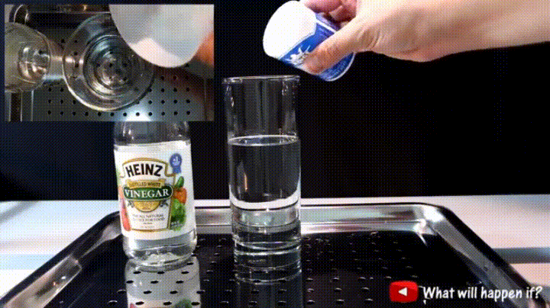
2-Gas Production:
Another observable change that is evidence of a chemical reaction is the production of gas from solid or liquid reactants.
For example, the chemical reaction between vinegar and baking soda produces carbon dioxide gas.
However, the presence of bubbles is not always a sign of a reaction taking place.
Bubbles of carbon dioxide appear in soda when the bottle is opened and pressure is released.
The only way to be certain that any chemical reaction has taken place is the presence of one or more new substances.

Slide 16
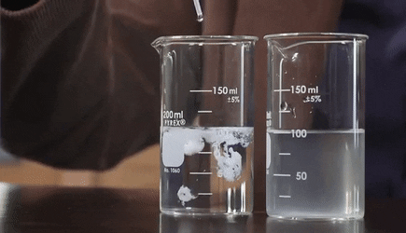
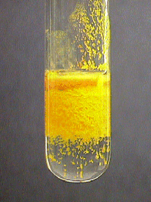
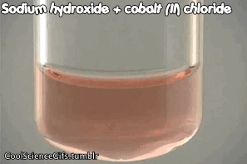
2- Formation of a Precipitate:
Mixing two liquids may produce a precipitate, which is a solid that forms from liquids.
When milk and lemon juice are mixed, a chunky precipitate forms.
Some dairy products are made by taking advantage of similar reactions between milk and other substances.

Slide 17
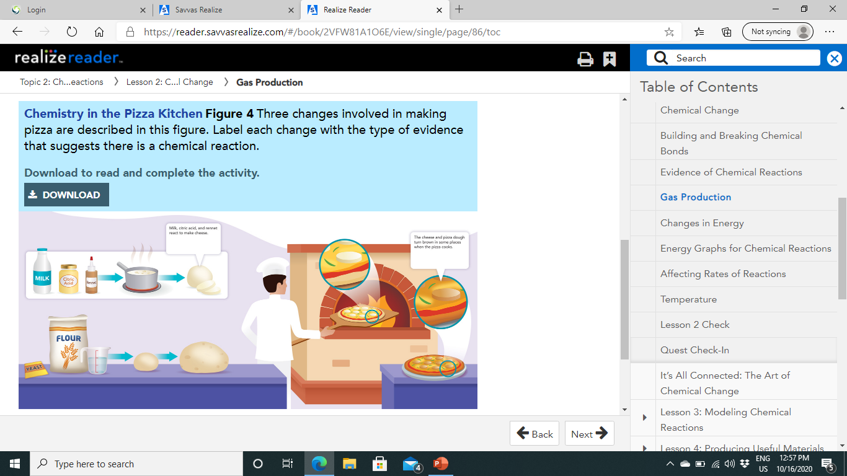
Formation of a precipitate
Color change
Gas production

Slide 18
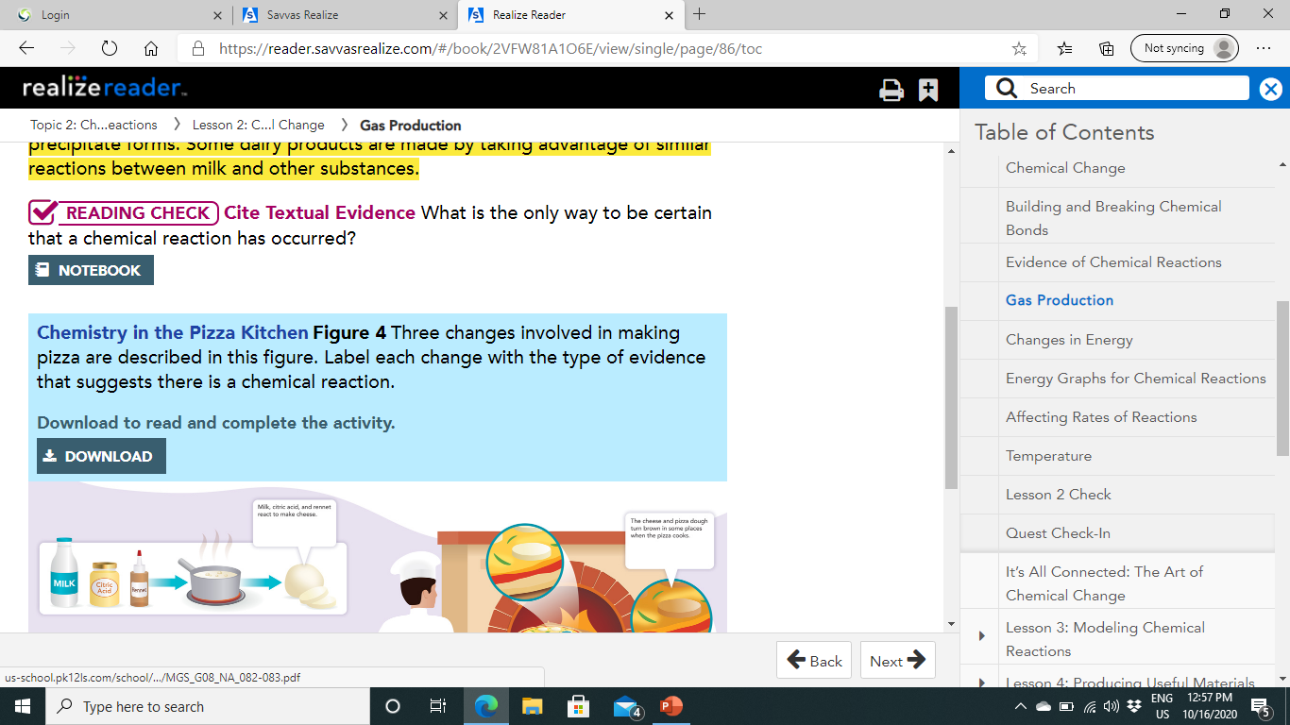
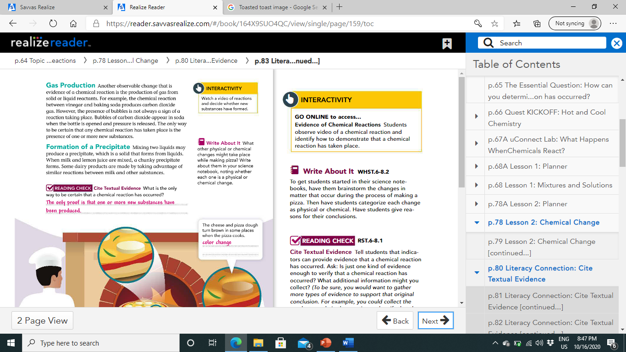

Slide 19
Changes in Energy:
You have seen that some chemical reactions, such as the browning that occurs on the surfaces of a pizza as it cooks, require energy in the form of heat.
Other chemical reactions give off energy.
Reactions are classified as exothermic or endothermic, based on the direction of heat flow.
Chemical reactions
Exothermic
Endothermic

Slide 20
1- Exothermic Reaction:
In an exothermic reaction, the energy released as the products form is greater than the energy required to break the bonds of the reactants.
The energy is usually released as heat.
For example, some ovens and stoves burn natural gas.
When natural gas burns, it releases heat.
This heat cooks your food.
Similarly, the reactions between oxygen and other flammable fuels, such as wood, coal, wax, or oil, release energy in the form of light and heat.

Slide 21
2-Endothermic Reaction:
In an endothermic reaction, more energy is required to break the bonds of the reactants than is released by the formation of the products.
Some endothermic reactions draw energy from the surroundings, leaving the surroundings feeling cold.
Others require a continuous source of energy, like frying an egg in a pan on a stove.
For example, baking soda undergoes an endothermic reaction when it is mixed with vinegar, the reaction absorbs heat from the surrounding air.

Slide 22
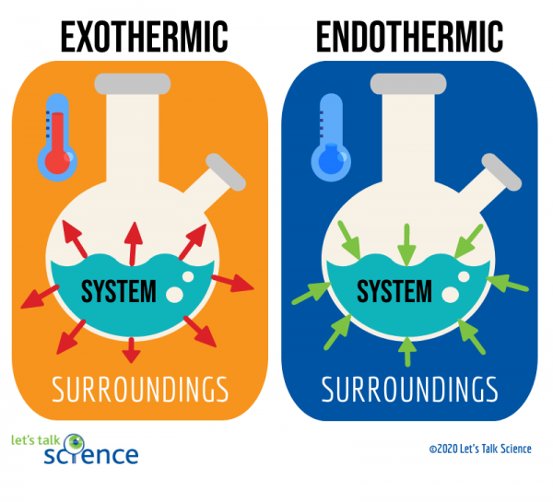

Slide 23
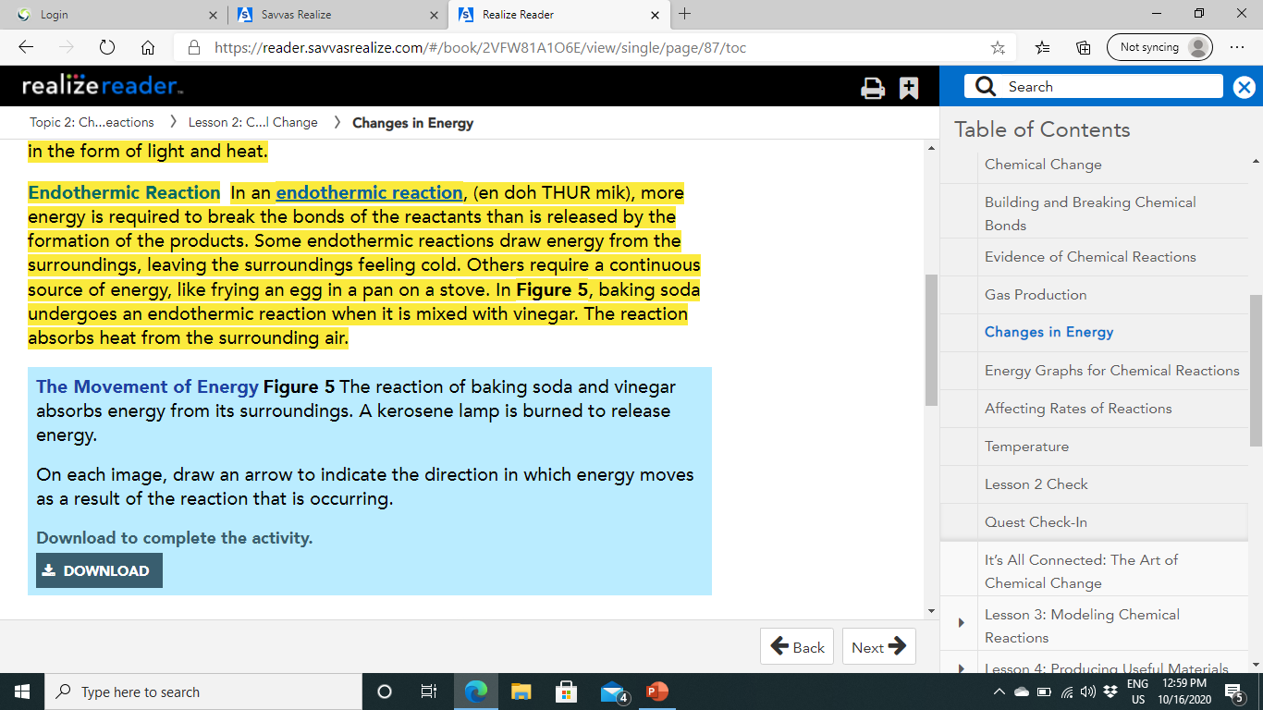
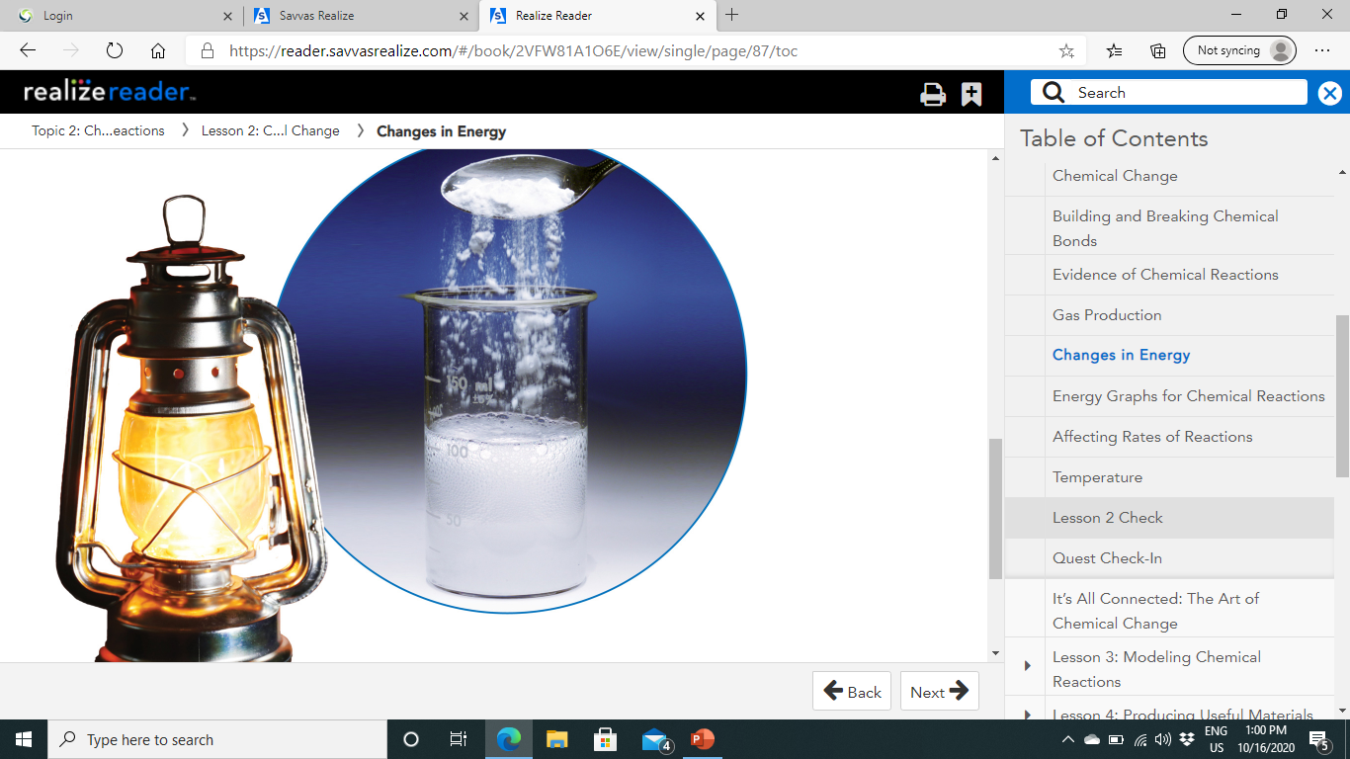

Slide 24
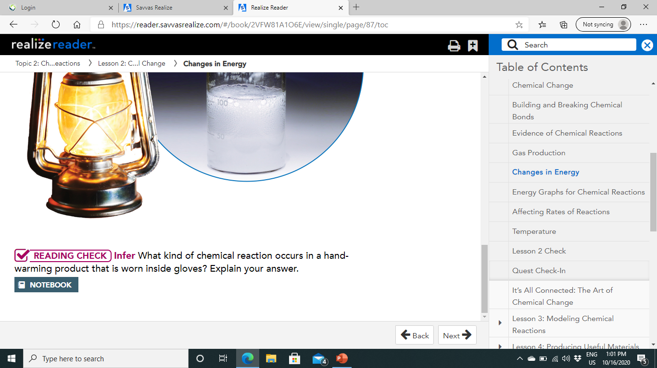
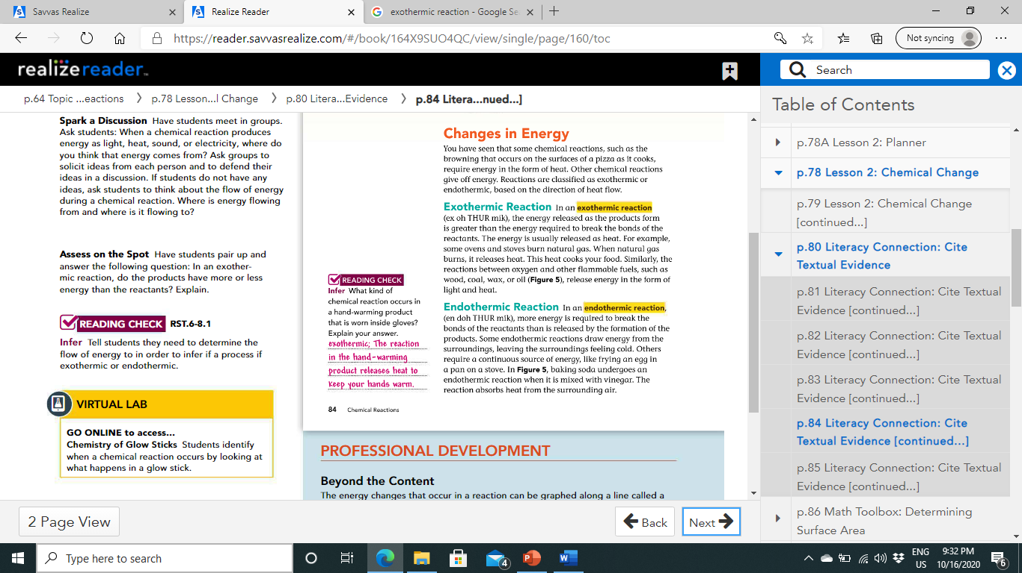

Slide 25
Energy Graphs for Chemical Reactions:
Reactants are a bit like kids on a swing set they need an initial push to get going.
The minimum amount of energy needed to start a chemical reaction is called activation energy.
Once a reaction is underway, it will either need more energy to keep going, or it will release energy.

Slide 26
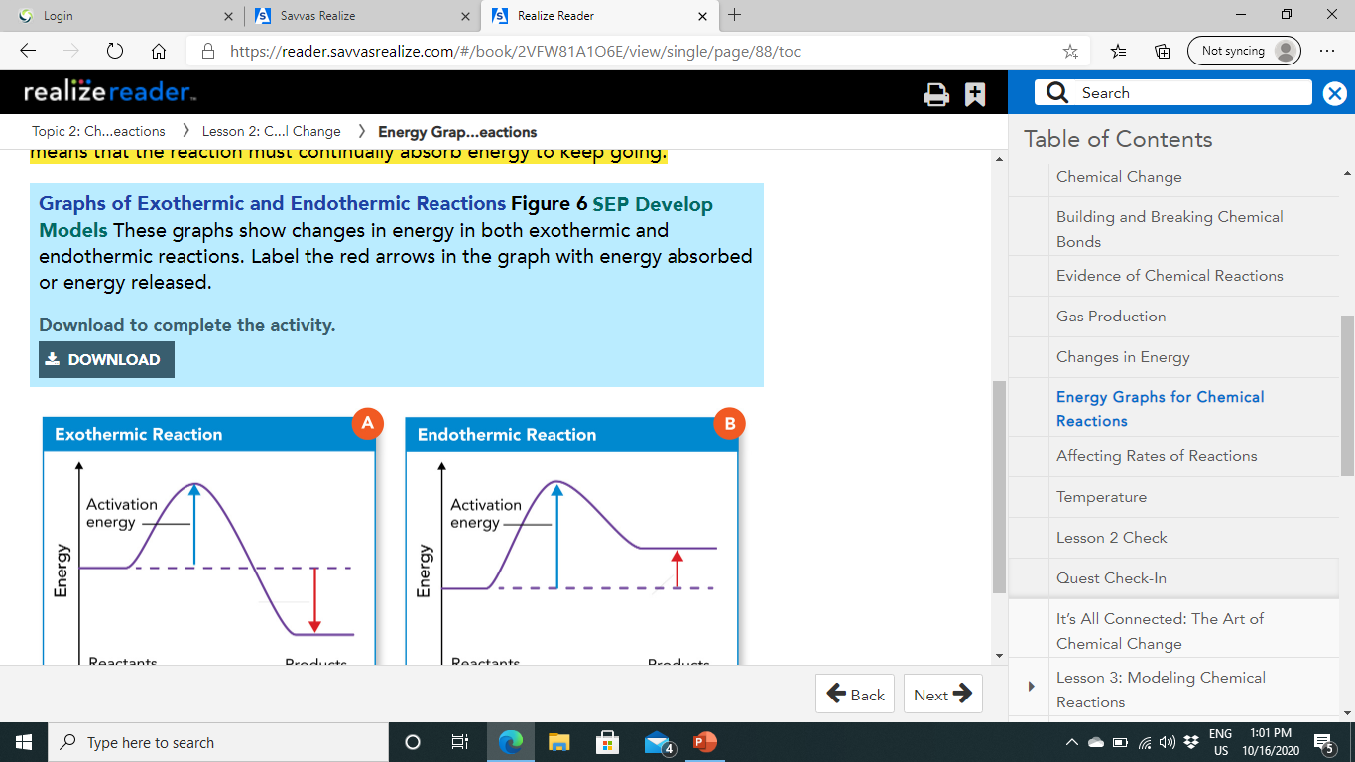
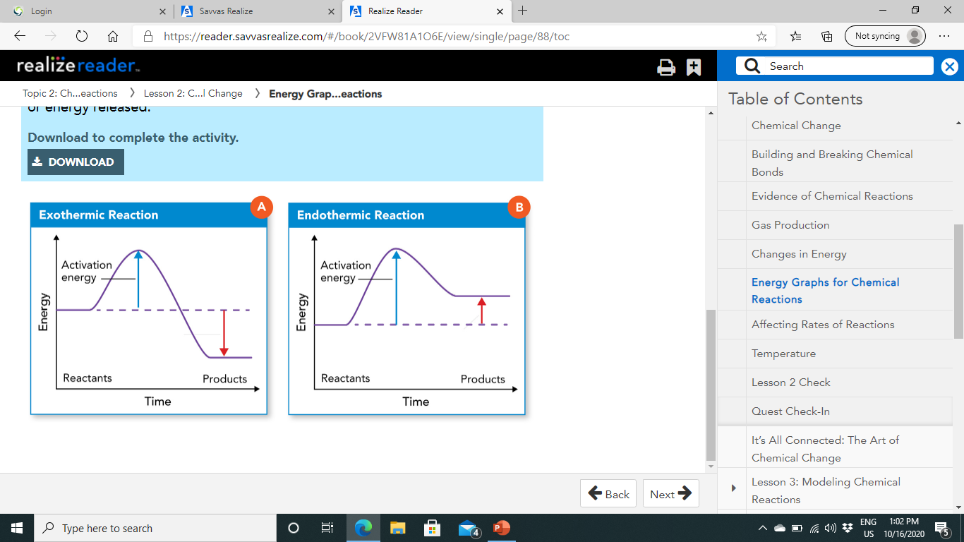
An exothermic reaction's energy is shown in Figure 6A.
The dotted line marks the energy of the reactants before the reaction begins.
The peak on the graph shows the activation energy.
Notice that at the end of the reaction, the products have less energy than the reactants did. An endothermic reaction is shown in Figure 6B.
Endothermic reactions need activation energy to get started, and they also need energy to continue. Notice that the energy of the products is greater than the energy of the reactants. This means that the reaction must continually absorb energy to keep going.
Energy absorbed
Energy released

Slide 27
Affecting Rates of Reactions:
Chemical reactions don't all occur at the same rate.
Some, such as explosions, are very fast.
Others, like the rusting of iron in air, are slow.
A particular reaction can occur at different rates depending on the conditions.
If you want to make a chemical reaction happen faster, the particles of the reactants need to collide either more quickly or with more energy.
Having more particles available to react is another way to make a reaction go faster.
Factors that may affect rates of reactions include surface area, temperature, concentration, and the presence of catalysts and inhibitors.

Slide 28
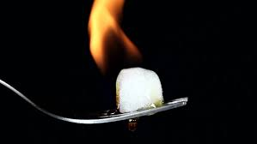
1-Surface Area:
Think of a sugar cube.
If held over a flame, the sugar will burn, but it will burn somewhat slowly.
This is because only the surface of the cube can react with oxygen in the air and the ignition provided by the flame.
All the grains of sugar underneath the surface can't react until they are exposed as well.
Increasing the surface area of the sugar cube would allow it to burn faster.

Slide 29
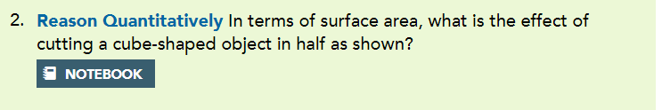
Surface area increases

Slide 30
2-Temperature:
Changing the temperature of a chemical reaction also affects the reaction rate.
When you heat a substance, its particles move faster.
Faster-moving particles have more energy, which helps reactions get started.
Also, faster- moving particles come into contact more often, which means more chances for reactants to react.
Reducing temperature slows down reaction rates because there is less energy in the movement of particles and particles interact less frequently.

Slide 31
3-Other Factors:(concentration, catalyst, inhibitors)
Another way to increase the rate of a chemical reaction is to increase the concentration of the reactants.
Increasing the concentration of reactants supplies more particles to react.
For example, an acidic solution whose concentration is 10 percent reacts more quickly with a base such as baking soda than would a 2 percent acidic solution. Catalysts also help increase rates of reactions.
Catalysts are substances that lower the activation energy needed to start a reaction.
Although catalysts affect a reaction's rate, they are not permanently changed by a reaction and are not considered reactants.
You can think of these as the parents who help get kids moving on a swing set.
Sometimes it is more useful to slow down a reaction rather than speed it up.
A material used to decrease the rate of a chemical reaction is an inhibitor.
For example, inhibitors called preservatives are added to food to prevent spoiling.

Slide 32
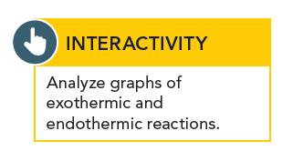
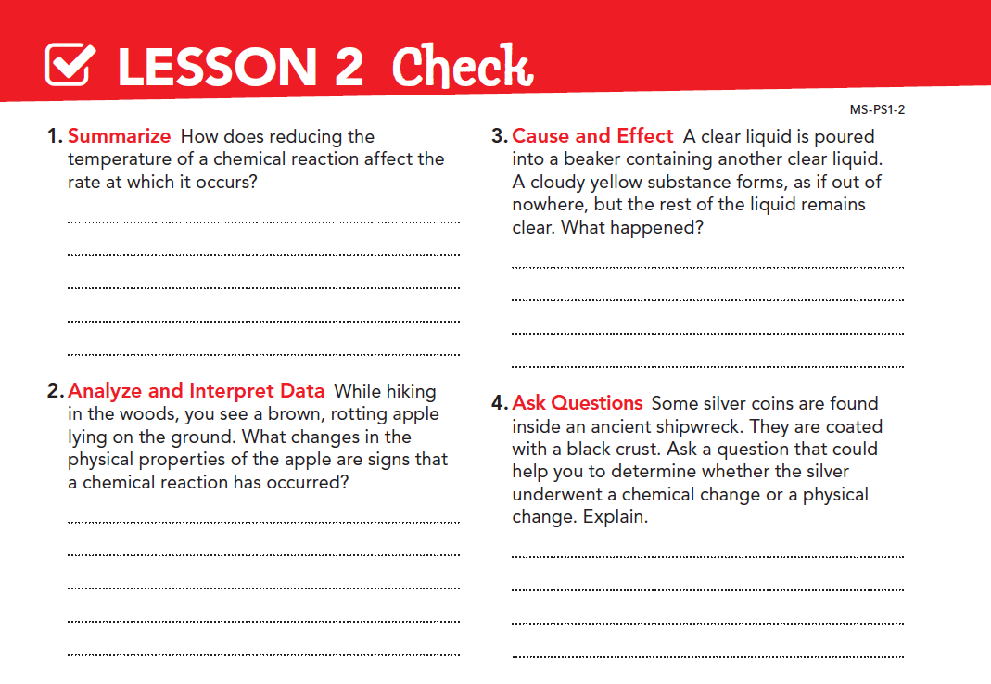
Reducing temperature slows down the reaction rate. The particles have less energy and interact less frequently.
A chemical reaction between reactants in the two liquids caused a solid precipitate to form.
Changes in physical properties such as the color of the apple and the smell ( which might indicate gas formation) indicate a chemical reaction has occurred.
Is the black crust a new substance that formed? If so, the silver underwent a chemical change.

