Slide 1
Genetic Coding and
Protein Synthesis

Slide 2
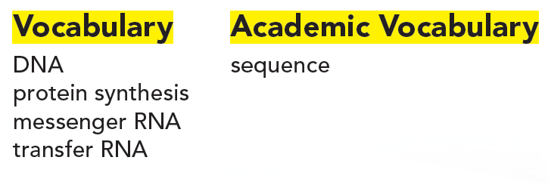
Objectives
• Why do cells undergo DNA replication?
• How do cells make proteins?
• Why do cells undergo protein synthesis?

Slide 3
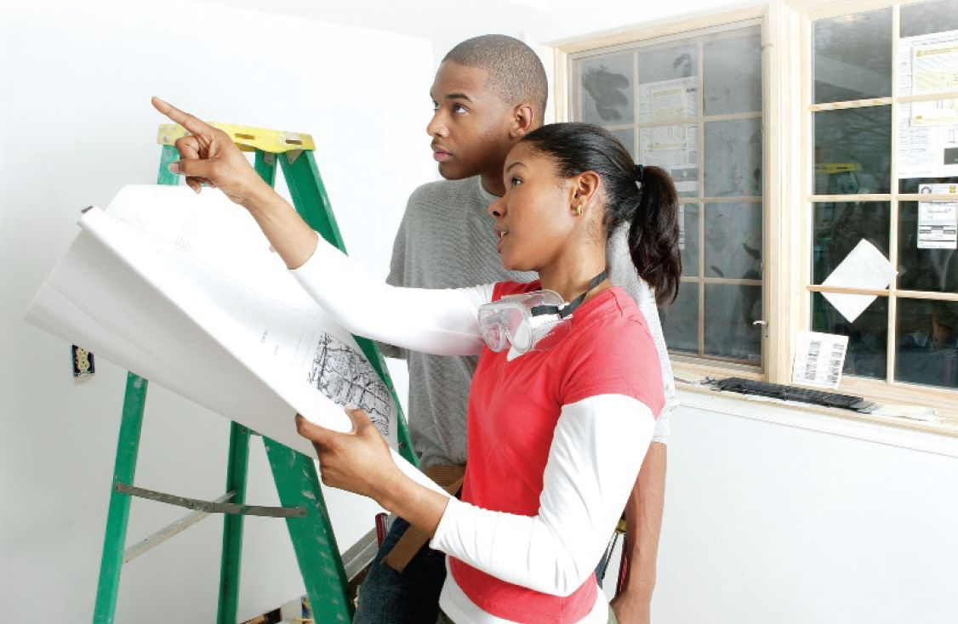
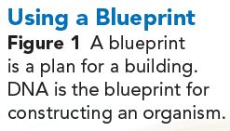
The Genetic Code
Just as the couple in Figure 1 need a blueprint to renovate a house, your body needs a plan to carry out daily functions.
Your "blueprint" is found in the nucleus of each cell in the form of DNA.
DNA (deoxyribonucleic acid) is the genetic material that carries information about an organism and is passed from parent to offspring.

Slide 4
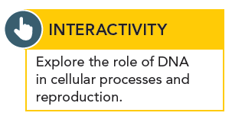
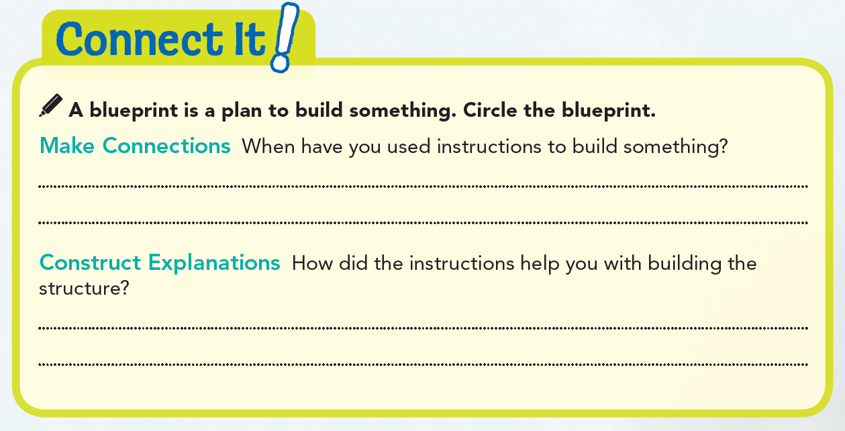
I used instructions to build a model airplane.
The directions helped me figure out how the parts connected and in what order to connect them.

Slide 5


Slide 6
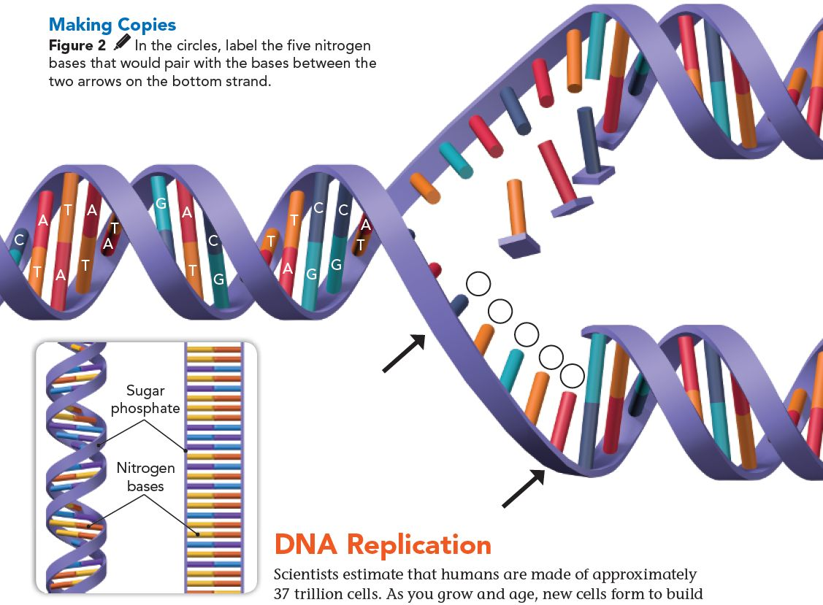
In 1953, almost 100 years after DNA was discovered, scientists realized that DNA was shaped like a double helix—a twisted ladder.
The structure of DNA consists of sugars, phosphates, and nitrogen bases.
The sides of the ladder are made of sugar molecules, called deoxyribose, alternating with phosphate molecules.
The rungs of the ladder are made of nitrogen bases. DNA has four nitrogen bases: adenine (A), thymine (T), guanine (G), and cytosine (C).
G
A
C
A
T

Slide 7
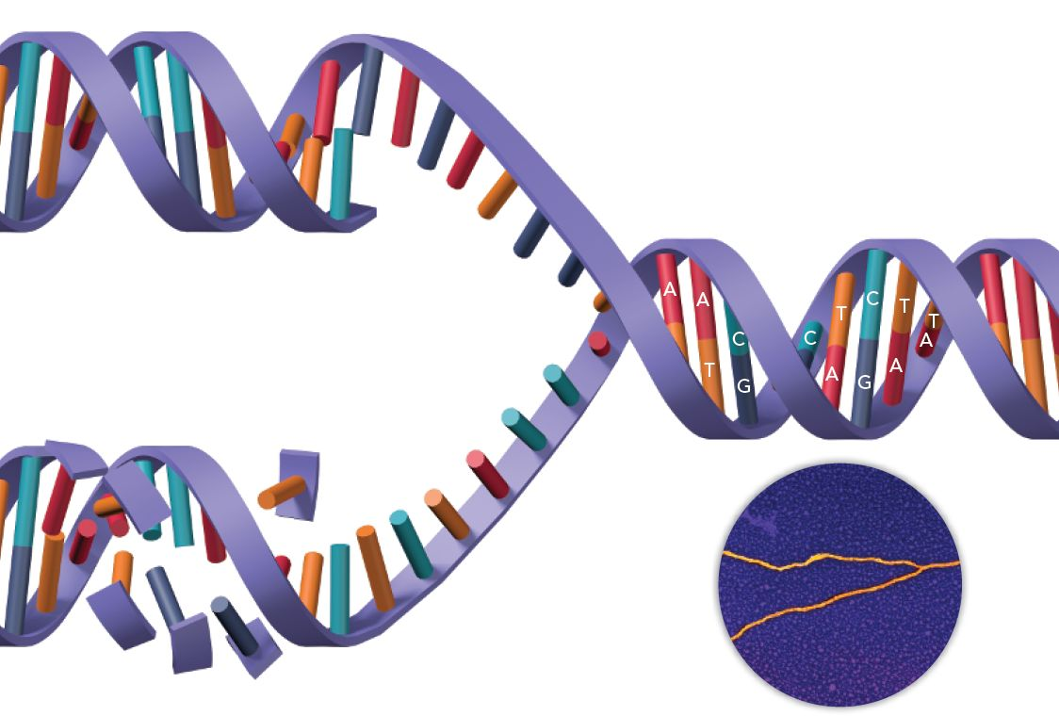
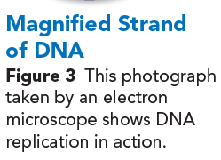
Genes are sections of DNA found on chromosomes.
Each gene consists of hundreds or thousands of nitrogen bases arranged in a sequence.
And it's this order that forms the instructions for building proteins — long chains of amino acids.
Genes direct the construction of proteins, which in turn affect the traits that individuals receive from their parent(s).
In other words, proteins trigger cellular processes that determine how inherited traits get expressed.

Slide 9
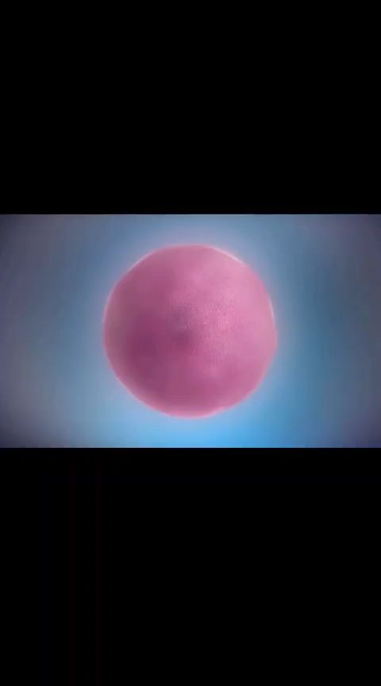
DNA Replication
Scientists estimate that humans are made of approximately 37 trillion cells.
As you grow and age, new cells form to build and repair structures or to replace cells that have died.
For this to happen, cells need to replicate, and this requires making copies of DNA. As shown in Figure 2, DNA replication begins when the double helix untwists.
Then, a protein breaks the DNA strand in half—at the structure's weakest point—between the nitrogen bases.
This separation actually looks like a zipper (Figure 3), and is often referred to as "unzipping the DNA."
Next, nitrogen bases with a sugar and phosphate attached pair up with the bases on each half of the DNA.
Because nitrogen bases always pair in the same way, adenine with thymine and guanine with cytosine, the order of the bases on both strands are identical.
At the end of replication, a chromosome with two identical DNA strands is formed.

Slide 10
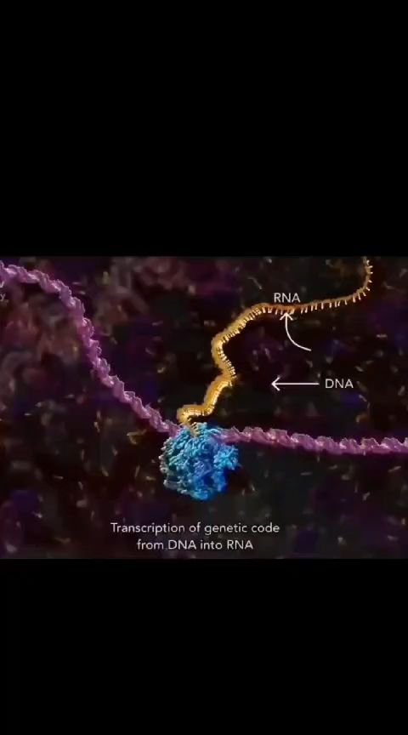
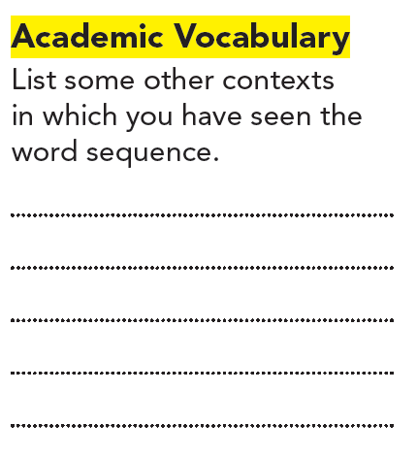
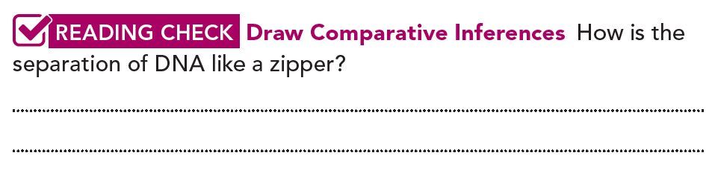
Pg. 195
The sequence of events in a story, a sequencer in music, a numerical sequence in math.
Pg. 196
When you unzip a zipper, the two halves part. In the same way, when DNA separates, it breaks along the center, into two halves.

Slide 11
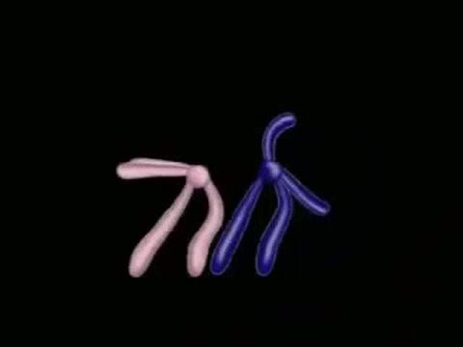
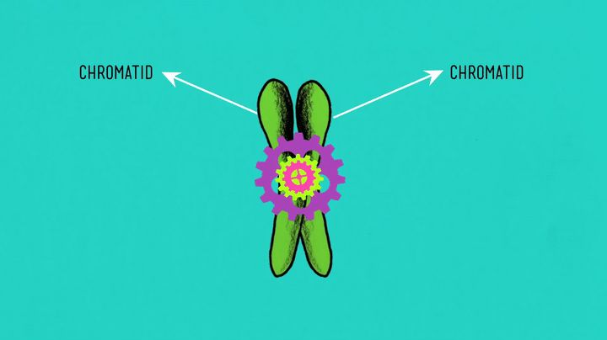
The process of DNA replication, or copying, ensures that each chromatid of a chromosome has identical DNA.
During cell division, chromosomes split.
During mitosis, the identical chromatids separate, resulting in identical DNA in each daughter cell.
During meiosis, crossing over occurs before the chromatids split.
No matter the type of cell division, DNA replication ensures that each cell contains the correct amount of DNA to carry out life processes.

Slide 12
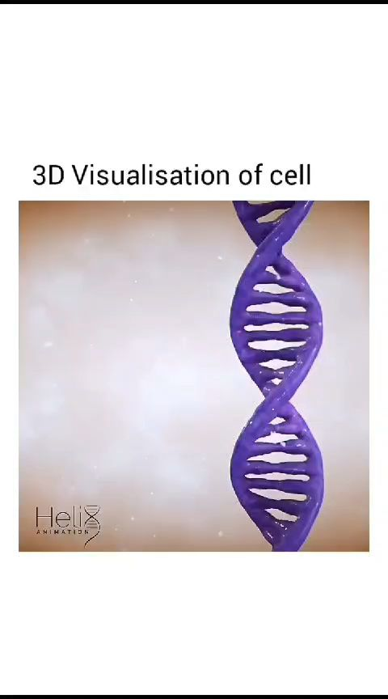
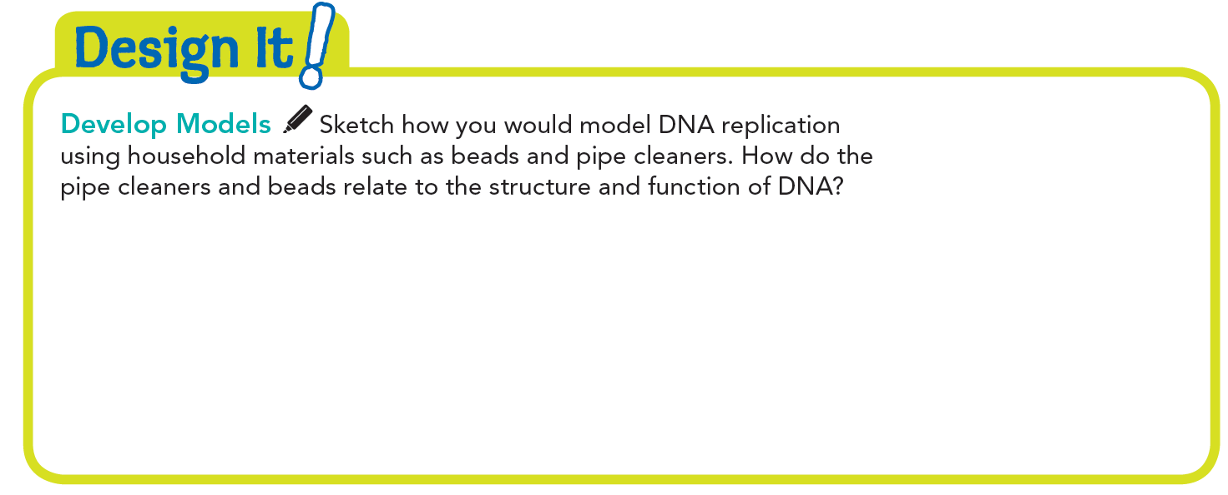
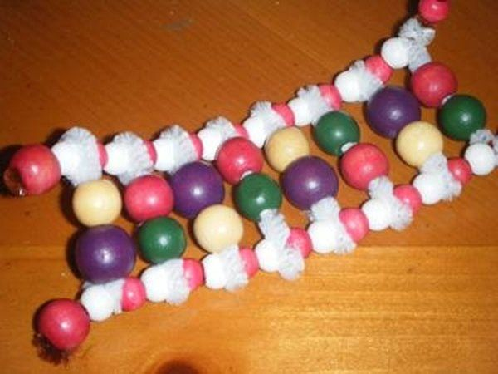

Slide 14
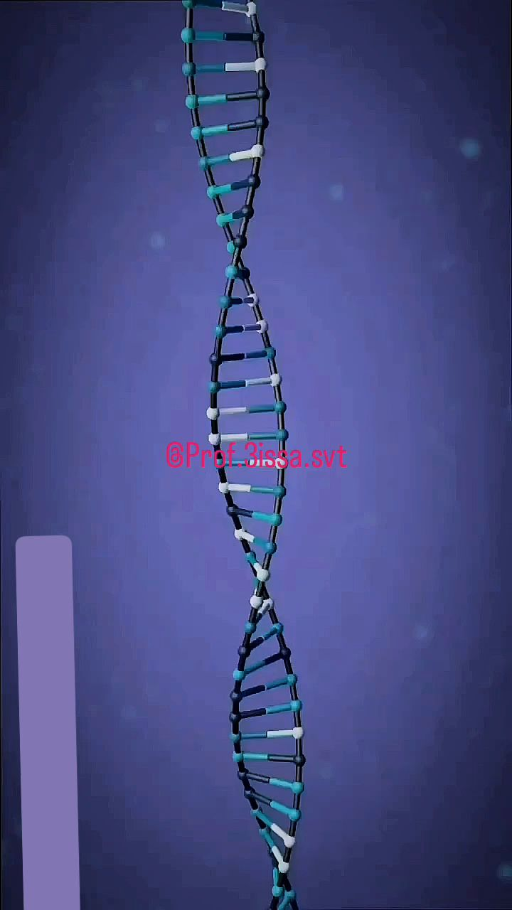

Making Proteins
Proteins are made from building blocks called amino acids.
There are only 20 amino acids in the human body, but your body can combine them in thousands of ways to make many different types of proteins needed to carry out cell processes.
Inside the cell, amino acids link to form proteins through a process called protein synthesis.
Once the protein is made, the cell will express the trait or perform a function.

Slide 15
RNA
The process of protein synthesis starts in the nucleus, where the DNA contains the code for the protein.
However, the actual assembly of the protein occurs at an organelle called the ribosome.
Before a ribosome can assemble a protein, it needs to receive the blueprint to assemble the right protein from the nucleus.
The blueprint is transferred from the nucleus to the ribosome by a different nucleic acid called RNA (ribonucleic acid).
Even though both RNA and DNA are nucleic acids, they have some differences.
One difference is that RNA contains the sugar ribose instead of deoxyribose.
Figure 4 shows two other differences.
Notes:
https://www.youtube.com/watch?v=oefAI2x2CQM

Slide 16
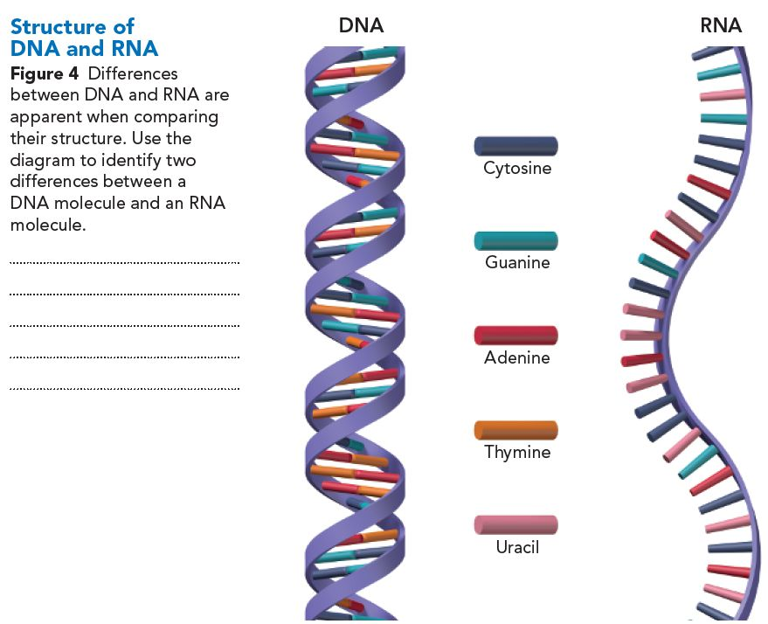
RNA has the nitrogen base uracil, while DNA has thymine. RNA is a single strand, while DNA is a double strand.
Notes:
https://www.youtube.com/watch?v=JQByjprj_mA

Slide 17
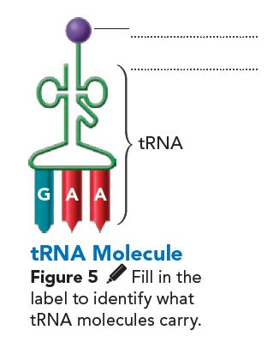
HOW RNA Is Used
amino acid
There are two main types of RNA involved in protein synthesis: messenger RNA and transfer RNA.
Messenger RNA (mRNA) carries copies of instructions for the assembly of amino acids into proteins from DNA to ribosomes in the cytoplasm.
Transfer RNA (tRNA), shown in Figure 5, carries amino acids to the ribosome during protein synthesis.
The order of the nitrogen bases on a gene determines the structure of the protein it makes.
In the genetic code, a group of three nitrogen bases codes for one specific amino acid.
For example, the three-base DNA sequence C-G-T (cytosine-guanine-thymine) always codes for the amino acid alanine.
The order of the three-base code units determines the order in which amino acids are put together to form a protein. (Figure 6).
See Figure 7 for a summary of the entire process of protein synthesis.
Notes:
https://www.youtube.com/watch?v=oefAI2x2CQM

Slide 18
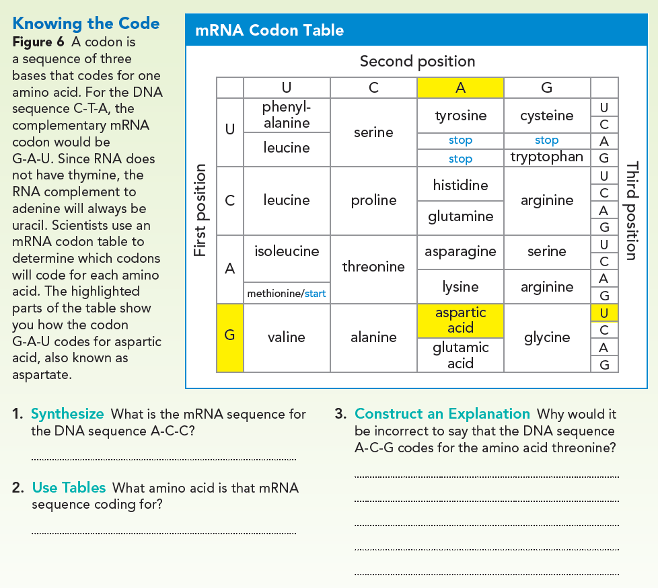
U-G-G
A-C-G is the DNA sequence, not the mRNA sequence. You must first find the complementary mRNA sequence, U-G-C. Then use the codon table to determine the amino acid is cysteine.
tryptophan

Slide 19
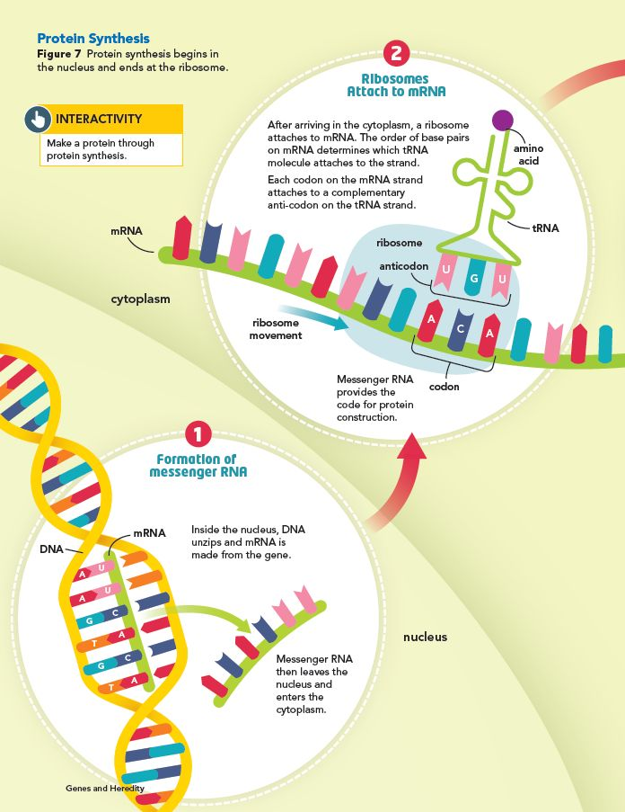
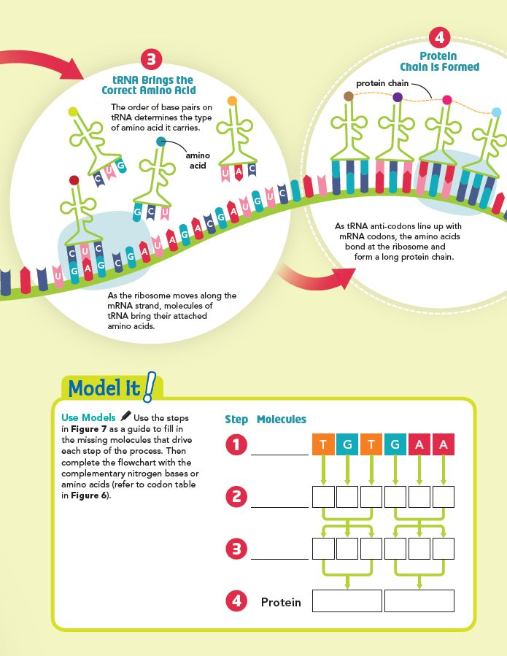
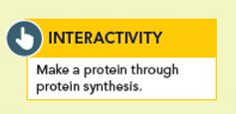
DNA
mRNA
A C A C U U
tRNA
U G U G A A
cysteine
glutamic acid

Slide 20
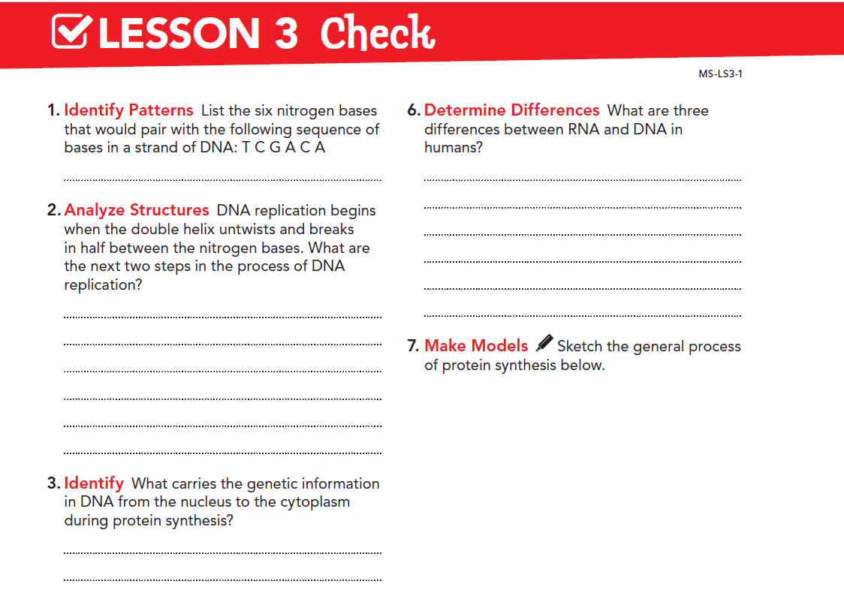
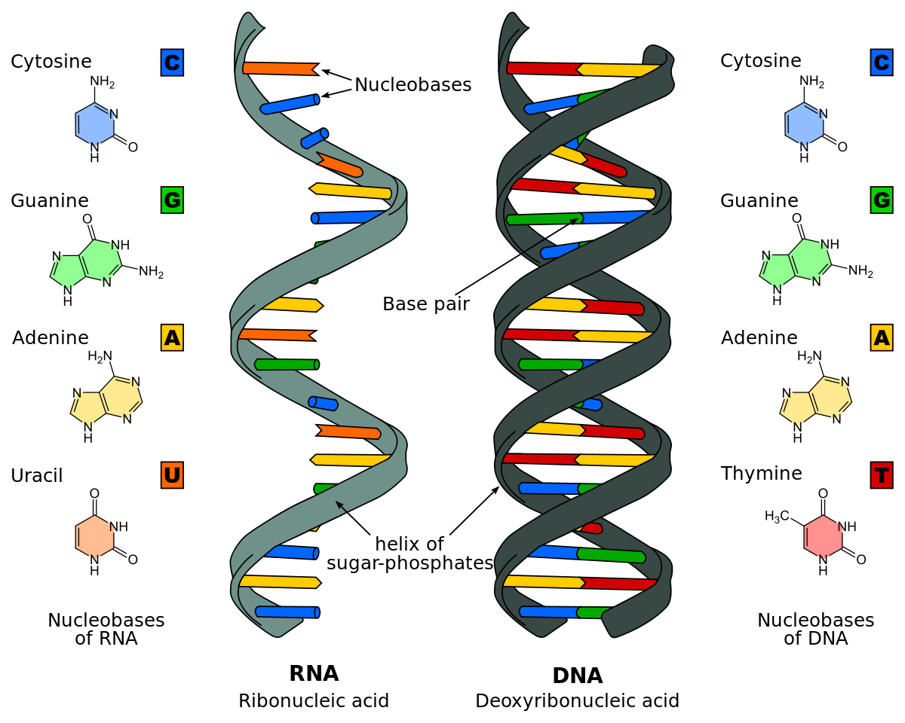
A G C T G T
Genes that are received from parent(s) determine the proteins that are made and in turn, the traits that are expressed.
DNA replication ensures that each cell contains the correct amount of DNA to carry out life processes.
A different protein will be constructed.

Slide 21
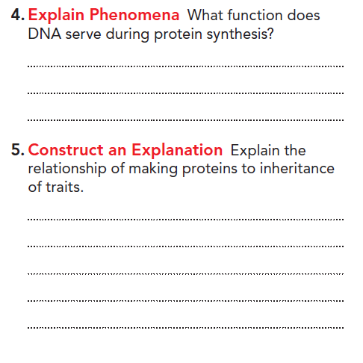
The sequence of nitrogen bases can be inherited. It directs the construction of proteins, which the cell uses to express the trait or perform a function.
The next step involves nitrogen bases with sugars and phosphates pairing up with the exposed bases on each half of the DNA strand. Then, with two new complete strands formed, each double helix twists into shape.

Slide 22
