Slide 1

Executive Boardroom AV Transformation
Delivering a Seamless Collaboration Experience
Integrated by YOUR COMPANY
Featuring:
Microsoft Teams Room
Crestron Control & Automation
DM NVX AV-over-IP Distribution
Biamp DSP Audio
Sennheiser Ceiling Microphone
Intelligent Camera Tracking

Slide 2
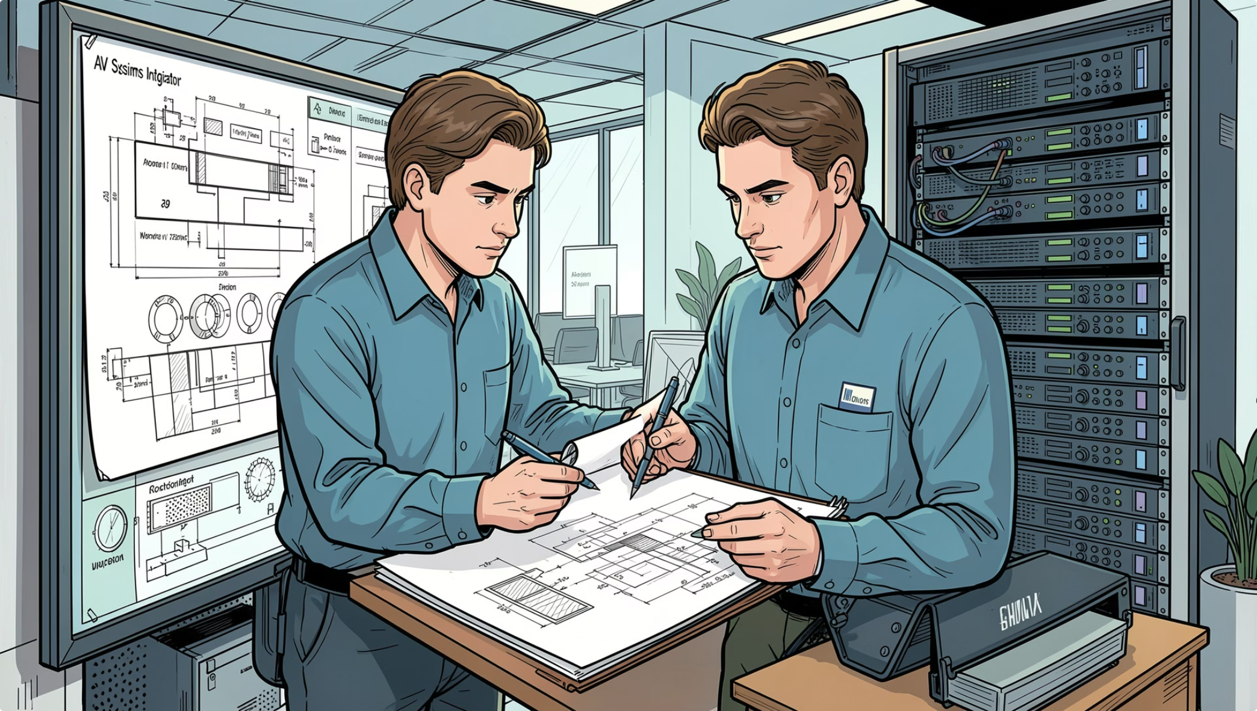
PROJECT OVERVIEW
What We're Building
This project delivers a fully integrated, enterprise-grade AV environment designed for seamless collaboration, reliable performance, and intuitive operation. Every subsystem is engineered to work in concert — from the moment a user enters the room to the final disconnect.
Unified Control
Crystal-Clear AV
Enterprise Network
Single-touch room management
High-fidelity audio and video
Dedicated, managed infrastructure

Slide 3

SYSTEM ARCHITECTURE
Integrated AV Ecosystem
Endpoints & Network
UC-C100, Lumens, JBL, AirMedia, Netgear switch
AV Processing
DM-NVX-384, OIP-N60D, TesiraFORTE DSP
Control Layer
Crestron CP4N, TS-1070, Keypad
The architecture follows a clean layered model — control, processing, endpoints, and network — ensuring each subsystem operates independently yet communicates seamlessly through a unified IP backbone.

Slide 4
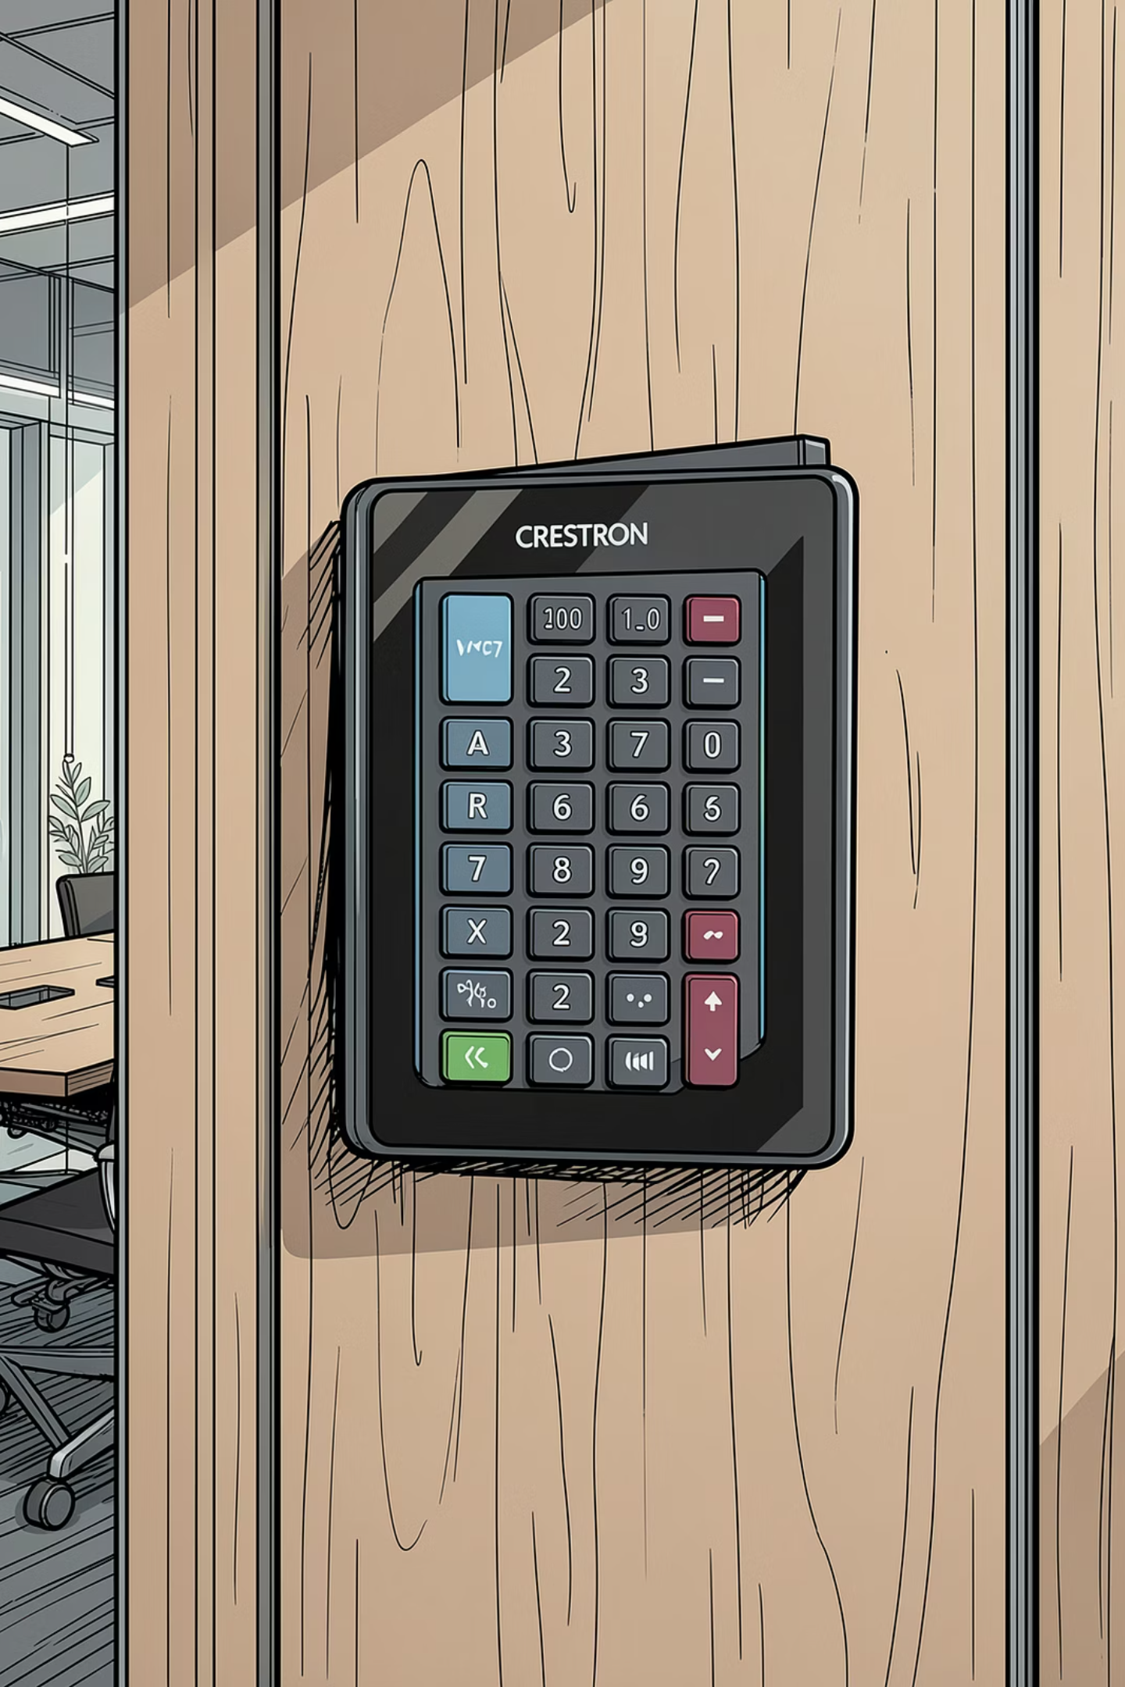
CONTROL SYSTEM
Centralised Room Control
CP4N Processor
TS-1070 Touch Panel
Crestron's 4-Series control engine — the brain of the room. Handles all logic, routing, and device communication over IP and serial.
10.1" tabletop touch panel providing intuitive room control — source selection, volume, camera presets, and conferencing launch.
9HZ2-KPCN-B Keypad
Wall-mounted keypad for quick-access functions — power, input recall, and mute — ideal for non-technical users.

Slide 5
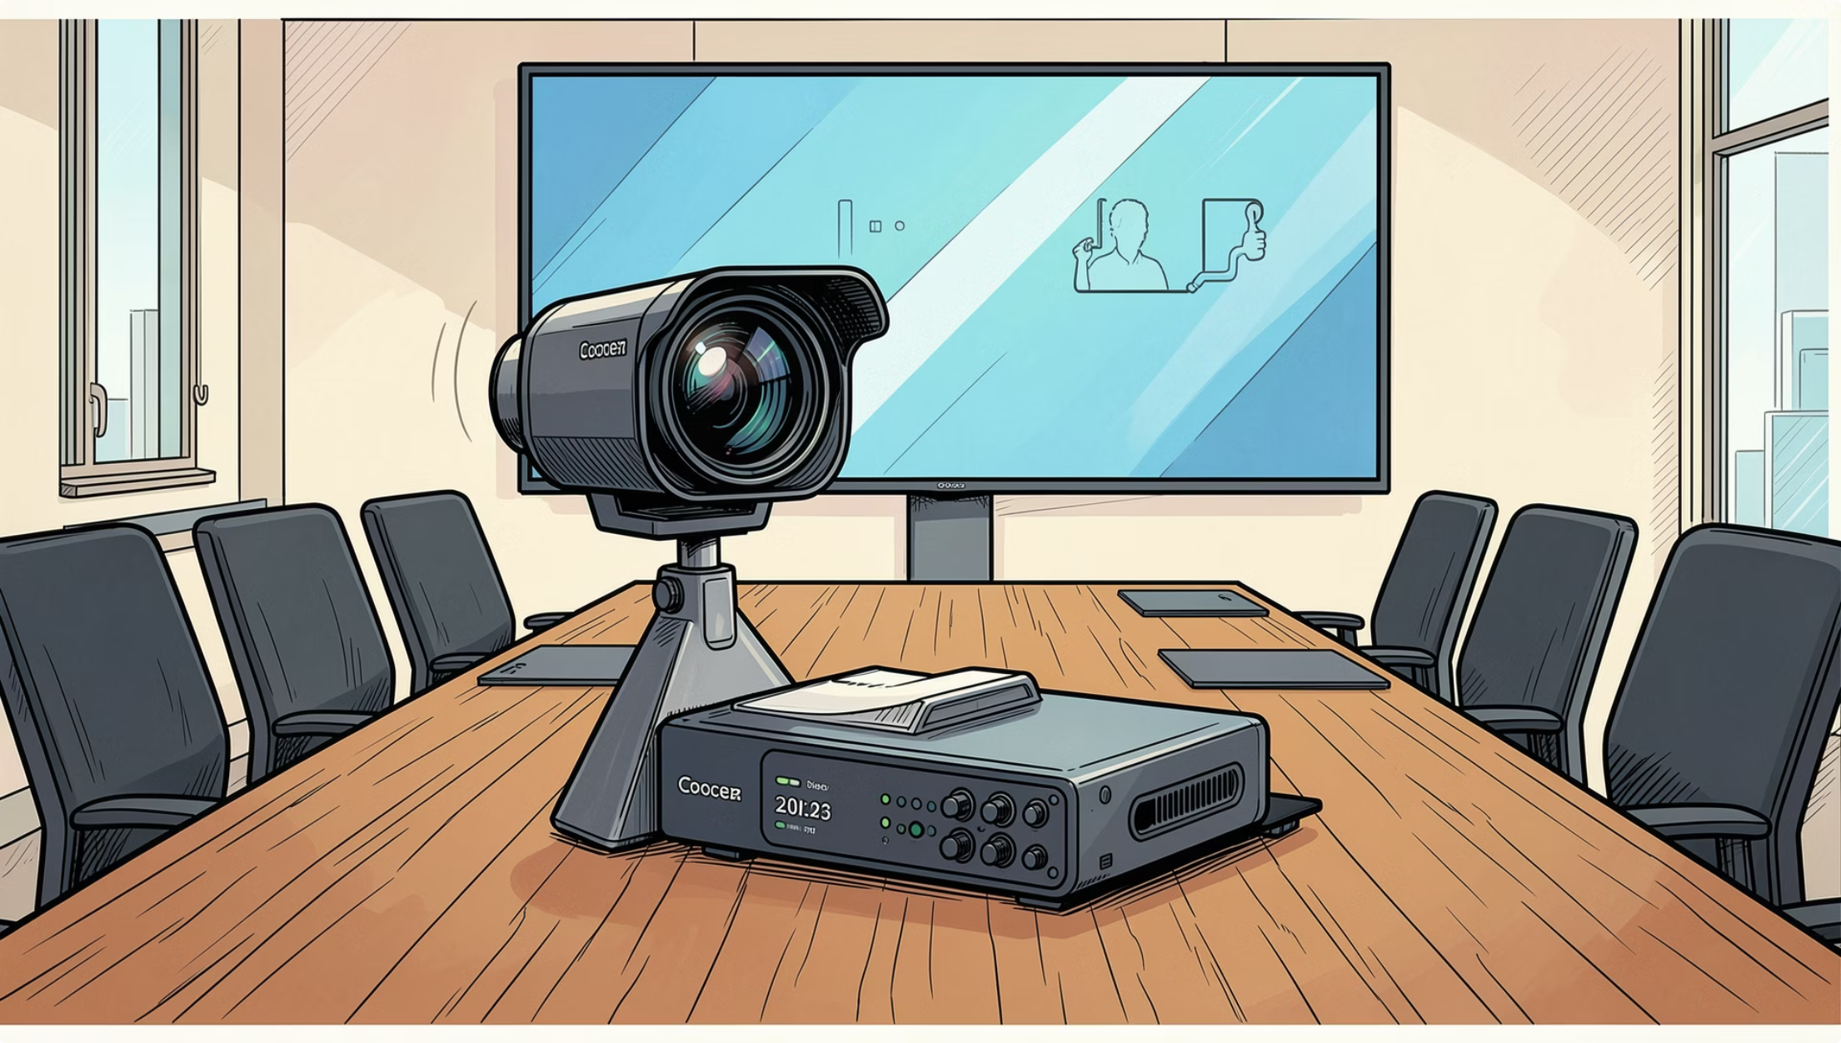

VIDEO CONFERENCING
Enterprise-Grade Collaboration
UC-C100 MTR
Crestron's UC platform delivers native integration with Microsoft Teams, Zoom, and other UC platforms — enabling one-touch join and seamless meeting experiences.
TSS-1070 Touch Panel
Dedicated touch interface for video conferencing control — dial, mute, camera framing, and content sharing — all from a single surface.
Both devices integrate natively with the Crestron control layer for unified room management.

Slide 6
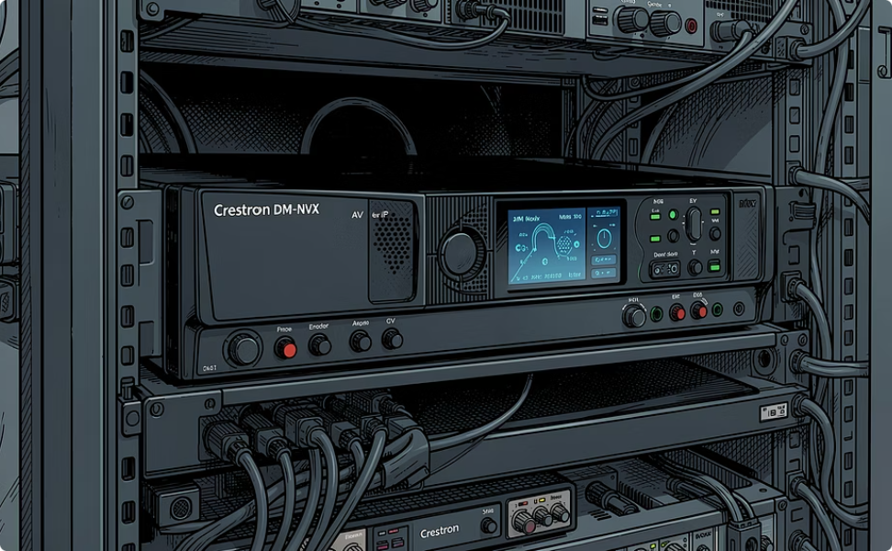
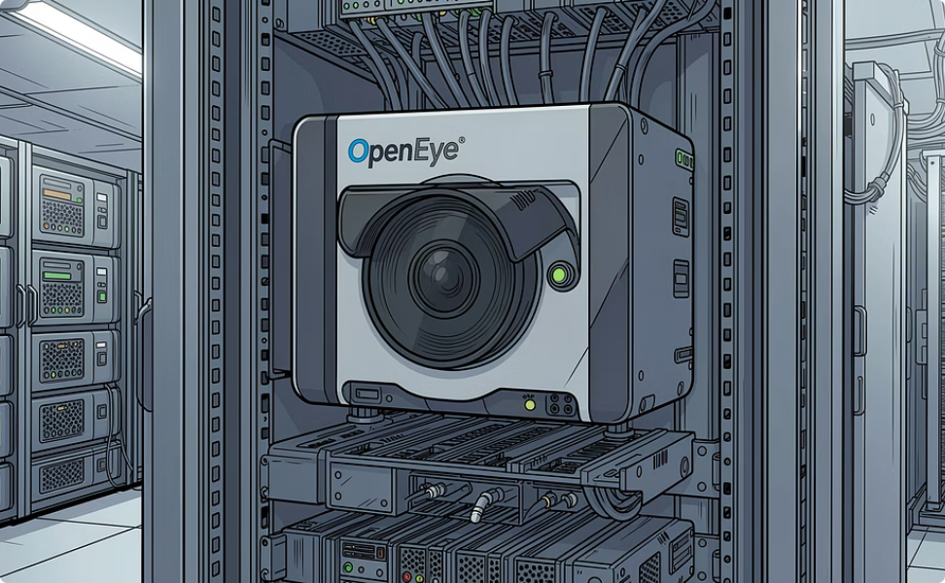
VIDEO DISTRIBUTION
Signal Routing & Extension
DM-NVX-384
OIP-N60D
AV-over-IP matrix switching and extension. Distributes 4K video, audio, and control signals across the enterprise LAN with sub-10ms latency.
Open IP distribution endpoint for extending and receiving video streams. Enables flexible, scalable video routing without dedicated matrix hardware.

Slide 7
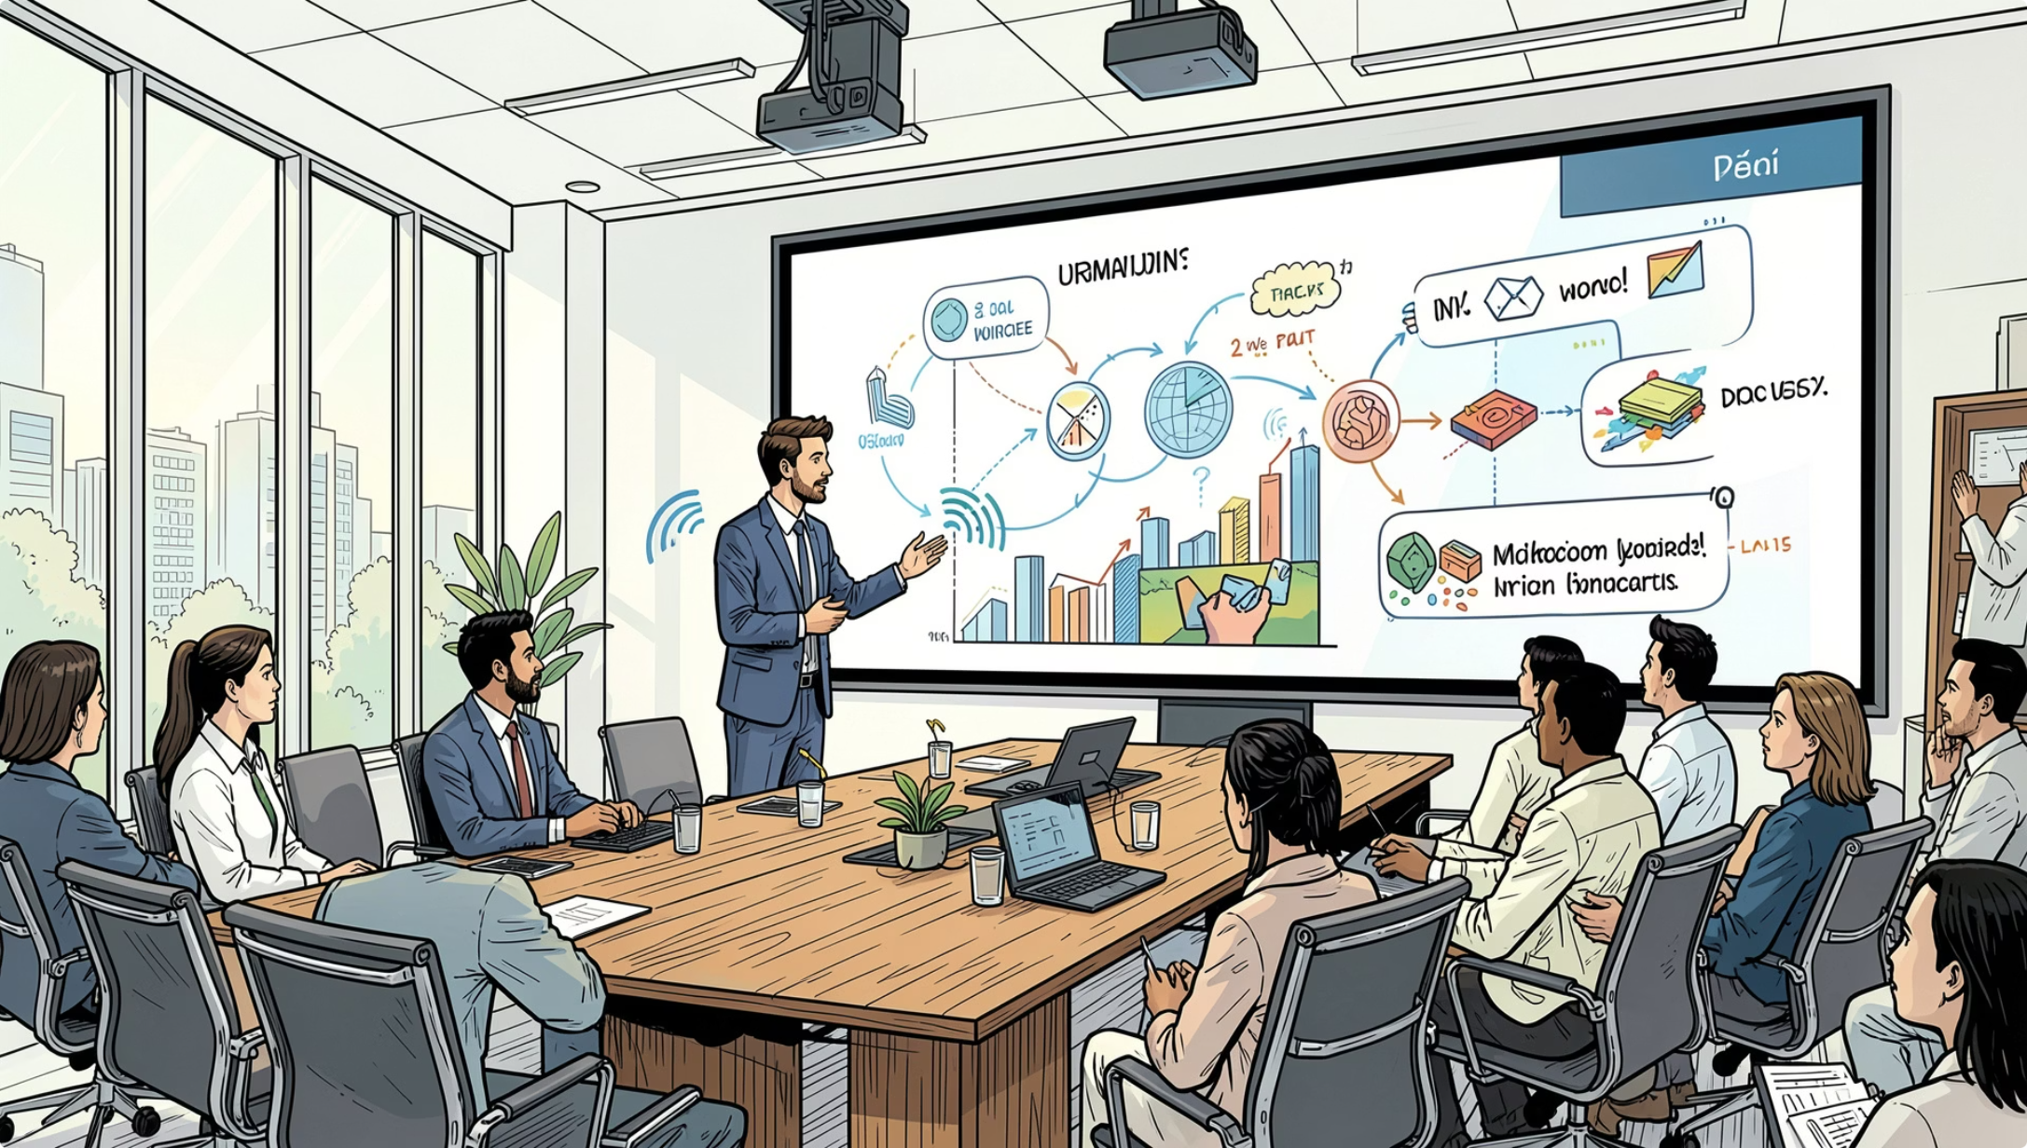
PRESENTATION SYSTEM
Wireless & Wired Content Sharing
AirMedia AM-3200
Wireless presentation gateway supporting BYOD content sharing. Guests connect via browser or app — no drivers required. Supports simultaneous multi-user display.
Kramer SWT3-31-HU
3×1 HDMI switcher with HDCP compliance. Provides reliable wired input switching for laptops, document cameras, and other HDMI sources.

Slide 8
CAMERA & AUDIO
Immersive AV Experience
Lumens VC-TR60A
Biamp TesiraFORTE DAN VT4
Crown CT8150 Amplifier
4K PTZ camera with 30× optical zoom. Supports auto-framing, preset positions, and RS-232/IP control integration.
DSP with Dante networking. Handles AEC, mixing, routing, and audio processing for the entire room.
8-channel installer amplifier delivering clean, reliable power to all room loudspeakers.
JBL Ceiling Speakers
TCC M Ceiling Mic
Commercial-grade ceiling loudspeakers providing even coverage and clear speech intelligibility.
Beam-steering ceiling microphone array for hands-free voice pickup across the full room.

Slide 9
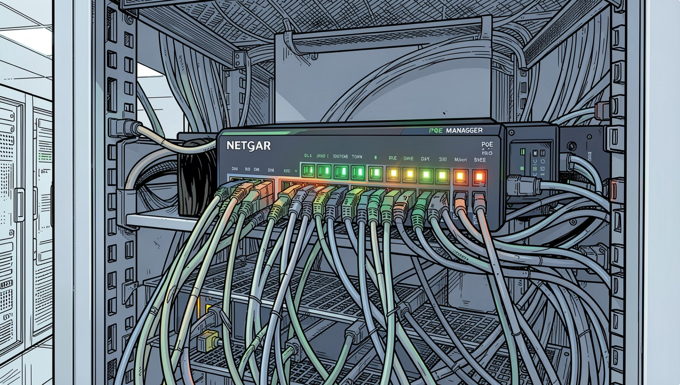
NETWORK INFRASTRUCTURE
Dedicated AV Network
Netgear GSM4230PX
A 28-port Gigabit managed PoE+ switch providing dedicated network segmentation for all AV-over-IP, control, and endpoint devices.
PoE+ Delivery
VLAN Segmentation
QoS Prioritisation
Powered devices — cameras, touch panels, endpoints
AV traffic isolated from corporate IT network
Latency-sensitive AV streams prioritised

Slide 10

USER WORKFLOW
Room User Journey
Enter Room
Power On
Select Source
Join or Present
End Session
The entire room experience is designed for zero-friction operation. From power-on to content sharing, every step is guided through the touch panel and keypad — no technical expertise required.
Thank You
We appreciate your attention. Our team is available for technical deep-dives, commissioning support, and ongoing service.
Commissioning
Training
Support
On-site setup & testing
End-user & admin sessions
Ongoing maintenance & SLA

