Slide 1
Before Performing This Clinic
At a Minimum, you should complete the Selkirk University for Advocates’ course
(Enrollment form)
Selkirk University | Product Education on YouTube
Be sure to review the various videos pertaining to paddle design and comparisons
Review all videos concerning Selkirk-brand paddles
Notes:
Please note, there are many videos within the YouTube collection which will not pertain to Clinic II, but will apply to Clinic III.

Slide 2
Presentation Suggestion
Options for presenting the material are:
Give just a straight lecture, using demo paddles as examples
You may want to use an Easel Ring Binder - Flip Over The Top Style Platform Binder (https://www.amazon.com/dp/B0CSWY5739) - $23
You could use the Long version of this course in a classroom environment for a more formal event

Slide 3
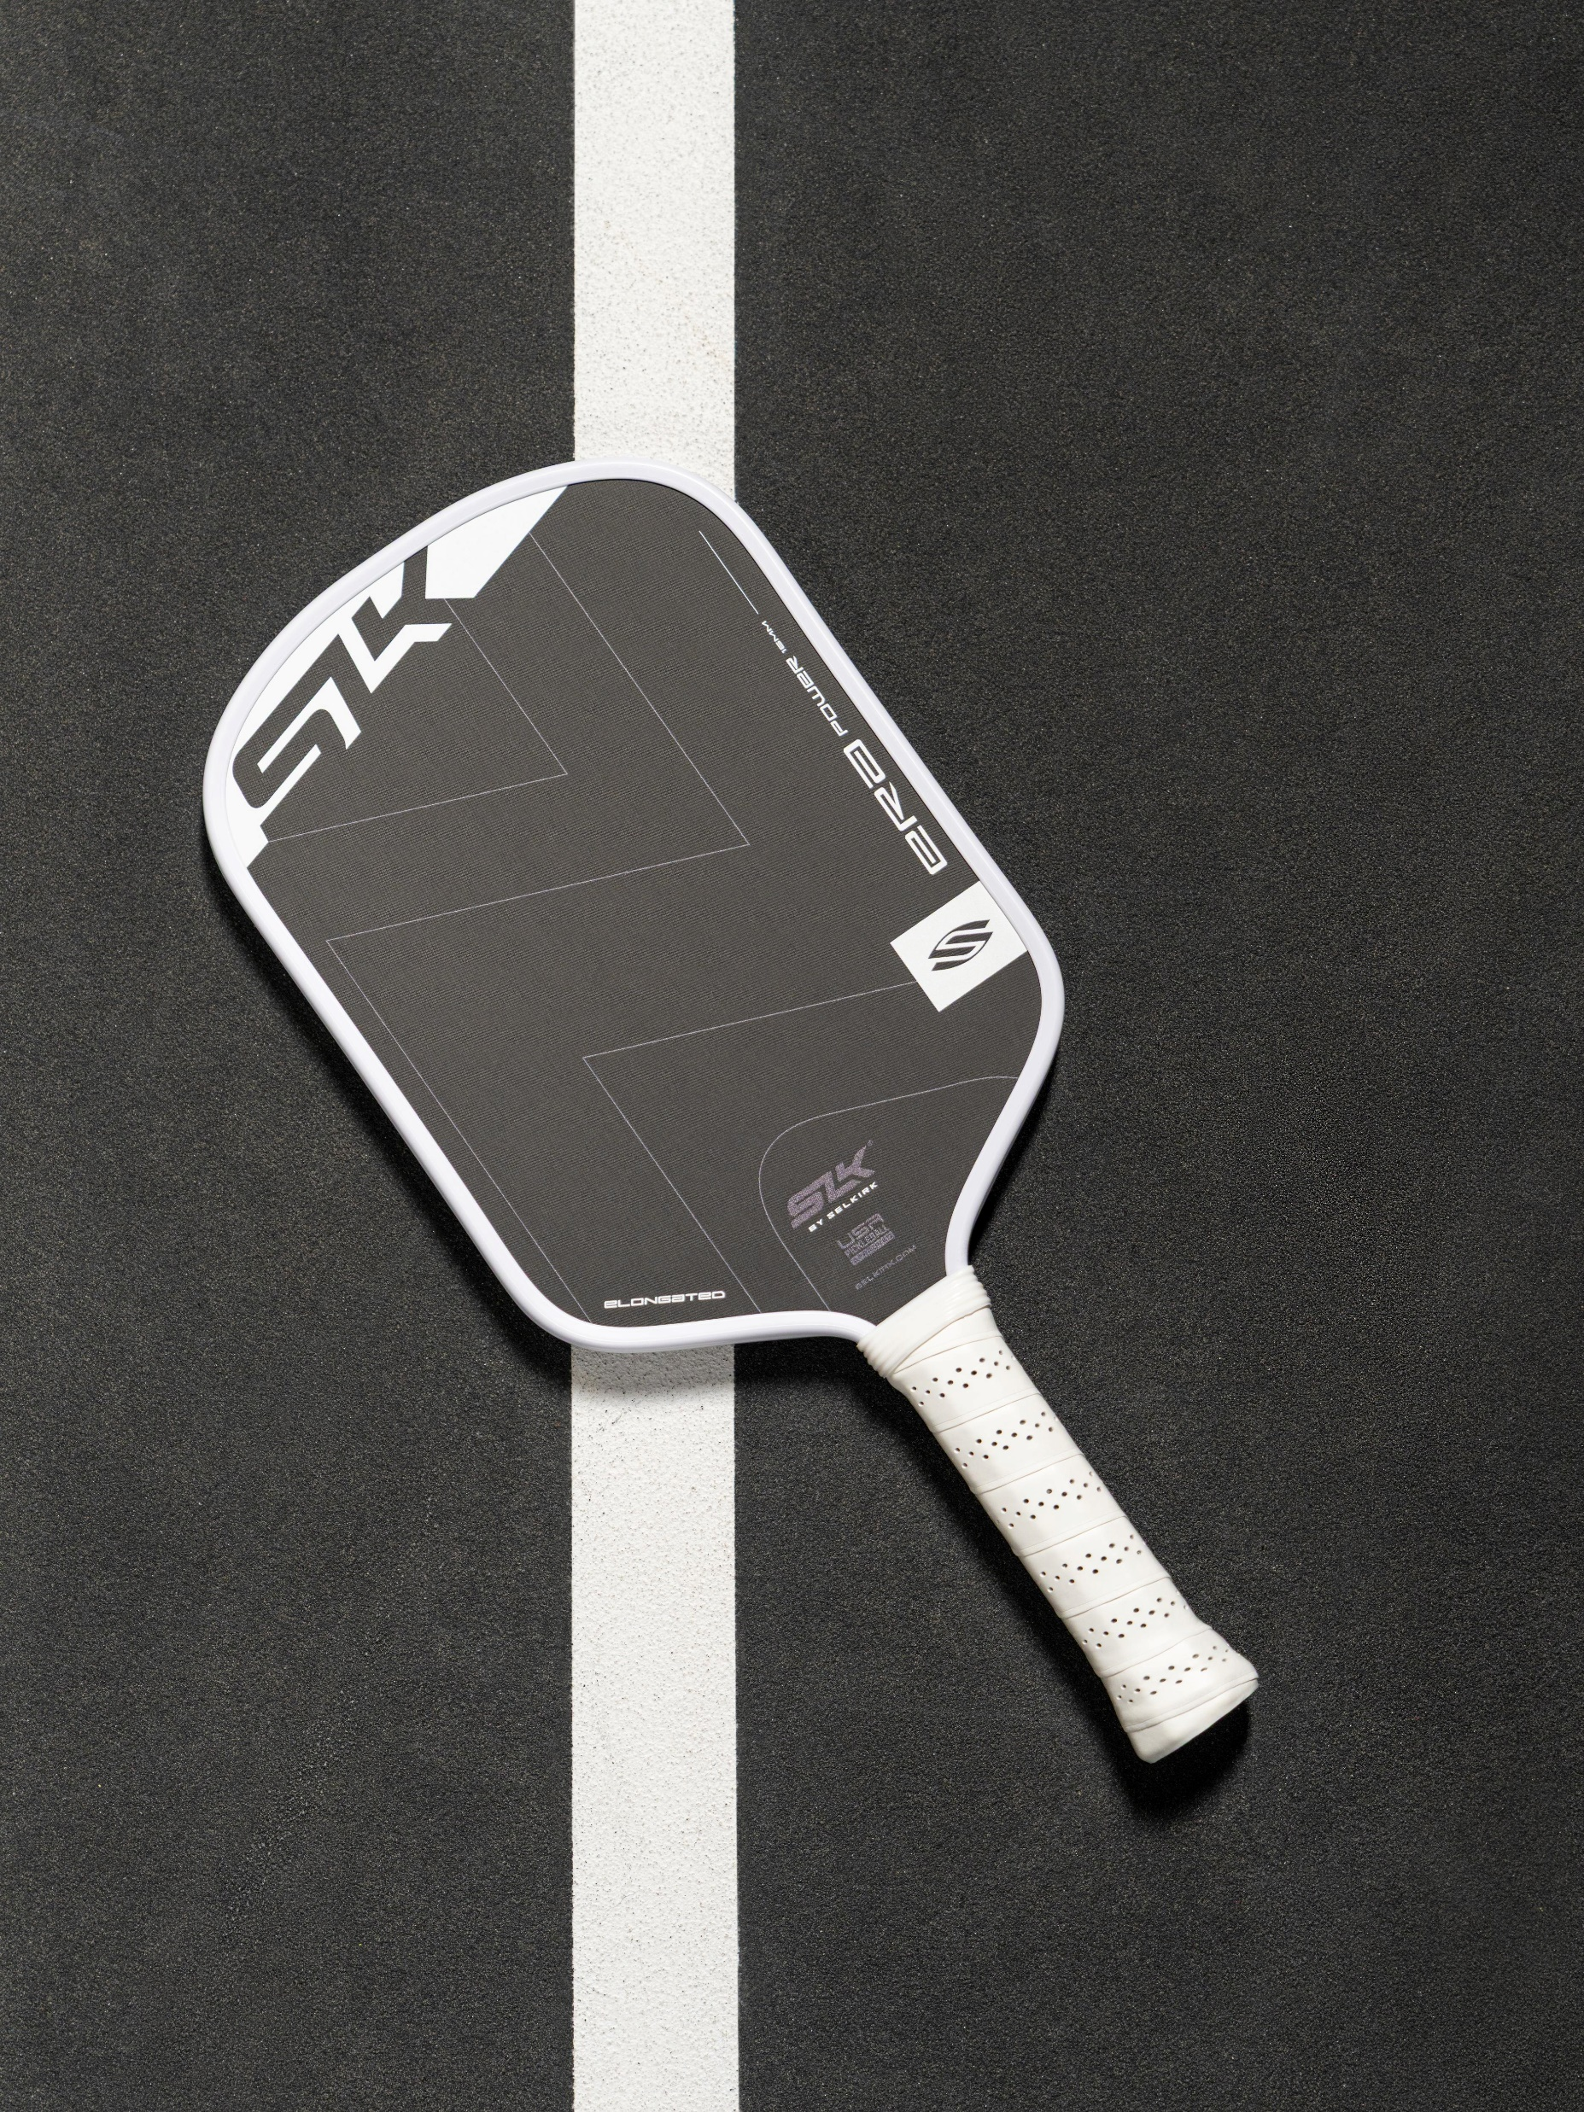
Investment Planning
Choosing Your Next Paddle
Pickleball Clinic II
Conducted by: Scott Milewski Selkirk Advocate
A Selkirk-based Clinic, applicable to most pickleball paddle brands
This clinic is partially based on Selkirk-produced paddle information, but is in no way endorsed by Selkirk Sports.
Notes:
Clinic I – Getting Started Playing Pickleball
Paddle Clinic II - Paddle Selection
Paddle Clinic III - Paddle Personalization
This clinic will focus on the various components and features of today’s pickleball paddles. We will be using Selkirk-brand paddles for our examples, but the concepts are applicable to most major paddle brands.
Much of the information contained in this clinic can be found on Selkirk.com, but is in no way endorsed by Selkirk Sports.
REFERENCE:
How to Choose the Right Pickleball Paddle for You https://www.selkirk.com/pages/selkirku/how-to-select-a-paddle

Slide 4
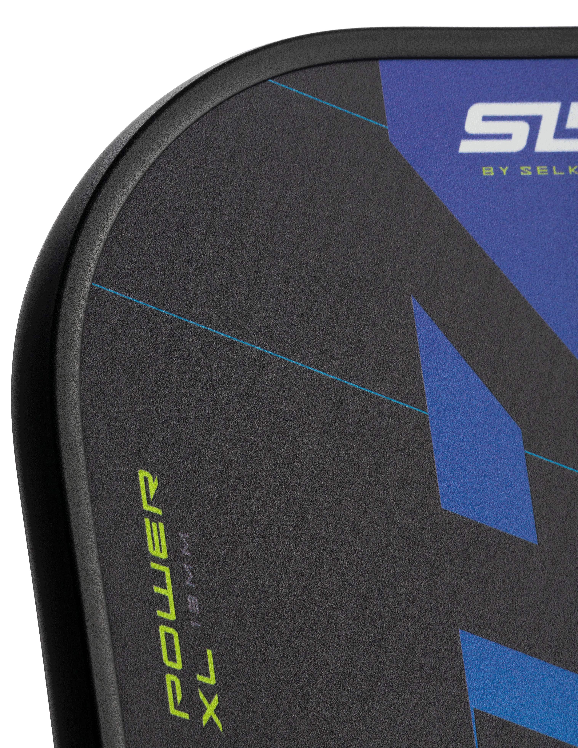
AGENDA
Playing Styles
Paddle Shapes
Cores
Materials
Thickness
Paddle Surface / Face
Edged or Edgeless?
Paddle Weights
Handles / Grips
Summaries
Investing
Notes:
The agenda will address the Factors to Consider when determining your next paddle:
Identify your playing style/skill level
Decide on what's most important: Needs and Wants - Power, Control, with/without Spin…
Understand Paddle Shapes
Paddle core materials and their impact
Paddle face materials and their impact
Choose the right weight
Select the correct grip size
Quality and durability
Give it a Test Drive (or Dink)!
“Investing” in a paddle

Slide 5
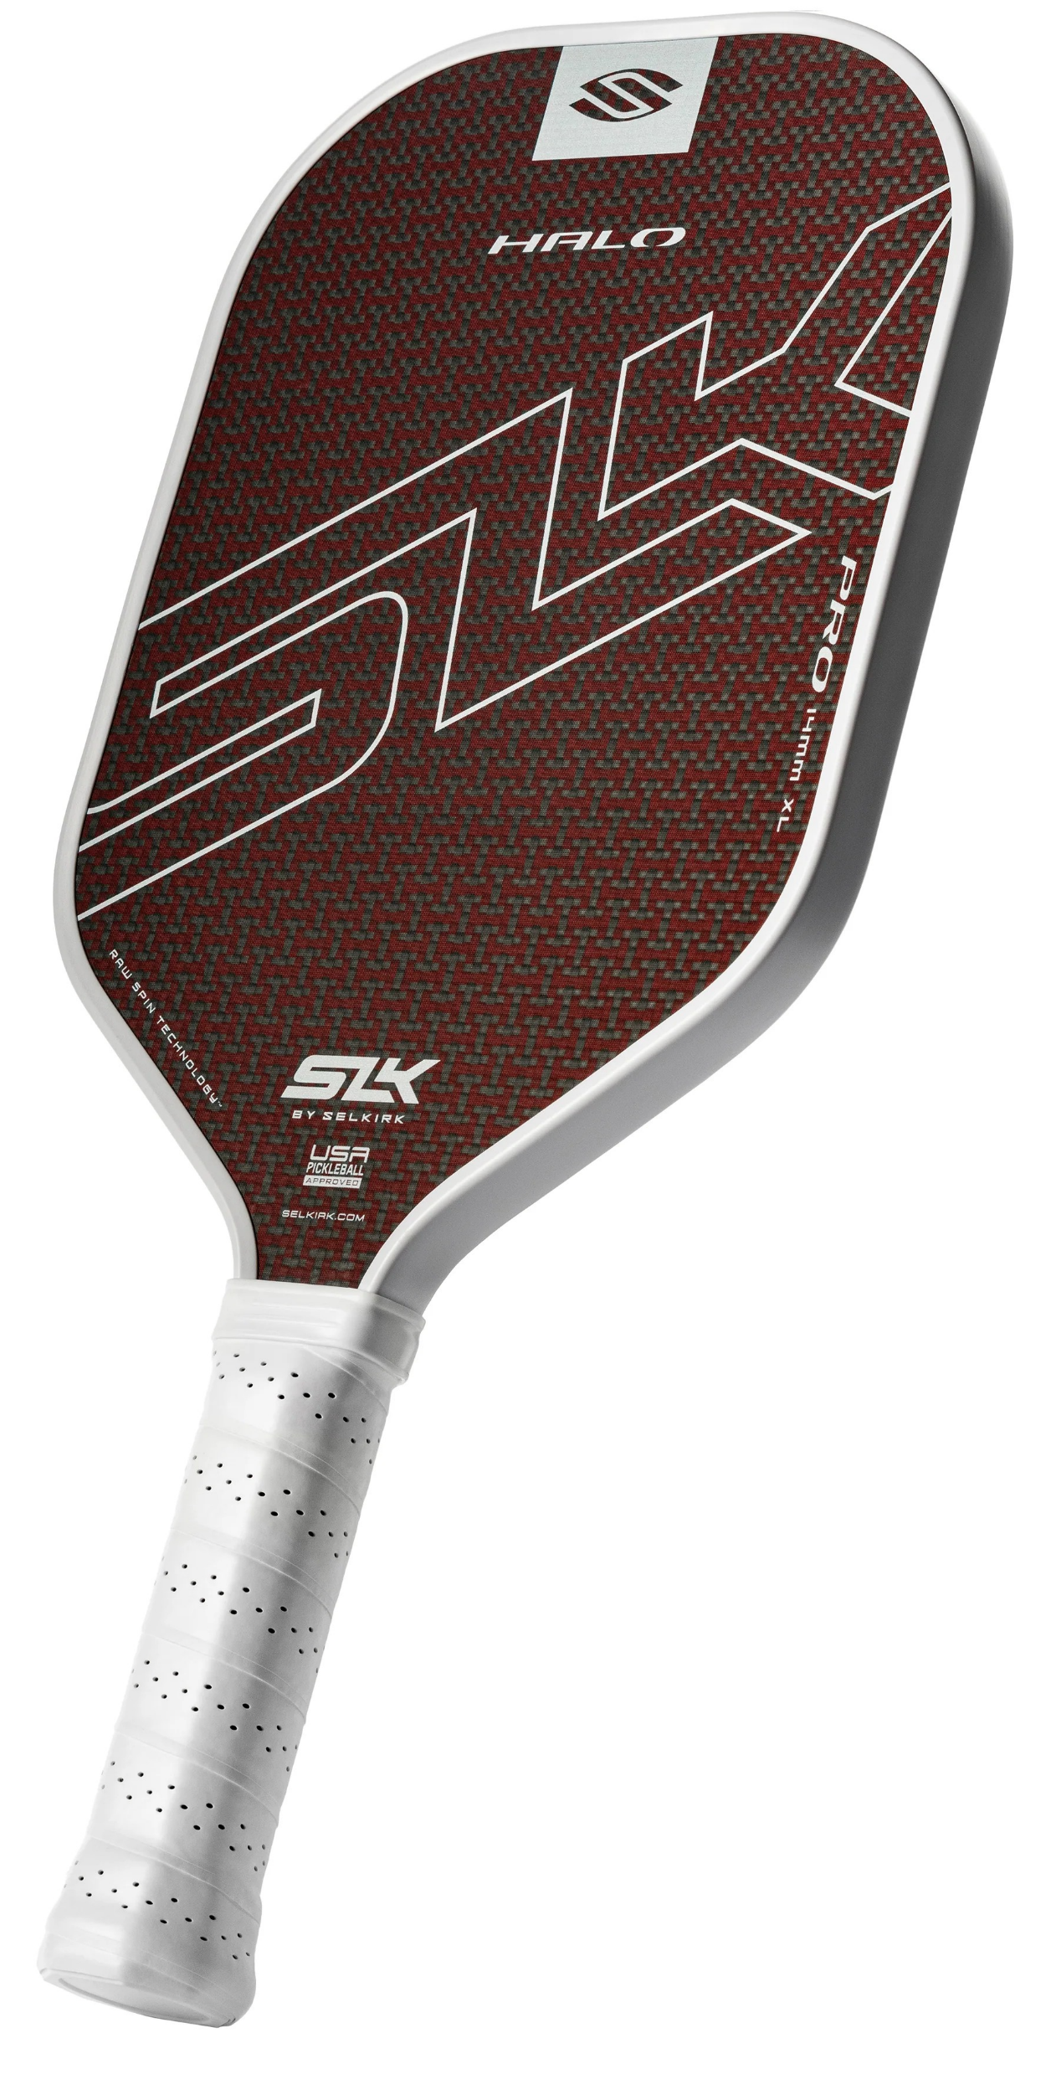
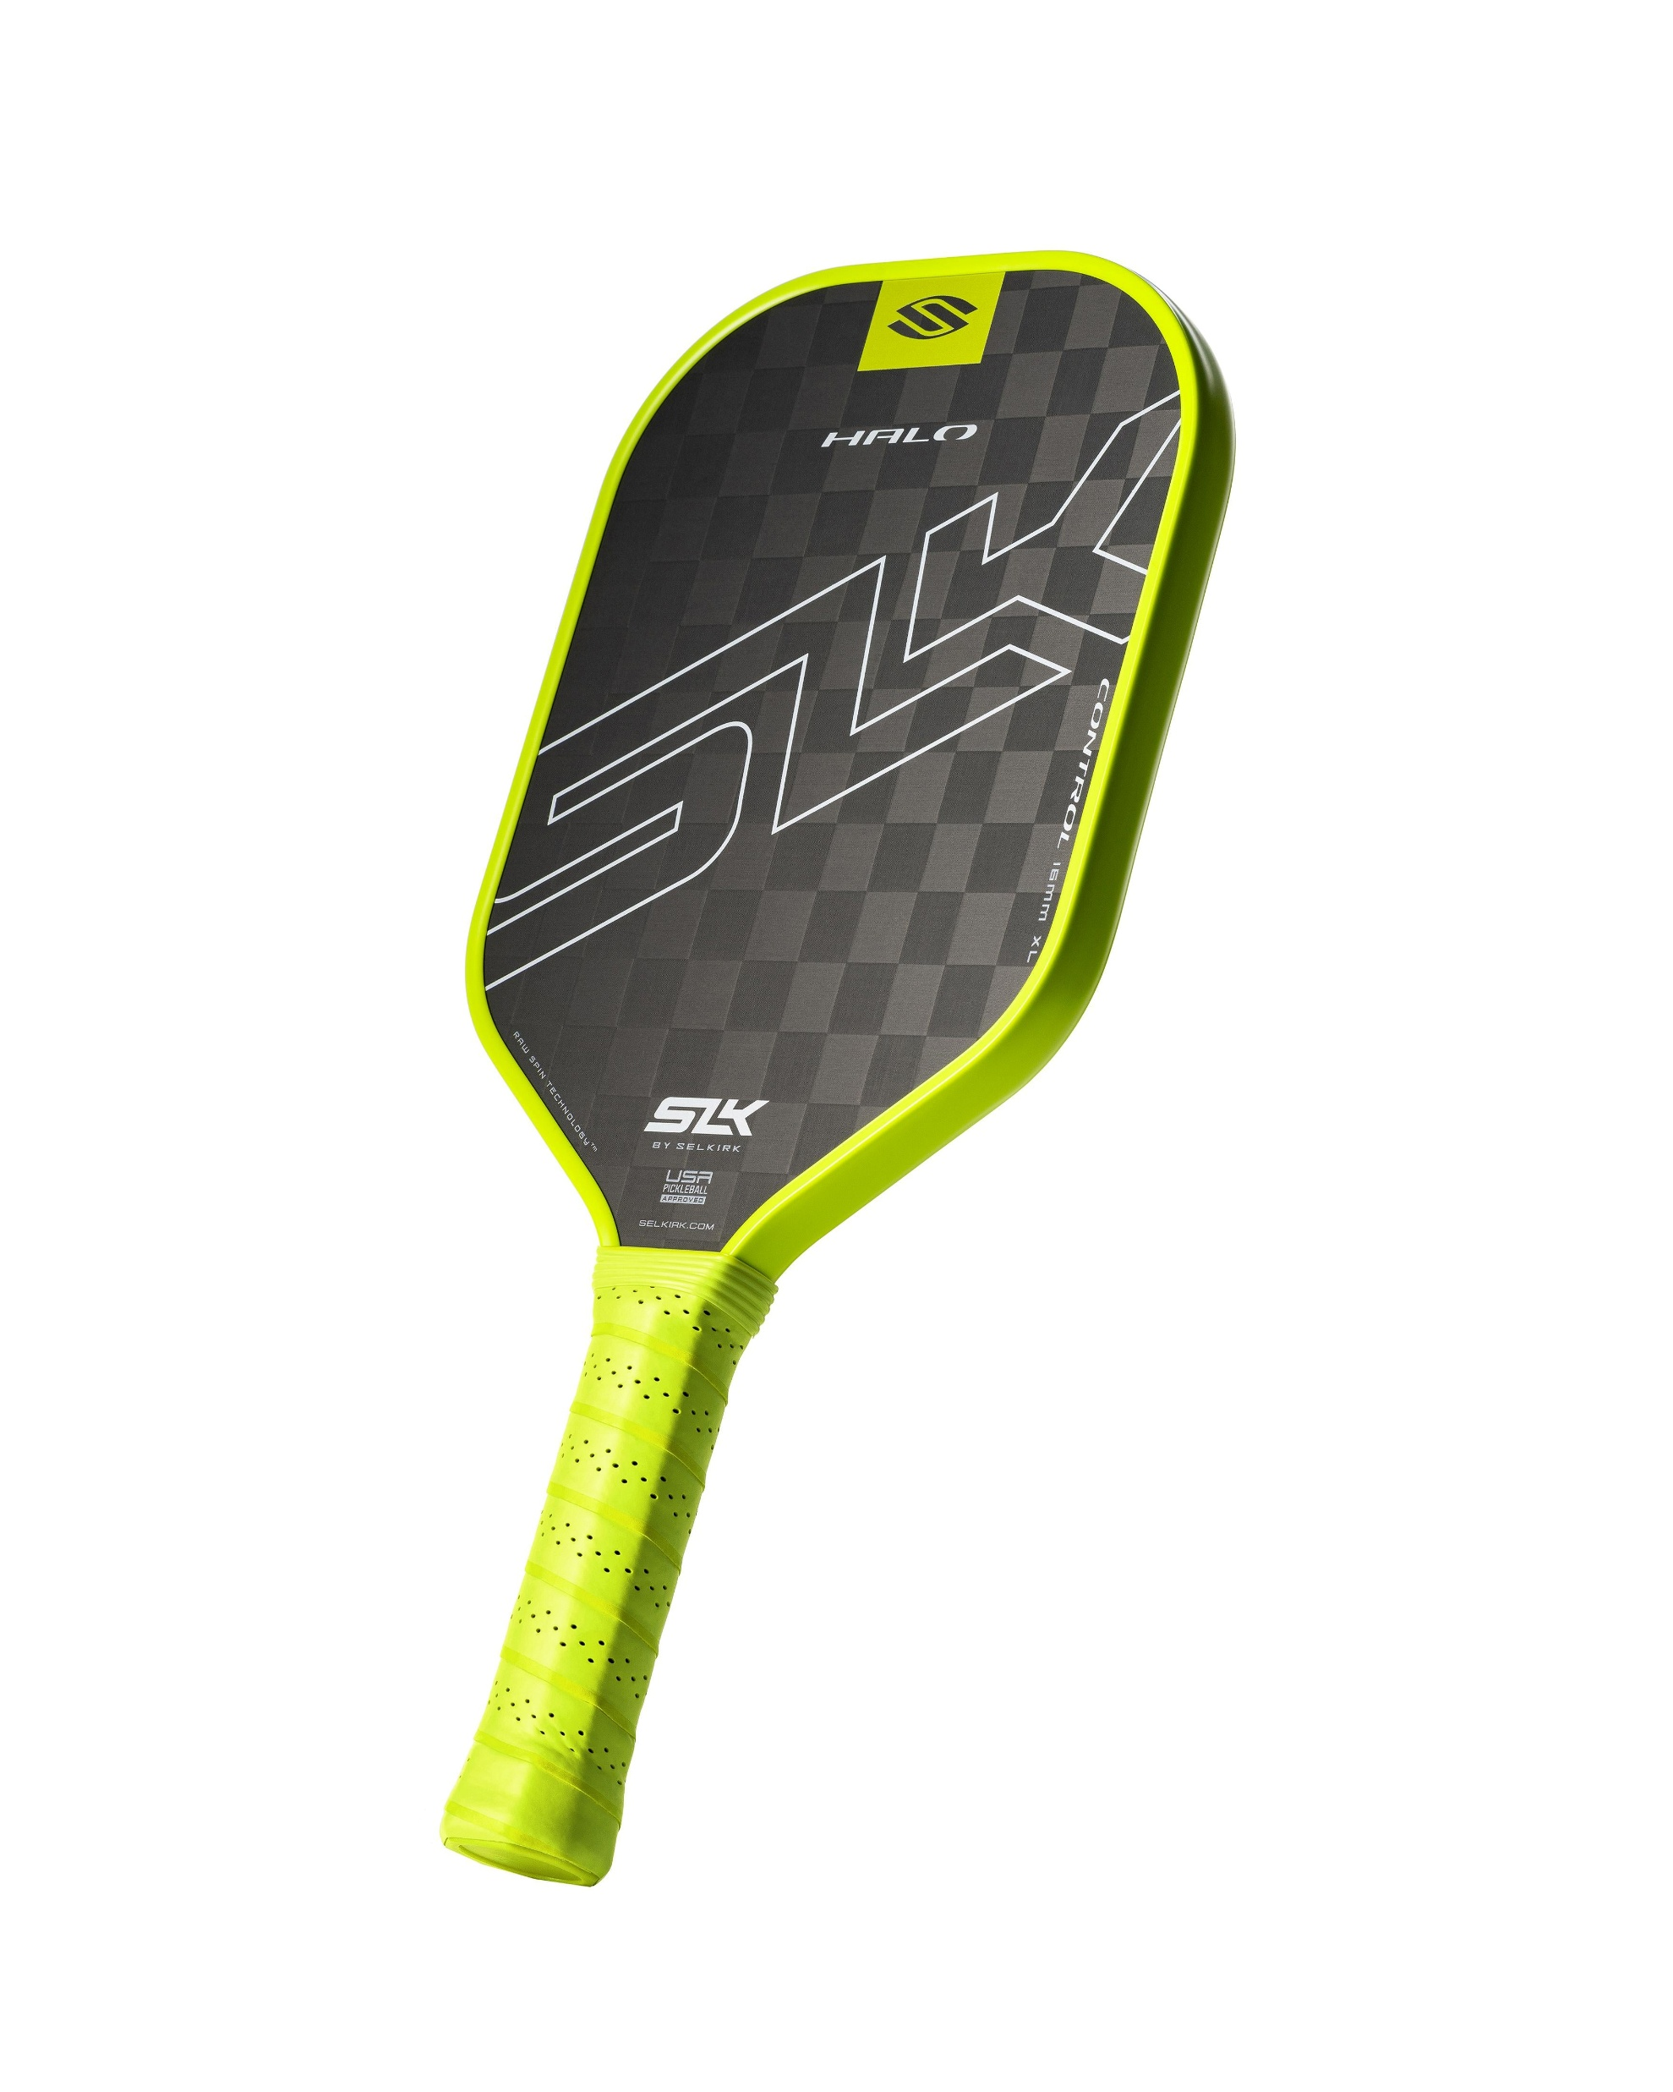
Playing Styles
Many of the decisions about the type of paddle to choose is based on the type of playing style you employ:
Control / Finesse
Power / Aggressive
Hybrid / Balanced
Notes:
Easch of the components of a pickleball paddle will tailor to one of these playing styles. Some offer more of a certain type of potential, while others only give a slight advantage. Selkirk paddles are designed with the most modern technology for the price-level of the paddle.
You level of experience plays a big part in learning how you like to play.
If you do not yet have an idea which style you prefer, or simply use,. Not to worry. There are a couple of options:
Attend a Selkirk Demo Day (or two), and play with the various paddles available
Purchase a “Starter Set” like the SLK Prime Bundle available at Costco. This set is a $69.99 value.
Once you have paddles, you should participate in ‘Open Play’ sessions. Only by playing can you truly discover your playing style.
Attend a class/couching session which focuses on Style Differentiation
---| CONTROL |---
A control-style pickleball player relies less on raw power and more on precision, patience, and strategy. Instead of trying to blast winners, they focus on managing the pace of the game and forcing opponents into errors. Here are the main aspects:
1. Shot Selection & Placement
Prioritizes consistency over speed.
Aims for deep returns to push opponents back.
Uses dinks, drops, and resets to control the kitchen and slow the game down.
Hits to opponents’ weaknesses (backhand, less mobile side).
2. Pace Control
Mixes soft shots and controlled drives rather than going for outright winners.
Neutralizes power players by absorbing and redirecting pace.
Uses off-speed shots to disrupt rhythm.
3. Patience & Rally Mindset
Comfortable in long dink rallies at the kitchen line.
Waits for the right moment (like a pop-up) before attacking.
Prefers constructing points rather than ending them quickly.
4. Footwork & Positioning
Strong at holding the non-volley zone (NVZ) and maintaining court positioning.
Quick recovery steps after each shot.
Focuses on court balance to reduce errors.
5. Spin & Touch
Uses topspin and underspin subtly to control ball height and bounce.
Relies heavily on touch and feel for drop shots and resets.
Excellent control of paddle face angle.
6. Mental Game
Very disciplined and avoids risky shots.
Stays calm under pressure, even in long rallies.
Uses strategy to frustrate opponents into making mistakes.
Summary: A control-style player slows down the game, keeps the ball in play, and waits for high-percentage opportunities, making them tough to beat for overly aggressive opponents.
---| POWER |---
A power-style pickleball player relies on pace, strength, and aggressive shot-making to pressure opponents and dictate play. Here are the key aspects:
1. Serve & Return
Strong, deep serves with pace and spin to push opponents back.
Aggressive returns, often driving the ball hard to force weak replies.
2. Groundstrokes
Hard drives from both forehand and backhand, using topspin to keep shots in.
Prefers baseline play over long dinking exchanges.
3. Net Play
Quick put-aways at the net, smashing high balls with power.
Looks for chances to attack instead of sustaining long soft rallies.
4. Shot Selection
Third-shot drives rather than drop shots, aiming to overwhelm opponents early.
Focus on winners and forcing errors rather than just extending rallies.
5. Movement & Positioning
Moves aggressively into the court after strong shots.
Uses quick reflexes to pounce on high or attackable balls.
6. Mindset
Plays with a dominate-and-finish mentality.
Comfortable taking risks to end points sooner.
7. Strengths
Can intimidate opponents with pace.
Shortens rallies and capitalizes on weak defenses.
8. Weaknesses
Can struggle against control players who reset and force consistency.
More prone to unforced errors if timing or accuracy is off.
Summary: A power-style pickleball player thrives on pace, pressure, and quick finishes, turning matches into battles of reaction and endurance rather than patience and touch.
---| HYBRID |---
A hybrid-style pickleball player blends elements of both power and control play, shifting between aggressive and precise strategies depending on the situation. Here are the key aspects:
1. Core Traits of a Hybrid Player
Adaptability – Reads the flow of the game and adjusts between fast, attacking shots and slower, placement-driven play.
Balanced Skillset – Equally comfortable driving the ball hard from the baseline or softening it with dinks at the kitchen line.
Shot Selection – Chooses shots not just based on their strengths, but on the opponent’s weaknesses and positioning.
Tempo Control – Capable of speeding up rallies to force errors or slowing them down to regain rhythm.
2. Technical Aspects
Serve & Return – Mixes powerful, deep serves with softer, precise placements to keep opponents guessing.
Groundstrokes – Alternates between heavy drives and controlled drops depending on court position.
Net Play – Combines touch dinks with sudden speed-ups or roll volleys to create unpredictability.
Defensive Versatility – Can reset with soft hands or counterattack with quick reflexes.
3. Mindset
Strategic Thinker – Doesn’t lock into one style; instead, plays situationally smart.
Deceptive – Keeps opponents off-balance by varying shot pace, spin, and placement.
Problem Solver – Finds ways to break through “pure power” or “pure control” opponents by blending both.
Summary: A hybrid player is a chameleon on the court—able to switch gears and thrive in different playing conditions, making them especially tough to predict and beat.

Slide 6
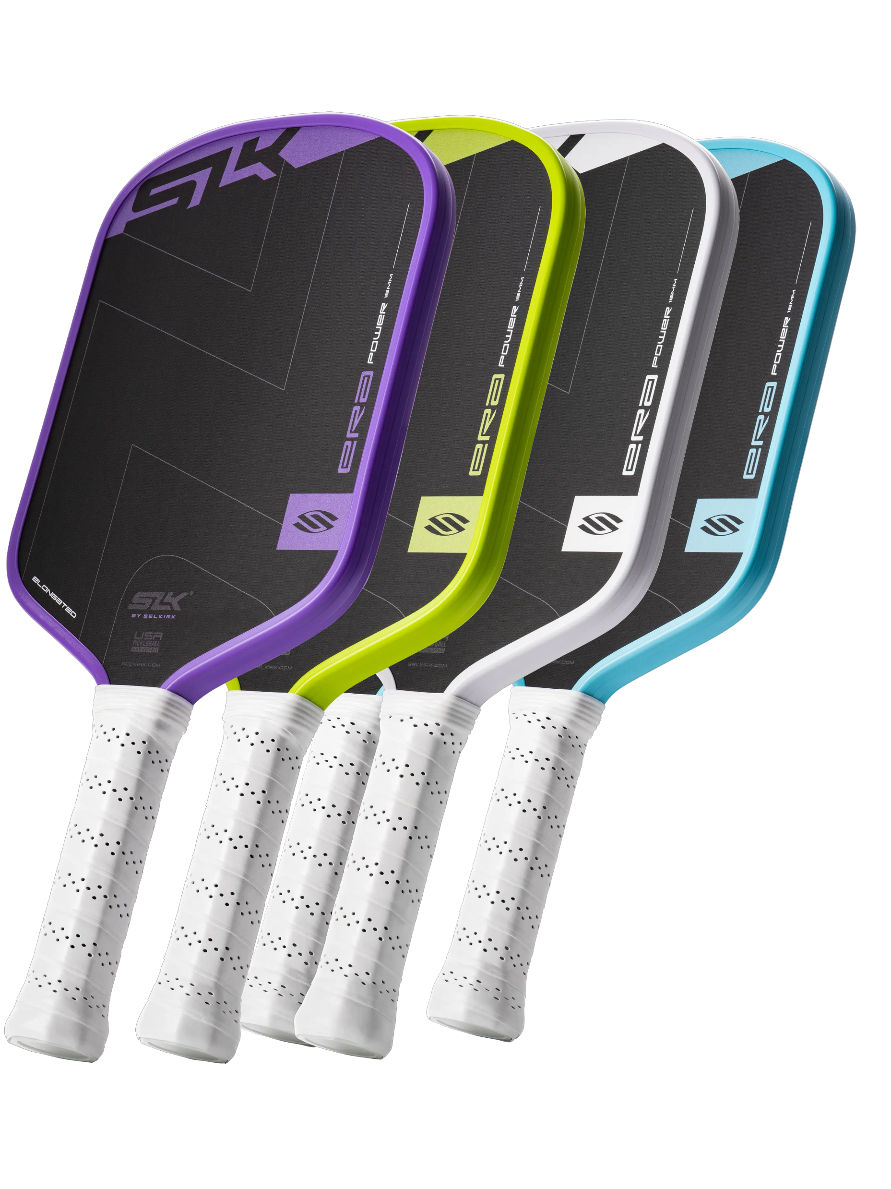
The choice of paddle can depend on what you want as well as what you need:
A AGGRESSIVE Player who likes pressing play, the pop of a Power paddle, and wants even More! Power Paddle | A Player whose game has aspects of a balanced game. Using Power when needed, and Restraint when touch is called for. Hybrid Paddle | Someone who already has enough Force regardless of which paddle is used. But can use some added Delicacy to enhance their game. Control Paddle
A Player who thrives on making those Finesse shots, and would like to get even MORE Control! Control Paddle
A Player who thrives on making those Controlled shots, and would like to get even MORE Control! Control Paddle |  | A Player with Tons of Subtlety, but not the Power they once may have had. A paddle with more POP would be welcome. Power Paddle
Notes:
A common misconception is that Power Paddles are meant only for Power Players. The same goes for Control Paddles and Control Players. But that is missing some of the possible benefits those paddle technologies can give to other playing styles.
For example, as we get older, we tend to lose muscle mass, and strength. It might be time for a control-style player whose baseline-to-baseline shots aren't quite making it there anymore to pickup a power paddle.

Slide 7
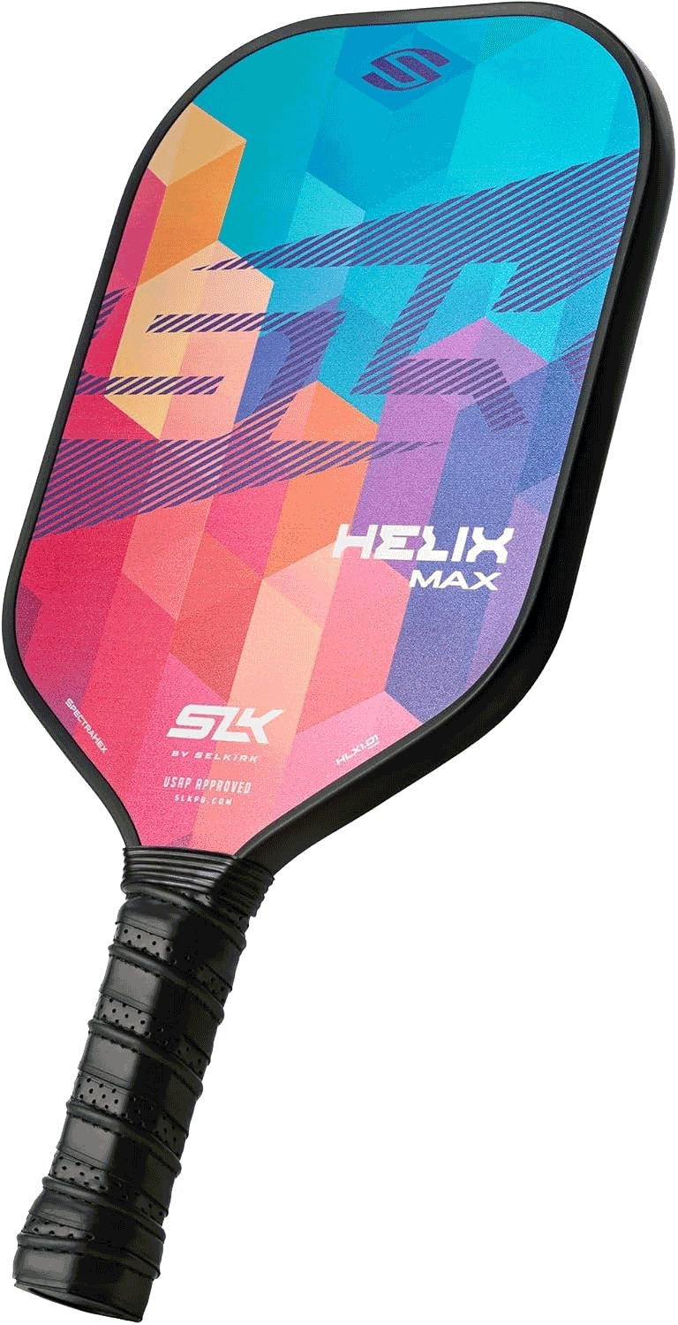
Paddle Shapes
Regardless of the manufacturer, most paddles fall into one of three categories:
Widebody
Elongated
Hybrid
Widebody paddles are an excellent choice for newer players, those with table tennis experience, and those without a previous tennis background
Elongated paddles are great for those with a previous tennis background and those with a two-handed backhand
Notes:
Pickleball paddles come in a variety of shapes, each designed to influence how the game is played. The shape of a paddle affects factors like power, control, reach, and sweet spot size. Choosing the right shape depends on whether a player prioritizes precision, speed, or extended reach on the court.
---| WIDEBODY |---
Widebody or "touch" paddles have a large, consistent sweet spot which helps players place the ball with more accuracy. These paddles help to “slow the game down” by absorbing more energy and taking pace off of their opponents’ shots, but that limited power can make creating pressure through aggressive offense difficult.
A widebody pickleball paddle is designed with a broader hitting surface than standard paddles, which changes the dynamics of play. Here are the key attributes and how they impact performance:
1. Paddle Shape
Wider face: The paddle is wider, often 1–2 inches more than a standard paddle.
Shorter length (sometimes): Some widebody paddles trade length for width, keeping overall area manageable.
Impact: A larger hitting area increases the sweet spot, making it easier to hit consistent shots.
2. Sweet Spot
Larger sweet spot: The wider surface distributes impact more evenly.
Forgiving on off-center hits: Great for beginners or players who want fewer mishits.
Impact: Reduces errors, especially for volleys and dinks.
3. Power vs. Control
Power: Slightly increased due to the wider surface catching more of the ball.
Control: Can be slightly reduced on fast reactions since a wider paddle may feel heavier or slower to maneuver.
Impact: Often preferred by defensive or all-around players rather than extreme power hitters.
4. Weight & Balance
Weight range: Usually similar to standard paddles (7.5–8.5 oz) but distributed across a wider face.
Balance: Some widebody paddles are head-heavy to add extra reach, while others are evenly balanced for maneuverability.
Impact: Can feel more stable on volleys but may fatigue the wrist slightly faster in long rallies.
5. Grip & Handle
Often paired with a shorter handle to complement the wider face.
Standard grip sizes apply, but some players prefer a slightly smaller grip to allow for wrist flexibility with a larger paddle.
6. Ideal Players
Beginners or intermediate players who want a larger sweet spot.
Doubles players who play near the net and need a forgiving paddle for quick reactions.
Players who prioritize placement over extreme spin or power.
7. Pros
More forgiving on off-center hits.
Larger hitting surface = easier to control dinks and volleys.
Can provide extra reach on wide shots.
8. Cons
Slightly reduced maneuverability for fast, precise swings.
May feel bulky to players used to standard shapes.
Less spin control compared to elongated paddles.
---| ELONGATED |---
Elongated paddles make it easy to hit with pace allowing those with shorter, more compact swings to generate additional speed. Players who already tend to hit the ball hard may enjoy the "extra boost" from power paddles. However, power paddles require precision and discipline to keep the ball inside the lines. Therefore, players who are just getting started on their pickleball journey might consider opting to start with a more forgiving paddle.
An elongated pickleball paddle is designed differently from standard or widebody paddles, with a focus on reach and leverage. Here are the key attributes:
1. Shape & Size
Longer length than standard paddles (often 17–17.5 inches).
Narrower width (usually 7–7.25 inches), giving it a slim profile.
Slightly more tapered or rectangular look compared to a widebody paddle.
2. Sweet Spot
The sweet spot is smaller and more centralized due to the narrow face.
Offers precision but can be less forgiving on off-center hits.
3. Reach Advantage
The extra length helps with defense at the baseline and dinking from farther away.
Good for players who want to cover more court without stepping forward as much.
4. Power & Control Balance
The narrower face and longer leverage can increase power on full swings.
Requires more control and accuracy, especially for volleys and dinks.
5. Weight & Balance
Often slightly head-light to reduce strain on the wrist with the longer handle.
Some models may keep a balanced weight for versatile play.
6. Grip & Handle
Usually comes with a standard or slightly longer handle to accommodate extended reach.
Longer handle can allow two-handed backhands if needed.
7. Ideal Player Style
Suited for baseline players or those who rely on reach and leverage.
Less ideal for players who need a large hitting surface for control-style dinking.
In short, an elongated paddle trades a wider hitting surface for extra reach and power, emphasizing precision and court coverage.
---| HYBRID |---
Hybrid paddles combine many features of both the widebody and elongated types to create a paddle with often times inferior aspects of the individual types, but combine to make a paddle that can allow for play-time adjustments the other types cannot.
A hybrid pickleball paddle is designed to combine features of both power and control paddles, aiming for a balance that suits versatile players. Here are its main attributes:
1. Shape
Often elongated or slightly wider than standard paddles, but not as wide as a full widebody.
Provides a mix of reach and sweet spot size.
2. Weight
Typically medium weight (7.5–8.5 oz).
Light enough for quick reaction and control, but heavy enough to generate solid power on shots.
3. Core Material
Commonly uses polymer (poly) or composite cores.
Poly cores give softer feel and more control.
Nomex or other harder cores add power potential, depending on design.
4. Face Material
Usually graphite, fiberglass, or composite.
Graphite offers better touch and precision.
Fiberglass adds slightly more pop, increasing power without losing too much control.
5. Sweet Spot
Medium-sized sweet spot—not as forgiving as widebody, but larger than standard control paddles.
Balances accuracy and power.
6. Handle
Medium length (typically 4–4¼ inches) to suit most grip styles.
Grip thickness is often moderate, balancing comfort and maneuverability.
7. Play Style Suitability
Ideal for players who want to mix aggressive shots and strategic placement.
Allows quick reaction at the net and strong baseline hits.
In short, a hybrid paddle is the “jack-of-all-trades” paddle: not specialized for maximum power or pinpoint control, but versatile for all-around gameplay.

Slide 8
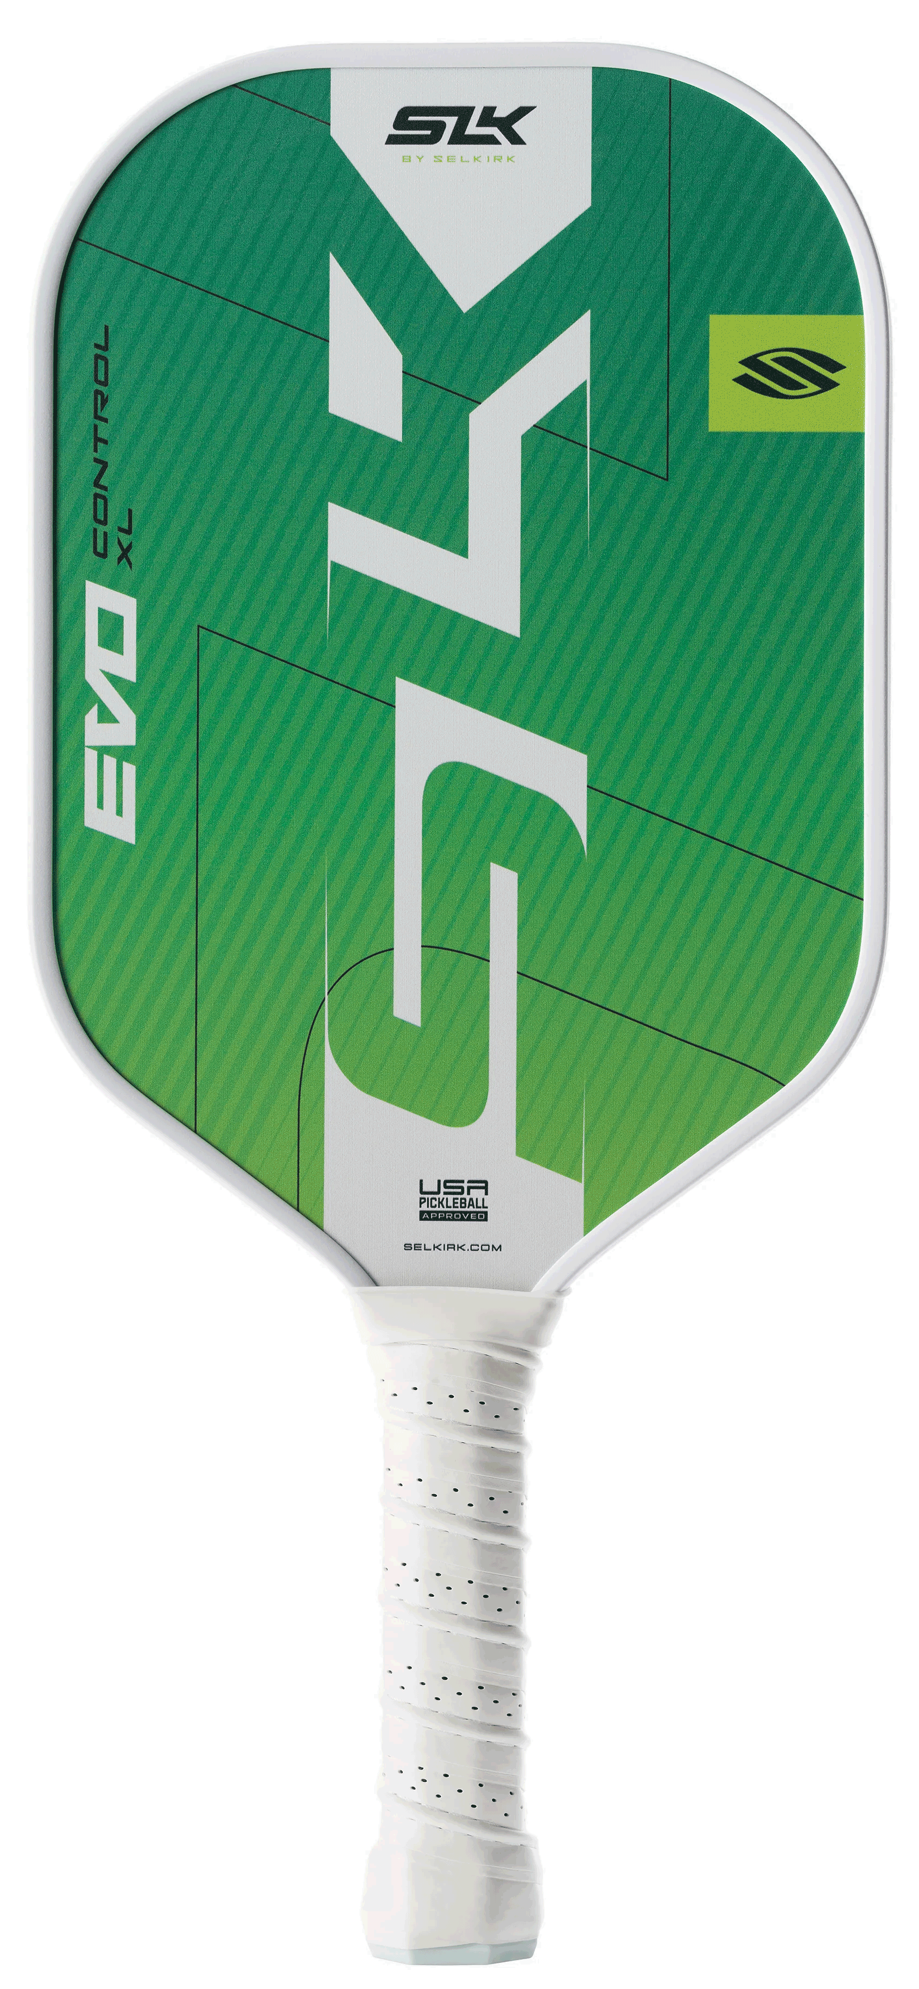
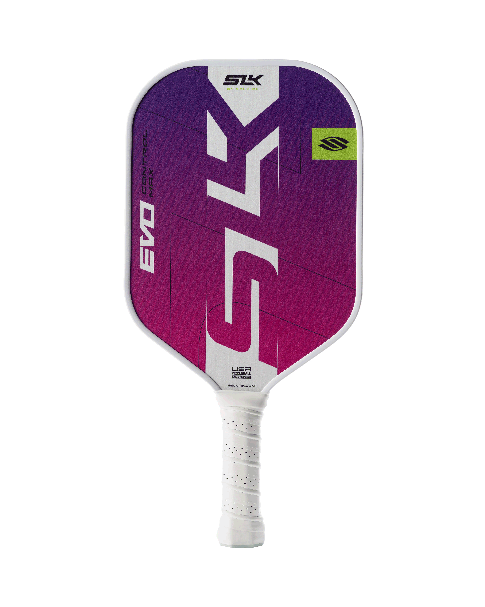
Paddle Shapes
For SLK paddles, the available shapes are:
Max Shape (SLK Series):
The Max is akin to the Epic in offering a traditional shape with a generous sweet spot
XL Shape (SLK Series):
The XL is designed for intermediate to advanced players who are ready to make the trade-off of a narrower sweet spot to get added reach
For Selkirk paddles:
Widebody
Epic
S2
Maxima
Elongated
Invikta
Mach6
Omni
Hybrid
Tour
Notes:
Max Shape (SLK Series):
The Max is akin to the Epic in offering a traditional shape with a generous sweet spot. It's perfect for players who are not yet ready to handle the elongated paddles but want a reliable and consistent paddle with a standard handle length.
XL Shape (SLK Series):
The XL is designed for intermediate to advanced players who are ready to make the trade-off of a narrower sweet spot to get added reach. This paddle is excellent for those with a background in racquet sports, offering a familiar feel to tennis players with its elongated face.
Selkirk and Selkirk Labs use proprietary names for these shapes:
Widebody shapes:
Epic
S2
Maxima
Elongated Shapes:
Invikta
Mach6
Omni
Hybrid Shapes:
Tour

Slide 9
What is a Core?
The hidden “engine” inside your paddle
It’s the layer sandwiched between the paddle’s two faces
Gives the paddle its:
Feel
Power
Control
Even sound on contact with the ball
Notes:
The core of a pickleball paddle is the material inside the paddle that gives it structure and determines its properties. The type of core material used in a paddle impacts the weight, strength, stiffness, and impact noise of the paddle.

Slide 10
Common Core Materials
Honeycomb
A grid of small, empty cells
Keeps the paddle strong but light
Used in the majority of today’s paddles
May be made from different materials:
Polymer (Polypropylene)
Nomex
Aluminum
Notes:
They strike a sweet balance between touch, control, and durability.
Advantages:
Soft, quiet feel
Excellent control & touch
Balanced power
High durability
Vibration dampening
Polymer (Polypropylene): Lightweight, durable, quiet, balanced power & control.
Best for: All-around play, control-focused players.
Nomex: Very strong, crisp feel, loud “pop,” heavier
Best for: Power hitters, aggressive play
Aluminum: Strong, consistent, good touch, lighter than Nomex but pricier.
Best for: Control and finesse shots

Slide 11
Common Core Materials Cont.
Foam
Characteristics
Bigger Sweet Spot
Longer Dwell Time
Customizable Response
No Core Crushing
Variable Foam Builds
Notes:
Foam cores are sometimes used in tennis and squash rackets, providing a softer and more cushioned feel. This type of core can absorb more shock and vibration, offering more comfort to the player. However, in pickleball, the foam core is not commonly used, as it lacks the power and control provided by the honeycomb design.
Foam-core pickleball paddles are a newer tech shift—especially in “Gen 4” designs—that swap the traditional polypropylene honeycomb for a solid or hybrid foam interior.
Bigger Sweet Spot – Foam distributes impact energy more evenly across the face, so off‑center hits feel more consistent and forgiving.
Longer Dwell Time – The ball stays on the paddle fractionally longer, giving you more control over spin and placement.
Customizable Response – Manufacturers can tweak foam density and cutout patterns to dial in power vs. control for different play styles.
No Core Crushing – Without honeycomb cells, there’s no risk of the “crushed core” issue that can plague polymer paddles over time.
Variable Foam Builds – Some use full EVA foam, others blend foam with edge‑wall reinforcements or fiberglass/carbon layers for tailored performance.

Slide 12
Common Core Materials Cont.
Foam
Trade-Offs
Power versus Control
Weight and Maneuverability
Durability (varies by manufacturer)
Selkirk’s implementation of the foam core is called PureFoam which offers:
Consistent Shots
Increased Paddle Lifespan
Improved Responsiveness
Resists Core Crushing and Deformation
Expanded Seet Spot
Notes:
There are many different types of foam cores — EVA, EPS, EPP, just to name a few. These different types of foam have unique characteristics, but generally speaking, paddles with foam cores offer a forgiving touch and quieter playing experience. The foam dampens impact by absorbing vibrations, making foam paddles ideal for players who value comfort. However, the energy return, or speed at which the ball comes off the paddle when striking the ball, is too high for sanctioned tournament play. Manufacturers are still looking for solutions to get foam paddles approved for more than recreational play.
Foam Cores come with some ups and downs as well:
Power vs. Control Balance – Well‑designed foam cores can deliver both pop and touch, but cheaper builds may feel muted or lack top‑end power.
Weight & Maneuverability – Foam cores can be lighter and more elastic, aiding quick reactions at the net, though some players prefer the firmer feedback of honeycomb.
Durability Caveats – While they avoid honeycomb collapse, certain foam materials may wear faster under repeated high‑impact play.
PUREFOAM CORE FOR CONSISTENT SHOTS AND INCREASED PADDLE LIFESPAN
As one of the first fully foam cores to meet rigorous playability standards, the PureFoam Core represents a new standard for pickleball paddles with its long-lasting durability and responsiveness. The high-density foam is engineered to resist crushing and deformation over time while expanding the sweet spot compared to traditional polypropylene-core paddles.
THRMOFORMED CONSTRUCTION WITH ADDITIONAL FOAM WALL
The Thermoformed Construction with Additional Foam Wall incorporates a foam wall along the paddle's perimeter, seamlessly bonded during the thermoforming process. The foam wall enhances structural integrity while expanding the effective sweet spot, ensuring consistent performance across the entire face of the paddle.
Foam-core pickleball paddles are a newer type of paddle design that use a lightweight foam insert instead of the more traditional honeycomb cores (polymer, Nomex, or aluminum). Here are the key characteristics:
1. Core Material & Feel
Made with a solid foam interior, rather than a hollow honeycomb.
Provides a softer, more controlled feel on contact.
Reduces vibration, making it easier on the arm and wrist.
2. Power vs. Control
Generally offer excellent control and touch, ideal for dinks, drops, and resets.
Tend to be a bit less powerful than stiffer honeycomb cores, though some newer models balance this with paddle face technology.
3. Sweet Spot
Foam cores distribute energy more evenly, which can create a larger sweet spot compared to honeycomb paddles.
More forgiving on off-center hits.
4. Weight & Balance
Typically lightweight to midweight.
Balanced feel, depending on manufacturer design (some head-heavy for power, some even-balanced for control).
5. Sound & Vibration
Quieter than honeycomb paddles — a benefit for communities with noise restrictions.
Softer sound on impact, often described as “muted” or “cushioned.”
6. Durability
Foam can compress over time, so they may not last as long as high-quality polymer honeycomb paddles if heavily used.
Performance depends greatly on brand and construction quality.
7. Player Fit
Great for players who value soft hands, control, and comfort.
Particularly good for players with elbow/shoulder sensitivity or those transitioning from tennis who want a cushioned feel.
May not satisfy “power players” who rely on hard drives and smashes.

Slide 13
Core Material Comparison
Feature | Honeycomb (Polymer) | Foam
Feel | Classic, crisp “pop” with a familiar rebound | Softer, more plush impact; very consistent across the face
Power | High potential, especially with smaller cells or stiffer walls | Moderate to high depending on foam density; generally smoother power delivery
Control | Good, but can be less forgiving on mishits | Excellent — longer dwell time aids spin and placement
Sweet Spot | Standard size; varies by build | Large and forgiving, even on off‑center hits
Vibration Dampening | Average; some shock passes through | Excellent — foam absorbs more impact energy2
Durability | Can develop “core crush” over time as cells collapse | Avoids core crush; long‑term wear still being evaluated2
Performance | Balanced; weight depends on cell size/thickness | Often lighter and more elastic, aiding quick reactions
Best For | All‑court players who like a familiar, punchy feel | Control‑oriented players, those with arm issues, or seeking a bigger sweet spot
Notes:
Foam Cores come with some ups and downs as well:
Power vs. Control Balance – Well‑designed foam cores can deliver both pop and touch, but cheaper builds may feel muted or lack top‑end power.
Weight & Maneuverability – Foam cores can be lighter and more elastic, aiding quick reactions at the net, though some players prefer the firmer feedback of honeycomb.
Durability Caveats – While they avoid honeycomb collapse, certain foam materials may wear faster under repeated high‑impact play.

Slide 14
Core Thickness Comparison
Thickness | Measurements | Best for Style Type
Thin | <10mm to 13mm | Power
Hybrid | 14mm to 16mm | Balance
Thick | 16mm to 19mm | Control
Ultra | >20mm | Max Control
Notes:
Thinner - Thinner paddles typically have more "pop" or rebound which is why many manufacturers will call their thinner options "power paddles". They often have a smaller sweet spot and can be difficult to control if players are unable to find it regularly making them more common choices for advanced players.
14mm – Lighter & Faster, Less dwell time = More Power | Harder to control and may feel harsh on contact.
Thicker - Thicker paddles tend to distribute force more evenly and make controlling the ball easier. They have a more even sweet spot across the face and slightly less rebound making shots more predictable. Players who want more forgiveness or are looking to improve their game often choose a thicker core paddle.
16mm = Heavier, More dwell time = Control; Plush, Soft feel. Excellent for drops and resets. More forgiving. | May lack Power, not as maneuverable.

Slide 15
Paddle Surfaces
Some available paddles face materials are:
Composite
Graphite
Kevlar
Raw Carbon Fiber (T700)
Hybrid Weave
Textured (InfiniGrit)
Notes:
Next, we will break down the most popular of these paddles face materials.
---| COMPOSITE |---
Composite (Fiberglass) Paddle Faces
Fiberglass, often referred to as a composite face, is one of the most established materials in pickleball and remains a staple, particularly for mid-range and entry-level paddles. The face is typically a blend of woven glass fibers coated in epoxy resin and often paired with polymer cores.
Performance Characteristics: Fiberglass is prized for its flexibility and “trampoline-like” pop, which translates into above-average power. The rougher, coarser weave of glass fibers (10–25 µm) provides inherent texture that promotes spin, especially when paired with added coatings or surface treatments46. The moderate stiffness and shock-absorbing qualities of fiberglass give it a relatively forgiving feel and enhance comfort, while its flexibility allows for large sweet spots—which are ideal for less experienced players who may mishit frequently. The power profile is superior to graphite but less than some advanced carbon fibers. Spin generation is moderate to high, amplified further with added surface texturing.
Durability: Fiberglass paddles offer solid longevity for their price point; however, their surface can scuff or chip more easily under heavy play than high-grade carbon fiber alternatives. Despite this, high-quality fiberglass is still considered highly durable at recreational and club-play levels.
Gameplay Impact & Player Recommendations: Composite fiberglass faces are highly adaptable and contextual—ideal for players who desire a “jack-of-all-trades” paddle suited to both offensive and defensive play. Their affordability and consistent comfort make them popular for all-court players, beginners, and intermediates looking for both power and initial forays into spin play9.
---| GRAPHITE |---
Graphite faces are constructed from tightly woven layers of graphite (a type of carbon) applied to both sides of the core. These layers are extremely lightweight and thin, contributing to the overall speed and maneuverability of the paddle.
Performance Characteristics: Graphite paddles are renowned for delivering exceptional control and finesse. The stiffness and low mass of graphite allow for rapid hand speed, precise placements, and delicate dinking at the kitchen line. They often feature a very smooth surface, which means less natural grip on the ball and therefore lower inherent spin than rougher composites or raw carbon paddles unless additional texture is applied16. Graphite paddles typically appeal to touch and control-oriented players. While some players may find graphite faces lack the “pop” or pronounced power of fiberglass or carbon fiber, advanced core and thickness adjustments can partially offset this limitation.
Durability: Graphite faces are highly durable and resistant to warping or cracking when paired with robust edge guards. However, the very thin layer can be more vulnerable at the edges to chipping or surface wear in entry-level builds.
---| KEVLAR |---
Kevlar (aramid) faces represent a growing niche. Kevlar is a synthetic fiber celebrated for low weight, exceptional tensile strength, and its ability to absorb impact without breaking.
Performance Characteristics: Kevlar faces provide a unique blend of vibration dampening, plush feel, and high durability. Their slightly coarser surface increases spin generation, while the inherent flexibility allows for greater comfort and joint protection—useful for players with elbow or wrist sensitivities. The power profile is generally moderate due to some flex on impact, but the combination of control and shock absorption is unmatched.
Durability: Kevlar offers extraordinary impact resistance and longevity, outlasting both fiberglass and most carbon fiber in high-impact, long-term use. It resists surface wear, chipping, and delamination exceptionally well, even during rugged play or paddle-to-paddle collisions.
---| RAW CARBON FIBER |---
Raw Carbon fiber, often differentiated by its weave (3K, 12K, T700, T300) and later by proprietary blends and thicknesses, is created from strands of carbon woven together and bonded with resin, producing an extremely stiff surface with a stunning strength-to-weight ratio. In the context of pickleball, “raw carbon fiber” (i.e., T700 raw carbon) refers to an uncoated open weave, maximizing friction for spin.
Performance Characteristics: Carbon fiber faces excel in both power and control. They provide a firm, consistent ball strike, excellent responsiveness, and extended sweet spots, but their headline benefit is superior spin generation—especially on raw carbon paddles, which use the uncoated, naturally gritty fiber for best-in-class dwell time and surface grip. Thicker carbon fiber faces (e.g., 16 mm+ paddles) lend extra control and dwell for dinking, while thinner carbon faces offer more power and pop18. Grit and texture endure far longer on raw carbon than on painted or sprayed surfaces.
Durability: High-quality carbon fiber faces are extremely resistant to cracking and delamination, offering better long-term surface integrity than most composites or fiberglass paddles. Thermoforming and advanced edge reinforcement can further extend life span. Wear is modest even with heavy, tournament-level play4.
Recommended for intermediate to advanced competitors seeking to maximize spin, power, and all-around tactical play. Thanks to their combination of dwell time, spin, and power, they are especially suited to aggressive hitters, bangers, and those employing complex spin shots; some models (e.g., T700 raw carbon, 3K weave) also cater well to finesse and touch players1920.
---| HYBRID WEAVE |---
Hybrid faces combine two or more advanced materials—typically carbon fiber, Kevlar, and fiberglass—in order to optimize the power, control, spin, and durability profile for specific player types. Leading-edge manufacturers meticulously select and layer materials to produce finely tuned paddles for all-court versatility.
Performance Characteristics: Hybrids bring together the surface grip of carbon fiber (for spin), the vibration dampening of Kevlar, and the flex/power of fiberglass. For example, a Kevlar/carbon blend can increase durability and shock absorption while maintaining spin and power near carbon-preferred levels. Some hybrid paddles offer textured surfaces, grit overlays, or proprietary layups (e.g., diagonal weaves or three-layer face stacks) to further enhance ball interaction and maximize customization potential.
Durability: Hybrid faces inherit the durability of their best constituent layers and are often paired with advanced edge-guarding techniques for maximal lifespan. As new manufacturing techniques—including thermoforming and sandwich lamination—advance, hybrid durability continues to improve.
---| TEXTURED |---
Types of Texture
Smooth Surfaces: Low grip, best for beginners learning basics, challenging to generate meaningful spin.
Painted/Sprayed-on Grit: Temporarily increases grit but wears off within days or weeks of heavy use. Often seen in mid-tier paddles; not recommended for serious spin-focused players due to fast texture loss.
Added Texture/Coating: Longer-lasting “sandpaper” or bonded coatings, although durability still varies, with some brands developing proprietary formulas to maximize grit longevity.
Raw Carbon Fiber: The industry standard in 2025 for best-in-class spin. No coatings—just exposed, woven or diagonal carbon. Maintains roughness and spin performance for far longer, and is legal under current USA Pickleball (USAP) standards.
Surface Texture and Spin Mechanics: Spin is a product of paddle dwell time (how long the ball sits on the paddle) and surface friction. More textured faces, especially raw carbon or intentionally rough weaves (e.g., 45° diagonal), grab the ball and allow a player to impart more topspin, slice, or cut shots.
Legal Considerations: USAP limits surface grit to prevent excessive spin and maintain fairness. Most major paddle makers now build faces that push right to the legal limit while ensuring consistent and lasting texture.
Durability and Maintenance: Traditionally, raw carbon or woven textures outperform sprayed textures for long-term spin ability. Clean textured surfaces regularly to remove ball residue and maintain friction, replacing paddles when significant smooth spots or bald patches appear.
With the advent of Selkirk’s InfiniGrit surface, the durability factor has been reversed allowing Serlkirk’s surface to last three-times longer than raw carbon fiber surfaces

Slide 16
Paddle Surface Comparison
Material | Control | Power | Spin | Feel
Fiberglass | Medium | Medium | Medium | Flexible
Graphite | High | Medium | Low | Soft/light
Kevlar (Aramid) | High | Medium | Medium | Plush/damped
Raw Carbon Fiber | High | High | High | Crisp/stable
Hybrid (Weave) | Variable | Variable | Variable | Tuned
Textured | High | Medium | Medium | Variable
Notes:
Carbon fiber is irreplaceable for advanced, spin-heavy, and power-oriented play. At least until the Selkirk Labs Project Boomstik arrived!
Kevlar and hybrids give comfort, vibration dampening, and adaptive control.
Fiberglass serves all-court and power beginners well at a modest price.

Slide 17
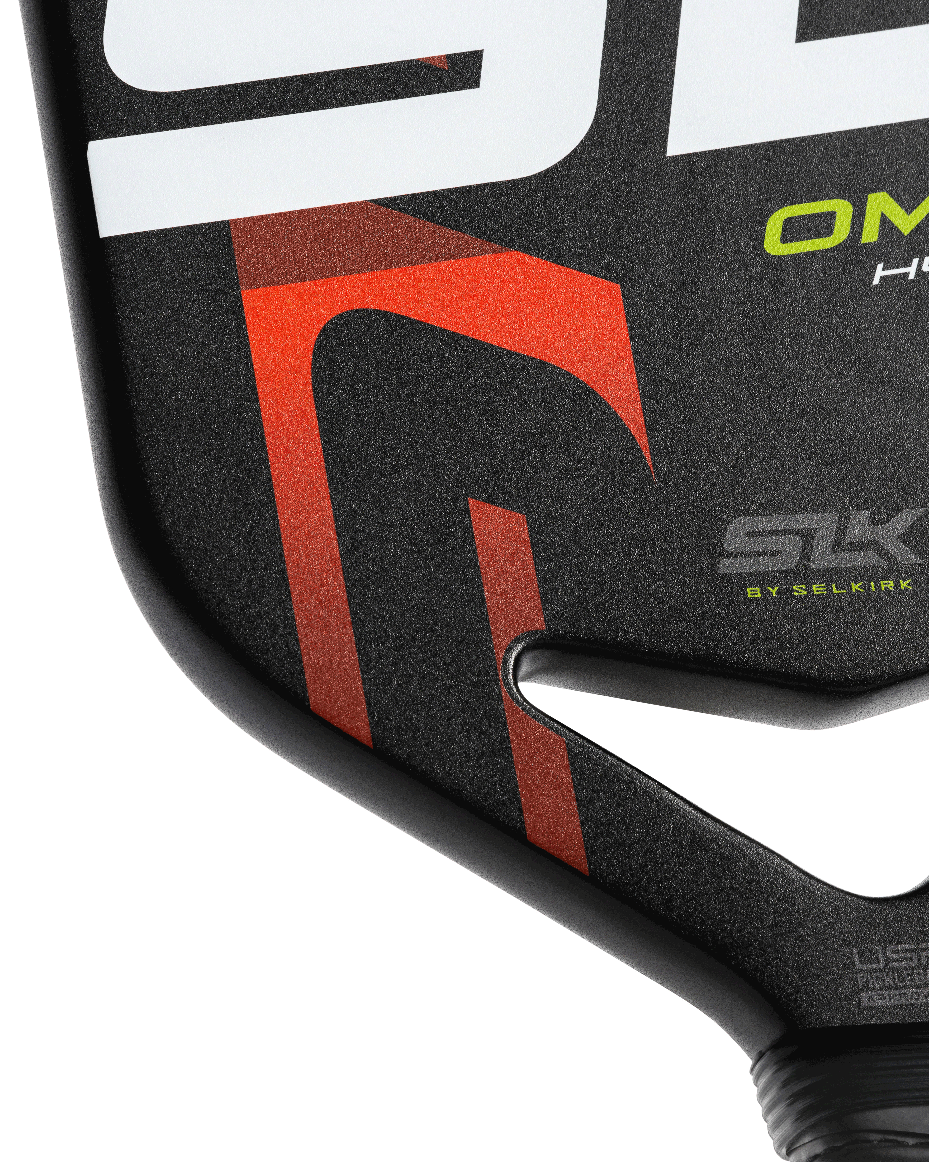
Edged Paddles
Edges are there to take the wear and tear of inevitable scrapes
The sweet spot is just a bit more concentrated toward the center
The extra weight of the guard shifts the balance slightly head-heavy, helping to steady off-center hits and softening vibrations as well as giving a bit more of a power feel
Edgeless Paddles
Expanding the sweet spot almost to the very corners
Crisp, lively feedback on contact & a neutral, feather-light balance
Maximizes the playing surface
More susceptible to chipping and cracking
Notes:
When you first pick up a traditional pickleball paddle—a non-thermoformed model—you immediately sense that familiar ridge of protective material hugging its edges. That edge guard, often a band of rubber or composite, is there for a reason: to take the wear and tear of those inevitable scrapes against the court or an opponent’s paddle, sparing the face from unsightly chips and cracks. Inside that guarded frame lies a sweet spot that’s just a bit more concentrated toward the center. The extra weight of the guard shifts the balance slightly head-heavy, helping to steady off-center hits and softening vibrations so you feel a gentler, muted thud instead of a jarring feedback when you don’t quite meet the ball perfectly.
Edgeless paddles generally feature larger sweet spots, loads of forgiveness, and nice, smooth feel
In contrast, the latest thermoformed paddles arrive without a guard—and that’s by design. Thanks to their heat-molded composite shells, they’re the latest thermoformed paddles arrive without a guard—and that’s by design so manufacturers can eliminate the bulky edge guard altogether. What you get instead is a flawlessly smooth, unbroken hitting surface, expanding your sweet spot almost to the very corners. That seamless design translates to crisp, lively feedback on contact and a more neutral, feather-light balance, since there’s no extra perimeter weight tugging at the paddle’s head. Even among edgeless styles, thermoformed builds stand apart. While other guard-free paddles still rely on ultra-tough face materials to fend off damage, thermoformed shells bond face and core into a single, fused layer—so scratches and nicks become far less of a concern. The result is that coveted fusion of rugged durability and pure performance: broader forgiveness across the entire face, sharper pop, and hair-trigger responsiveness that serious players crave. Aesthetically, the differences are striking. Traditional paddles wear their edge guards like a sturdy frame, often in contrasting colors, hinting at their protective purpose. Thermoformed paddles, on the other hand, look like they’ve been carved from one flawless piece—graphics flow uninterrupted to the very edge, giving them a sleek, futuristic vibe that matches their high-tech construction. In shops, you’ll often see them positioned as top-tier, performance-first choices, with a price tag to reflect that cutting-edge engineering. So how do you choose? If you’re someone who values set-and-forget resilience—who wants the peace of mind that comes from knowing your paddle can take a beating without you even thinking about it—a traditional non-thermoformed model with an edge guard is a perfect companion. But if you hunger for the maximum playing surface, crave lively feedback in every corner, and appreciate the seamless durability that thermoforming delivers, then stepping up to a guard-free, thermoformed paddle might just give your game that extra spark.

Slide 18
Weights
Categories
Lightweight (7.0 – 7.5oz)
Best for finesse, hand speed, touch, and quick volleys
Offers less power
Midweight (7.6 – 8.4oz)
Balanced power and control — Ideal for most players
Heavyweight (8.5oz+)
Increased power potential
Can tire the arm.
Notes:
Should You Choose a Light or Heavy Paddle?
As a general rule: You should choose the heaviest weight you can comfortably play with over a session without becoming fatigued.
Choose a Lightweight Paddle If:
You prefer control and finesse over power.
You play a lot of dinks and soft shots.
You want to reduce strain on your wrist and arm.
Choose a Heavy Paddle If:
You like hitting hard, powerful shots.
You want extra stability for blocking and drives.
You don’t mind the extra weight for added momentum.
If you’re unsure, a midweight paddle (7.6 - 8.4 oz) is a safe choice for most players.

Slide 19
Grip Size
Grip Sizes are the Circumference of the Grip
Choosing the correct pickleball paddle grip size is important for comfort, control, and injury prevention
Grip Diameter | Best Suited For:
Small (4.0 - 4.125 inches) | Players with small hands, allows for more wrist action and added spin capabilities
Medium (4.25 inches) | Most players, provides a good balance of comfort and control
Large (4.5+ inches) | Players with large hands, extra stability for power shots
Notes:
A grip that’s too small or too large can affect your game and even strain your wrist or elbow.
A key factor in preventing elbow injuries is to use a paddle with the correct size!
Smaller Grip
More wrist snap → more spin.
Better maneuverability.
Can cause wrist/elbow strain if too small.
Larger Grip
More stability and control on volleys.
Less wrist movement → less spin.
Too big can reduce maneuverability.

Slide 20
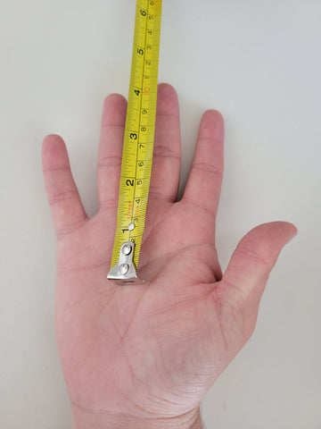
Grip Size Cont.
Palm Test
Open your hand, fingers extended.
Measure from the bottom lateral crease in your palm to the tip of your ring finger.
Hand Length (inches) | Recommended Grip Size
4" grip | Smaller hands (often juniors).
4 ⅛" – 4 ¼" grip | Small to medium adult hands.
4 ⅜" – 4 ½" grip | Medium to large hands.
4 ⅝" grip and up | Larger hands
Notes:
Palm Test (More Precise)
Open your hand, fingers extended.
Measure from the bottom lateral crease in your palm to the tip of your ring finger.
This measurement (in inches) usually corresponds to your ideal grip size.

Slide 21
Grip Size Cont.
Hand Test
Measure from the base of the palm, to the finger tips.
Hand Length (inches) | Recommended Grip Size
< 6 ¾" | 4" grip (Small)
6 ¾" – 7" | 4 ⅛" grip (Small/Medium)
7" – 7 ¼" | 4 ¼" grip (Medium)
7 ¼" – 7 ½" | 4 ⅜" grip (Medium/Large)
> 7 ½" | 4 ½" grip (Large)
Notes:
Hand Test (More Precise)
Open your hand, fingers extended.
Measure from the base of your palm to the tip of your ring finger.
This measurement (in inches) usually corresponds to your ideal grip size.

Slide 22
Grip Shape
Three Primary Shapes
Round
A more universal shape
Good for whether continental, semi-Western, or Western grips
Square
Preferred by those with a ping pong background
Suited for continental, or “handshake,” playing grip
Octagonal
Favored by those with tennis or other racket sports experience
Notes:
Generally, most pickleball paddles will come with a uniform grip shape, so players may have to decide whether the grip shape or paddle face is more important to them. That’s why it’s important to test your pickleball paddle before buying.
Round
A rounded grip shape can be a good option for general players because it fits universally in each player’s hand. It can lend itself to any type of playing grip, whether continental, semi-Western, or Western.
Square
Players who converted from ping pong often prefer a square-shaped handle because it feels similar to a ping pong paddle. This shape is also beneficial for players who prefer the continental, or “handshake,” playing grip.
Octagonal
Octagonal grips are often preferred by players with tennis or other racket sports experience. The octagonal shape, featured in the Vanguard Control, allows players to easily find their preferred playing grip as they switch from backhand to forehand shots by feeling for the ridges.
We always recommend you consult with a licensed physician when endeavoring to find the cause of your tennis elbow. We have seen a wide range of reasons why people have experienced tennis elbow. It could be caused by improper form, too large of a grip, too small of a grip, too light of a paddle, too heavy of a paddle, or too much vibration in his or her paddle. Due to the diverse array of tennis elbow sources, you may want to try changing things up to see if it helps (e.g. get a heavier or lighter paddle, smaller grip or larger grip).

Slide 23
Handle Length
Longer Handles (5” or longer)
Moves the sweet spot higher up on a paddle face
Ideal for players who prefer a two-handed backhand
Well suited for those looking to generate more power
Shorter Handles (4” to 4¾”)
Larger, more centrally located, sweet spot
Reduces mishits
Notes:
Pickleball handle lengths not only affect a player’s reach but also where a sweet spot sits on the paddle.
Typically speaking, the longer the handle, the more reach a player has. However, a longer handle — typically 5.5 inches or longer — also moves the sweet spot higher up on a paddle face. Longer handles are typically ideal for players who prefer a two-handed backhand or who want to generate more power.
A shorter pickleball handle — typically 4 inches to 4.75 inches — is usually associated with a greater, more centered sweet spot. As such, paddles with shorter handles typically allow players to minimize mishits.

Slide 24
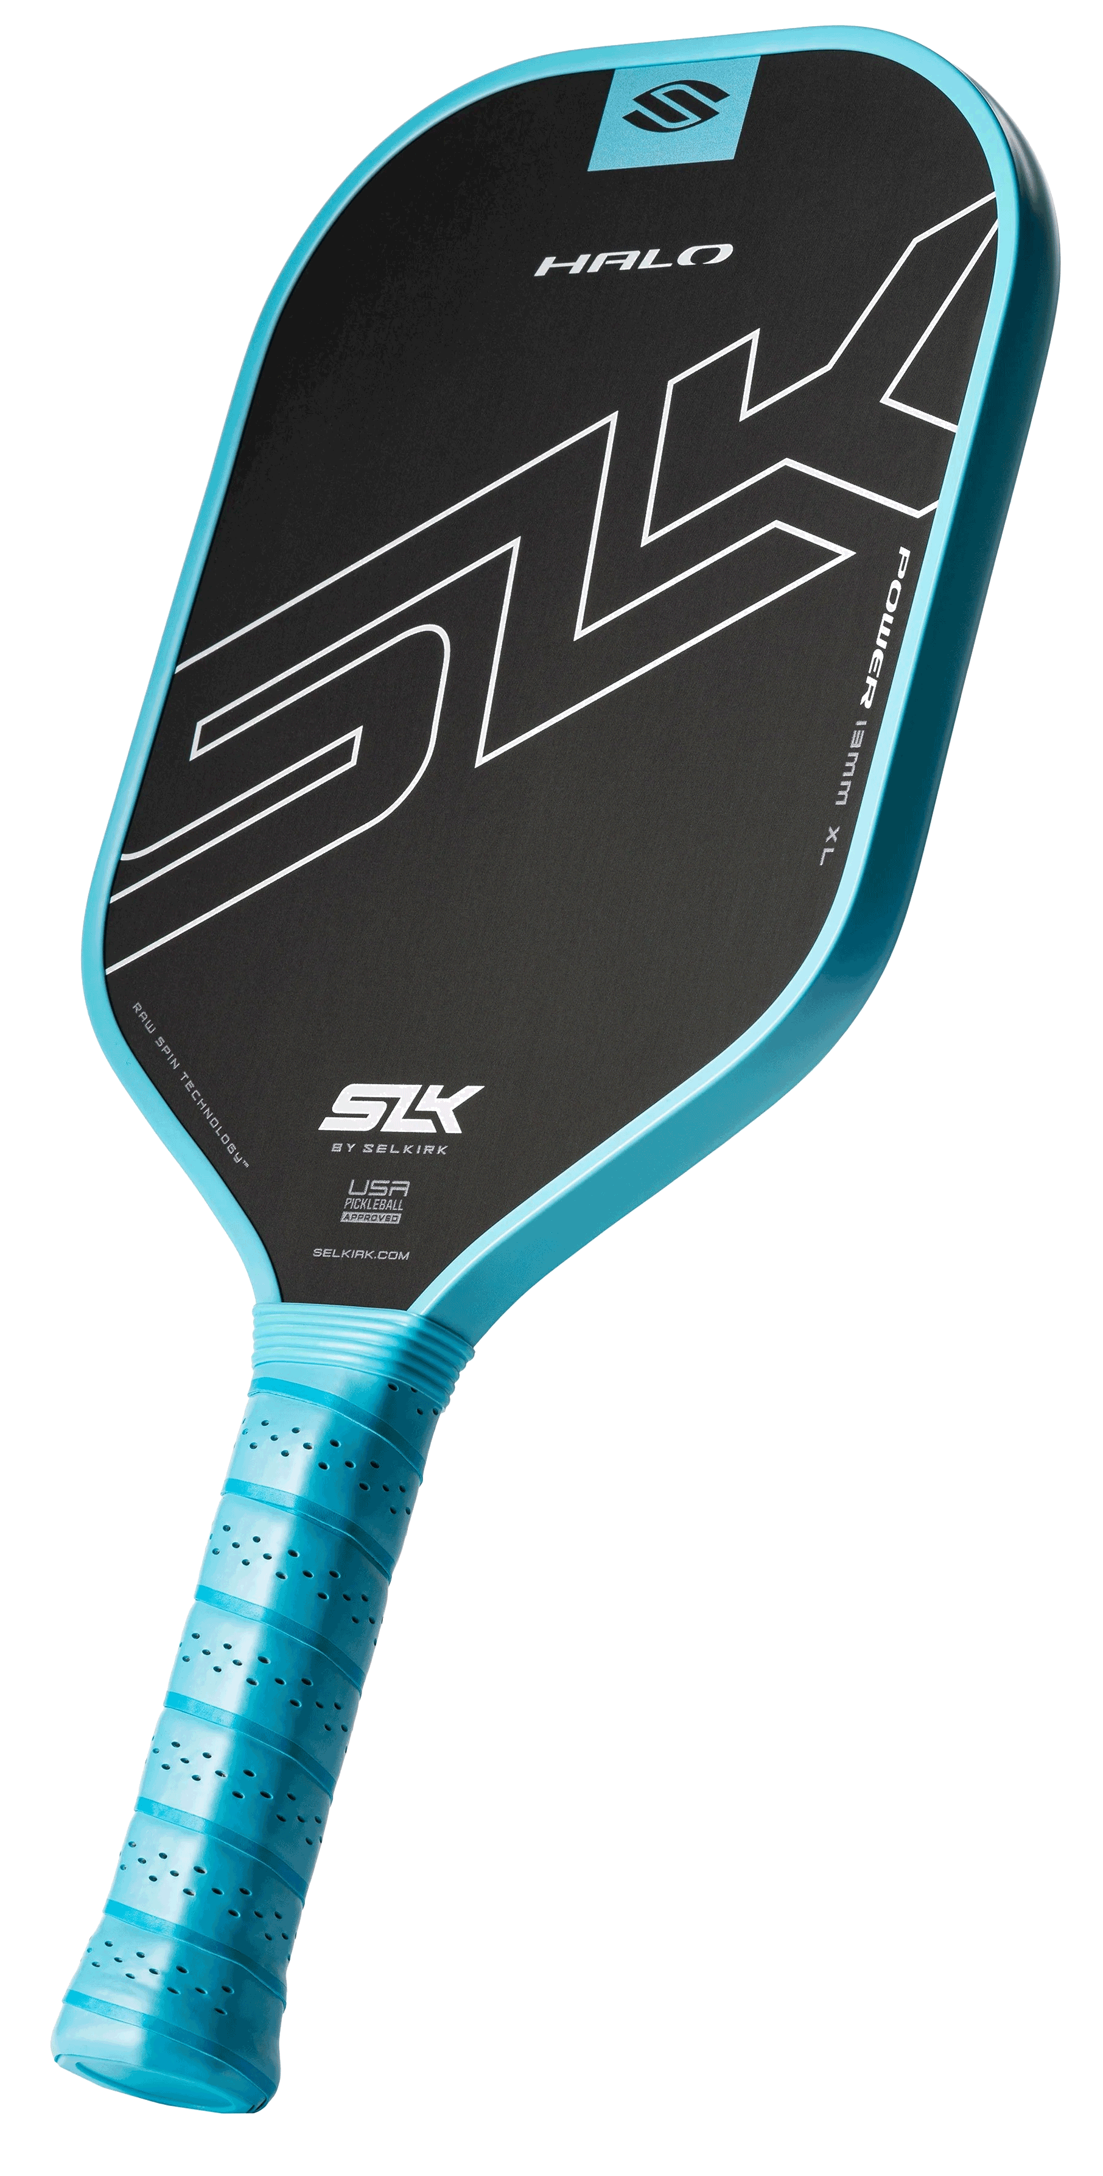
Power Paddle Summary
Core thickness: A thinner core, typically 13mm or less
Weight: A heavier paddle, around 7.5 oz or more
Paddle shape: Longer paddle/elongated shape
Paddle face: Fiberglass and carbon fiber
Handle length: Longer handle
Notes:
What makes a power paddle?
Power paddles provide more pop off the paddle to give players who prefer a powerful playstyle the pace of game they crave. Power paddles require less effort to provide pace, but they do often require more effort to make finesse shots.
Core thickness: Power paddles often have a thinner core, typically 13 mm or less, allowing for a stiffer surface that enhances the power behind each shot.
Weight: A heavier paddle, around 7.5 oz or more, utilizes more mass to generate force, making it ideal for power hits. Players can also customize lighter paddles with lead tape to add mass.
Paddle shape: Longer paddles offer more leverage, which can translate into more powerful swings.
Paddle face: Fiberglass and carbon fiber are preferred materials for power paddles as they contribute to their ability to deliver forceful hits.
Handle length: Longer handles shift the sweet spot further from your hand, providing more leverage and reach for powerful swings.
REFERENCE:
The Traits of a Power Pickleball Paddle https://www.selkirk.com/pages/selkirku/the-traits-of-a-power-pickleball-paddle

Slide 25
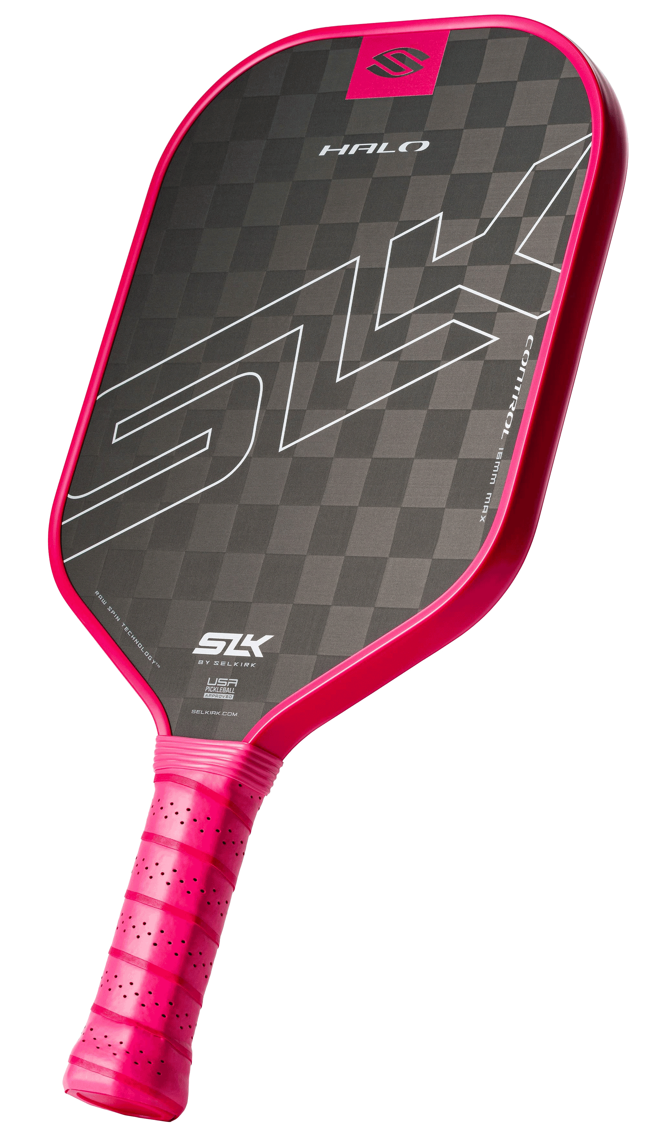
Control Paddle Summary
Core thickness: Feature a thicker core, around 16 mm or more
Weight: Lighter paddles, approximately 7.3 oz or less
Paddle shape: Shorter and wider paddles /widebody shape
Paddle face: Carbon fiber and graphite
Handle length: Shorter handle
Notes:
What makes a control paddle?
Control paddles are often thicker with a wider sweet spot to help players take pace off the ball. This allows control players to make precise shots, but they will have to use more force to execute put away shots.
Core thickness: Control paddles feature a thicker core, around 16 mm or more, which absorbs more of the ball's energy, facilitating precise shots.
Weight: Lighter paddles, approximately 7.3 oz or less, offer greater maneuverability, making them perfect for players focusing on control.
Paddle shape: Shorter and wider paddles provide a larger sweet spot, enhancing the ability to control the ball.
Paddle face: Materials like carbon fiber and graphite are optimal for control paddles as they help absorb the ball's energy, allowing for more precise shot placement.
Handle length: Shorter handles make the paddle easier to maneuver, keeping the sweet spot closer to your hand for better control over shots.
REFERENCE:
What Makes A Control Paddle? https://www.selkirk.com/pages/selkirku/what-makes-a-control-paddle

Slide 26
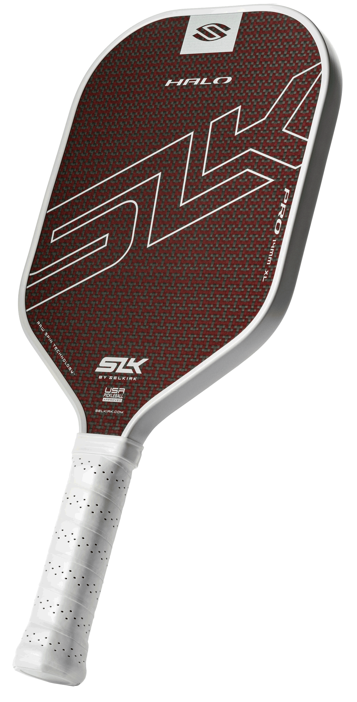
Hybrid Paddle Summary
Core thickness: Typically, around 14mm - 15mm to give both pop and control
Weight: Favoring midweight paddles, approximately 7.4 oz
Paddle shape: There shapes are evolving, but depend on the players needs and strengths
Paddle face: Carbon fiber, Fiberglass, and Graphite
Handle length: Varies based on the players experience in other sports
Notes:
Hybrid players are versatile, often adapting their play style to the dynamics of each game. They balance between power and precision, making them unpredictable and flexible competitors.
Characteristics of a hybrid paddle
Hybrid paddles incorporate a balanced approach, featuring intermediate specs from both power and control designs.
They typically have a core thickness that provides a moderate level of energy absorption and power delivery, medium weight, and an average paddle shape that facilitates a decent sweet spot while allowing for extended reach. Although these paddles offer a nice middle ground, they typically do not rank the highest in either category of power or control.
Core thickness: Neither too thick nor too thin, hybrid paddles typically measure around 14-15 mm in core thickness. This helps absorb energy off opponents’ fast shots but allows players to generate power.
Weight: Hybrid pickleball paddles often fall in the midweight category, usually around 7.4 ounces. This weight allows for more force on shots, but still enough maneuverability to execute precise placement.
Paddle shape: The shape of hybrid paddles varies, but generally speaking, they offer a mix of paddle face shape and handle length. For example, they may offer a shorter, wider paddle face (designed for control) and a longer handle (designed for power). Or, they may feature the reverse — an elongated paddle face with a shorter handle.
Paddle face: Hybrid paddles often combine several materials to create a surface that is neutral. Common materials in hybrid paddles include carbon fiber, fiberglass, and graphite.
Handle length: Handle length varies on hybrid paddles and is typically left to the user’s discretion. A longer handle is advisable for players who prefer to execute two-handed backhands, while a shorter handle is better suited for players who like the extra maneuverability.
REFERENCE:
What makes a hybrid pickleball paddle?
https://www.selkirk.com/blogs/paddles-and-product-education/what-makes-a-hybrid-pickleball-paddle
What to look for in hybrid pickleball paddles
https://www.selkirk.com/blogs/paddles-and-product-education/what-to-look-for-in-hybrid-pickleball-paddles

Slide 27
Before Making a Paddle Choice
Determine the features you Need in your next paddle
Determine the features you would Like to have in your next paddle
Determine how often will you be using the paddle
Infrequently, Once a week, 2-3 times per week, more
Determine your price point for a paddle which would possess those features
Notes:
A good paddle is an investment.
If you enjoy the game, but will not play that often. A starter set like the SLK Prime Bundle available at Costco is an excellent choice at $69.99.
As you play more, you would like your paddle to aide you on your journey, so opting for the less expensive option may not be the best choice for your pickleball game over time, especially if you end up out growing the paddle in short order, and need to buy a better replacement.
As a Loose Guide
Just getting started: One of the bundles will serve this segment best - SLK Prime Bundle available at Cosco - $69.99 -or- SLK Reflex Pickleball Bundle - $90
Plays infrequently: SLK Atlas, Latitude, EVO
Plays once a week/Beginner: EVO to Halo
Plays 2 to 3 times a week/Intermediate: SLK Halo to Selkirk AMPED Pro Air
3 or more times a week/Advanced – SLK ERA, Selkirk Vanguard Pro or Control, LUXX…

Slide 28
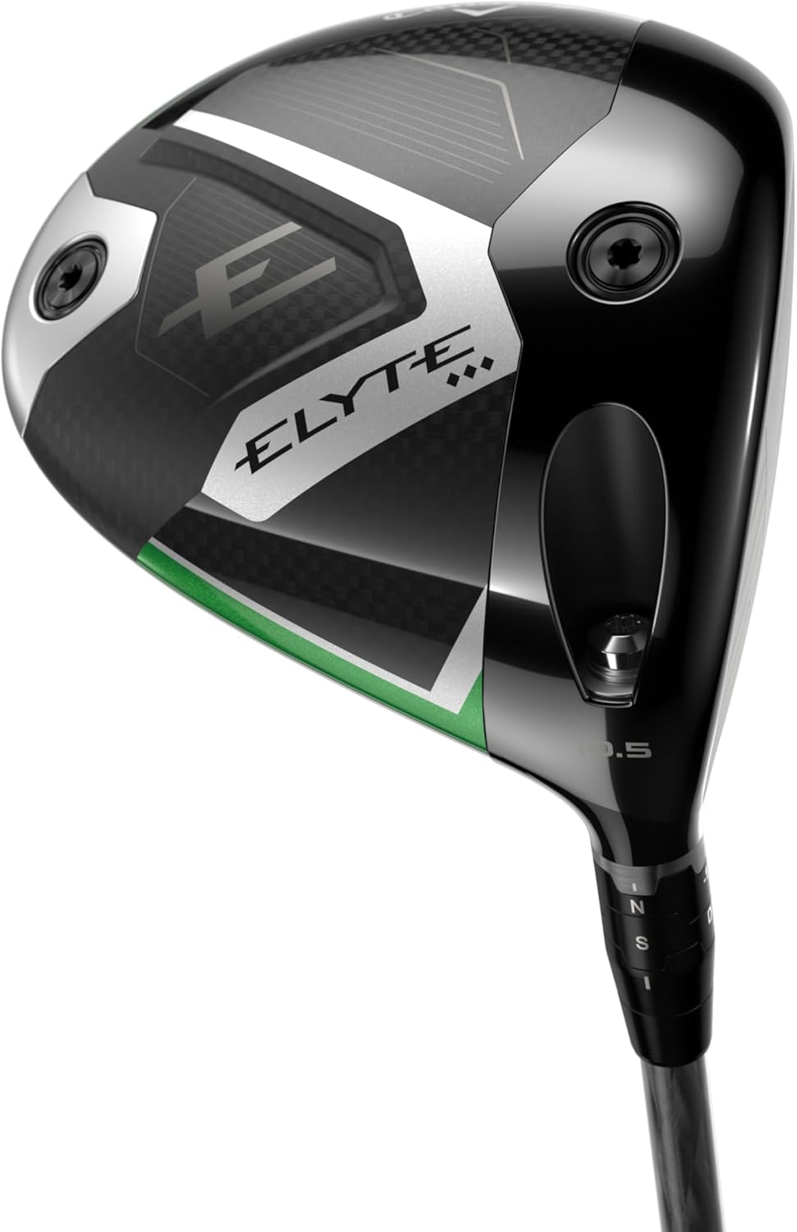
Before Making a Paddle Choice
Keeping the cost of other sports in mind can make the cost of a pickleball paddle understandable
Equipment Cost Comparison By Sport
Sport | Primary Equipment | Typical Cost
Pickleball | Paddle | $80 to $350
Golf | Clubs (Driver) | $100 to $650+
Tennis | Racquet | $100 to $350
Bowling | Bowling Ball | $100 to $350
Notes:
Like any sport, there are costs. Pickleball’s costs are very comparable to the costs of other sports.
This is one sport that the equipment that the top pros use, is not out of the realm of many recreational player’s budgets.
And here is the question people ask all the time: How long does a pickleball paddle last?
How long a pickleball paddle lasts depends on a few factors:
General Lifespan
Frequent/recreational players (2–3 times a week): about 1–2 years.
Casual players (once a week or less): can last 2–5 years.
Competitive/tournament players: often replace every 6 months to 1 year, since performance drops matter more.
Factors That Affect Durability
1. Core material
Polymer cores (most common) last the longest.
Nomex or aluminum cores may wear down faster.
2. Face material
Carbon fiber holds up longer than fiberglass.
Graphite is lightweight but may show wear sooner.
3. Playing style
Power hitters stress the paddle more than soft/control players.
4. Conditions
Exposure to heat, cold, or moisture can shorten life.
Outdoor play wears paddles faster than indoor.
Signs It’s Time to Replace
Dead spots where the ball doesn’t bounce well.
Loss of “pop” or power compared to when new.
Face surface worn smooth (less spin control).
Edge guard or core damage.
A good rule of thumb: if you play regularly and notice your paddle feels “flat” or inconsistent, it’s probably time for a new one—even if it looks fine.

Slide 29
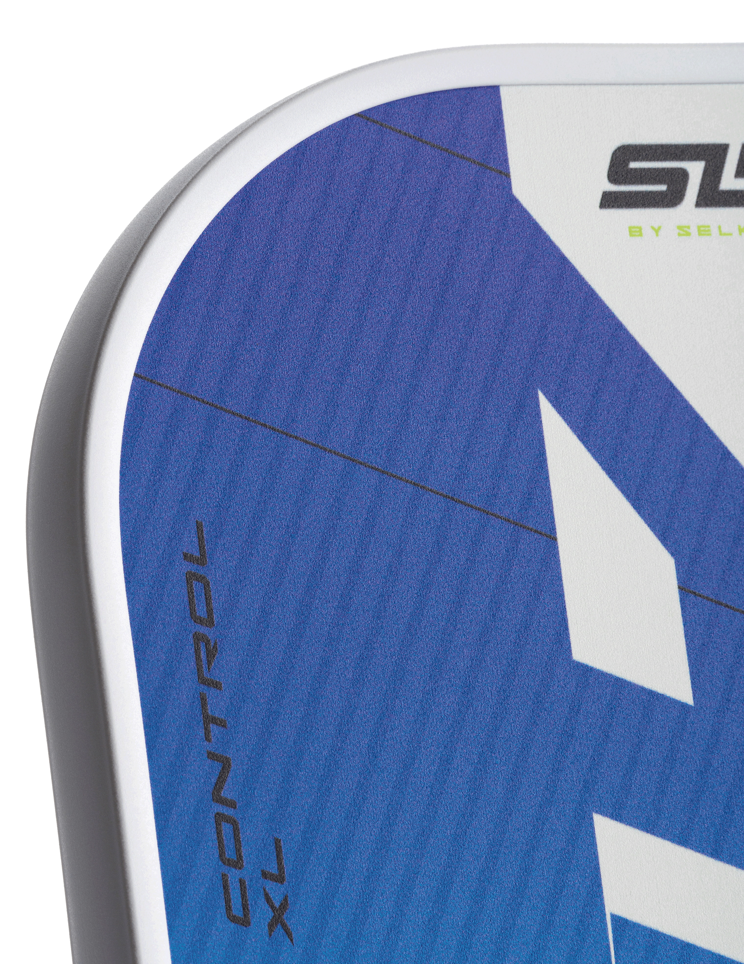
Above ALL Else
Do NOT purchase ANY paddle without having tried it first!
Notes:
REFERENCE:
How to demo a pickleball paddle before buying
https://www.selkirk.com/blogs/paddles-and-product-education/how-to-demo-a-pickleball-paddle-before-buying

Slide 30
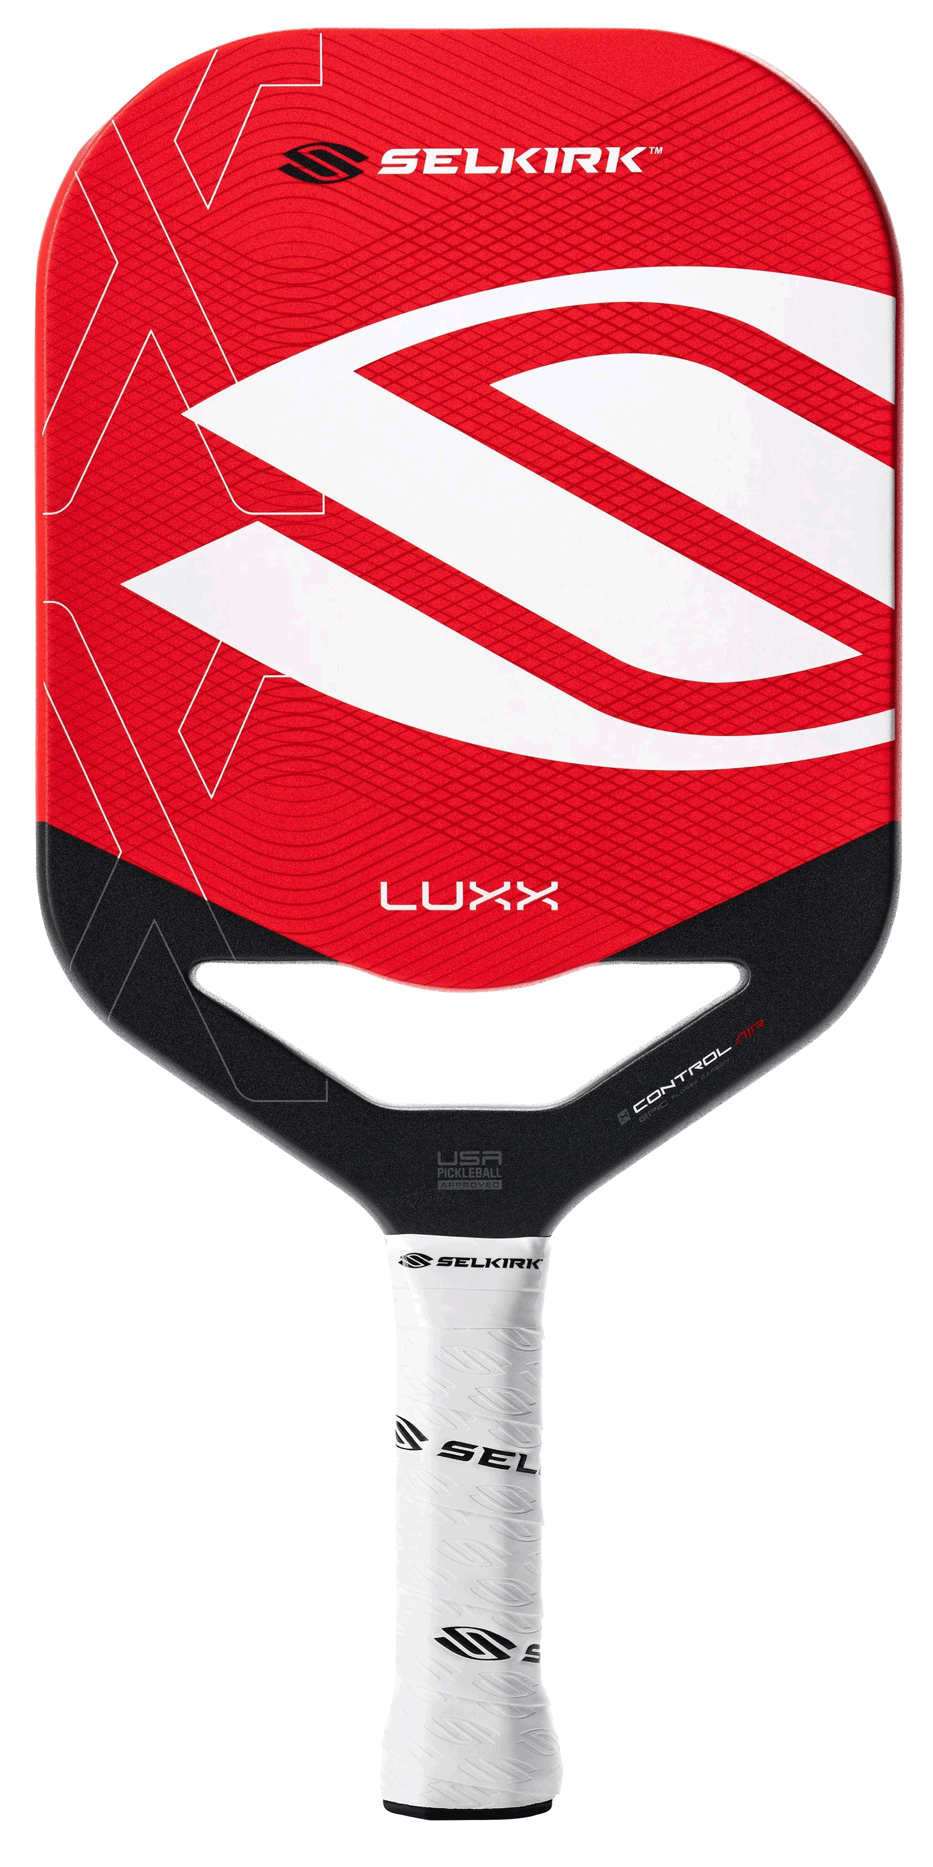
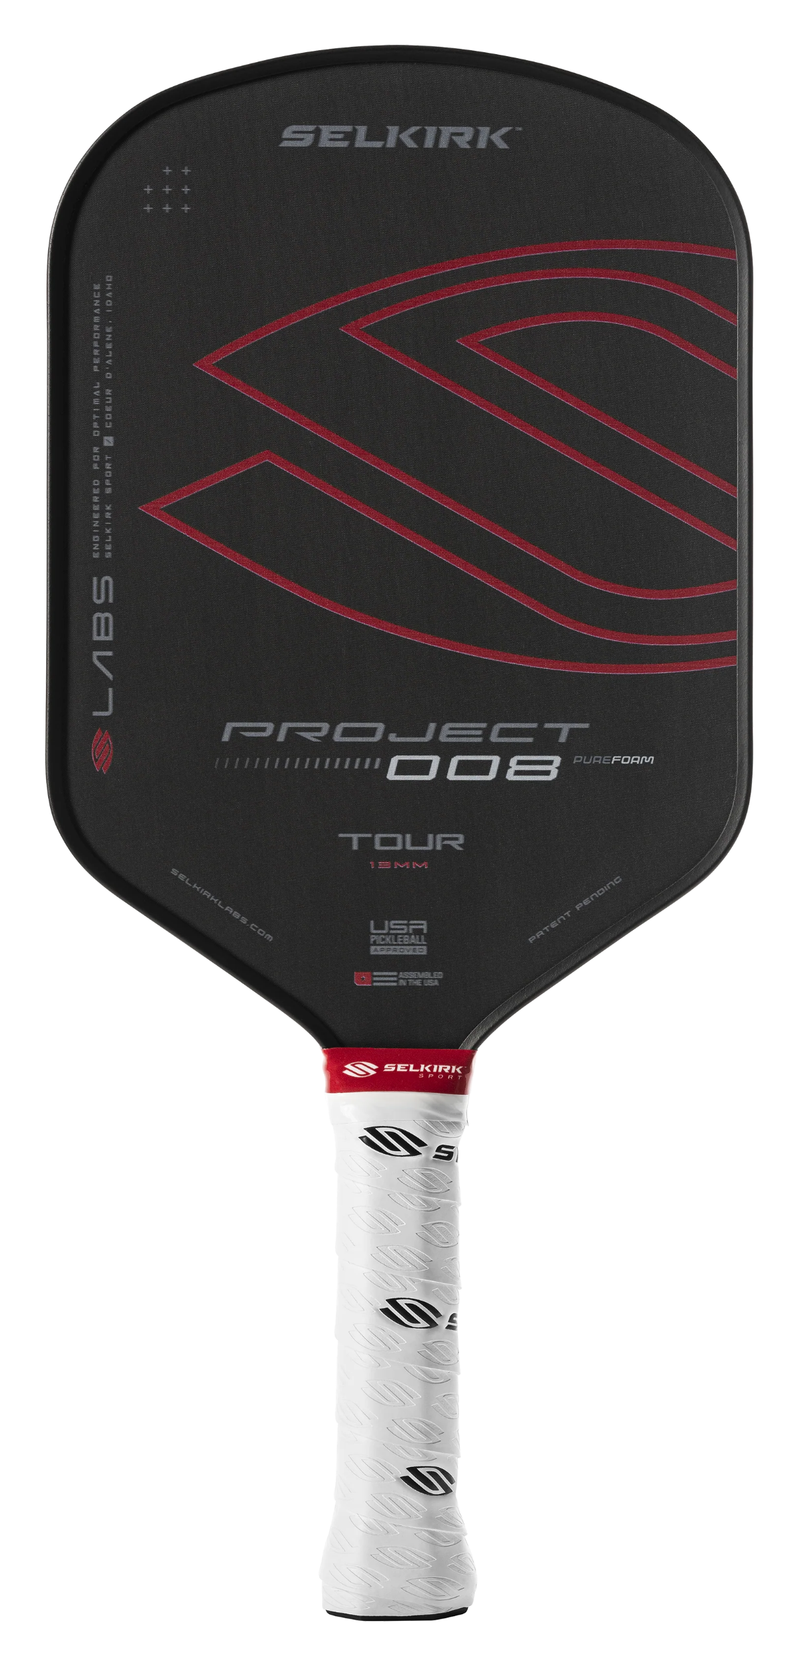
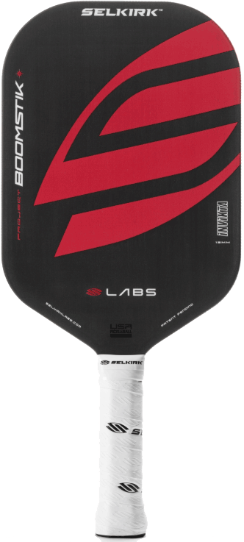
After Buying, Register the Warranty!
https://www.selkirk.com/pages/warranty
Selkirk Sport Pickleball Paddles
Limited Lifetime Warranty
Selkirk Sport pickleball paddles are guaranteed against workmanship and manufacturer defects for the lifetime of the paddle after warranty activation.
SLK by Selkirk Pickleball Paddles
One-Year Limited Warranty
SLK pickleball paddles are guaranteed against workmanship and manufacturing defects for a period of one year from the original date of purchase.
LABS Pickleball Paddles
Two-Year Limited Warranty
Selkirk Labs pickleball paddles have a two-year warranty that protects against manufacturer defects.
LABS Project Boomstik Pickleball Paddles
Limited Lifetime Warranty
LABS Project Boomstik pickleball paddles have a limited lifetime warranty that protects against manufacturer defects.
Notes:
A good paddle is an investment, make sure the company making it stands behind it.
But when is it a warranty issue, or do I just need a new paddle?
Failing Edge Guard (May be covered if within warranty period)
Chipped Edges (If effects performance/use)
Exposed Core (Edgeless Paddles)
Smooth Paddle Face
Cracked Frame / Face
Delamination / Core Crush
Time to revisit this clinic to help determine your next paddle choice.

Slide 31

Selkirk University
https://www.selkirk.com/pages/selkirk-u
This is 24/7 Pickleball.
Proudly brought to you by Selkirk Sport.
Created to bring the best of Pickleball to your smartphone, tablet, and big screen TV, Selkirk TV is Pickleball’s first and only Free TV App—your 24/7/365 destination for the industry’s leading Pickleball media content.
Featuring live stream matches, past tournaments, pro lessons, podcasts, and on-demand shows, Selkirk TV is the Pickleball media source and community hotspot you definitely won’t want to miss.
https://tv.selkirk.com/
Notes:
This is 24/7 Pickleball. Proudly brought to you by Selkirk Sport.

Slide 32
Thank You for Participating!

