Slide 1


English GRAMMAR with Chris Farmer
Proper usage of adequate, sufficient, and enough.
Notes:
NOTE:
To change the image on this slide, select the picture and delete it. Then click the Pictures icon in the placeholder to insert your own image.

Slide 2






Introduction: Why do we need to discuss these words?

Slide 3
History
Etymology | Adequate | Sufficient | Enough
Language | Latin | Latin | Old English
Year | 1300 | 1500 | 1300
Origin Word | sufficere | adaequare | genog
Meaning | suffice | to make equal | sufficient in quantity or number
Adequate: equal to what is needed or desired, sufficient
Sufficient: adequate for a purpose
Enough: sufficiently for the purpose; a quantity or number sufficient for the purpose

Slide 4
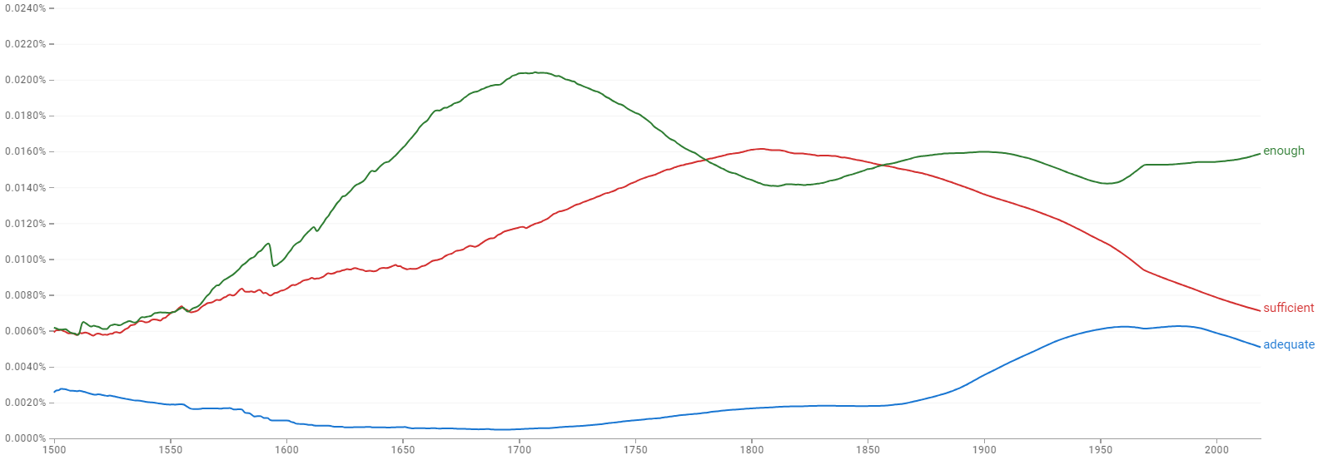

Popular Usage (1500–2019)
This image shows usage in books from 1500 to 2019 that were scanned by Google.

Slide 5
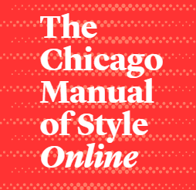
Proper Usage
adequate; sufficient; enough
Adequate refers to the suitability of something in a particular circumstance {an adequate explanation} {adequate provisions}.
Sufficient refers to an amount that is enough to meet a particular need (always with an abstract concept, a mass noun, or a plural) {sufficient water} {sufficient information} {sufficient cause} {sufficient resources}.
Enough, the best word for everyday purposes, meaning “as much or as many as are needed or wanted,” modifies both count nouns {enough people} and mass nouns {enough oil}.
Part 2•Style and Usage
5•Grammar and Usage by Bryan A. Garner
5.250: Good usage versus common usage

Slide 6
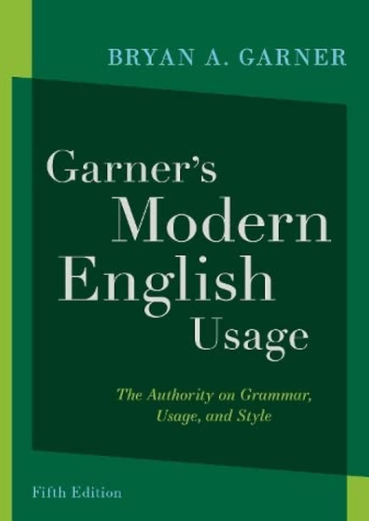
Adequate, Sufficient, & Enough
Garner wrote:
Originally, both adequate and sufficient both referenced quantity.
Adequate means suitable to the occasion or circumstances. Its usage tends toward qualitative.
Sufficient means you have the required amount for a particular need or purpose. Its usage tends toward quantitative. In Modern English Usage, Garner says that “sufficient” should only be used to modify mass nouns.
Enough differs from sufficient because it modifies both count nouns and mass nouns.

Slide 7

Garner versus Garner
The Chicago Manual of Style:
Garner says that “sufficient” is “always with an abstract concept, a mass noun, or a plural.”
He provides the example: “sufficient resources.” “Resources” is a count noun, because it is countable (1 resource, versus two or three resources, for example). Mass nouns do not have a plural form.
Modern English Usage:
Garner says that “sufficient should modify only mass nouns.”
He provides the example, “sufficient oxygen.” Note that “oxygen” has no plural form because it is a mass noun.
Tie Breaker. “Vitamins” is a count noun, not a mass noun.
Sentence example: Because canines are, for the most part, unable to naturally manufacture sufficient vitamins to meet their daily requirements, a dog's routinely consumed meals, with some exceptions, must be augmented with them during the manufacturing process.

Slide 8
Final Thoughts
Adequate
  Describes things in qualitative terms; how good something is.
    Example: The air quality is adequate. The light is adequate for reading. The apple is adequate.
      Note: Here, we are saying the light is good enough for reading.
Sufficient
  Describes things in quantitative terms; how much of something there is.
  Only used to describe mass nouns and plural count nouns.
    Example: There is sufficient air. There is sufficient light for reading. The apples are sufficient for two to share.
      Note: Here we are saying we don’t need more light for reading.
Enough
  Describes things in quantitative terms; how much of something there is.
  Only used to describe mass nouns AND count nouns.
    Example: There is enough air. There is enough light for reading. The apple is enough for two to share.
  Can also serve as a pronoun, “Enough were present at the meeting.”

Slide 9


That’s all!
Have a great rest of your day!

