Slide 1
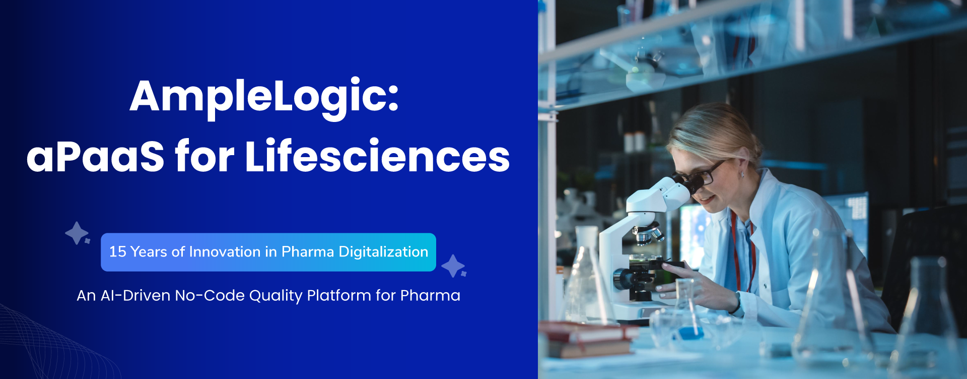

15
Years
100+
Satisfied Clients
500+
Implementations
14+
GAMP Solutions

Slide 2

02
01
Amplelogic: Key Company Facts and Value Claims
Concise snapshot of AmpleLogic capabilities and compliance
10x
Time-to-market acceleration
1
Founded in
2
Staff: 200+
Established presence since 2010
Global team with pharma domain expertise
Rapid rollout of QA, QC, Manufacturing, and Regulatory systems using low-code pharma components.
80%
Reduction in Integration costs
3
Trusted by 100+ customers
4
14 ready products
All applications built on single Platform offers ready integrations, reducing integration costs significantly
Customer base across mid-market to Fortune 500
Pre-built, deployable solutions for life sciences
70%
Savings in Infrastructure Costs
5
Compliance: US FDA and MHRA; CFR part 11 and Annex 11
06
Adoption of open-source servers like Linux and PostgreSQL significantly reduces licensing and h
Built for regulated pharma environments

Slide 3





Modern Challenges in Pharma & Biotech
Executive summary of operational and compliance gaps
Siloed QA, QC, and manufacturing workflows delay batch release
QA/QC teams face rising workloads despite eQMS, DMS and LIMS
Legacy, inflexible platforms make process updates slow and expensive
Growing expectations for traceability, audit readiness, and data intelligence
Increasing product complexity—biologics, personalized therapies, and global operations
Separated systems increase release time and regulatory exposure.
Volume and complexity outpace current team capacity.
Slow change cycles risk non-compliance and higher expenses.
Demand for AI-enabled quality systems to improve oversight and insights.
More complex products intensify operational and compliance challenges.

Slide 4












aPaaS for Lifesciences-- One Vendor, One Platform
Integrated, pre-validated digital ecosystem for pharma/biotech quality, compliance, manufacturing, and regulatory workflows.
APQR (Annual Product Quality Review) — AI-assisted product quality analytics
eLog (Electronic Logbook) — centralized, searchable electronic records
QMS — AI-recommended Quality Management System with 7 in build modules
DMS — AI-enabled Document Management Software with validation and control
eBMR — Electronic Batch Record System bridging ERP to shop floor
LMS — AI enabled Learning Management System for training and compliance records
CAPS — Calibration & Preventive Maintenance scheduling
LIMS — Laboratory Information Management System
RIMS — Regulatory Information Management System for submissions
Cleaning Validation to find and handle worst case scenarios
UAM-
User Access Management Software

Slide 5
aPaaS for Lifesciences-- Solution Integrations
Samples /Stability
Schedules
QC Planning
eLog Book
DMS
STP, Spec sheets
LIMS
eLogs Data
New /Update
Document
eQMS
Batch Master
Records
Training
Material
Training
Effectiveness Record
E Logs Data
Training Needs
LMS
GMP Training
Records
eBMR
Batch Data
Data Lake
Quality Metrics
Regulatory
Changes
Performance
indicators
Deviations
Statistical Analysis
RIMS
CAPS
QMS + Training
Data
APQR
Cleaning Validation
SAP
UMS

Slide 6








AI Solutions for Pharma Digitalization
Automate processes and strengthen compliance across document, reporting, SOPs, and CAPA
AI-powered Document Management: chatbot UI, automated indexing, regulatory-ready audit trails
Agentic AI Report Builder: automated report generation and context-aware summaries for QC and leadership
AI Recommendation Engines: root-cause suggestions for deviations and CAPA, prioritized actions for faster resolution
SOP Podcast and Employee Evaluation: Automated question generation and SOP podcast in multilingual for training and engagement
2
3
04
1
4
Faster retrieval, consistent records, and audit readiness
Reduce manual reporting time and improve oversight
Data-driven prioritization to shorten resolution cycles
Generate multiple-choice questions with plausible distractors and detailed explanations for effective knowledge evaluation

Slide 7
Model and Platform Improvement Strategy: Roadmap
Three-phase timeline of platform evolution and capabilities
Continuous Innovation
Steady expansion of automation, no-code, and AI-Enhancements
Enabled non-technical users to build and run workflows
Low-Code Transformation
1
3
01
2010
Platform 2.0
03
2023
Ongoing
2
2017
Platform 3.0
4
02
04
2025 >>
Platform 1.0 - Workflow Automation
Digitized manufacturing and quality workflows
Low-Code No-Code Studio and AI Engine
AI-first capabilities and broad product expansion across pharma and biotech

Slide 8





DEPLOY ANYWHERE, GOVERN EVERYWHERE
Deployment Flexibility and Architecture Microservices, OS/DB choices, cloud or on-premise parity
Low IT operations cost via flexible deployment options
OS and databases: Linux + PostgreSQL or Windows + SQL Server; also supports MySQL and Oracle
Deployment parity: cloud, on-premise (validated), or hybrid with identical features
Optimize TCO by choosing best-fit hosting
Multiple certified stacks for compatibility
Same functionality across deployment targets
Container-ready and CI/CD friendly with API-first design
Microservices for independent scaling, rapid updates, and high availability
Supports modern DevOps pipelines
Decoupled services reduce risk and accelerate releases

Slide 9

Technology and Talent
WHY AMPLELOGIC? COMMITMENTS THAT DRIVE ADOPTION
Product Innovation and TCO
Proactive adoption of emerging technologies to enable employee learning and secure market leadership.
Continuous product updates that streamline integrations and minimize total cost of ownership.
01
02
Two adoption pillars that accelerate learning, repeat business, and lower ownership costs

Slide 10


Independent Validation and Customer Impact
Rapid implementation and intuitive drag-and-drop builder delivered accelerated, compliant app delivery with ROI in months.
Verified Customer
Verified G2 rating 4.8/5 from 283 Reviews
  Faster validation, stronger compliance, measurable ROI
Responsive customer service and pre-validated components accelerated our audit readiness and reduced compliance risk across implementations.
Verified Customer
Customers report faster validation, stronger compliance, and measurable ROI following adoption.
Verified Customer

Slide 11













AmpleLogic — From 100+ Customers to Proven Repeat Business
Selected repeat engagements demonstrating trust, compliance, and faster ROI
Over 100 global clients
4
Proven scale across pharma and biotech
BIMS, LMS, eLog book
UAM, Audit, RIMS, Snapshot
QMS
DMS, LMS, BIMS and CAPS
9
BIMS, CAPS, LMS and DMS
eQMS, LMS and DMS
eQMS, LMS and DMS
APQR, eQMS, DMS, LMS
DMS , UAM

