Slide 1











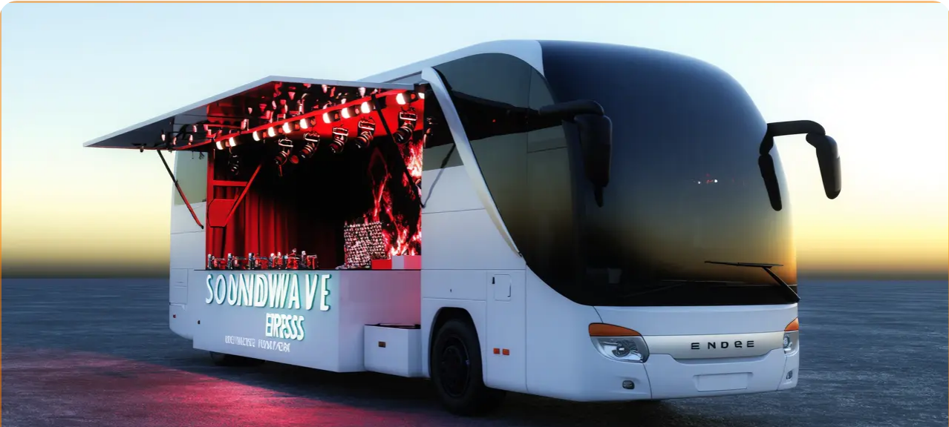





PARTNERSHIP PRESENTATION
NOV 2025
THE
SOUNDWAVE
EXPRESS
Partnership Opportunity
A revolutionary mobile music studio and performance platform seeking strategic brand partnerships for equipment and marketing collaboration.
MOBILE STUDIO + STAGE
LEARN MORE →
EXPLORE PARTNERSHIPS
WATCH DEMO
Confidential • For Partnership Consideration Only
soundwaveexpress.com

Slide 2







The Vision - Mobile Music Innovation
The Soundwave Express is a revolutionary project merging live performance, production, and design into one cutting-edge mobile experience.
State-of-the-Art Studio
Open-Air DJ Stage
Content Creation
A fully equipped mixing studio designed by world-renowned architect Chris Bosse, featuring premium audio equipment for professional production.
The center passenger side transforms into an open-air DJ stage with a powerful sound system capable of delivering crystal-clear audio to crowds of 400+.
Every performance and session will be filmed, live-streamed, and shared across social media as part of a continuous content series featuring artists and producers.
The Soundwave Express
Page 2 of 9

Slide 3

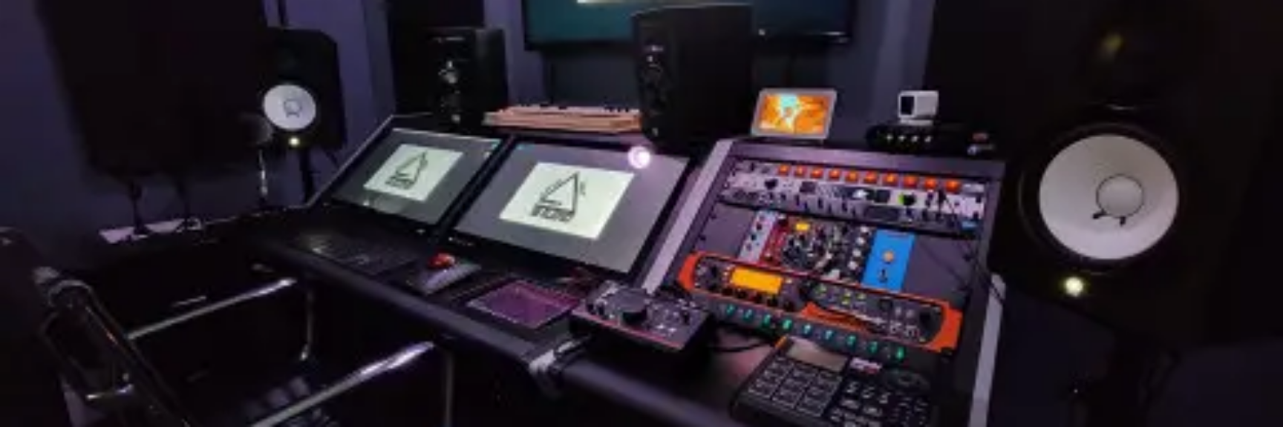







Dual Platform Experience
Interior Studio
Exterior Stage
Acoustically optimized space designed by world-renowned architect Chris Bosse
Center passenger side transforms into an open-air DJ stage
Powerful integrated sound system designed for crowds of 400+
State-of-the-art mixing studio for professional production
Hosts regular streamed mix sessions and production masterclasses
Delivers crystal-clear audio in an immersive live performance experience
Features acclaimed engineers such as Rick O'Neil
Seamless transition between studio and stage capabilities
The Soundwave Express
Page 3 of 9

Slide 4

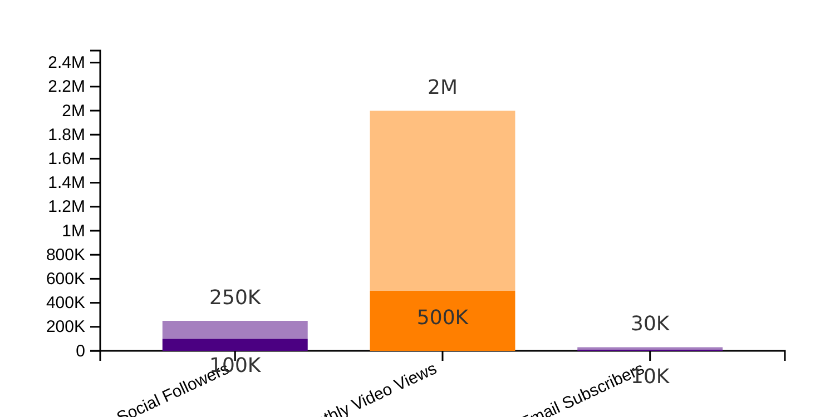








Digital Reach & Content Strategy
The Soundwave Express leverages a robust multi-channel live streaming strategy to extend its reach far beyond physical events. In partnership with Turba Media , all performances and studio sessions will be filmed, live-streamed, and shared across various social media platforms.
Content Channels
Target Metrics
Live Streaming
Daily mix sessions and masterclasses
Artist Collaborations
Features with emerging and established artists
Content Series
Documentary-style episodes following the tour
Social Followers
Video Views
Email Subscribers
The Soundwave Express
Page 4 of 9

Slide 5









Partnership Benefits & Brand Exposure
Brand Exposure
Content Integration
Audience Engagement
Prime logo placement on bus exterior (full-panel wraps, strategic decals)
"Tech Deep-Dive" video series showcasing your products in action
On-site activations and interactive brand experiences at events
Interior branding (studio walls, equipment housing)
Masterclass product placement during streamed mix sessions
Co-branded merchandise increasing brand recall and fan loyalty
Visible branding on the exterior open-air DJ stage
Artist collaboration features highlighting your products
Private VIP events and product demonstrations aboard the bus
Exposure to live crowds of 400+ people
Seamless logo integration across all live streams and social media
Exclusive access for clients to private events and showcases
The Soundwave Express
Page 5 of 9

Slide 6























Sponsorship Packages & Investment Tiers
Our sponsorship packages offer flexible 6-12 month terms with strategic mix of cash and in-kind contributions.
Title Sponsor
Gold Partner
Silver Partner
Bronze Partner
Equipment Sponsor
Primary bus wrap & interior branding
Secondary exterior placement
Medium logo placement
Small logo placement
Core equipment supply
3 video features per 6 months
Social mentions (2-4)
"Tech Deep-Dive" videos
12 long-form videos
6 long-form videos
Event branding & headline recognition
Event branding & featured placement
Event branding at select events
Product reviews & demonstrations
Product reviews & highlights
Product reviews in scheduled content
Additional branding opportunities
Additional branding opportunities
Vehicle available for one private event
Vehicle available for multiple private events
Vehicle available for several private events
ESTIMATED VALUE
ESTIMATED VALUE
ESTIMATED VALUE
ESTIMATED VALUE
ESTIMATED VALUE
$150K-$350K/year
$50K-$120K/year
$15K-$40K/6-12 months
$3K-$12K/campaign
Equipment + exposure
Flexible contribution: Cash, equipment, or hybrid models. Packages typically 6-12 months.
The Soundwave Express
Page 6 of 9

Slide 7













Target Partners - Phase 1 Anchors
To establish the foundational technical capabilities and credibility of The Soundwave Express, our initial outreach will focus on high-priority partners capable of providing core equipment and immediate in-kind support.
Australian Targets
Global Targets
Jands
Meyer Sound
Key distributor for live event equipment, staging, lighting, and DJ/production gear
Premium brand for touring and installed PA systems, ideal for anchoring the front-of-house sound
RØDE Microphones
d&b audiotechnik
Sydney-based manufacturer of studio and field microphones with strong Australian brand identity
Renowned for premium touring PA systems, offering prestige and high-quality sound reinforcement
Yamaha Music Australia
Genelec
Suppliers of essential consoles, powered speakers, and monitors for studio and live performance
High-end studio monitors, essential for establishing the mixing room's credibility
Audio-Technica Australia
Solid State Logic (SSL)
Providers of microphones, monitoring equipment, and headphones
Prestigious name in studio and live consoles, providing high-quality mixing and broadcast integration
These strategic partners provide immediate in-kind support and establish the technical credibility of The Soundwave Express
Page 7 of 9

Slide 8




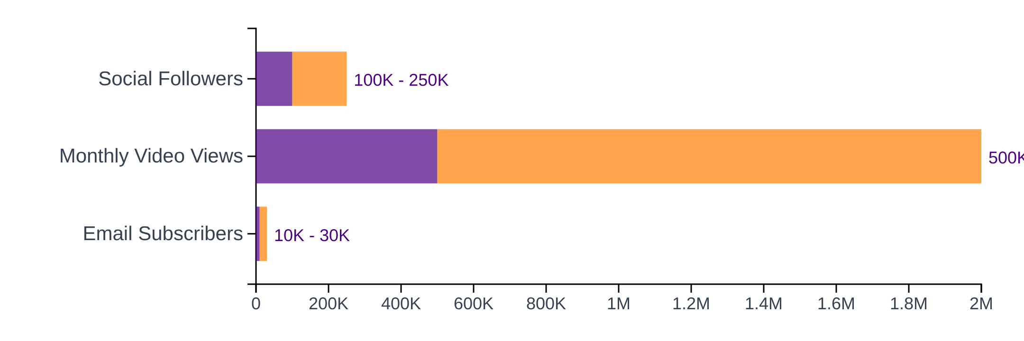





Measurable ROI & Performance Metrics
Year 1 Performance Targets
Reporting Cadence
Monthly
Reach & engagement metrics, top-performing content, upcoming schedule
Quarterly
Deep ROI analysis, content performance, brand impressions
Post-Event
Event metrics & photo/video documentation within 72 hours
Lower Range
Upper Range
Measurement Methods
Platform analytics (TikTok, IG, YouTube)
UTM-tracked links for ticketing
Fan surveys at events
The Soundwave Express
Page 8 of 9

Slide 9













Next Steps & Contact Information
Join the Movement
Contact Information
Partnership Inquiry
Contact us to discuss customized partnership options aligned with your brand's objectives and marketing goals.
[Project Lead Name]
[Title]
Project Demonstration
[Email Address]
Schedule a demo to experience The Soundwave Express firsthand and see how your brand can integrate with our content.
partnerships@soundwaveexpress.com
[Phone Number]
+61 2 9999 8888
Customized Partnership
Create a tailored sponsorship package that maximizes brand impact while supporting our mission to revolutionize mobile music experiences.
"Let's discuss how your brand can be part of this revolutionary mobile music experience"
The Soundwave Express
Page 9 of 9

Slide 10





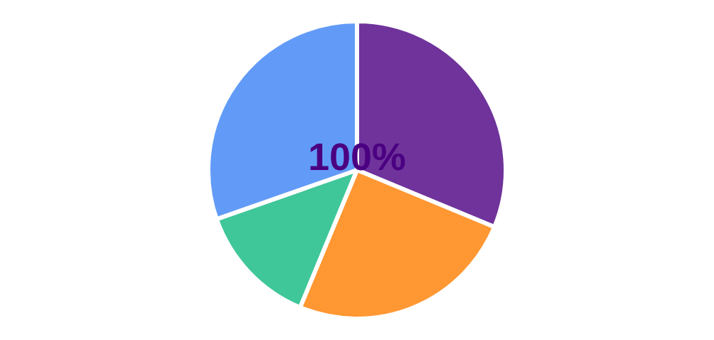









Budget Breakdown: Setup Costs
Total Initial Investment: $87,500
Equipment Distribution
Equipment Investment
Mobile Studio Components
$35,000
Sound System Integration
$28,000
Professional DJ Setup
$15,000
Vehicle & Build Investment
Modified Chassis & Body
$18,000
Interior Customization
$9,000
Safety Systems
$4,500
Decal & Branding
$2,500
Studio Equipment
Sound System
Software & Legal Investment
DJ Setup
Build Costs
Business Licenses & Permits
$2,800
Insurance Premiums
$2,200
Software Subscriptions
$1,500
Marketing Materials
$1,000
Cost-Saving Measures
Phase 1 setup with essential equipment
Partner with equipment suppliers for package deals
Deferred branding implementation
Phased vehicle interior upgrades
The Soundwave Express
Page 9 of 13

Slide 11









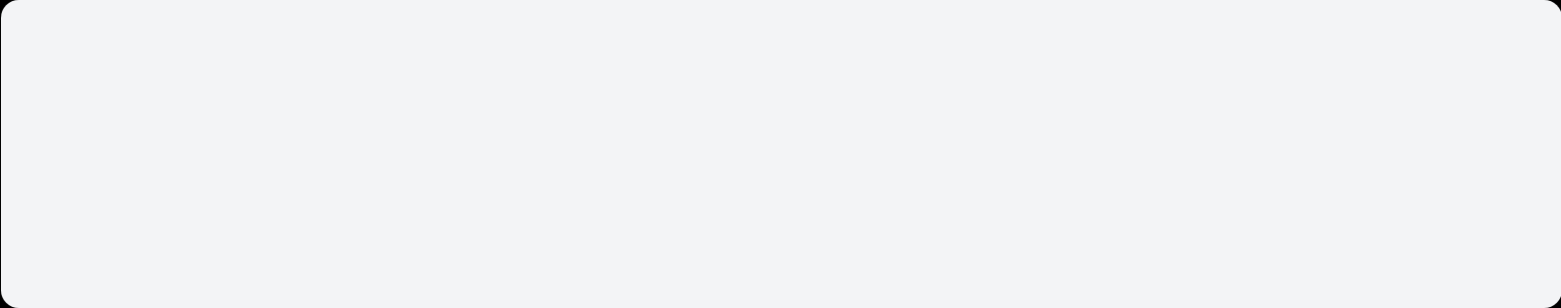










Budget Breakdown: Running Costs
Year 1 Monthly and Annual Costs
Year 1 Total Operating Costs: $80,900
Monthly Operating Expenses
$46,200
$4,200
$14,500
Personnel
$3,850
Vehicle Maintenance
$450
Personnel
Vehicle & Utilities
Software & Marketing
2 Full-time crew (dj, engineer, stage)
Oil changes, inspections, minor repairs
Utilities
$200
Software Subscriptions
$150
Estimated Annual Operating Costs
Charging, refrigeration
Streaming, booking platforms
$80,900
Equipment Insurance
$300
Promotion
$500
Average revenue increase per month: 18%
Coverage for mobile studio
Local partnerships, PR
Annual Operating Expenses
Equipment Depreciation
$2,200
Advanced Insurance
$1,800
Seasonal Revenue Timing
Accumulated over year
High coverage period
Legal & Accounting
$1,000
Professional Development
$750
Q1 (Jan-Mar)
35%
Quarterly filings, services
Education, training
Q2 (Apr-Jun)
25%
Q3 (Jul-Sep)
20%
Q4 (Oct-Dec)
20%
The Soundwave Express
Page 10 of 13

Slide 12














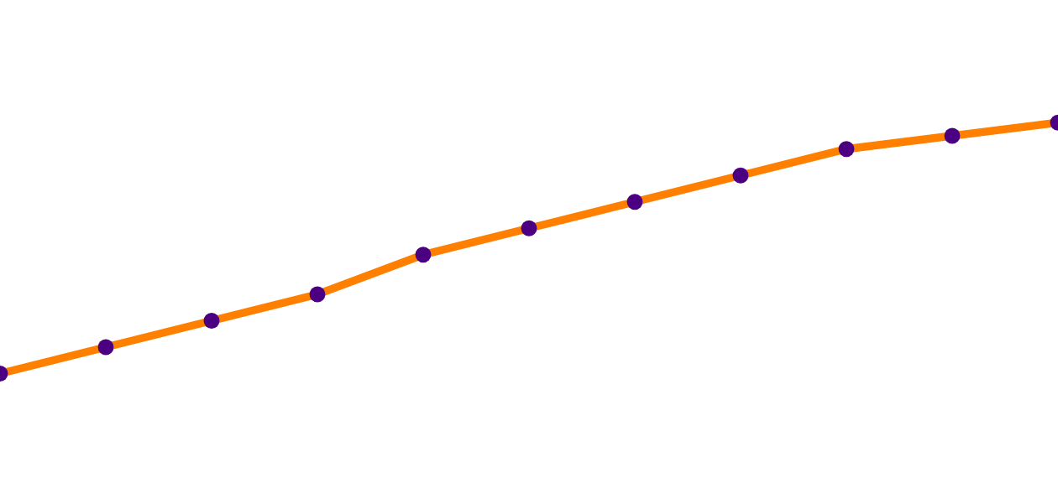



Year 1 Revenue Forecast: Revenue Streams
Quarterly & Stream Breakdown
Financial Highlights
Year 1 Total: $485,000
Quarterly Revenue Distribution
Average Event Revenue
$89,000
Q1 (Jan-Mar)
$158,000
Average Ticket Price
$75
Q2 (Apr-Jun)
$122,000
Capacity Utilization
78%
Q3 (Jul-Sep)
$115,000
Q4 (Oct-Dec)
$90,000
3-Year Growth Rate
22%
Revenue Stream Breakdown
Year 1 Break-Even
Month 1
Studio Sessions
Live Performance
Streaming Rights
96 events
$185,000
52 events
$91,000
64 events
$46,400
Revenue Growth Trajectory
Equipment Rental
Co-hosting Fees
Digital Content
48 events
$33,600
36 events
$28,800
96/videos
$28,800
Merchandise Sales
VIP Experiences
Workshops
86 events
$24,800
32 events
$24,000
16 workshops
$41,400
$100k
$0k
4
8
12
16
Month 1
20
The Soundwave Express
Page 11 of 13

Slide 13



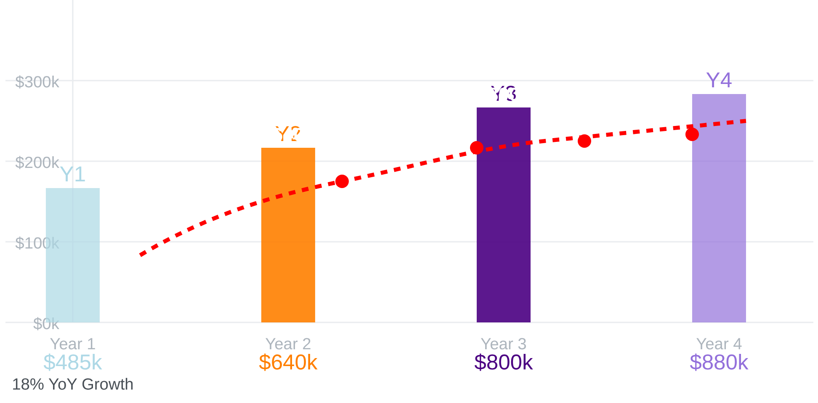








Year 2 and Year 3 Revenue Projections
3-Year Revenue Growth
Year 2 Revenue Streams
Studio Sessions
$250,000
132 events
↑ 37% (96 → 132)
Live Performance
$128,000
69 events
↑ 33% (52 → 69)
Streaming Rights
$61,000
84 events
↑ 31% (64 → 84)
Other Streams
$153,600
Equipment, Merch, Workshops
Year 3 Revenue Streams
Overall Growth
↑ 25% Year-over-Year
Market Expansion
New locations (+2)
Digital Growth
Multi-platform (YouTube/Spotify)
3-Year CAGR
Year 1 to 2
Year 2 to 3
Premium Content
Add-ons (+18%)
22%
32%
25%
Production Quality
Professional standards
New Sponsorships
Title sponsor level
The Soundwave Express
Page 12 of 13

Slide 14



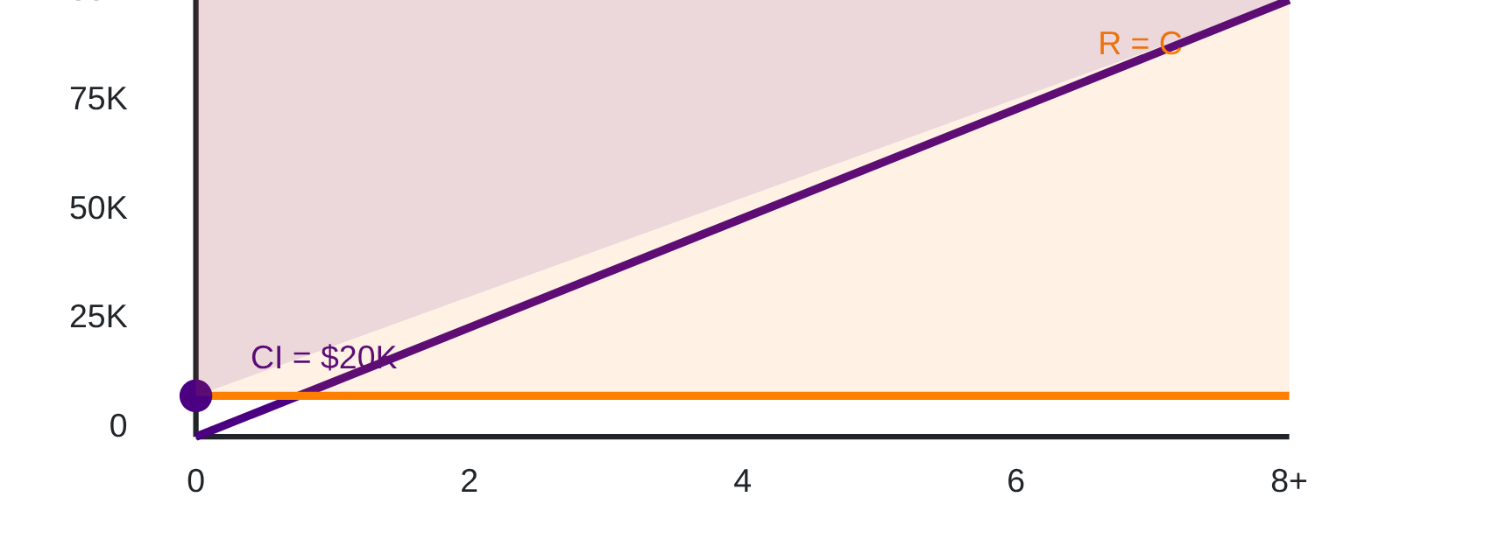











Break-Even Analysis: Immediate Profitability
Break-Even Calculation
Break-Even Point Visualization
Total Initial Setup Investment
Equipment & Build
$53,000
Marketing & Launch
$22,000
Working Capital
$12,500
Legal & Administration
$2,000
Total Initial Investment
=$89,500
Break-Even Analysis
Monthly Operating Costs
Revenue Line
Cost Line
Personnel
$3,850
Vehicle Maintenance
$450
Profit Area
Utilities
$200
Software & Insurance
$450
Monthly Operating Expenses
$5,000
Key Break-Even Advantages
Financial Performance
Minimal Investment Required
Initial bus build costs of $53,000 vs. typical startup costs of $150K+
Break-Even Point
Avg. Monthly Revenue
Multiple Revenue Streams
Month 1
$40K
9 diverse revenue streams providing multiple income sources and risk reduction
Minimal revenue
Q1 Average
High Average Transaction Value
Premium pricing of $75+ per event with customization options
Monthly Contribution
ROI (Year 1)
Quick Month 1 Break-Even
$35K
232%
Year 1 projected revenue of $485K ($40K/month) exceeds annual costs of $60K
After Costs
Initial Investment
The Soundwave Express
Page 13 of 13

Slide 15




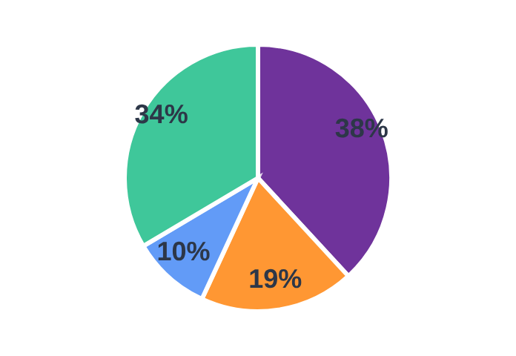











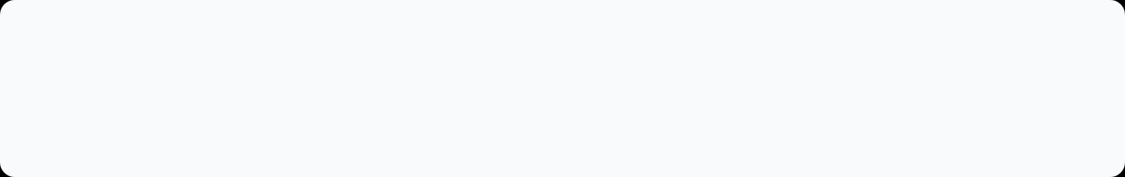
Financial Metrics Dashboard
Revenue Streams & Profit Margins
EBITDA & Cash Flow Projections
Stream
Year 1
Margin%
Year 1 EBITDA
$139,000
$185K
39%
Studio Sessions
Year 2 EBITDA
$190,000
$91K
28%
Live Performance
$46K
42%
Year 3 EBITDA
$246,000
Streaming Rights
Other Streams
$163K
23%
Annual Cash Flow
$365,000
TOTAL
$485K
29%
Gross Margin
Net Profit Margin
ROI (Year 1)
Payback Period
Investment Return Metrics
61%
29%
232%
3.6 mos
3-Year CAGR
22%
IRR (10-Year)
38%
Revenue Per Bus Day
$3,850
EV/EBITDA Multiple
6.3x
Risk Analysis
Operational Risk: Low
Revenue Risk: Medium
Market Risk: Low
Liquidity Risk: Low
Recovery Sensitivity
97% break-even buffer
Even with 3% revenue drop, profitability maintained
The Soundwave Express
Page 14 of 13

