Slide 1


A SEARCH FOR BIOLOGY BEYOND EARTH
ASTROBIOLOGY
AND EXOPLANET HABITABILITY
A Rafael Diaz Tamariz Presentation
By Tamarium Genetics

Slide 2






WHERE WE'RE HEADED
Roadmap
Astrobiology
A BIOLOGY-FIRST JOURNEY
Defining the field
We start with what life actually requires, then travel outward, from extreme life on Earth, to promising worlds nearby, to planets we'll never visit but might one day detect.
Requirements for Life
Water, energy, chemistry, time
Habitable Planets
Where conditions could align
Solar System Candidates
Mars, Europa, Enceladus
Biosignatures
How we'd recognize life
02
Notes:
I’ll begin by defining astrobiology as a field and explaining why it connects biology, chemistry, and planetary science. Then I’ll discuss what life needs from a biological perspective, including solvent availability, energy flow, nutrient access, cellular stability, and evolutionary continuity. After that, I’ll move into exoplanet habitability and then into three major astrobiological targets in our own solar system: Mars, Europa, and Enceladus. Finally, I’ll talk about biosignatures, how scientists distinguish biological signals from abiotic ones, and what all of this means for our understanding of life in the universe.

Slide 3





DEFINING THE FIELD
What Is Astrobiology?
Biology
The interdisciplinary study of the origin, evolution, distribution, and future of life in the universe.
It asks three linked questions: how did life begin, where else could it exist, and how would we recognize it?
Planetary Science
Astronomy
Geology
Chemistry
03
Notes:
Astrobiology is the study of the origin, evolution, distribution, and future of life in the universe. From a biological standpoint, that means understanding how life begins, what environmental conditions allow it to persist, how it adapts to stress, and how it changes over evolutionary time. The field also asks how living systems interact with planets for example, how a biosphere modifies an atmosphere, sediments, minerals, or nutrient cycles. So astrobiology is not only a search for life elsewhere, but also a framework for understanding life on Earth as part of a planetary system. That planetary perspective is essential, because when we search for life beyond Earth, we usually search not for organisms directly, but for the environmental consequences of biology

Slide 4



THE BASELINE REQUIREMENTS
What Does Life Need?
Water
Energy
Elements
Stability
A liquid medium for chemistry to happen in
Light, heat, or chemical gradients to exploit
Carbon, hydrogen, nitrogen, oxygen and more
Enough time and particle interaction for complexity to build
These four ingredients define the search image astrobiologists use across the solar system and beyond.
04
Notes:
Life requires more than the presence of molecules. At the biological level, an environment has to support metabolism, structural integrity, replication, and adaptation. Liquid water is important because it enables transport, solvation, and controlled biochemical interaction, making it the best known medium for life as we know it. Organisms also require a source of free energy, because metabolism depends on maintaining systems far from thermodynamic equilibrium. In addition, the major bioessential elements especially carbon, hydrogen, nitrogen, oxygen, phosphorus, and sulfur must be available in usable forms. Finally, the environment must remain stable enough over time for populations to reproduce and for evolution to act. If conditions are too transient or too destructive, chemistry may occur, but biology will not establish itself

Slide 5






LIFE AT THE EDGES, ON EARTH
Extremophiles
Thermophiles
Psychrophiles
Halophiles
Thrive near boiling hydrothermal vents
Metabolize in sub-zero polar ice
Flourish in saturated brine lakes
Radioresistant Microbes
Piezophiles
Acidophiles
Survive doses lethal to nearly everything else
Live under crushing deep-ocean pressure
Grow in highly acidic volcanic springs
If life can endure these conditions on Earth, similar niches elsewhere become plausible habitats too.
05
Notes:
Extremophiles are critical to astrobiology because they show that life can function across a much wider range of conditions than previously assumed. These organisms survive not because they ignore stress, but because evolution has equipped them with specific adaptations: highly stable proteins, specialized membranes, efficient DNA repair systems, osmotic regulation mechanisms, and flexible metabolic pathways. This matters because many extraterrestrial environments would be extreme by terrestrial standards. If Earth life can survive in brines, permafrost, hydrothermal systems, deep subsurface rock, or highly acidic waters, then those environments become useful analogs for other worlds. Extremophiles therefore expand our concept of habitability and help us ask better biological questions about where life might exist elsewhere
A mold grew in space without them wanting to

Slide 6



BEYOND OUR SOLAR SYSTEM
Exoplanet Habitability
Orbits within its star's habitable zone, where liquid water can persist
Rocky composition and plausible atmosphere, inferred from mass and radius
Detectable spectral signatures that hint at surface or atmospheric chemistry
Thousands of confirmed exoplanets, a small but growing fraction sit in the habitable zone.
06
Notes:
When we talk about exoplanet habitability, the biological question is whether a planet could support a living system over time. That involves much more than temperature alone. A habitable world must allow cells to maintain structure, exchange matter with the environment, generate energy, and reproduce across many generations. It also needs enough environmental continuity for natural selection to act, because a biosphere is not a one-time event but a dynamic population process. So from a biological perspective, exoplanet habitability is really about whether an environment can support metabolism, ecological persistence, and evolutionary continuity. A world can be chemically interesting without being biologically viable

Slide 7
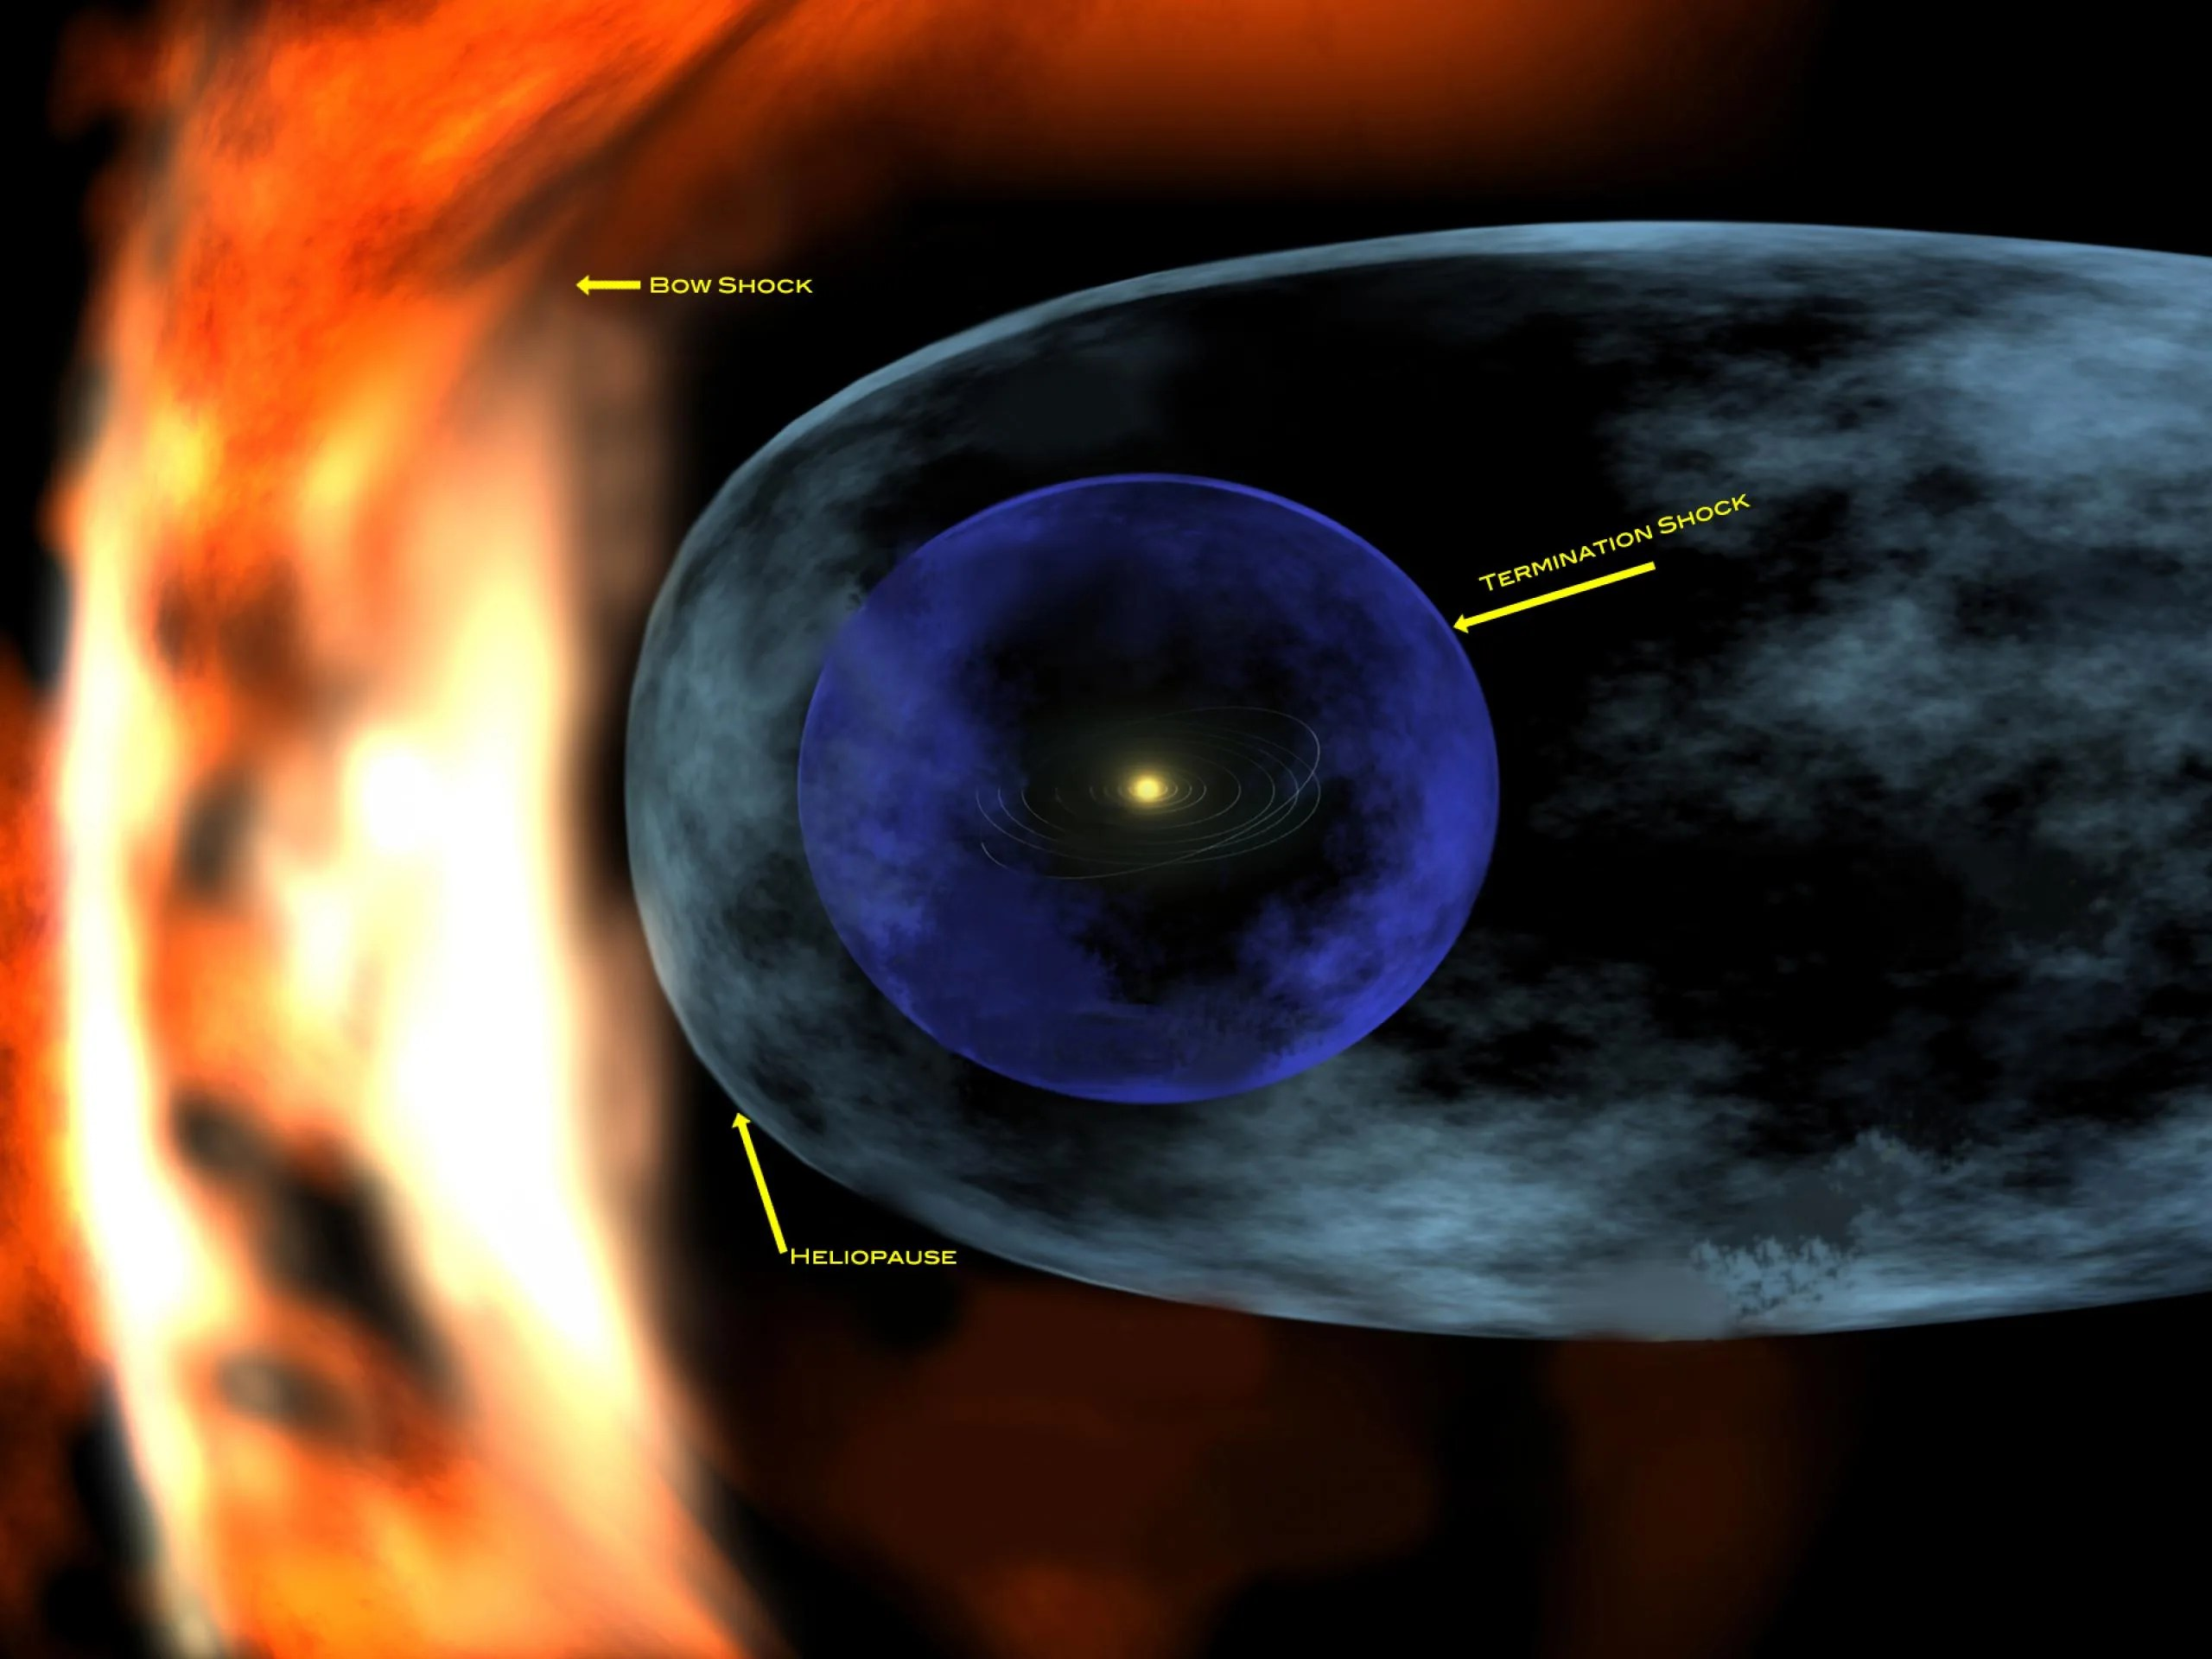
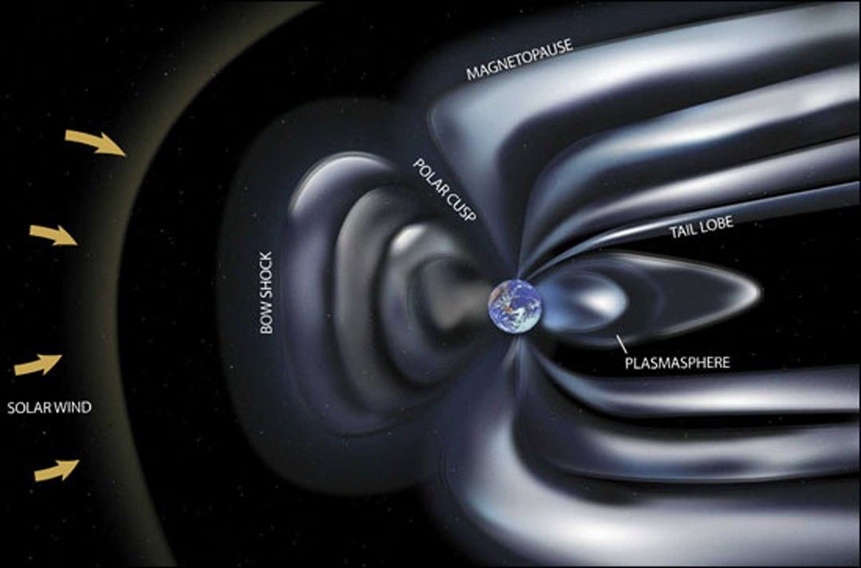


THE CIRCUMSTELLAR 'GOLDILOCKS' REGION
The Habitable Zone
TOO COLD
Too Hot
Water boils away; any surface ocean is lost to space.
HABITABLE
Habitable
Temperatures allow liquid water to persist on the surface.
Too Cold
TOO HOT
Water freezes solid; surface chemistry slows dramatically.
07
Notes:
The habitable zone is the region around a star where a planet could, in principle, maintain liquid water at its surface. This is useful because liquid water is one of the strongest indicators of potential habitability. However, from a biological perspective, the habitable zone is only a first filter. It says little about atmospheric composition, nutrient availability, radiation intensity, climate stability, or whether the planet actually supports long-term ecological niches. A planet inside the habitable zone might still be sterile if it experiences strong atmospheric loss, intense stellar flaring, or unstable surface conditions. Likewise, a planet or moon outside the classical habitable zone might still support subsurface life if internal heating and liquid reservoirs exist. So biological habitability is broader than orbital position alone.

Slide 8


THE CLOSEST CANDIDATE
Mars
Dry riverbeds and deltas show water once flowed for millions of years
Subsurface ice and possible seasonal brines persist today
A thin, cold, low-pressure atmosphere preserves ancient surface evidence
Preservation, more than present-day activity, is what makes Mars such an accessible biosignature hunt.
08
Notes:
Mars is one of the most important astrobiological targets because it appears to have had habitable environments in the past. Geological evidence shows that liquid water once existed in rivers, lakes, and sedimentary systems, which are environments that on Earth can preserve evidence of microbial life. Organic molecules have also been detected in Martian rocks, showing that carbon-bearing material can survive there over long timescales. However, preservation on Mars is difficult. Radiation, oxidation, and surface chemistry can degrade or transform organic signals, which means any biosignature search has to consider not only whether life could have been present, but whether its traces could survive and still be recognized. So Mars is not just a question of ancient life, but also a question of biological taphonomy and preservation science.

Slide 9
AN ICY PLANET OF TRAPPIST-1
Trappist-1f
Ice Shell
A frozen crust several kilometers thick shields what's below
Subsurface Ocean
A global saltwater ocean, likely in contact with rock
Rocky Core
Tidal flexing from Jupiter may drive hydrothermal activity
09
Notes:
Europa is biologically fascinating because it may host a global ocean beneath an icy shell. If that ocean is in contact with a rocky interior, then water-rock interactions could provide chemical gradients that support metabolism. From a biological point of view, that is important because life does not necessarily need sunlight; many Earth microbes use chemical energy instead of light, particularly in subsurface or hydrothermal settings. So Europa represents a model of habitability in which biology would be hidden, likely microbial, and potentially sustained by geochemical processes over long periods. The key scientific question is whether such an ocean can provide sufficient energy, nutrients, and environmental stability to support a persistent biosystem

Slide 10

PLUME-SPOUTING MOON
Enceladus
Geysers at the south pole eject water-ice grains into space
Cassini detected salts, silica, and organic molecules in the plumes
A subsurface ocean and hydrothermal chemistry make it a top target
10
Notes:
Enceladus is one of the strongest current candidates for extraterrestrial habitability because it actively ejects ocean-derived material through its plumes. That gives scientists direct access to a subsurface environment without drilling through ice. The detected presence of water, organics, and phosphorus is especially important because these are key components of biological systems on Earth. In addition, evidence consistent with hydrothermal activity suggests that Enceladus may maintain the kind of chemical disequilibria that life can exploit metabolically. Biologically, this makes Enceladus a compelling example of a world where a microbial ecosystem could, in principle, exist in a protected aquatic habitat driven by geochemical energy rather than sunlight

Slide 11



IF LIFE TAKES HOLD
Evolution Elsewhere
Wherever replication, variation, and hereditary exists, the same basic process should apply, regardless of the chemistry involved.
Environment
Local conditions set the pressures an organism faces
Selection
Traits that aid survival are favored over time
Adaptation
Advantageous traits accumulate across generations
Evolution
Populations diverge into new, better-fit forms
11
Notes:
If life exists elsewhere, it would still be governed by evolution, but the direction of that evolution would depend strongly on the local environment. Selection pressures such as temperature, gravity, radiation, nutrient limitation, solvent conditions, and energy availability would shape which traits are advantageous. That means extraterrestrial life may not resemble familiar Earth organisms in form, but it may still follow the same biological principles: variation, selection, adaptation, and ecological specialization. For example, on a world with low energy availability, one might expect slow-growing microbial systems with highly efficient metabolism. In a high-radiation environment, robust repair mechanisms and protective structural adaptations would likely be favored. So the important point is that alien life may be unfamiliar in appearance, but evolution would still organize it around environmental constraints.

Slide 12

RETHINKING THE BUILDING BLOCKS
Alternative Biologies
Carbon Chemistry
Silicon Chemistry
Forms four stable bonds, builds long flexible chains, and works well across a wide temperature range, the chemistry every known organism uses.
Also forms four bonds and is far more abundant in rock, but its compounds are typically rigid, less soluble, and chemically less versatile.
Speculative, but scientifically interesting.
12
Notes:
When astrobiologists discuss alternative biologies, the real biological question is not whether different molecules are possible, but whether they can support the defining functions of life. A living system needs some form of heredity, catalysis, structural organization, and the capacity for adaptive variation. Carbon-based systems are currently the best known way to achieve this, which is why they remain the default model in astrobiology. Alternative forms, such as silicon-based life, are scientifically interesting because they challenge our assumptions, but they remain speculative because we do not yet know whether they could support the full biological architecture required for metabolism, information storage, and evolution. So while astrobiology should remain open to unfamiliar forms of life, it still relies on biology as we know it to define what a living system must accomplish
Ammonia
plasma

Slide 13


READING THE EVIDENCE
Biosignatures
Organic Molecules
Minerals
Isotopes
Atmospheric Gases
Life
Biosignatures
Detection
Interpretation
No single clue is proof on its own — confidence builds when several independent signatures agree.
13
Notes:
A biosignature is any object, substance, or pattern that may indicate biological activity. Importantly, biosignatures are not limited to one category. They can include organic molecules, isotopic fractionation patterns, mineral associations, sedimentary structures, or even environmental disequilibria that are difficult to explain without life. But detection alone is never enough. Scientists need to ask whether the signal could also be produced abiotically, whether the local environment would preserve it, and whether multiple lines of evidence point toward the same interpretation. This is why NASA’s life-detection frameworks emphasize standards of evidence and additive measurements. A convincing biosignature is usually not one dramatic observation, but a coherent pattern of biological plausibility, environmental context, and preservation potential

Slide 14


WHY DON'T WE SEE ANYONE ELSE?
The Fermi Paradox & The Great Filter
The Fermi Paradox: with hundreds of billions of stars and billions of years for life to arise, civilizations should statistically be common, yet we observe no evidence of any. So where is everybody?
Where does the filter sit?
?
Chemistry
Life
Complex Cells
Animals
Intelligence
Civilization
The Great Filter is one proposed answer: somewhere along this path sits a step so improbable that almost nothing gets past it. Whether that filter lies behind us or still ahead of us changes everything.
14
Notes:
The Great Filter is a useful idea because it connects astrobiology to evolutionary rarity. It suggests that somewhere between prebiotic chemistry and advanced technological civilization, there is at least one step that is extremely unlikely or unstable. From a biological point of view, this matters because the hardest transition may not be the origin of life itself, but perhaps the emergence of complex cells, multicellularity, intelligence, or long-term ecosystem stability. The Kardashev scale then describes what civilizations would look like if they successfully passed those barriers, at planetary, stellar, or galactic energy scales. Even though these ideas are speculative, they help frame an important astrobiological point: microbial habitability may be relatively common, while complex, technologically visible life may be extraordinarily rare
-Abiogenesis: The transition from non-living chemicals to self-replicating molecules (like RNA).
-Eukaryogenesis: The development of complex cells from simple prokaryotes.
-The emergence of consciousness/tool use: While life is abundant, true tool-using intelligence might be a massive cosmic anomaly.

Slide 15



MEASURING COSMIC PROGRESS
Types of Civilizations
In 1964, astronomer Nikolai Kardashev proposed ranking civilizations by how much energy they can harness, not by technology or culture, but by raw scale.
TYPE 0
TYPE I
TYPE II
TYPE III
Pre-Planetary
Planetary
Stellar
Galactic
Draws on chemical fuels, not yet mastering its full home planet's energy, believed to be roughly where humanity stands today.
Harnesses all the energy available on and from its home planet, including its star's total incoming light.
Captures the total energy output of its home star directly, for example, via a theoretical Dyson swarm.
Commands energy on the scale of an entire galaxy, harnessing billions of stars at once.
Some extensions add a hypothetical Type IV (universal) and even Type V but these remain purely speculative.
15
Notes:
The Kardashev scale, proposed by Soviet astronomer Nikolai Kardashev in 1964, classifies civilizations by the amount of energy they can capture and use, not by their technology or values. Type I harnesses everything available on and from its home planet; Type II captures its entire star's output, classically illustrated with a Dyson sphere or swarm; Type III operates on a galactic scale. Carl Sagan later interpolated a continuous scale and placed humanity at roughly Type 0.7 - we're not yet a full Type I civilization, but we're on the way, sometimes labeled Type 0. Note this scale measures energy consumption, not necessarily benevolence, sustainability, or detectability - a civilization could plausibly be advanced without being obvious to observe, which loops back into the Fermi Paradox discussion. Transition: 'With that sense of scale in mind, let's turn from destroying-the-search cynicism to what fiction imagines contact might look like.'

Slide 16


ENGINEERING A SECOND EARTH
Terraforming Mars
Mars Today
A 'Green Mars' Concept
Thin CO2 atmosphere, frozen water, no protective magnetic field
Thickened atmosphere, liquid surface water, engineered or introduced life
Still largely theoretical, but it reframes habitability as something life might also help create.
16
Notes:
Terraforming is often presented as a matter of changing a planet’s atmosphere or warming its surface, but biologically that is only a small part of the challenge. A habitable biosphere requires stable nutrient cycles, functioning microbial communities, environmental buffering, ecological succession, and long-term resilience. In other words, supporting life at planetary scale means establishing a self-maintaining system, not just creating superficially comfortable conditions. That is why terraforming is better understood as biosphere engineering rather than simple planetary engineering. From a scientific perspective, it remains highly speculative because creating and stabilizing a living planetary system is far more complex than altering a few physical parameters
Von Neuman replicating machine
MOGA
Oxygen, Hydrogen and Carbon separator
Combining Fungi to bind Regolith (planetary surface rock) and Cyanobacteria to sustain the mold

Slide 17
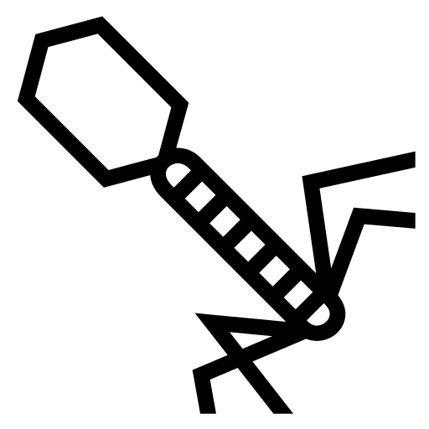
HELPING BIOLOGY KEEP UP
Genetic Adaptation
Engineered microbes could tolerate radiation, cold, or extreme dryness
Directed adaptation is studied on Earth to model extraterrestrial resilience
The same principles could one day help sustain life on other worlds
Framed as applied science, not speculation, the diagrams above are illustrative, not exhaustive.
17
Notes:
An alternative to terraforming is to adapt biology to the environment instead of adapting the environment to biology. In practice, this would most likely begin with microbes, because microbial systems are metabolically flexible, genetically tractable, and already capable of surviving in extreme environments on Earth. From a biological engineering perspective, one could imagine modifying stress responses, repair pathways, osmotic tolerance, or metabolic networks for controlled extraterrestrial applications. However, this quickly raises planetary protection concerns. Releasing engineered organisms into a natural extraterrestrial environment could contaminate the very biosignatures we are trying to detect and could irreversibly alter that environment before we understand it. So while genetically adapted organisms are scientifically plausible in controlled systems, their use in open planetary environments remains deeply problematic

Slide 18




A LIGHTER INTERLUDE
What Pop Culture Imagines
Fiction usually imagines contact with intelligent, humanoid civilizations.
Most likely first discovery: microbes.
18
Notes:
Science fiction usually imagines alien life as complex, visible, and intelligent, but real astrobiology suggests that the first life we detect is much more likely to be microbial or indirect. The earliest evidence may come from atmospheric chemistry, isotopic anomalies, sedimentary structures, or preserved molecular patterns rather than from visible organisms. From a biological standpoint, this makes sense because microbial life is simpler, more adaptable, and more likely to persist under extreme conditions than complex multicellular life. So while fiction often focuses on bodies and intelligence, astrobiology focuses first on metabolism, adaptation, and biosignature formation. In reality, extraterrestrial life may be biologically profound while still being microscopically small and analytically subtle.

Slide 19

CLOSING THOUGHTS
Conclusion
Life on Earth shows biology can thrive in far more extreme conditions than once assumed.
Mars, Europa, and Enceladus each offer a plausible, testable habitat within reach.
Biosignatures give us a rigorous way to search, without needing to travel there ourselves.
"The search for life is ultimately a search for biology beyond Earth."
19
Notes:
To conclude, astrobiology is best understood as the biology of life in planetary context. It asks where living systems can originate, what conditions allow them to persist, how they adapt to environmental stress, and how they leave detectable traces behind. Habitability is therefore not just a matter of water or chemistry; it is the capacity of an environment to support metabolism, reproduction, and evolutionary continuity. Mars, Europa, and Enceladus each illustrate different models of biological opportunity, while biosignatures remain the key bridge between planetary observations and life-detection claims. The overall scientific message is that the search for life must be cautious, contextual, and based on converging evidence rather than single exciting observations.

Slide 20
A SEARCH FOR BIOLOGY BEYOND EARTH
ASTROBIOLOGY
AND EXOPLANET HABITABILITY
A https://innovationshapesthefuture.com/ Presentation
By https://tamarium.eu/

Slide 21

SELECTED SOURCES
References
NASA
Nature
ESA
Science
Astrobiology Journal
PubMed
Full citations available on request. Thank you.
20
Notes:
NASA Astrobiology Program. (2026, June 28). Life, here and beyond. https://astrobiology.nasa.gov/about/
National Aeronautics and Space Administration. (2023, August 2). Core capability 7 - astrobiology and detection of life. https://www.nasa.gov/core-capability-7-astrobiology-and-detection-of-life/
National Aeronautics and Space Administration. (2023, October 3). The astrobiology strategy. https://science.nasa.gov/astrobiology/strategy/
National Aeronautics and Space Administration. (2025, July 20). Astrobiology resources for life detection missions. https://science.nasa.gov/astrobiology/researchers/life-detection-resources/
National Aeronautics and Space Administration. (2019). The critical role of extremophiles in answering the great questions of astrobiology. https://ntrs.nasa.gov/citations/20190026774
National Aeronautics and Space Administration. (2022, November 22). Terrestrial analogues and the search for biosignatures in the solar system. https://astrobiology.nasa.gov/news/terrestrial-analogues-and-the-search-for-biosignatures-in-the-solar-system/
National Aeronautics and Space Administration. (2026, June 2). NASA astrobiology program overview. https://science.nasa.gov/astrobiology/program-overview/
National Aeronautics and Space Administration. (2023, August 2). Core capability 7 - astrobiology and detection of life. https://www.nasa.gov/core-capability-7-astrobiology-and-detection-of-life/
National Aeronautics and Space Administration. (2023, August 1). Habitable environments and biosignatures (HEB). https://www.nasa.gov/general/habitable-environments-and-biosignatures-heb/
National Aeronautics and Space Administration. (2006). The space physics of life: Searching for biosignatures on habitable worlds [PDF]. https://ntrs.nasa.gov/citations/20060013112
National Aeronautics and Space Administration. (2018, June 6). NASA finds ancient organic material, mysterious methane on Mars. https://www.nasa.gov/news-release/nasa-finds-ancient-organic-material-mysterious-methane-on-mars/
National Aeronautics and Space Administration. (2020). Biosignature preservation and detection in Mars analog environments. https://pubmed.ncbi.nlm.nih.gov/28177270/
National Aeronautics and Space Administration. (2023). Exploring Europa’s interior [via Europa Clipper overview]. https://link.springer.com/article/10.1007/s11214-023-00990-y
Nature. (1998). Evidence for a subsurface ocean on Europa. https://www.nature.com/articles/34857
Waite, J. H., et al. (2020). NASA's Europa Clipper—a mission to a potentially habitable ocean world. Nature Communications, 11, Article 2459. https://www.nature.com/articles/s41467-020-15160-9
National Aeronautics and Space Administration. (2022). The astrobiological potential of Enceladus [overview sources]. https://ntrs.nasa.gov/api/citations/20180001231/downloads/20180001231.pdf
National Aeronautics and Space Administration. (2020, April 13). Ancient genes, evolution, & the origin of life with Dr. Betül Kaçar. https://astrobiology.nasa.gov/ask-an-astrobiologist/episodes/38/
National Aeronautics and Space Administration. (2023, October 3). The astrobiology strategy. https://science.nasa.gov/astrobiology/strategy/
National Academies of Sciences, Engineering, and Medicine. (2007). An astrobiology strategy for the exploration of Mars. https://www.nationalacademies.org/read/11937/chapter/5
National Aeronautics and Space Administration. (2023). Astrobiology resources for life detection missions. https://science.nasa.gov/astrobiology/researchers/life-detection-resources/
National Aeronautics and Space Administration. (2023, August 1). Habitable environments and biosignatures (HEB). https://www.nasa.gov/general/habitable-environments-and-biosignatures-heb/
Arnold, G. L., et al. (2019). Deciphering biosignatures in planetary contexts. Astrobiology, 19(9), 1107–1120. https://www.liebertpub.com/doi/10.1089/ast.2018.1903
National Aeronautics and Space Administration. (2016). Astrobiology: Life on Earth (and elsewhere?) https://ntrs.nasa.gov/citations/20160012759
National Aeronautics and Space Administration. (2023, August 2). Core capability 7 - astrobiology and detection of life. https://www.nasa.gov/core-capability-7-astrobiology-and-detection-of-life/
National Aeronautics and Space Administration. (2023, October 3). The astrobiology strategy. https://science.nasa.gov/astrobiology/strategy/
National Aeronautics and Space Administration. (2023, August 2). Core capability 7 - astrobiology and detection of life. https://www.nasa.gov/core-capability-7-astrobiology-and-detection-of-life/
National Aeronautics and Space Administration. (2019). The critical role of extremophiles in answering the great questions of astrobiology. https://ntrs.nasa.gov/citations/20190026774
National Aeronautics and Space Administration. (2025, July 20). Astrobiology resources for life detection missions. https://science.nasa.gov/astrobiology/researchers/life-detection-resources/
National Aeronautics and Space Administration. (2023, August 1). Habitable environments and biosignatures (HEB). https://www.nasa.gov/general/habitable-environments-and-biosignatures-heb/
National Aeronautics and Space Administration. (2023, August 2). Core capability 7 - astrobiology and detection of life. https://www.nasa.gov/core-capability-7-astrobiology-and-detection-of-life/

