Slide 1
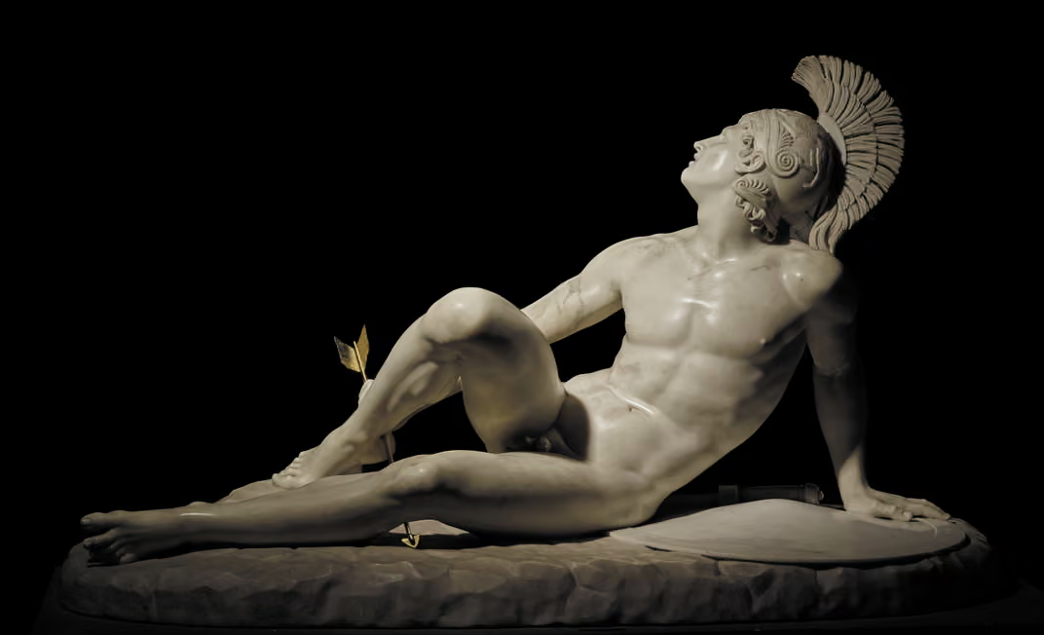
Achilles
The tragedy of a hero plagued by hate

Slide 2
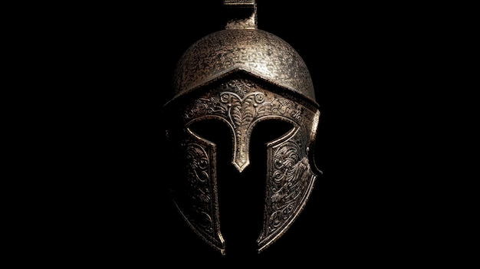
Agenda
Introduction
Story
Hate
Heroism
Revenge
Forgiveness
Tragedy
Death

Slide 3
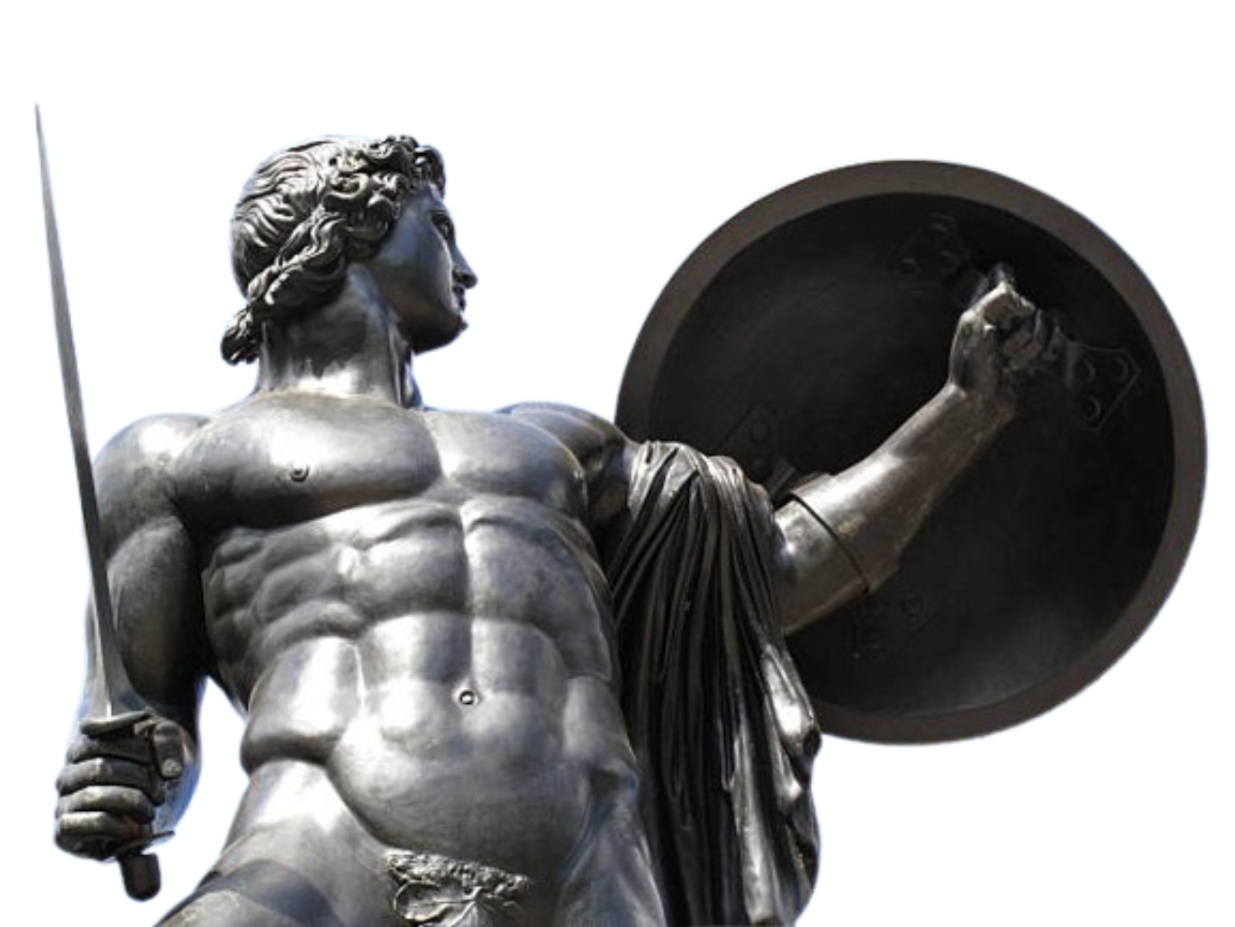
Introduction
Achilles – the iconic and tragic hero of the Trojan War – has been one of the most complex and important characters in history. While he is most well known as the best fighter of all of Greece, his heroism instead mainly comes from his character: his willingness to sacrifice for his comrades and his ability to forgive.

Slide 4
Story
Patroclus dies on the battlefield. Achilles, wearing a new set of armour made by Hephasteus, fights and kills Hector. After Hector’s father Priam goes beg for his body, Achilles gives Priam time to bury his son.
Without Achilles, the Greeks struggle to fight the Trojans. The Trojans push the Greeks to the beaches and burn some of their ships.
Achilles goes to war, knowing it will be his death.
Agememnon steals Briseis, Achilles’ prize from raiding other lands. Furious, Achilles leaves the army.
Agememnon sends Odysseus to call back Achilles, who refuses. Instead, Patroclus wears Achilles’ armor and goes to fight.
In revenge, Achilles is killed by an arrow from Paris and Apollo, and dies at the gates of Troy.

Slide 5
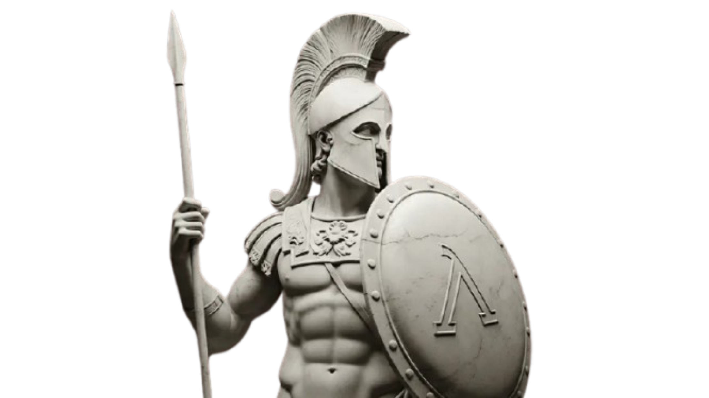
Hate
Throughout the story, Achilles is driven by hate. This is particularly shown when Agememnon takes Briseis from him. His hate against Agememnon takes control of him for the majority of the story, which is the reason why he refuses to fight for a long time. He despises Agememnon as a leader can calls him a “dirty dog”. However, he doesn’t fight for hate throughout the story, but instead for protecting his comrades and avenging Patroclus.

Slide 6
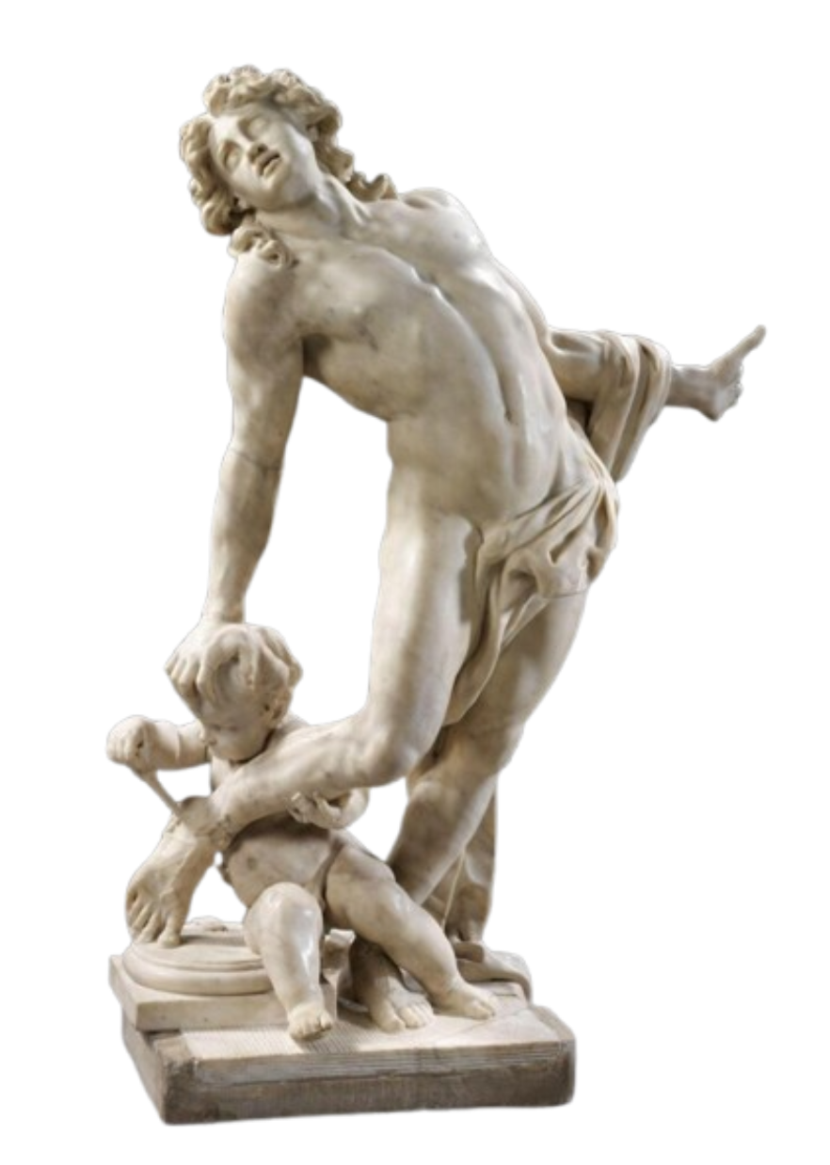
Heroism
While Achilles was rageful, he also was heroic in how he was willing to sacrifice himself to save his men. When he was leaving for the war, a prophet had predicted he would die. However, another has also stated that the Greeks could not win without him. Even though he knew his death lay there, he chose to sacrifice himself to save the Greek soliders.

Slide 7
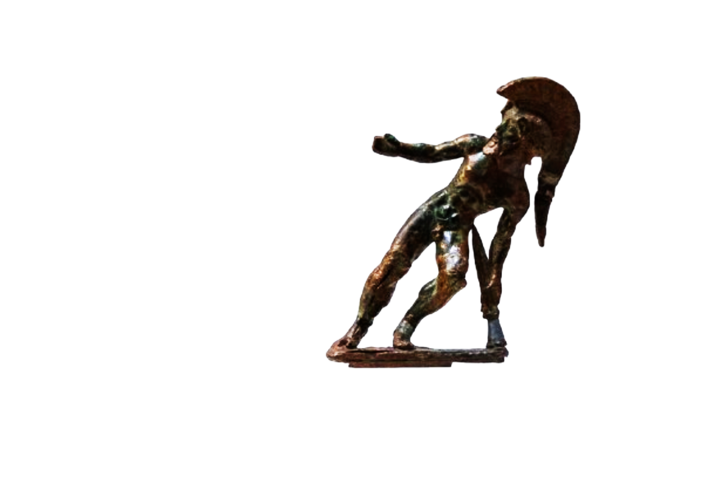
Revenge
Achilles was also a vengeful person. When Patroclus dies, Achilles immediately goes to fight the man who did it. Even though Achilles still has rage against Agememnon, his will to avenge Patroclus surpasses even that. He kills many Trojans and chases Hector around Troy to get his revenge. After Patroclus died, he also avenges Antilochus. Ultimately, he dies for his actions.

Slide 8
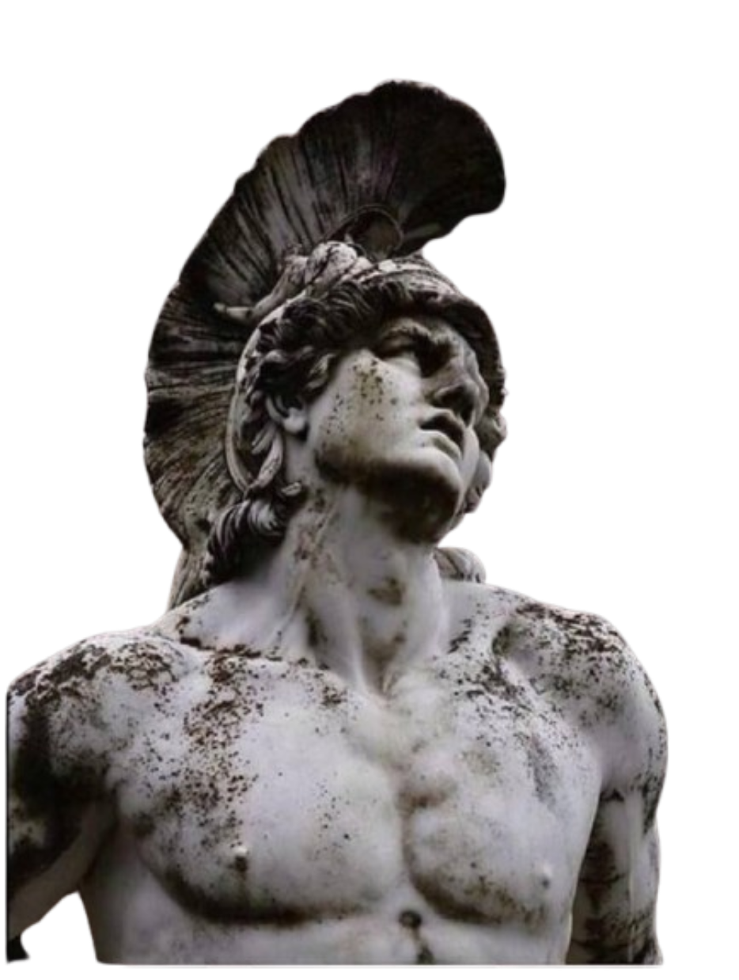
Forgiveness
While Achilles may be vengeful and sometimes irrational, he is still forgiving. After he kills Hector, Hector’s father Priam comes to beg with Achilles. While Achilles is still sad for Patroclus, he relinquishes his fury and forgives Priam. Similarly, he also forgives Agememnon, and even becomes friends in the underworld. Throughout the war, he actually reveals that he doesn’t wish to actually kill some of the Trojans.

Slide 9
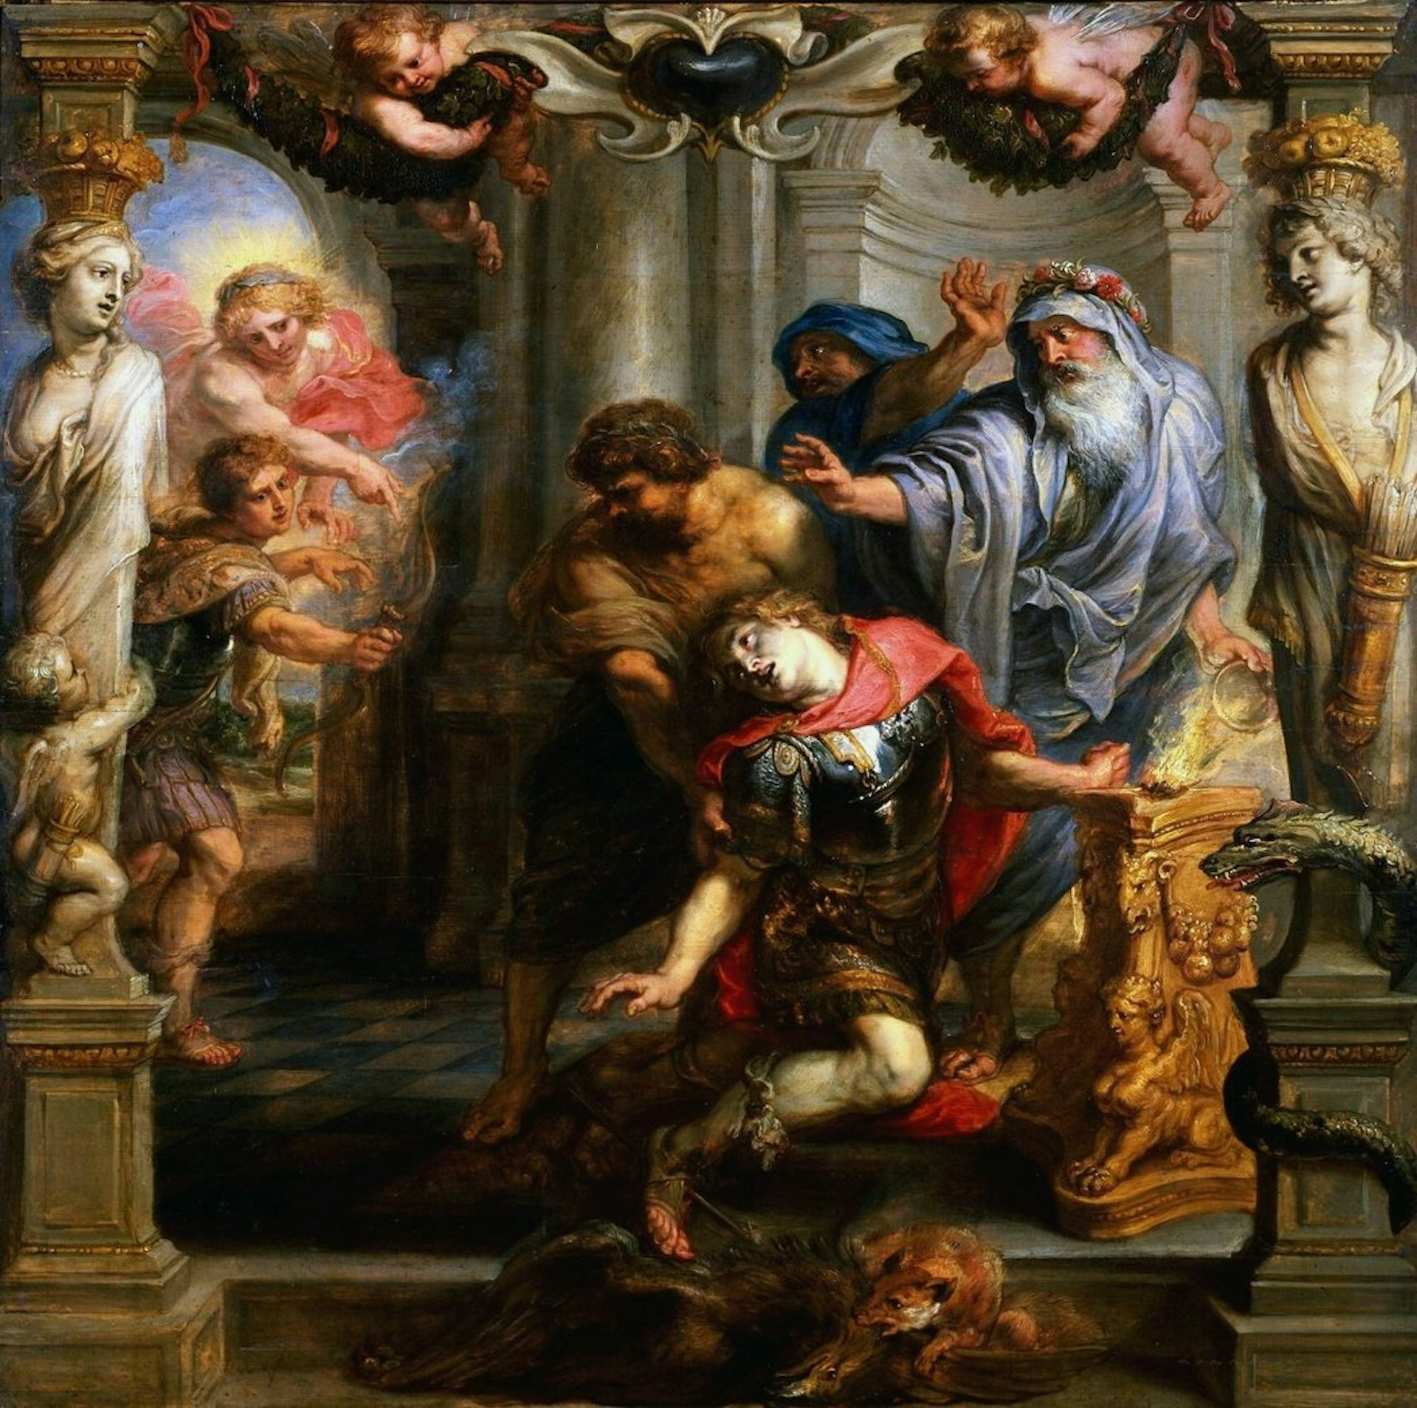
Tragedy
Achilles’ character is also filled with tragedy. He knows he is going to die, but that’s not it. First, Briseis is taken from him. Then, Patroclus is killed. Furthermore, his second-closest friend, Antilochus, is also murdered. Then, he himself dies a painful death from the arrow in his tendon. His life is painful, short, and not very appealing. But this feature can be found in almost all of the Greek heroes. Perseus is the only one who had ever gotten a happy ending: all the other heroes were either poisoned, stabbed, or commited suicide.

Slide 10
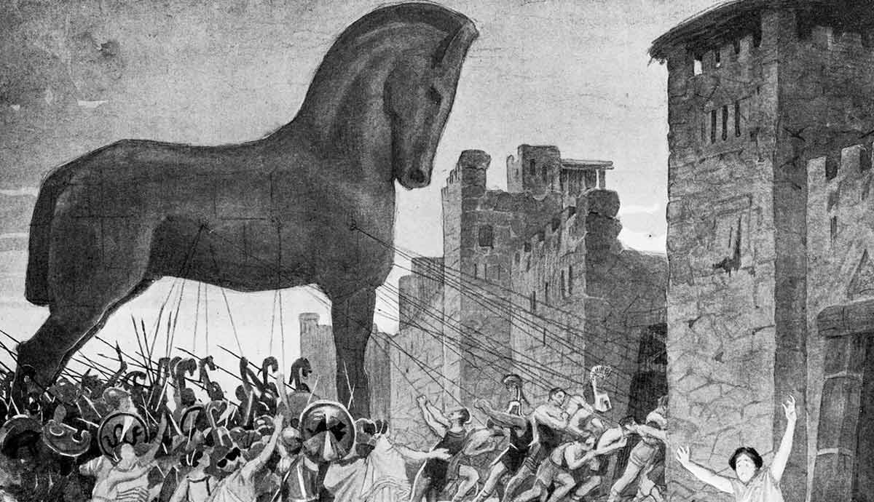
Death
In the end, Achilles’ hate and revenge kills him. Paris, guided by Apollo, kills Achilles by shooting him in the heel. Achilles dies on the spot. Ajax and Odysseus rescue him from the Trojans, but it’s no use. The Greeks give Achilles a grand funeral, with many funeral duels. Following his death, the Greeks eventually penetrate Troy. While dead, Achilles’ story of heroism, revenge, hate, forgiveness, and tragedy will continue to reverberate across the world.

Slide 11
Thank you for watching
By Daniel Zhang, based on the Illiad by Homer (translated by Robert Fagles) and other sources.

