Slide 1
Project Hail Mary
An Analysis

Slide 2
Mission Briefing
Objectives:
Find a solution against Astrophage and deliver it to Earth
Mission Status:
Uncompleted
Danger Rating:
Extreme
Mission Vehicle:
Hail Mary
Time Left: 3 years, 1 month, 5 days, 2 hours, 15 minutes, 50 seconds
Death Rate:
99%
Mission Priority
Global Code Red

Slide 3
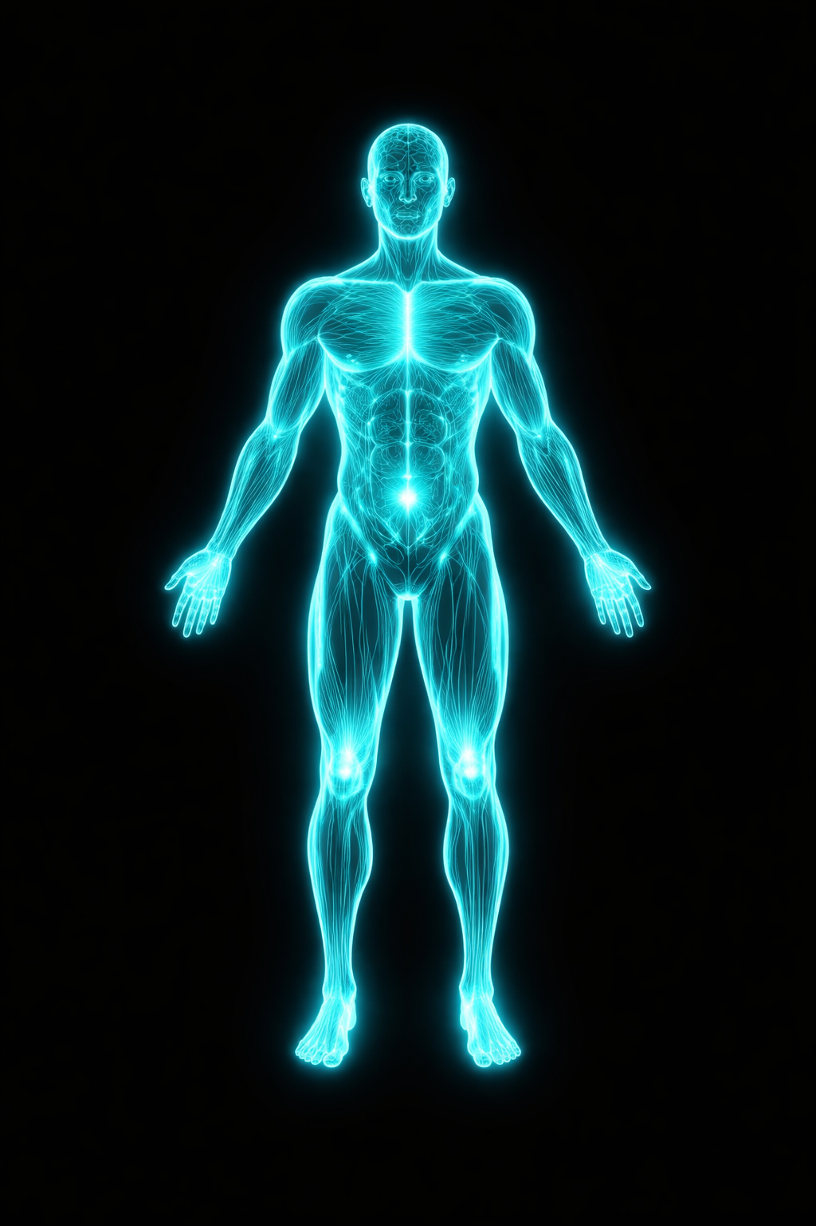

Crew Needs
Intelligence:
Very high, leading science minds of the scientific community
Health: Near Perfect
Genes: Containing Anti-Coma genes
Agility: Strong
Resilience: Extreme
Possible Candidates:
<100

Slide 4
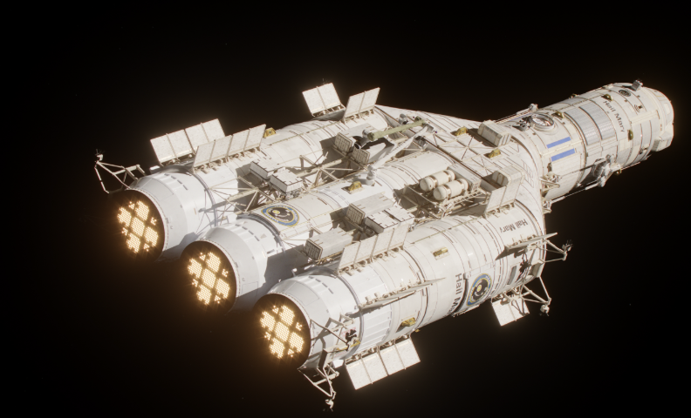
Vehicle
Fully Equiped Lab
2 million kilograms of Astrophage stored in Fuel Tanks
Control Room
Centrifuge Seperation point
Spin Drive
Name of Ship: Hail Mary
Type: Exploration
Fuel: 2 million kg of Enriched Astrophage
Thrust: 70 MN
Mass: 3 million KG
Crew: 3
Hail Mary

Slide 5

Psychological Pressure
Crew knows that they will die, for certain.
Will have to go through periods of extreme stress
In the end they will have to kill themselves.
Knows that even if they succeed, they die
The crew will be alone for years, in a confined space

Slide 6
Conclusions
Project Hail Mary is the story of a hero doomed to die, yet able to change fate.
Ryland Grace was never meant to survive, yet through will of xenonite, he prevails.
A Story of how will can change fate

Slide 7
Thank You
All designs and content by Daniel Zhang

