Slide 1
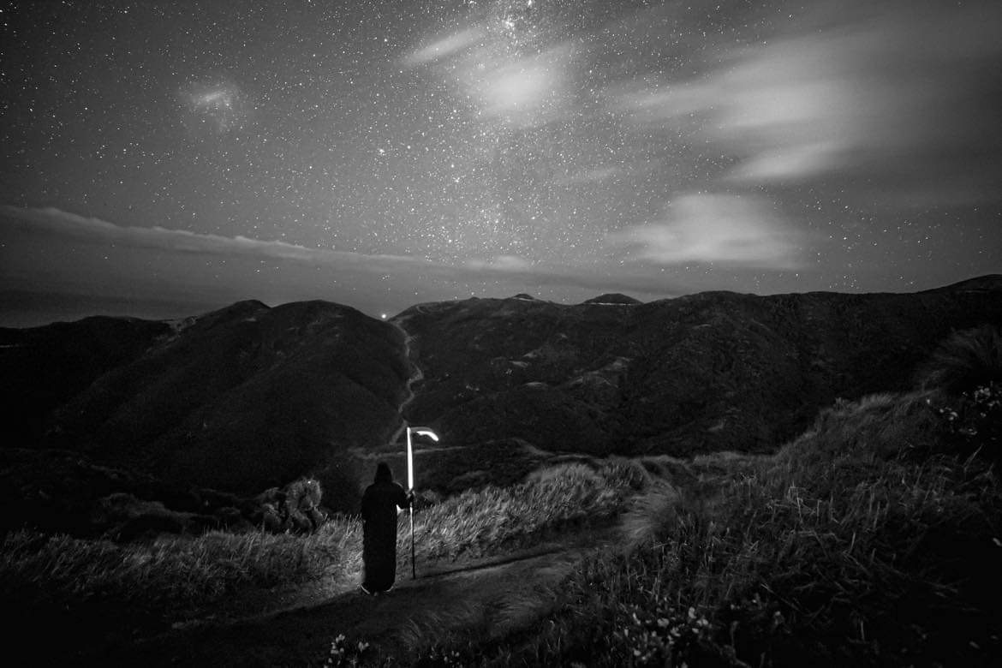
TIP TRACK MARATHON
2025 Race Briefing

Slide 2
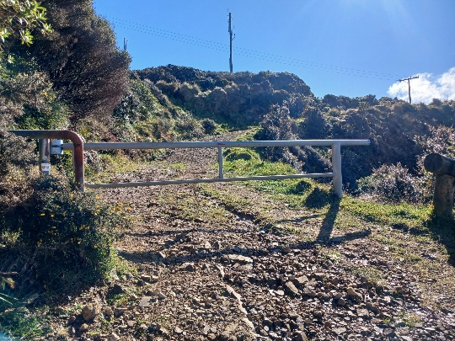
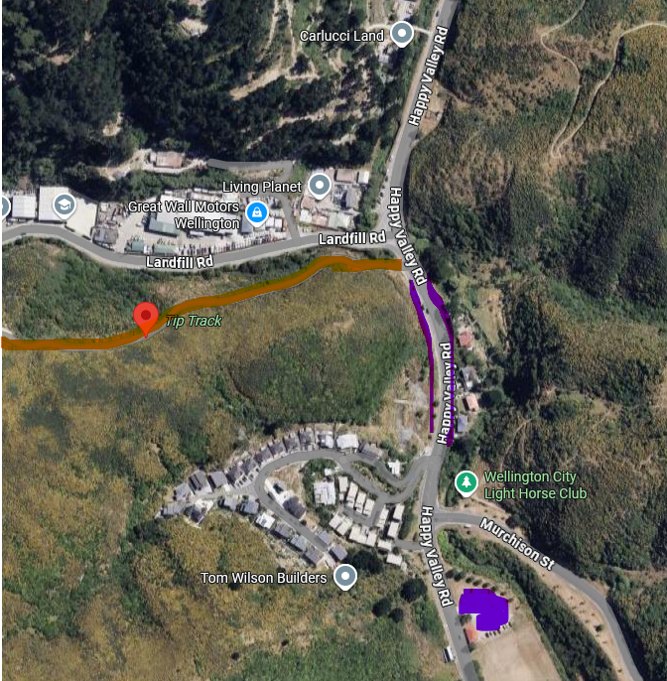
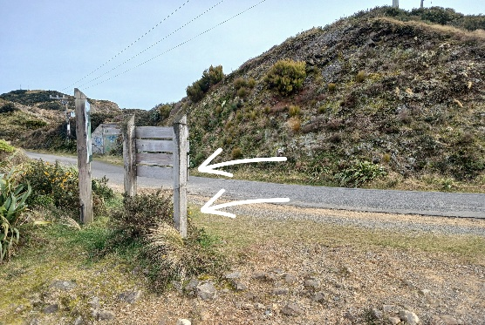

Tip Track Marathon 2025
Course and Location
The Course
Starting at the gate from the bottom, you’ll make your way up and up and up for what will feel like an eternity until you reach… the Race HQ - you are only 50m from the start and it has only just begun. Shout profanities at me here and flip the bird if it helps. I don’t care. You signed up for this.
Getting to the top of Tip Track is 3.6km and about 450m of elevation. Never leave the main track – there are some really appealing side tracks but save them for another day. There is a major junction at about 3.4km – once again, don’t be tempted to veer off, keep heading up! At 3.5km is a gate (pic to the right) and this is still not the top! Dammit! Pass this and in about 100m is a road with a big sign – YOU’VE MADE IT! Tap the sign and head back to the bottom. That is one lap complete (once back to the bottom).
MARATHON = 6 LAPS
HALF MARATHON = 3 LAPS
Location and Parking
The Tip Track is on Happy Valley Rd in Happy Valley and runs parallel to the Brooklyn Tip. The track is coloured orange on the map in the top right and the start is about 200m from Carlucci Land.
The purple sections are the best spots for parking. Public transport is not great unfortunately, but if you can car pool or bike then please do that. Please do not park on the open sections opposite tippy – I’m not sure of the rules here but some people were ticketed last year.
Note that Happy Valley Park is about 300m from the start line and has a nice car park (coloured purple on map). Please park here if you can and walk up.
If you are running the marathon – please do not park by the entrance!
The portaloo will be arriving from 7.30am or so and I need that space empty to park it in here.

Slide 3
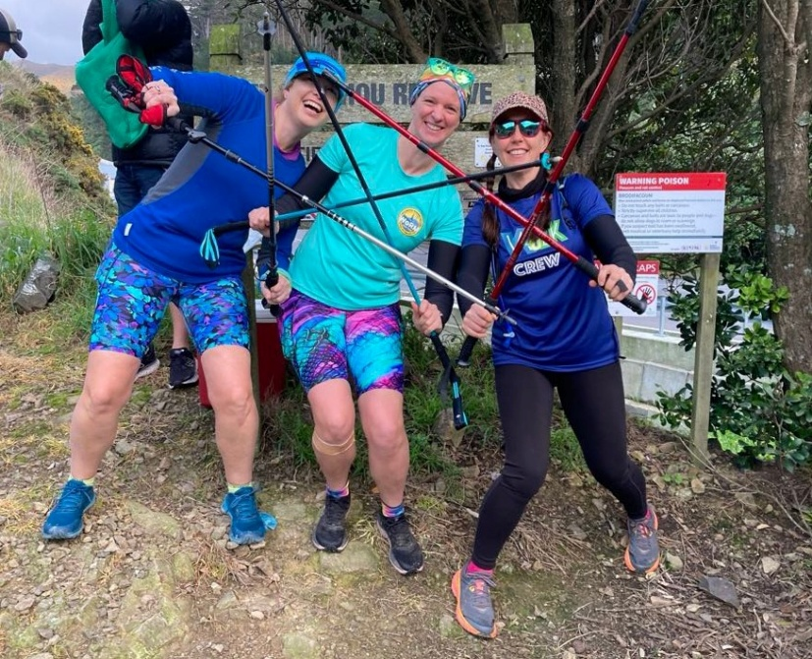
Tip Track Marathon 2025
Registration and Safety
Race HQ and your gear
Race HQ is getting ramped up this year. There will be stages, bands playing, bouncy castles and a brief appearance from Batman. It definitely ISN’T a wonky table, two deckchairs and a slightly hungover race director with a clipboard marking your times. That would be embarrassing for such a marquee event.
Race HQ is about 50m from the start gate and you are welcome to drop any bags you have here. While I can’t guarantee your things will be secure, there will be volunteers and myself there all day so it is highly unlikely anything will go missing.
Note: If you place something on the wonky table, it becomes communal! So any baking etc for runners and volunteers can be placed here.
You do need to be self sufficient! Bring all the food and water you think you’ll need. While there will be some stuff available, this isn’t a catered event.
Registration
You will need to sign in at registration when you arrive on race day. The reason for this is so I can cross off any no-shows, but also because I’ll need to jot down your race bib number. Please arrive half an hour before your race so we can get everyone through rego please.
YOU WILL NEED TO BRING YOUR OWN RACE BIB!! TTM is cheap and I’d rather the money went to the charities instead of ordering 200 race bibs off Temu. If you do not have an old race bib lying around then get creative and make one – there will be a prize for the best!
Each lap when you pass Race HQ, please make sure the timekeeper has noticed you and your bib number is visible. Once you have completed your race (whether you have done all the laps or not), please tell the timekeeper you are done, so they know to cross your name off. This is particularly important if you did not complete all your laps.
Start Times
Marathon – 7am
Half Marathon – 9am
There is a cut-off to start your final lap of 1.30pm!
If you are concerned about pace or you need to be somewhere in the afternoon then you are welcome to start earlier – but please let the timekeeper know your start time.
Compulsory Gear
As the course is out and back laps of tippy, there is no compulsory gear. That being said, if the forecast is a howling southerly and rain, I won’t be letting you take off in a singlet. Make sure you come prepared for Wellington weather (and it’s ability to change suddenly).
I think there is a little bit of a lackadaisical attitude to safety in trail running in NZ. While the Tip Track is not remote or extreme, if you have a fall and can’t continue, do you really want to be in minimal clothing with that wind whipping through while waiting for assistance?
There will also be a first aid trained volunteer at Race HQ to assist if anything should happen to you, plus first aid provisions and supplies at HQ.

Slide 4
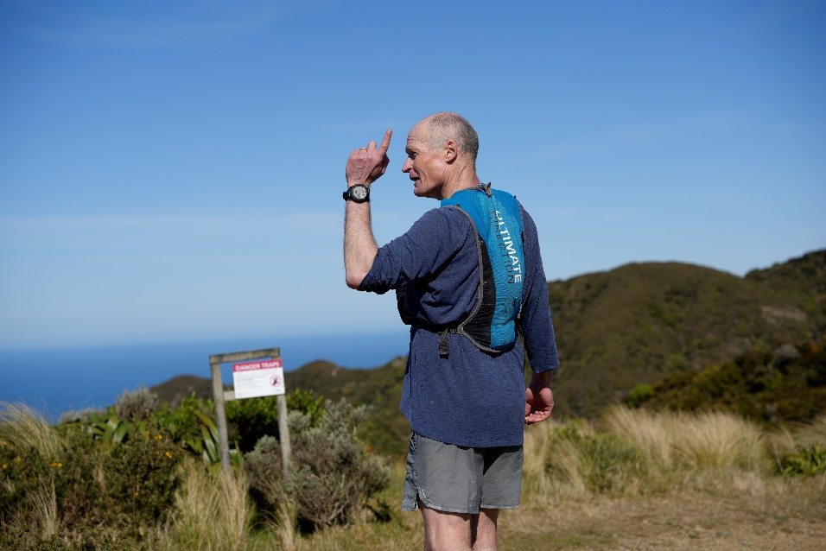
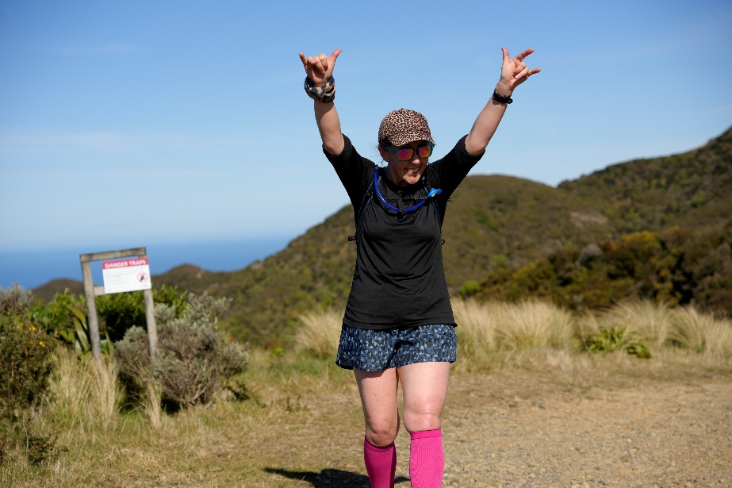
Tip Track Marathon 2025
Vibes
TTM ethos aka “it’s just the vibe of the thing”
TTM is proudly not-for-profit. It exists as a space for good people to do something really freaking hard for something really positive – our charities.
TTM is a judgment-free zone and doesn’t care whether you are slow, seasoned, weird, or a combination of all three.
TLDR; the world drools, TTM rules.
After Party
I’ve completely forgotten to book somewhere! I’ll announce on the day where we’ll go – but it will be in the city centre from 5pm. There is no prize giving as such or anything like that – but it’s always good to get together after an event and have a drink. You are welcome to bring partners/family/friends too.
Sustainability
Please take all rubbish etc with you when you leave. Do not litter on the trails or throw anything away – yes I realise the irony of this as we are right next to the tip lol but Te Kopahou Reserve is such a beautiful place and it takes enough of a beating from the tip as it is. Don’t add to it. Anyone caught littering will be disqualified.
There will be rubbish bags at Race HQ but it’d be great if you could take your rubbish with you.
Please do not purchase any disposable goods for TTM such as plastic cups etc – this includes if you are making a race bib, make it from things around the house if possible.
THANK YOU
I want to finish by saying a huge thank you to you all for getting behind this event, getting into the spirit of things, donating your money during some damn difficult times, and just being your legendary selves.
TTM started as a bit of a piss take (cue shocked gasps) and I love what it has become – a much larger and more successful piss take. Together we have raised over $25,000 for a variety of charities over the past few years and we are on track to go over $5,000 this year (for the third year in a row!).

