Slide 1


Slide 2
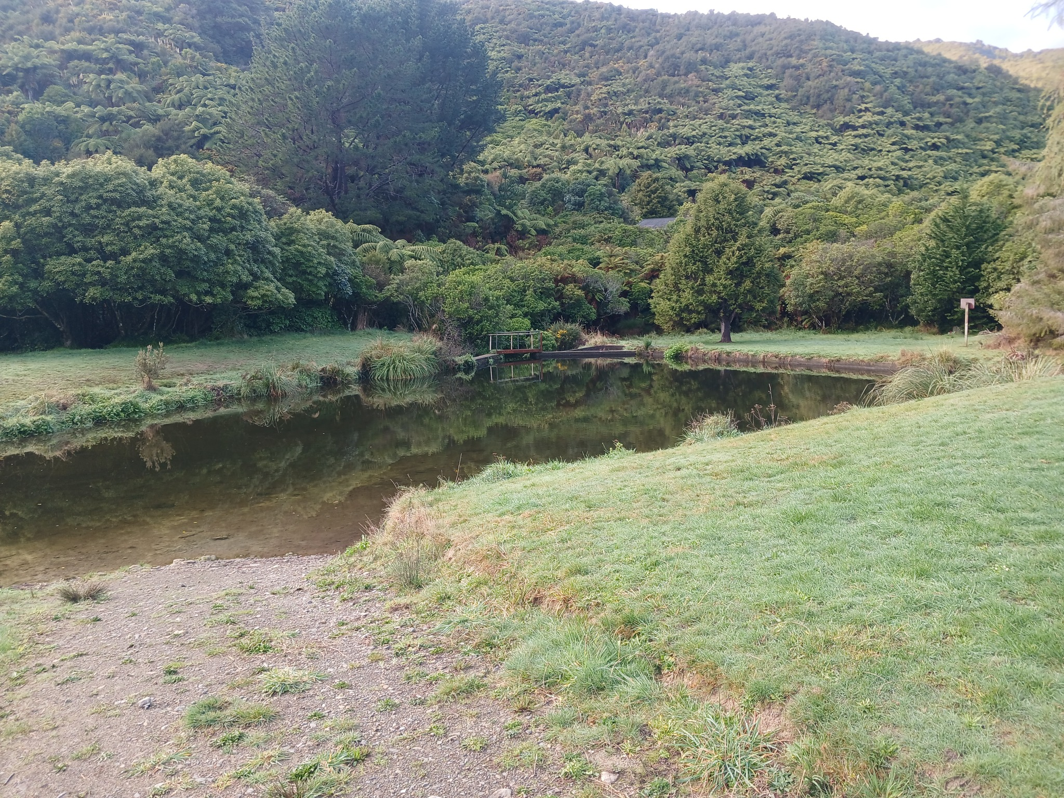

LOCATION

Slide 3
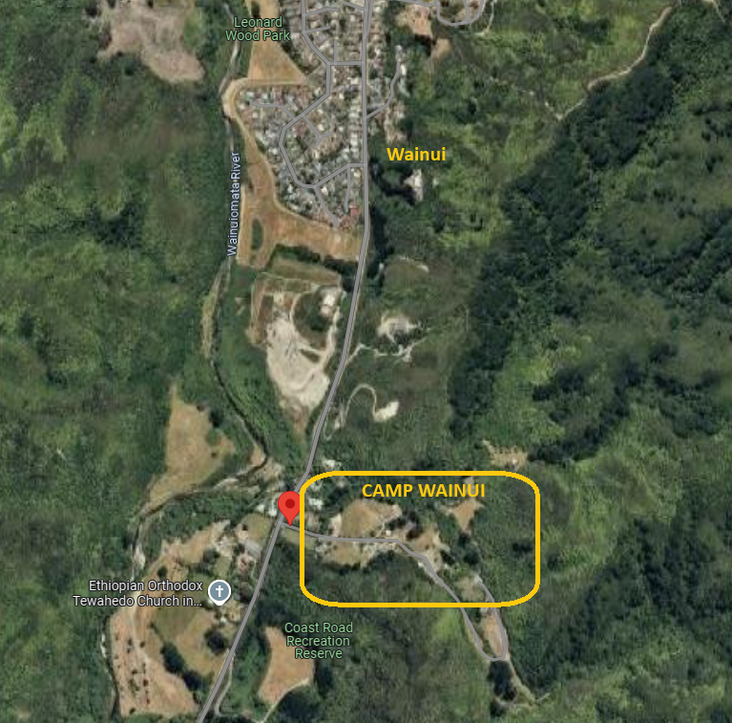
LOCATION
Q. Where the hell is this place?
The address is 203 Coast Rd, Wainuiomata (30mins from Wellington). Basically, head over the Wainui hill and stick to the main road. You'll eventually veer right on to Coast Rd – follow this for a few kms and you'll see a sign for Camp Wainui on the left. Drive right in – past the lagoon and cross a small bridge before looping around to the car park.
Q. Will there be carpooling?
YES! A week or two before B2W we will post a sheet on the Facebook page to organise carpooling. I'll email it too for non-Facebookers.
If you need a ride, or can offer a ride, then coordinate through this.

Slide 4
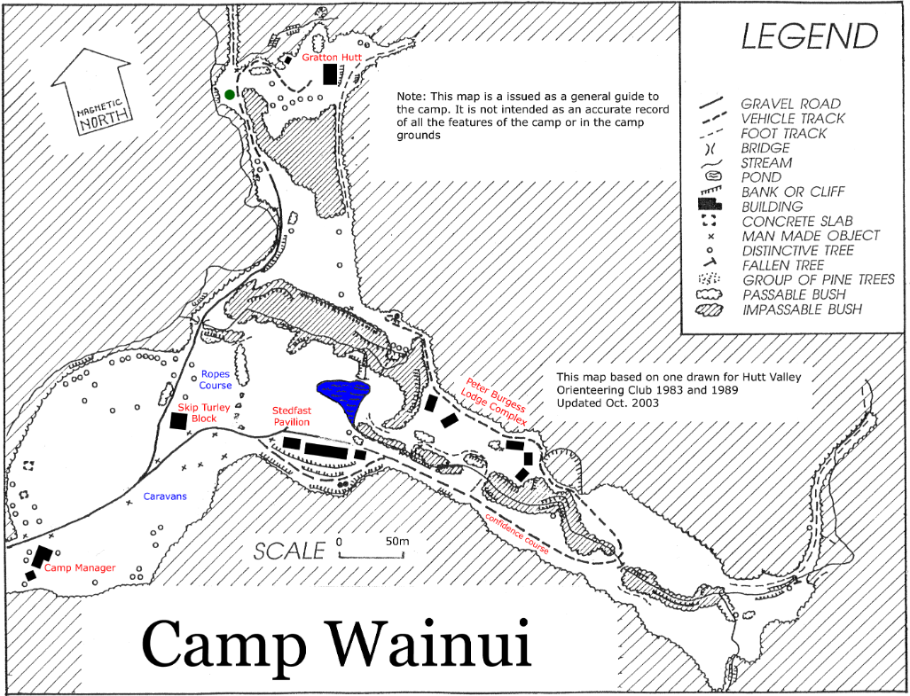
LOCATION
Q. What facilities are available at Camp Wainui?
There are lodges for sleeping, tent sites, grassy areas, picnic tables, a hall, kitchen areas, bathrooms, a lagoon for swimming, a river, and bush tracks.
Q. Is there food available to buy?
NO. There is nothing available at Camp Wainui to purchase. However, there are shops, restaurants, supermarkets etc a short drive away in Wainuiomata if you need to top up. Don't forget that dinner will be provided on Saturday – but all other meals and snacks you will need to provide.

Slide 5
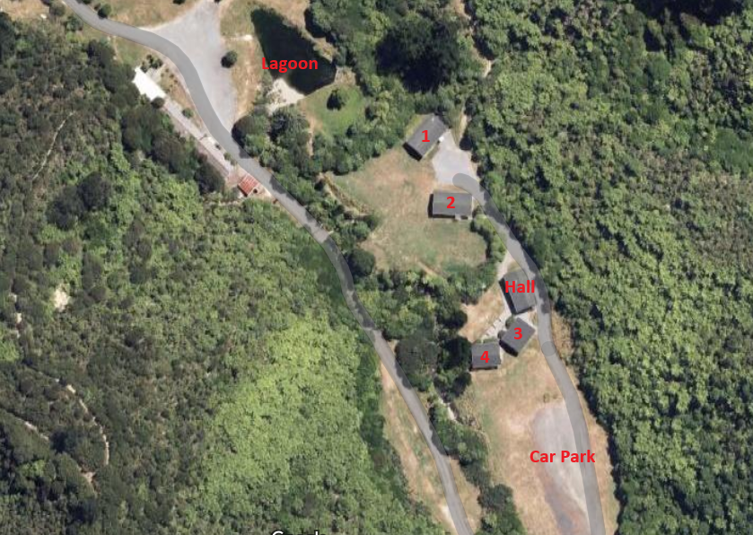
LOCATION
Q. Where do I sleep?
If you are in a lodge, you will be designated a lodge number and a room number. Remember this, because it will make finding your room much easier. Each lodge has four dorms that can sleep 18 people, two toilets, two showers, plus a utility room. Two of the four lodges also have a kitchen and living area (these will be available for all people, not just the people in those lodges).
If you are camping, then you will be directed to your campsite on arrival (please don't randomly decide your camping spot).
If you want to bunk with your besties, fill in this form and we can make sure your group gets a dorm together.

Slide 6
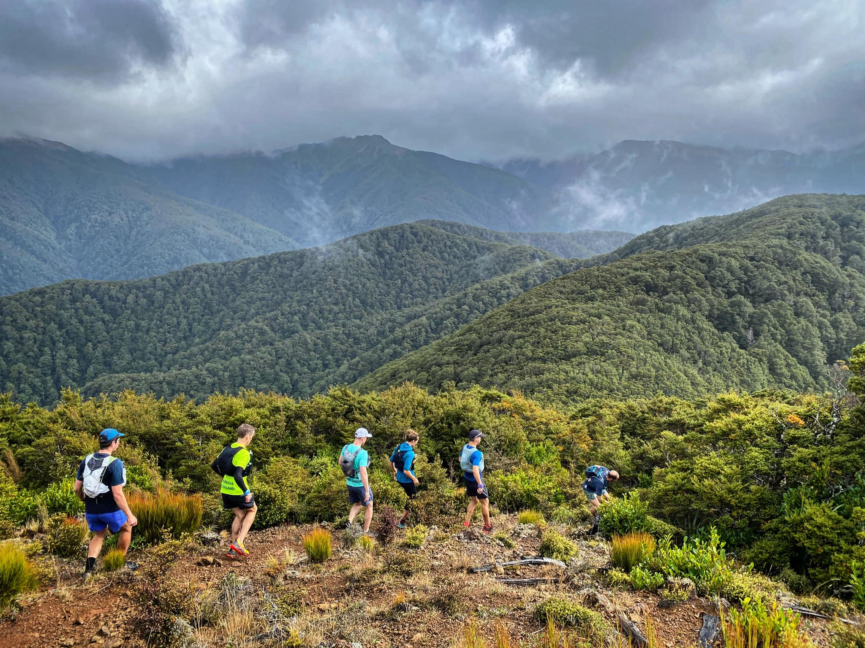
PROGRAMME

Slide 7
FRIDAY
Arrival from 12.30pm
2pm – Gear Swap
5pm – Manu / Dive Comp
Main Hall
Swap, sell or donate all your unwanted trail running gear. Bring along those pants that didn't quite fit you, or your old watch after your Xmas upgrade – and find yourself some new kit as well!
Lagoon
Grab a drink and head to the lagoon for a yarn or two. If you feel up for it, enter the dive comp and do your best manu into the lagoon.
3pm – Run Pōneke
7.30pm – WoRM Awards
Main Hall
Join Will Cass as he showcases the brand new running hub on the Wellington waterfront. Featuring a recovery centre, breakfast bar, lockers, breakout spaces and much more – Run Pōneke is the coolest thing to hit our capital since the recent southerlies.
Main Hall
Did you do something incredible this year? No? Then did you do something stupid? Well, you may be up for an award! Join your host Neil as he presents awards for the best (and worst) achievements this past year.
4pm – Rogaine or Darts
8.30pm – Movie Night
Lagoon (rogaine) or Main Hall (darts)
Break the ice with your choice of fun activity! Let Tash and Dave send you off on an adventure (in teams) or throw a 180 with Sam from Drowning Prevention Darts.
Main Hall
Grab a chair, some popcorn, and a bevvie and enjoy a selection of trail running documentaries!

Slide 8
SATURDAY
8am – Group Runs
5:30pm – Beer Mile
Meet in the Carpark
A range of distances and paces available. You'll have the chance to sign up to your preferred route in the week prior – sign up details to come. Group runs will start in nearby Catchpool Valley and we’ll coordinate rides there and back.
TBC
Four drinks. Four laps. It's the perfect event for the imperfect athlete. Not a beer fan? All good – just get something fizzy and participate. Assemble 10 minutes before the start for a briefing.
3pm – Sleep Optimisation Talk
6:30pm – Dinner
Main Hall
Join Kate Sprecher sorry, DOCTOR Kate Sprecher as she facilitates a workshop on sleep optimisation for runners. Featuring a segment on how to survive an overnight ultra for you crazies out there. Make sure you get back, showered and fed from your runs in time for this one.
Main Hall
We've got you (and your dietary requirements) covered for a fantastic meal!
8.30pm – PARTY TIME!
Main Hall
Get into your 'W' costume and join in the hall for the party to end all parties! We've even got Wellington legends Hoot N Annies kicking us off, before DJ WoRM (aka you) takes over with the playlist you contributed to here (song selection at bottom of form).
4pm – Lawn Games
Grassy Area outside hall
A time to chill. Grab a drink and join for some music and lawn activities – or just chill on the lawn and watch. Featuring Kubb, backyard cricket and more!

Slide 9
SUNDAY
9am – Stretching class
11am – Clean up
Under the Pine Trees
Join Amanda in the woods (not as scary as it sounds) for a runner-focused stretching session. Ease out the aches and pains from the previous couple of days, surrounded by the chirps of our native birds.
Note: about 100m from the carpark is a set of pine trees – join here (or meet at the carpark at 8.55am to walk over).
Everywhere
Please respect our hosts (and the organisers) by making sure the facilities and grounds are spotless. If you are leaving early, please contribute to the clean up before you go.
12pm – Exit ☹
10am – Bush walk
Anywhere but Camp Wainui
We have to be out by midday. Don't be sad it is over, be happy it happened.
Meet in the Carpark
Now that you are loosened up – meet at the carpark to go for a guided bush walk. Some tracks will be flat, some steep, so choose wisely. A chill way to read some of the DOC signs around and see what natural flora and fauna is on display.

Slide 10



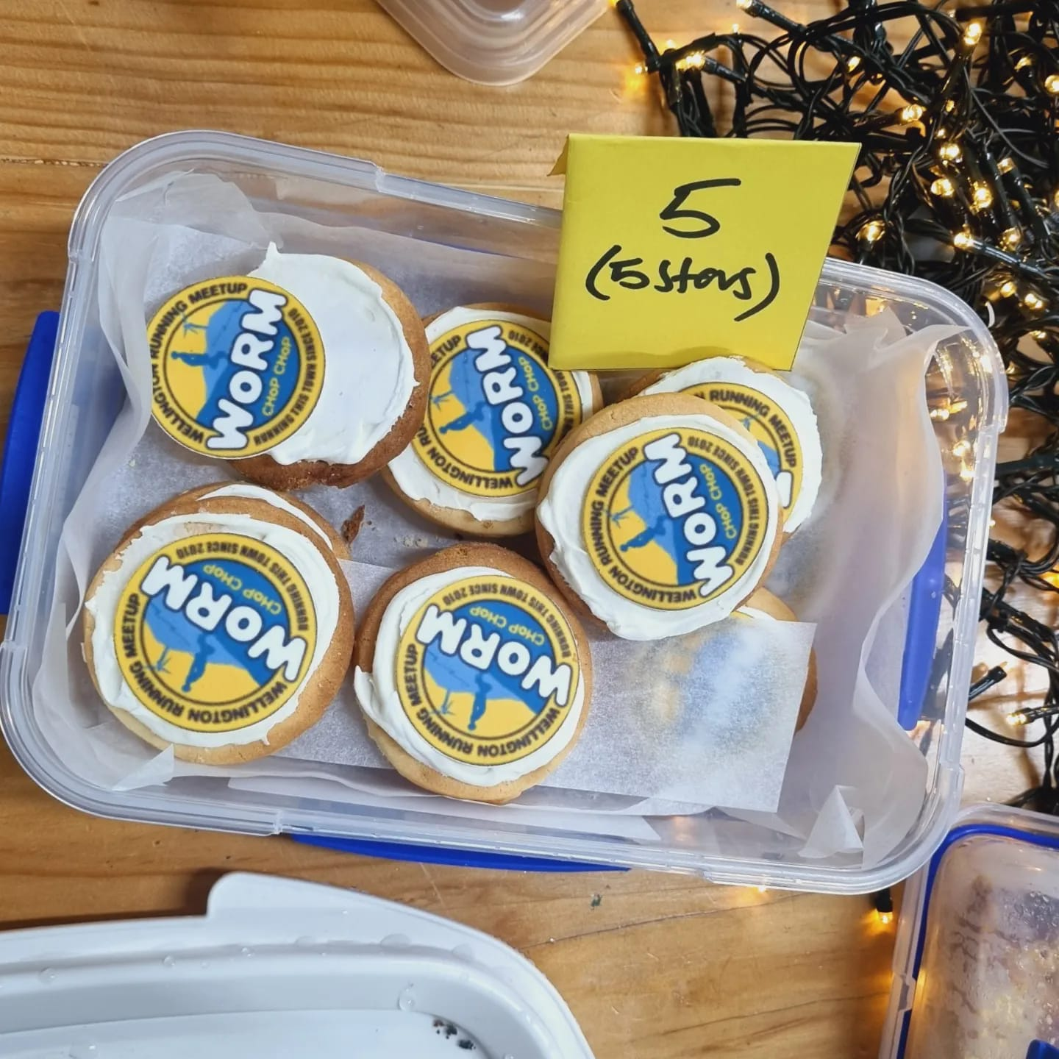

OTHER STUFF
WoRM Bake-off Competition
The bake-off is back this year! Bring your best dish and battle it out against other WoRMers for the esteemed prize of WoRM’s Greatest Baker! We have three categories this year: Overall winner, best WoRM theme, and best dietary requirement.
When you arrive on Friday, place your baking entry on the 'WoRM Bake-off' table in the Main Hall. Label it with the category, dietary info (i.e. vegan, gluten-free etc) and provide your name + details to Sarah Mackey.
Over the next day or two, people can sample your baking and place their vote for their favourites.
Voting closes on Saturday evening before dinner and winners will be announced that evening.
‘W’ themed costume party
Everyone loves a dress up party right?! Well, tough if you don't! The Saturday night party will be 'W' themed and there will be prizes for the best outfits. Get into the spirit and please, please, PLEASE do not come as a WoRMer LOL.
PRIZES!!!
There are a range of prizes on offer over the weekend. While we are still finalising these, here is an indication of what is on offer:
Run Pōneke sauna vouchers
Hospitality vouchers
Coffee, coffee, coffee!
Entry to UTMB*
*if available. Failing that, entry to
Tip Track Marathon.

Slide 11
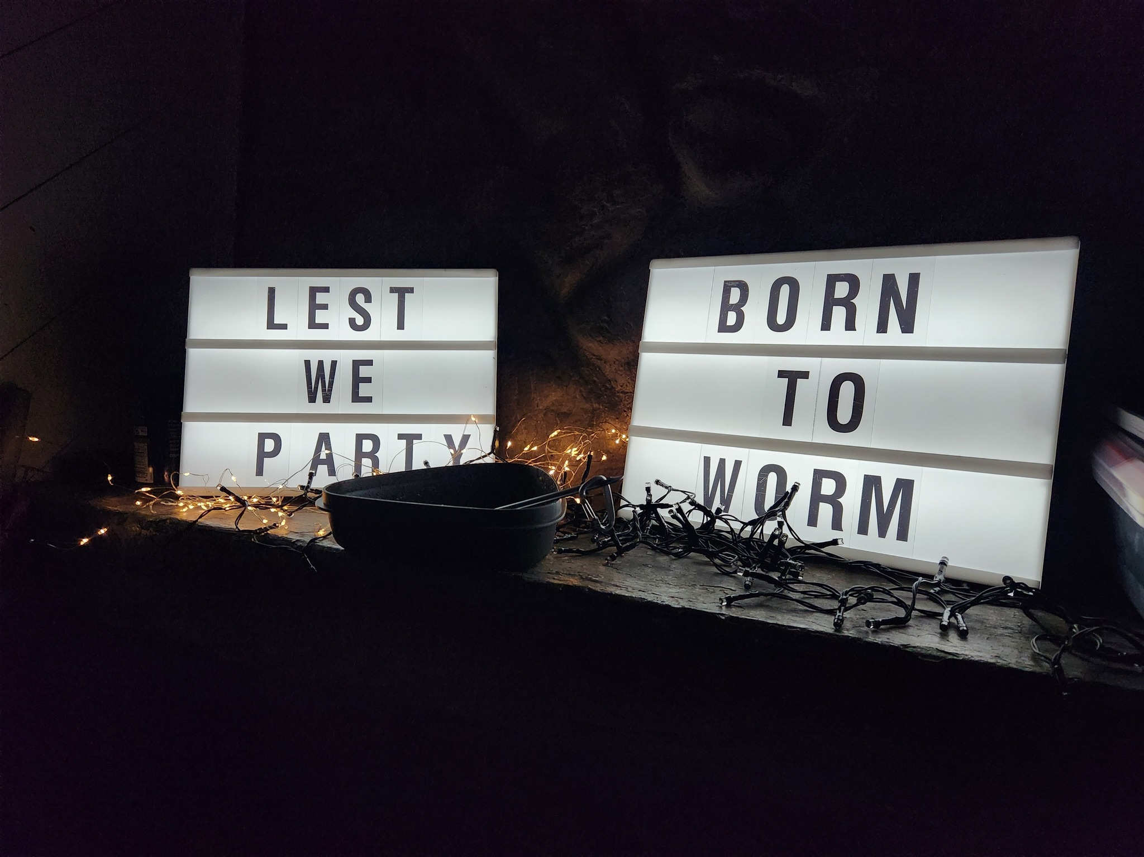
CAMP RULES

Slide 12
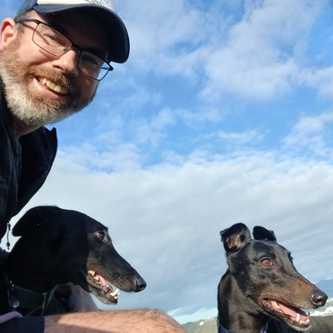
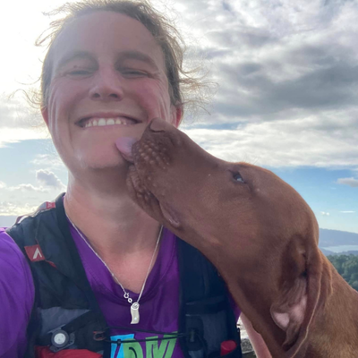
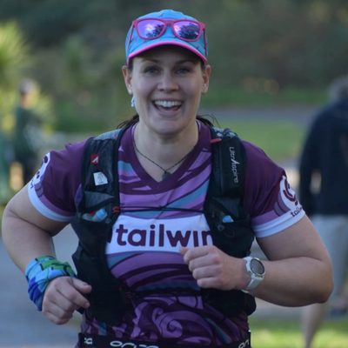
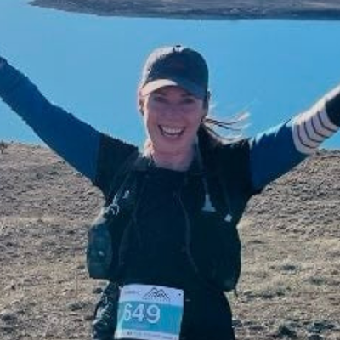
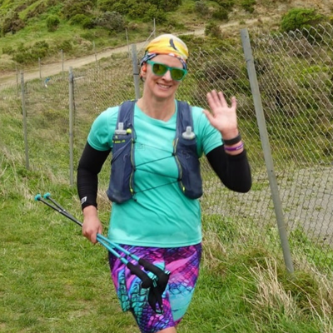
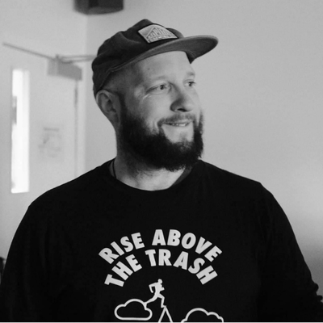
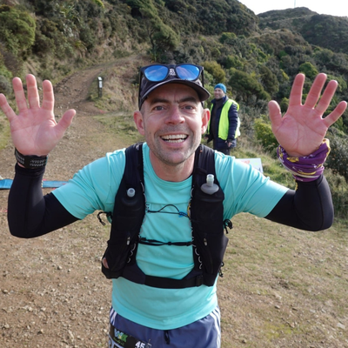
CAMP RULES
Meet your organising team
Brad Coleman
Chief Organiser and greyhound enthusiast. Constantly injured.
Natasha Furness
​Always running or cycling. Don't trust her when she says the group she's leading will be medium slow.
Heather McDonald
Has run further than most of us (Tarawera Miler). Use the code HEATHER at basically any website and receive a discount.
Sarah Mackey
​Usually found in the hills around Welly early morning. You'll hear her before you see her though.
4
Elspeth Knewstubb
WoRMer for over a decade! Claims the South Island is better yet hasn't lived there in years.
Dave Collett
​Owns the smallest dog in WoRM. Is potentially a penguin considering how often he is in Antarctica.
Neil Wilson
Entered the 70+ category recently but is still faster than most of us. Loves a pie.
All organisers are available throughout the weekend to help out and provide info.

Slide 13
CAMP RULES
Gear Checklist – what to bring
Food and snacks – Friday lunch and dinner, Saturday breakfast and lunch (dinner is provided) and Sunday breakfast. Plus snacks.
Drinks - all beverages you wish to consume over the weekend, including four cans for the Beer Mile (if participating)
Your own cutlery, bowl, plate, mug etc
Swimwear and towel
Sunscreen and insect repellent
Torch
Powerbank and phone charger
Sheets/pillow case/sleeping bag (mattress and pillow provided)
Yoga mat for stretching class
Costume for the W party
Your entry for the baking competition
Running gear
The following items are mandatory for the group runs – you will not be allowed to run without them:
Trail shoes / sandals
Waterproof jacket
Emergency blanket or bag
Thermal long sleeve top
Beanie or buff
Thermal gloves
First aid kit
Water/hydration in flasks
Food/nutrition
Sunscreen
Whistle

Slide 14
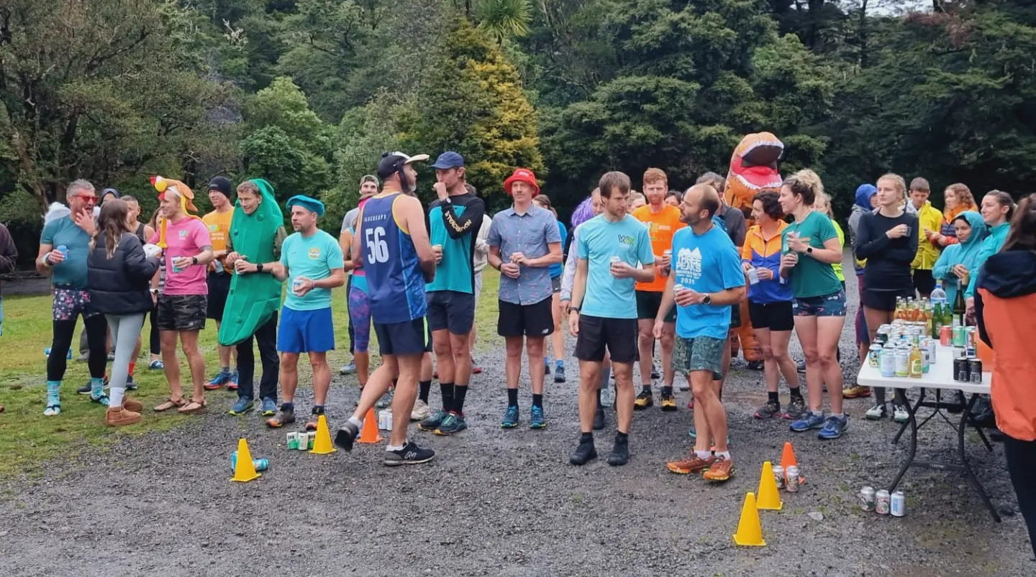
CAMP RULES
Q. Will there be cell reception?
Q. What are the rules for the Beer Mile?
It's patchy. The further into the camp you go the less reliable it is. But you should be able to get some reception over the weekend. Please note I am unsure how many power sockets there are in the lodges – so if you want to charge your phone then bring a powerbank to be sure.
The rules are typically that you drink a beer before running a 400m lap – and then repeat four times. The beer must be 5% or higher, 330ml and in an unopened can. However, we are not wanky on this. Participation is key and it is all about having fun. If beer isn't your thing, drink cider, or Coke. Or if all of this sounds horrible then drink seltzers. Or if drinking four drinks that quickly will make you collapse on the floor, then mix it up. It's all good!
Q. Can I bring my doggo?
Sadly, no. Under no circumstances are dogs allowed on the premises. These are the venue's rules :(
Q. How many bathrooms are there?
There are two unisex toilets and two unisex showers in each lodge. We will also have access to the Skip Turley block with another couple of toilets and showers – these are to be used by the campers.

Slide 15
CAMP RULES
Q. What night is the free dinner?
Q. Will there be any quieter spaces?
We will provide dinner on the Saturday night – catering for all dietary requirements. Every other meal or snack you will need to provide for yourself. There are kitchens in lodges 1 and 2 and a kitchen in the main hall. Please be mindful that there will be many people wanting to use the kitchen areas, so keep usage to reheating meals and do not spend half an hour cooking up a deluxe meal. 5-10 mins each only.
YES! After last year's rain-filled cram-fest, we have made sure to create some quiet spaces. These will be in the lounge / kitchen areas in lodges 1 and 2 and are available for everyone. Please be respectful of others using this space, but also recognise that these are 'quiet' spaces and not 'silent' spaces.
After 8pm each night, these two spots will become 'Chill Zones' that are a place to chill if you need to get away from the party / festivities. These spaces will be stocked with tea, coffee, and the occasional snack.
Q. How deep is that lagoon?
It's pretty shallow in parts. The end closest to the lodges does get a bit deeper – maybe 2m at a guess. It is sludgy underneath and if you step on something that feels like a wedding ring – pick it up and return to Scott Mellins.
We do ask that you refrain from using the lagoon when under the influence, for your own safety. If accompanied by a (sober) strong swimmer, then please let someone in the organising team know before you go (and when you return!).

Slide 16
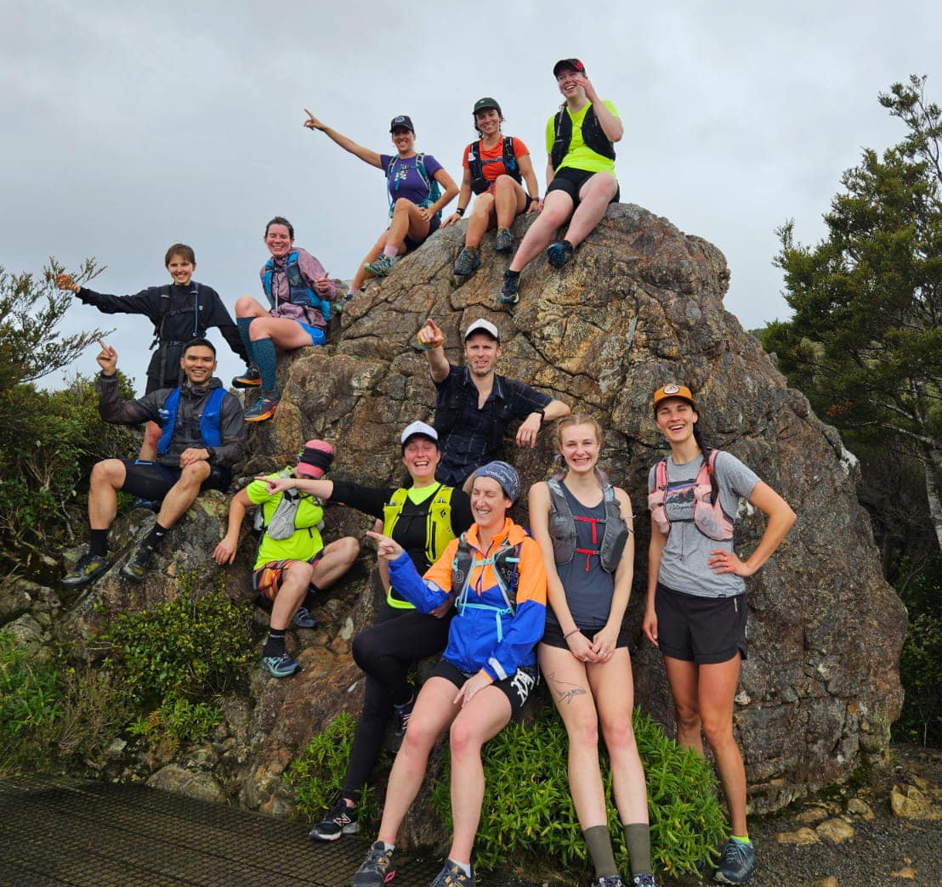
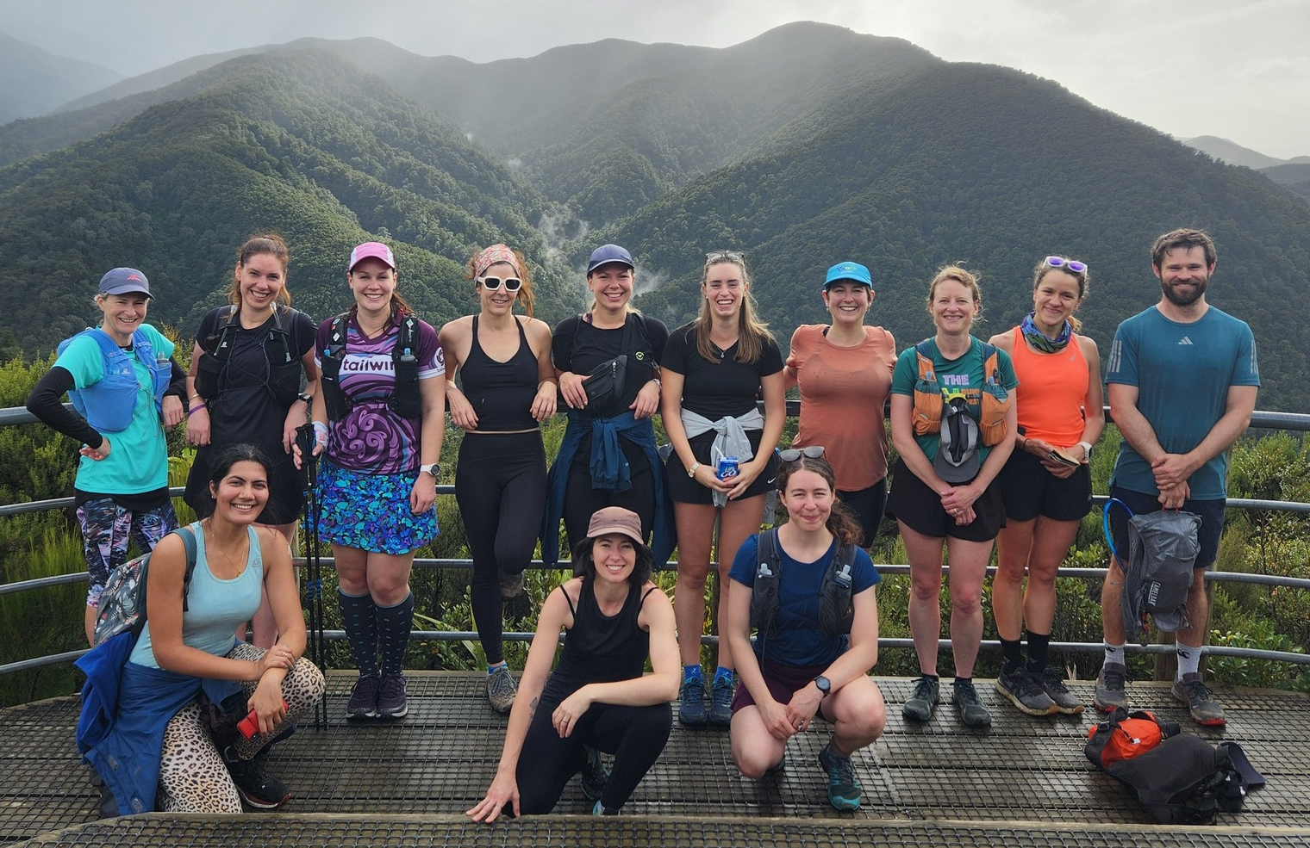
CAMP RULES
Q. How do I sign up for group runs?
TBA. But you will be able to sign up for the route/pace of your choice in the lead-up. Please be aware that, due to the number of people attending, there will be a cap on the group sizes – so signing up early will guarantee you a spot in your preferred group. You can change this at any time though!
You will also need to come prepared for a few hours in the Remutaka ranges. You will not be allowed to participate unless you have the following gear: trail shoes (or appropriate sandals), warm gear (thermals, beanie, gloves), emergency blanket, sun protection, whistle, water bottles, food, jacket in case of rain. It doesn't matter how fit or fast you are, a sprained ankle can easily happen and mean you are idle and in the bush for hours, or potentially overnight. We will also ensure that each group has at least one PLB with them.

Slide 17




CAMP RULES
Cleaning and recycling
Cleaning
Everyone is equally responsible for the cleanliness of the camp. While we have designated people making sure it all goes smoothly – if you see some rubbish, put it in the bin. If the bin is overflowing, empty it and replace the bag. If someone left water all over the bathroom floor, mop it up. You get the idea!
Recycling
There will be several bins available to deposit your recycling and rubbish. All bins will be labeled so please pay attention and place everything into the appropriate bin. All recycling will be taken to the nearest recycling facility, as needed.
Sustainability
We ask that you be mindful of the environment during your time at B2W. Reusable or biodegradable items are encouraged, as is carpooling or public transport. When out on the group runs, please keep to the main tracks to avoid disturbing wildlife and keep all rubbish with you, to be deposited back at camp.
Composting
A bin will be provided in the main hall kitchen to deposit any compost.

Slide 18
CAMP RULES
Code of Conduct
Respect and inclusivity
We expect all participants to show respect to each other, our hosts, the venue, nature, and themselves. This includes respecting personal boundaries and treating everyone with kindness and consideration.
2. No tolerance for inappropriate behaviour
Any behaviour that could be interpreted as creepy, aggressive, disrespectful, too forward, or repetitive is strictly prohibited. This includes unwanted advances, harassment, or any actions that make others feel uncomfortable, regardless of the intention.
3. Safety first
Follow all safety protocols set out by the organising team. These will be updated closer to the event and must be followed at all times.
4. Compliance with rules and regulations
Participants are required to follow all rules and regulations as outlined by the event organisers. These rules are in place to ensure the safety and enjoyment of everyone involved.
5. Responsible drinking
We encourage responsible drinking and remind you to be mindful of your alcohol (or any other substance) consumption. Any disruptive or unsafe behaviour resulting from this will not be tolerated.
6. Respect for the environment
As we will be enjoying the natural beauty of Wellington’s trails and Camp Wainui, it’s important that we leave no trace. Please dispose of any waste properly and avoid disturbing wildlife or damaging the environment.
7. Responsibility for damages
Participants are responsible for any damages or costs that may occur as a result of their actions during the event. This includes any damage to the venue, equipment, or property, as well as any costs incurred due to violations of the Code of Conduct or event rules.

Slide 19
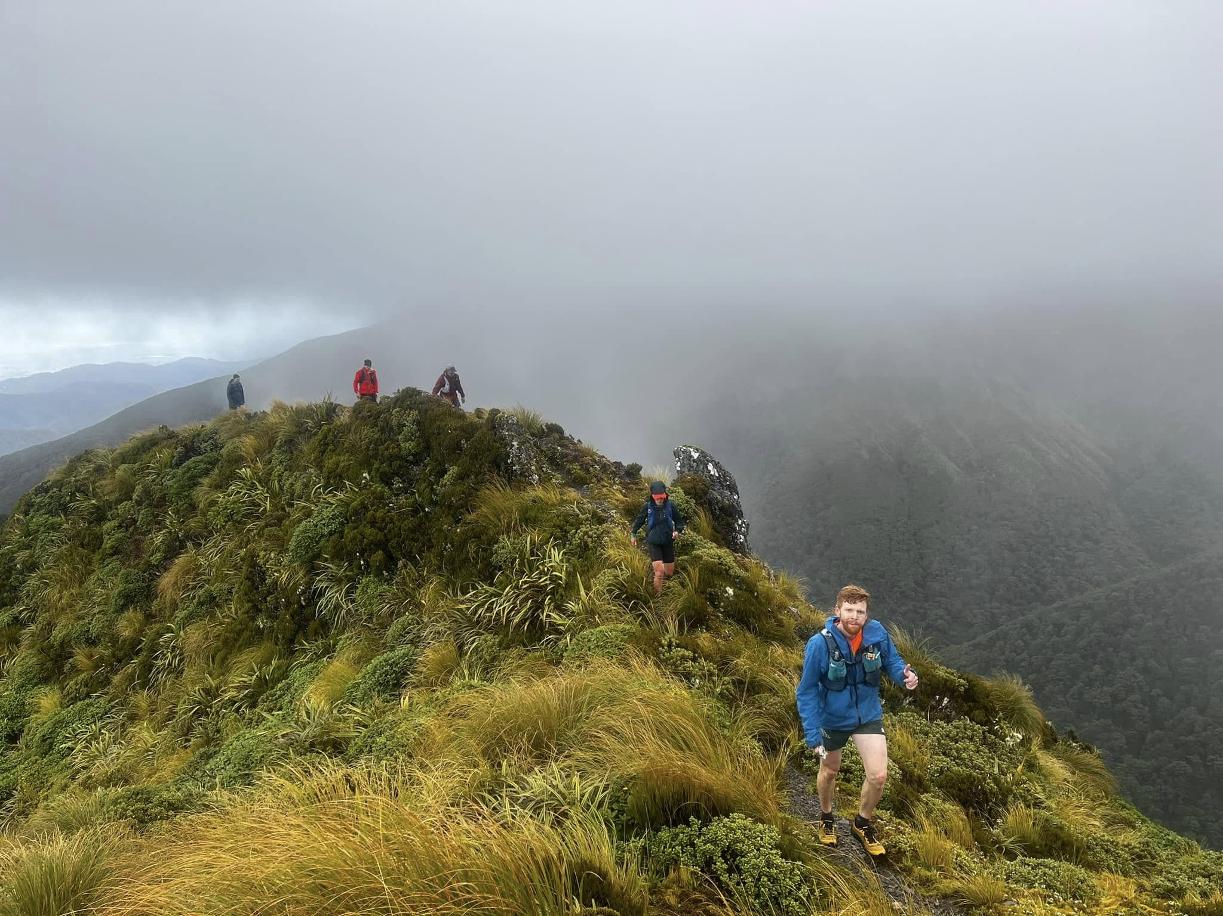
PHOTOS AND MAPS

Slide 20
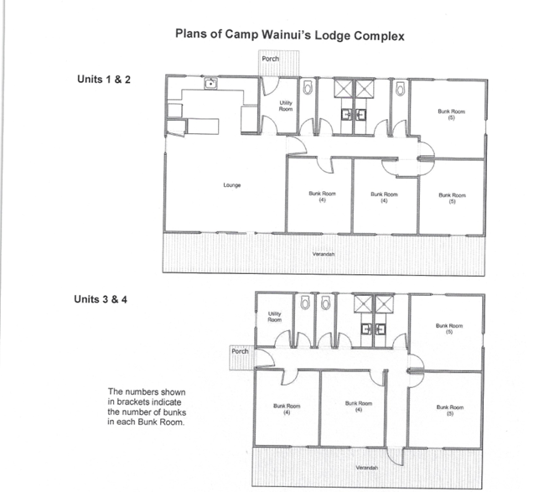
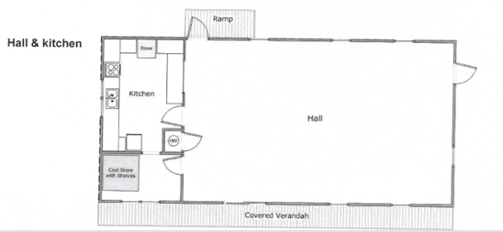
PHOTOS AND MAPS

Slide 21
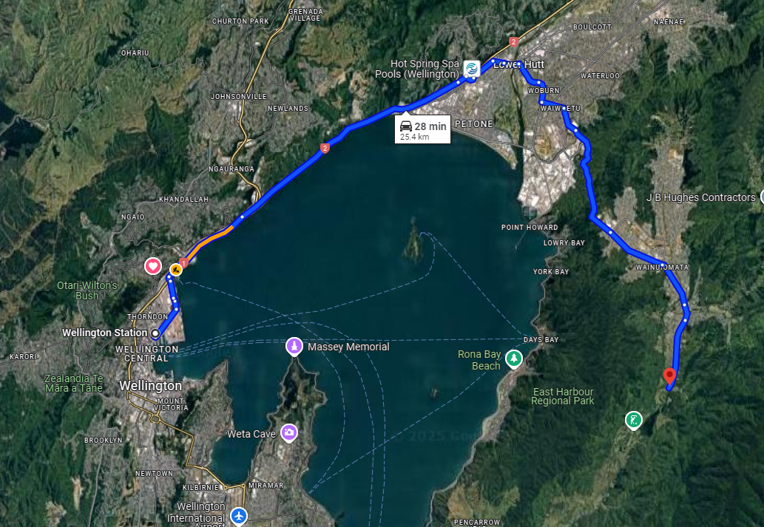
PHOTOS AND MAPS

Slide 22
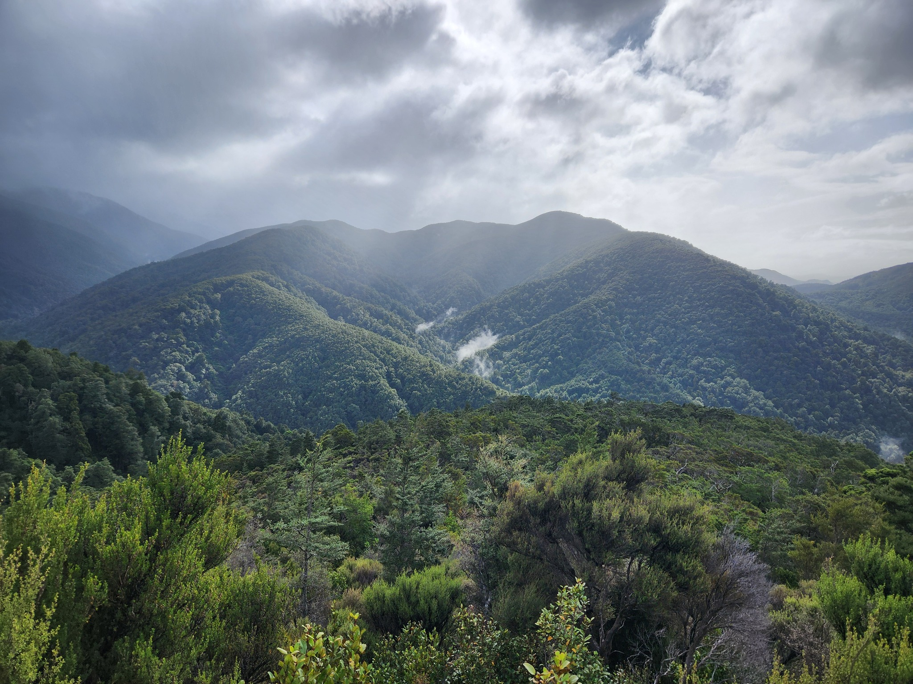
A final word from the organiser
I want to acknowledge how fortunate we are to secure this space. There is a considerable amount of room for us at Camp Wainui – it can sleep up to 120 people. It backs on to the Remutaka ranges, has a lagoon for swimming, is private, has bathroom facilities, a hall for our activities... in a word, it is PERFECT!
The only reason we have been able to land this space is due to WoRM being a community group and B2W being not-for-profit. But it is also due to the awesome people at Camp Wainui and the The Boys' Brigade Camp Wainui Trust – keeping spaces like this open and available for community groups to use.
Ideally, we will be able to keep using this space for future Born 2 WoRM events. Please keep this in mind during B2W and respect the space and the hosts by treating the grounds and facilities as if they were your own.
Brad

