Slide 1
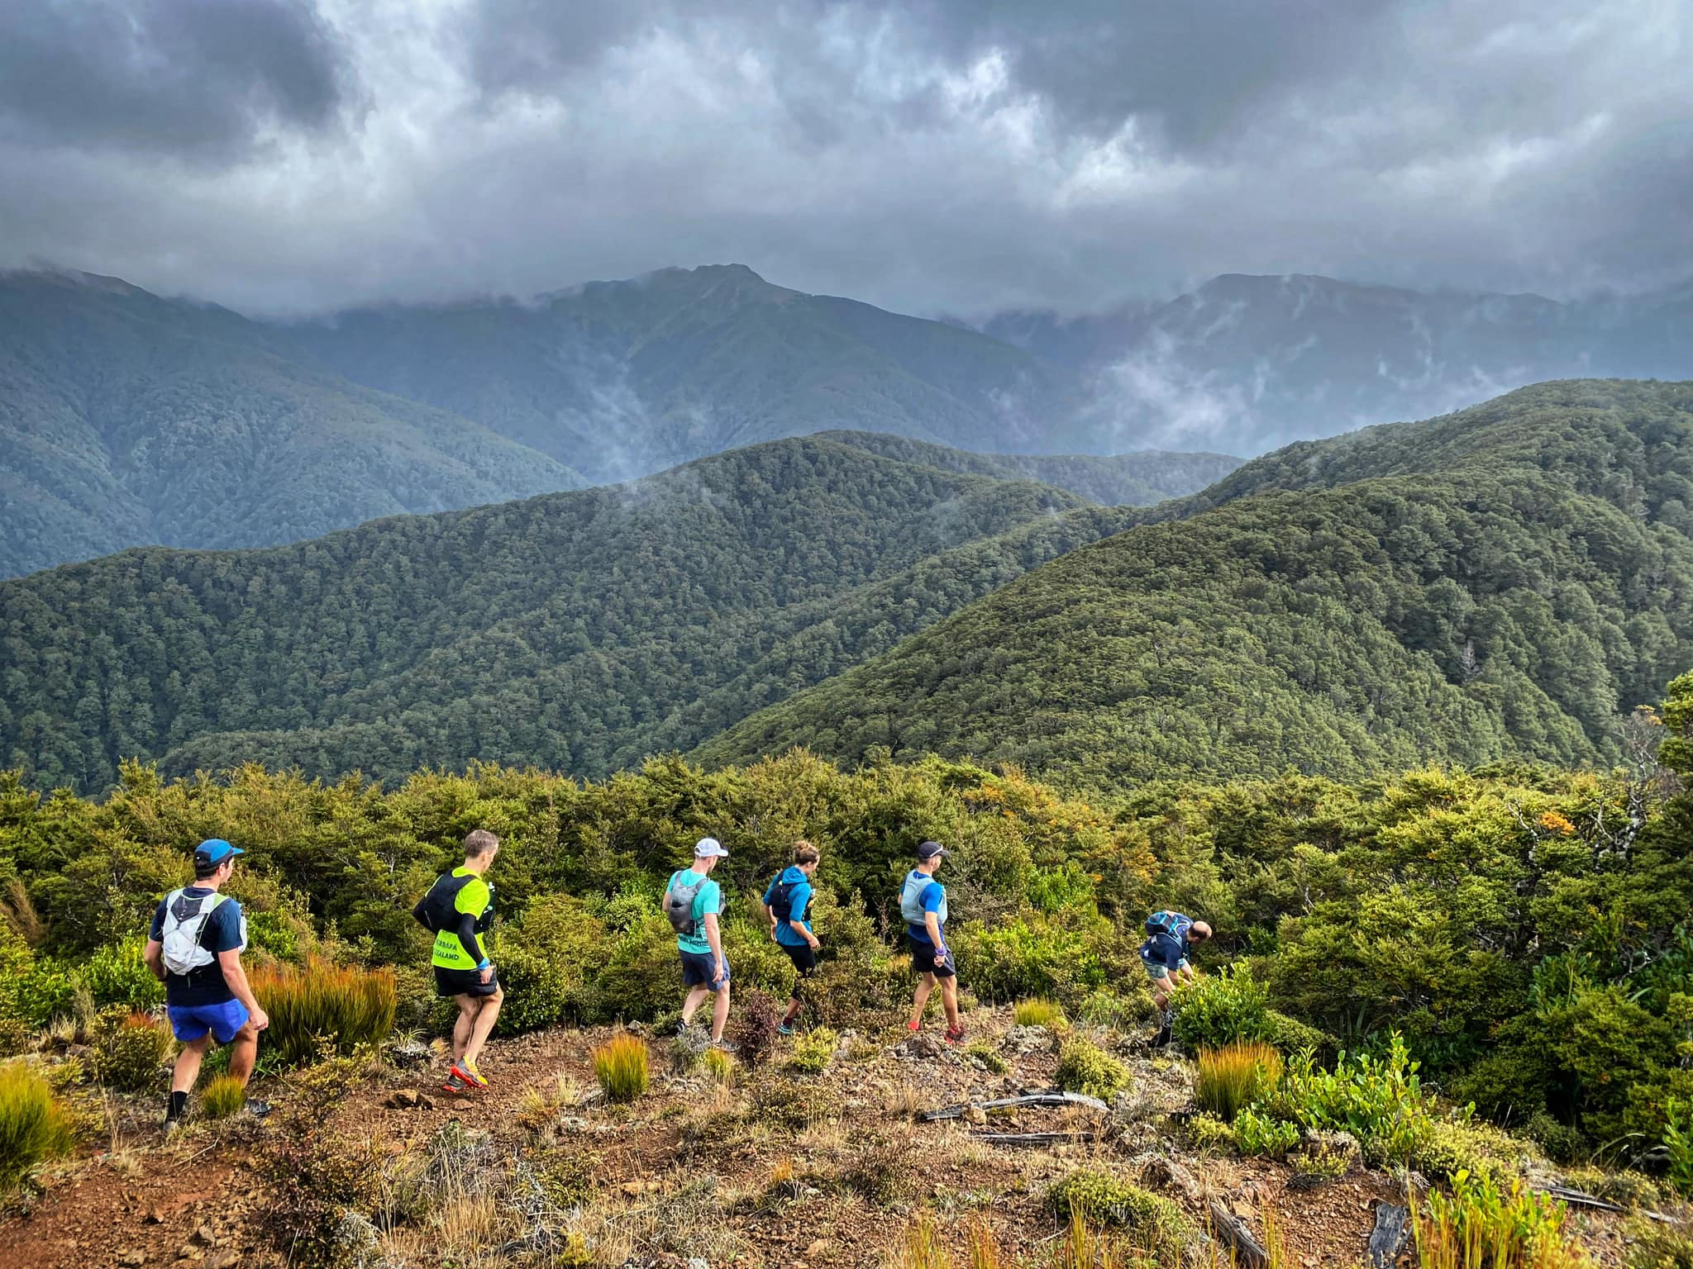

PROGRAMME

Slide 2
FRIDAY
Arrival from 12.30pm
2pm – Gear Swap
5pm – Manu / Dive Comp
Main Hall
Swap, sell or donate all your unwanted trail running gear. Bring along those pants that didn't quite fit you, or your old watch after your Xmas upgrade – and find yourself some new kit as well!
Lagoon
Grab a drink and head to the lagoon for a yarn or two. If you feel up for it, enter the dive comp and do your best manu into the lagoon.
3pm – Run Pōneke
7.30pm – WoRM Awards
Main Hall
Join Will Cass as he showcases the brand new running hub on the Wellington waterfront. Featuring a recovery centre, breakfast bar, lockers, breakout spaces and much more – Run Pōneke is the coolest thing to hit our capital since the recent southerlies.
Main Hall
Did you do something incredible this year? No? Then did you do something stupid? Well, you may be up for an award! Join your host Neil as he presents awards for the best (and worst) achievements this past year.
4pm – Rogaine or Darts
8.30pm – Movie Night
Lagoon (rogaine) or Main Hall (darts)
Break the ice with your choice of fun activity! Let Tash and Dave send you off on an adventure (in teams) or throw a 180 with Sam from Drowning Prevention Darts.
Main Hall
Grab a chair, some popcorn, and a bevvie and enjoy a selection of trail running documentaries!

Slide 3
SATURDAY
8am – Group Runs
5:30pm – Beer Mile
Meet in the Carpark
A range of distances and paces available. You'll have the chance to sign up to your preferred route in the week prior – sign up details to come. Group runs will start in nearby Catchpool Valley and we’ll coordinate rides there and back.
TBC
Four drinks. Four laps. It's the perfect event for the imperfect athlete. Not a beer fan? All good – just get something fizzy and participate. Assemble 10 minutes before the start for a briefing.
3pm – Sleep Optimisation Talk
6:30pm – Dinner
Main Hall
Join Kate Sprecher sorry, DOCTOR Kate Sprecher as she facilitates a workshop on sleep optimisation for runners. Featuring a segment on how to survive an overnight ultra for you crazies out there. Make sure you get back, showered and fed from your runs in time for this one.
Main Hall
We've got you (and your dietary requirements) covered for a fantastic meal!
8.30pm – PARTY TIME!
Main Hall
Get into your 'W' costume and join in the hall for the party to end all parties! We've even got Wellington legends Hoot N Annies kicking us off, before DJ WoRM (aka you) takes over with the playlist you contributed to here (song selection at bottom of form).
4pm – Lawn Games
Grassy Area outside hall
A time to chill. Grab a drink and join for some music and lawn activities – or just chill on the lawn and watch. Featuring Kubb, backyard cricket and more!

Slide 4
SUNDAY
9am – Stretching class
11am – Clean up
Under the Pine Trees
Join Amanda in the woods (not as scary as it sounds) for a runner-focused stretching session. Ease out the aches and pains from the previous couple of days, surrounded by the chirps of our native birds.
Note: about 100m from the carpark is a set of pine trees – join here (or meet at the carpark at 8.55am to walk over).
Everywhere
Please respect our hosts (and the organisers) by making sure the facilities and grounds are spotless. If you are leaving early, please contribute to the clean up before you go.
12pm – Exit ☹
10am – Bush walk
Anywhere but Camp Wainui
We have to be out by midday. Don't be sad it is over, be happy it happened.
Meet in the Carpark
Now that you are loosened up – meet at the carpark to go for a guided bush walk. Some tracks will be flat, some steep, so choose wisely. A chill way to read some of the DOC signs around and see what natural flora and fauna is on display.

Slide 5



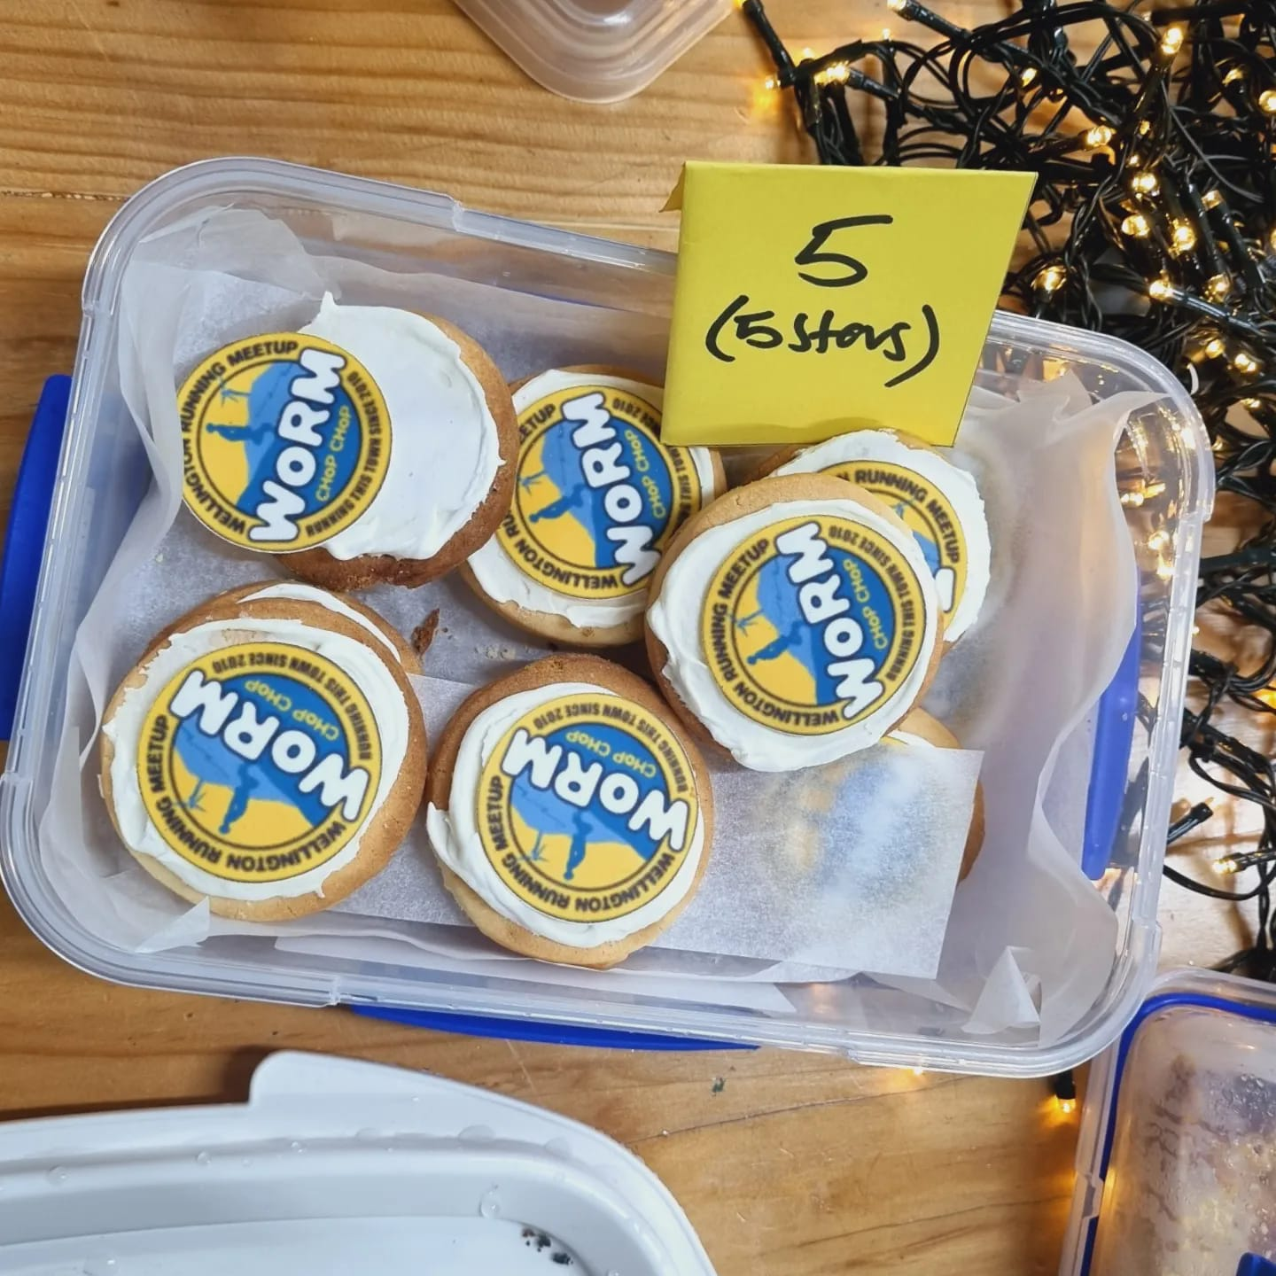

OTHER STUFF
WoRM Bake-off Competition
The bake-off is back this year! Bring your best dish and battle it out against other WoRMers for the esteemed prize of WoRM’s Greatest Baker! We have three categories this year: Overall winner, best WoRM theme, and best dietary requirement.
When you arrive on Friday, place your baking entry on the 'WoRM Bake-off' table in the Main Hall. Label it with the category, dietary info (i.e. vegan, gluten-free etc) and provide your name + details to Sarah Mackey.
Over the next day or two, people can sample your baking and place their vote for their favourites.
Voting closes on Saturday evening before dinner and winners will be announced that evening.
‘W’ themed costume party
Everyone loves a dress up party right?! Well, tough if you don't! The Saturday night party will be 'W' themed and there will be prizes for the best outfits. Get into the spirit and please, please, PLEASE do not come as a WoRMer LOL.
PRIZES!!!
There are a range of prizes on offer over the weekend. While we are still finalising these, here is an indication of what is on offer:
Run Pōneke sauna vouchers
Hospitality vouchers
Coffee, coffee, coffee!
Entry to UTMB*
*if available. Failing that, entry to
Tip Track Marathon.

