Slide 1
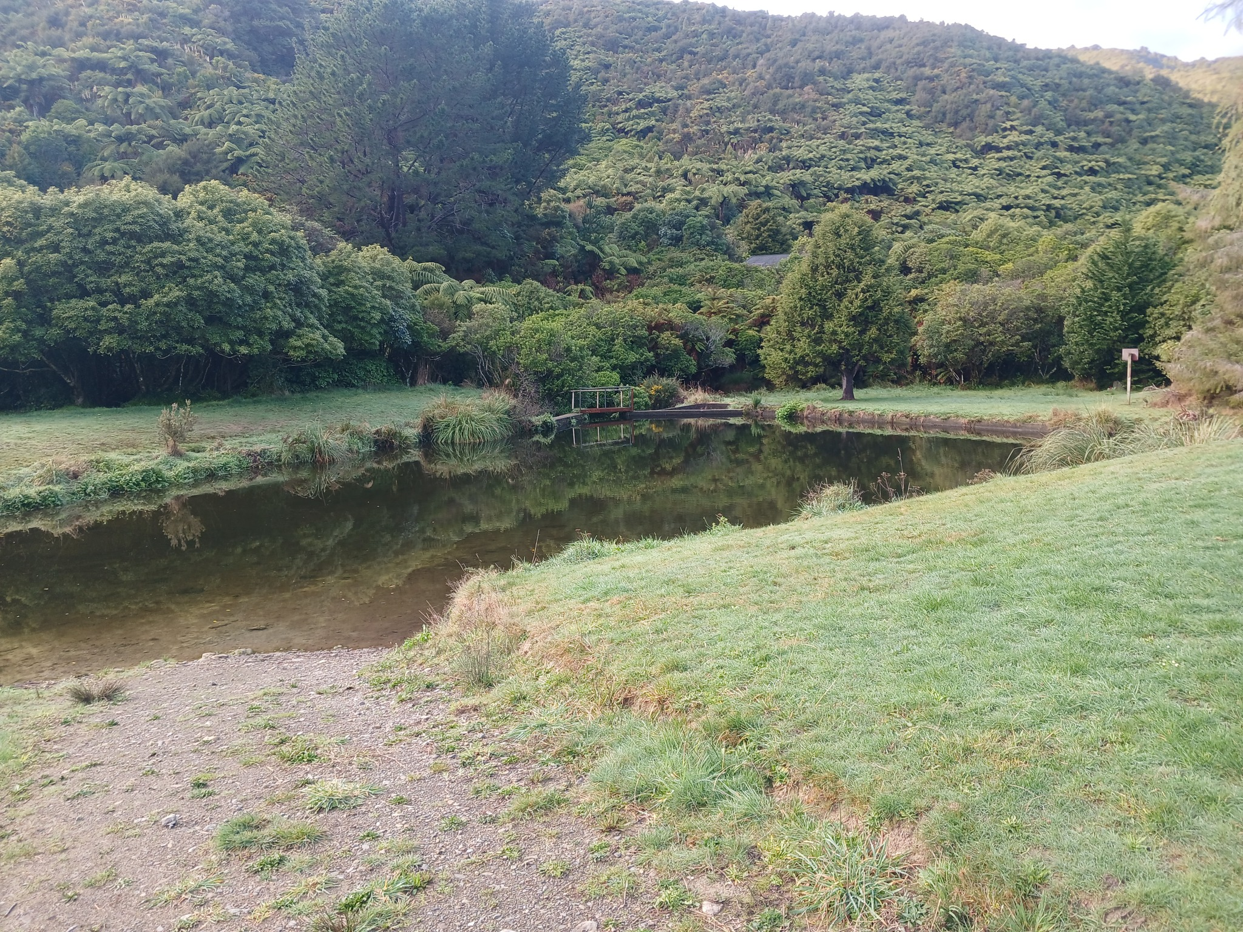

LOCATION

Slide 2
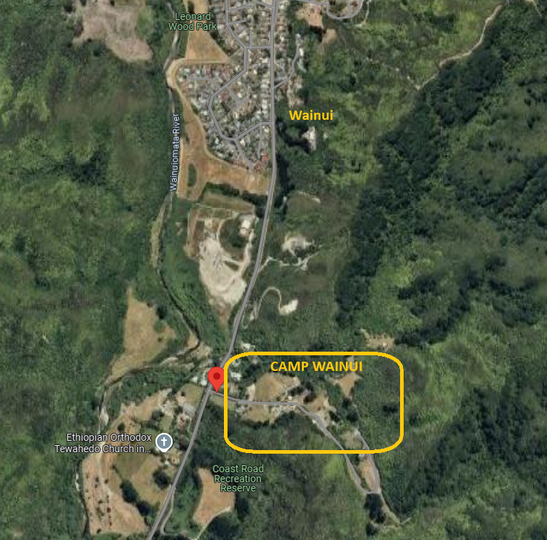
LOCATION
Q. Where the hell is this place?
The address is 203 Coast Rd, Wainuiomata (30mins from Wellington). Basically, head over the Wainui hill and stick to the main road. You'll eventually veer right on to Coast Rd – follow this for a few kms and you'll see a sign for Camp Wainui on the left. Drive right in – past the lagoon and cross a small bridge before looping around to the car park.
Q. Will there be carpooling?
YES! A week or two before B2W we will post a sheet on the Facebook page to organise carpooling. I'll email it too for non-Facebookers.
If you need a ride, or can offer a ride, then coordinate through this.

Slide 3
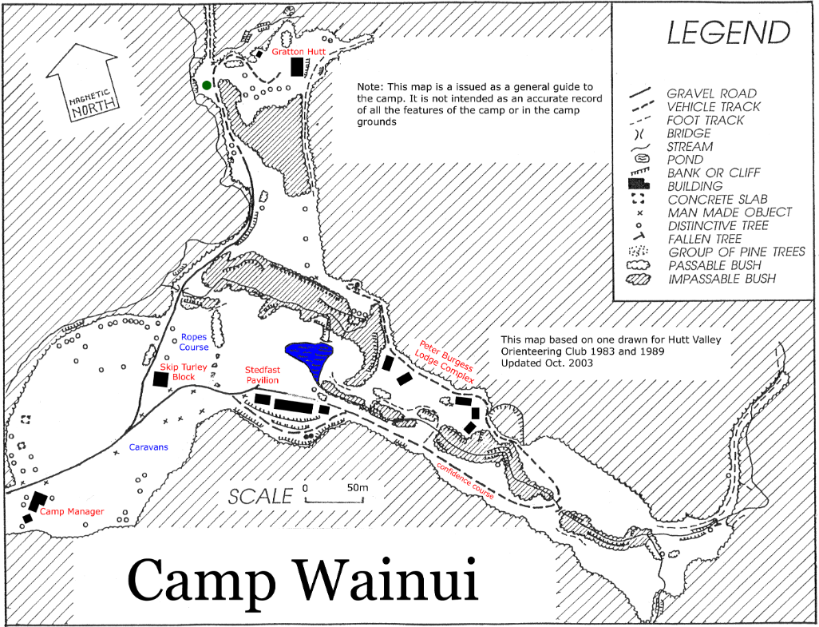
LOCATION
Q. What facilities are available at Camp Wainui?
There are lodges for sleeping, tent sites, grassy areas, picnic tables, a hall, kitchen areas, bathrooms, a lagoon for swimming, a river, and bush tracks.
Q. Is there food available to buy?
NO. There is nothing available at Camp Wainui to purchase. However, there are shops, restaurants, supermarkets etc a short drive away in Wainuiomata if you need to top up. Don't forget that dinner will be provided on Saturday – but all other meals and snacks you will need to provide.

Slide 4
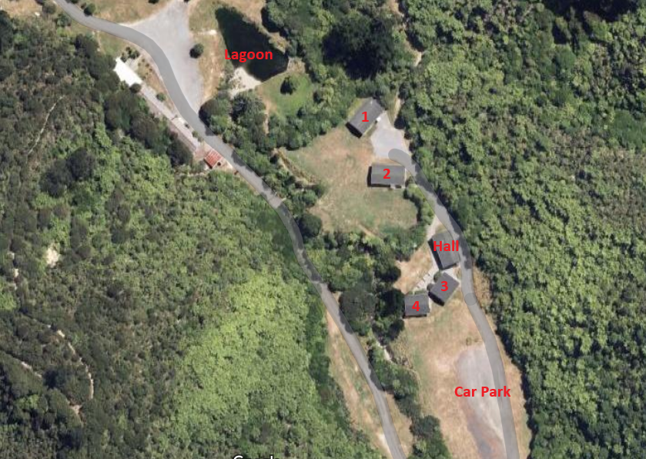
LOCATION
Q. Where do I sleep?
If you are in a lodge, you will be designated a lodge number and a room number. Remember this, because it will make finding your room much easier. Each lodge has four dorms that can sleep 18 people, two toilets, two showers, plus a utility room. Two of the four lodges also have a kitchen and living area (these will be available for all people, not just the people in those lodges).
If you are camping, then you will be directed to your campsite on arrival (please don't randomly decide your camping spot).
If you want to bunk with your besties, fill in this form and we can make sure your group gets a dorm together.

Slide 5
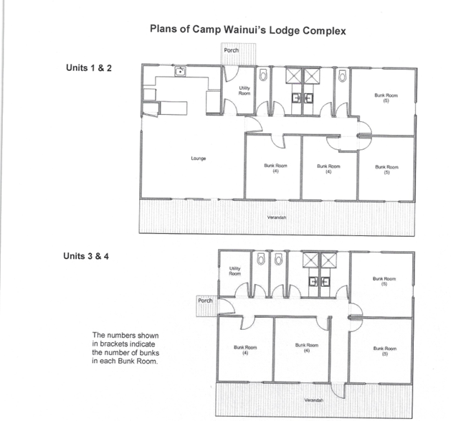
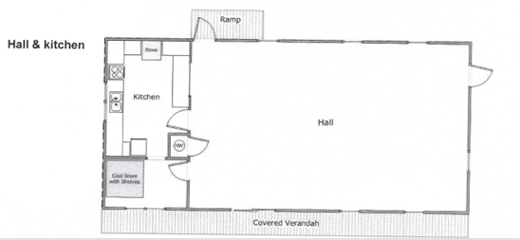
PHOTOS AND MAPS

Slide 6
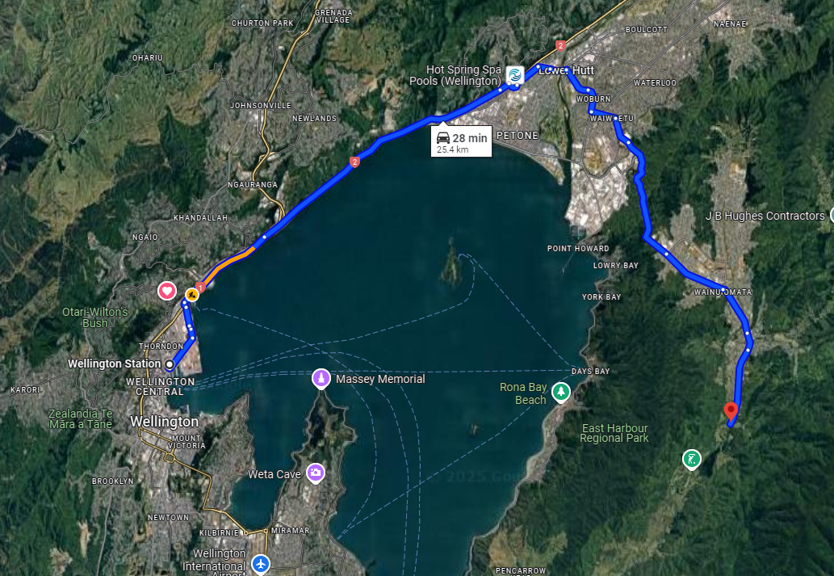
PHOTOS AND MAPS

