Slide 1

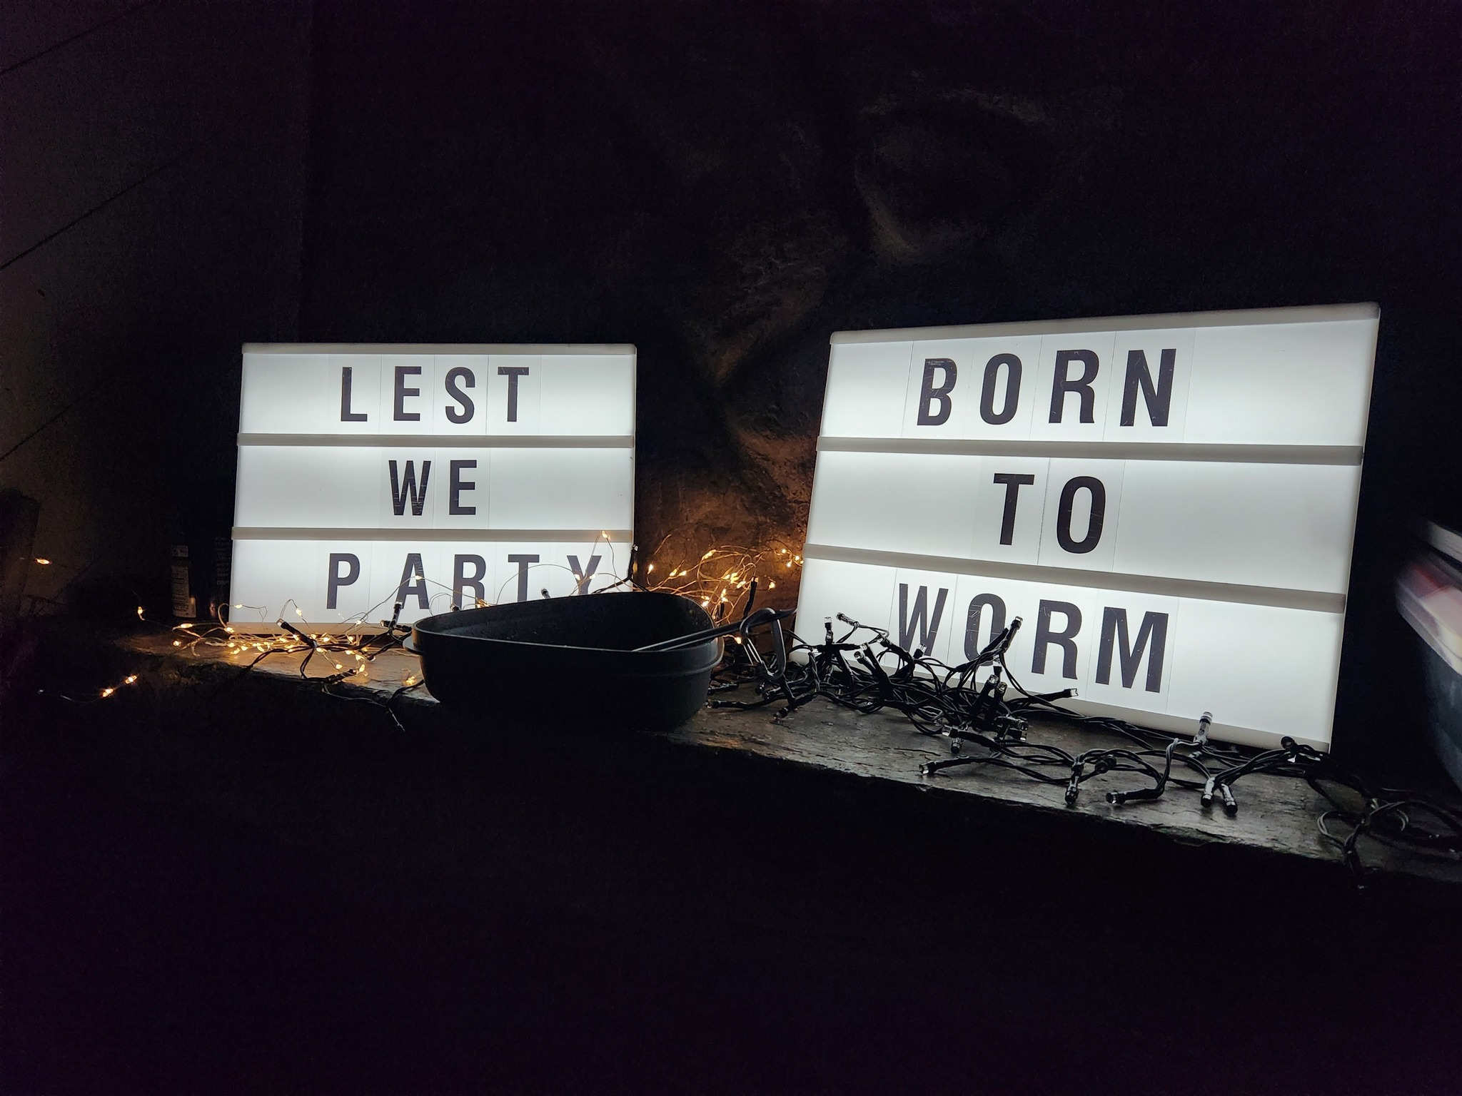
CAMP RULES

Slide 2
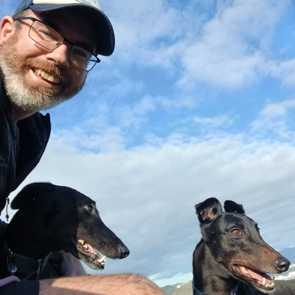
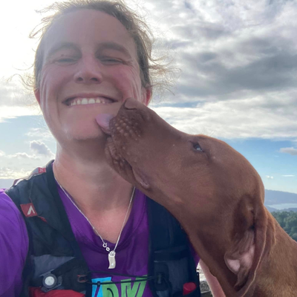
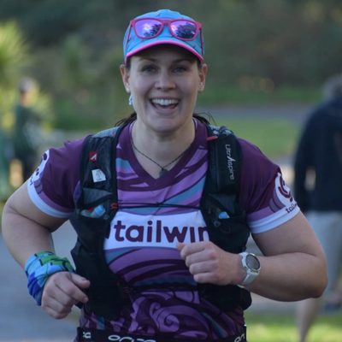
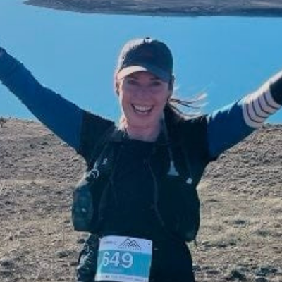
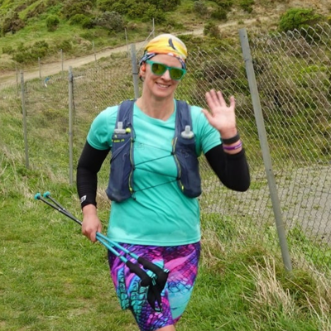
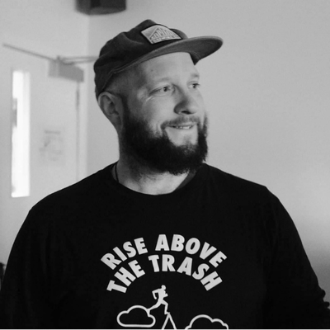
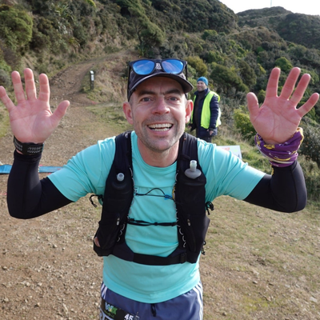
CAMP RULES
Meet your organising team
Brad Coleman
Chief Organiser and greyhound enthusiast. Constantly injured.
Natasha Furness
​Always running or cycling. Don't trust her when she says the group she's leading will be medium slow.
Heather McDonald
Has run further than most of us (Tarawera Miler). Use the code HEATHER at basically any website and receive a discount.
Sarah Mackey
​Usually found in the hills around Welly early morning. You'll hear her before you see her though.
4
Elspeth Knewstubb
WoRMer for over a decade! Claims the South Island is better yet hasn't lived there in years.
Dave Collett
​Owns the smallest dog in WoRM. Is potentially a penguin considering how often he is in Antarctica.
Neil Wilson
Entered the 70+ category recently but is still faster than most of us. Loves a pie.
All organisers are available throughout the weekend to help out and provide info.

Slide 3
CAMP RULES
Gear Checklist – what to bring
Food and snacks – Friday lunch and dinner, Saturday breakfast and lunch (dinner is provided) and Sunday breakfast. Plus snacks.
Drinks - all beverages you wish to consume over the weekend, including four cans for the Beer Mile (if participating)
Your own cutlery, bowl, plate, mug etc
Swimwear and towel
Sunscreen and insect repellent
Torch
Powerbank and phone charger
Sheets/pillow case/sleeping bag (mattress and pillow provided)
Yoga mat for stretching class
Costume for the W party
Your entry for the baking competition
Running gear
The following items are mandatory for the group runs – you will not be allowed to run without them:
Trail shoes / sandals
Waterproof jacket
Emergency blanket or bag
Thermal long sleeve top
Beanie or buff
Thermal gloves
First aid kit
Water/hydration in flasks
Food/nutrition
Sunscreen
Whistle

Slide 4
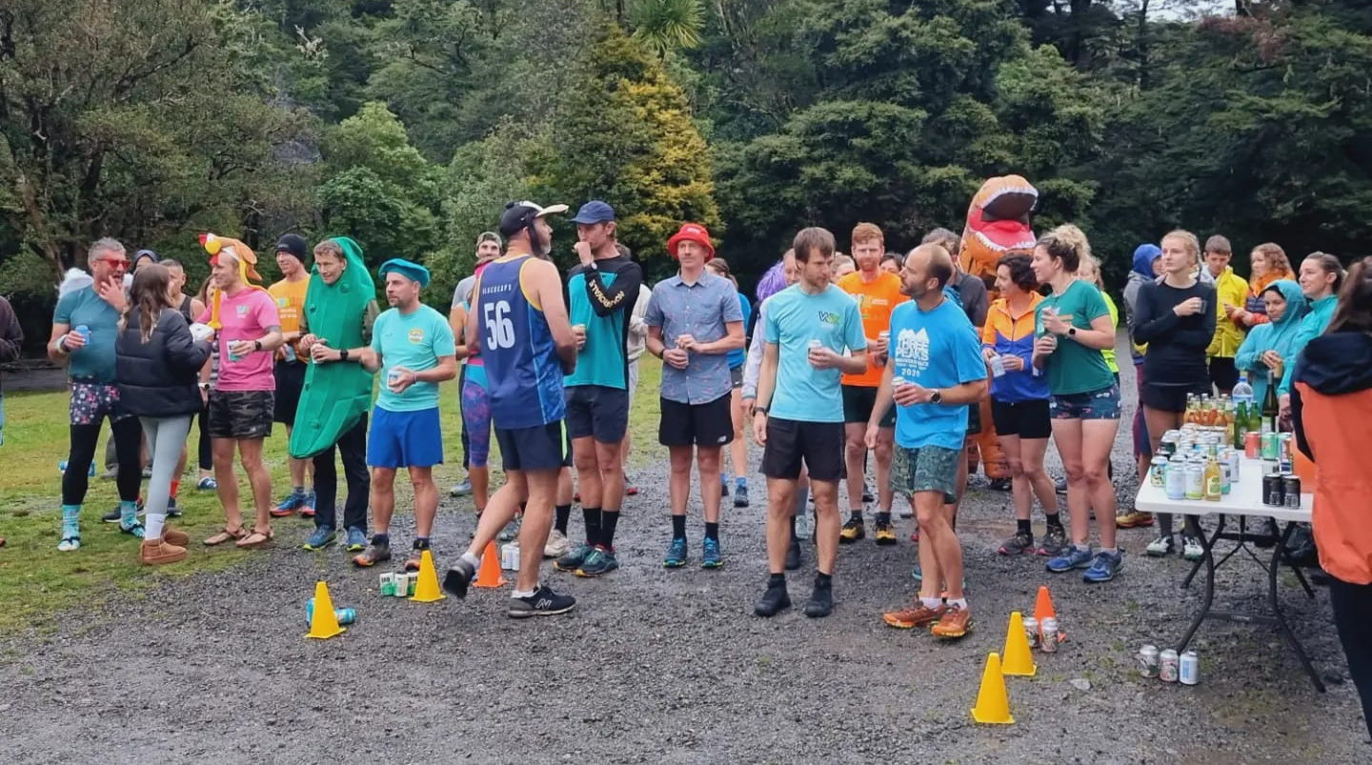
CAMP RULES
Q. Will there be cell reception?
Q. What are the rules for the Beer Mile?
It's patchy. The further into the camp you go the less reliable it is. But you should be able to get some reception over the weekend. Please note I am unsure how many power sockets there are in the lodges – so if you want to charge your phone then bring a powerbank to be sure.
The rules are typically that you drink a beer before running a 400m lap – and then repeat four times. The beer must be 5% or higher, 330ml and in an unopened can. However, we are not wanky on this. Participation is key and it is all about having fun. If beer isn't your thing, drink cider, or Coke. Or if all of this sounds horrible then drink seltzers. Or if drinking four drinks that quickly will make you collapse on the floor, then mix it up. It's all good!
Q. Can I bring my doggo?
Sadly, no. Under no circumstances are dogs allowed on the premises. These are the venue's rules :(
Q. How many bathrooms are there?
There are two unisex toilets and two unisex showers in each lodge. We will also have access to the Skip Turley block with another couple of toilets and showers – these are to be used by the campers.

Slide 5
CAMP RULES
Q. What night is the free dinner?
Q. Will there be any quieter spaces?
We will provide dinner on the Saturday night – catering for all dietary requirements. Every other meal or snack you will need to provide for yourself. There are kitchens in lodges 1 and 2 and a kitchen in the main hall. Please be mindful that there will be many people wanting to use the kitchen areas, so keep usage to reheating meals and do not spend half an hour cooking up a deluxe meal. 5-10 mins each only.
YES! After last year's rain-filled cram-fest, we have made sure to create some quiet spaces. These will be in the lounge / kitchen areas in lodges 1 and 2 and are available for everyone. Please be respectful of others using this space, but also recognise that these are 'quiet' spaces and not 'silent' spaces.
After 8pm each night, these two spots will become 'Chill Zones' that are a place to chill if you need to get away from the party / festivities. These spaces will be stocked with tea, coffee, and the occasional snack.
Q. How deep is that lagoon?
It's pretty shallow in parts. The end closest to the lodges does get a bit deeper – maybe 2m at a guess. It is sludgy underneath and if you step on something that feels like a wedding ring – pick it up and return to Scott Mellins.
We do ask that you refrain from using the lagoon when under the influence, for your own safety. If accompanied by a (sober) strong swimmer, then please let someone in the organising team know before you go (and when you return!).

Slide 6
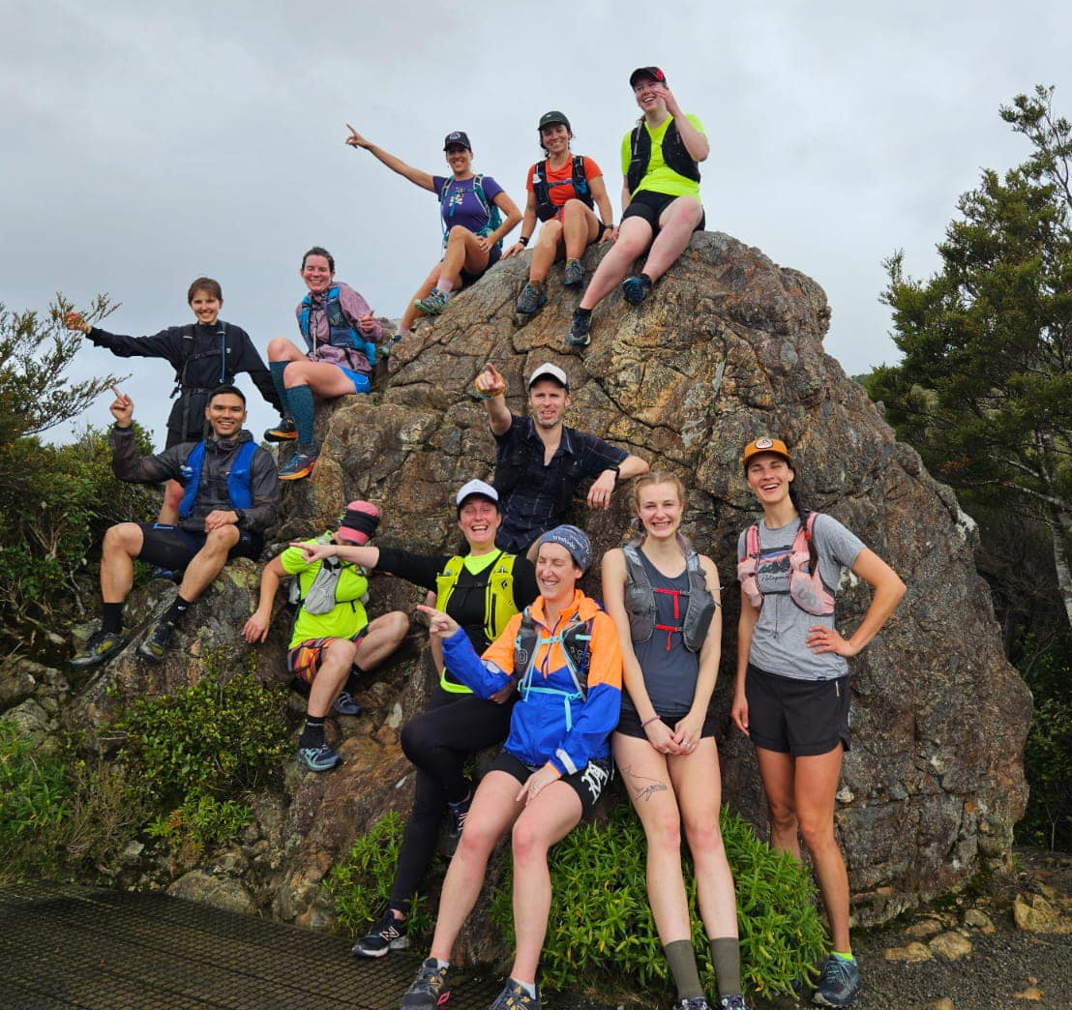
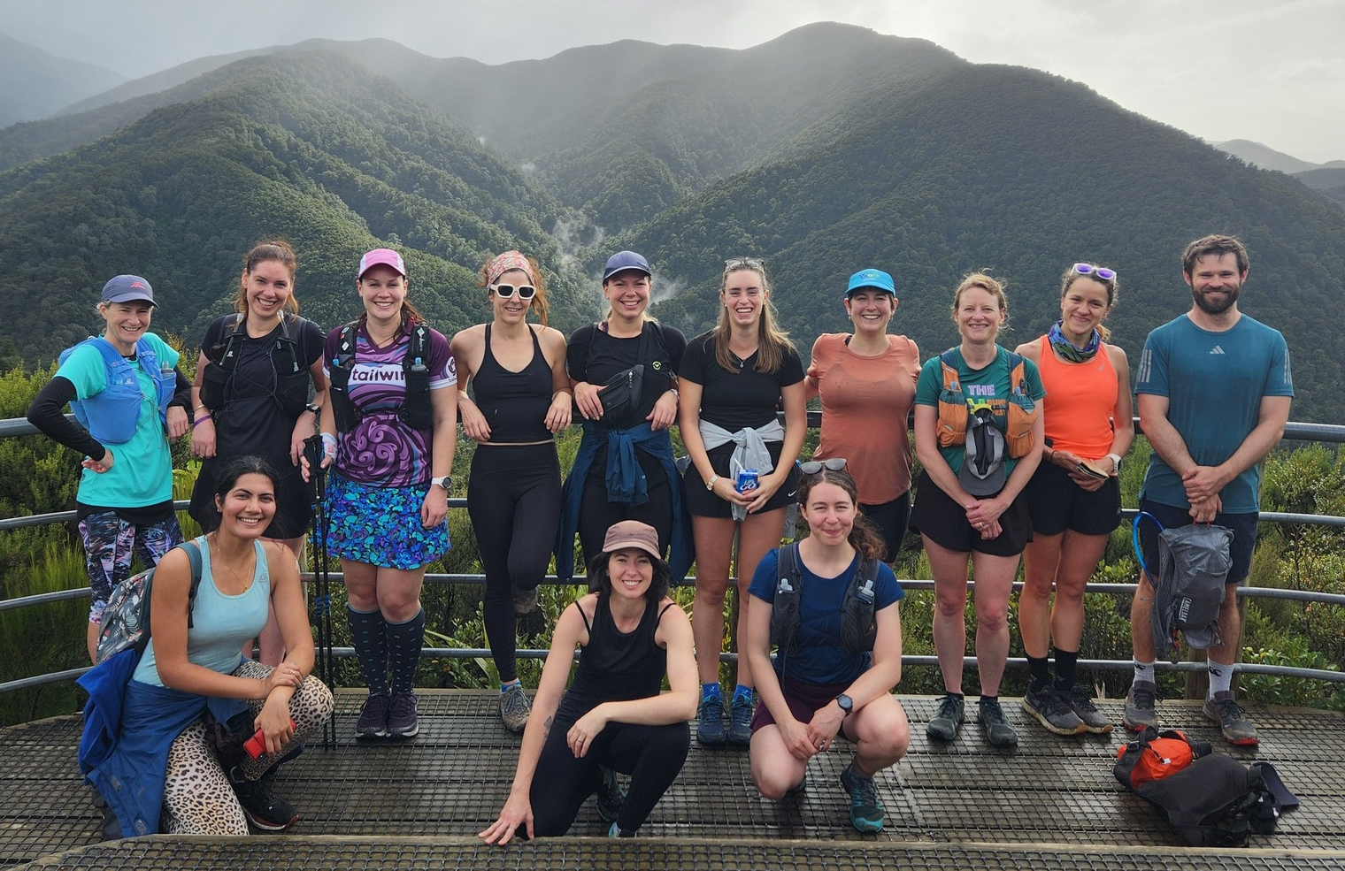
CAMP RULES
Q. How do I sign up for group runs?
TBA. But you will be able to sign up for the route/pace of your choice in the lead-up. Please be aware that, due to the number of people attending, there will be a cap on the group sizes – so signing up early will guarantee you a spot in your preferred group. You can change this at any time though!
You will also need to come prepared for a few hours in the Remutaka ranges. You will not be allowed to participate unless you have the following gear: trail shoes (or appropriate sandals), warm gear (thermals, beanie, gloves), emergency blanket, sun protection, whistle, water bottles, food, jacket in case of rain. It doesn't matter how fit or fast you are, a sprained ankle can easily happen and mean you are idle and in the bush for hours, or potentially overnight. We will also ensure that each group has at least one PLB with them.

Slide 7




CAMP RULES
Cleaning and recycling
Cleaning
Everyone is equally responsible for the cleanliness of the camp. While we have designated people making sure it all goes smoothly – if you see some rubbish, put it in the bin. If the bin is overflowing, empty it and replace the bag. If someone left water all over the bathroom floor, mop it up. You get the idea!
Recycling
There will be several bins available to deposit your recycling and rubbish. All bins will be labeled so please pay attention and place everything into the appropriate bin. All recycling will be taken to the nearest recycling facility, as needed.
Sustainability
We ask that you be mindful of the environment during your time at B2W. Reusable or biodegradable items are encouraged, as is carpooling or public transport. When out on the group runs, please keep to the main tracks to avoid disturbing wildlife and keep all rubbish with you, to be deposited back at camp.
Composting
A bin will be provided in the main hall kitchen to deposit any compost.

Slide 8
CAMP RULES
Code of Conduct
Respect and inclusivity
We expect all participants to show respect to each other, our hosts, the venue, nature, and themselves. This includes respecting personal boundaries and treating everyone with kindness and consideration.
2. No tolerance for inappropriate behaviour
Any behaviour that could be interpreted as creepy, aggressive, disrespectful, too forward, or repetitive is strictly prohibited. This includes unwanted advances, harassment, or any actions that make others feel uncomfortable, regardless of the intention.
3. Safety first
Follow all safety protocols set out by the organising team. These will be updated closer to the event and must be followed at all times.
4. Compliance with rules and regulations
Participants are required to follow all rules and regulations as outlined by the event organisers. These rules are in place to ensure the safety and enjoyment of everyone involved.
5. Responsible drinking
We encourage responsible drinking and remind you to be mindful of your alcohol (or any other substance) consumption. Any disruptive or unsafe behaviour resulting from this will not be tolerated.
6. Respect for the environment
As we will be enjoying the natural beauty of Wellington’s trails and Camp Wainui, it’s important that we leave no trace. Please dispose of any waste properly and avoid disturbing wildlife or damaging the environment.
7. Responsibility for damages
Participants are responsible for any damages or costs that may occur as a result of their actions during the event. This includes any damage to the venue, equipment, or property, as well as any costs incurred due to violations of the Code of Conduct or event rules.

