Slide 1

DOCUMENT CONTROL PAGE
Document ID | SCG/PSPPPT/115/1.0
Security Classification | Confidential
Date Issued | 30-Jul-2025
Version | 1.0
Project Name | NA
Author | AJ KHAN
VERSION HISTORY / CHANGE HISTORY
Version | Date Issued | Issued to | Comments
0.1 | 30-Jul-2025 |  | Issued for internal review
1.0 | 30-Jul-2025 |  | Final version

Slide 2
Physical Security Policy

Slide 3
1. Physical Security? What's in your mind?
2. Area Classification
3. Office Structure
4. Security Guards
5. Physical Access Controls
6. Monitoring [CCTV]
7. Fire Detection and prevention Mechanism
8. HVAC [Heating, Ventilation, and Air Conditioning]
9. Bank Negara Requirements for Physical Security
10. Top Physical Security Risks
11. Related Policies
12. Discussion

Slide 4
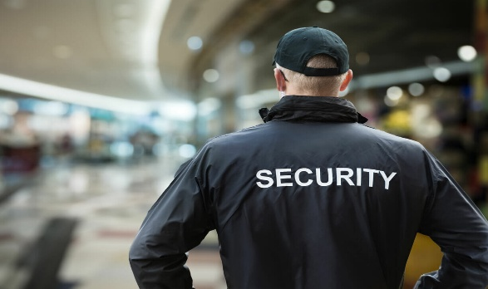
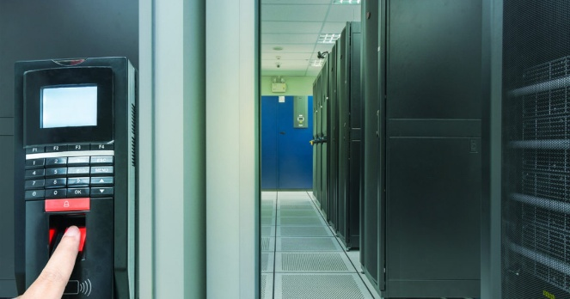
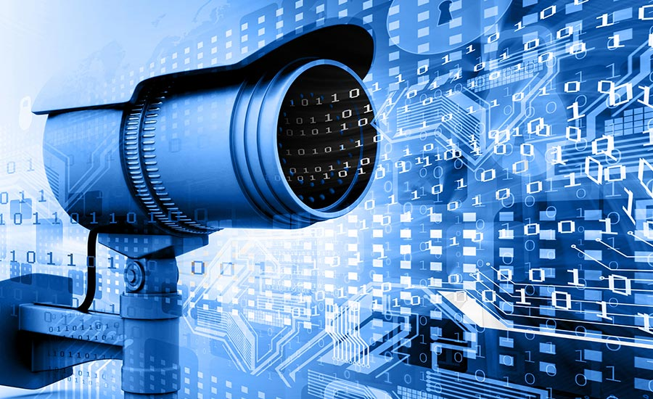
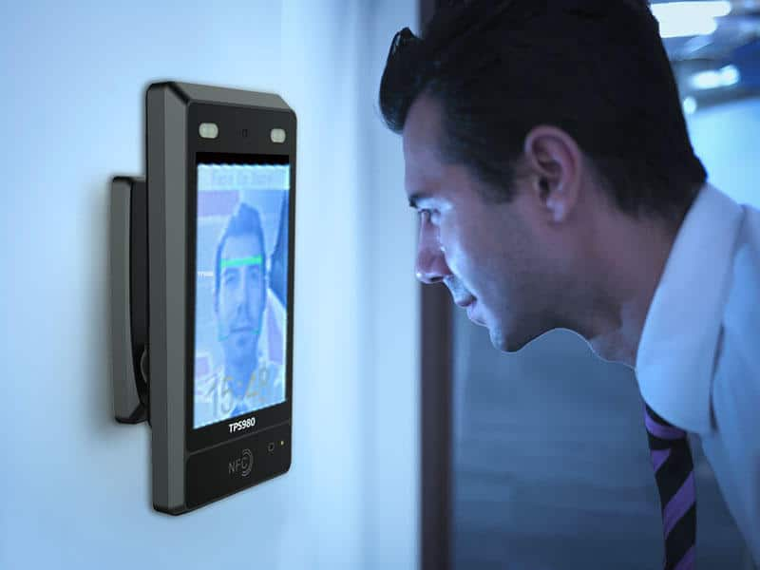
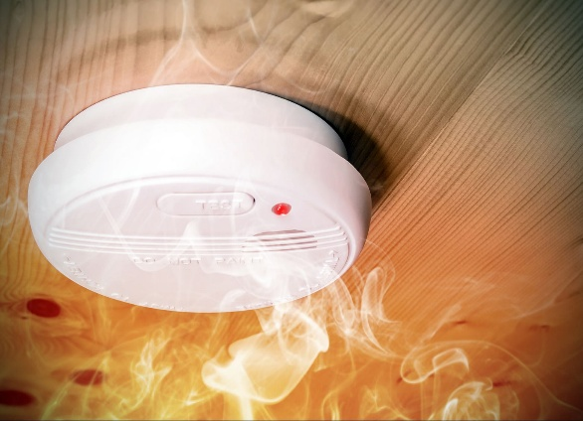
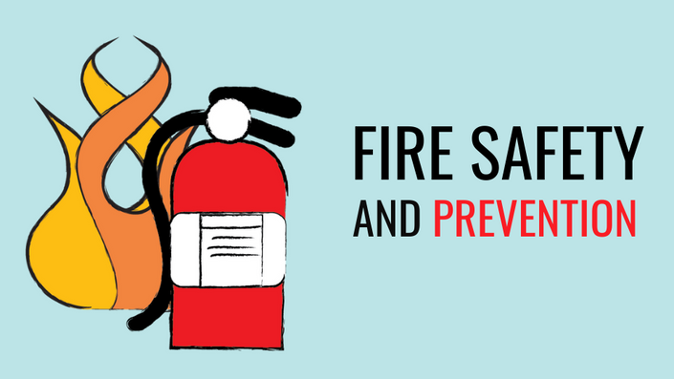
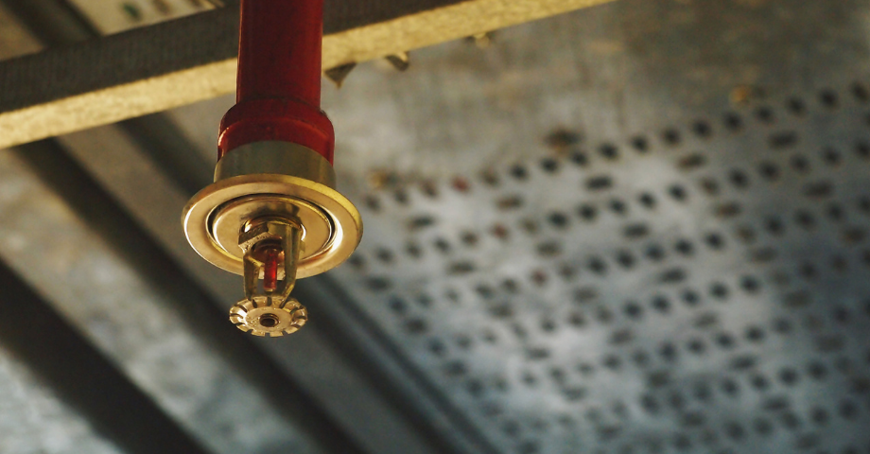
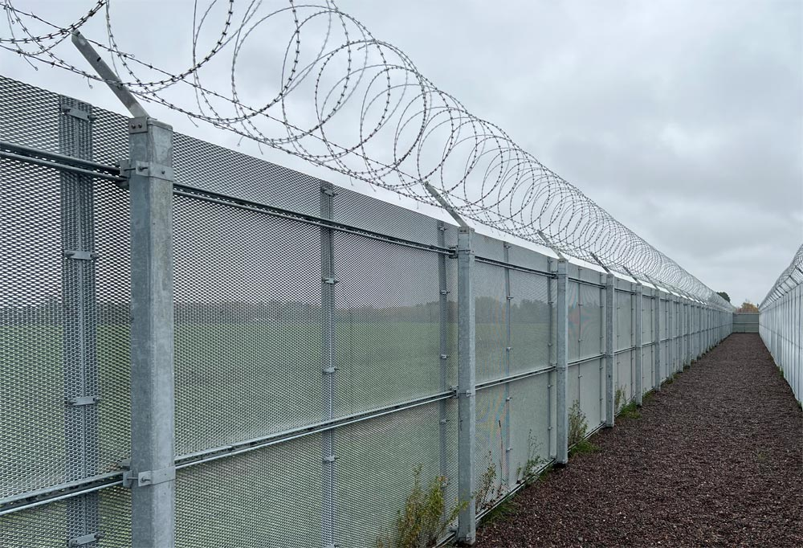
1. List down the items that comes to your mind with respect to Physical Security
Security Guards
Physical Access to buildings / Company Area [Building/Premise Area where you need Access]
Physical Access to Lockers , safes , Premise Areas
CCTV for Premise monitoring
Fire Detection and prevention Mechanism
HVAC

Slide 5
2. Area Classification
The first thing you do is Classify Physical area , Areas can be broadly classified in 4 Types:
1) Public Areas / Common Areas [Reception , Parking, Cafeteria , Sports section / Play area, Public gathering rooms, Safe Assembly Areas etc.][Company Employees + Other Company Employees + Common Public]
2) Private Areas [Only Employees can access / All Employees have access as per their roles and responsibilities : e.g. Meeting Rooms , Office Cubicle]
3) Protected Areas / Highly Sensitive Areas [Only Few Employees can access] [Secure Access Rooms / Server Rooms / Critical Areas / Restricted Areas]
[Above 3 Physical Areas are applicable for Companies having physical office at some Location]
4) Remote Work / Employee working from Remote location / Shared Office Space / Co Working Space
This area is applicable for Companies allowing remote work to their staff

Slide 6
2. Area Classification [Continued]
Remote Work / Employee working from Remote location / Shared Office Space / Co Working Space
Remote Location Could be a
Home
Co Working Space / Shared Office Space
Hotel / Coffee Shops
any other Remote Location
Company Does NOT have any Physical premise and all Sensitive data / Assets are taken care by Cloud Service Providers[CSP] e.g. Company have all their Servers hosted on Azure Cloud , Employees Work from Home / Remote and access these servers , hence Physical security would be majorly taken care
by CSP [Physical Security of its Datacenter where Company assets are hosted]
To access these servers , Company have 2 Options
1) Company provide Laptops / Desktops to their Employees , This Laptop is fully managed by Company IT team [They control this Laptop , Before providing this Laptop to Employee , Company IT team would apply Security Baseline configuration , Ensure Antivirus is working , Employees Don't have Admin access to install any software and then provide Laptop to its Employees]

Slide 7
2. Area Classification [Continued]
2) Company allows Employees to use their own Personal Laptop and then connect to a Secure machine using software's / browsers. Here all Company data would be inside this secure machine.
[e.g.. Taking care of the devices from which they are Connecting to this CSP , here Company can make use of VDIs / fully managed Desktop-as-a-Service (DaaS) [e.g. AWS Workspace , Azure Virtual Desktop , Citrix DaaS]
Some of the Physical security would be responsibility of Employee/IT Staff e.g. Ensuring they always keep their Devices Safe from Physical Theft , Enabling BitLocker , Remote Wipe in case of Device is Stolen , Ensuring to Lock the Screen , Ensuring NOT to connect USB[Pen Drives] on Company devices [Company can share a policy [Remote Work Policy]to maintain Remote Work security for such requirements where Employee have to sign it and share back to HR]
A Clean Desk Policy would ensure Employee does NOT damage Physical devices [e.g. Not eating / drinking or placing any items near to Laptop that can damage it]

Slide 8
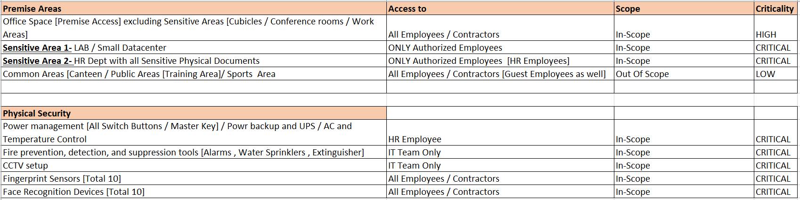
2. Area Classification [Continued]
Now we have already listed Physical areas for SOC2 scope as below
Security Controls would be applied as per Physical Area Classification
e.g. We DON’T need CCTV footage retention for 90 days for Common Areas , But we would need to keep CCTV footage for 90 days for all CRITICAL/HIGH Physical Areas

Slide 9
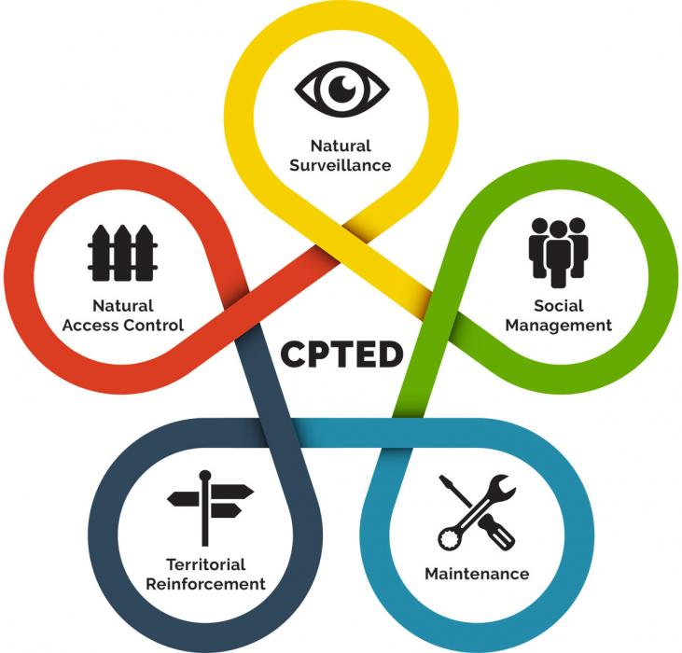
3. Office/Building Structure
Building/Premise structural design SHOULD follow CPTED [Crime Prevention Through Environmental Design]
CPTED principles can be applied to create safer, more secure, and productive work environments for employees and visitors
Core Principles of CPTED
https://www.apta.com/wp-content/uploads/Standards_Documents/APTA-SS-SIS-RP-007-10.pdf
https://www.researchgate.net/figure/Examples-of-places-most-in-need-of-intervention-following-CPTED-principles_tbl1_320547175

Slide 10
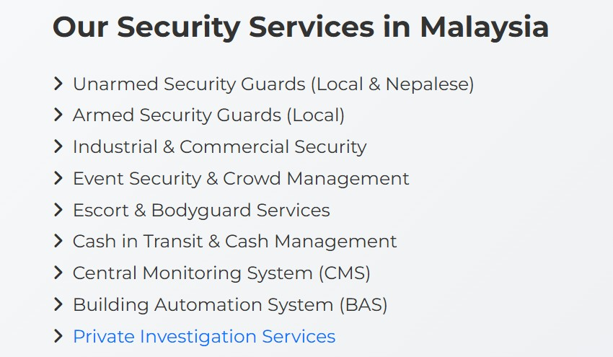
4. Security Guards [Security Agencies]
Company may hire Own Security Guards and create a team but better to Delegate this Completely to a Third Party service provider. These service providers servers below services:
[e.g.In Malaysia, the regulation and licensing of physical security guards falls under the purview of the Ministry of Home Affairs (MOHA)
Other organizations like Persatuan Perkhidmatan Kawalan Keselamatan Malaysia (PPKKM) (Malaysian Security Services Association)

Slide 11
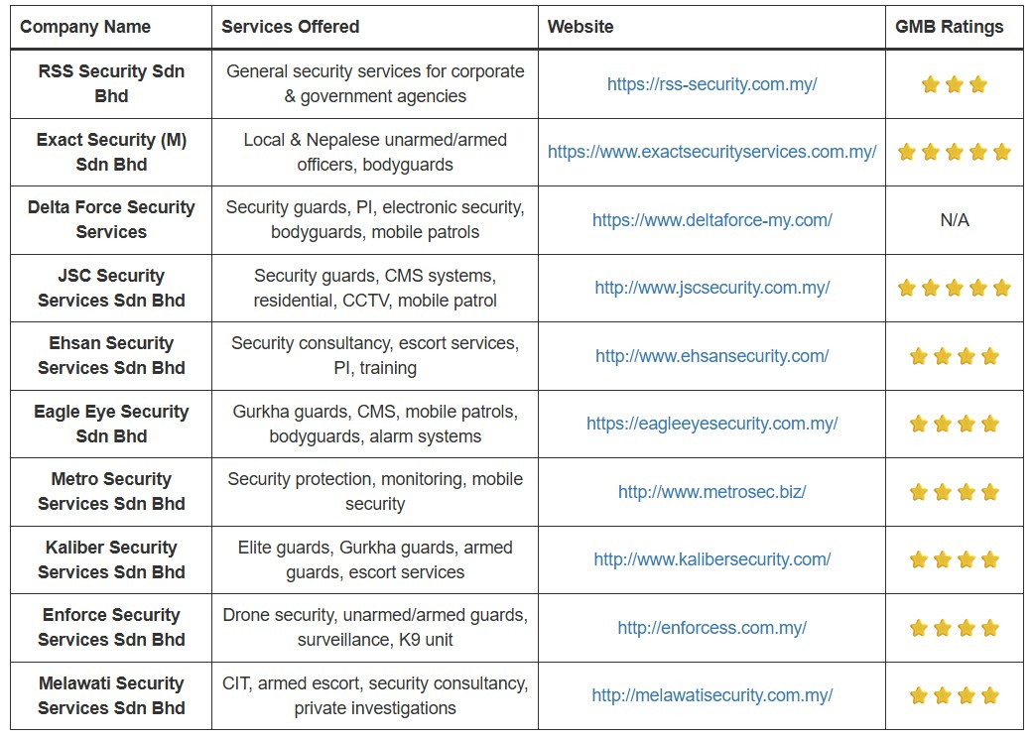
4. Security Guards [Security Agencies]
Some of the Top Security Agencies in Malaysia… [Not any recommendations , Kindly do all due diligence before selecting any vendor]
[Credits]
https://blog.facilitybot.co/blog/top-security-companies-msia/

Slide 12
5. Physical Access Controls
1) Mechanical Lock and Keys
2) Manual ID Cards [Without any Magnetic stripes For Manual Identification]
3) Smart Cards [Magnetic stripe cards, proximity cards (RFID) for Automated Identification and Access]
4) Biometric authentication - Finger Print Access
5) Biometric authentication - Facial Recognition
6) Visitor Access management Process [ Visitor Access Validation]
Auditing/reporting : Physical Access Control solutions MUST record and maintain Log information with all details [e.g. Which Person Accessed What Premise At What Time [Time-IN , Time-Out]
These Logs MUST be maintained for 90-Days for all CRITICAL/HIGH Physical Areas , 60-Days for all MEDIUM Physical Areas and 30-Days for all LOW Physical Areas [This depends on Local Laws and business requirements]
Company Must Define “Visitor Access management Process” , this process should include how Physical access can be provided to visitors and what areas visitor can access.

Slide 13
6. Premise Monitoring [CCTV]
1) Refer
“Requirements for Installation of Closed-Circuit Television (CCTV) System at Business Premises for the Conduct of Money Services Business (MSB)”
2) Refer
“ GUIDE ON THE MANAGEMENT OF CCTV UNDER PERSONAL DATA PROTECTION ACT (PDPA) 2010”
All Sensitive areas MUST be covered
Entry/Exit Point SHOULD be covered
Recording MUST be of HIGH Quality
Time MUST be properly synced
Regular testing of CCTV to ensure its working.
CCTV footage available for minimum of 60-DAYS.

Slide 14
7. Fire Detection and prevention Mechanism
1) Refer
MS 1910:2017 Standard
All Employees SHOULD be provided with proper training on how to use Fire extinguishers , Do’s and Don'ts in case of Fire Incident while Joining , ATLEAST ONCE in a YEAR [Preferably TWICE in a YEAR]
All Employees SHOULD be briefed about “NEAREST EXIT” and “SAFE ASSEMBLY AREAS” .
There SHOULD be ATLEAST ONE DRR [Disaster recovery Representative] on every floor [Preferably a Team of 5-10 DRR on every floor available on every Shifts]. DRR acts as Superhero's in case of any Fire Incident, They are provided with Advanced Firefighting Trainings and expected to guide other staff in case of Fire incident.
Proper maintenance and testing of Fire Alarms , Water Sprinklers and other equipment's SHOULD be done at least ONCE a year [Recommended TWICE a year]

Slide 15
8. HVAC [Heating, Ventilation, and Air Conditioning]
1) Refer
http://epsmg.jkr.gov.my/images/4/4e/TECHNICAL_SPECIFICATION_FOR_ACMV_SECTION_3_EDITION_2020_6.10.21.pdf
ONLY Authorized personnel's CAN access HVAC Operational area
Isolate HVAC systems on a separate network from sensitive business operations to limit the potential impact of breaches
Ensure Proper Maintenance and testing of HVAC devices.
Note: Apart from HVAC devices , other devices [CNC machines, SCADA systems, centrifuges, insulin pumps, etc. may also be vulnerable to security threats , kindly refer to OWASP OT[Operational Technology ] Top 10 [https://ot.owasp.org/]

Slide 16
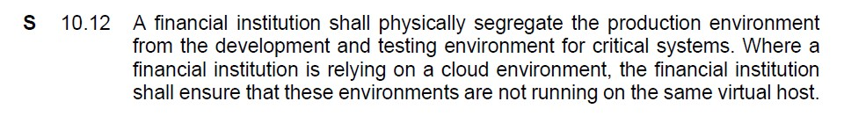
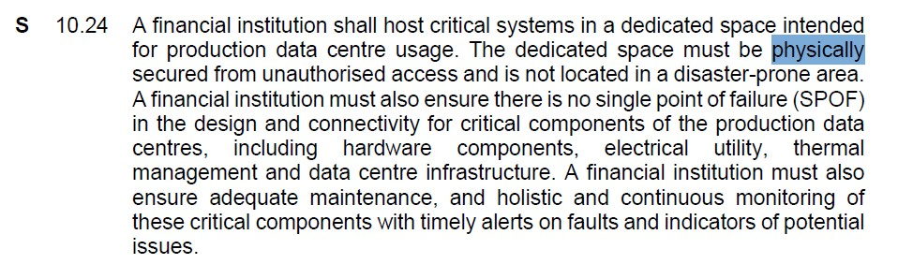
9. Bank Negara Requirements for Physical Security]
1) Refer
https://www.bnm.gov.my/-/risk-management-in-technology-rmit-policy-document

Slide 17
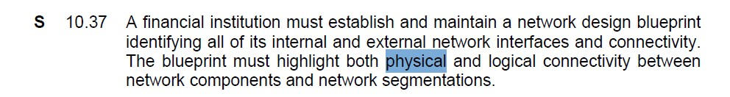
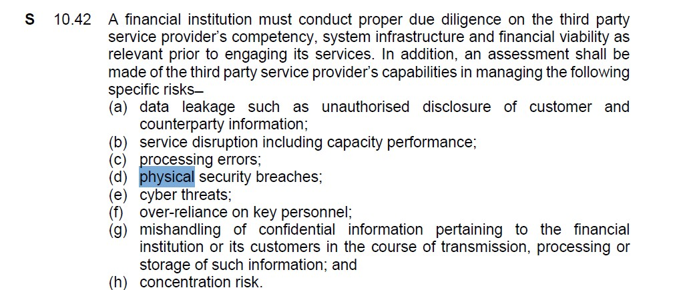
9. Bank Negara Requirements for Physical Security]

Slide 18
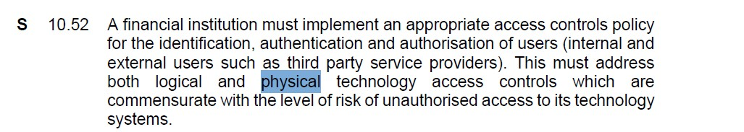
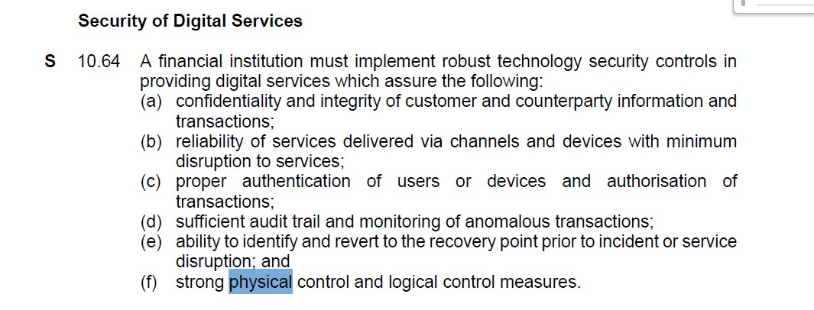
9. Bank Negara Requirements for Physical Security]

Slide 19
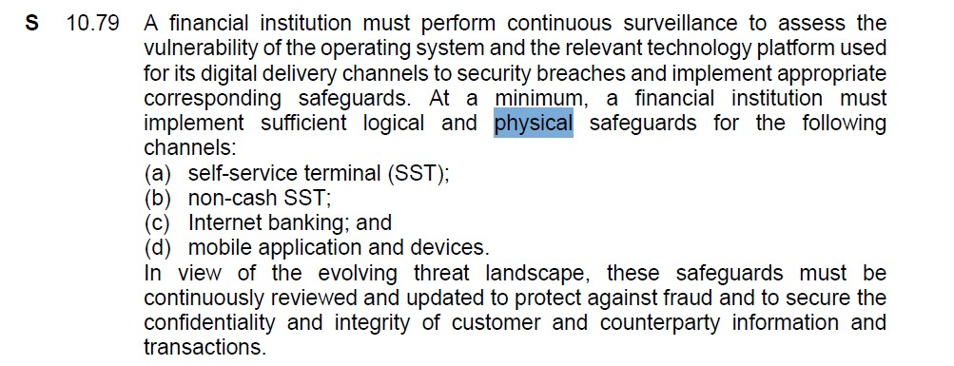
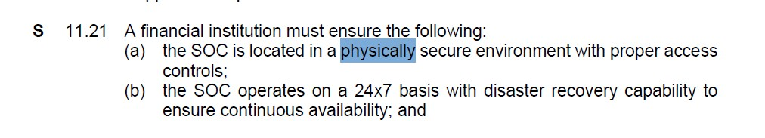
9. Bank Negara Requirements for Physical Security]

Slide 20
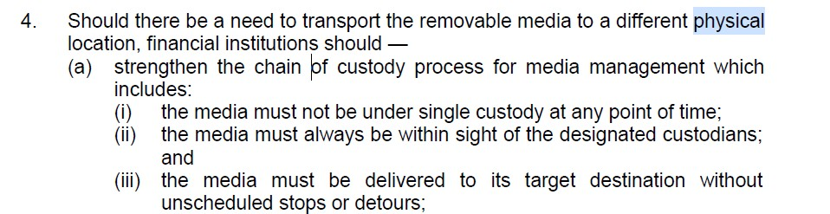
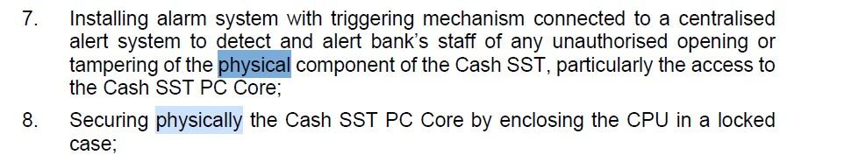
9. Bank Negara Requirements for Physical Security]
Below requirements are for Banks Self-service Terminals (SSTs) e.g. ATM

Slide 21
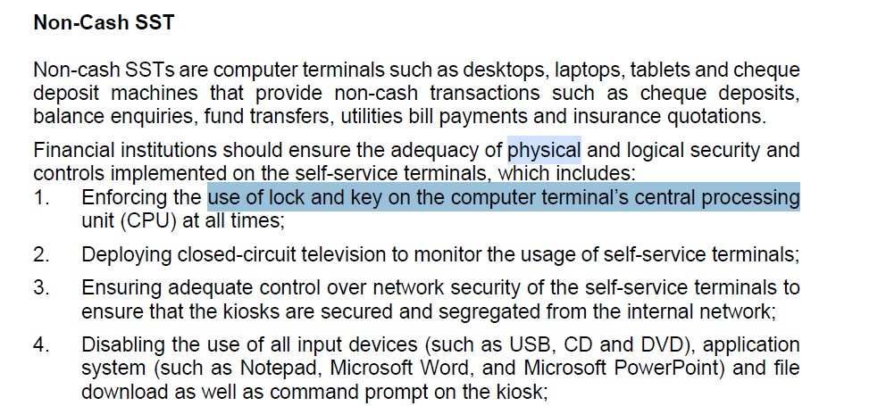
9. Bank Negara Requirements for Physical Security]
Below requirements are for Banks Self-service Terminals (SSTs) e.g. ATM

Slide 22
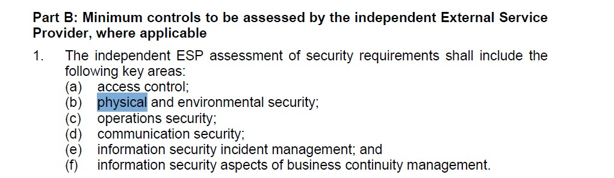
9. Bank Negara Requirements for Physical Security]

Slide 23
10. Top Physical Security Risks
Insider threats / Internal bad actors [Threats from employees, contractors, cleaning staff—who have legitimate access to data, networks and infrastructure]
2) Tailgating and piggybacking
3) Physical Theft [Asset Theft ultimately Data theft]
4) Sufficient Logs Not available [e.g. CCTV footage not available for Some point , CCTV footage not kept for 90 Days ]
5) Equipment's NOT properly maintained and tested / Equipment Failure [Equipment not functioning when a real incident occur][e.g. Fire Alarms , CCTV , etc. Alarm & Intrusion Detection Systems]

Slide 24
10. Top Physical Security Risks
6) Natural Disasters [ Earthquake , Monsoon , Lightning , Dust, Soiling , Storms , Inadmissible temperature and humidity, Loss of personnel etc.]
7) Other disasters [Power failure , Fire , Water , Epidemic ,Subsidence and lanslides , Hazardous / Malicious Animals , etc.]
8) Workplace violence [Physical violence , harassment etc. Civil unrest or violence]
9) Lack of Trainings [Employees NOT properly prepared to respond to Emergency situations]
10) Attacks on office Premise [e.g. Physical Attack, Drone Attack]

Slide 25
11. Related Policies
Clean Desk Policy
Remote Work Policy
Access Control Policy
Data Retention Policy

Slide 26
12. Discussion for a scenario for SOC2 attestation
Company “ABC Sdn Bhd” only have a Virtual address [Not a Physical address] , All Company Employees are working remotely] , This company have clients hosted on cloud environments
[e.g. Lets say “ABC Sdn Bhd” with employees in the range 30-50 , This Company provide IT services [They use Cloud services like Microsoft Office 365 , Cloud environments like Azure , AWS for their clients] and full setup is Remote although they have Virtual office address , Now “ABC Sdn Bhd” Company needs SOC2 attestation but they DONT have any Physical office.
1) So can “ABC Sdn Bhd” Company get SOC2 without any Physical office?
2) Do “ABC Sdn Bhd” need Virtual office address to get SOC2 or SOC2 is possible even without Virtual office address?
Kindly Comment down your answers
https://www.usestable.com/blog/soc-2-compliance-for-virtual-address

Slide 27
THANK YOU!
FOR CYBER-SECURITY RELATED UPDATES, KINDLY FOLLOW BELOW PAGES...
https://www.linkedin.com/in/aj57/
https://www.linkedin.com/company/securecybergates
https://www.youtube.com/@SECURECYBERGATES
https://securecybergates.com/services
https://hackerone.com/crypto-khan
https://x.com/securecybergate
securecybergates@gmail.com

