Slide 1
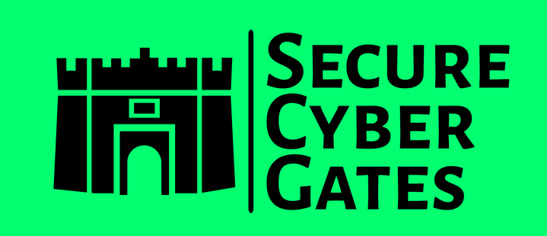
DOCUMENT CONTROL PAGE
Document ID | SCG/BASEPPT/004/1.0
Security Classification | Confidential
Date Issued | 30-Jul-2025
Version | 1.0
Project Name | NA
Author | AJ KHAN
VERSION HISTORY / CHANGE HISTORY
Version | Date Issued | Issued to | Comments
0.1 | 30-Jul-2025 |  | Issued for internal review
1.0 | 30-Jul-2025 |  | Final version

Slide 2
1. Policy
2. Procedure
3. Standards
4. Baseline /Security Baseline
5. Guideline

Slide 3
1. Policy
1. Policy is a High level statement / Generic statements written by Higher Management of any Company
2. Mostly created At Company Level
3. e.g. An Employee Joins a new IT Company
Company ask you to sign some Policy Documents like you Should abide that Policy Statements
e.g. Confidentiality Policy , Acceptable Use Policy (AUP)
Before joining this Company you have to Sign these Policies Documents.
4. If any Company Employee Violates this policy then necessary actions are taken by Management / HR [e.g. Send them Warnings , Penalties , Termination of Employment]
High level Policy Statement : Only authorized users with a valid business need may access Company IT resources and data.
Note , This is just one Policy statement from entire Policy Document

Slide 4
2. Procedure [Standard operating Procedure [SOP]]
SOP are Step by Step guides that assist to achieve a High level Policy statement [Any Task]
2. Mostly created At Project Level [May be created at Company level but SOP differs from Project to Project or as per Technologia… ]
3. SOPs are created by SME [Subject Matter Experts] /IT team/ Project team
[e.g. SOP to access VPN] or by [e.g. SOP to Change password for ecommerce application]
4. If any Employee does NOT follow SOP properly then relevant task cannot be accomplished [e.g. Employee cannot access Company data on Mobile device]
5. SOP changes as per Projects / Technology [Policies are generic statement not dependent on any Project or Technology hence they don’t changes frequently [They may be yearly Amendments to policies but changes are NOT frequent as compared with SOPs ]

Slide 5
2. Procedure [Standard operating Procedure [SOP]]
High level Policy Statement : Only authorized users with a valid business need may access Company IT resources and data.
Now to achieve this Policy Statement , we can have an SOP created
e.g. 1. SOP to access Company data on Mobile Devices
Step 1) Create a new email under Azure AD and provide normal access to relevant applications
Step 2) Ask new Employee to install Microsoft Authenticator on Mobile device [For 2FA Code] 2.1 Open PlayStore and install Authenticator 2.2 Configuration details 2.3 Add email ....
Step 3) Install and Access Microsoft teams on Mobile
Step 4) Install and access Microsoft Outlook on Mobile device
e.g. 2. SOP to configure Fortinet VPN [Access Company Data on Laptops/Desktops]
https://docs.fortinet.com/document/fortigate/7.4.4/administration-guide/215051/connecting-from-forticlient-vpn-client
Similarly we can SOP create to get access to other Assets [e.g. Servers , Databases , Web Applications , Software's etc.]

Slide 6
3. Standards
1. Set of guidelines or best practices that organizations can use to improve their cybersecurity posture
2. Created by International organizations / Companies /Industry/ Government Agencies and Bodies
3. [e.g. ISO 27001 : ISO 27001 is a globally recognized international standard for information security management systems (ISMS) by ISO International Organization for Standardization, a non-governmental organization [NGO] that develops and publishes international standards]
ISO 27017 : Widely recognized standard that provides guidance on information security controls specific to cloud environments
ISO 27018 : Standard that provides guidelines for protecting personally identifiable information (PII) in public cloud computing environments
ISO 31000 and ISO 27005 : International standard for risk management [31000 for Enterprise Risk Management] [ISO 27005 : Only Information security risks]

Slide 7
3. Standards
4. PCI [Payment Card Industry] Data Security Standard (PCI DSS) : Standard used to handle credit cards from major card brands developed by the Payment Card Industry Security Standards Council (PCI SSC) PCI DSS was created in 2004 by five major credit card companies: Visa, Mastercard, Discover, JCB and American Express
5. Standards are created to agree on specific controls
e.g. All PCI SSC members agrees that any Bank would be PCI-DSS compliant if they follow PCI-DSS 12 requirements
6. If any Government implement such standards we call it as ACT/Regulation
HIPPAA : The Health Insurance Portability and Accountability Act (HIPAA) was developed by the U.S. Congress , GDPR by EU
7. If any Individual / Company [Solutions offered by this Company] are not in Compliant with Standards [e.g. ISO 27001 , PCI-DSS] then that Company will not achieve that certification and will not able to prove its security to its Customers resulting in Financial loss and other security risks.

Slide 8
3. Standards
4. PCI [Payment Card Industry] Data Security Standard (PCI DSS) : Standard used to handle credit cards from major card brands developed by the Payment Card Industry Security Standards Council (PCI SSC) PCI DSS was created in 2004 by five major credit card companies: Visa, Mastercard, Discover, JCB and American Express
5. Standards are created to agree on specific controls
e.g. All PCI SSC members agrees that any Bank would be PCI-DSS compliant if they follow PCI-DSS 12 requirements
6. If any Government implement such standards we call it as ACT/Regulation
HIPPAA : The Health Insurance Portability and Accountability Act (HIPAA) was developed by the U.S. Congress , GDPR by EU
7. If any Individual / Company [Solutions offered by this Company] are not in Compliant with Standards [e.g. ISO 27001 , PCI-DSS , GDPR ] then that Company will not achieve that certification and will not able to prove its security to its Customers resulting in Financial loss [Penalties / Loss of deals] and other security risks.
Company with ISO 27001 Standard certification will have higher chances of getting a deal from a customer [If Competitors does NOT have this certification]

Slide 9
3. Standards
8. If any standard provides you a structure or foundation [structured set of best practices, standards, and guidelines designed to help businesses manage cybersecurity risk] upon which something is built or developed then it is a standard as well as Framework
Framework = better manage policies, standards, baselines, procedures, and guidelines
ISO 27001 is a STANDARD , it provides a comprehensive framework for establishing, implementing, and maintaining an ISMS
ISO 31000 is both a standard and a framework for enterprise risk management
SOC2 is primarily a framework developed by AICPA
NIST Cybersecurity Framework 2.0 developed by the U.S. government

Slide 10
4. Baseline /Security Baseline
Apply minimum Security requirements to all Assets / group of objects
A security baseline is a document that outlines an organization's minimum security requirements [A Benchmark] and expectations across various areas.
e.g.
All Company Laptops Security Baseline https://www.microsoft.com/en-us/download/details.aspx?id=55319
All Web-Servers Hardening Security Baseline [Apache Hardening]
All Database-Servers Hardening Security Baseline [DB Hardening]
All Active directory servers should follow this Security Baseline
All Windows based O.S Security Baseline https://learn.microsoft.com/en-us/windows/security/operating-system-security/device-management/windows-security-configuration-framework/windows-security-baselines
All Linux based O.S Security Baseline
All Web applications Security Baseline [e.g. Strong Passwords , MFA enabled , User activity logged , Session Expiry , Sensitive information masking on GUI [e.g. Passwords, Credit Card numbers] etc.]

Slide 11
4. Baseline /Security Baseline
2. If any asset [e.g. Company Laptop] is NOT compliant with Security baseline then IT Administrator/ Automated tools will make that device non Compliant and Employee will loose access to Company resources until it become Compliant.

Slide 12
5. Guideline /Security Guideline/Best Practices
Set of rules and recommendations organizations can follow to protect their systems and data from cyber threats
NOT Mandatory to follow but if you DON’T follow then it may increase Security Risk [It May increase Attack surface
[Following Policy , Procedure , Standards , Baseline are MANDATORY]
High level Policy Statement : Only authorized users with a valid business need may access Company IT resources and data.
SOP/Procedure. SOP to access Company data on Mobile Devices
Security Baseline : All Mobile devices should be Locked with Forti-Token[MFA for VPN] and Authenticator app [MFA for Office 365] installed and Configured.
Guideline : For Mobile Authentication and Authorization , It is recommended to use Biometric security feature [Instead of PIN/Passwords] on Mobile device
For mobile device security, biometric authentication (fingerprint or facial recognition) generally offers a better balance of security and convenience compared to PINs or passwords

Slide 13
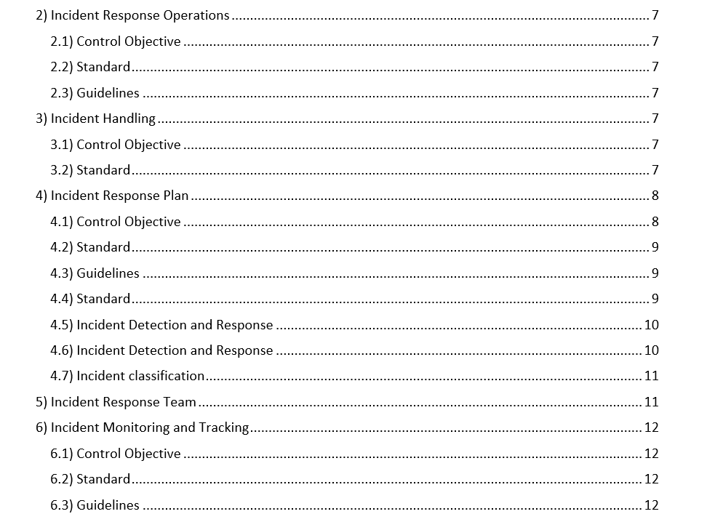
Policy , Standard , Generic Procedure , Guidelines can be in ONE same Document.
E.g.
INCIDENT MANAGEMENT POLICY
Now under this policy we may have all things [Policy details , Standards , Generic procedure[Not a detailed one] , Guidelines ]
Security Baseline usually is a Separate Checklist

Slide 14
Instead of thinking what is the difference between Policy , Procedure , Standards , Frameworks , Guidelines , Baselines
Focus on critical aspects you MUST be Compliant with Policies…
[else Company may take a legal action against you e.g. Not following Code of Conduct Policy] you MUST be Compliant with Standards…
[else you wont be eligible to get certificate/attestation e.g. ISO 27001 , you will get Non conformities / exceptions for SOC2 resulting in financial loss] you MUST be Compliant with ACT/regulation…
[else any Country/Government would take a legal action against you e.g. Not following GDPR/HIPAA] you MUST be Compliant with Baseline…
[else your system may not function properly e.g. Application Server does NOT meet minimum Baseline] you SHOULD follow a Guideline…
[although it is NOT Mandatory , but if you do so, you would minimize the Security risk by reducing the Attack Surface]

Slide 15
THANK YOU!
FOR CYBER-SECURITY RELATED UPDATES, KINDLY FOLLOW BELOW PAGES...
HTTPS://WWW.LINKEDIN.COM/IN/AJ57/
HTTPS://WWW.LINKEDIN.COM/COMPANY/SECURECYBERGATES
HTTPS://SECURECYBERGATES.COM/SERVICES
HTTPS://WWW.YOUTUBE.COM/@SECURECYBERGATES
HTTPS://HACKERONE.COM/CRYPTO-KHAN
HTTPS://X.COM/SECURECYBERGATE
SECURECYBERGATES@GMAIL.COM

