Slide 1
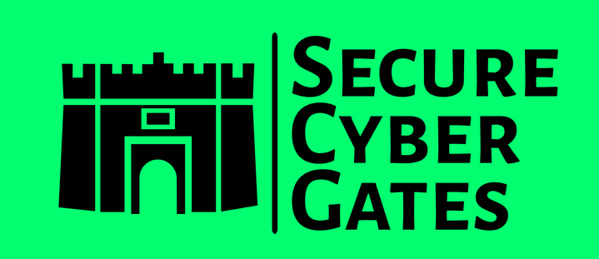
DOCUMENT CONTROL PAGE
Document ID | SCG/INTRO/119/1.0
Security Classification | Confidential
Date Issued | 30-Jul-2025
Version | 1.0
Project Name | NA
Author | AJ KHAN
VERSION HISTORY / CHANGE HISTORY
Version | Date Issued | Issued to | Comments
0.1 | 30-Jul-2025 |  | Issued for internal review
1.0 | 30-Jul-2025 |  | Final version

Slide 2




PAGE 1.1
HTTPS://SECURECYBERGATES.COM/
SOC2 COMMANDO
Practical approach towards
SERVICE ORGANIZATION CONTROL TYPE 2
  2025

Slide 3
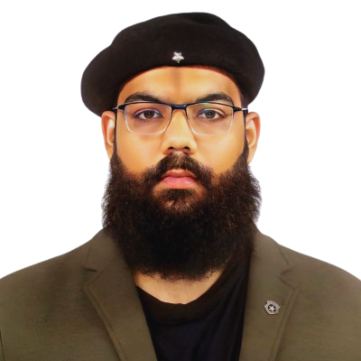
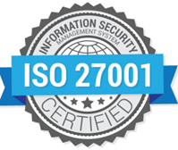

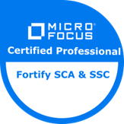
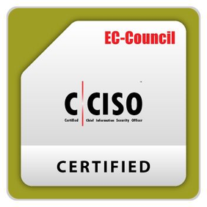
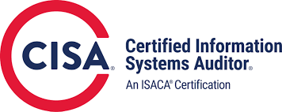

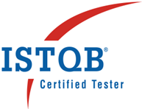
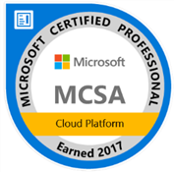

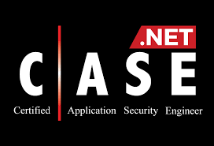
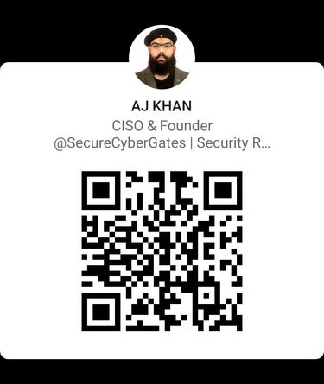
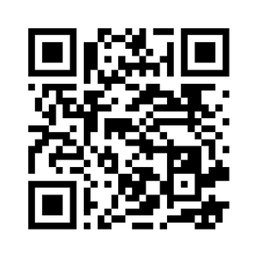

PAGE 1.2
15+ YEARS IN IT INDUSTRY
WIPRO , INFOSYS , APAC / MENA CLIENTS
AJ KHAN
[FOUNDER,CISO]
AURANGABAD, MH, INDIA
HTTPS://SECURECYBERGATES.COM/
HTTPS://WWW.LINKEDIN.COM/IN/AJ57

Slide 4
PAGE 1.3
REAL PROJECT : JURISTEK [FINTECH]
https://www.fintech.coffee/research/56-malaysia
Fintech Company that deals with End to End Loan management
JurisTech have many banking customers and they ask if JurisTech have any security certifications like ISO 27001 / SOC2 as part of due diligence
Loan Origination, Debt Collection, AI powered early warning systems, enterprise solutions for banks. Based out of Kuala Lumpur, Kuala Lumpur, Malaysia
Physical address : ABC Building, Kuala Lumpur, Malaysia [1 Floor in one same building] [No Other Physical Locations]
AJ is hired as CISO/Security Manager and now JurisTech wants AJ to research and drive the program to get any global certification /attestation ASAP. [3-6 Months]
200-500 Employees [Some work from Office , Some work Remotely]
NOTE : We will see more details about this company in Due Diligence stage
https://juristech.net/juristech/

Slide 5

PAGE 2.1
2 DUE DILIGENCE
1
2.1 Research about Company
2
2.2 Research on Security Frameworks
3
2.3 Research on SOC2 Providers

Slide 6


PAGE 2.1.1
RESEARCH ABOUT Company - Buiseness
About JurisTek https://juristech.net/juristech/about-us/
Goals, Vission , Mission
Competitors https://www.owler.com/company/juristechnologies
https://tracxn.com/d/companies/juristech/__xqtw6L9vzn5t6774RgTjxgxMpEhtK6baL6jN8XRFxRI#competitors-and-alternates

Slide 7
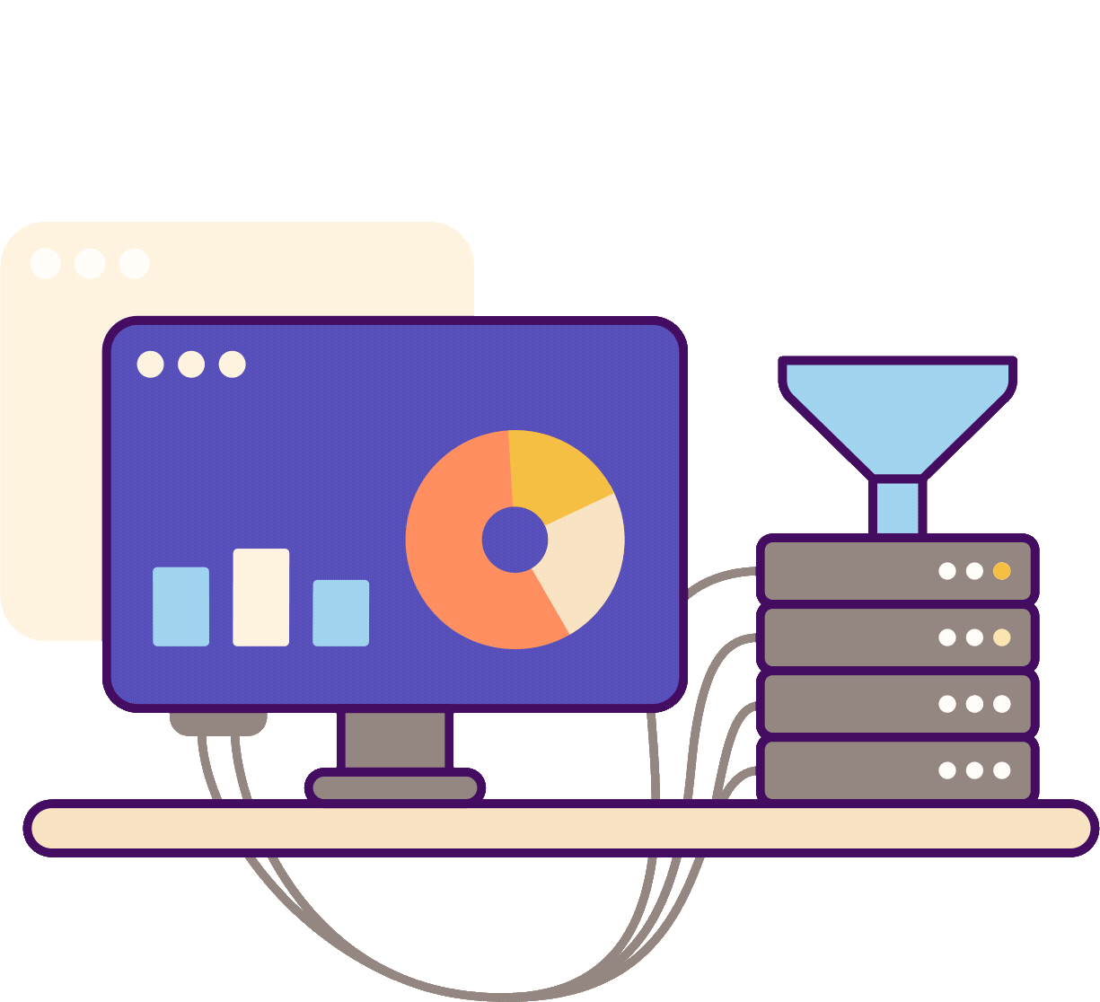
PAGE 2.1.2
RESEARCH ABOUT Company - PRODUCTS
JurisTek FinTech Solutions [Value add to Buiseness] https://juristech.net/juristech/juris-access/
Application Functionality [End to End Features]
Understanding Security features of all applications [Software Point of view : e.g. Application Architecture, Authentication , Authorization , Data encryption , Application Logs and monitoring etc]
Note: Here we are only considering selling products / softwares , there are other software applications that are required to run IT team like any 3rd party sofwatre, Employee management, Email and Communication, Payroll , etc. we will consider this shortly

Slide 8
PAGE 2.1.3
RESEARCH ABOUT Company - COMPANY OPERATIONS
Teams in JurisTek
Top Level Management : All C-Level profiles , BU Heads
Support team : Once project is live , Support team Support clients [Ticket Management tool]
Management : Project Managers , Senior Managers etc.
HR / Finance /Training/Social Media Management : Takes care of employees onborading , HR tasks , Payroll and other Finance tasks, Providing Trainings to employees , Manages Social media
Sales / Presales : Takes care of digital marketting , Generating Leads , providing Demos of Juris=Tech products to Sales Leads
Facilities management : Security Guards , Premise Maintainence Employees etc.
Software Development Team : Architect , Developers , Testers / QA
IT Team : Takes care of Infrastructure [Servers , DB , Cloud etc.] [DBA team]

Slide 9
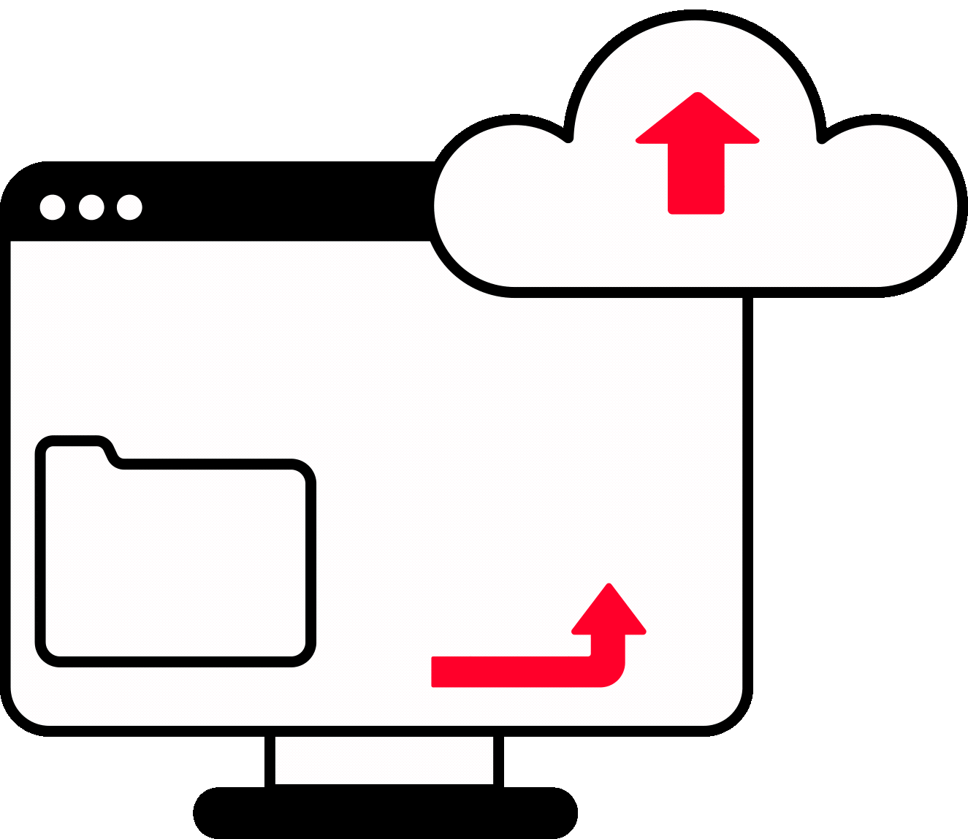
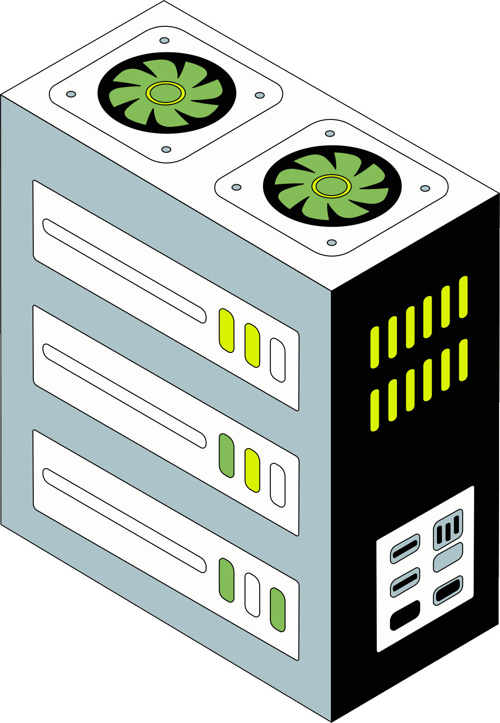

PAGE 2.1.4
RESEARCH ABOUT Company - Infrastructure
Company Data is hosted on Premise [e.g. Development Servers , Internal applications like Employee management [Employee Attendance , Their Details , Leaves etc]
Some Company Data is hosted on Cloud e.g. Company uses JIRA Cloud , Some data on Azure Cloud, Some on AWS cloud , Company uses Office 365 products for daily Communication]
Customer Data is managed by Customers. e.g. JurisTech develop Loan management Software and deliver the product to Customer [Now all Production Data is responsibility of Customer] . Some of thee cients have asked JursTech to handle their own Customer data for this JurisTech uses Oracle Cloud

Slide 10
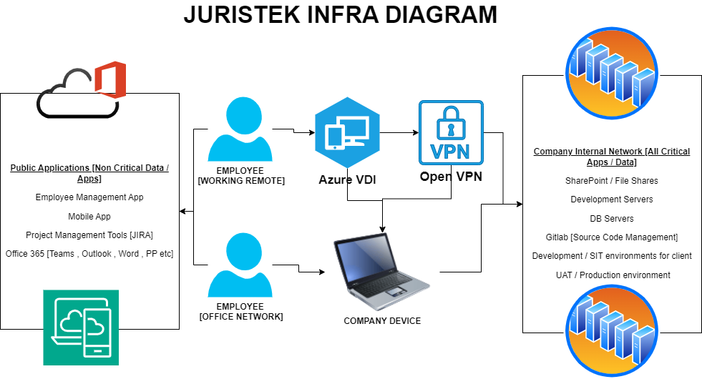
RESEARCH ABOUT Company - nfrastructure DIAGRAM
PAGE 2.1.5

Slide 11

TOOLS AND TECHNOLOGIES
PAGE 2.1.6
Office Communication | Office 365 Suite [Teams]
VPN | Open VPN
Employee Management [Employee Attendance Records , Leave System , Employee details] | In House Web and Mobile Applications
Support Tool / Ticketing Tool | ServiceNow or Internal Help Desk Website [Accessible over Internet for all Clients]
DevOps Tools | GitHub Enterprise [On Premise Version / Self Managed] , Visual Studio Code , Docker , Microsoft Data Protection Manager backups
AntiVirus | McAfee Total Protection | Antivirus software
Cloud / On prem | Development Server VMs on premise [Inside Company Office Building , Server Machines with Microsoft Server OS and Hyper-V] , UAT / Production Servers for Some client managed on Oracle / Azure [Azure VDI for Remote Employees]
Project Management | JIRA

Slide 12
PAGE 2.2
2 RESEARCH ON SECURITY FRAMEWORKS
2.2.1 ⟶ Security Frameworks / Data Protection Standards high level
2.2.2 ⟶ Understanding SOC2 , SOC 2 Principles
2.2.3 ⟶ Why you need SOC2
2.2.4 ⟶ A Sample SOC2 Report
2.2.5 ⟶ Challenges with SOC2
2.2.6 ⟶ ISO 27001 vs SOC2
2.2.7 ⟶ Decided to go with SOC2
2.2.8 ⟶ SOC2 Scope Agreement and Teams Availability

Slide 13
PAGE 2.2.1
SECURITY Frameworks / high leveL
Security Framework | Description
ISO 27001 | An international standard by ISO [International Organisation for Standardisation] [Latest Version ISO/IEC 27001:2022]. Total 93 Security Controls in Annexure A. More details can be found here https://www.isms.online/iso-27001/annex-a/. [Global Level Acceptance]
NIST CSF 2.0 | The NIST Cybersecurity Framework (CSF) is a set of voluntary guidelines and best practices developed by the National Institute of Standards and Technology (NIST) to help organizations manage and reduce cybersecurity risks. The framework is structured around five core functions: Identify, Protect, Detect, Respond, and Recover.
SOC2 | SOC 2 is a compliance framework developed by the American Institute of Certified Public Accountants (AICPA) to help organizations demonstrate they have appropriate controls in place to protect customer data. The five SOC 2 Trust Principles are Security, Availability, Processing Integrity, Confidentiality, and Privacy. Compliance standard in North America. While it's commonly seen in the SaaS sector,SOC 2 is not limited to SaaS companies ,it applies to any organization that processes, stores, or transmits customer data, regardless of their service model.
NCA [KSA] | The National Cybersecurity Authority (NCA) of Saudi Arabia introduced the Essential Cybersecurity Controls (ECC – 1: 2018) after conducting a comprehensive study of multiple national and international cybersecurity frameworks and standards. The Essential Cybersecurity Controls (ECC) consists of: 5 Cybersecurity Main Domains. 29 Cybersecurity Sub-Domains.114 Cybersecurity Controls.
Please note that these are just some of the ISMS frameworks , ISO is accepted at Global level. Some Frameworks are designed specifically for particular geography like SOC2 would be for companies doing business in North America . ISO , NIST CSF 2.0 , SOC2 are NOT mandatory but NCA is Mandatory for Companies operating in KSA.

Slide 14
PAGE 2.2.1
DATA PROTECTION STANDARDS high leveL
Data Protection Standards | Description
ISO/IEC 27701:2019 [[Global Level Acceptance]] | Protects Personally Identifiable Information (PII) : Data privacy standard that extends ISO/IEC 27001 to include specific privacy requirements . Not Mandatory.
GDPR (General Data Protection Regulation) | General Data Protection Regulation (GDPR) is a European Union law that governs how organizations within and outside the EU handle the personal data of EU residents. (GDPR) is mandatory for organizations that process the personal data of EU citizens.
California Consumer Privacy Act (CCPA) | Data privacy laws for California residents [Applies to businesses that collect data from California residents, regardless of the business's location] [Like GDPR is for European Residents] . Mandatory to Comply.
Malaysia Personal Data Protection Act 2010 (PDPA) | Main data protection law in Malaysia :The PDPA applies to the processing of personal data in commercial transactions, which includes collecting, recording, holding, storing, or carrying out any operations on personal data.Mandatory to Comply.
ISMS scope is broad , Protect information assets [Including Data] , Data Protection Standards are subset of information security that focuses specifically on protecting personal or sensitive data.

Slide 15
PAGE 2.2.1
DATA PROTECTION STANDARDS high leveL
Data Protection Standards | Description
India's Digital Personal Data Protection (DPDP) Rules 2025 | Protect the personal data of Indian citizens in the digital space. Mandatory for Organizations and individuals who process digital personal data within India
PCI DSS (Payment Card Industry Data Security Standard) V4 | Protect Payment related Data [e.g. Credit Card numbers , Name, CVV , Expiry Date , Name on the Card].Applies to any organization that stores, processes, or transmits cardholder data (CHD) or sensitive authentication data (SAD), regardless of size or transaction volume.
HIPAA (Health Insurance Portability and Accountability Act) | Protect sensitive patient data. HIPAA is focused on healthcare organizations and how personal health information is used in the US. HITRUST [HITRUST Common Security Framework (CSF): The Health Information Trust Alliance (HITRUST) ]: HITRUST is a global security and risk management framework [HIPAA is for US] : HITRUST is a framework that provides a comprehensive set of security controls to help organizations demonstrate HIPAA compliance and manage broader information risks.
Data Protection Standards are some related to certain geographies [e.g. GDPR, CCPA , PDPA, DPDP] and some related to particular Industry [e.g. HIPAA , PCI-DSS]

Slide 16
PAGE 2.2.2
SOC2
  SOC2 is by American Institute of Certified Public Accountants [AICPA] : A professional body for accountants, developed SOC 2 to provide a framework for service providers to demonstrate their security controls and to provide assurance to their client.
  Applicable to any Service organizations [Not Just SaaS based Companies] that process, store, or transmit data for their clients or partners.
  SOC 2 compliance is NOT mandatory in the US, nor is it a legal requirement [SOC 2 is a voluntary attestation, not a legal mandate like HIPAA or GDPR] but it's widely used in the US and gaining recognition globally to demonstrate a commitment to data protection.
Official Website : https://www.aicpa-cima.com/

Slide 17
PAGE 2.2.2
SOC2
  Under SSAE 16 [ Statement on Standards for Attestation Engagement ], the AICPA released three new reports SOC1, SOC2, SOC3. This resulted in the Service Organization Controls (SOC) and the ever-popular SOC 2
SOC 2 is based on five Trust Services Criteria [TSC]: Security, Availability, Confidentiality, Processing integrity, and Privacy
Security (CC): Your systems and data are protected against unauthorized access and disclosure.
Availability (A): Your information and systems are available for their intended use.
Confidentiality (C): Confidential information is kept confidential.
Processing integrity (PI): Data processing is complete, valid, accurate, and timely.
Privacy (P): Consumer data is protected and consumers are informed about the collection, use retention, and disposal of their data.

Slide 18
PAGE 2.2.2
SOC TYPES
  SOC1 : Audit on Company Financial Process. A SOC 1 report details the controls your organization has in place for financial reporting
  SOC2: Audit on Company Information Security Process.
  SOC3: Short version of SOC2 used for public display [Marketing] [Does NOT contain technical details], No need to sign NDA for this.

Slide 19
PAGE 2.2.2
SOC Type 1 & Type 2 Reports
  SOC1 and SOC2 are further divided in 2 types [SOC1 TYPE1 , SOC1 TYPE2 , SOC2 TYPE1 , SOC2 TYPE2]
  TYPE1 : When you start with SOC2 , you start first with TYPE1 where all Policies are documented for in scope assets. Once you have documented all the policies and provided sufficient evidances then you would get your TYPE1 report. TYPE1 are easy to implement , Usually takes some weeks. TYPE1 is an audit that assesses an organization’s systems and the suitability of its design to meet relevant trust principles as of a specified date.
  TYPE2 : Now once you have all policies in place then we need to test its operational effectiveness .Suppose we got TYPE1 report by 30-JAN then we minimum wait for 3 months and try to collect all evidances for SOC2 TYPE2 e.g. We have written Risk management Policy which states that Company would perform Risk Management every Month , Now we need to prove that we did that for FEB,MARCH,APRIL Month [So this is the duration for TYPE2 ] Minimum 3 Months and Maximum for 1 Year]

Slide 20
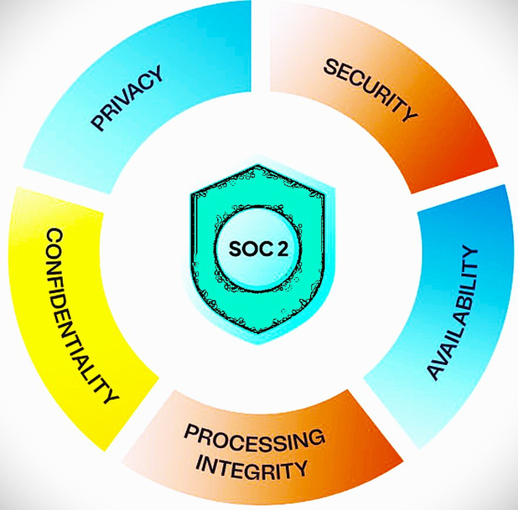
PAGE 2.2.3
SOC2 : Why you need SOC2?
Implementation of strong policies and procedures
Demonstrate your Cyber Security controls
Customer Confidence
Brand's Reputation

Slide 21
PAGE 2.2.4
Sample Report
The main sections include the following:
  Section I — Management assertion
  Section II — Independent service auditor’s opinion
  Section III — Systems description
  Section IV — Description of controls and test results
  Section V (optional) — Management’s response to exceptions – this section is optional, written from the client’s voice, and not a section audited by the auditor.
Lets see a sample report online ....

Slide 22
PAGE 2.2.4
SAMPLE SOC2 TYPE1 REPORT
https://trisk.io/resources/security/soc2-june-2022.pdf
https://provectus.com/wp-content/uploads/2022/05/Provectus-IT-Inc.-SOC-2-Type-I-Report-Final.pdf
https://bryllyant.com/soc-2-final-report.pdf
  Note : SOC reports should NOT be displayed without signing NDA , But we still see lot of Companies Openly display their SOC2 reports for marketing purpose. Only SOC3 reports can be disclosed in Public. This depends on Company if they want to display SOC2 reports on public channels but there are security risks associated with this.

Slide 23
PAGE 2.2.4
SAMPLE SOC2 TYPE2 REPORT
https://www-assets.kolide.com/assets/marketing/documents/soc2-f9823fc1.pdf
https://provectus.com/wp-content/uploads/2022/08/Provectus-IT-Inc.-SOC2-Type-II-Report-Final.pdf
https://nayaone.com/wp-content/uploads/2024/04/NayaOne-Limited-2024-SOC-2-Type-II-Final-report.pdf
  Note : SOC reports should NOT be displayed without signing NDA , But we still see lot of Companies Openly display their SOC2 reports for marketing purpose. Only SOC3 reports can be disclosed in Public

Slide 24
PAGE 2.2.4
SAMPLE SOC3
https://www.oracle.com/a/ocom/docs/oci-soc-3-report.pdf
https://d1.awsstatic.com/whitepapers/compliance/AWS_SOC3.pdf
https://www.peopledatalabs.com/pdf/pdl-soc3.pdf

Slide 25
PAGE 2.2.5
Challenges with SOC2
  Confusion if you really need it? [Will ISO 27001 Suffice?]
  Scope Definition : Missing something in scope OR Too Broad Scope
  Team Support : You would need support from various teams like HR , IT , Software Development , ,Vendor management etc. Teams Availability is a concern
  Documentation Overload : Too much Documentation with no effectiveness . Employees not taking Policies seriously ..
  Budget Issues : SOC2 reports are expensive as compared with ISO27001.

Slide 26
PAGE 2.2.6
SOC2 VS ISO 27001
ISO 27001 | SOC2
Information Security Management System (ISMS) Framework by ISO[International Organization for Standardization] | More focused on the Data security and privacy controls of service organizations by AICPA[American Institute of Certified Public Accountants]
ISMS scope is broad , Protect information assets [Including Data] | SOC2 Scope morenarrowly focused, targeting service organizations and their data handling practices
End result is a certification valid for 3 years [But requires Yearly surveillance audit]. Customers can verify this certificate using certificate number. | End result is a detailed report Attested by Licensed CPA or Licensed CPA firm. There is not a central tracker by AICPA to validate if attestation is valid [Since its an Attestation]
Go for ISO 27001 if your customers are present globally [Including America] | Go for SOC2 if your Customer have specifically asked for it and based in America and Europe
Discussion : Can an Individual Licensed CPA [Not belonging to any CPA Firm] attest a SOC2 report and does that stand a valid SOC2 report?

Slide 27
PAGE 2.2.6
SOC2 VS ISO 27001
ISO27001 | SOC2
Minimum Time frame [3 to 12 Months] | Minimum Time frame [2-6 Months for SOC2 TYPE1 and 3-12 Months for SOC2 TYPE2] Minimum 6 Months to get SOC2 TYPE2
Less Expensive then SOC2 [I have compared the quotation of ISO27001 including Yearly surveillance audit and found that SOC2 was expensive then ISO27001] | Expensive then ISO27001 since it expires in 1 year and there is no Yearly surveillance audit , You need to again start SOC2 TYPE2 for a fresh new Timeframe]
The purpose of ISO 27001 is to establish ISMS at organizational level | The purpose of SOC2 is to Provides assurance to clients that a service organization's controls are designed and operating effectively to meet specific Trust Services Criteria [TSC]
NOT MANDATORY | NOT MANDATORY

Slide 28
PAGE 2.2.7
We will go with SOC2 and ISO 27001 Combo!
  Now JurisTech have some clients based in US and Europe who are asking if they have SOC2 report , Some of the clients are OK if JurisTech have ISO27001 but few of them are specifically asking for SOC2
  Also there is a requirement which states this needs to be done Quickly within 3-4 Months or ASAP
  Hence as CISO AJ have decided to go for SOC2 Type 1 and achieve that in 1 Month and then next 3 Months would be for SOC2 TYPE2 as observation period [During this 3-Months of observation we will work on ISO 27001 policies implementation as well as collecting evidences for SOC2 TYPE2 and we will try to achieve both SOC2 TYPE2 and ISO 27001 in 4-6 Months]

Slide 29
PAGE 2.2.8
SOC2 Scope Agreement and Teams Availability
  Now before searching for SOC2 vendors , AJ will internally allign with management to decide SOC2 Scope and Teams availability.
  For SOC2 Scope, we will consider it at organizational Level applicable to all Products and Teams and we need one Point of Contact from all teams to support this activity
HR/Finance/Vendor Management | Sales / Presales/Contract Management
Software Development [PM , Technical Leads , Developers , Testers etc] | Training Team [Provide Trainings to new Hires / Employees]
IT [Taking care if complete Infra , Security] | Support Team [Tickets Management / Change Mgmt]
  Once we have Scope agreed internally and Teams available for support
we will search for SOC2 vendors to assist us with SOC2 process....

Slide 30
PAGE 2.3.1
SOC2 TSC details
  Lets have a closer look at SOC2 Trust Services Criteria [TSC]
  For the latest updated SOC2 TSC , Register on AICPA Official website and Search for SOC2 https://www.aicpa-cima.com/
  You may check other resources as well on this website , Some of them are free while others are Paid [Or for Only Members]
https://www.aicpa-cima.com/resources/download/2017-trust-services-criteria-with-revised-points-of-focus-2022
Only for Members / Paid : https://www.aicpa-cima.com/resources/download/soc-for-service-organizations-toolkit

Slide 31
PAGE 2.3.2
Basic Company Information and SOC2 TSC Scope agreement
  Lets get some basic information about our Company that vendors would ask during initial stage.
  For Company Scope, We already discussed we will consider all departments , all products
  SOC2 for One Business Unit Only: Now I have one Company with multiple BU , I would need SOC2 only for BU which hosts Data on Azure Cloud, So is that Possible [SOC2 for One Business Unit Only , I dont want to include other BU in scope]
[ For initial SOC2 TYPE1 , We will choose 3 Trust Service Criteria (TSC) in scope --> SECURITY , CONFIDENTIALITY , AVAILABILITY ] [SECURITY TSC is MANDATORY]

Slide 32
PAGE 2.3.3
SOC2 Providers online Comparison
https://www.topcertifier.com/soc2-certification
https://www.certpro.co/soc-2-compliance/
https://kratikal.com/soc2-compliance
https://www.certvalue.com/soc-2-certification/
https://www.riskpro.in/soc-1-and-soc-2-audits-end-end-consulting-and-attestation
https://www.riskpro.in/sites/default/files/2025%20Website%20brochures/SOC%202%20(SSAE)%20Advisory%20Brochure%202025.pdf
Kindly note that these vendors are NOT recommendations

Slide 33
PAGE 2.3.3
SOC2 Providers online Comparison
https://www.topcertifier.com/soc2-certification
https://www.certpro.co/soc-2-compliance/
https://kratikal.com/soc2-compliance
https://www.certvalue.com/soc-2-certification/
https://www.riskpro.in/soc-1-and-soc-2-audits-end-end-consulting-and-attestation
https://www.riskpro.in/sites/default/files/2025%20Website%20brochures/SOC%202%20(SSAE)%20Advisory%20Brochure%202025.pdf
Kindly note that these vendors are NOT recommendations

Slide 34
PAGE 2.3.3
SOC2 Providers online Comparison
Select any ONE vendor
Get in Touch with Sales Person [Share Company Details]
Demo Would be scheduled to showcase all Process , Timeline , Deliverables, Quotations and expectations

Slide 35
PAGE 2.3.4
What things to clarify with Vendor?
1) Is the SOC2 attestation from an Individual Licensed CPA or from Licensed CPA firm?
2) Could you please share details of Individual Licensed CPA or Licensed CPA firm [e.g. Name , License number ]
Check if Vendor have Licensed CPA https://www.aicpa-cima.com/directories and https://app.cpaverify.org/search_result [Search with Name or check with Firm]
3) Company Legal Name , Legal Address , Registration Number [EIN Number] , https://namescan.io/companysinglescan United States , Delaware RiskPro , Certpro [ACN = 7438051]

Slide 36
PAGE 2.3.4
What things to clarify with Vendor?
4) Company Social media pages [Their leaders , Client testimonials , Employee Count and other things]
5) Company account number should be on their Legal Name [Ensure before transferring any Amount to this Company]
6) Audit would be 100% Virtual / Online and No Offsite Visits.
[You may NOT get all details until you show interest to Proceed]

Slide 37
PAGE 2.3.4
What things to clarify with Vendor?
7) How many TSC would be covered? Will it be 3 Trust Service Criteria (TSC).* Or 5 TSC [For CertPro its 3 TSC] , Some vendors would consider all 5 TSC.
Yes, a SOC 2 report can be valid for three Trust Service Criteria (TSC) out of the five available. The SOC 2 framework allows organizations to choose which criteria to include in their audit, but Security is always required. Other criteria like Availability, Processing Integrity, Confidentiality, and Privacy can be added based on the specific needs and services of the organization
8) Can you share list of "Total of Point of Focus" That would be covered in the report?

Slide 38
PAGE 2.3.4
What things to clarify with Vendor?
9) Do you have an in house-CPA?
An in-house CPA is a Certified Public Accountant who is employed directly by a company or organization, rather than working for an external accounting firm
10) Could you please share list of Policies we would be creating during this exercise? [Should be somewhere 20-25 policies and some records/ list for 3 Trust Service Criteria (TSC).]
SECURITY , CONFIDENTIALITY , AVAILABILITY
e.g. https://www.riskpro.in/sites/default/files/2025%20Website%20brochures/SOC%202%20(SSAE)%20Advisory%20Brochure%202025.pdf

Slide 39
PAGE 2.3.4
What things to clarify with Vendor?
11) Can you share a Combo quotation for SOC2 TYPE1 as well as TYPE2
--ONLY for SOC2 TYPE1
Only Consultation [As a company we manage to get Audit and attestation]
ONLY AUDIT and ATTESTATION [No Consultation]
Both Consultation, Audit & Attestation services
--ONLY for SOC2 TYPE2
Only Consultation [As a company we manage to get Audit and attestation]
ONLY AUDIT and ATTESTATION [No Consultation]
Both Consultation, Audit & Attestation services
-- Once done with SOC2 TYPE2 then after 1 year , Yearly AUDIT and ATTESTATION [No Consultation] charges [e.g. For next 3 years what could be these charges? --> Better to have a fixed term and in case if we are interested next year we can get it done else find a new vendor]
Implementing SOC2 and ISO27001 in Parallel
27001:2022
You may also plan to implement ISO 27001 in parallel with SOC2 , in such cases ask for Combo price since we have 70% control overlap [There are approx. 30% more controls in ISO 27001]

Slide 40
PAGE 2.3.5
What to expect from Vendors?
1) Only Consultation [Vendors will share you templates and may explain about them but they will NOT design and Implement policies for your Company , This would be responsibility of Security Head of your own Company , Hence you need at least ONE resource minimum from your Company who takes care of Security] , In case you Dont have this then you may hire some person on Contract for this purpose, This Person should understand your Company business, existing security controls in place ,well known on your Company Infrastructure [Servers , Cloud , Data , etc] and Software development security [A person working in IT department who takes care of server / firewalls / Network / Data can be good fit in case you dont want to hire external Contractor but Once implemented you need a security team in your company to manage SOC2]
VAPT reports [You need Security Team to Conduct VAPT , else you can contact vendor to do this for you , This would be charged separately]
Evidence of regular data backups and restore
Risk Management Reports
Asset Register
Physical Security etc.

Slide 41
PAGE 2.3.6
Pricing / Quotations : Sample Standalone quotation vs Combo quotations
Here is a sample Pricing quotation for JurisTech...
Before your team transfer the Payment : 1) Ensure Company Legal Name and Legal Address 2) Account number where you are making transfer is to Registered Company 3) Read the Agreement
3rd Party Vendor now Selected , Next Section we will KickStart the Project with “GAP Assessment”

Slide 42
THANK YOU!
FOR CYBER-SECURITY RELATED UPDATES, KINDLY FOLLOW BELOW PAGES...
https://www.linkedin.com/in/aj57/
https://www.linkedin.com/company/securecybergates
https://www.youtube.com/@SECURECYBERGATES
https://securecybergates.com/services
https://hackerone.com/crypto-khan
https://x.com/securecybergate
securecybergates@gmail.com

