Slide 1
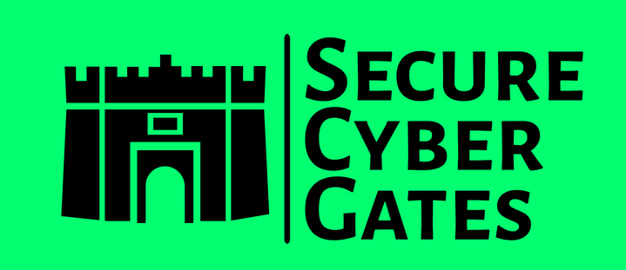
DOCUMENT CONTROL PAGE
Document ID | SCG/AUTO/124/1.0
Security Classification | Confidential
Date Issued | 30-Jul-2025
Version | 1.0
Project Name | NA
Author | AJ KHAN
VERSION HISTORY / CHANGE HISTORY
Version | Date Issued | Issued to | Comments
0.1 | 30-Jul-2025 |  | Issued for internal review
1.0 | 30-Jul-2025 |  | Final version

Slide 2
SOC2 COMPLIANCE AUTOMATION

Slide 3
1. SOC2 Tasks and possible Automation [High level]
2.Vendors
3.Automated tools features[High Level]
4.Risks with such tools
5.Recommendation

Slide 4
1. SOC2 Tasks and possible Automation [High level]
SOC2 Task Description | Possible Automation [High Level]
Defining SOC2 audit Objectives and Scope | Mostly Manual Approach
Risk Assessment | 50-70% Automation
Gap Assessment [Checking current Security controls in place / Evaluating existing security posture of Company] | 50-70% Automation
Applying Security Controls [Developing Policies and Procedures – Review and Approval] | 60-80% Automation
Audit Phase -- Evidences Collection and queries | 50-70% Automation
Compiling SOC2 report -- Review and Approval | 60-80% Automation
Document Maintainence and management for next Audit | 60-80% Automation

Slide 5
Sprinto https://sprinto.com/
Vanta https://www.vanta.com/
Drata https://drata.com/
Secureframe https://secureframe.com/
Scrut https://www.scrut.io/
EasyAudit https://www.easyaudit.ai/
Hyper Proof https://hyperproof.io/
2. Some Vendors who provide Compliance automation.

Slide 6
1) You need to integrate [Connect your Cloud accounts / Cloud applications] into these tools , So do check for the integration support of tools e.g. https://sprinto.com/integrations/
Search for Oracle , AWS , Azure , GCP , Office 365 , Github , GitLab , Zoho, JIRA
2) A central Dashboard for all Compliances [e.g. ISO 27001 , SOC2 , GDPR , HIPAA etc.] : Now as we have security controls overlap , one security control may be applied to multiple Frameworks / Standards]
3) Compliance by Day : If we selected manual approach and if any existing security control is modified / removed then this will have impact on next Audit cycle , but if we use automated tools any any of the supported integration are non compliance with the policies then we immediately or next day can get non Compliance report [This depends how we can schedule scanning]
Check a sample video below from Sprinto on some of the features: https://www.youtube.com/watch?v=RC_lWZVm-xU
3. Some of the Automated tools features

Slide 7
3) Whenever we have change in the systems [We are adding a new server / new database / new Cloud app etc.] then we can anytime add this into our SOC2 scope and get compliance for newly added resource]
Note: There is a need of Information Security Consultant if you are using automation tools [Its just the work load would be reduced depending on Automation effectiveness]
3. Some of the Automated tools features

Slide 8
1) As we are integrating our Cloud accounts and apps , for this integration you would need to connect to your cloud administrator account under such tools , So there is a risk that control of your cloud account may be transferred to this vendor [If due to some reason this vendor platform is hacked then it may affect your environment , this need to be verified in detail if our cloud account credentials are stored anywhere inside application or Database?
Can someone from vendor team abuse these details?
Are there any chances these vendors can access our database or applications or systems?
If main vendor application is hacked then what is the impact on our integrated environments?
This is one risk factor
4.Risks with such tools

Slide 9
2) As these vendors applications will scan our systems [Once integration is successful] then will it impact system performance?
3) How access to other companies are prevented? e.g. As these vendors caters multiple clients so how they segregate / separate clients ? Are there any chances of Unauthorized access for other clients? Can any other client try to access any other company details with IDOR [Indirect Object references] then how system handle this?
4) Do they provide On-Premise setup? If any client is NOT interested to connect to their Cloud accounts / Cloud applications over SaaS based web application then do they have a full Fledge Self managed application [So that this client can first deploy these vendor central application on their own infrastructure and then connect to their cloud accounts / cloud apps?]
5) All of your in scope SOC2 audit applications may NOT be supported for integrations e.g. If you have internal applications , applications that are not well known
6) How much this tool will cost? A Price comparison between Manual approach and Automated approach
4.Risks with such tools

Slide 10
Recommendation:
For any Compliance , First go with Manual approach for 2 to 3 cycles and then if you feel you need to automate then do all due diligence and then decide if it Is feasible to go with Automation or stick to manual approach.
5.Recommendation

Slide 11
THANK YOU!
FOR CYBER-SECURITY RELATED UPDATES, KINDLY FOLLOW BELOW PAGES...
https://www.linkedin.com/in/aj57/
https://www.linkedin.com/company/securecybergates
https://www.youtube.com/@SECURECYBERGATES
https://securecybergates.com/services
https://hackerone.com/crypto-khan
https://x.com/securecybergate
securecybergates@gmail.com

