Slide 1

LADAN ABDI
CENTURY COLLEGE
INET 1100-90
5-YEAR CAREER PLANNING
12/16/2025
1

Slide 2

Introduction
I am a cybersecurity student developing my technical foundation while embracing a strong ethical mindset. This portfolio captures my motivations and five‑year vision.
Motivation
Help desk and cybersecurity roles provide hands‑on experience protecting data and supporting users while paving the way toward leadership in identity and access management.
Introduction & Ethics
Motivation and Guiding Principles
Ethics & Core Values
• Honesty – truthful work and communication
• Integrity – do the right thing even without oversight
• Responsibility – apply knowledge wisely
• Confidentiality – respect personal data
• Accountability – own my actions and decisions
[1] [2]

Slide 3



IT, Cybersecurity & IAM
Information Technology
Cybersecurity
Identity & Access
Computers, software and networks store, protect and share information. IT powers business, healthcare and education. Key areas include networking, cloud, software and analytics.
Cybersecurity defends data and systems from attacks and unauthorised access. Professionals identify threats, secure systems and monitor networks.
Identity & Access Management (IAM) ensures only authorised users access sensitive systems. It manages authentication, roles and permissions.
[3]

Slide 4

Career Direction
Begin in a help desk role to build troubleshooting and customer support skills, while learning to manage basic networks and accounts.
Long‑Term Goal
Grow into an IAM specialist working in the cloud.
Area of Interest
Cybersecurity & Help Desk
Help Desk Responsibilities
• Install and troubleshoot software and hardware
• Support users with logins and system issues
• Manage basic networks and connections
• Set up accounts, passwords and permissions
• Document issues and track solutions
[4]

Slide 5

Entry‑Level Roles
• Help Desk Support Specialist
• IT Support Technician
• Technical Support Analyst
• Desktop Support
Career Pathway & Roles
Mid‑Level Roles
• Cybersecurity Analyst
• SOC Analyst
• IAM Specialist
• Network Security Technician
Advanced Roles
• Penetration Tester
• Cybersecurity Engineer
• IAM Security Manager
[4]

Slide 6

Formal Education Goals
• AAS in Cybersecurity – Century College (Expected 2026)
• Bachelor’s degree in Cybersecurity or Information Assurance (Expected 2028)
Education & Certifications
Current Certifications
• CompTIA A+ (earned)
• CompTIA Network+ (earned)
Planned Certifications
• Short‑Term (1–2 yrs): Security+, Microsoft AZ‑900, Google Cybersecurity
• Mid‑Level (3–4 yrs): CySA+, Pentest+ or CEH, Azure Security Engineer (AZ‑500)
• Advanced: CISSP, Bachelor’s degree in Cybersecurity
[5] [6]

Slide 7

Preparation Steps
• Gain a help desk internship or part‑time IT role
• Build skills in Active Directory, IAM, Linux, ticketing & monitoring
• Create a professional portfolio and LinkedIn profile
• Transition into an entry‑level SOC or IAM role after graduation
Career Preparation & Skills
Job Competencies & Skills
• Troubleshooting hardware & software
• Active Directory & IAM
• Network configuration & security
• Linux & command line
• Incident response & monitoring
• Ticketing systems & documentation
• Professional communication
[7] [8]

Slide 8

Starting Salary
Help Desk: $40K–55K
Financial Planning
• Build an emergency fund (6 months of expenses)
• Start 401(k) or Roth IRA contributions
• Use budgeting & savings tools
• Invest in long‑term retirement accounts
Salary & Financial Plan
Mid‑Level
Cybersecurity Analyst: $65K–85K
Advanced
Security Engineer/IAM Specialist: $90K–120K+
[9]

Slide 9

Geographic Opportunities
• Minnesota – 3M, Delta, State Government
• California – federal agencies & tech companies
• Hybrid & Remote – IT roles available
Opportunities & Benefits
Benefits
• Health & Wellness – health, life & disability insurance
• Financial & Future – 401(k) & tuition reimbursement
• Work‑Life Balance – paid time off & certification funding
[10] [11]

Slide 10





2025
2025–26
2026
2027–28
2029
Timeline & Conclusion
Complete AAS
Begin Help Desk
Earn Security+
SOC/IAM Analyst
Security Engineer
Finish AAS in Cybersecurity
Start help desk role
Move into cyber role
SOC Analyst or IAM Specialist
Become Cybersecurity/IAM Engineer
Conclusion
Through dedication to ethics, continuous learning, and hands‑on experience, I will progress from help desk support to become a cybersecurity leader specialising in IAM.
Thank you for reviewing my five‑year career plan.
[12]

Slide 11
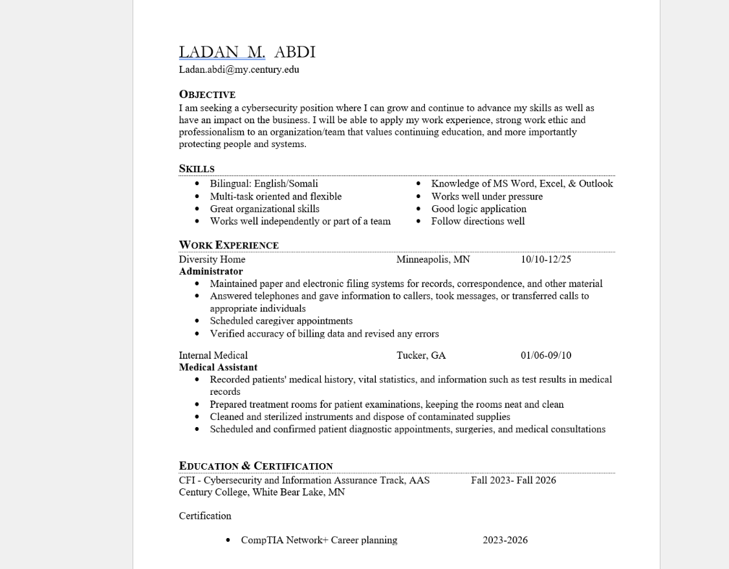

Slide 12

Sources:
Minnesota works.net
LinkedIn
Technical Support Specialist - Information Technology Specialist 1
https://www.minnesotaworks.net/ViewJob.aspx
Technical Support Specialist
https://www.linkedin.com/jobs/search/?currentJobId=3891685260&f_AL=true&f_E=2&f_SB2=1&f_WT=2&geoId=103644278&keywords=it%20support%20specialist&location=United%20States&origin=JOB_SEARCH_PAGE_KEYWORD_AUTOCOMPLETE&refresh=true
U.S Bureau of Labor Statistics
Computer Support Specialists
https://www.bls.gov/ooh/computer-and-information-technology/computer-support-specialists.htm

Slide 13


THANK YOU
Ladan Abdi
Ladan.abdi@my.century.edu
Portfolio

