Slide 1


Unit 9.5 Related Rates of Change
©

Slide 2
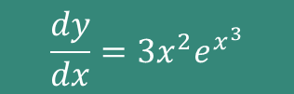
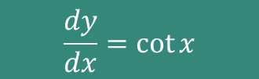
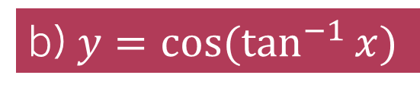
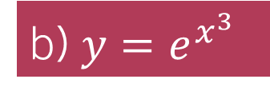
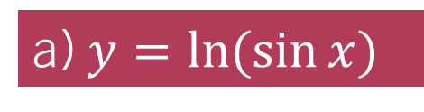
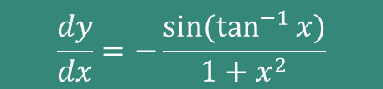
STARTER – on your whiteboards:
Use the chain rule to find $\frac{dy}{dx}$ for each of the following:
a) $y=ln⁡(\sin{x)}$
b) $y=e^{x^{3}}$
b) $y=cos⁡(\tan^{−1}{x})$
$$\frac{dy}{dx}=\cot{x}$$
$$\frac{dy}{dx}=3x^{2}e^{x^{3}}$$
$$\frac{dy}{dx}=−\frac{sin⁡(\tan^{−1}{x)}}{1+x^{2}}$$

Slide 3
9.5 Related Rates Of Change Learning ObjectiveS
Understand how to use the chain rule to solve problems with related rates of change;
Be able to form simple differential equations (rate of change equations) – we do not need to solve these at this stage.

Slide 4
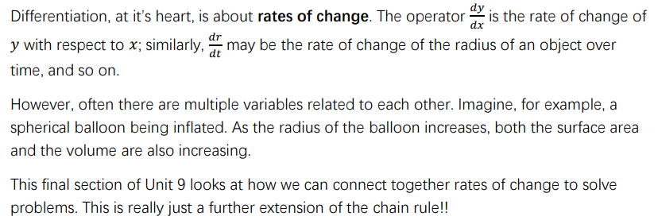
Introduction (Page 22)

Slide 5
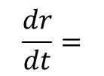
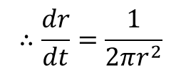
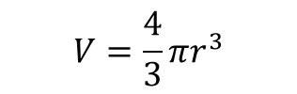
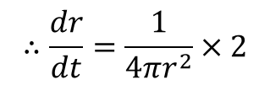
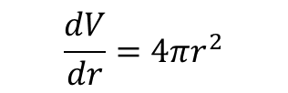
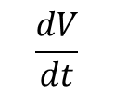
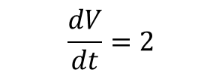

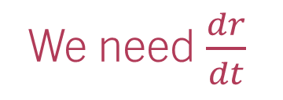
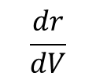
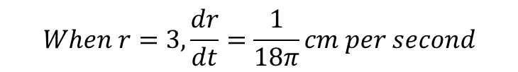
Example 1:
A spherical balloon is being inflated at a constant rate of $2cm^{3}$ per second. At the instant at which the radius is $3cm$, find how fast the radius is increasing.
We need $\frac{dr}{dt}$
Pro Examiner Tip: These type of questions generally involve needing one or more formulae for shapes such as spheres, cones, cylinders etc. Make sure you know the formulae for volume and surface area!
$$V=\frac{4}{3}πr^{3}$$
$$\frac{dV}{dt}=2$$
$$\frac{dV}{dr}=4πr^{2}$$
Now, we need to work out how we can get what we want by chaining the results we have!
$$\frac{dr}{dt}=$$
$$\frac{dr}{dV}$$
$$\frac{dV}{dt}$$
$$×$$
$$When r=3,\frac{dr}{dt}=\frac{1}{18π}cm per second$$
$$∴\frac{dr}{dt}=\frac{1}{4πr^{2}}×2$$
$$∴\frac{dr}{dt}=\frac{1}{2πr^{2}}$$

Slide 6
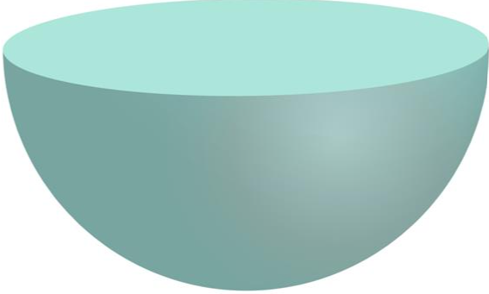
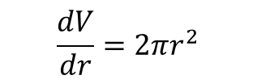



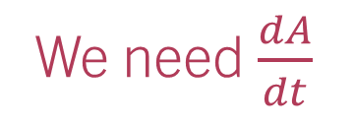

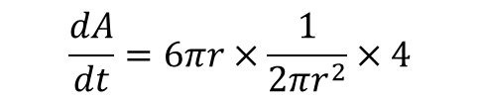
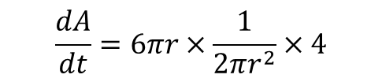

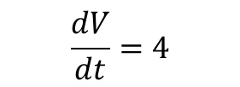

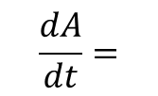
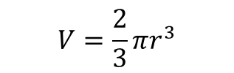
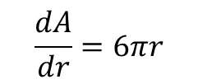

Example 2:
Write down formulae for the volume 𝑉 and surface area 𝐴 of a hemisphere of radius 𝑟.
A hemispherical object is inflated such that the rate of increase of volume is 4𝑐𝑚3 /𝑠𝑒𝑐. Find the rate of increase of the surface area.
$$V=\frac{2}{3}πr^{3}$$
$$A=3πr^{2}$$
We need $\frac{dA}{dt}$
$$\frac{dV}{dt}=4$$
$$\frac{dV}{dr}=2πr^{2}$$
$$\frac{dA}{dr}=6πr$$
Now, we need to work out how we can get what we want by chaining the results we have!
$$\frac{dA}{dt}=$$
$$\frac{dA}{dr}$$
$$\frac{dr}{dV}$$
$$\frac{dV}{dt}$$
$$\frac{dA}{dt}=\frac{12}{r}$$
$$×$$
$$×$$
$$\frac{dA}{dt}=6πr×\frac{1}{2πr^{2}}×4$$
$$\frac{dA}{dt}=6πr×\frac{1}{2πr^{2}}×4$$

Slide 7
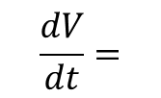

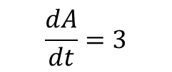
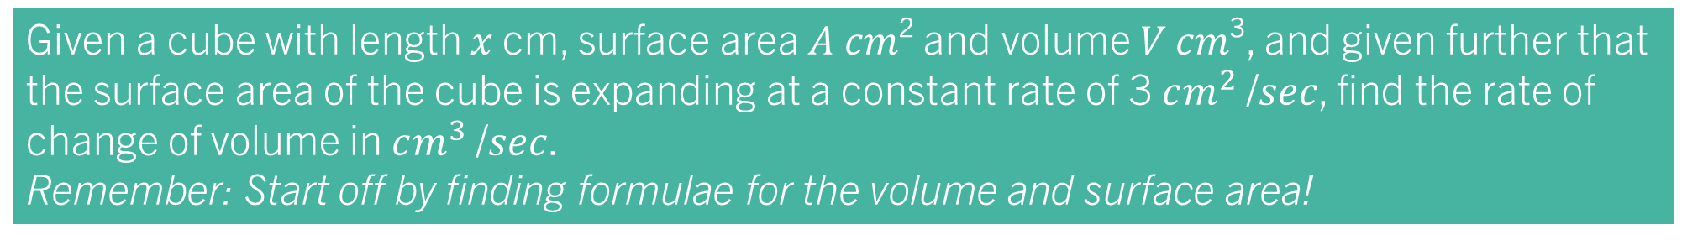
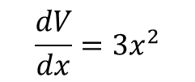
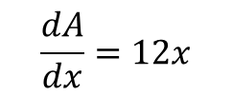



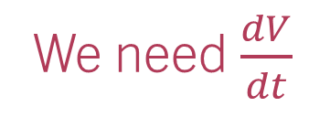
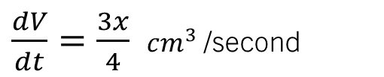


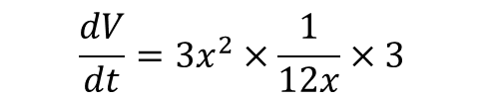
Task 1:
Given a cube with length 𝑥 cm, surface area 𝐴 𝑐𝑚² and volume 𝑉 𝑐𝑚³, and given further that the surface area of the cube is expanding at a constant rate of 3 $cm^{2}$ /𝑠𝑒𝑐, find the rate of change of volume in $cm^{3}$/𝑠𝑒𝑐.
Remember: Start off by finding formulae for the volume and surface area!
$$V=x^{3}$$
$$A=6x^{2}$$
We need $\frac{dV}{dt}$
$$\frac{dV}{dx}=3x^{2}$$
$$\frac{dA}{dx}=12x$$
$$\frac{dA}{dt}=3$$
Now, we need to work out how we can get what we want by chaining the results we have!
$x$ cm
$$\frac{dV}{dt}=$$
$$\frac{dV}{dx}$$
$$\frac{dx}{dA}$$
$$\frac{dA}{dt}$$
$$×$$
$$×$$
$$\frac{dV}{dt}=3x^{2}×\frac{1}{12x}×3$$
$\frac{dV}{dt}=\frac{3x}{4}$ $cm^{3}$/second

Slide 8
Test Your Understanding 4, page 25

Slide 9
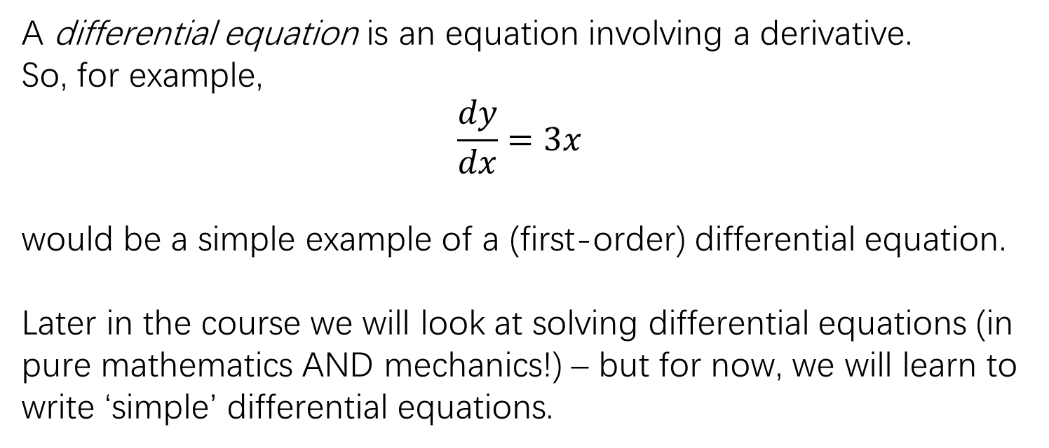
Writing simple differential equations
A differential equation is an equation involving a derivative.
So, for example,
$$\frac{dy}{dx}=3x$$
would be a simple example of a (first-order) differential equation.
Later in the course we will look at solving differential equations (in pure mathematics AND mechanics!) – but for now, we will learn to write ‘simple’ differential equations.

Slide 10
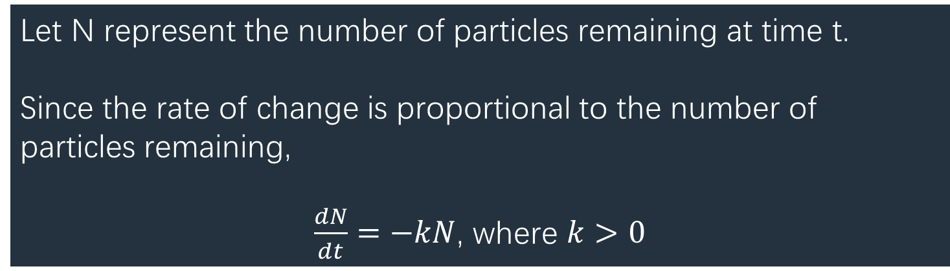
Example 1:
In the decay of radioactive particles, the rate of decay of the particles is proportional to the number of particles remaining.
Write down a differential equation for the rate of change of the number of particles.
Let N represent the number of particles remaining at time t.
Since the rate of change is proportional to the number of particles remaining,
$\frac{dN}{dt}=−kN$, where $k>0$

Slide 11
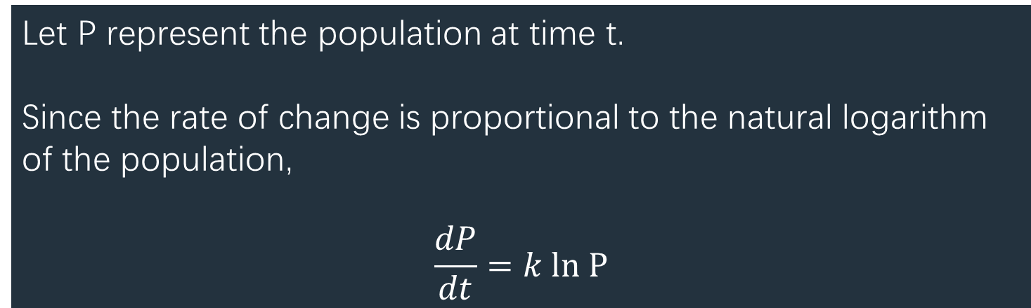
Example 2:
Within a population of a particular species of insect, the rate of increase of population at any given time is proportional to the natural logarithm of the population at that time.
Write a differential equation to model this situation
Let P represent the population at time t.
Since the rate of change is proportional to the natural logarithm of the population,
$$\frac{dP}{dt}=k ln P$$

Slide 12
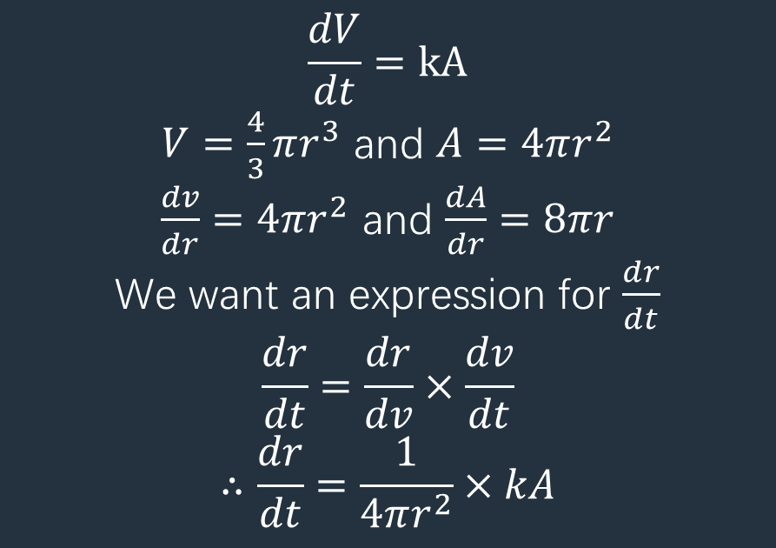
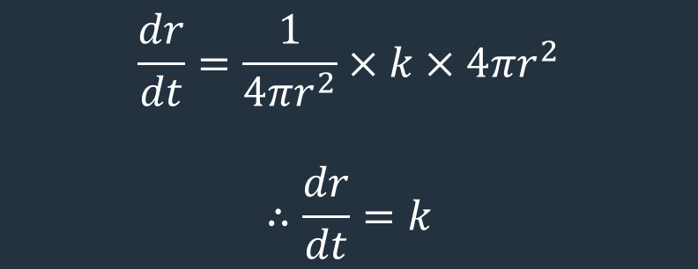
Example 3:
A snowball rolling down a snowy hill gains volume at a rate proportional to its surface area. Write down a differential equation for the rate of change of the radius of the snowball.
$$\frac{dV}{dt}=kA$$
$V=\frac{4}{3}πr^{3}$ and $A=4πr^{2}$
$\frac{dv}{dr}=4πr^{2}$ and $\frac{dA}{dr}=8πr$
We want an expression for $\frac{dr}{dt}$
$$\frac{dr}{dt}=\frac{dr}{dv}×\frac{dv}{dt}$$
$$∴\frac{dr}{dt}=\frac{1}{4πr^{2}}×kA$$
$$\frac{dr}{dt}=\frac{1}{4πr^{2}}×k×4πr^{2}$$
$$∴\frac{dr}{dt}=k$$

