Slide 1


Unit 9.3 inverse trigonometric differentiation
©

Slide 2
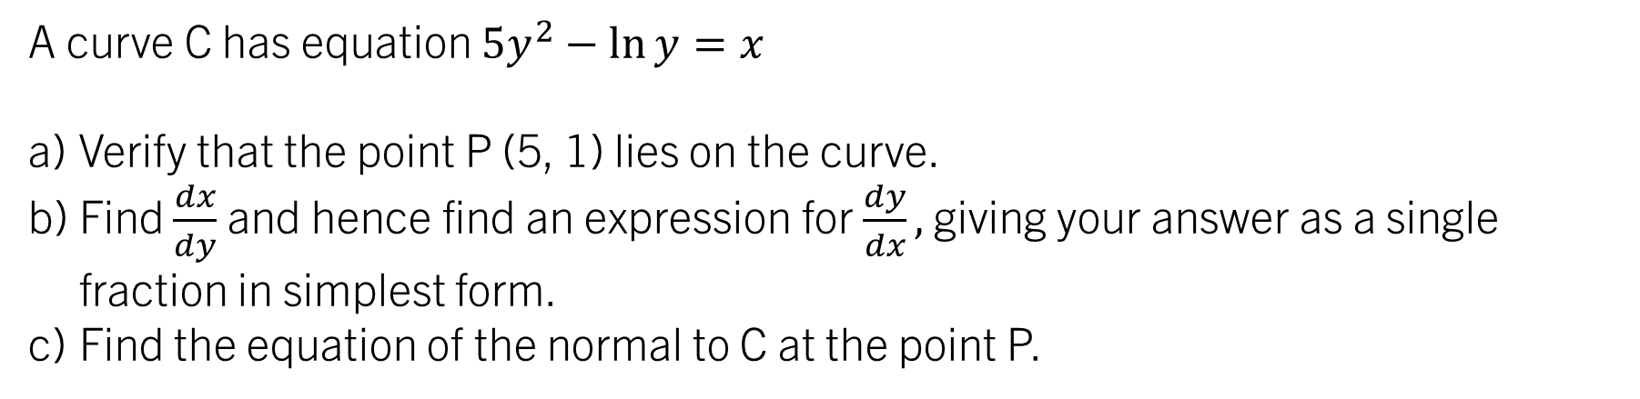
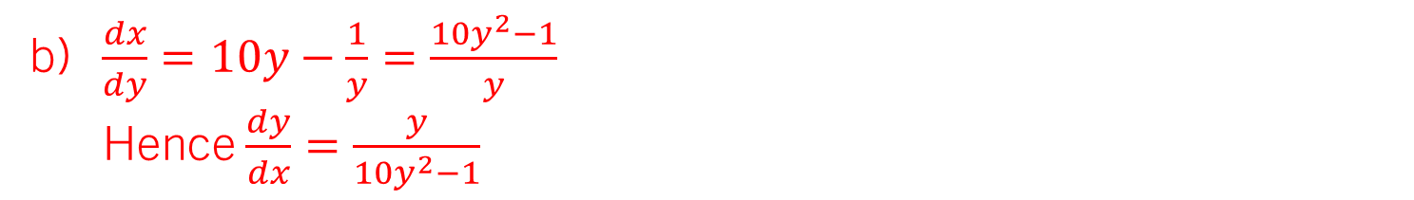
STARTER – on your whiteboards:
A curve C has equation $5y^{2}−\ln{y}=x$
Verify that the point P (5, 1) lies on the curve.
Find $\frac{dx}{dy}$ and hence find an expression for $\frac{dy}{dx},$ giving your answer as a single fraction in simplest form.
Find the equation of the normal to C at the point P.
When $y=1, x=5{\left(1\right)}^{2}−\ln{1}=5$ therefore (5, 1) lies on C.
b) $\frac{dx}{dy}=10y−\frac{1}{y}=\frac{10y^{2}−1}{y}$
Hence $\frac{dy}{dx}=\frac{y}{10y^{2}−1}$
c) When $y=1,\frac{dy}{dx}=\frac{1}{9}$, hence $m_{N}=−9$ and $y=46−9x$

Slide 3

9.3 differentiating the inverse trigonometric functions Learning ObjectiveS
Be able to prove the derivatives of $\sin^{−1}{x}$, $\cos^{−1}{x}$ and $\tan^{−1}{x}$;
To understand and justify the decision for the signs of $\frac{dy}{dx}$ in the cases of $\sin^{−1}{x}$ and $\cos^{−1}{x};$
To be able to use the standard results for the above, along with chain/product/quotient rules, to find harder derivatives.

Slide 4
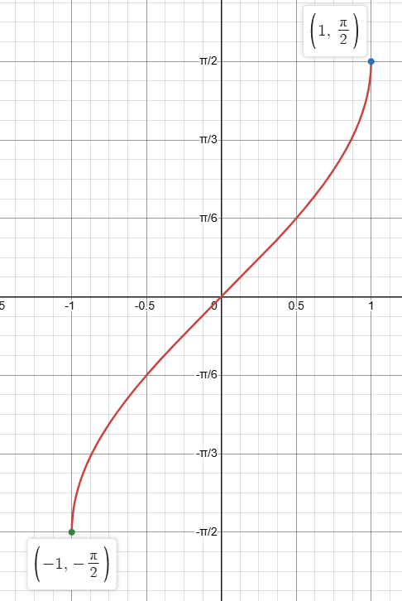
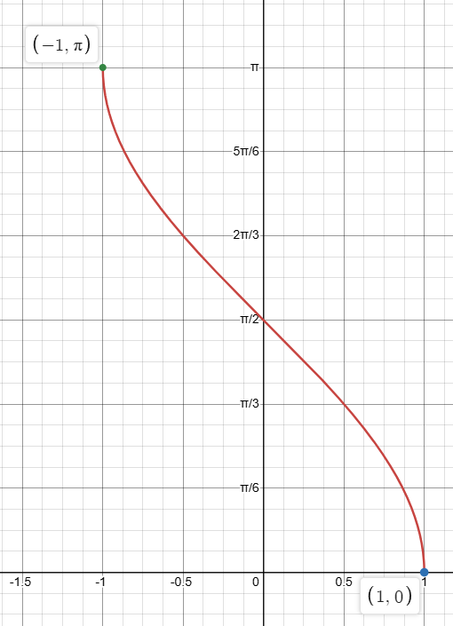
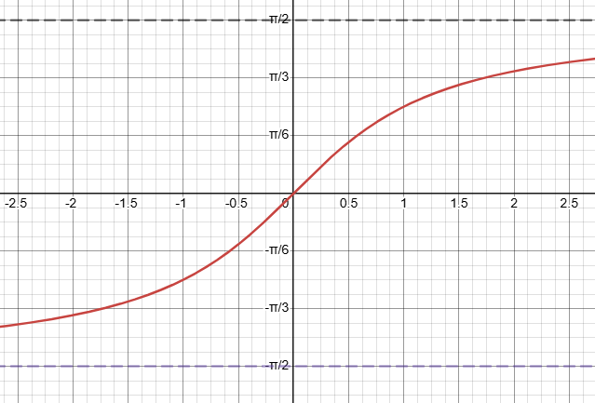



recap – the graphs of the inverse trigonometric functions
We have previously met the three inverse trigonometric functions. It is important that we understand the graphs – they are needed today!
$$y=\sin^{−1}{x}$$
$$y=\cos^{−1}{x}$$
$$y=\tan^{−1}{x}$$

Slide 5

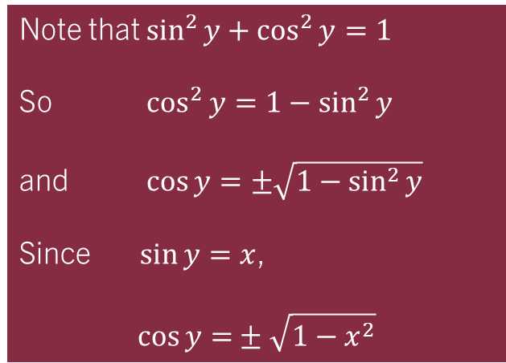

Example 1:
Show that the derivative of $y=\sin^{−1}{x}$ is $\frac{dy}{dx}=\frac{1}{\sqrt{1−x^{2}}}$
$$\sin{y}=x$$
$$\frac{dx}{dy}=cosy$$
$$∴\frac{dy}{dx}=\frac{1}{\cos{y}}$$
Note that $\sin^{2}{y+\cos^{2}{y}=1}$
So $\cos^{2}{y=1−\sin^{2}{y}}$
and $\cos{y}=±\sqrt{1−\sin^{2}{y}}$
Since $\sin{y}=x$,
$$\cos{y=}±\sqrt{1−x^{2}}$$
Wait... That doesn’t look right?
$$∴\frac{dy}{dx}=\frac{1}{\sqrt{1−x^{2}}}$$
Gradient is always positive, so we take the positive root

Slide 6
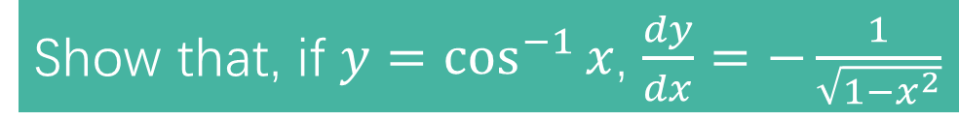
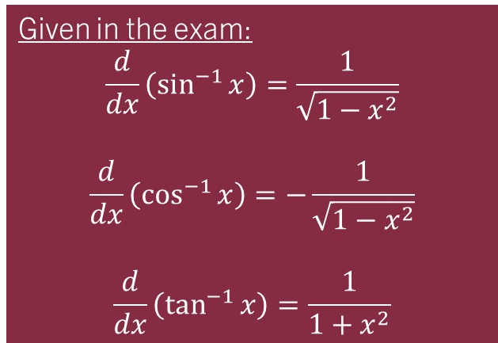
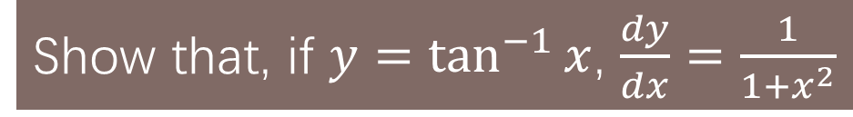
Tasks 1A and 1B:
Show that, if $y=\cos^{−1}{x}$, $\frac{dy}{dx}=−\frac{1}{\sqrt{1−x^{2}}}$
Show that, if $y=\tan^{−1}{x}$, $\frac{dy}{dx}=\frac{1}{1+x^{2}}$
Given in the exam:
$$\frac{d}{dx}\left(\sin^{−1}{x}\right)=\frac{1}{\sqrt{1−x^{2}}}$$
$$\frac{d}{dx}\left(\cos^{−1}{x}\right)=−\frac{1}{\sqrt{1−x^{2}}}$$
$$\frac{d}{dx}\left(\tan^{−1}{x}\right)=\frac{1}{1+x^{2}}$$
It has been a while since these have been examined – be prepared!!

Slide 7
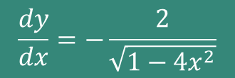

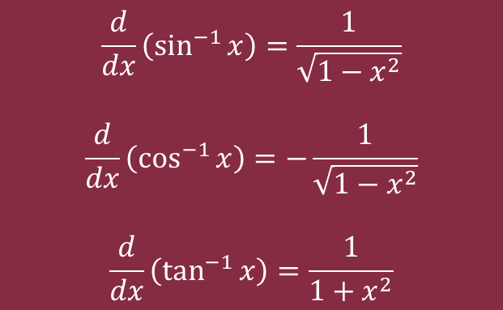
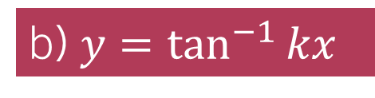
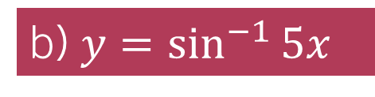
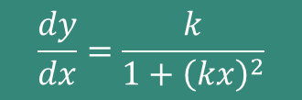

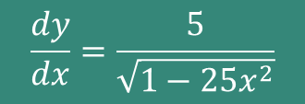
Example 2:
Find $\frac{dy}{dx}$ when:
a) $y=\cos^{−1}{2x}$
b) $y=\sin^{−1}{5x}$
b) $y=\tan^{−1}{kx}$
$$\frac{dy}{dx}=−\frac{2}{\sqrt{1−4x^{2}}}$$
$$\frac{dy}{dx}=\frac{5}{\sqrt{1−25x^{2}}}$$
$$\frac{dy}{dx}=\frac{k}{1+{\left(kx\right)}^{2}}$$
$$\frac{d}{dx}\left(\sin^{−1}{x}\right)=\frac{1}{\sqrt{1−x^{2}}}$$
$$\frac{d}{dx}\left(\cos^{−1}{x}\right)=−\frac{1}{\sqrt{1−x^{2}}}$$
$$\frac{d}{dx}\left(\tan^{−1}{x}\right)=\frac{1}{1+x^{2}}$$

Slide 8
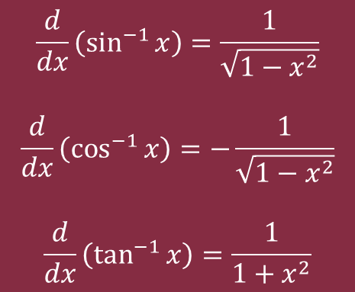

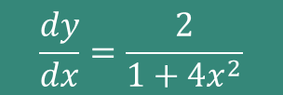

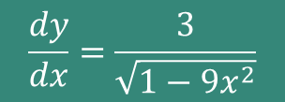

TASK 2 – on onenote
$$\frac{d}{dx}\left(\sin^{−1}{x}\right)=\frac{1}{\sqrt{1−x^{2}}}$$
$$\frac{d}{dx}\left(\cos^{−1}{x}\right)=−\frac{1}{\sqrt{1−x^{2}}}$$
$$\frac{d}{dx}\left(\tan^{−1}{x}\right)=\frac{1}{1+x^{2}}$$
Find $\frac{dy}{dx}$ for each of:
$$y=\sin^{−1}{3x}$$
$$\frac{dy}{dx}=\frac{3}{\sqrt{1−9x^{2}}}$$
$$y=\tan^{−1}{2x}$$
$$\frac{dy}{dx}=\frac{2}{1+4x^{2}}$$

Slide 9



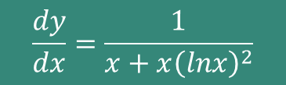
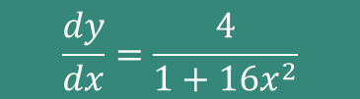


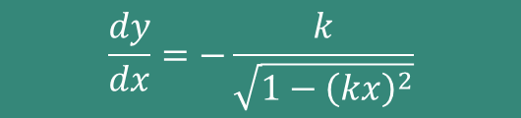
Quickfire derivatives - whiteboards
$$\frac{d}{dx}\left(\sin^{−1}{x}\right)=\frac{1}{\sqrt{1−x^{2}}}$$
$$\frac{d}{dx}\left(\cos^{−1}{x}\right)=−\frac{1}{\sqrt{1−x^{2}}}$$
$$\frac{d}{dx}\left(\tan^{−1}{x}\right)=\frac{1}{1+x^{2}}$$
Find $\frac{dy}{dx}$ for each of:
$$y=\tan^{−1}{4x}$$
$$\frac{dy}{dx}=\frac{4}{1+16x^{2}}$$
$$y=\sin^{−1}{9x}$$
$$\frac{dy}{dx}=\frac{9}{\sqrt{1−81x^{2}}}$$
$$y=\cos^{−1}{kx}$$
$$\frac{dy}{dx}=−\frac{k}{\sqrt{1−{\left(kx\right)}^{2}}}$$
$$y=\tan^{−1}{(lnx)}$$
$$\frac{dy}{dx}=\frac{1}{x+x{\left(lnx\right)}^{2}}$$

Slide 10







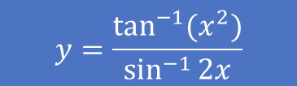
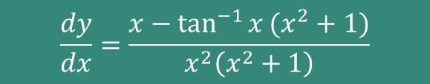

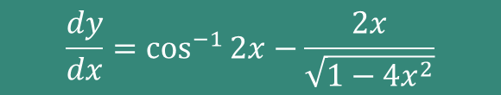
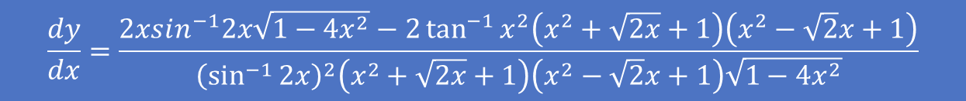
stretch your understanding
$$y={xcos}^{−1}{2x}$$
$$y=\frac{\tan^{−1}{x}}{x}$$
$$y=\sin^{−1}{(e^{x})}$$
$$y=\tan^{−1}{\frac{x}{2}}$$
$$y=\frac{\tan^{−1}{(x^{2})}}{\sin^{−1}{2x}}$$
$$y=ln⁡(\tan^{−1}{x)}$$
All of the above are significantly beyond what has been asked on this content – this is very much stretch and challenge work!
$$\frac{dy}{dx}=\frac{2xsin^{−1}2x\sqrt{1−4x^{2}}−2\tan^{−1}{x^{2}\left(x^{2}+\sqrt{2x}+1\right)\left(x^{2}−\sqrt{2}x+1\right)}}{{\left(\sin^{−1}{2x}\right)}^{2}\left(x^{2}+\sqrt{2x}+1\right)\left(x^{2}−\sqrt{2}x+1\right)\sqrt{1−4x^{2}}}$$
$$\frac{dy}{dx}=\cos^{−1}{2x}−\frac{2x}{\sqrt{1−4x^{2}}}$$
$$\frac{dy}{dx}=\frac{x−\tan^{−1}{x}(x^{2}+1)}{x^{2}\left(x^{2}+1\right)}$$
$$\frac{dy}{dx}=\frac{e^{x}}{\sqrt{1−e^{2x}}}$$
$$\frac{dy}{dx}=\frac{2}{x^{2}+4}$$
$$\frac{dy}{dx}=\frac{1}{\left(x^{2}+1\right)\tan^{−1}{x}}$$

