Slide 1


Unit 9.2 IMPLICIT differentiation
©

Slide 2
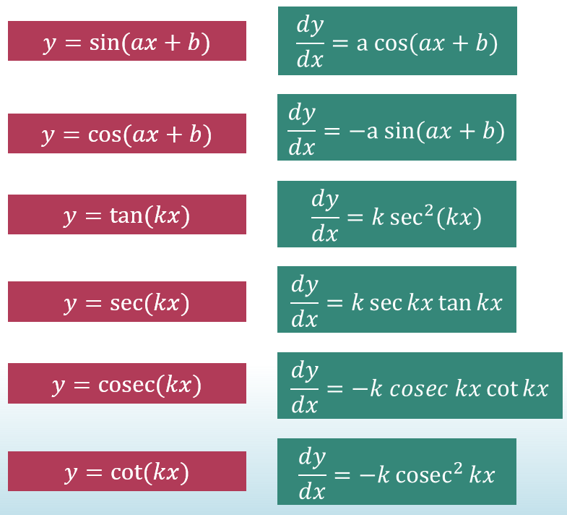
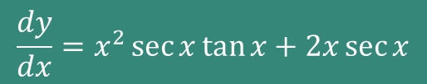
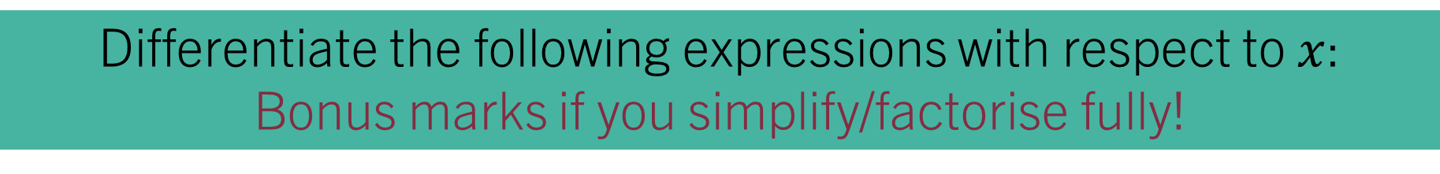
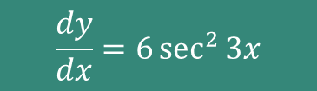



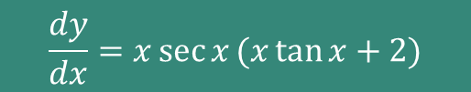

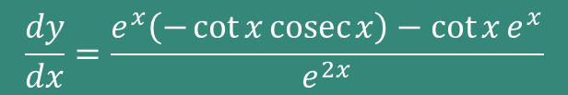
STARTER – on your whiteboards:
Differentiate the following expressions with respect to $x$:
Bonus marks if you simplify/factorise fully!
$$y=2tan{3x}$$
$$y=x^{2}\sec{x}$$
$$y=\frac{\cot{x}}{e^{x}}$$
$$\frac{dy}{dx}=6\sec^{2}{3x}$$
$$\frac{dy}{dx}=x^{2}\sec{x}\tan{x}+2x\sec{x}$$
$$\frac{dy}{dx}=\frac{e^{x}\left(−\cot{x}\operatorname{cosec}{x}\right)−\cot{x}e^{x}}{e^{2x}}$$
$$\frac{dy}{dx}=x\sec{x}(x\tan{x+2)}$$
$$\frac{dy}{dx}=\frac{\cot{x}(−\operatorname{cosec}{x}−1)}{e^{x}}$$

Slide 3
9.2 – Implicit Differentiation Learning ObjectiveS
To understand what is meant by implicit differentiation, and why it is needed;
To be able to find derivatives of expressions using implicit differentiation;
To spot and use product and quotient rules where required with implicit differentiation;
To solve problems with gradients and tangents by implicit differentiation.
This includes cases where we are asked for vertical tangents!

Slide 4
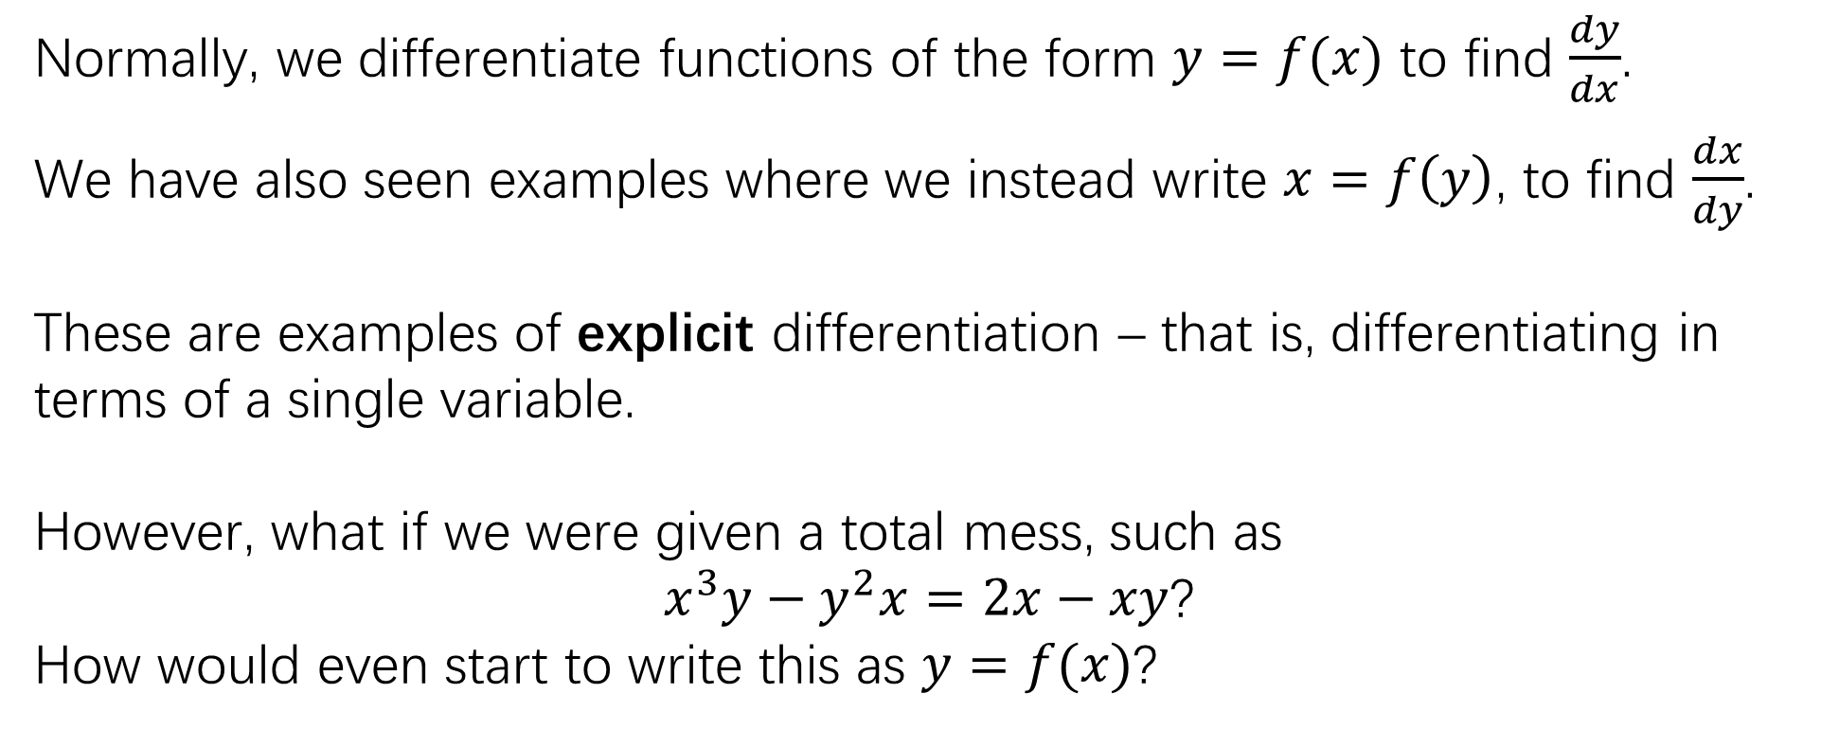
Wait... What was explicit differentiation??
Normally, we differentiate functions of the form $y=f(x)$ to find $\frac{dy}{dx}$.
We have also seen examples where we instead write $x=f\left(y\right)$, to find $\frac{dx}{dy}$.
These are examples of explicit differentiation – that is, differentiating in terms of a single variable.
However, what if we were given a total mess, such as
$x^{3}y−y^{2}x=2x−xy$?
How would even start to write this as $y=f(x)$?
This is given in the formula booklet!

Slide 5
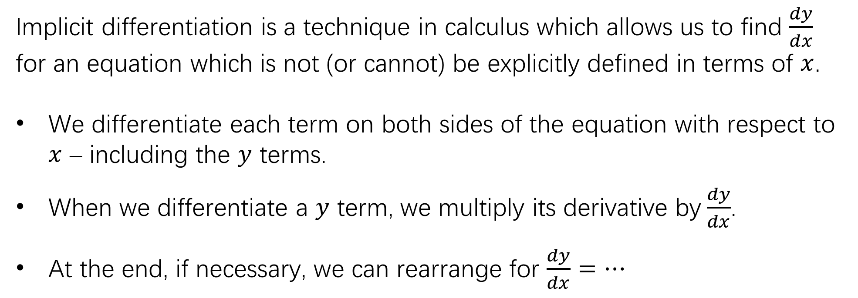
Implicit Differentiation
Implicit differentiation is a technique in calculus which allows us to find $\frac{dy}{dx}$ for an equation which is not (or cannot) be explicitly defined in terms of $x$.
We differentiate each term on both sides of the equation with respect to $x$ – including the $y$ terms.
When we differentiate a $y$ term, we multiply its derivative by$\frac{dy}{dx}$.
At the end, if necessary, we can rearrange for $\frac{dy}{dx}=…$
This is really just using the chain rule on every $y$ term – we know that the derivative of $y$ with respect to $x$ is $\frac{dy}{dx}$
These are given in the formula booklet!

Slide 6






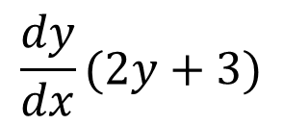


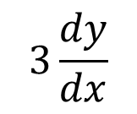



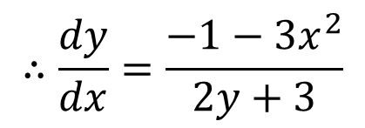
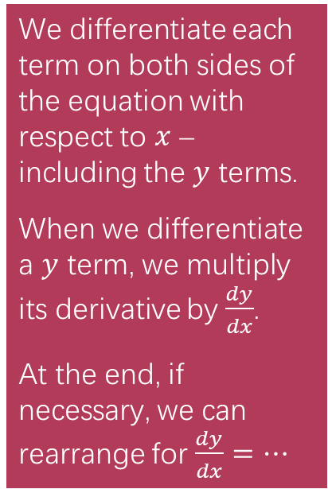
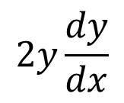
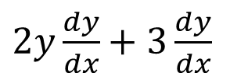
Example 1:
We differentiate each term on both sides of the equation with respect to $x$ – including the $y$ terms.
When we differentiate a $y$ term, we multiply its derivative by$\frac{dy}{dx}$.
At the end, if necessary, we can rearrange for $\frac{dy}{dx}=…$
Find $\frac{dy}{dx}$ where $x^{3}+x +{ y}^{2} + 3y=5$
$$2y\frac{dy}{dx}$$
$$3\frac{dy}{dx}$$
$$3x^{2}$$
$$+$$
$$1$$
$$+$$
$$+$$
$$=$$
$$0$$
$2y\frac{dy}{dx}+3\frac{dy}{dx}$
$$=$$
$$−1−3x^{2}$$
$$\frac{dy}{dx}(2y+3)$$
$$=−1−3x^{2}$$
$$∴\frac{dy}{dx}=\frac{−1−3x^{2}}{2y+3}$$

Slide 7





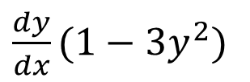

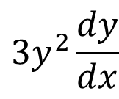


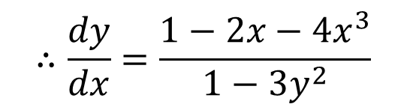

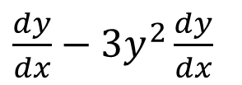
On your boards:
We differentiate each term on both sides of the equation with respect to $x$ – including the $y$ terms.
When we differentiate a $y$ term, we multiply its derivative by$\frac{dy}{dx}$.
At the end, if necessary, we can rearrange for $\frac{dy}{dx}=…$
Find $\frac{dy}{dx}$ where $x^{4}+y+x^{2} −y^{3}=x$
$$\frac{dy}{dx}$$
$$3y^{2}\frac{dy}{dx}$$
$$+$$
$$+$$
$$4x^{3}$$
$$2x$$
$$−$$
$$=$$
$$1$$
$\frac{dy}{dx}−3y^{2}\frac{dy}{dx}$
$$=$$
$$1−2x−4x^{3}$$
$\frac{dy}{dx}(1−3y^{2})$
$$=1−2x−4x^{3}$$
$$∴\frac{dy}{dx}=\frac{1−2x−4x^{3}}{1−3y^{2}}$$

Slide 8




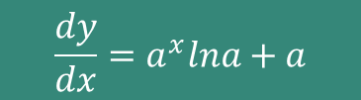




Quickfire derivatives - whiteboards
We differentiate each term on both sides of the equation with respect to $x$ – including the $y$ terms.
When we differentiate a $y$ term, we multiply its derivative by$\frac{dy}{dx}$.
At the end, if necessary, we can rearrange for $\frac{dy}{dx}=…$
Find $\frac{dy}{dx}$ for each of:
$$x^{2}+y^{3}=1$$
$$\frac{dy}{dx}=\frac{−2x}{3y^{2}}$$
$$x^{3}+\ln{y}=x$$
$$\frac{dy}{dx}=y(1−3x^{2})$$
$$\sin{y}=e^{2x}$$
$$\frac{dy}{dx}=\frac{e^{2x}}{\cos{y}}$$
$$y−ax=a^{x}$$
$$\frac{dy}{dx}=a^{x}lna+a$$

Slide 9


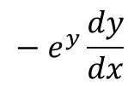
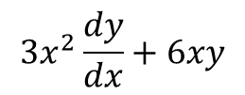

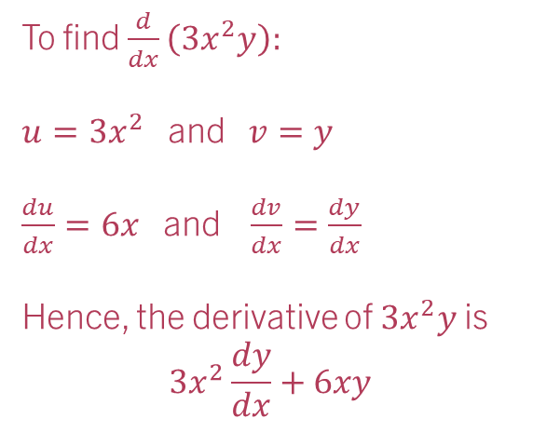


Look out for products and quotients:
We differentiate each term on both sides of the equation with respect to $x$ – including the $y$ terms.
When we differentiate a $y$ term, we multiply its derivative by$\frac{dy}{dx}$.
At the end, if necessary, we can rearrange for $\frac{dy}{dx}=…$
Find $\frac{dy}{dx}$ where $3x^{2}y−e^{y}=1$
$$3x^{2}\frac{dy}{dx}+6xy$$
$$− e^{y}\frac{dy}{dx}$$
To find $\frac{d}{dx}\left(3x^{2}y\right):$
$u=3x^{2}$ and $v=y$
$\frac{du}{dx}=6x$ and $\frac{dv}{dx}=\frac{dy}{dx}$
Hence, the derivative of $3x^{2}y$ is
$$3x^{2}\frac{dy}{dx}+6xy$$
$$=0$$
$$3x^{2}\frac{dy}{dx}−e^{y}\frac{dy}{dx}=−6xy$$
$$\frac{dy}{dx}(3x^{2}−e^{y})=−6xy$$
$$\frac{dy}{dx}=\frac{−6xy}{3x^{2}−e^{y}}$$

Slide 10

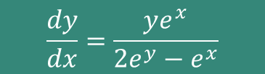
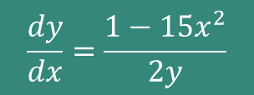


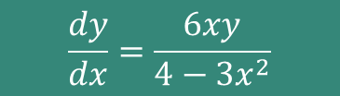
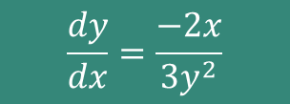
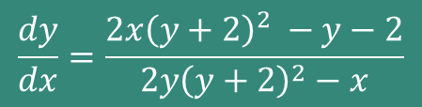


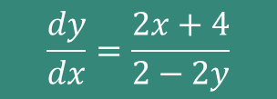
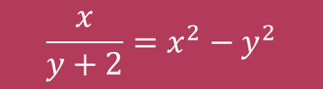
TASK 1 – on onenote
Find $\frac{dy}{dx}$ for each of:
Beware products and quotients – use the correct rule(s)!
$$x^{2}+y^{3}=2$$
$$\frac{dy}{dx}=\frac{−2x}{3y^{2}}$$
$$\frac{dy}{dx}=\frac{6xy}{4−3x^{2}}$$
$$3x^{2}y=4y$$
$$5x^{3}+y^{2}=x$$
$$\frac{dy}{dx}=\frac{1−15x^{2}}{2y}$$
$$ye^{x}=2e^{y}$$
$$\frac{dy}{dx}=\frac{ye^{x}}{2e^{y}−e^{x}}$$
$$x^{2}+4x+y^{2}−2y=20$$
$$\frac{dy}{dx}=\frac{2x+4}{2−2y}$$
$$\frac{x}{y+2}=x^{2}−y^{2}$$
$$\frac{dy}{dx}=\frac{2x{\left(y+2\right)}^{2} −y−2}{2y{\left(y+2\right)}^{2}−x}$$

Slide 11
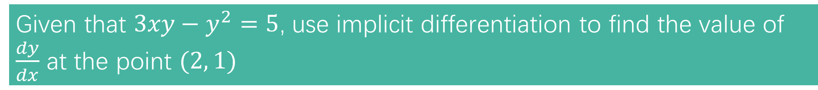

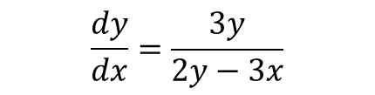
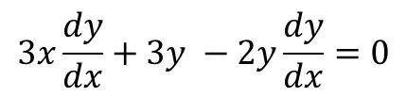
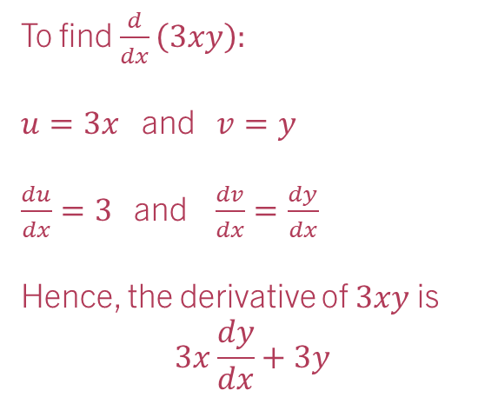
Example 2:
Given that $3xy−y^{2}=5$, use implicit differentiation to find the value of $\frac{dy}{dx}$ at the point $(2, 1)$
$$3x\frac{dy}{dx}+3y −2y\frac{dy}{dx}=0$$
To find $\frac{d}{dx}\left(3xy\right):$
$u=3x$ and $v=y$
$\frac{du}{dx}=3$ and $\frac{dv}{dx}=\frac{dy}{dx}$
Hence, the derivative of $3xy$ is
$$3x\frac{dy}{dx}+3y$$
$$\frac{dy}{dx}=\frac{3y}{2y−3x}$$
At $\left(2, 1\right) \frac{dy}{dx}=\frac{3\left(1\right)}{2\left(1\right)−3\left(2\right)}=−\frac{3}{4}$

Slide 12
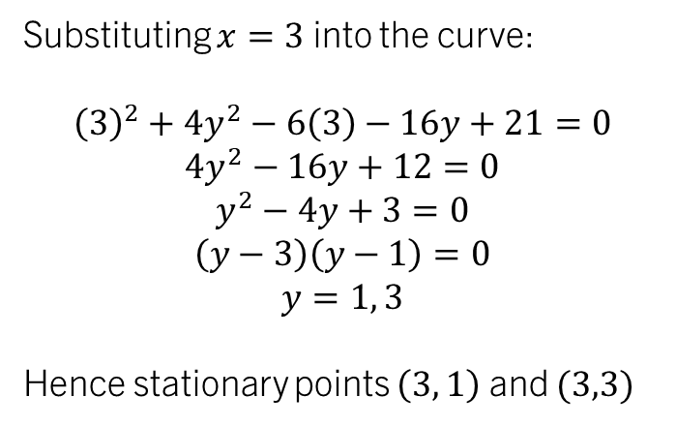

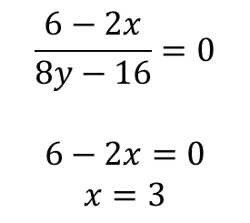

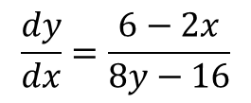
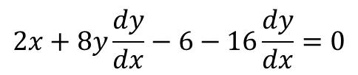
Example 3:
Find the coordinates of the stationary point(s) on the curve defined implicitly by the equation $x^{2}+4y^{2}−6x−16y+21=0$
$$2x+8y\frac{dy}{dx}−6−16\frac{dy}{dx}=0$$
Substituting $x=3$ into the curve:
$${\left(3\right)}^{2}+4y^{2}−6\left(3\right)−16y+21=0$$
$$4y^{2}−16y+12=0$$
$$y^{2}−4y+3=0$$
$$\left(y−3\right)\left(y−1\right)=0$$
$$y=1, 3$$
Hence stationary points $\left(3, 1\right)$ and $(3,3)$
$$\frac{dy}{dx}=\frac{6−2x}{8y−16}$$
At stationary points $\frac{dy}{dx}=0$
$$\frac{6−2x}{8y−16}=0$$
$$6−2x=0$$
$$x=3$$
The examiner will happily give 5 or 6 marks for a question like this!

Slide 13
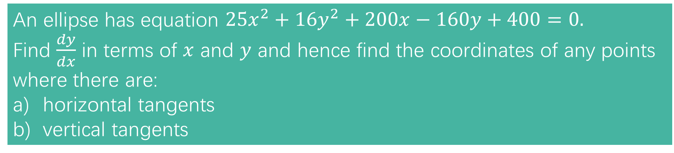
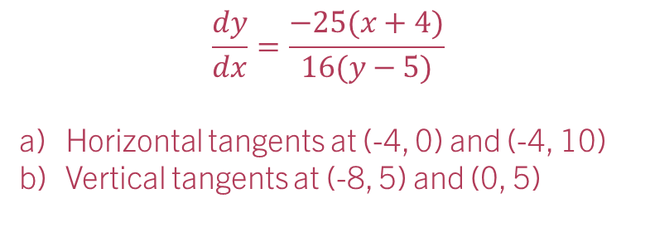
Task 2 – work in pairs
An ellipse has equation $25x^{2}+16y^{2}+200x−160y+400=0.$
Find $\frac{dy}{dx}$ in terms of $x$ and $y$ and hence find the coordinates of any points where there are:
horizontal tangents
vertical tangents
$$\frac{dy}{dx}=\frac{−25(x+4)}{16(y−5)}$$
Horizontal tangents at (-4, 0) and (-4, 10)
Vertical tangents at (-8, 5) and (0, 5)

Slide 14
Test your understanding 2
Complete TYU 2 from your pack.
Further questions available in student booklet (Exercise 9H page 29)

