Slide 1


Unit 9.1 – Trigonometric differentiation
©

Slide 2
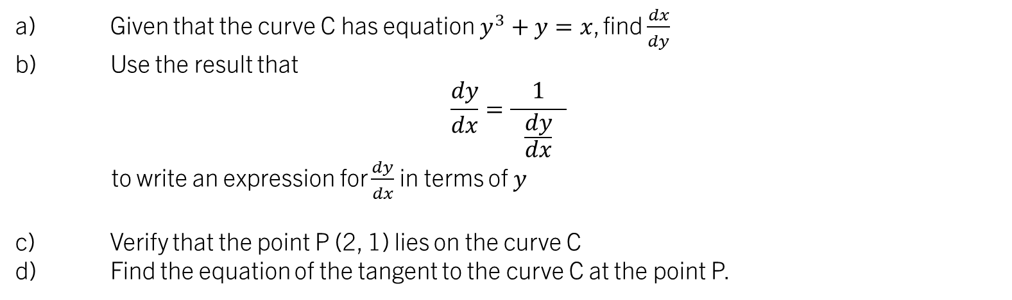

STARTER:
Key Point:
$$\frac{dy}{dx}=\frac{ 1 }{\frac{dy}{dx}}$$
Given that the curve C has equation $y^{3}+y=x$, find $\frac{dx}{dy}$
Use the result that
$$\frac{dy}{dx}=\frac{ 1 }{\frac{dy}{dx}}$$
to write an expression for $\frac{dy}{dx}$ in terms of $y$
Verify that the point P (2, 1) lies on the curve C
Find the equation of the tangent to the curve C at the point P.

Slide 3

9.1 – Trigonometric Differentiation
Learning ObjectiveS
To recap on the standard results for $\sin\left(ax+b\right)$ and $cos⁡(ax+b)$
To be able to derive and use the standard results for differentiating $\tan{x},\sec{x}, cosec x$and $\cot{x}$
To be able to solve problems involving these derivatives

Slide 4
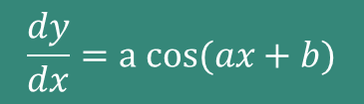



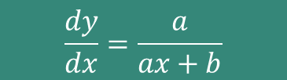
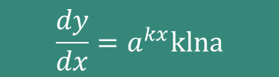




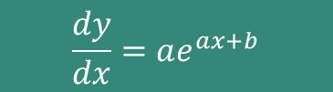

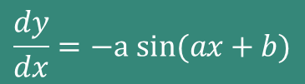

STANDARD RESULTS RECAP
$$y=sin⁡(ax+b)$$
$$\frac{dy}{dx}=a cos(ax+b)$$
$$\frac{dy}{dx}=−a sin(ax+b)$$
$$y=cos⁡(ax+b)$$
$$y=e^{ax+b}$$
$$\frac{dy}{dx}=ae^{ax+b}$$
$$\frac{dy}{dx}=\frac{1}{x}$$
$$y=ln\left|ax\right|$$
$$y=ln\left|ax+b\right|$$
$$\frac{dy}{dx}=\frac{a}{ax+b}$$
$$\frac{dy}{dx}=a^{x}lna$$
$$y=a^{x}$$
$$\frac{dy}{dx}=a^{kx}klna$$
$$y=a^{kx}$$

Slide 5
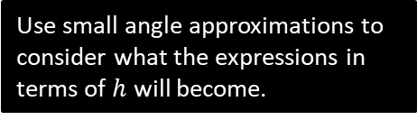
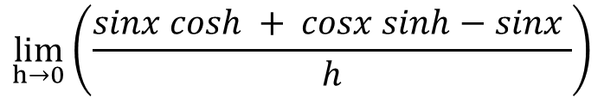




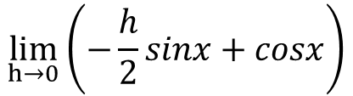
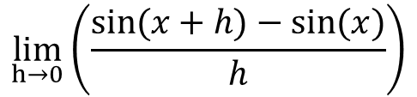

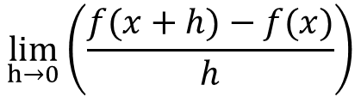

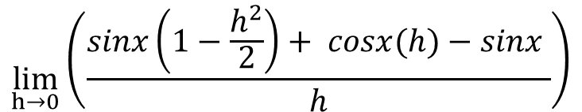


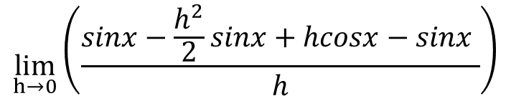
Differentiating sin(x) from first principles
$$\lim_{h→0}\left(\frac{f(x+h)−f(x)}{h}\right)$$
Let $y=f(x)=sinx$. Then, $f^{′}\left(x\right)=$
$$\lim_{h→0}\left(\frac{sin(x+h)−sin(x)}{h}\right)$$
$$=$$
$$\lim_{h→0}\left(\frac{sinx cosh + cosx sinh−sinx }{h}\right)$$
$$=$$
Use addition formula.
$$\lim_{h→0}\left(\frac{sinx\left(1−\frac{h^{2}}{2}\right)+ cosx(h)−sinx }{h}\right)$$
$$=$$
Use small angle approximations.
$$\lim_{h→0}\left(\frac{sinx−\frac{h^{2}}{2}sinx+hcosx−sinx }{h}\right)$$
Expand, simplify and cancel $h$s
$$=$$
$$\lim_{h→0}\left(−\frac{h}{2}sinx+cosx\right)$$
$$=$$
$f^{′}\left(x\right)=cosx$, $∴\frac{dy}{dx}=cosx$

Slide 6
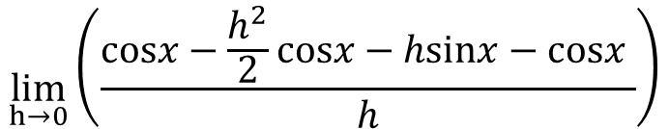

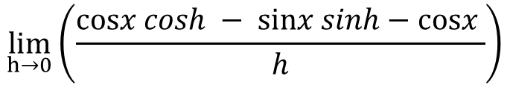

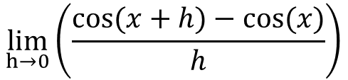
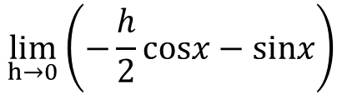
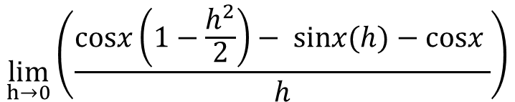
Exercise 1: Differentiating cos(x) from first principles
$$\lim_{h→0}\left(\frac{f(x+h)−f(x)}{h}\right)$$
Let $y=f(x)=cosx$. Then, $f^{′}\left(x\right)=$
$$\lim_{h→0}\left(\frac{cos(x+h)−cos(x)}{h}\right)$$
$$=$$
$$\lim_{h→0}\left(\frac{cosx cosh − sinx sinh−cosx }{h}\right)$$
$$=$$
Use addition formula.
$$\lim_{h→0}\left(\frac{cosx\left(1−\frac{h^{2}}{2}\right)− sinx(h)−cosx }{h}\right)$$
$$=$$
Use small angle approximations.
$$\lim_{h→0}\left(\frac{cosx−\frac{h^{2}}{2}cosx−hsinx−cosx }{h}\right)$$
Expand, simplify and cancel $h$s
$$=$$
$$\lim_{h→0}\left(−\frac{h}{2}cosx−sinx\right)$$
$$=$$
$f^{′}\left(x\right)=−sinx$, $∴\frac{dy}{dx}=−sinx$

Slide 7




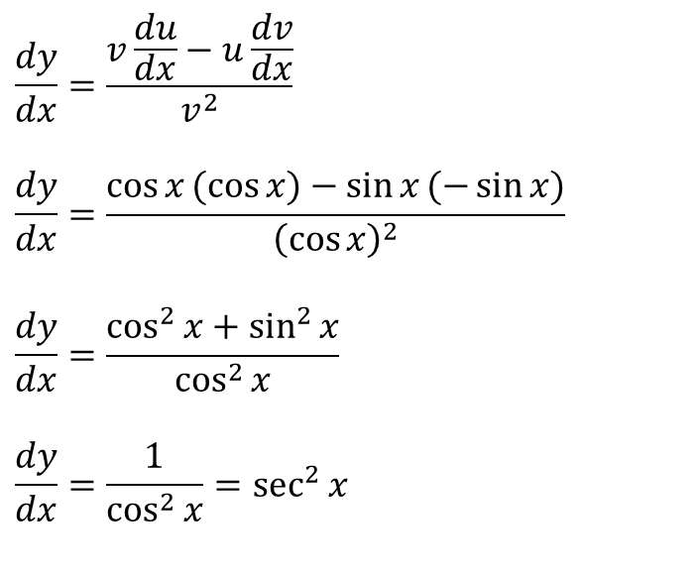

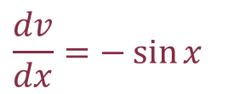
Differentiating $y=tanx$
We can differentiate $y=\tan{x}$by rewriting it using an identity from AS mathematics
$$y=\tan{x}$$
$$y=\frac{\sin{x}}{\cos{x}}$$
$$u=\sin{x}$$
$$v=\cos{x }$$
$$\frac{du}{dx}=\cos{x}$$
$$\frac{dv}{dx}=−\sin{x}$$
$$\frac{dy}{dx}=\frac{v\frac{du}{dx}−u\frac{dv}{dx}}{v^{2}}$$
$$\frac{dy}{dx}=\frac{\cos{x}(\cos{x)}−\sin{x}(−\sin{x)}}{{\left(\cos{x}\right)}^{2}}$$
$$\frac{dy}{dx}=\frac{\cos^{2}{x}+\sin^{2}{x}}{\cos^{2}{x}}$$
$$\frac{dy}{dx}=\frac{1}{\cos^{2}{x}}=\sec^{2}{x}$$
This is given in the formula booklet!

Slide 8
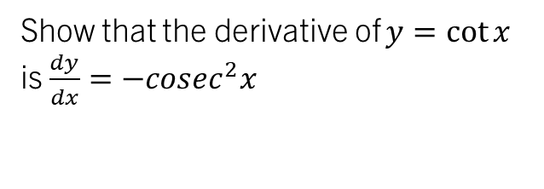
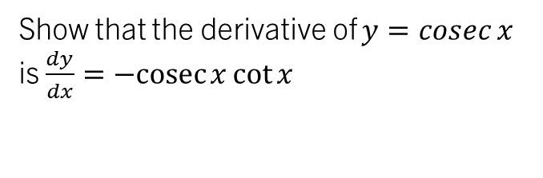
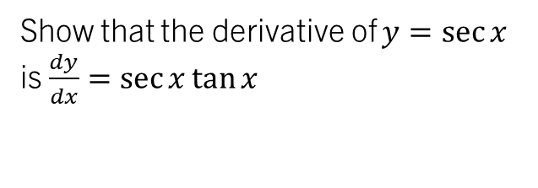
Differentiating the Reciprocal Trigonometric Functions
We can similarly find derivatives for $\sec{x},\operatorname{cosec}{x}$and $\cot{x}$
Show that the derivative of $y=\sec{x}$ is $\frac{dy}{dx}=\sec{x}\tan{x}$
Show that the derivative of $y=\operatorname{cosec}{x}$ is $\frac{dy}{dx}=−cosec{x}\cot{x}$
Show that the derivative of $y=\cot{x}$ is $\frac{dy}{dx}=−cosec^{2}x$
Hint: Chain Rule!
Hint: Chain Rule!
Hint: Quotient Rule!
These are given in the formula booklet!

Slide 9


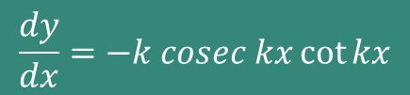

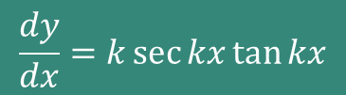

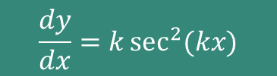
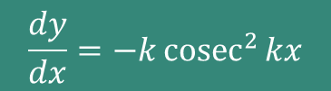
STANDARD trigonometric RESULTS RECAP
$$y=sin⁡(ax+b)$$
$$\frac{dy}{dx}=a cos(ax+b)$$
$$\frac{dy}{dx}=−a sin(ax+b)$$
$$y=cos⁡(ax+b)$$
$$y=\tan{(kx)}$$
$$\frac{dy}{dx}=k\sec^{2}{(kx)}$$
$$\frac{dy}{dx}=k\sec{kx}\tan{kx}$$
$$y=\sec{(kx)}$$
$$y=\operatorname{cosec}{(kx)}$$
$$\frac{dy}{dx}=−k cosec kx\cot{kx}$$
$$y=\cot{(kx)}$$
$$\frac{dy}{dx}=−k{cosec}^{2}{kx}$$

Slide 10
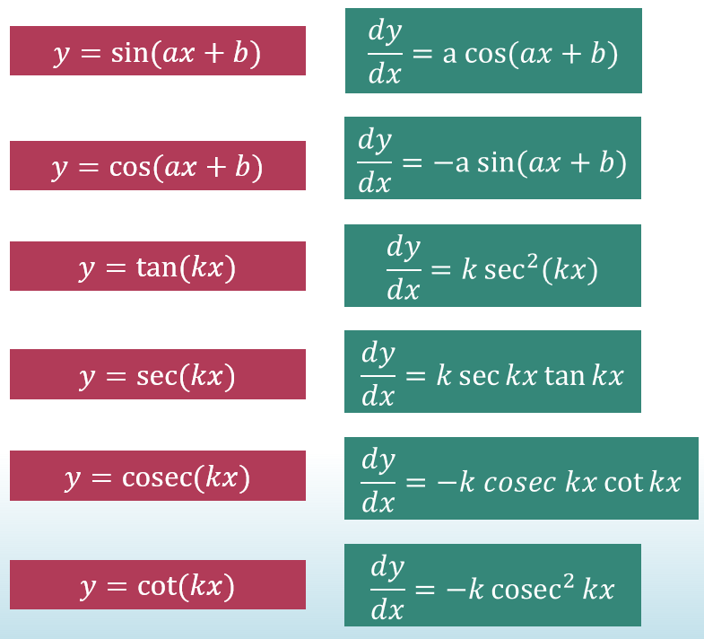
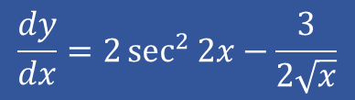





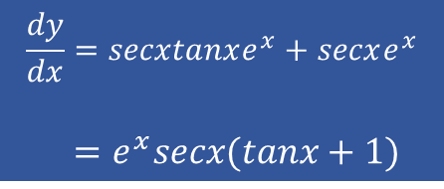
Task 1:
Find $\frac{dy}{dx}$ for each of:
$$y=\tan{2x}−3\sqrt{x}$$
$$y=\sec{x}e^{x}$$
$$y=\ln{x}−3cosec(3x−10)$$
$$\frac{dy}{dx}=2\sec^{2}{2x−\frac{3}{2\sqrt{x}}}$$
$$\frac{dy}{dx}=secxtanxe^{x}+secxe^{x}$$
$=e^{x}secx(tanx+1)$
$$\frac{dy}{dx}=\frac{1}{x}+9cosec\left(3x−10\right)cot⁡(3x−10)$$

Slide 11
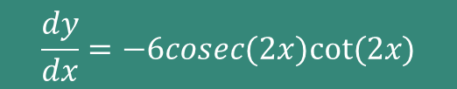


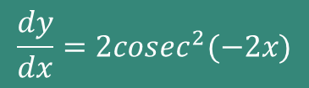
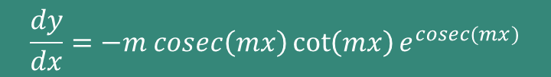
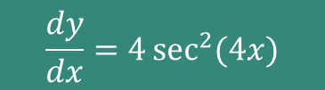



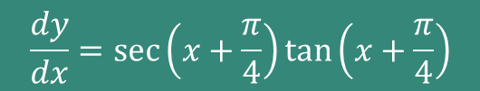

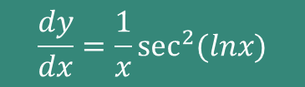
Quickfire derivatives - whiteboards
Find $\frac{dy}{dx}$ for each of:
$$y=tan⁡(4x)$$
$$\frac{dy}{dx}=4\sec^{2}{(4x})$$
$$y=3cosec⁡(2x)$$
$$\frac{dy}{dx}=−6cosec(2x)cot⁡(2x)$$
$$y=\sec{(x+\frac{π}{4})}$$
$$\frac{dy}{dx}=\sec\left(x+\frac{π}{4}\right)\tan\left(x+\frac{π}{4}\right)$$
$$y=cot⁡(−2x)$$
$$\frac{dy}{dx}=2cosec^{2}(−2x)$$
$$y=\tan\left(\ln{x}\right)$$
$$\frac{dy}{dx}=\frac{1}{x}\sec^{2}{(lnx)}$$
$$y=e^{cosec(mx)}$$
$$\frac{dy}{dx}=−m cosec\left(mx\right)\cot\left(mx\right)e^{cosec(mx)}$$

Slide 12
Test your understanding 1
Complete TYU 1 from your pack.
Further questions available in student booklet (Exercise 9.6 page 25)

