Slide 1


Unit 8.1 – parametric equations and coordinate geometry
©

Slide 2
Learning ObjectiveS: introduction to parametric equations
To understand how curves can be defined parametrically;
To be able to convert simple parametric equations into a Cartesian equation;
To solve coordinate geometry problems involving curves defined parametrically.

Slide 3
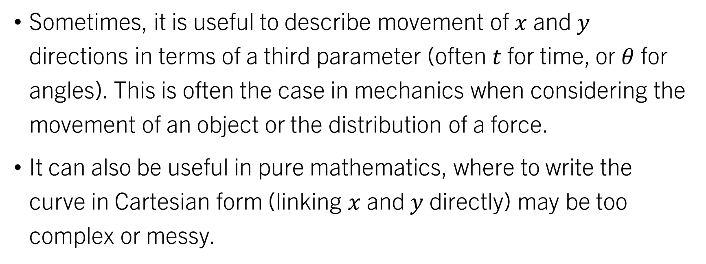
introduction
Sometimes, it is useful to describe movement of $x$ and $y$ directions in terms of a third parameter (often $t$for time, or $θ$ for angles). This is often the case in mechanics when considering the movement of an object or the distribution of a force.
It can also be useful in pure mathematics, where to write the curve in Cartesian form (linking $x$ and $y$ directly) may be too complex or messy.

Slide 4
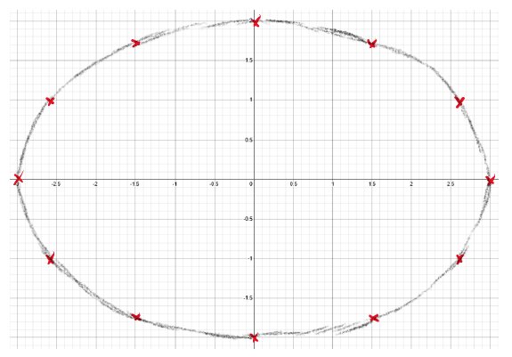
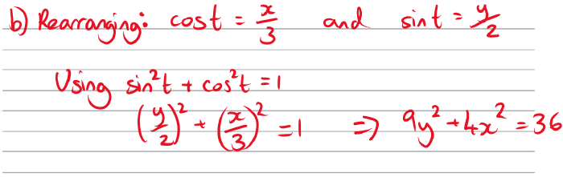
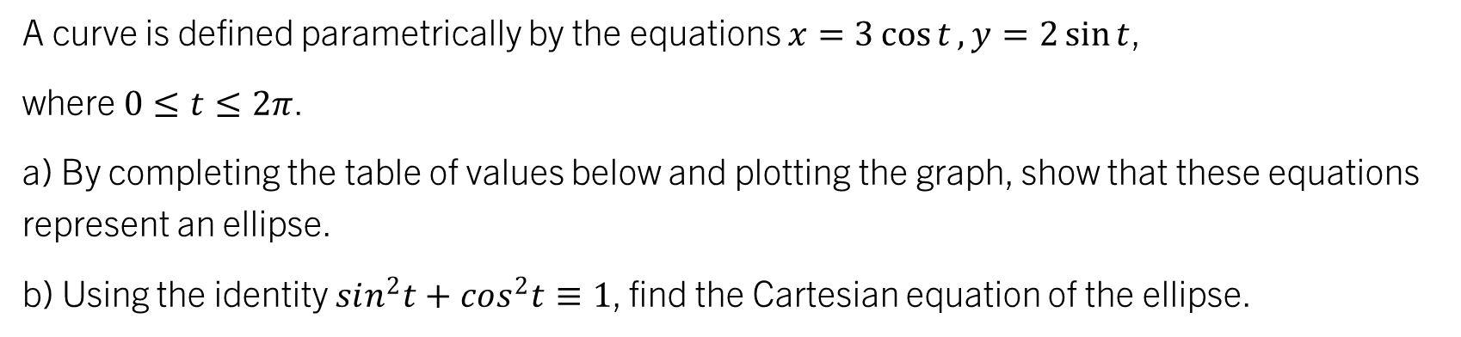
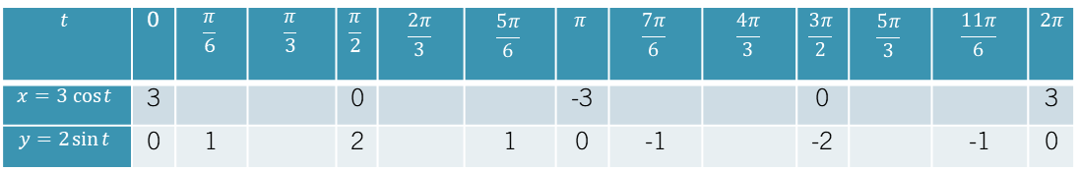
Example 1
A curve is defined parametrically by the equations $x=3\cos{t}, y=2\sin{t}$,
where $0≤t≤2π$.
a) By completing the table of values below and plotting the graph, show that these equations represent an ellipse.
b) Using the identity $sin^{2}t+cos^{2}t≡1$, find the Cartesian equation of the ellipse.
Make sure you are in radians!!!
e.g. the form y = f(x)
$$t$$ | 0 | $$\frac{π}{6}$$ | $$\frac{π}{3}$$ | $$\frac{π}{2}$$ | $$\frac{2π}{3}$$ | $$\frac{5π}{6}$$ | $$π$$ | $$\frac{7π}{6}$$ | $$\frac{4π}{3}$$ | $$\frac{3π}{2}$$ | $$\frac{5π}{3}$$ | $$\frac{11π}{6}$$ | $2π$
$$x=3 cos{t}$$ | 3 |  |  | 0 |  |  | -3 |  |  | 0 |  |  | 3
$$y=2\sin{t}$$ | 0 | 1 |  | 2 |  | 1 | 0 | -1 |  | -2 |  | -1 | 0
2.6
1.5
-1.5
-2.6
-2.6
-1.5
1.5
2.6
1.73
1.73
-1.73
-1.73
Investigate this curve at: https://www.desmos.com/calculator/c2wl8thyhu

Slide 5
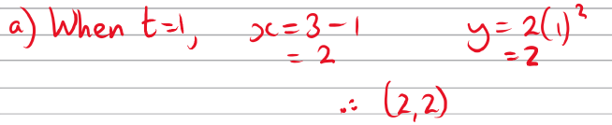
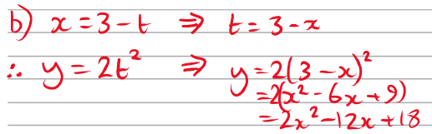
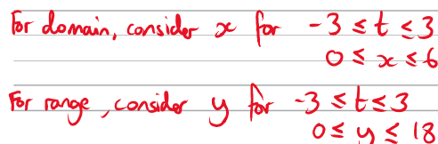
Example 2
Where the parametric equations are non-trigonometric, we can usually find the Cartesian equation relatively simply by a combination of rearrangement and substitution.
A curve is defined by parametric equations 𝑥 = 3−𝑡, 𝑦 = 2𝑡², for −3 ≤ 𝑡 ≤ 3.
a) Find the coordinates of the point where 𝑡 = 1.
b) Find a Cartesian equation of the curve, stating the domain and range.
Key Point: To find the domain and range of a parametric curve, we can just consider the possible values of the 𝑥 (domain) and 𝑦 (range) parameters - it arguably makes life easier!

Slide 6
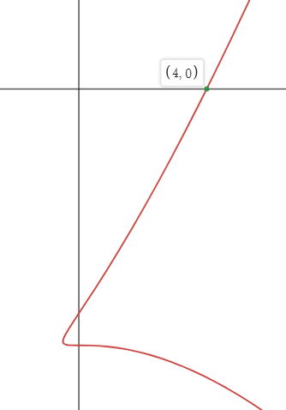
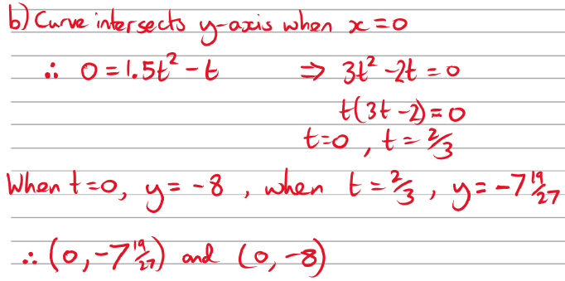
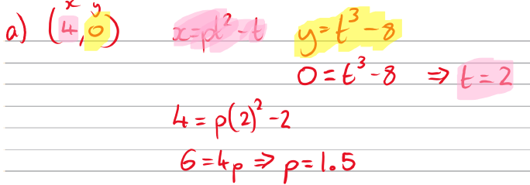
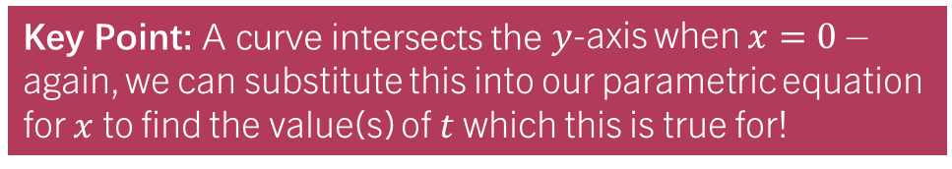
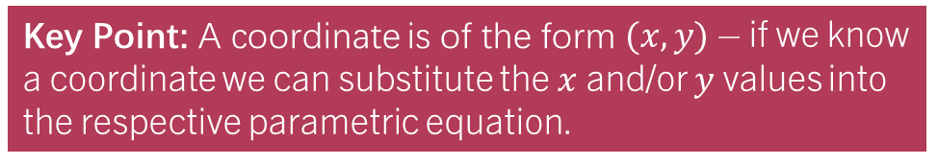
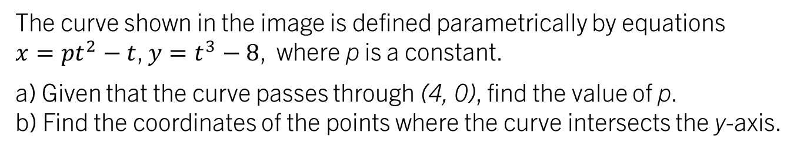
Example 3
The curve shown in the image is defined parametrically by equations
$x=pt^{2}−t$, $y=t^{3}−8$, where p is a constant.
a) Given that the curve passes through (4, 0), find the value of p.
b) Find the coordinates of the points where the curve intersects the y-axis.
Key Point: A coordinate is of the form $(x, y)$ – if we know a coordinate we can substitute the $x$ and/or $y$ values into the respective parametric equation.
Key Point: A curve intersects the $y$-axis when $x=0$ – again, we can substitute this into our parametric equation for $x$ to find the value(s) of $t$ which this is true for!

Slide 7
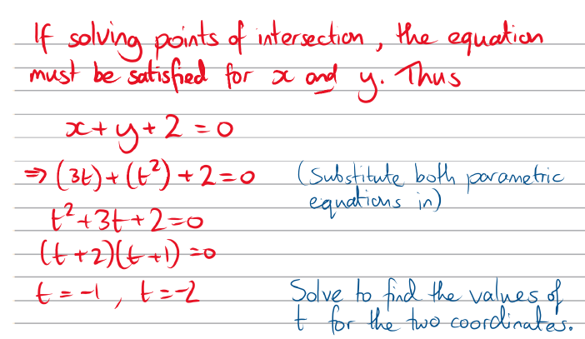
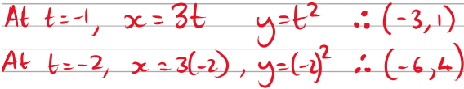
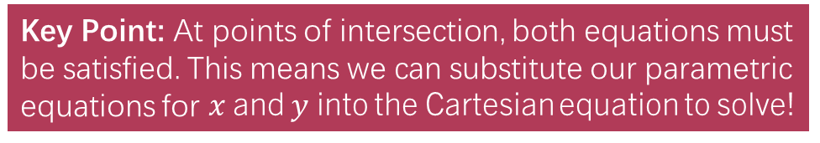
Example 4
The curve $C$ is defined by parametric equations $x=3t$, $y=t²$. The line with equation
$x+y+2=0$ meets $C$ at the points $A$ and $B$. Find the coordinates of $A$ and $B$.
Key Point: At points of intersection, both equations must be satisfied. This means we can substitute our parametric equations for $x$ and $y$ into the Cartesian equation to solve!

Slide 8
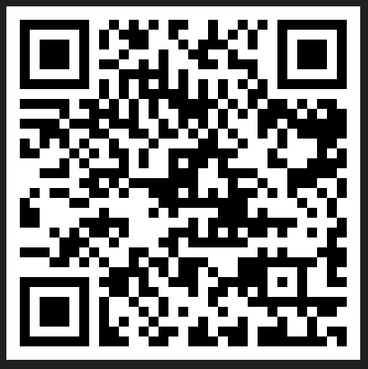
Now:
Complete and self-mark the “Test Your Understanding” Exercise
Optional – complete the quality feedback form at https://form.typeform.com/to/t4X8n0p3 - it is hugely appreciated!

