Slide 1


Unit 6.3 - The Product Rule Unit 6.4 – The Quotient Rule
©

Slide 2
6.3 – The Product Rule Learning ObjectiveS
To know and use the product rule for differentiating the product of two functions;
To be able to differentiate products also containing one or more applications of the chain rule;
To be able to solve stationary point, tangent and normal problems using the product rule.

Slide 3
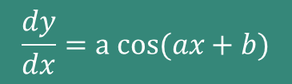



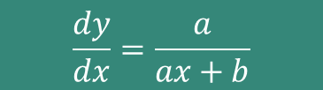
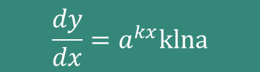




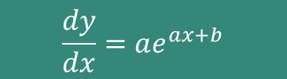

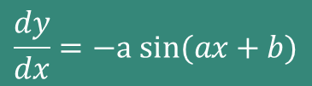
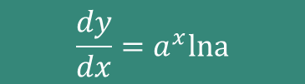
STANDARD RESULTS RECAP
$$y=sin⁡(ax+b)$$
$$\frac{dy}{dx}=a cos(ax+b)$$
$$\frac{dy}{dx}=−a sin(ax+b)$$
$$y=cos⁡(ax+b)$$
$$y=e^{ax+b}$$
$$\frac{dy}{dx}=ae^{ax+b}$$
$$\frac{dy}{dx}=\frac{1}{x}$$
$$y=ln\left|ax\right|$$
$$y=ln\left|ax+b\right|$$
$$\frac{dy}{dx}=\frac{a}{ax+b}$$
$$\frac{dy}{dx}=a^{x}lna$$
$$y=a^{x}$$
$$\frac{dy}{dx}=a^{kx}klna$$
$$y=a^{kx}$$

Slide 4
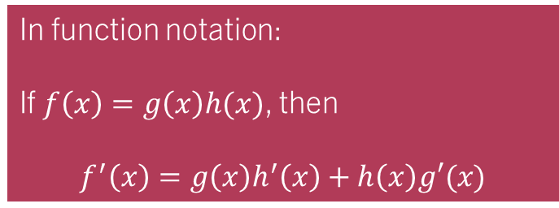
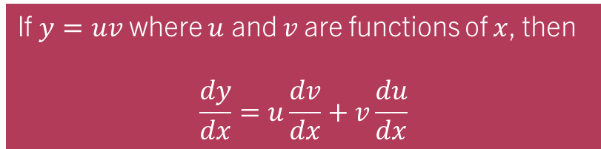
The Product Rule - Introduction
We can differentiate the product of two functions being multiplied together:
If $y=uv$ where $u$ and $v$ are functions of $x$, then
$$\frac{dy}{dx}=u\frac{dv}{dx}+v\frac{du}{dx}$$
In function notation:
If $f\left(x\right)=g\left(x\right)h(x)$, then
$$f^{′}\left(x\right)=g\left(x\right)h^{′}\left(x\right)+h\left(x\right)g′(x)$$
This is NOT given in the exam – we must learn it!

Slide 5
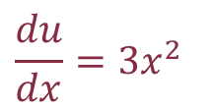


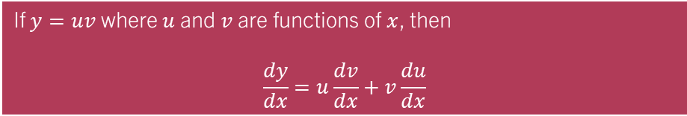
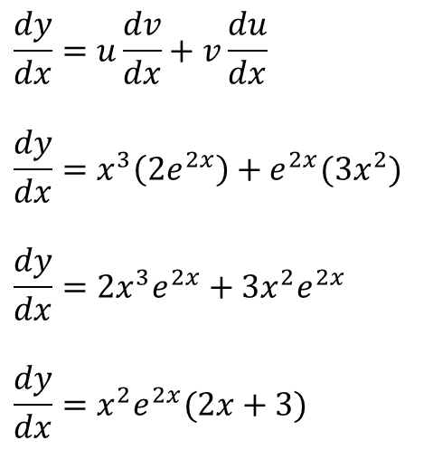
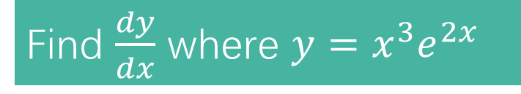
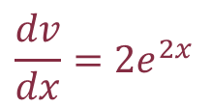
The Product Rule – Example 1
If $y=uv$ where $u$ and $v$ are functions of $x$, then
$$\frac{dy}{dx}=u\frac{dv}{dx}+v\frac{du}{dx}$$
Find $\frac{dy}{dx}$ where $y=x^{3}e^{2x}$
$$u=x^{3}$$
$$v=e^{2x}$$
$$\frac{du}{dx}={3x}^{2}$$
$$\frac{dv}{dx}={2e}^{2x}$$
$$\frac{dy}{dx}=u\frac{dv}{dx}+v\frac{du}{dx}$$
$$\frac{dy}{dx}=x^{3}\left(2e^{2x}\right)+e^{2x}(3x^{2})$$
$$\frac{dy}{dx}=2x^{3}e^{2x}+3x^{2}e^{2x}$$
$$\frac{dy}{dx}=x^{2}e^{2x}(2x+3)$$
Always look to simplify and factorise if possible – especially if there is a follow-up question using your derivative!

Slide 6
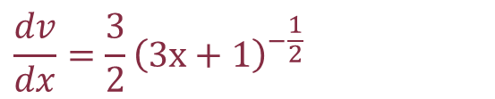
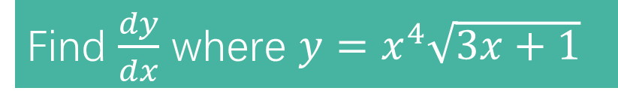
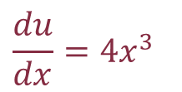


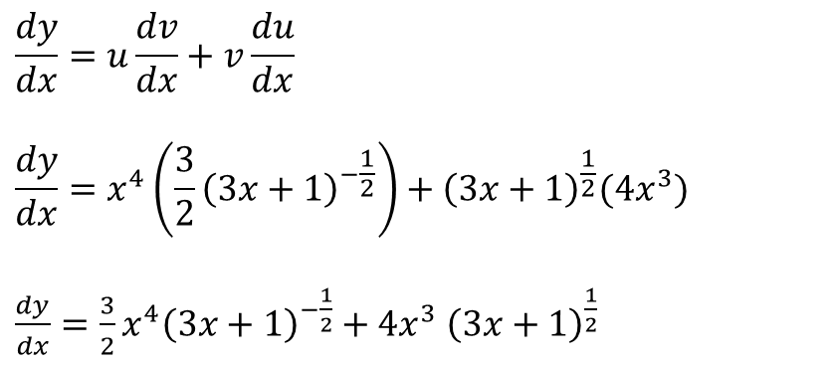
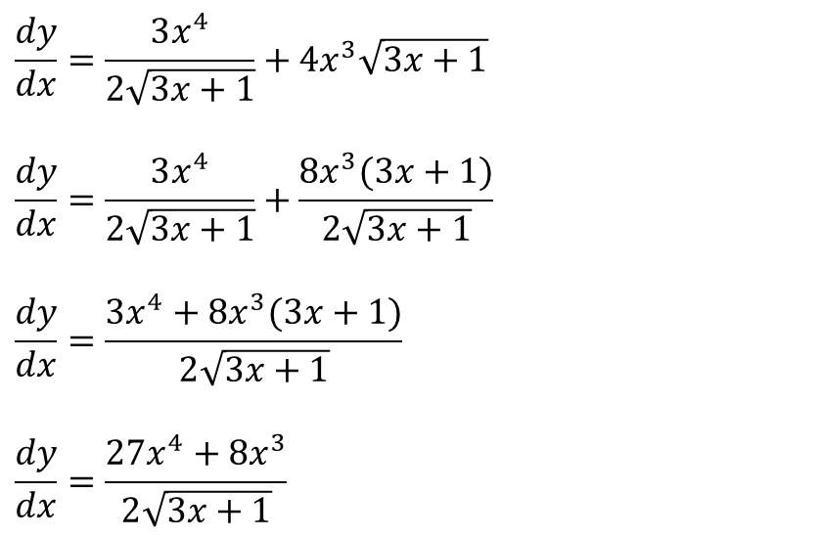
The Product Rule – task 1
If $y=uv$ where $u$ and $v$ are functions of $x$, then
$$\frac{dy}{dx}=u\frac{dv}{dx}+v\frac{du}{dx}$$
Find $\frac{dy}{dx}$ where $y=x^{4}\sqrt{3x+1}$
$$u=x^{4}$$
$$v={\left(3x+1\right)}^{\frac{1}{2}}$$
It is important we develop the algebraic skills to tidy up this sort of mess!
$$\frac{du}{dx}={4x}^{3}$$
$$\frac{dv}{dx}=\frac{3}{2}{\left(3x+1\right)}^{−\frac{1}{2}}$$
$$\frac{dy}{dx}=\frac{3x^{4}}{2\sqrt{3x+1}}+4x^{3}\sqrt{3x+1}$$
$$\frac{dy}{dx}=\frac{3x^{4}}{2\sqrt{3x+1}}+\frac{8x^{3}(3x+1)}{2\sqrt{3x+1}}$$
$$\frac{dy}{dx}=\frac{3x^{4}+8x^{3}(3x+1)}{2\sqrt{3x+1}}$$
$$\frac{dy}{dx}=\frac{27x^{4}+8x^{3}}{2\sqrt{3x+1}}$$
$$\frac{dy}{dx}=u\frac{dv}{dx}+v\frac{du}{dx}$$
$$\frac{dy}{dx}=x^{4}\left(\frac{3}{2}{\left(3x+1\right)}^{−\frac{1}{2}}\right)+{\left(3x+1\right)}^{\frac{1}{2}}(4x^{3})$$
$\frac{dy}{dx}=\frac{3}{2}x^{4}{\left(3x+1\right)}^{−\frac{1}{2}}+4x^{3}$ ${\left(3x+1\right)}^{\frac{1}{2}}$

Slide 7

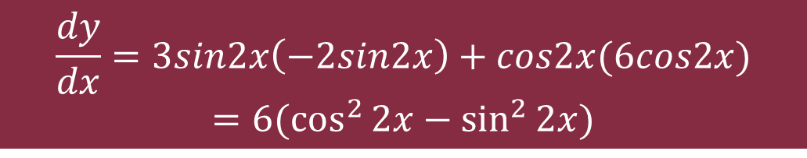
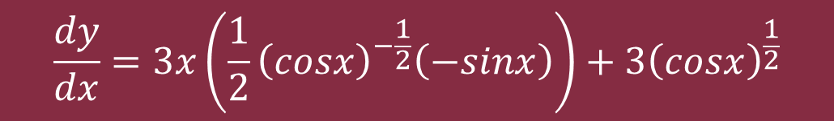

Further Examples (needing chain rule)
Differentiate the following with respect to $x$ (no need to simplify)
$$y=3x\sqrt{cosx}$$
$$\frac{dy}{dx}=3x\left(\frac{1}{2}{\left(cosx\right)}^{−\frac{1}{2}}\left(−sinx\right)\right)+3{\left(cosx\right)}^{\frac{1}{2}}$$
$$y=3sin2xcos2x$$
$$\frac{dy}{dx}=3sin2x\left(−2sin2x\right)+cos2x(6cos2x)$$
$$=6(\cos^{2}{2x−\sin^{2}{2x)}}$$

Slide 8
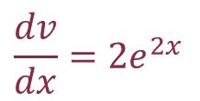

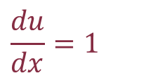


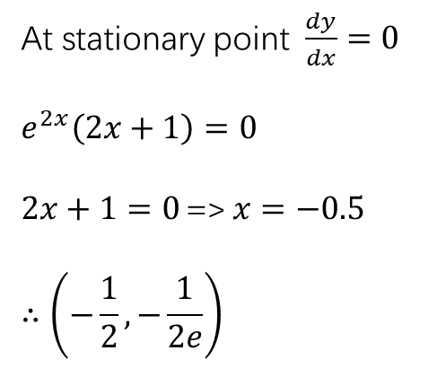
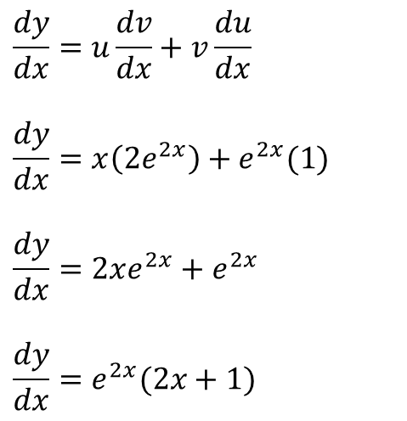
The Product Rule – Example 1
If $y=uv$ where $u$ and $v$ are functions of $x$, then
$$\frac{dy}{dx}=u\frac{dv}{dx}+v\frac{du}{dx}$$
Find the coordinates of any stationary points on the curve with equation $y=xe^{2x}$
$$u=x$$
$$v=e^{2x}$$
$$\frac{du}{dx}=1$$
$$\frac{dv}{dx}={2e}^{2x}$$
At stationary point$\frac{dy}{dx}=0$
$$e^{2x}\left(2x+1\right)=0$$
$2x+1=0$ => $x=−0.5$
$$∴\left(−\frac{1}{2},−\frac{1}{2e}\right)$$
$$\frac{dy}{dx}=u\frac{dv}{dx}+v\frac{du}{dx}$$
$$\frac{dy}{dx}=x\left(2e^{2x}\right)+e^{2x}(1)$$
$$\frac{dy}{dx}=2xe^{2x}+e^{2x}$$
$$\frac{dy}{dx}=e^{2x}(2x+1)$$

Slide 9
6.4 – The quotient Rule Learning ObjectiveS
To know and use the quotient rule for differentiating one function divided by another;
To be able to differentiate fractions also containing one or more applications of the chain rule;
To be able to solve stationary point, tangent and normal problems using the quotient rule.

Slide 10
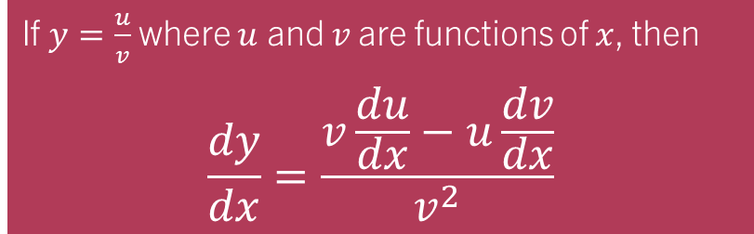
The Quotient Rule - Introduction
We can differentiate the quotient of two functions (one being divided by the other):
If $y=\frac{u}{v}$ where $u$ and $v$ are functions of $x$, then
$$\frac{dy}{dx}=\frac{v\frac{du}{dx}−u\frac{dv}{dx}}{v^{2}}$$
This is given in the exam – make sure you know where to find it!

Slide 11
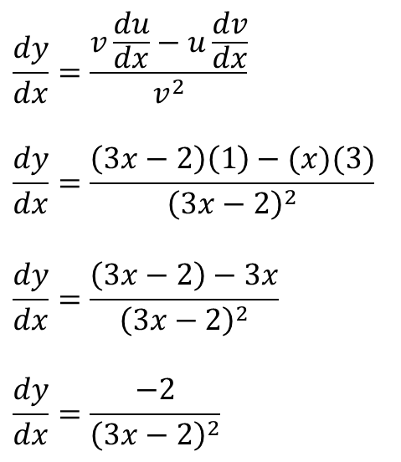
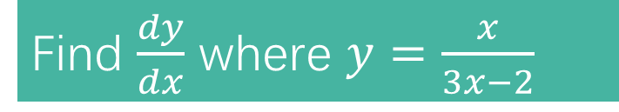
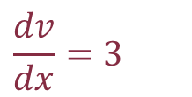
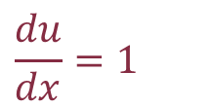


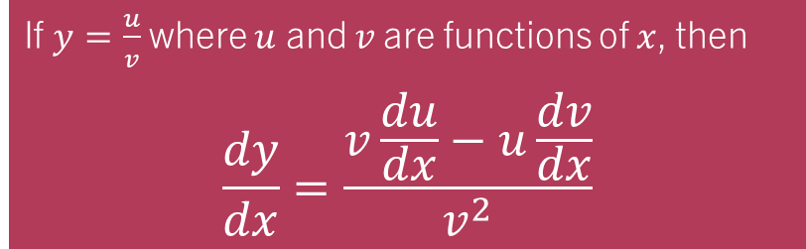
The quotient Rule – Example 1a
If $y=\frac{u}{v}$ where $u$ and $v$ are functions of $x$, then
$$\frac{dy}{dx}=\frac{v\frac{du}{dx}−u\frac{dv}{dx}}{v^{2}}$$
Find $\frac{dy}{dx}$ where $y=\frac{x}{3x−2}$
$$u=x$$
$$v=3x−2$$
$$\frac{du}{dx}=1$$
$$\frac{dv}{dx}=3$$
$$\frac{dy}{dx}=\frac{v\frac{du}{dx}−u\frac{dv}{dx}}{v^{2}}$$
$$\frac{dy}{dx}=\frac{\left(3x−2\right)\left(1\right)−(x)(3)}{{\left(3x−2\right)}^{2}}$$
$$\frac{dy}{dx}=\frac{\left(3x−2\right)−3x}{{\left(3x−2\right)}^{2}}$$
$$\frac{dy}{dx}=\frac{−2}{{\left(3x−2\right)}^{2}}$$
Always look to simplify and factorise if possible – especially if there is a follow-up question using your derivative!

Slide 12
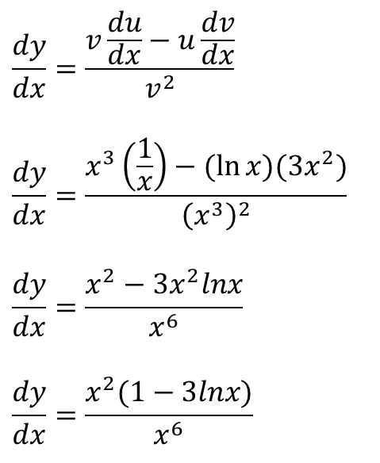


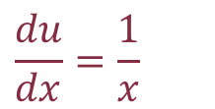


The quotient Rule – Example 1b
If $y=\frac{u}{v}$ where $u$ and $v$ are functions of $x$, then
$$\frac{dy}{dx}=\frac{v\frac{du}{dx}−u\frac{dv}{dx}}{v^{2}}$$
Find $\frac{dy}{dx}$ where $y=\frac{\ln{x}}{x^{3}}$
$$u=\ln{x}$$
$$v=x^{3}$$
$$\frac{du}{dx}=\frac{1}{x}$$
$\frac{dv}{dx}=3x^{2}$
$$\frac{dy}{dx}=\frac{v\frac{du}{dx}−u\frac{dv}{dx}}{v^{2}}$$
$$\frac{dy}{dx}=\frac{x^{3}\left(\frac{1}{x}\right)−(\ln{x})(3x^{2})}{{\left(x^{3}\right)}^{2}}$$
$$\frac{dy}{dx}=\frac{x^{2}−3x^{2}lnx}{x^{6}}$$
$$\frac{dy}{dx}=\frac{x^{2}(1−3lnx)}{x^{6}}$$
Always look to simplify and factorise if possible – especially if there is a follow-up question using your derivative!

Slide 13
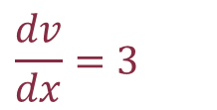
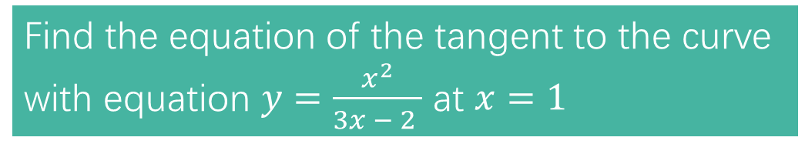
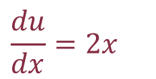


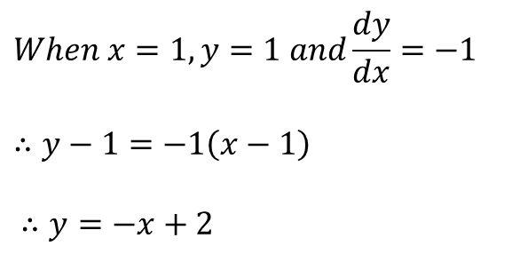
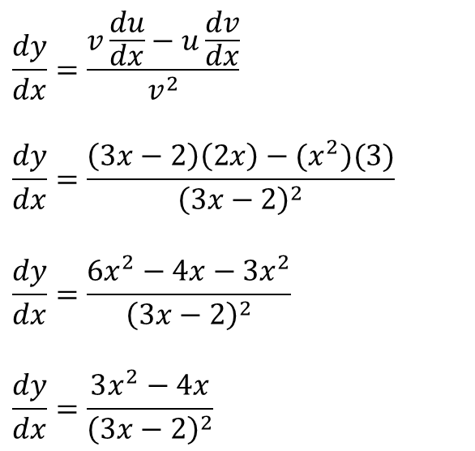
The quotient Rule – task 1
If $y=uv$ where $u$ and $v$ are functions of $x$, then
$$\frac{dy}{dx}=u\frac{dv}{dx}+v\frac{du}{dx}$$
Find the equation of the tangent to the curve with equation $y=\frac{x^{2}}{3x − 2 }$ at $x=1$
$$u=x^{2}$$
$$v=3x−2$$
$$\frac{du}{dx}=2x$$
$$\frac{dv}{dx}=3$$
$$\frac{dy}{dx}=\frac{v\frac{du}{dx}−u\frac{dv}{dx}}{v^{2}}$$
$$\frac{dy}{dx}=\frac{\left(3x−2\right)\left(2x\right)−(x^{2})(3)}{{\left(3x−2\right)}^{2}}$$
$$\frac{dy}{dx}=\frac{6x^{2}−4x−3x^{2}}{{\left(3x−2\right)}^{2}}$$
$$\frac{dy}{dx}=\frac{3x^{2}−4x}{{\left(3x−2\right)}^{2}}$$
$$When x=1,y=1 and\frac{dy}{dx}=−1$$
$$∴y−1=−1\left(x−1\right)$$
$∴y=−x+2$

Slide 14
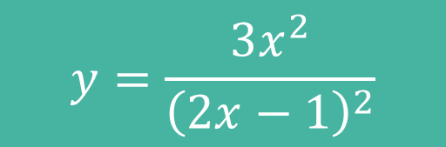


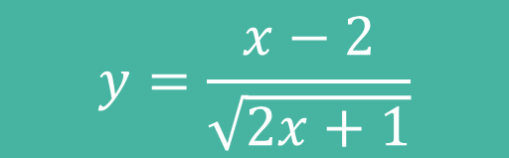
Further Examples (needing chain rule)
Differentiate the following with respect to $x$ and fully simplify:
$$y=\frac{3x^{2}}{{\left(2x−1\right)}^{2}}$$
$$\frac{dy}{dx}=\frac{−6x}{{\left(2x−1\right)}^{3}}$$
$$y=\frac{x−2}{\sqrt{2x+1}}$$
$$\frac{dy}{dx}=\frac{x+2}{{\left(2x+1\right)}^{\frac{3}{2}}}$$

Slide 15

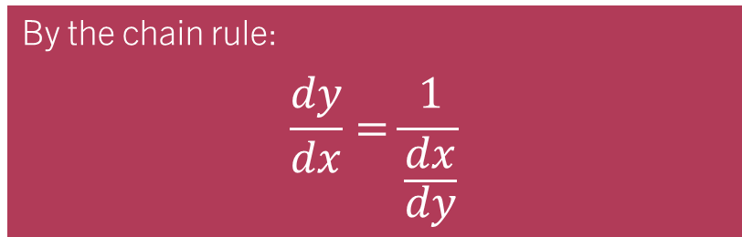
A special use of the chain rule
Sometimes we are given a function in the form $x=f\left(y\right)$ where it would be very difficult to rearrange to the form $y=…$
By the chain rule:
$$\frac{dy}{dx}=\frac{1}{\frac{dx}{dy}}$$
This allows us to differentiate in terms of $y$ and then take the reciprocal – very useful!
We will need this trick later to differentiate the inverse trigonometric functions!

Slide 16
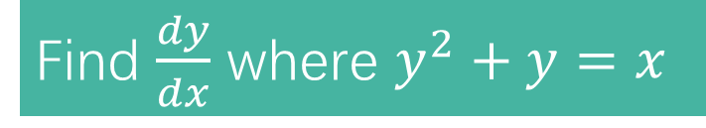
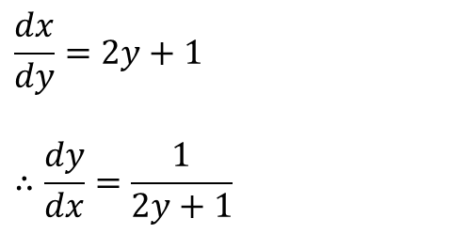

Example 1
$$\frac{dy}{dx}=1÷\frac{dx}{dy}$$
Find $\frac{dy}{dx}$ where $y^{2}+y=x$
$$\frac{dx}{dy}=2y+1$$
$$∴\frac{dy}{dx}=\frac{1}{2y+1}$$

Slide 17
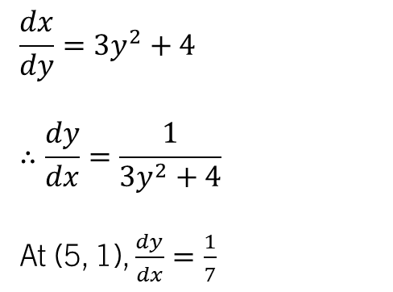
TASK 1
$$\frac{dy}{dx}=1÷\frac{dx}{dy}$$
Given that $y^{3}+4y=x$, find the value of $\frac{dy}{dx}$ at the point (5, 1).
$$\frac{dx}{dy}=3y^{2}+4$$
$$∴\frac{dy}{dx}=\frac{1}{3y^{2}+4}$$
At (5, 1), $\frac{dy}{dx}=\frac{1}{7}$

