Slide 1


Unit 6.1 - standard results for exponential and logarithmic differentiation
Unit 6.2 – The Chain Rule
©

Slide 2

6.1 – Standard Results
Learning ObjectiveS
To know and use the standard results for $\sin\left(ax+b\right),\cos\left(ax+b\right), e^{ax+b} and ln\left|ax+b\right|$
To apply differentiation of these functions to simple problems with gradient, tangents/normals and stationary points

Slide 3
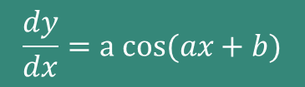



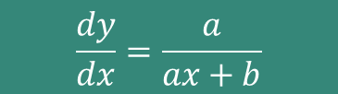
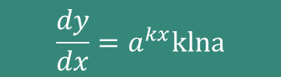




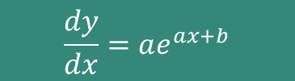

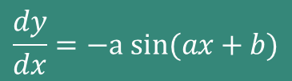

STANDARD RESULTS
$$y=sin⁡(ax+b)$$
$$\frac{dy}{dx}=a cos(ax+b)$$
$$\frac{dy}{dx}=−a sin(ax+b)$$
$$y=cos⁡(ax+b)$$
$$y=e^{ax+b}$$
$$\frac{dy}{dx}=ae^{ax+b}$$
$$\frac{dy}{dx}=\frac{1}{x}$$
$$y=ln\left|ax\right|$$
$$y=ln\left|ax+b\right|$$
$$\frac{dy}{dx}=\frac{a}{ax+b}$$
$$\frac{dy}{dx}=a^{x}lna$$
$$y=a^{x}$$
$$\frac{dy}{dx}=a^{kx}klna$$
$$y=a^{kx}$$

Slide 4
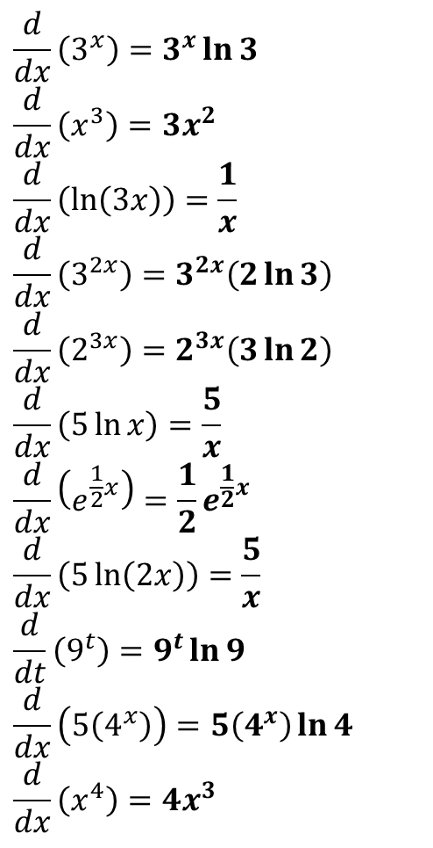
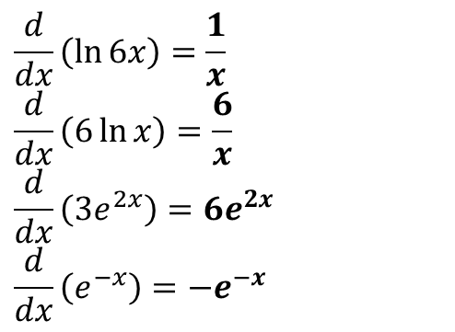
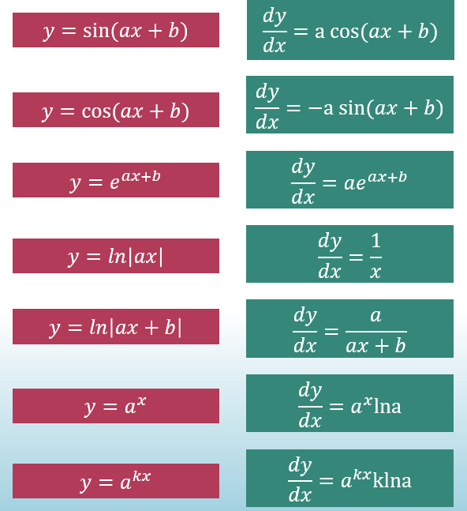
Quickfire Questions: MWB (from DrFrostMaths)
?
?
?
?
?
?
?
?
?
?
?
?
?
?
?

Slide 5
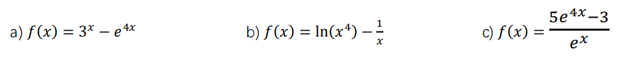
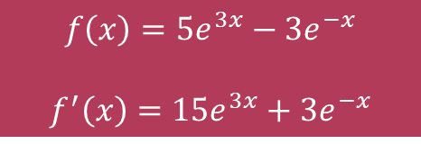
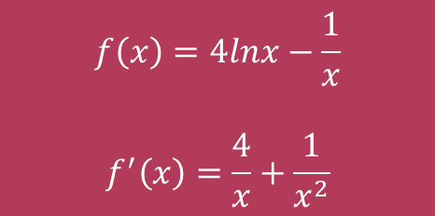

EXAMPLES
$$f^{′}\left(x\right)=3^{x}ln3−4e^4x$$
$$f\left(x\right)=4lnx−\frac{1}{x}$$
$$f^{′}\left(x\right)=\frac{4}{x}+\frac{1}{x^{2}}$$
$$f\left(x\right)=5e^{3x}−3e^{−x}$$
$$f^{′}\left(x\right)=15e^{3x}+3e^{−x}$$

Slide 6
6.2 – The Chain Rule
Learning ObjectiveS
To know and use the chain rule;
To be able to quickly apply the chain rule in simple cases;

Slide 7
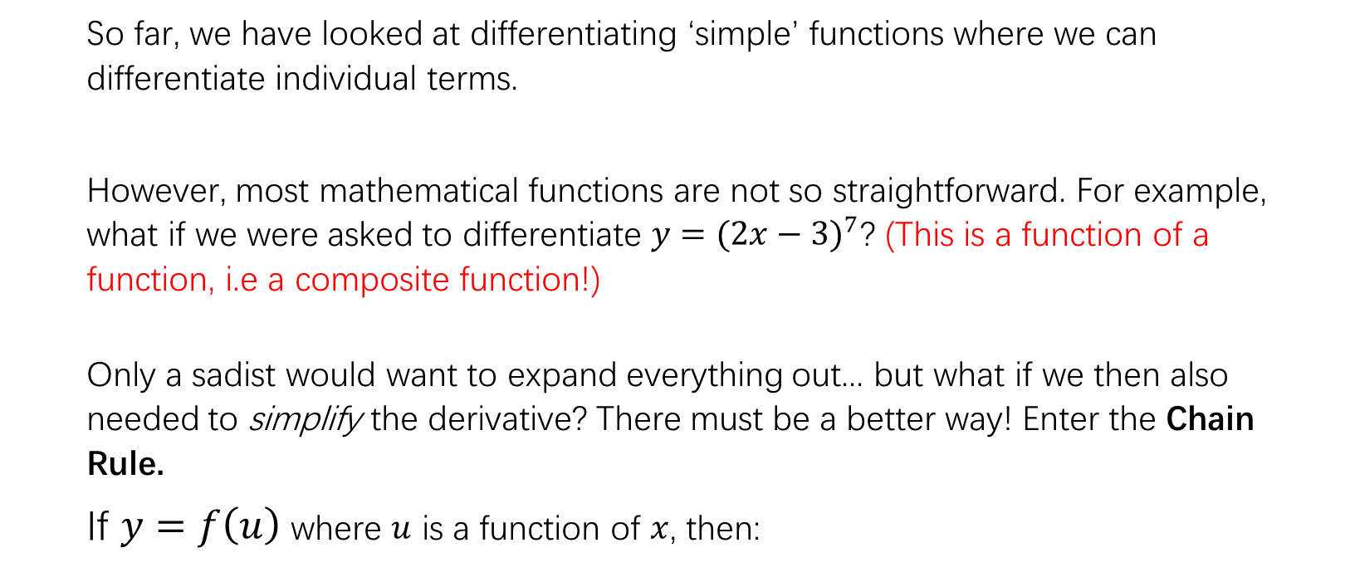

The Chain Rule
So far, we have looked at differentiating ‘simple’ functions where we can differentiate individual terms.
However, most mathematical functions are not so straightforward. For example, what if we were asked to differentiate $y={(2x−3)}^{7}$? (This is a function of a function, i.e a composite function!)
Only a sadist would want to expand everything out... but what if we then also needed to simplify the derivative? There must be a better way! Enter the Chain Rule.
If $y=f\left(u\right)$ where $u$ is a function of $x$, then:
$$\frac{dy}{dx}=\frac{dy}{du}×\frac{du}{dx}$$

Slide 8
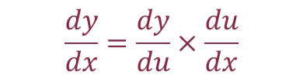

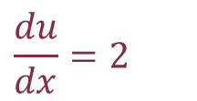
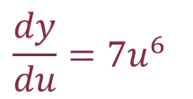

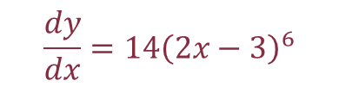

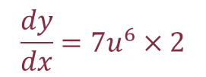
EXAMPLE 1
Differentiate $y={(2x−3)}^{7}$
$$y=u^{7}$$
$$u=2x−3$$
$$\frac{dy}{du}={7u}^{6}$$
$$\frac{du}{dx}=2$$
$$\frac{dy}{dx}=\frac{dy}{du}×\frac{du}{dx}$$
$$\frac{dy}{dx}=7u^{6}×2$$
$$\frac{dy}{dx}=14{\left(2x−3\right)}^{6}$$

Slide 9

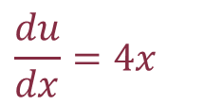
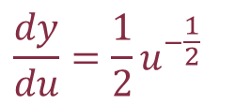
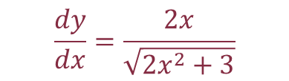

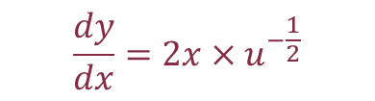

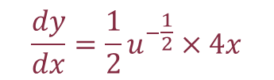
EXAMPLE 2
Differentiate $y=\sqrt{2x^{2}+3}$
$$y=u^{\frac{1}{2}}$$
$$u=2x^{2}+3$$
$$\frac{dy}{du}={\frac{1}{2}u}^{−\frac{1}{2}}$$
$$\frac{du}{dx}=4x$$
$$\frac{dy}{dx}=\frac{dy}{du}×\frac{du}{dx}$$
$$\frac{dy}{dx}={\frac{1}{2}u}^{−\frac{1}{2}}×4x$$
$$\frac{dy}{dx}=2x×u^{−\frac{1}{2}}$$
$$\frac{dy}{dx}=\frac{2x}{\sqrt{2x^{2}+3}}$$

Slide 10





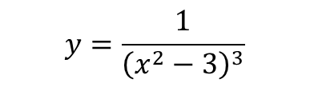
TASK 1
Differentiate the following:
$$y={\left(5x−3\right)}^{6}$$
$$y=\frac{1}{{\left(x^{2}−3\right)}^{3}}$$
$$y=e^{x^{2}}$$
$$\frac{dy}{dx}=30{(5x−3)}^{5}$$
$$\frac{dy}{dx}=\frac{−6x}{{\left(x^{2}−3\right)}^{4}}$$
$$\frac{dy}{dx}=2xe^{x^{2}}$$

Slide 11


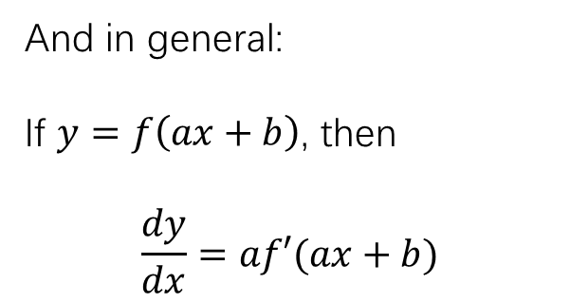

As a note…
Now we can explain why:
$y=e^{kx}$ gives $\frac{dy}{dx}=ke^{kx}$
$y=sin⁡(ax+b)$ gives $\frac{dy}{dx}=acos⁡(ax+b)$
$y=ln⁡(ax+b)$ gives $\frac{dy}{dx}=\frac{a}{ax+b}$
And in general:
If $y=f\left(ax+b\right)$, then
$$\frac{dy}{dx}=af′(ax+b)$$

Slide 12

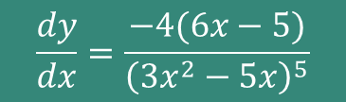
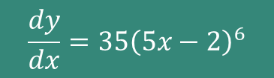
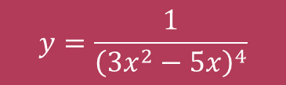

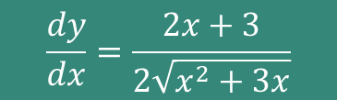
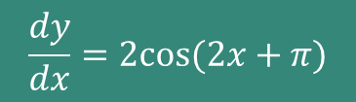


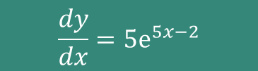
Quickfire(ISH) Questions
Differentiate the following:
$$y=sin⁡(2x+π)$$
$$\frac{dy}{dx}=2cos(2x+π)$$
$$y={\left(5x−2\right)}^{7}$$
$$\frac{dy}{dx}=35{\left(5x−2\right)}^{6}$$
$$y=e^{5x−2}$$
$$\frac{dy}{dx}=5e^{5x−2}$$
$$y=\sqrt{x^{2}+3x}$$
$$\frac{dy}{dx}=\frac{2x+3}{2\sqrt{x^{2}+3x}}$$
$$y=\frac{1}{{\left(3x^{2}−5x\right)}^{4}}$$
$$\frac{dy}{dx}=\frac{−4(6x−5)}{{\left(3x^{2}−5x\right)}^{5}}$$

