Slide 1


Unit 13 – Differential Equations
(Specification Reference 2.3.6 + 2.3.7)
©

Slide 2
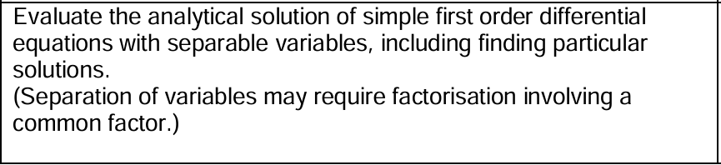
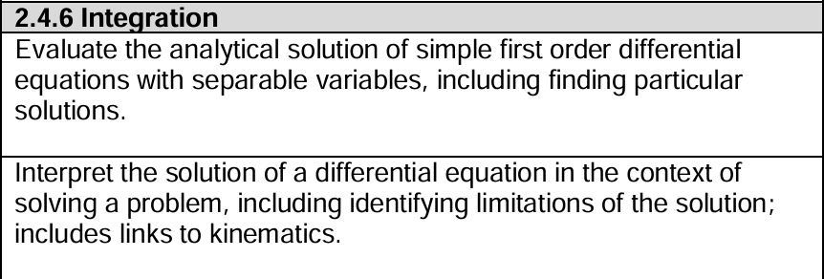
SPECIFICATION REFERENCES:
Unit 3
Unit 4
©

Slide 3
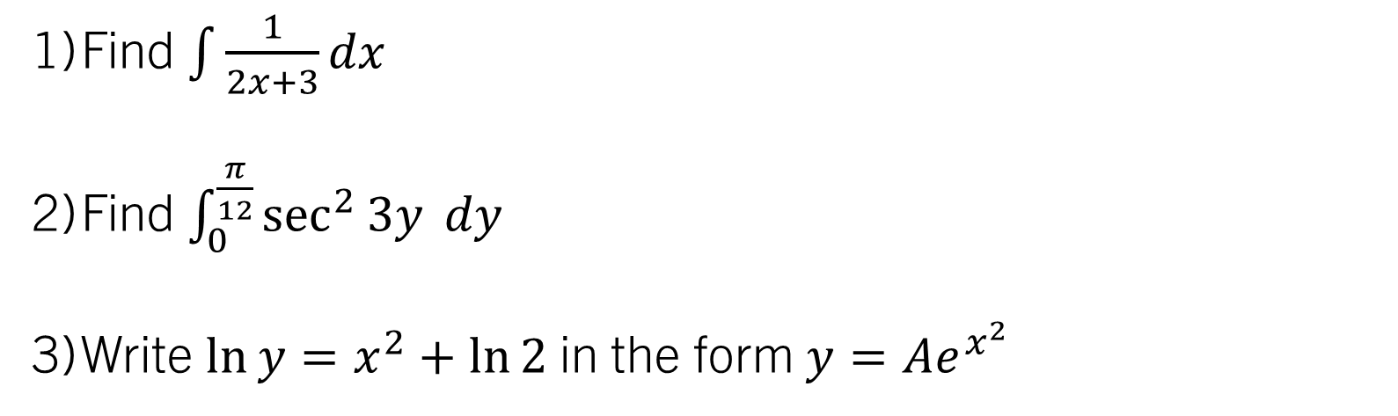

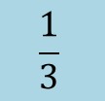
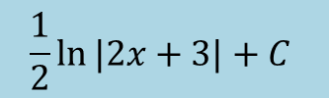
STARTER (Prerequisite atom check):
Find $\int{\frac{1}{2x+3}}dx$
Find $\int_{0}^{\frac{π}{12}}{\sec^{2}{3y} dy}$
Write $\ln{y}=x^{2}+\ln{2}$ in the form $y=Ae^{x^{2}}$
$$\frac{1}{2}\ln{|2x+3|}+C$$
$$\frac{1}{3}$$
$$y=2e^{x^{2}}$$

Slide 4
Unit 13 – Differential Equations
Learning objectives
To understand what is meant by a first-order differential equation;
To solve first-order differential equations by separating variables, understanding the difference between the general and particular solutions;
To be able to form first-order differential equations in a variety of contexts, and solve mechanics problems involving separation of variables.
Prior Learning Atoms:
Differentiation
Integration
Logarithms and Exponentials
A knowledge of the AS/A2 Mechanics content (for the applied questions)

Slide 5
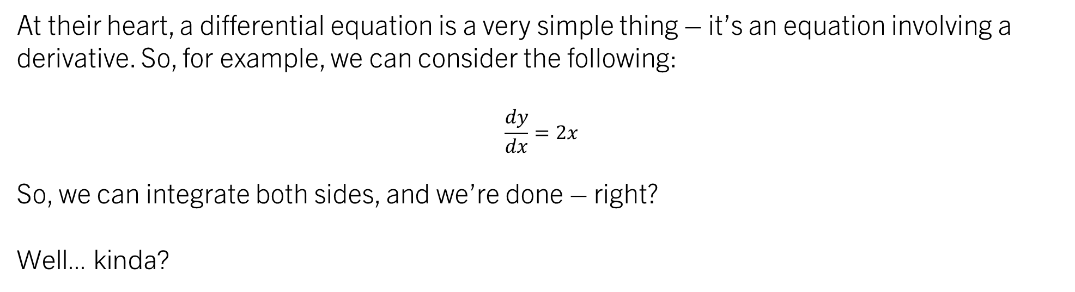
Introducing differential equations
At their heart, a differential equation is a very simple thing – it’s an equation involving a derivative. So, for example, we can consider the following:
$$\frac{dy}{dx}=2x$$
So, we can integrate both sides, and we’re done – right?
Well... kinda?

Slide 6
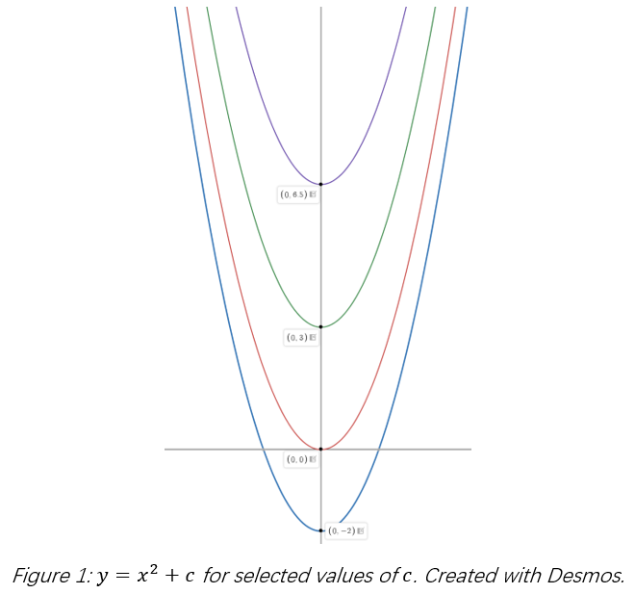

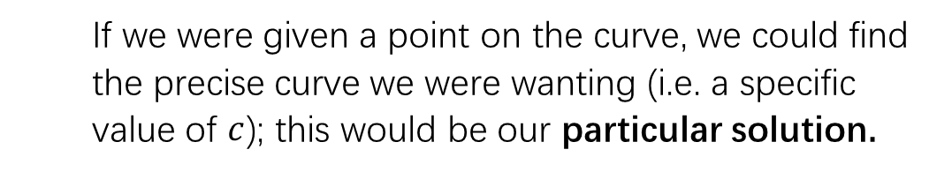
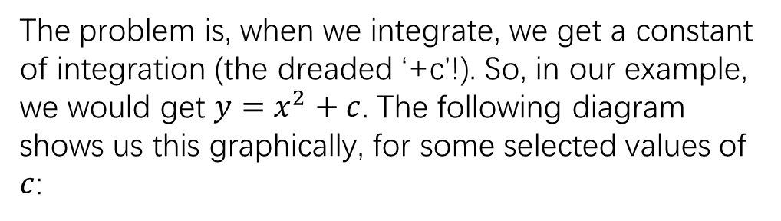
Introducing differential equations
$$\frac{dy}{dx}=2x$$
The problem is, when we integrate, we get a constant of integration (the dreaded ‘+c’!). So, in our example, we would get $y=x^{2}+c$. The following diagram shows us this graphically, for some selected values of $c$:
What we actually have here are a ‘family’ of solutions; an infinite number of solutions depending on the value of 𝑐. This is what we call the general solution of the differential equation.
If we were given a point on the curve, we could find the precise curve we were wanting (i.e. a specific value of $c$); this would be our particular solution.

Slide 7
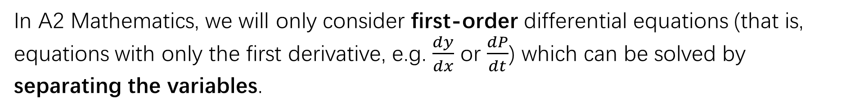
Finding the General Solution
So, how do we actually solve a differential equation?
In Further Mathematics and the real world, this is an important and complicated topic, on which thousands of books exist. However, we have to start somewhere, right?
In A2 Mathematics, we will only consider first-order differential equations (that is, equations with only the first derivative, e.g. $\frac{dy}{dx}$ or $\frac{dP}{dt}$) which can be solved by separating the variables.

Slide 8
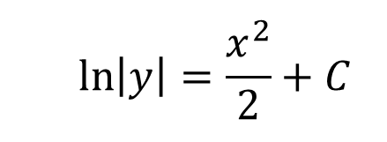
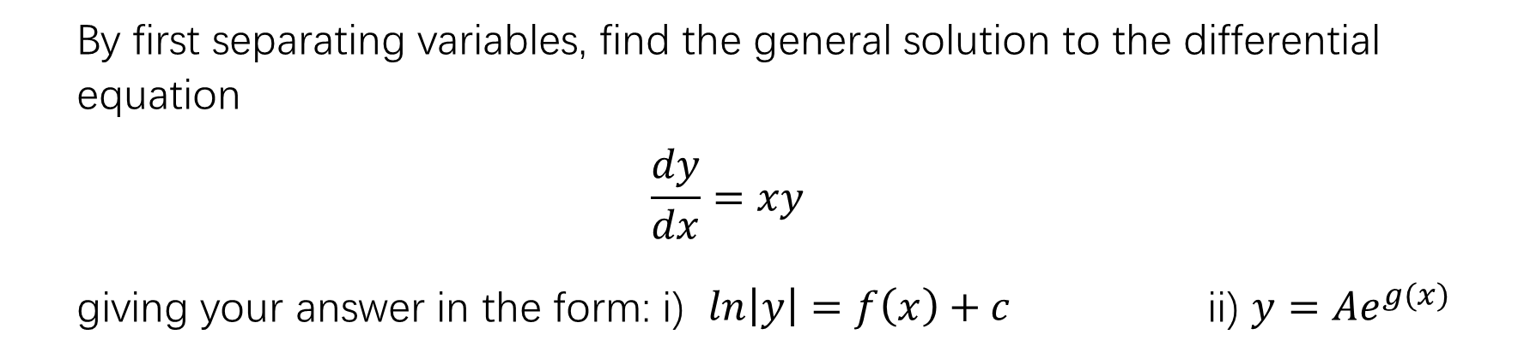
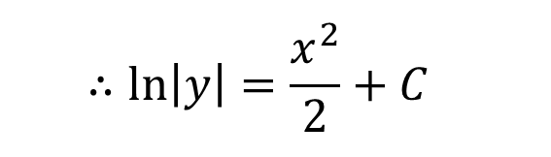
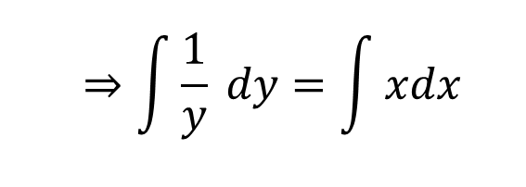

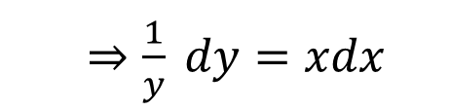
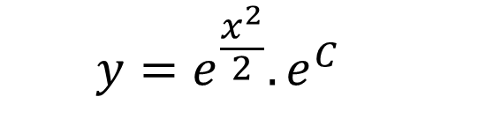
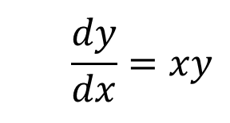
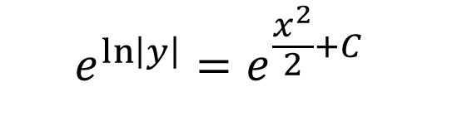
example 1:
By first separating variables, find the general solution to the differential equation
$$\frac{dy}{dx}=xy$$
giving your answer in the form: i) $ln\left|y\right|=f\left(x\right)+c$ ii) $y=Ae^{g(x)}$
$$\frac{dy}{dx}=xy$$
$⇒\frac{1}{y} dy=xdx$
$$\ln\left|y\right|=\frac{x^{2}}{2}+C$$
$$⇒\int{\frac{1}{y} dy}=\int{xdx}$$
$$e^{\ln\left|y\right|}=e^{\frac{x^{2}}{2}+C}$$
$$y=e^{\frac{x^{2}}{2}}.e^{C}$$
$$∴\ln\left|y\right|=\frac{x^{2}}{2}+C$$
$$y=Ae^{\frac{x^{2}}{2}}$$
Pro tip – we often need to write a solution in this form!!

Slide 9
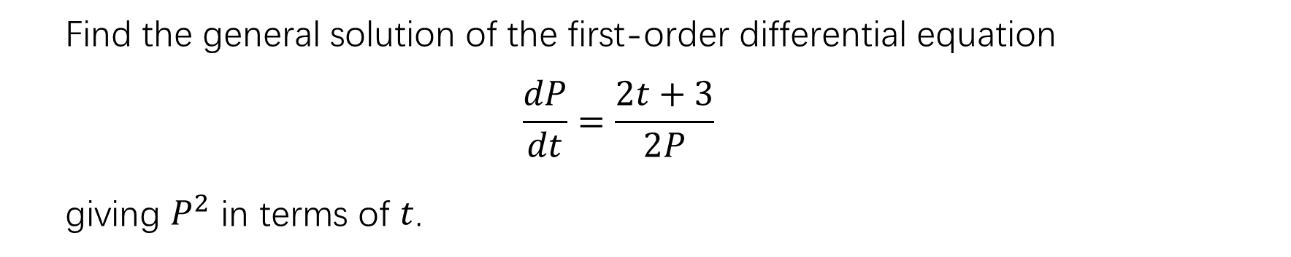

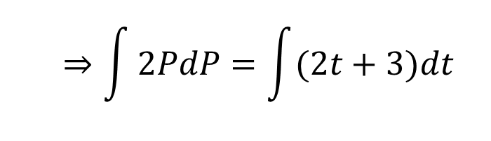

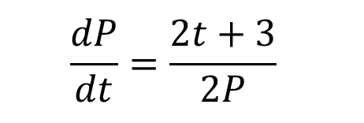
example 2:
Find the general solution of the first-order differential equation
$$\frac{dP}{dt}=\frac{2t+3}{2P}$$
giving $P^{2}$ in terms of $t$.
$$\frac{dP}{dt}=\frac{2t+3}{2P}$$
$⇒ 2PdP=(2t+3)dt$
$$⇒\int{2PdP=\int{(2t+3)dt}}$$
$$∴P^{2}=t^{2}+3t+c$$

Slide 10
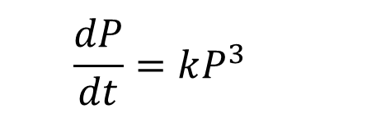


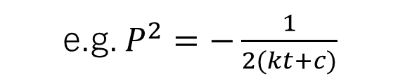
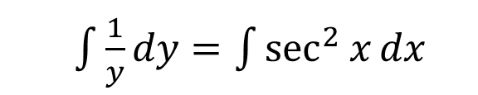
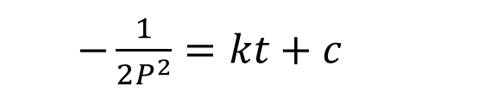
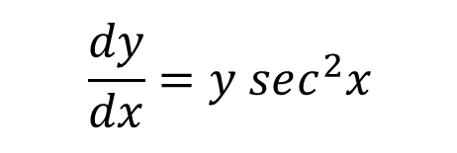
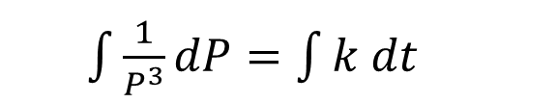
Task 1:
Find the general solution of each of the following, giving your answers in a suitable form.
$$\frac{dy}{dx}=y sec^{2}x$$
$$\frac{dP}{dt}=kP^{3}$$
$\int{\frac{1}{y}dy}=\int{\sec^{2}{x}dx}$
$\int{\frac{1}{P^{3}}dP}=\int{k dt}$
$−\frac{1}{2P^{2}}=kt+c$
$$\ln\left|y\right|=\tan{x}+c$$
$$y=Ae^{\tan{x}}$$
e.g. $P^{2}=−\frac{1}{2(kt+c)}$

Slide 11
Test your understanding 1, Question 1
Complete TYU 1 Q1 from your pack.
Further questions available in student booklet.

Slide 12
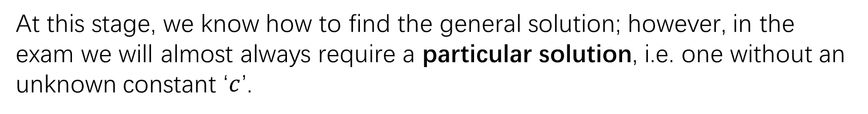
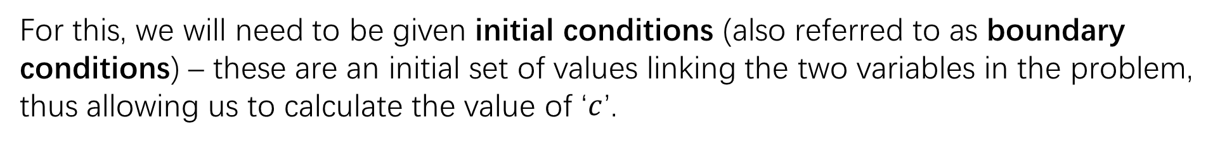
Finding the particular Solution
At this stage, we know how to find the general solution; however, in the exam we will almost always require a particular solution, i.e. one without an unknown constant ‘$c$’.
For this, we will need to be given initial conditions (also referred to as boundary conditions) – these are an initial set of values linking the two variables in the problem, thus allowing us to calculate the value of ‘$c$’.

Slide 13
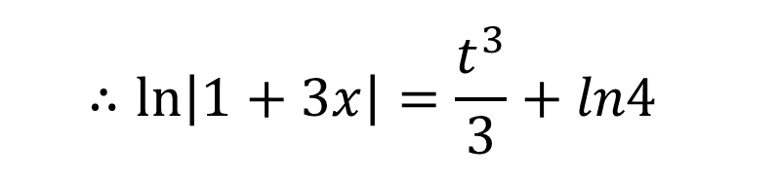
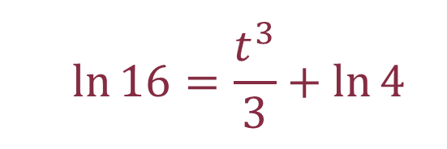
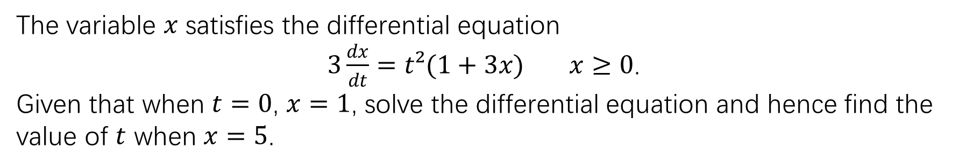
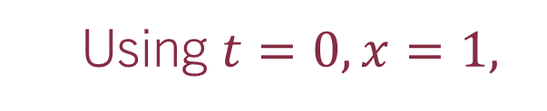


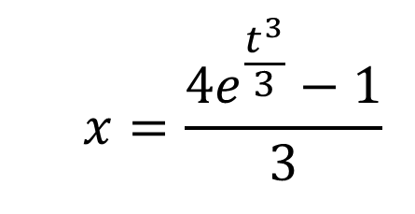
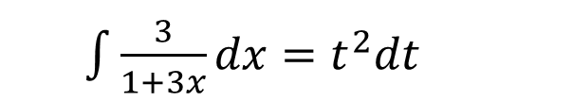


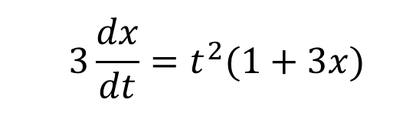


example 1:
The variable $x$ satisfies the differential equation
$3\frac{dx}{dt}=t²(1+3x)$ $x≥0$.
Given that when $t=0$, $x=1$, solve the differential equation and hence find the value of $t$ when $x=5$.
$$3\frac{dx}{dt}=t^{2}(1+3x)$$
Using $t=0, x=1,$
$$\ln{4}=C$$
When $x=5$
$$∴\ln\left|1+3x\right|=\frac{t^{3}}{3}+ln4$$
$$\ln{16}=\frac{t^{3}}{3}+\ln{4}$$
$\int{\frac{3}{1+3x}dx}=t^{2}dt$
$$∴\ln\left|1+3x\right|=\frac{t^{3}}{3}+C$$
$$∴1+3x=e^{\frac{t^{3}}{3}+ln4}$$
$$3\ln{4}=t^{3}$$
$$x=\frac{{4e}^{\frac{t^{3}}{3}}−1}{3}$$
$$t=\sqrt[3]{ln64}$$

Slide 14
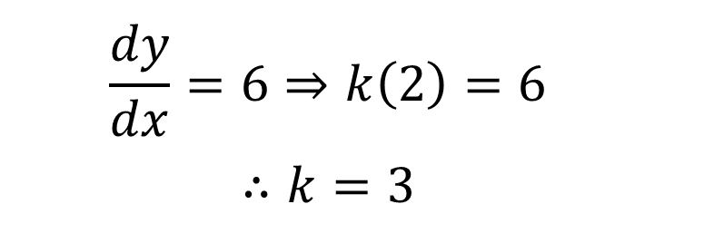
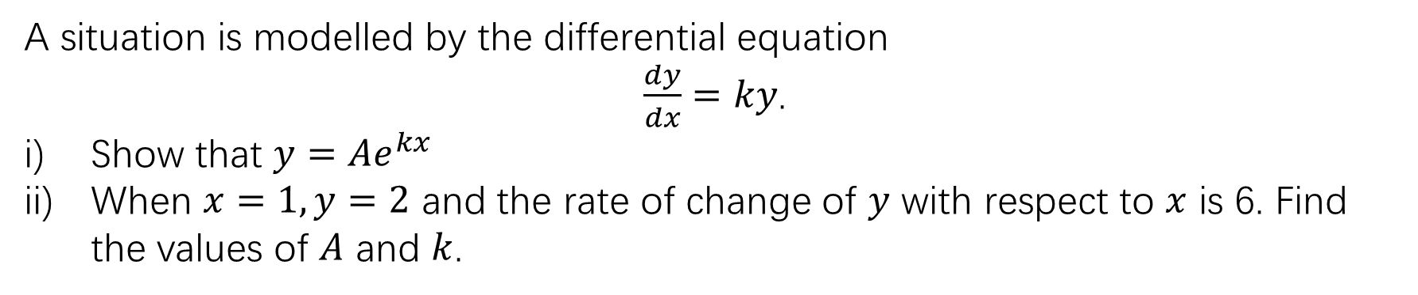


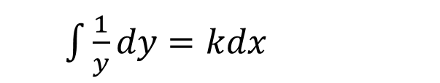
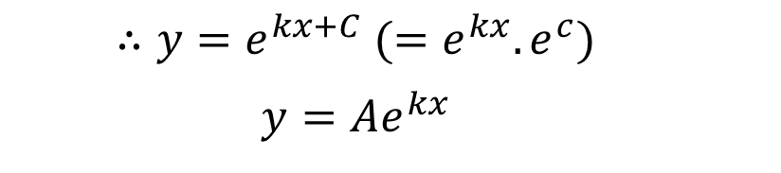
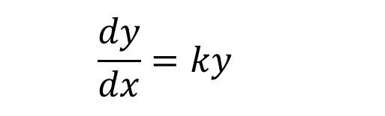

example 2:
A situation is modelled by the differential equation
$\frac{dy}{dx}=ky$.
Show that $y=Ae^{kx}$
When $x=1, y=2$ and the rate of change of $y$ with respect to $x$ is 6. Find the values of $A$ and $k$.
$$\frac{dy}{dx}=ky$$
Using $x=1, y=2,\frac{dy}{dx}=6$
$$\frac{dy}{dx}=6⇒k\left(2\right)=6$$
$$∴k=3$$
$\int{\frac{1}{y}dy}=kdx$
$$∴\ln\left|y\right|=kx+C$$
$$∴y=e^{kx+C} (=e^{kx}.e^{c})$$
$$y=Ae^{kx}$$
$$∴2=Ae^{(3)(1)}$$
$$∴A=2e^{−3}$$

Slide 15

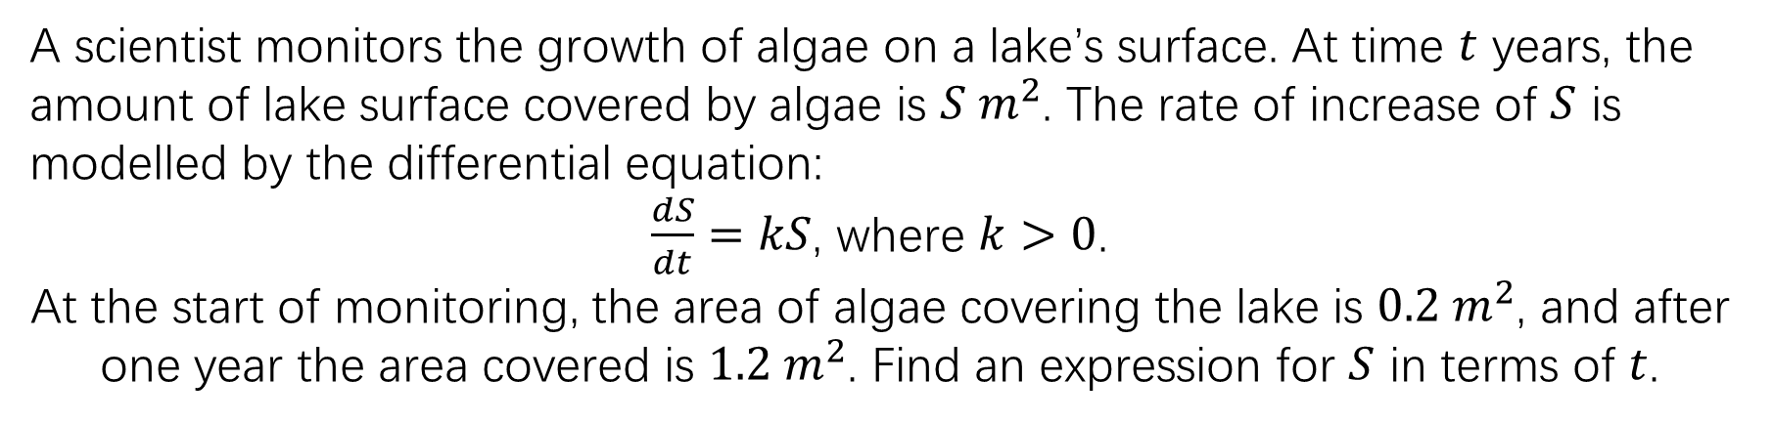



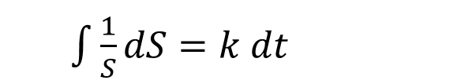

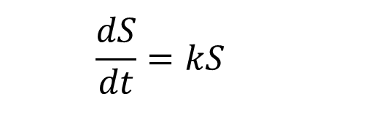

TASK 1:
A scientist monitors the growth of algae on a lake’s surface. At time $t$ years, the amount of lake surface covered by algae is $S m^{2}$. The rate of increase of $S$ is modelled by the differential equation:
$\frac{dS}{dt}=kS$, where $k>0$.
At the start of monitoring, the area of algae covering the lake is $0.2 m^{2}$, and after one year the area covered is $1.2 m^{2}$. Find an expression for $S$ in terms of $t$.
$$\frac{dS}{dt}=kS$$
$$t=0⇒S=0.2$$
$$∴0.2=Ae^{k×0}$$
$$⇒A=0.2$$
$\int{\frac{1}{S}dS}=k dt$
$$t=1⇒S=1.2$$
$$∴\ln\left|S\right|=kt+C$$
$$∴1.2=0.2e^{k×1}$$
$$⇒k=ln6$$
$$∴S=Ae^{kt}$$

Slide 16
Test your understanding 1
Complete TYU 1 from your pack.
Further questions available in student booklet.

Slide 17
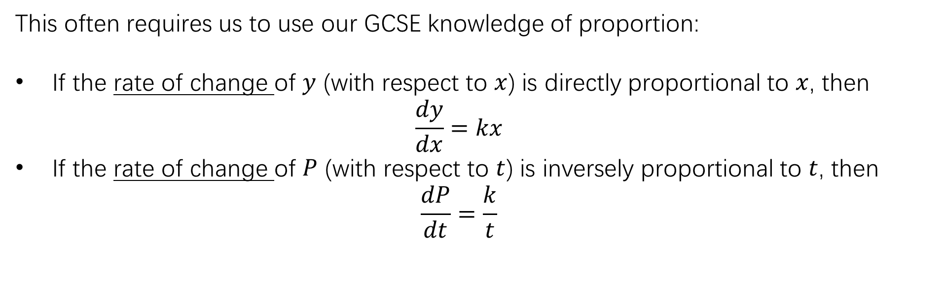
Forming and Solving Equations
Sometimes, the examiner will require us to form the initial differential equation to be solved (or, at least, to show how it can be formed/written in a given way) – this is particularly the case in Mechanics (Unit 4).
This often requires us to use our GCSE knowledge of proportion:
If the rate of change of $y$ (with respect to $x$) is directly proportional to $x$, then
  $$\frac{dy}{dx}=kx$$
If the rate of change of $P$ (with respect to $t$) is inversely proportional to $t$, then
  $$\frac{dP}{dt}=\frac{k}{t}$$

Slide 18


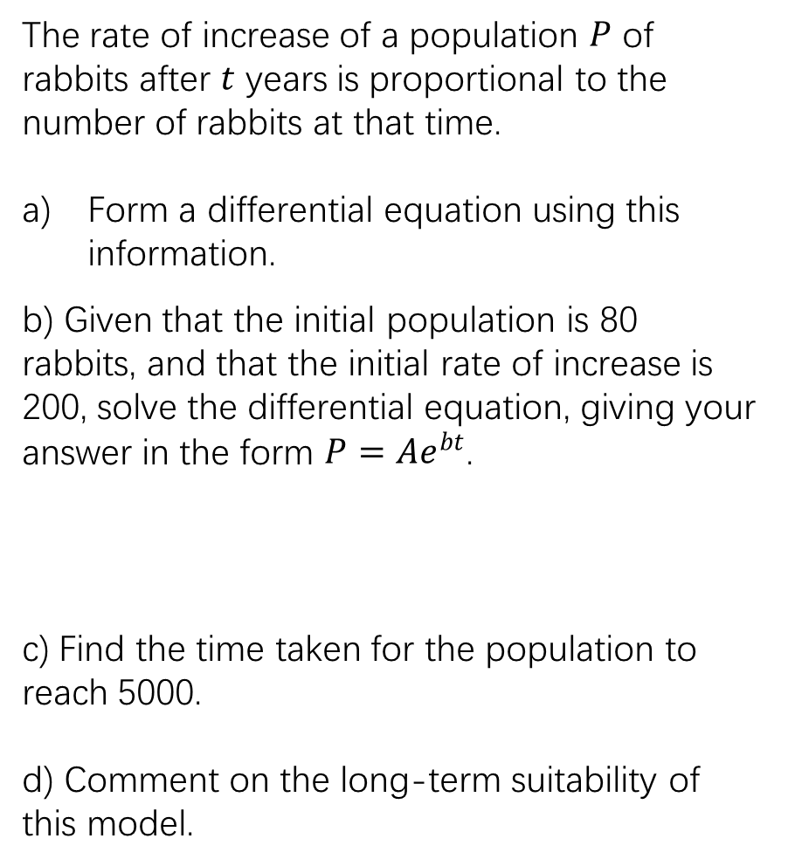
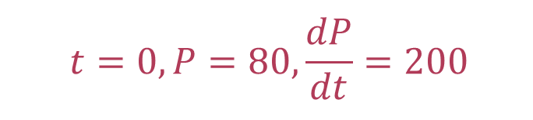



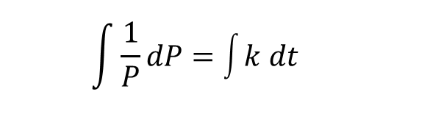

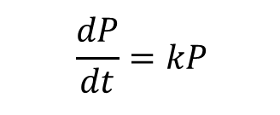


EXAMPLE 1:
The rate of increase of a population $P$ of rabbits after $t$ years is proportional to the number of rabbits at that time.
Form a differential equation using this information.
b) Given that the initial population is 80 rabbits, and that the initial rate of increase is 200, solve the differential equation, giving your answer in the form $P=Ae^{bt}$.
c) Find the time taken for the population to reach 5000.
d) Comment on the long-term suitability of this model.
$$\frac{dP}{dt}=kP$$
$$\int{\frac{1}{P}dP}=\int{k dt}$$
$$⇒\ln\left|P\right|=kt+C$$
$$⇒P=Ae^{kt}$$
$$t=0, P=80,\frac{dP}{dt}=200$$
$$A=80$$
$$k=2.5$$
$$⇒P=80e^{2.5t}$$
$$80e^{2.5t}=5000$$
$$⇒t=1.65 years$$
As $t$ gets large, $e^{2.5t}$ grows without limit (tends to infinity), which implies the population grows indefinitely. This is not realistic, therefore the model is not suitable long-term.

Slide 19












Task 1:
The rate of radioactive decay of a substance is to be modelled. The rate of decay is found to be proportional to the number of particles $N$ remaining at time $t$, where t is in days. Letting the constant of proportionality be $λ$
a) Form a differential equation using this information.
b) Given that the initial quantity of the substance contained 4000 particles, and that the number of particles had halved after 10 days, find the value of $λ$ to 3 significant figures.
c) Find the time taken for substance to contain one tenth of the initial number of particles.
$$\frac{dN}{dt}=−λN$$
$$\int{\frac{1}{N}dN}=\int{−λ dt}$$
$$⇒\ln\left|N\right|=−λt+C$$
$$⇒N=Ae^{−λt}$$
$$t=0, N=4000$$
$$4000=Ae^{−λ\text{(0)} }⇒A=4000$$
$$t=10, N=2000$$
$$2000=4000e^{−10λ } ⇒λ=0.0693$$
$$⇒N=4000e^{−0.0693t}$$
$$4000e^{−0.0693t}=400$$
$$⇒t=33.2 days$$

Slide 20
Test your understanding 2
Complete TYU 2 from your pack.
Further questions available in student booklet.
The following slides contain solutions generated by AI (Gemini Pro 3.0 Preview Edition).
These may contain errors!

Slide 21


Test your understanding 1
Question 1

Slide 22


Test your understanding 1
Question 2:

Slide 23


Test your understanding 1

Slide 24

Test your understanding 1

Slide 25

Test your understanding 1

Slide 26

Test your understanding 1
Question 3
Question 4

Slide 27

Test your understanding 1
Question 4

Slide 28

Test your understanding 1
Question 5

Slide 29


Test your understanding 2

Slide 30


Test your understanding 2

Slide 31


Test your understanding 2

Slide 32


Test your understanding 2

Slide 33

Test your understanding 2

Slide 34


Test your understanding 2

