Slide 1


Unit 12 – Integration
(Specification Reference 2.3.7)
©

Slide 2
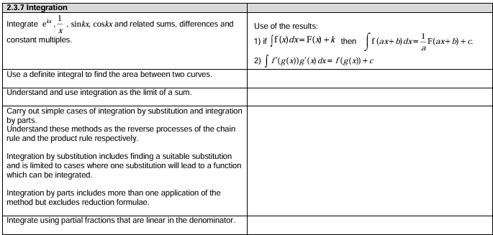
Unit 12 – Integration
©

Slide 3


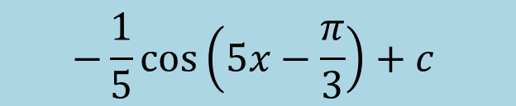

STARTER (Prerequisite atom check):
Find $\int{\frac{3}{x}}dx$
Find $\int{\sin\left(5x−\frac{π}{3}\right)dx}$
Find $\int_{ln2}^{ln3}{e^{2x}}$
$$3ln\left|x\right|+C$$
$$−\frac{1}{5}\cos\left(5x−\frac{π}{3}\right)+c$$
$$2.5 units^{2}$$

Slide 4
Unit 12.7 – Integration by parts
Learning objectives
To understand how the formula for integration by parts (IBP) links to the product rule;
To be able to use for the formula for integration by parts;
To be able to integrate functions involving repeated integration by parts, and apply limits to functions integrated by parts.

Slide 5
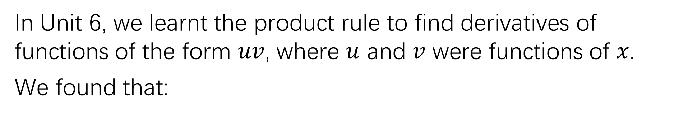
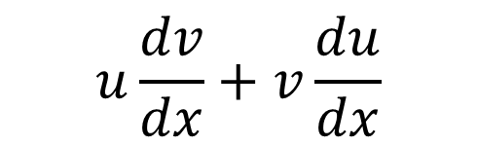

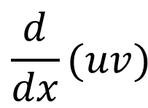
Integration By Parts
In Unit 6, we learnt the product rule to find derivatives of functions of the form $uv$, where $u$ and $v$ were functions of $x$.
We found that:
$$\frac{d}{dx}(uv)$$
$$u\frac{dv}{dx}+v\frac{du}{dx}$$
$$=$$
We can easily prove the formula for integration by parts by rearranging and integrating the above formula.
(This proof is not needed for the examination!)

Slide 6
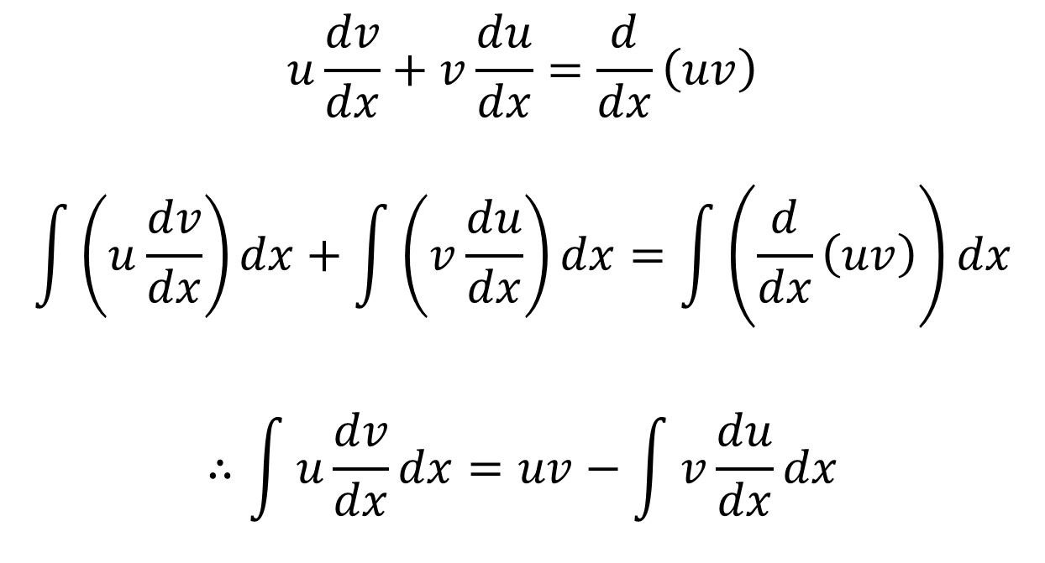
Integration By Parts
$$u\frac{dv}{dx}+v\frac{du}{dx}=\frac{d}{dx}\left(uv\right)$$
$$\int{\left(u\frac{dv}{dx}\right)dx}+\int{\left(v\frac{du}{dx}\right)dx}=\int{\left(\frac{d}{dx}\left(uv\right)\right)dx}$$
$$∴\int{u\frac{dv}{dx}dx}=uv−\int{v\frac{du}{dx}dx}$$
Note that this is a product – usually we are looking for a product or quotient if IBP is needed!
This formula is given in the formula booklet, and is way less scary to use than it looks – “I promise”!

Slide 7
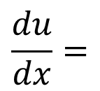



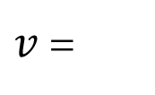

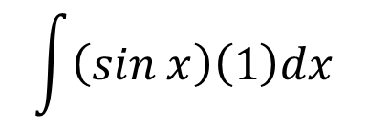

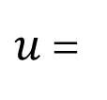




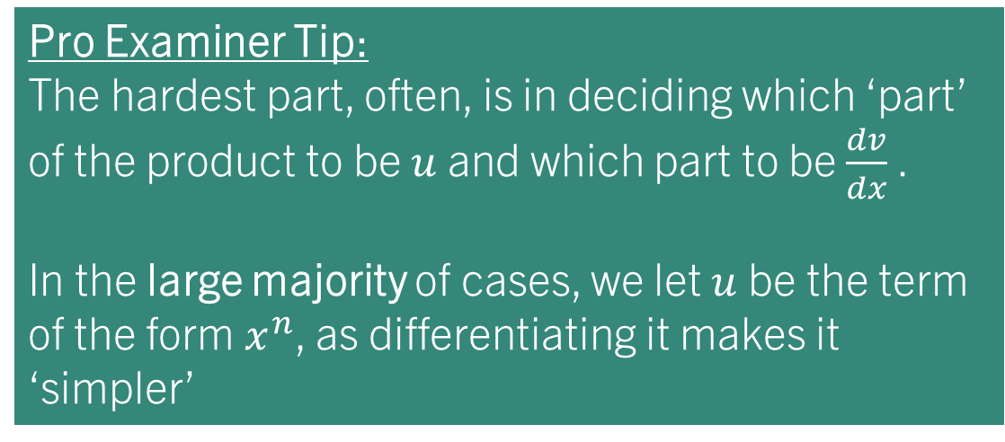
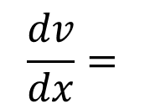
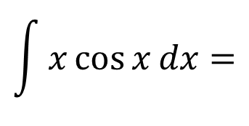
example 1:
Pro Examiner Tip:
The hardest part, often, is in deciding which ‘part’ of the product to be $u$ and which part to be $\frac{dv}{dx}$ .
In the large majority of cases, we let $u$ be the term of the form $x^{n}$, as differentiating it makes it ‘simpler’
Find:
$$\int{x}\cos{x} dx$$
$$\int{u\frac{dv}{dx}dx}=uv−\int{v\frac{du}{dx}dx}$$
$u$ =
$$x$$
$v$ =
$$sin x$$
$$\frac{du}{dx}=$$
$$\frac{dv}{dx}=$$
$$1$$
$$cos x$$
$$\int{x}\cos{x}dx=$$
$$\int{\left(sin x\right)\left(1\right)dx}$$
$$−$$
$$x sin x$$
$$=x\sin{x}+\cos{x}+ c$$

Slide 8
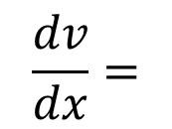
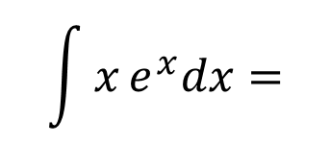

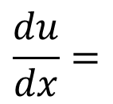


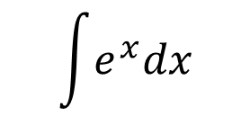
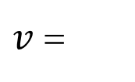

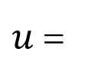


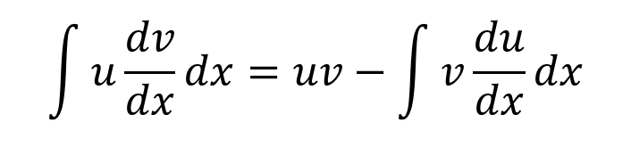


Task 1:
Find:
$$\int{x}e^{x}dx$$
$$\int{u\frac{dv}{dx}dx}=uv−\int{v\frac{du}{dx}dx}$$
$u$ =
$$x$$
$v$ =
$$e^{x}$$
$$\frac{du}{dx}=$$
$$\frac{dv}{dx}=$$
$$1$$
$$e^{x}$$
$$\int{x}e^{x}dx=$$
$$\int{e^{x}dx}$$
$$−$$
$$xe^{x}$$
$$= xe^{x}−e^{x}+ c$$

Slide 9
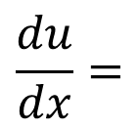

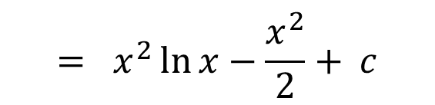

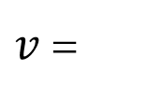
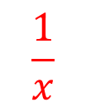
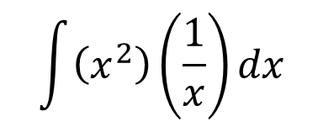

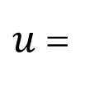




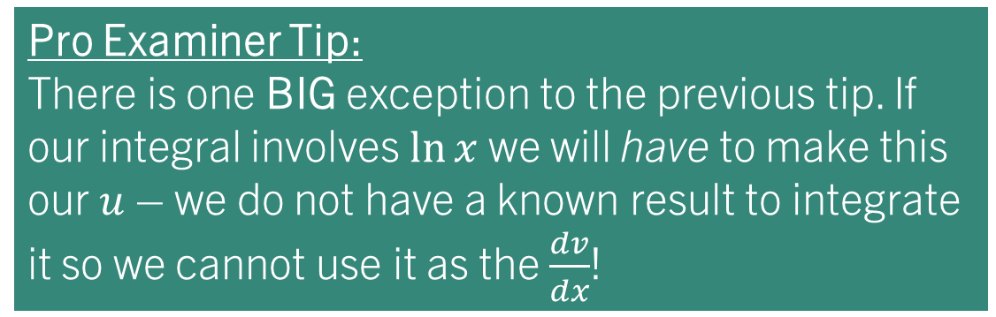
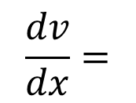
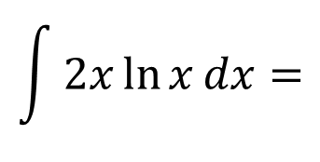
example 2:
Pro Examiner Tip:
There is one BIG exception to the previous tip. If our integral involves $\ln{x}$ we will have to make this our $u$ – we do not have a known result to integrate it so we cannot use it as the $\frac{dv}{dx}$!
Find:
$$\int{2x}\ln{x}dx$$
$$\int{u\frac{dv}{dx}dx}=uv−\int{v\frac{du}{dx}dx}$$
$$\ln{x}$$
$$x^{2}$$
$u$ =
$v$ =
$$\frac{du}{dx}=$$
$$\frac{1}{x}$$
$$\frac{dv}{dx}=$$
$$2x$$
$$\int{2x}\ln{x}dx=$$
$$\int{\left(x^{2}\right)\left(\frac{1}{x}\right)dx}$$
$$−$$
$$x^{2}\ln{x}$$
$$= x^{2}\ln{x}−\frac{x^{2}}{2}+ c$$

Slide 10
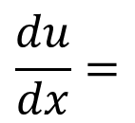



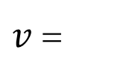
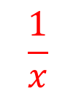
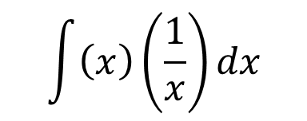

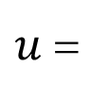




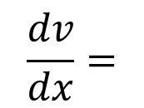
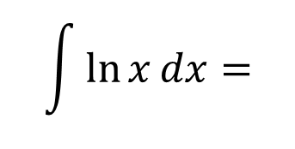
TASK 2:
The examiner loves this question!
Hint: Start by writing $\ln{x}$ as $1\ln{x}$…
Find:
$$\int{\ln{x}}dx$$
$$\int{u\frac{dv}{dx}dx}=uv−\int{v\frac{du}{dx}dx}$$
$$\ln{x}$$
$$x$$
$u$ =
$v$ =
$$\frac{du}{dx}=$$
$$\frac{1}{x}$$
$$\frac{dv}{dx}=$$
$$1$$
$$\int{\ln{x}}dx=$$
$$\int{\left(x\right)\left(\frac{1}{x}\right)dx}$$
$$−$$
$$x\ln{x}$$
$$=x\ln{x}−x+ c$$

Slide 11
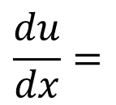

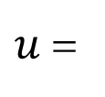


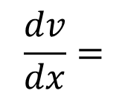
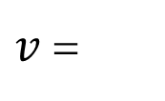




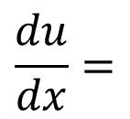
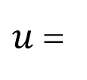







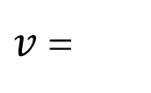
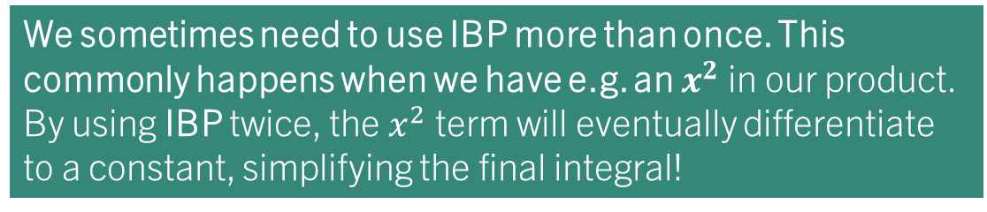
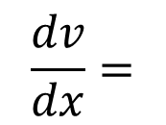
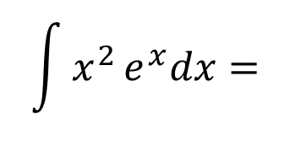

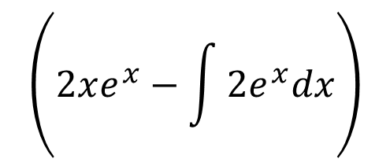
example 3:
We sometimes need to use IBP more than once. This commonly happens when we have e.g. an $x^{2}$ in our product. By using IBP twice, the $x^{2}$ term will eventually differentiate to a constant, simplifying the final integral!
Find:
$$\int{x^{2}}e^{x}dx$$
$$x^{2}$$
$$e^{x}$$
$u$ =
$v$ =
$$\int{u\frac{dv}{dx}dx}=uv−\int{v\frac{du}{dx}dx}$$
$$\frac{du}{dx}=$$
$$\frac{dv}{dx}=$$
$$2x$$
$$e^{x}$$
$$\int{x^{2}}e^{x}dx=$$
$$\int{2xe^{x}dx}$$
$$−$$
We still can’t integrate this term yet…
$$x^{2}e^{x}$$
$u$ =
$$2x$$
$v$ =
$$e^{x}$$
$$\left(2xe^{x}−\int{2e^{x}dx}\right)$$
$$\frac{du}{dx}=$$
$$\frac{dv}{dx}=$$
$$= x^{2}e^{x}−$$
$$2$$
$$e^{x}$$
$$= x^{2}e^{x}−2xe^{x}+2e^{x}+c$$

Slide 12
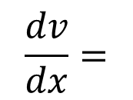














EXAMPLE 4:
We can, of course, integrate between limits!
The ‘uv’ part of the formula is already ‘integrated’ for the purpose of substituting in limits.
Find:
$$\int_{0}^{ln2}{xe^{x}}dx$$
$$\int{u\frac{dv}{dx}dx}=uv−\int{v\frac{du}{dx}dx}$$
$u$ =
$$x$$
$v$ =
$$e^{x}$$
$$\frac{du}{dx}=$$
$$\frac{dv}{dx}=$$
$$1$$
$$e^{x}$$
$$\int{x}e^{x}dx=$$
$$\left[xe^{x}\right]\begin{matrix}\ln{2} \\ 0\end{matrix}$$
$$\int_{0}^{ln2}{e^{x}}dx$$
$$−$$
$$= [xe^{x}−e^{x}]\begin{matrix}\ln{2} \\ 0\end{matrix}$$
$$= \left((ln{2}\right)e^{\ln{2}}−e^{ln2})−(0e^{0}−e^{0})$$
$$= 2\ln{2}−1$$

Slide 13


TASK 3:
Find:
$$\int_{0}^{\frac{π}{2}}{x cos x}dx$$
$$= \frac{π}{2}−1$$

Slide 14
Test your understanding 5
Complete TYU 5 from your pack – this is to be finished and self-marked for homework.
Further questions available in student booklet.
The following slides contain solutions generated by AI (Gemini Pro 2.5).
These may contain errors!

Slide 15

Test your understanding 5 – SUMMARY ANSWERS

Slide 16



Test your understanding 5

Slide 17

Test your understanding 5

Slide 18

Test your understanding 5

Slide 19

Test your understanding 5

Slide 20

Test your understanding 5

Slide 21

Test your understanding 5

Slide 22

Test your understanding 5

Slide 23

Test your understanding 5

