Slide 1


Unit 12 – Integration (Specification Reference 2.3.7)
©

Slide 2
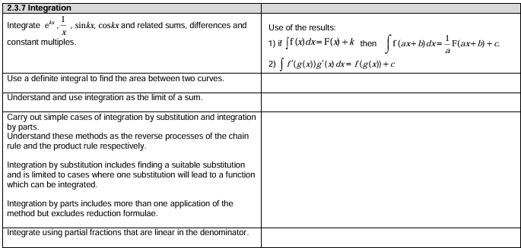
Unit 12 – Integration
©

Slide 3
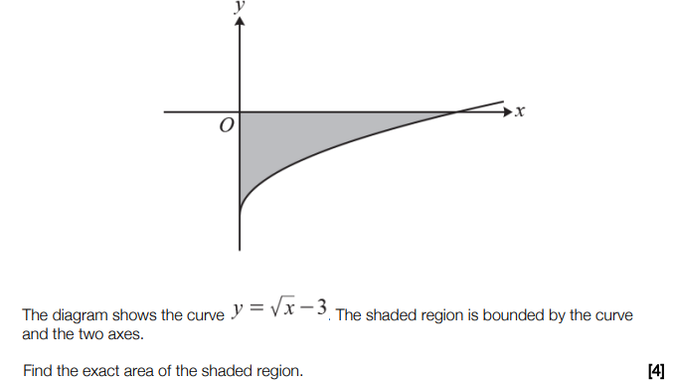
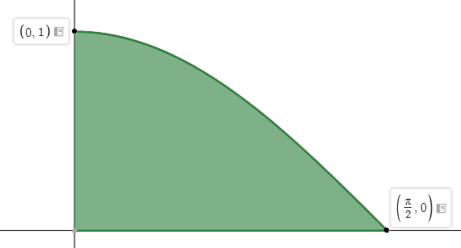

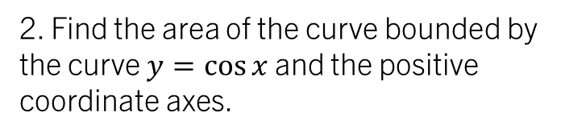

STARTER (Prerequisite atom check):
2. Find the area of the curve bounded by the curve $y=\cos{x}$ and the positive coordinate axes.
1.
$$9 units^{2}$$
$$1 square unit$$

Slide 4
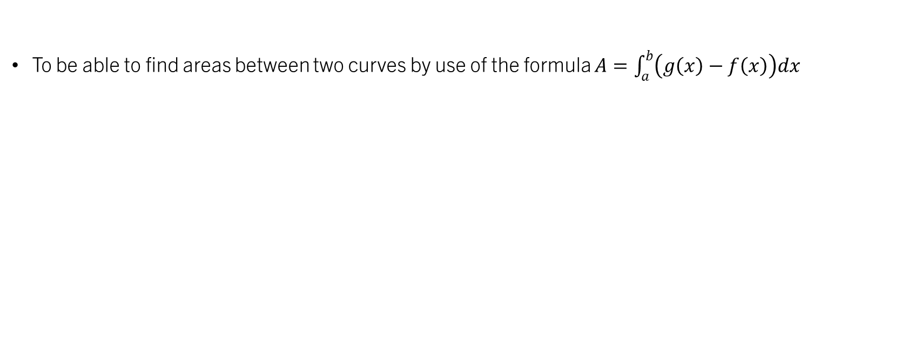
Unit 12.4 – Areas between two curves
To be able to find areas between two curves by use of the formula $A=\int_{a}^{b}{\left(g\left(x\right)−f\left(x\right)\right)dx}$

Slide 5
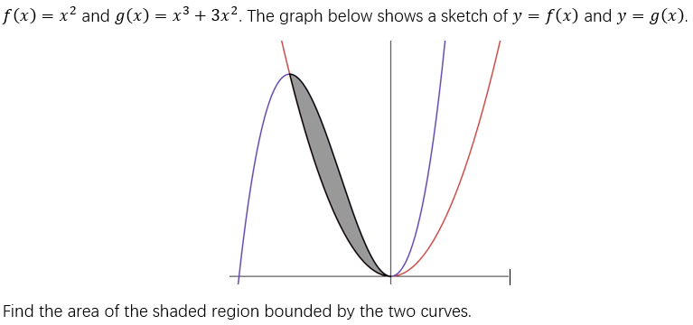
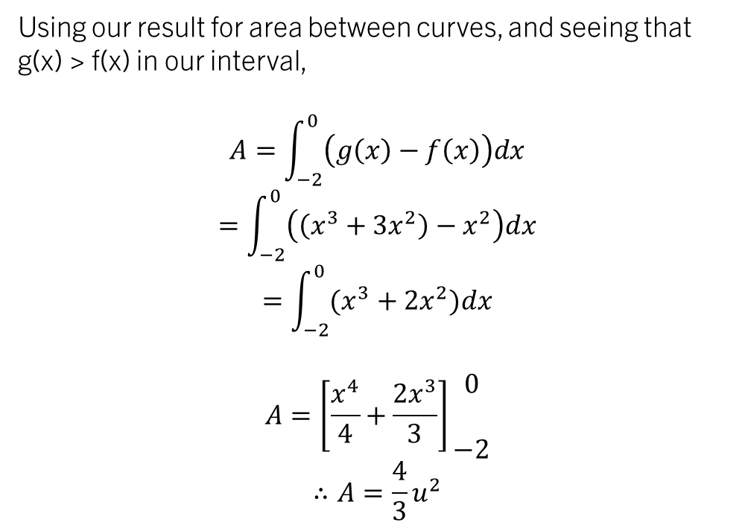
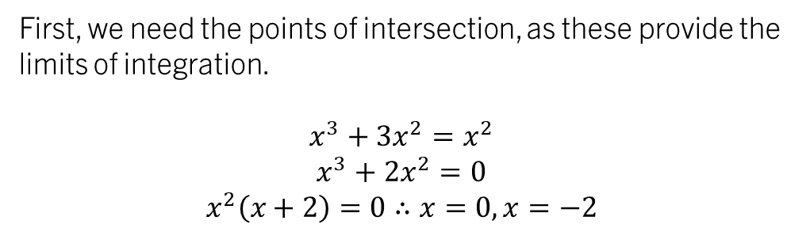
example 1:
Using our result for area between curves, and seeing that g(x) > f(x) in our interval,
$$A=\int_{−2}^{0}{\left(g\left(x\right)−f\left(x\right)\right)dx}$$
$$=\int_{−2}^{0}{\left(\left(x^{3}+3x^{2}\right)−x^{2}\right)dx}$$
$$=\int_{−2}^{0}{(x^{3}+2x^{2})dx}$$
$$A=\left[\frac{x^{4}}{4}+\frac{2x^{3}}{3}\right]\begin{matrix}0 \\ \\ −2\end{matrix}$$
$$∴A=\frac{4}{3}u^{2}$$
First, we need the points of intersection, as these provide the limits of integration.
$$x^{3}+3x^{2}=x^{2}$$
$$x^{3}+2x^{2}=0$$
$$x^{2}\left(x+2\right)=0∴x=0, x=−2$$

Slide 6
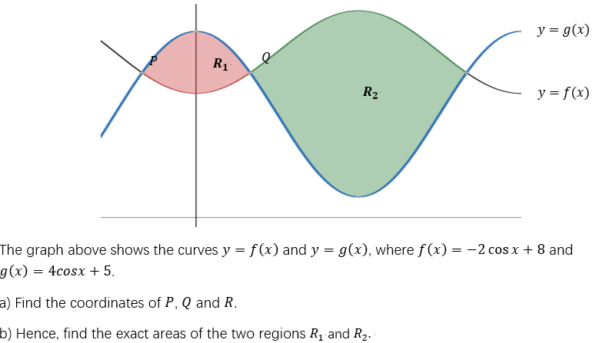

TASK 1:

Slide 7
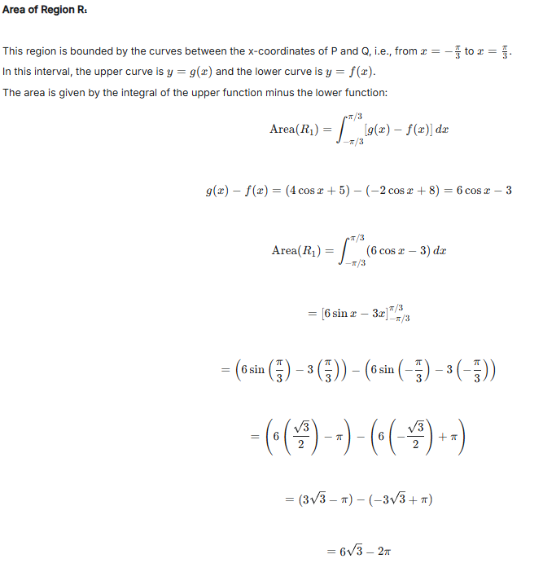
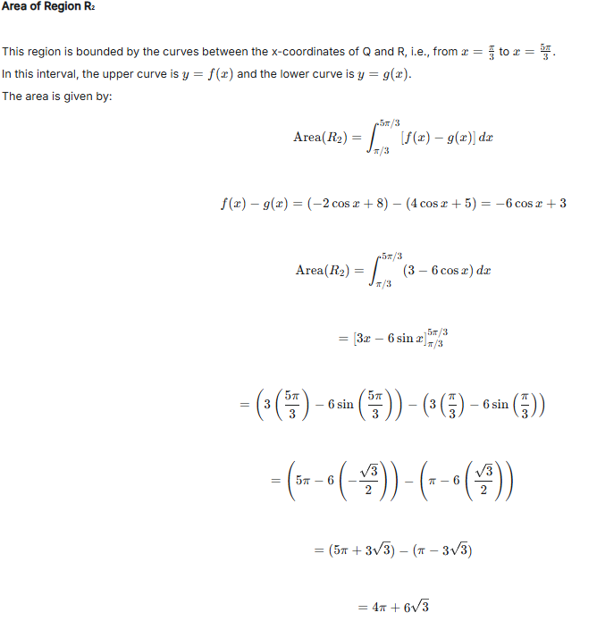
TASK 1:

Slide 8
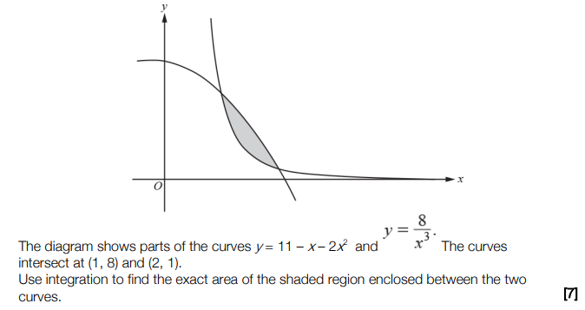
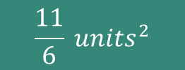
TASK 2:
$$\frac{11}{6} units^{2}$$

Slide 9
Test your understanding 4
Complete TYU 4, ALL questions from your pack.
Further questions available in student booklet.
The following slides contain AI-generated solutions to the questions. These have NOT been checked and therefore may contain errors.

Slide 10
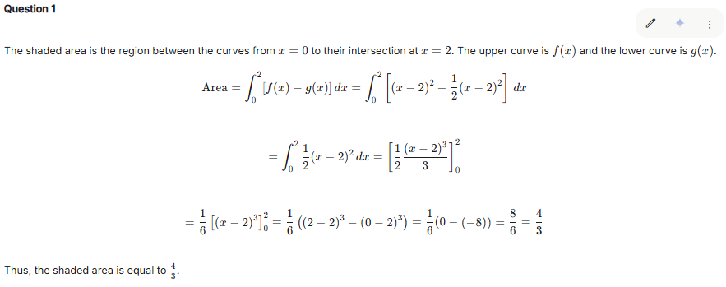
Test your understanding 4

Slide 11
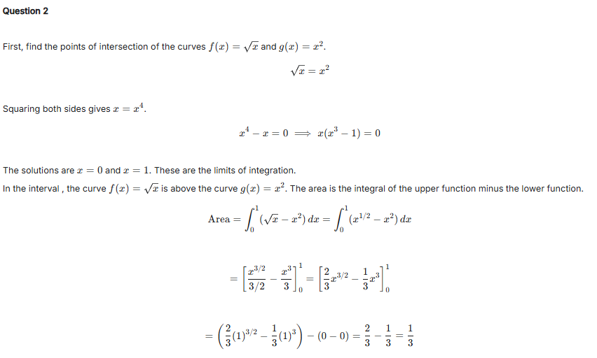
Test your understanding 4

Slide 12
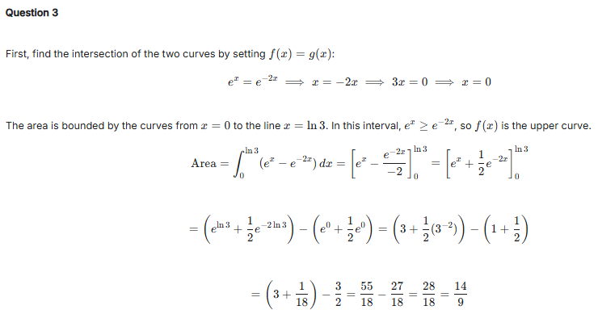
Test your understanding 4

Slide 13
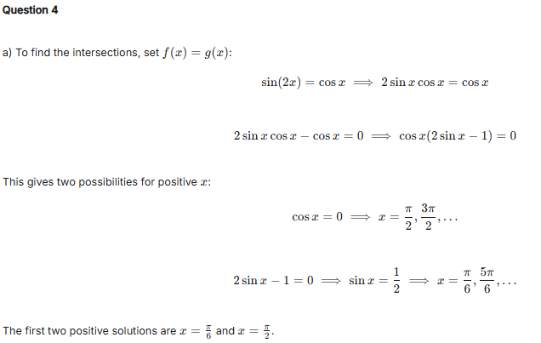
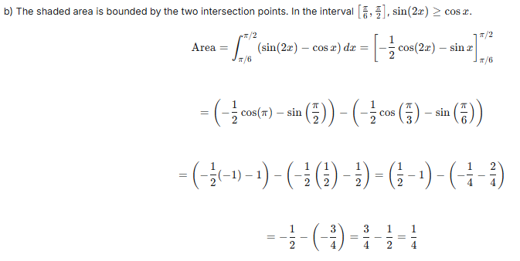
Test your understanding 4

Slide 14
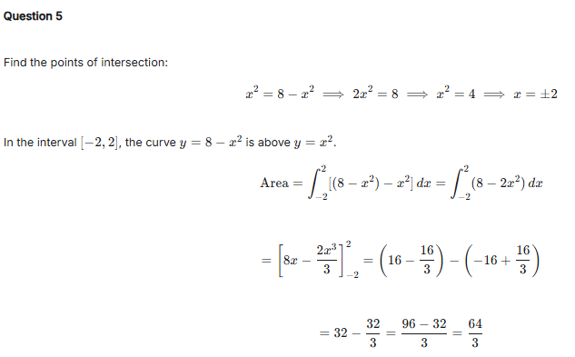
Test your understanding 4

Slide 15
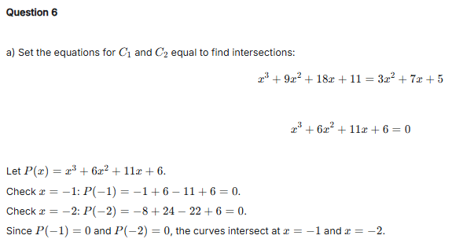
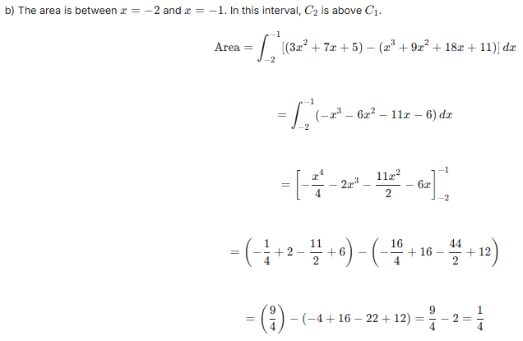
Test your understanding 4

Slide 16
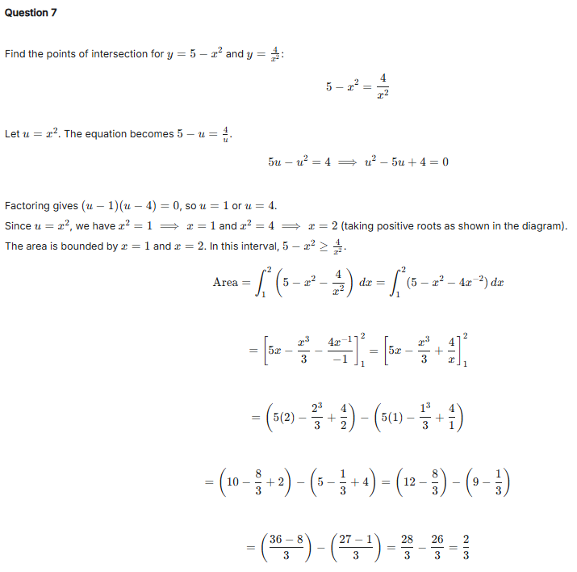
Test your understanding 4

Slide 17
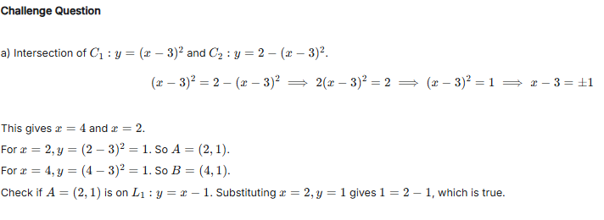
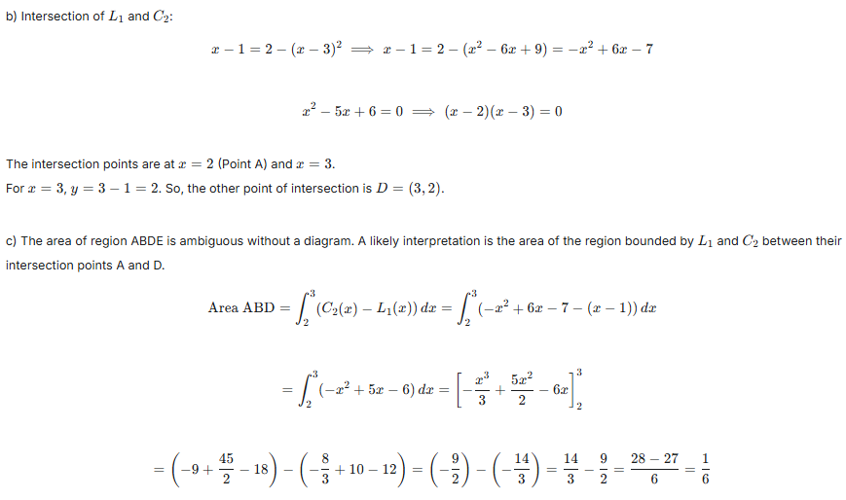
Test your understanding 4

Slide 18
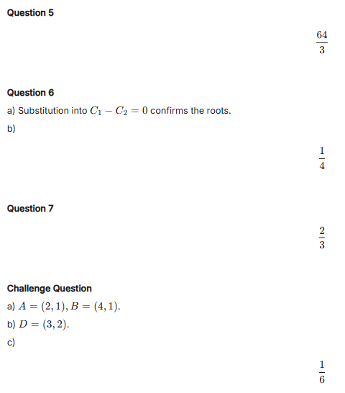
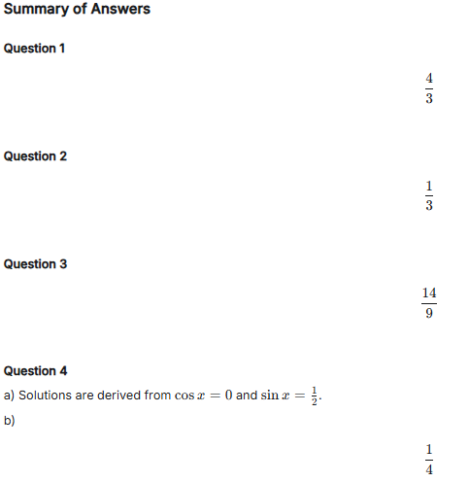
Test your understanding 4 – Answer summary

