Slide 1


Unit 12 – Integration
(Specification Reference 2.3.7)
©

Slide 2
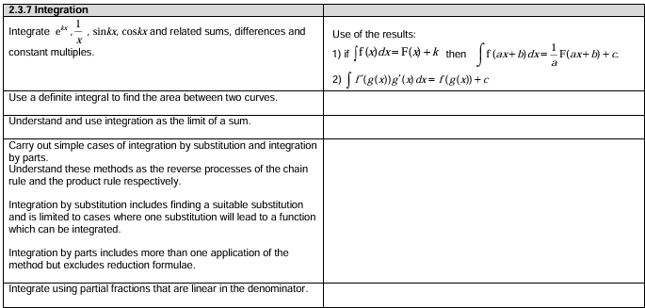
Unit 12 – Integration
©

Slide 3



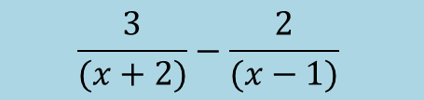
STARTER (Prerequisite atom check):
Express $\frac{x−7}{(x+2)(x−1)}$ in partial fractions.
Find $\int{\frac{1}{2x−3}dx}$
Find $\int{\frac{6}{5x+1}dx}$
$$\frac{3}{(x+2)}−\frac{2}{(x−1)}$$
$$\frac{1}{2}\ln\left|2x−3\right|+c$$
$$\frac{6}{5}\ln\left|5x+1\right|+c$$

Slide 4
Unit 12.4 – Integrating partial fractions
Learning objectives
To be able to find integrals where the use of partial fractions is required.

Slide 5


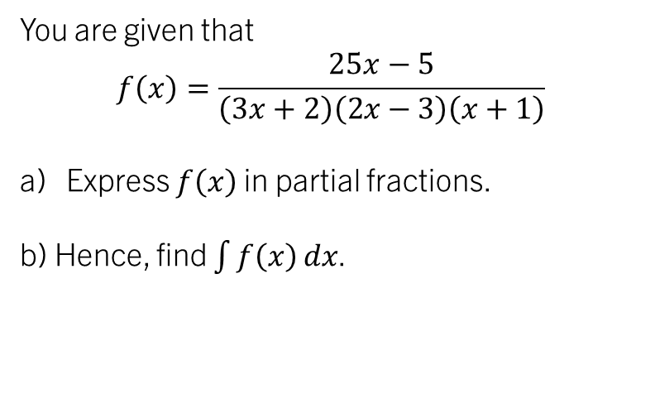
example 1:
You are given that
$$f\left(x\right)=\frac{25x−5}{\left(3x+2\right)\left(2x−3\right)\left(x+1\right)}$$
Express $f\left(x\right)$ in partial fractions.
b) Hence, find $\int{f\left(x\right)}dx$.

Slide 6

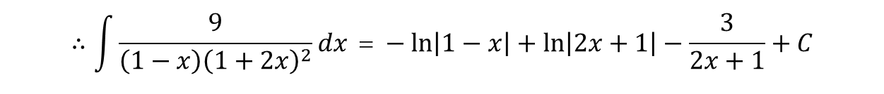

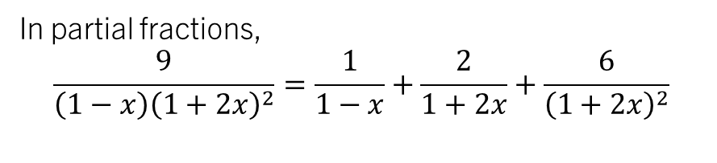
TASK 1:
Find
$$\int{\frac{9}{\left(1−x\right){\left(1+2x\right)}^{2}}dx }$$
Find
$$\int{\frac{9}{\left(1−x\right){\left(1+2x\right)}^{2}}dx }$$
In partial fractions,
$$\frac{9}{\left(1−x\right){\left(1+2x\right)}^{2}}=\frac{1}{1−x}+\frac{2}{1+2x}+\frac{6}{{\left(1+2x\right)}^{2}}$$
$$∴\int{\frac{9}{\left(1−x\right){\left(1+2x\right)}^{2}}dx \text{ =} −\ln\left|1−x\right|+\ln\left|2x+1\right|−\frac{3}{2x+1}+C}$$

Slide 7
Unit 12.5 – Integrating with trigonometric identities
Learning objectives
To be able to find integrals where the use of trigonometric identities is required.
To understand that powers of sine/cosine generally have to be converted to double angles in cosine to integrate.

Slide 8

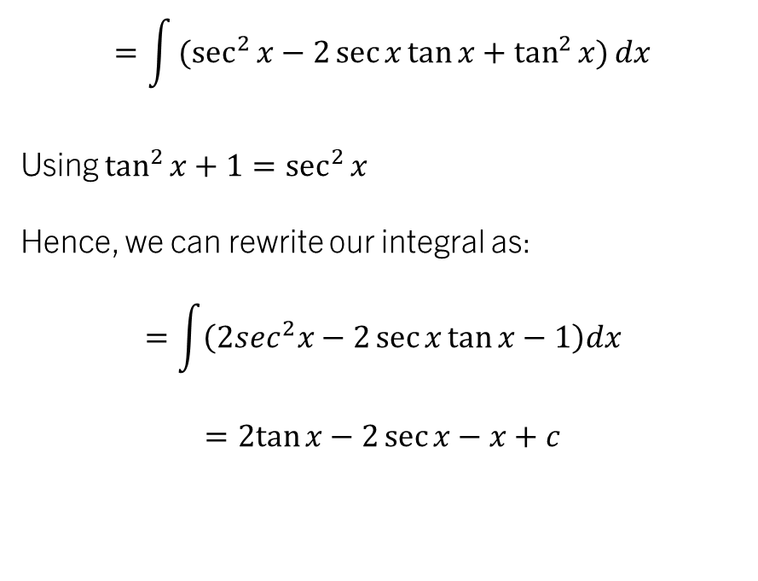

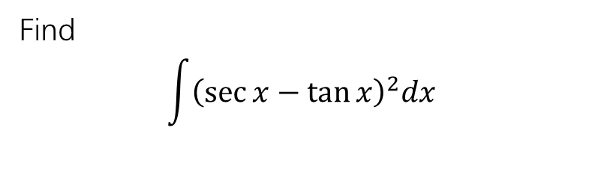
example 1:
TASK 1:
Find
$$\int{\tan^{2}{x}dx}$$
Find
$$\int{{\left(\sec{x}−\tan{x}\right)}^{2}dx}$$
Note that since $\sin^{2}{x+\cos^{2}{x}=1}$
Therefore $\tan^{2}{x}+1=\sec^{2}{x}$
Hence, we can rewrite our integral as:
$$\int{{(sec}^{2}{x−}1})dx$$
$$=\tan{x}−x+c$$
$$=\int{{(sec}^{2}{x−2\sec{x}\tan{x}+\tan^{2}{x})}}dx$$
Using $\tan^{2}{x}+1=\sec^{2}{x}$
Hence, we can rewrite our integral as:
$$=\int{\left(2sec^{2}x−2\sec{x}\tan{x}−1\right)dx}$$
$$=2tan{x}−2\sec{x}−x+c$$

Slide 9
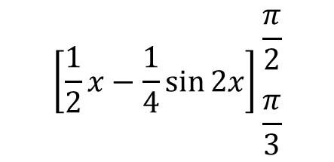
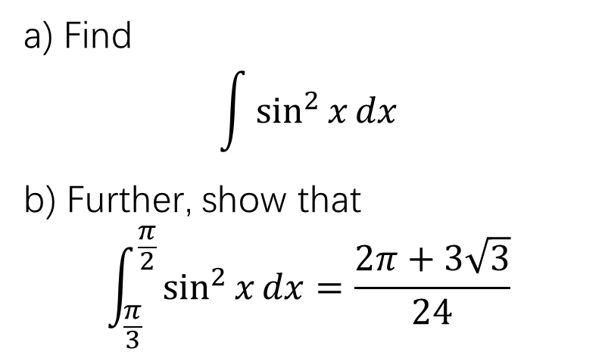

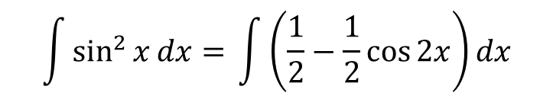

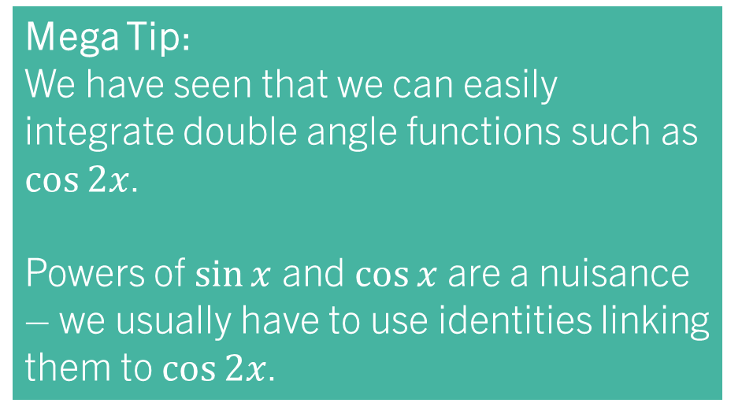
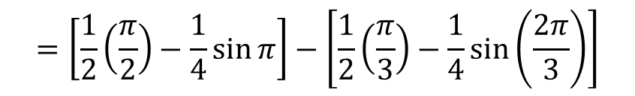
example 2:
Mega Tip:
We have seen that we can easily integrate double angle functions such as $\cos{2x}$.
Powers of $\sin{x}$ and $\cos{x}$ are a nuisance – we usually have to use identities linking them to $\cos{2x}$.
a) Find
$$\int{\sin^{2}{x}dx}$$
b) Further, show that
$$\int_{\frac{π}{3}}^{\frac{π}{2}}{\sin^{2}{x}dx=\frac{2π+3\sqrt{3}}{24}}$$
$$\left[\frac{1}{2}x−\frac{1}{4}\sin{2x}\right]\begin{matrix}\frac{π}{2} \\ \\ \frac{π}{3}\end{matrix}$$
Using $\cos{2x}=1−2\sin^{2}{x}$ we can rewrite our integral as…
$$\int{\sin^{2}{x}dx= }\int{\left(\frac{1}{2}−\frac{1}{2}\cos{2x}\right)dx}$$
$$=\left[\frac{1}{2}\left(\frac{π}{2}\right)−\frac{1}{4}\sin{π}\right]−\left[\frac{1}{2}\left(\frac{π}{3}\right)−\frac{1}{4}\sin\left(\frac{2π}{3}\right)\right]$$
$$=\frac{1}{2}x−\frac{1}{4}\sin{2x}+C$$
$$=\left(\frac{π}{4}\right)−\left(\frac{π}{6}−\frac{\sqrt{3}}{8}\right)$$
$$=\frac{2π+3\sqrt{3}}{24}$$

Slide 10
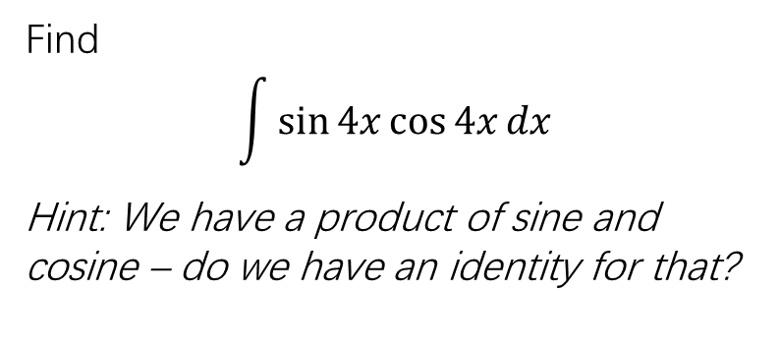
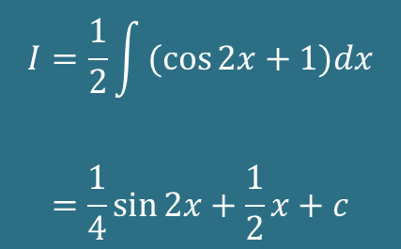
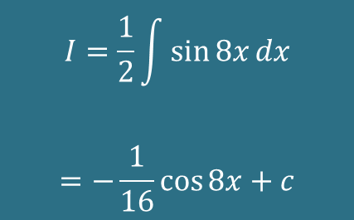

TASk 2:
TASK 3:
Find
$$\int{\sin{4x}\cos{4x}dx}$$
Hint: We have a product of sine and cosine – do we have an identity for that?
Find
$$\int{\cos^{2}{x}dx}$$
$$I=\frac{1}{2}\int{\sin{8x}dx}$$
$$=−\frac{1}{16}\cos{8x}+c$$
$$I=\frac{1}{2}\int{(cos{2x}+1)dx}$$
$$=\frac{1}{4}\sin{2x}+\frac{1}{2}x+c$$

Slide 11

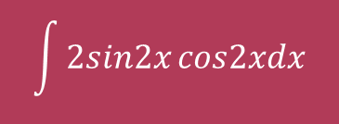
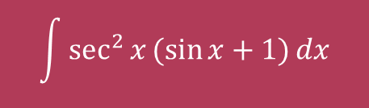

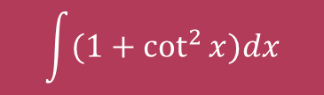
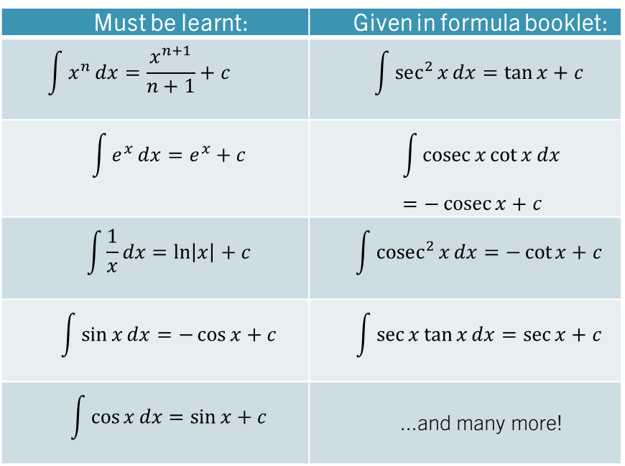
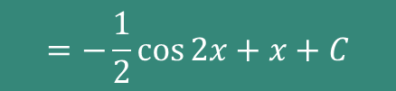
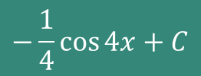
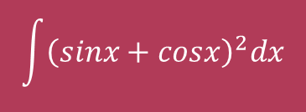
Quickfire Integrals – whiteboards (IN PAIRS!)
Find each of:
$$\int{2sin2x}cos2xdx$$
$$−\frac{1}{4}\cos{4x}+C$$
Must be learnt: | Given in formula booklet:
$$\int{x^{n}}dx=\frac{x^{n+1}}{n+1}+c$$ | $$\int{sec^{2}{x}}dx=\tan{x}+c$$
$$\int{e^{x}}dx=e^{x}+c$$ | $$\int{\operatorname{cosec}{x}\cot{x}}dx=−\operatorname{cosec}{x}+c$$
$$\int{\frac{1}{x}}dx=\ln\left|x\right|+c$$ | $$\int{cosec^{2}{x}}dx=−\cot{x}+c$$
$$\int{\sin{x}}dx=−\cos{x}+c$$ | $$\int{\sec{x}\tan{x}}dx=\sec{x}+c$$
$$\int{\cos{x}}dx=\sin{x}+c$$ | ...and many more!
$$\int{(1+\cot^{2}{x})dx}$$
$$=−\cot{x}+C$$
$$\int{\sec^{2}{x}(\sin{x+1)}dx}$$
$$=\sec{x}+\tan{x}+C$$
$$\int{{\left(sinx+cosx\right)}^{2}dx}$$
$$=−\frac{1}{2}\cos{2x}+x+C$$

Slide 12
Test your understanding 3
Complete TYU 3, remaining questions from your pack.
Further questions available in student booklet.

Slide 13
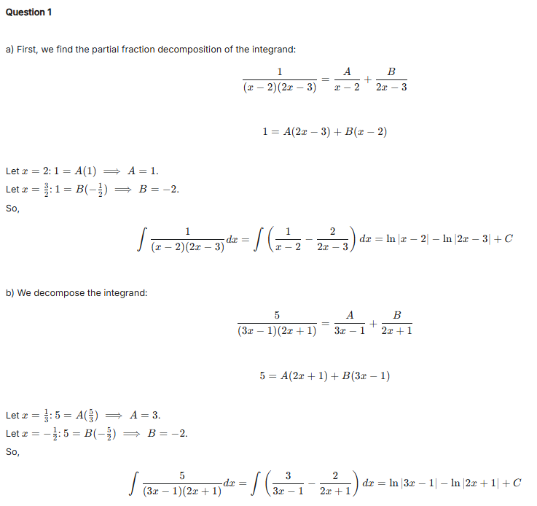
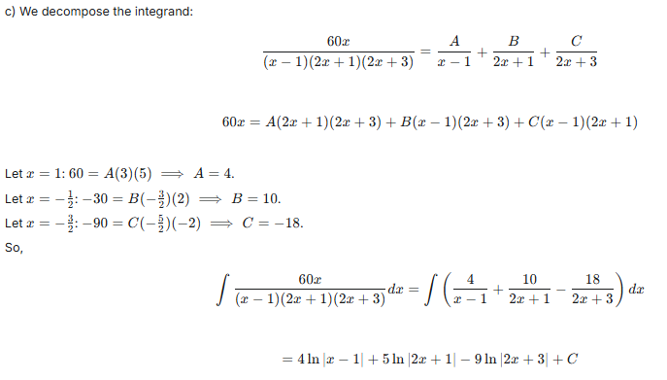
Test your understanding 3

Slide 14
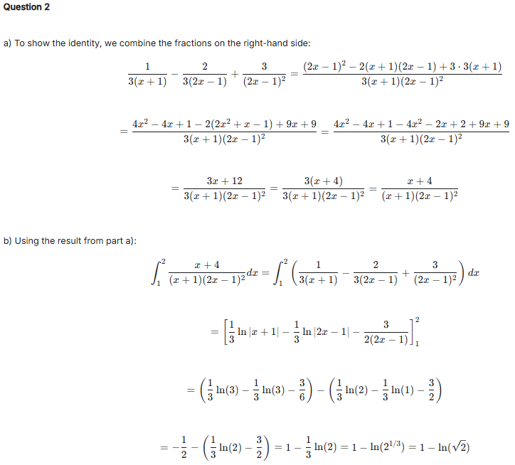
Test your understanding 3

Slide 15
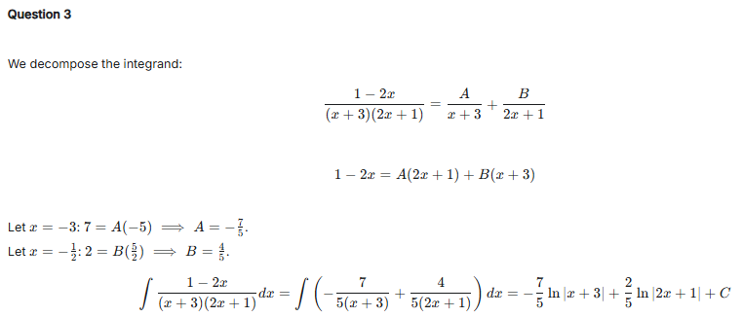
Test your understanding 3

Slide 16
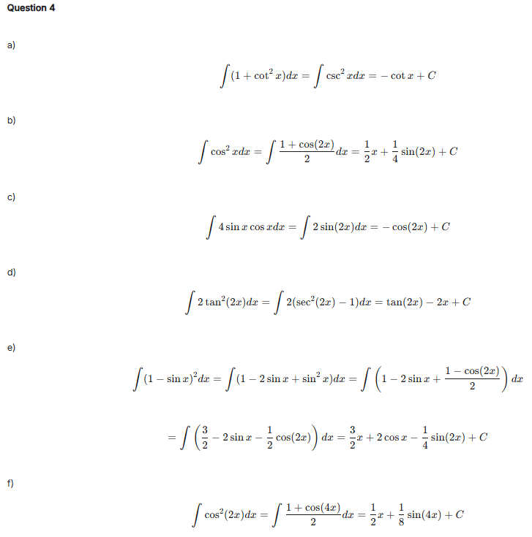
Test your understanding 3

Slide 17
Test your understanding 3

Slide 18
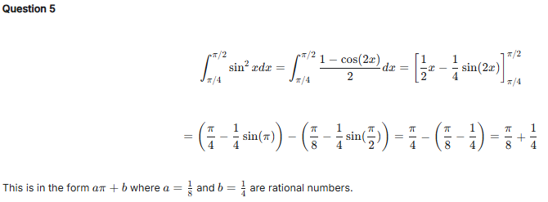
Test your understanding 3

Slide 19
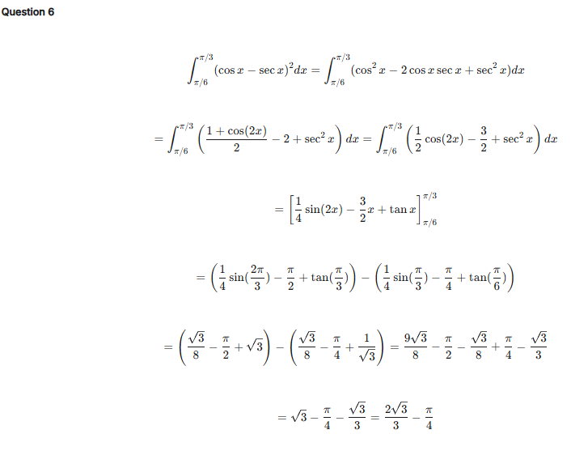
Test your understanding 3

Slide 20
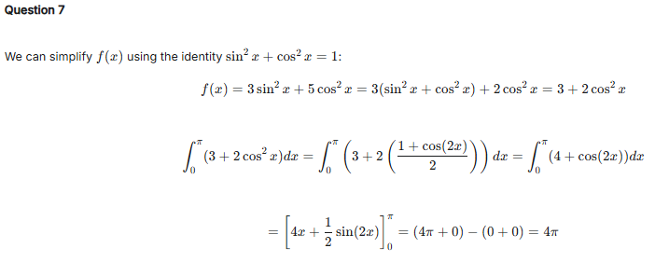
Test your understanding 3

Slide 21
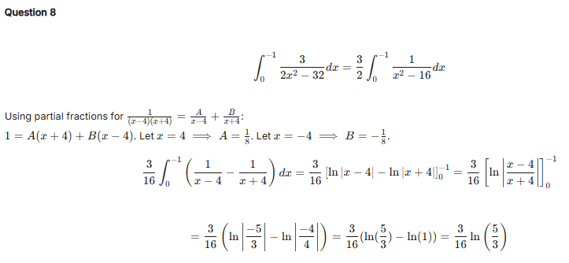
Test your understanding 3

Slide 22
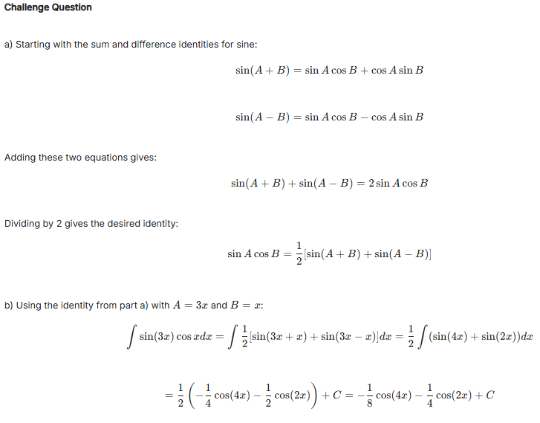
Test your understanding 3

