Slide 1


Unit 12 – Integration (Specification Reference 2.3.7)
©

Slide 2
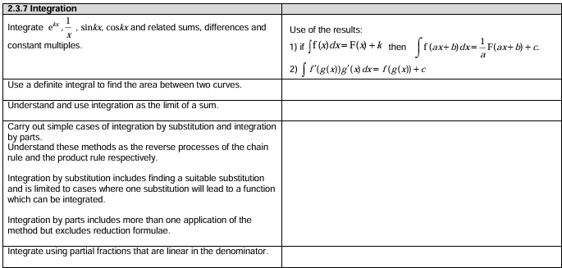
Unit 12 – Integration
©

Slide 3
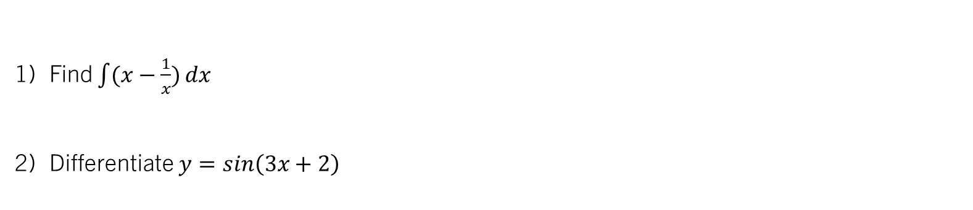
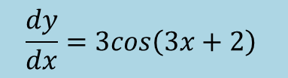
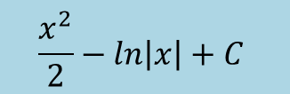
STARTER (Prerequisite atom check):
$$\frac{x^{2}}{2}−ln\left|x\right|+C$$
Find $\int{(x−\frac{1}{x})}dx$
Differentiate $y=sin\left(3x+2\right)$
$$\frac{dy}{dx}=3cos\left(3x+2\right)$$

Slide 4
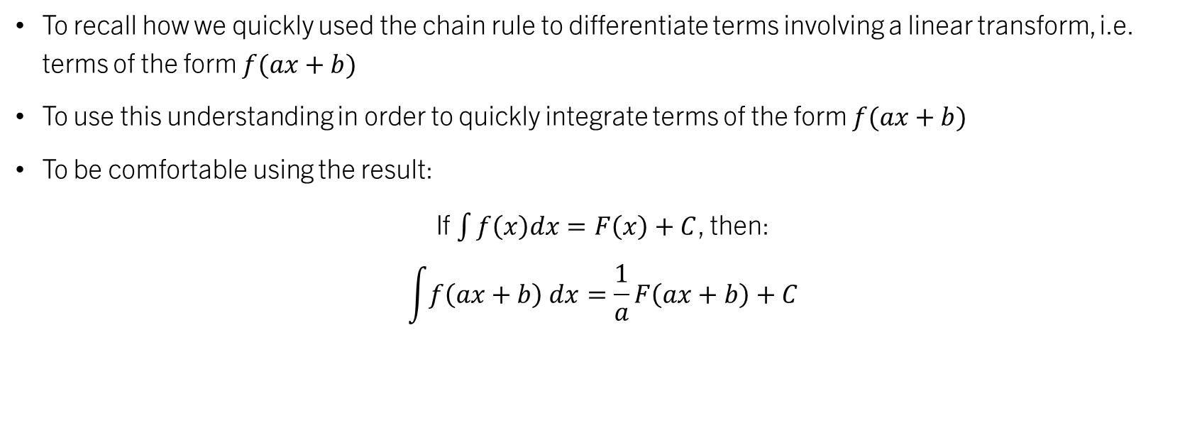

Unit 12.3 – Integrating $f\left(ax+b\right)$
To recall how we quickly used the chain rule to differentiate terms involving a linear transform, i.e. terms of the form $f(ax+b)$
To use this understanding in order to quickly integrate terms of the form $f(ax+b)$
To be comfortable using the result:
If $\int{f\left(x\right)dx=F\left(x\right)+C}$, then:
$$\int{f\left(ax+b\right) dx}=\frac{1}{a}F\left(ax+b\right)+C$$

Slide 5


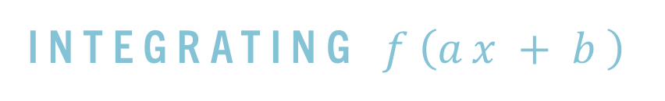


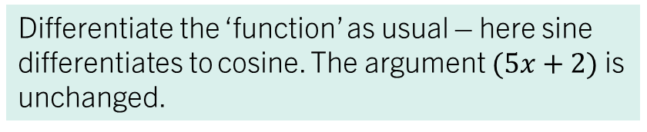

Integrating $f\left(ax+b\right)$
We have looked at using the chain rule to quickly differentiate terms such as $sin\left(5x+2\right)$:
$$\frac{d}{dx}$$
$$\sin{(5x+2)}$$
$$=$$
$$5$$
$$\cos{(5x+2)}$$
Multiply by the derivative of the argument (inner function)
Differentiate the ‘function’ as usual – here sine differentiates to cosine. The argument $(5x+2)$is unchanged.

Slide 6





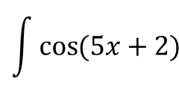
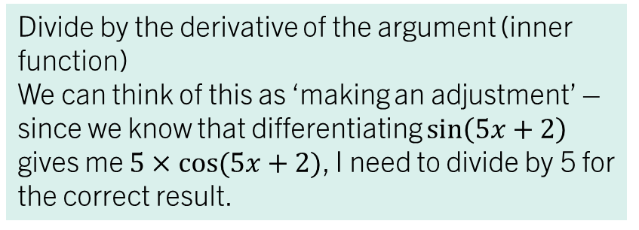
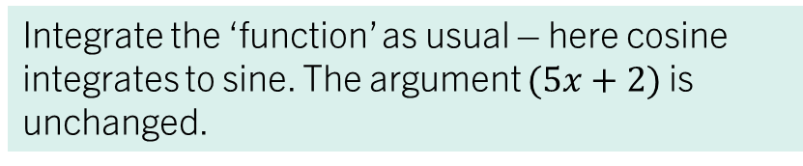
Integrating $f\left(ax+b\right)$
What if we wanted to integrate $\cos\left(5x+2\right)$? Since we know that differentiating $sin⁡(5x+2)$ would give us $5\cos{(5x+2)}$, then it makes sense that:
$$\int{\cos{(5x+2)}}$$
$$\frac{1}{5}$$
$$\sin\left(5x+2\right)$$
$$=$$
$$+C$$
Divide by the derivative of the argument (inner function)
We can think of this as ‘making an adjustment’ – since we know that differentiating $\sin\left(5x+2\right)$ gives me $5×cos⁡(5x+2)$, I need to divide by 5 for the correct result.
Integrate the ‘function’ as usual – here cosine integrates to sine. The argument $(5x+2)$is unchanged.
A ‘general’ result is that, if $∫f\left(x\right)dx=F\left(x\right)+c$, then
$$\int{f\left(ax+b\right)dx=\frac{1}{a}F\left(ax+b\right)+c}$$

Slide 7
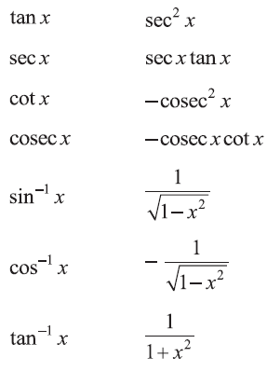
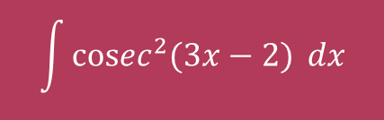





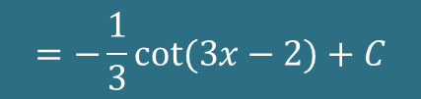
example 1:
Integrate the following with respect to $x$:
$$\int{\cos{3x}} dx$$
$$\int{\left(e^{5x−2}\right)}dx$$
$$\int{cosec^{2}{(3x−2)}} dx$$
$$=\frac{1}{3}sin⁡3x+C$$
$$=\frac{1}{5}e^{5x−2}+C$$
$$=−\frac{1}{3}cot⁡(3x−2)+C$$
Differentiation Results:

Slide 8
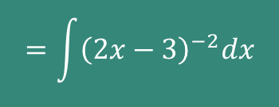
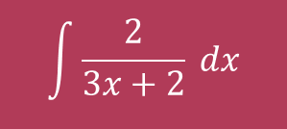
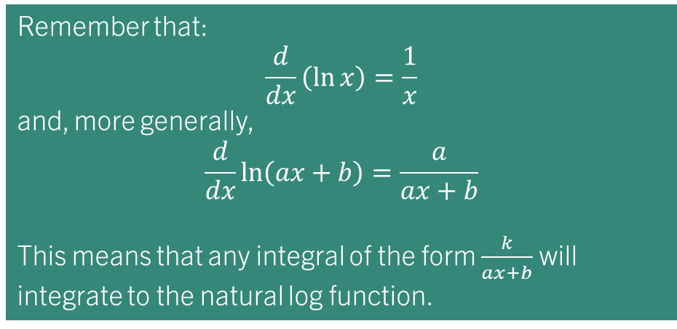
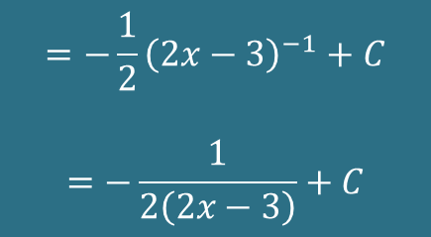
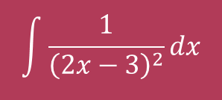
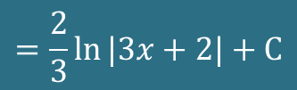
example 2:
Find:
$$\int{\frac{2}{3x+2}} dx$$
$$=\frac{2}{3}\ln{|3x+2|}+C$$
$$\int{\frac{1}{{\left(2x−3\right)}^{2}}}dx$$
$$=−\frac{1}{2}{\left(2x−3\right)}^{−1}+C$$
$$=−\frac{1}{2\left(2x−3\right)}+C$$
Remember that:
$$\frac{d}{dx}\left(\ln{x}\right)=\frac{1}{x}$$
and, more generally,
$$\frac{d}{dx}\ln\left(ax+b\right)=\frac{a}{ax+b}$$
This means that any integral of the form $\frac{k}{ax+b}$ will integrate to the natural log function.
$$=\int{{\left(2x−3\right)}^{−2}dx}$$

Slide 9
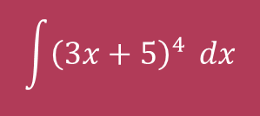
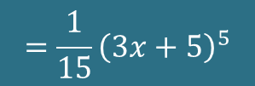
example 3:
Find:
$$\int{{\left(3x+5\right)}^{4}} dx$$
$$=\frac{1}{15}{\left(3x+5\right)}^{5}$$

Slide 10
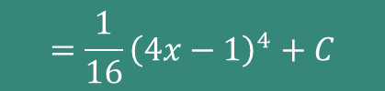
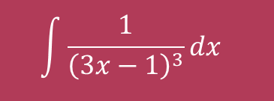

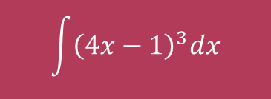
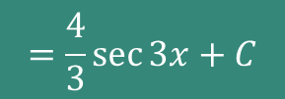
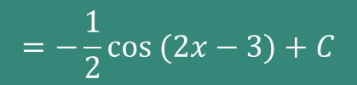
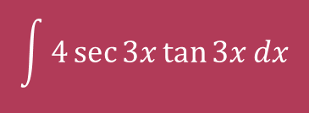
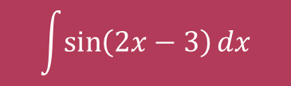
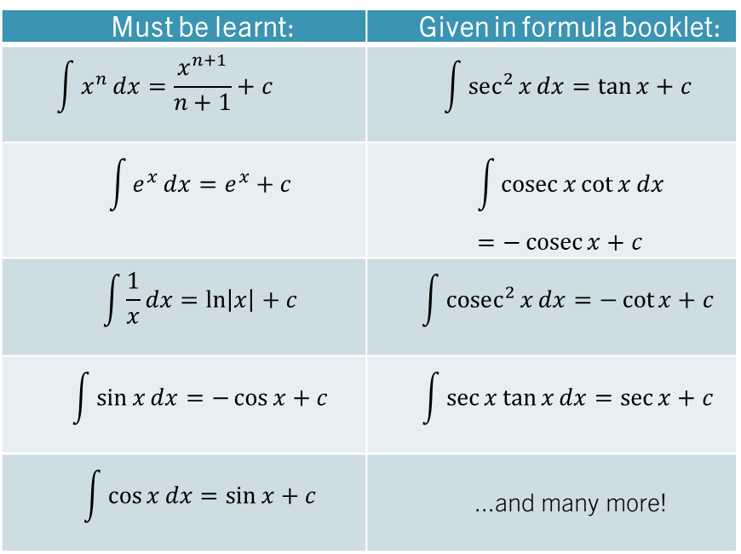
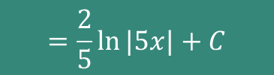
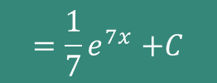

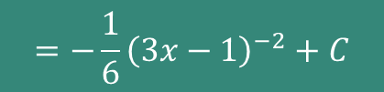
Quickfire Integrals - whiteboards
Find each of:
$$\int{e^{7x}}dx$$
$${=\frac{1}{7}e}^{7x}+C$$
Must be learnt: | Given in formula booklet:
$$\int{x^{n}}dx=\frac{x^{n+1}}{n+1}+c$$ | $$\int{sec^{2}{x}}dx=\tan{x}+c$$
$$\int{e^{x}}dx=e^{x}+c$$ | $$\int{\operatorname{cosec}{x}\cot{x}}dx=−\operatorname{cosec}{x}+c$$
$$\int{\frac{1}{x}}dx=\ln\left|x\right|+c$$ | $$\int{cosec^{2}{x}}dx=−\cot{x}+c$$
$$\int{\sin{x}}dx=−\cos{x}+c$$ | $$\int{\sec{x}\tan{x}}dx=\sec{x}+c$$
$$\int{\cos{x}}dx=\sin{x}+c$$ | ...and many more!
$$\int{\sin\left(2x−3\right)dx}$$
$$=−\frac{1}{2}cos (2x−3)+C$$
$$\int{{\left(4x−1\right)}^{3}dx}$$
$$=\frac{1}{16}{\left(4x−1\right)}^{4}+C$$
$$\int{\frac{2}{5x}dx}$$
$$=\frac{2}{5}ln⁡|5x|+C$$
$$\int{4\sec{3x}\tan{3x}dx}$$
$$=\frac{4}{3}sec{3x}+C$$
$$\int{\frac{1}{{\left(3x−1\right)}^{3}}dx }$$
$$=−\frac{1}{6}{\left(3x−1\right)}^{−2}+C$$

Slide 11
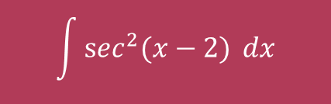
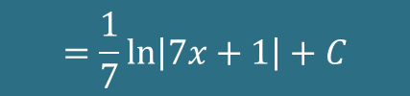

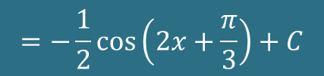
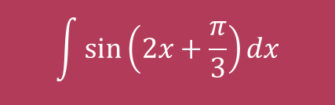

TASK 1:
Integrate the following with respect to $x$:
Differentiation Results:
$$\int{\sin\left(2x+\frac{π}{3}\right)}dx$$
$$\int{\frac{1}{7x+1}}dx$$
$$\int{sec^{2}{(x−2)}} dx$$
$$=−\frac{1}{2}\cos\left(2x+\frac{π}{3}\right)+C$$
$$=\frac{1}{7}\ln\left|7x+1\right|+C$$
$$=\tan{(x−2)}+C$$

Slide 12
Test your understanding 2
Complete TYU 2 from your pack.
Further questions available in student booklet.

Slide 13
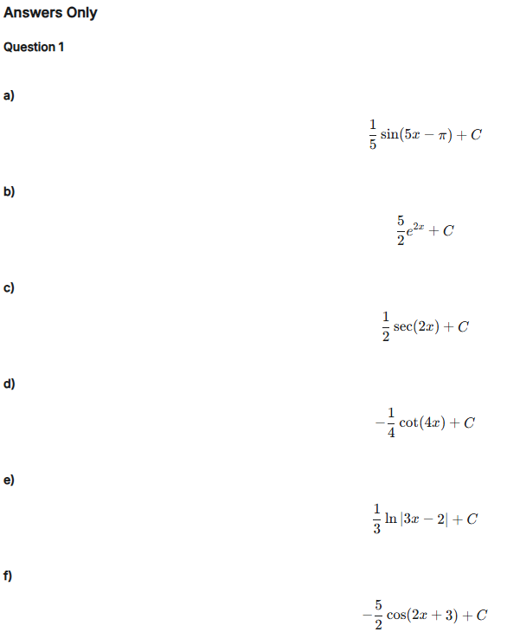
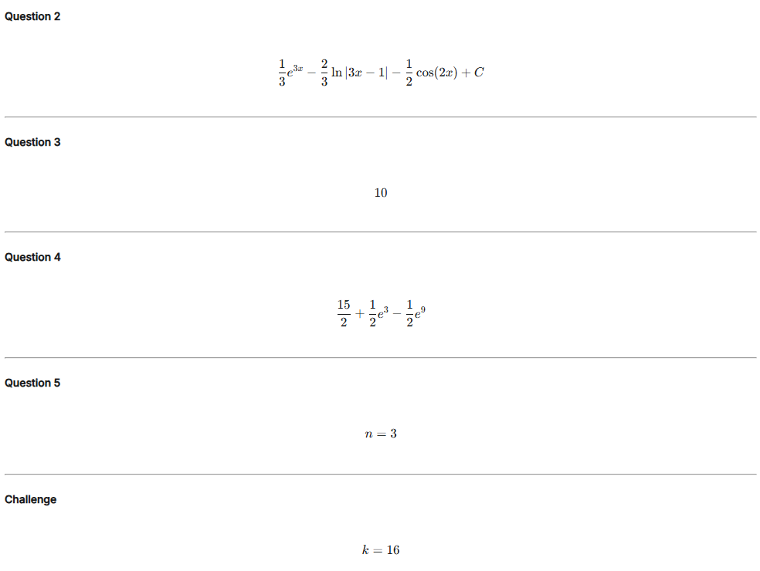
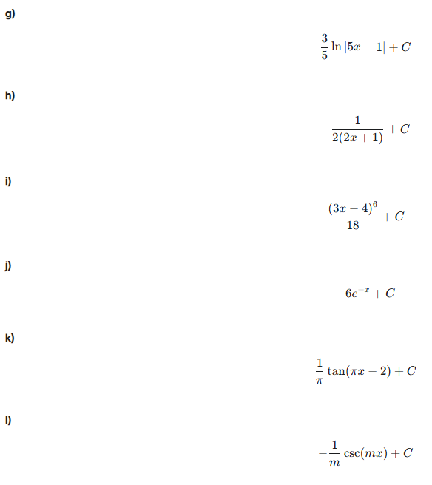
Test your understanding 2

Slide 14
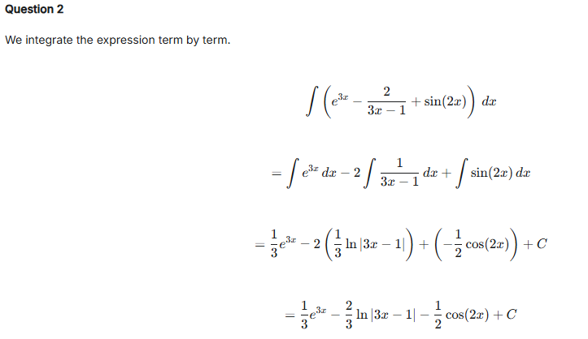
Test your understanding 2

Slide 15
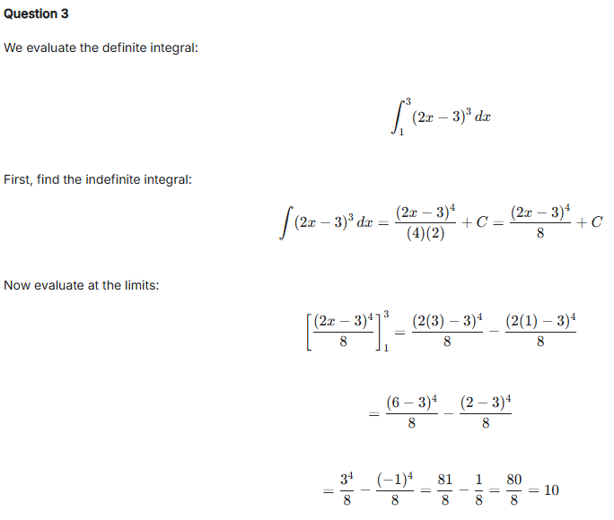
Test your understanding 2

Slide 16
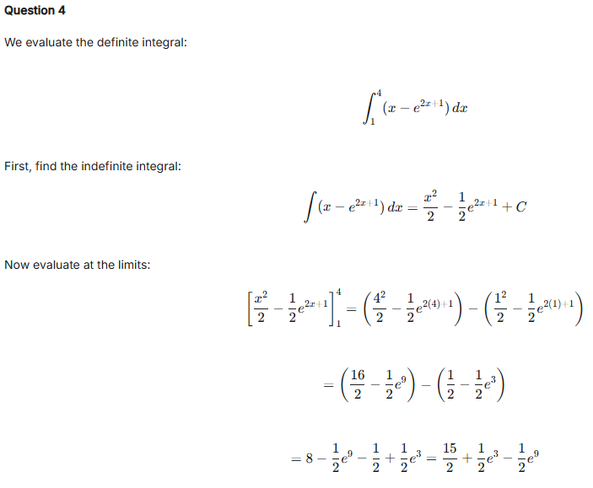
Test your understanding 2

Slide 17
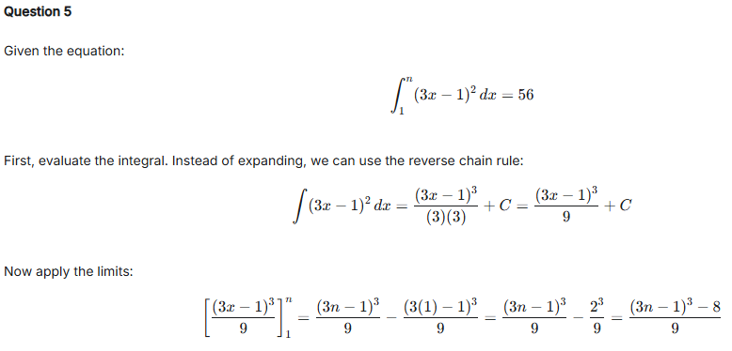
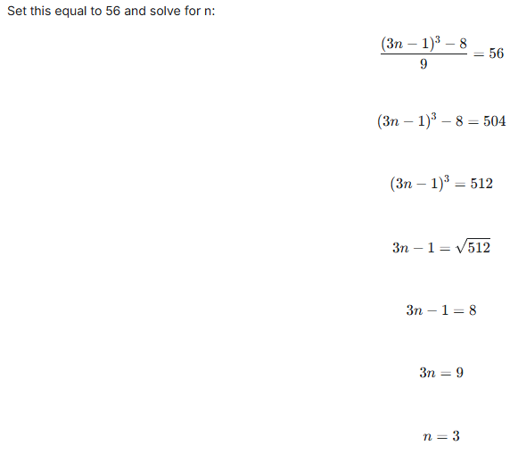
Test your understanding 2

Slide 18
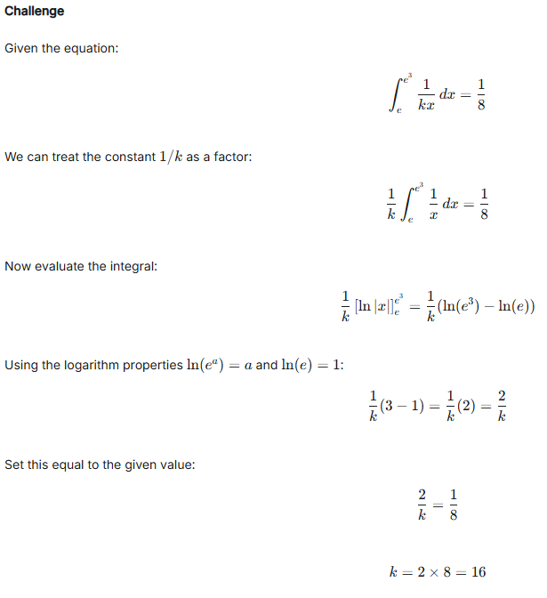
Test your understanding 2

