Slide 1


Unit 12 – Integration (Specification Reference 2.3.7)
©

Slide 2
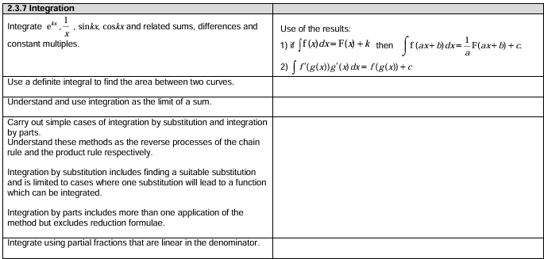
Unit 12 – Integration
©

Slide 3
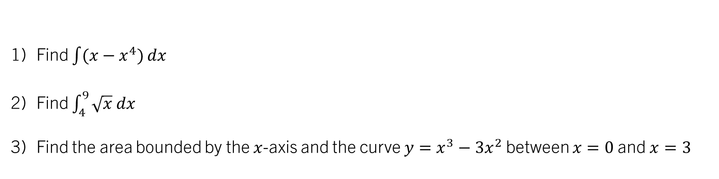
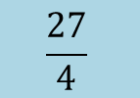


STARTER (Prerequisite atom check):
$$\frac{x²}{2}−\frac{x^{5}}{5}+C$$
Find $\int{(x−x^{4})}dx$
Find $\int_{4}^{9}{\sqrt{x} dx}$
Find the area bounded by the $x$-axis and the curve $y=x^{3}−3x^{2}$ between $x=0$ and $x=3$
$$\frac{38}{3}$$
$$\frac{27}{4}$$

Slide 4
Unit 12.1 – Integration as the limit of summation
To understand integration as the limit of a summation;
To be able to calculate summations of area using integration

Slide 5
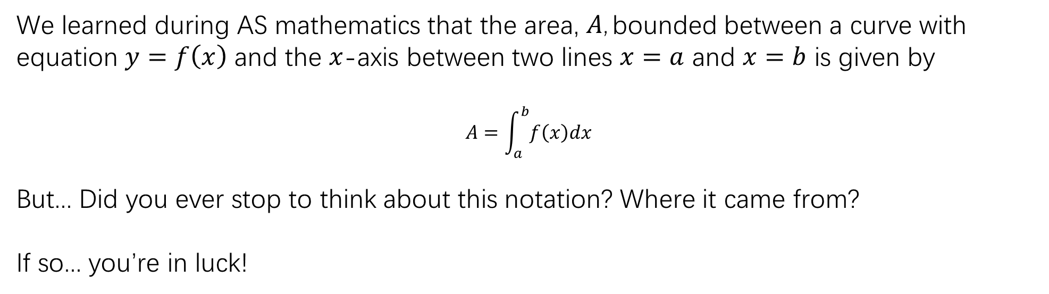
Integration as a limit of summation
We learned during AS mathematics that the area, $A$, bounded between a curve with equation $y=f\left(x\right)$ and the $x$-axis between two lines $x=a$ and $x=b$ is given by
$$A=\int_{a}^{b}{f\left(x\right)dx}$$
But... Did you ever stop to think about this notation? Where it came from?
If so... you’re in luck!

Slide 6
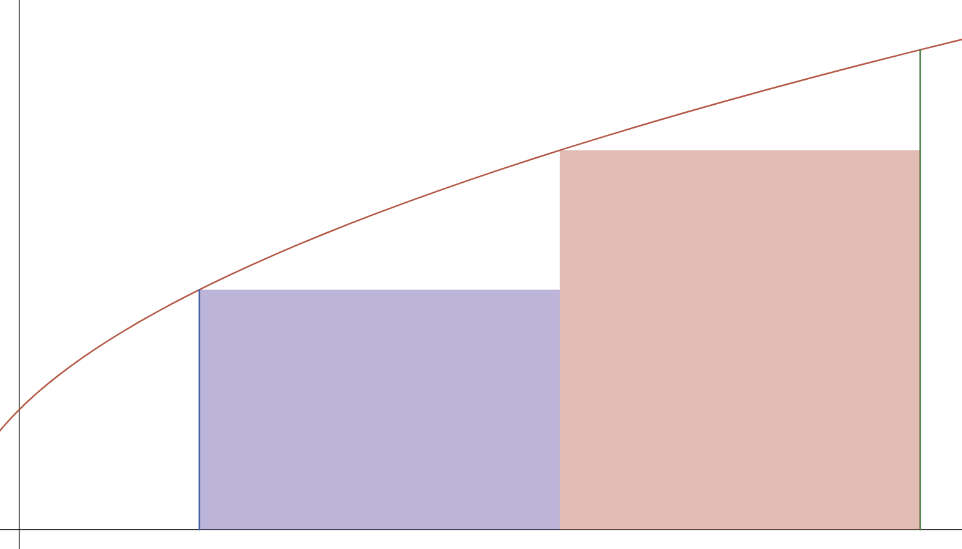
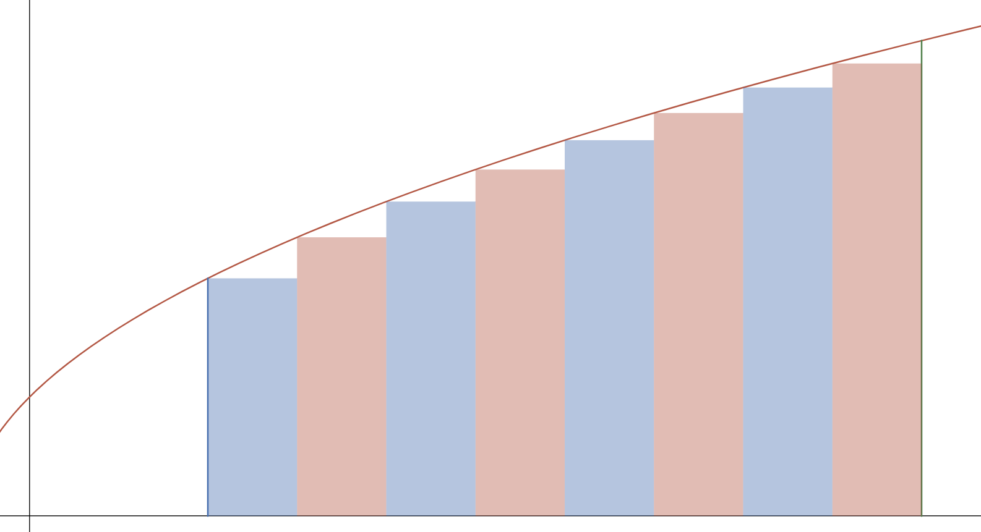
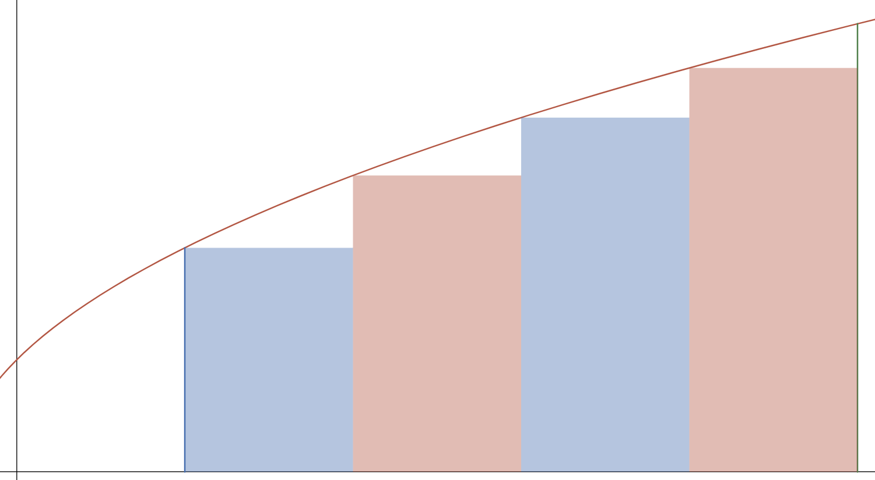
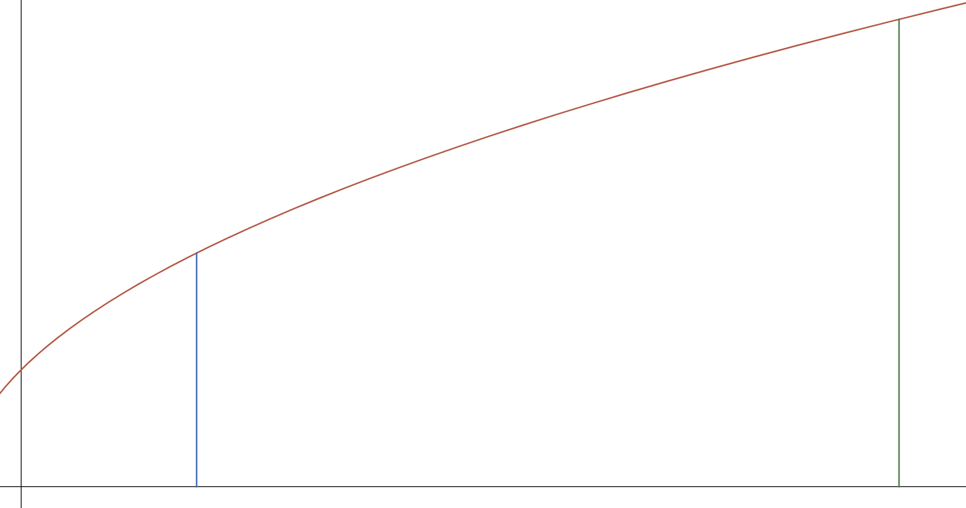



Integration as a limit of summation
Consider finding the area underneath the curve $y=f(x)$, between $x=a$ and $x=b$ :
We could perhaps estimate it by splitting it into two rectangles?
$$y=f(x)$$
We can see that using more rectangles would give a more accurate approximation:
We can extend this idea to consider what would happen if we take more and more rectangles, each with an infinitely thin width...
$$a$$
$$b$$

Slide 7
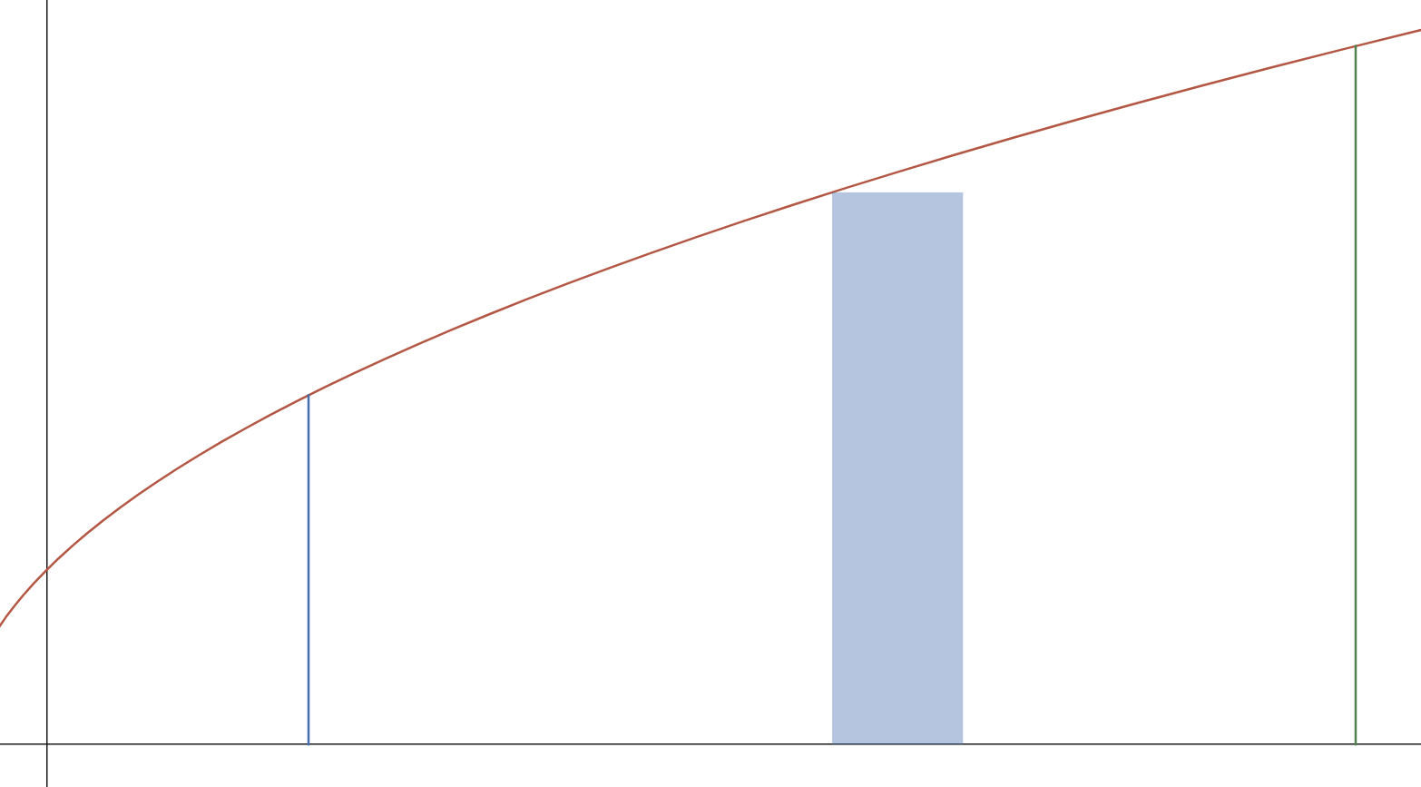
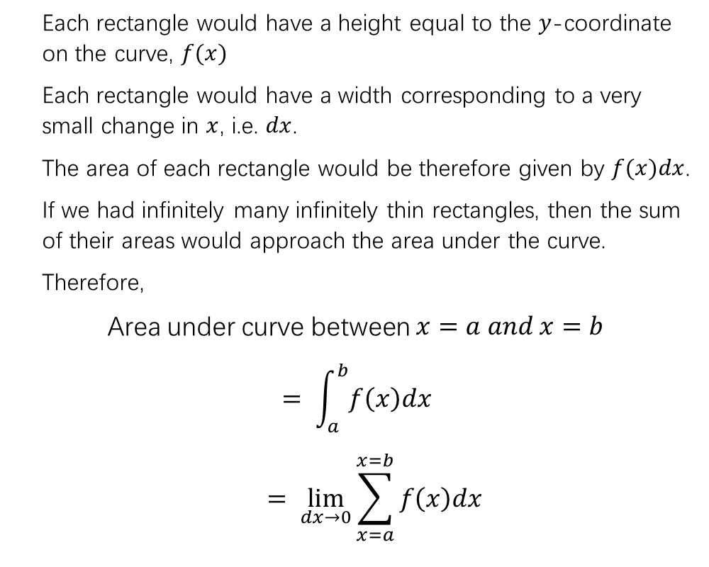



Integration as a limit of summation
Each rectangle would have a height equal to the $y$-coordinate on the curve, $f(x)$
Each rectangle would have a width corresponding to a very small change in $x$, i.e. $dx$.
The area of each rectangle would be therefore given by $f(x)dx$.
If we had infinitely many infinitely thin rectangles, then the sum of their areas would approach the area under the curve.
Therefore,
Area under curve between $x=a and x=b$
$$= \int_{a}^{b}{f\left(x\right)dx}$$
$$= \lim_{dx→0}{\sum_{x=a}^{x=b}{f\left(x\right)dx}}$$
$$y=f(x)$$
$$a$$
$$b$$
The integral symbol is really an elongated ‘S’ to represent this limit of summation!

Slide 8
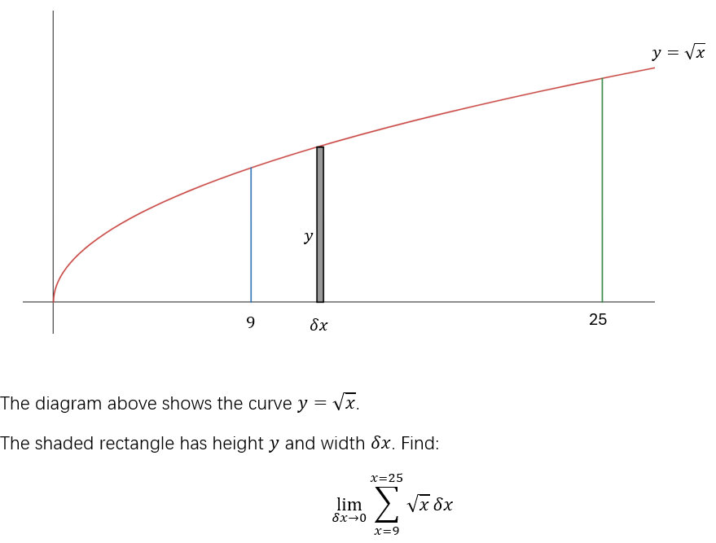
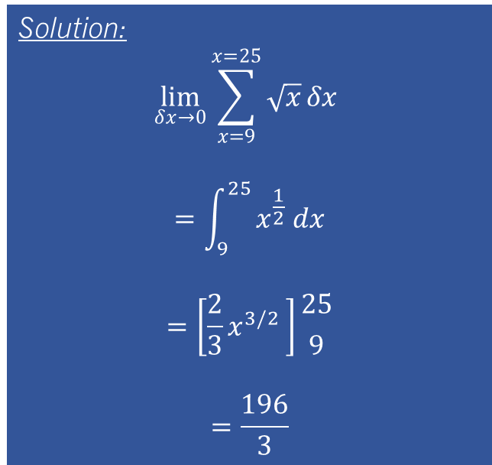
example 1:
Solution:
$$\lim_{δx→0}{\sum_{x=9}^{x=25}{\sqrt{x}}}δx$$
$$=\int_{9}^{25}{x^{\frac{1}{2}} dx}$$
$$=\left[\frac{2}{3}x^{3/2 }\right]{25 \atop 9}$$
$$=\frac{196}{3}$$
Note that, as of the current date (March 2025 at time of writing) WJEC have not examined this understanding. Still, it’s mentioned in the spec, so... better safe than sorry!

Slide 9
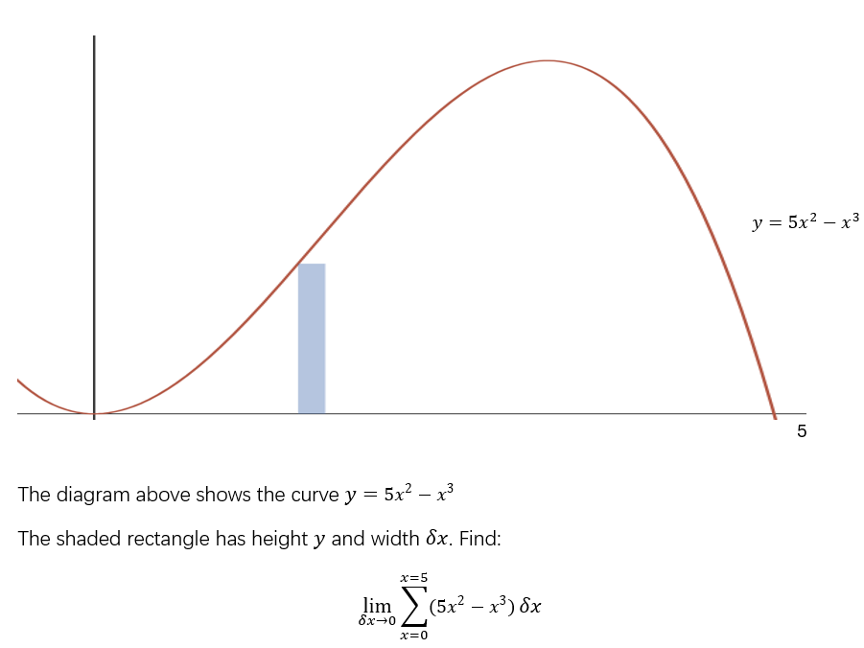
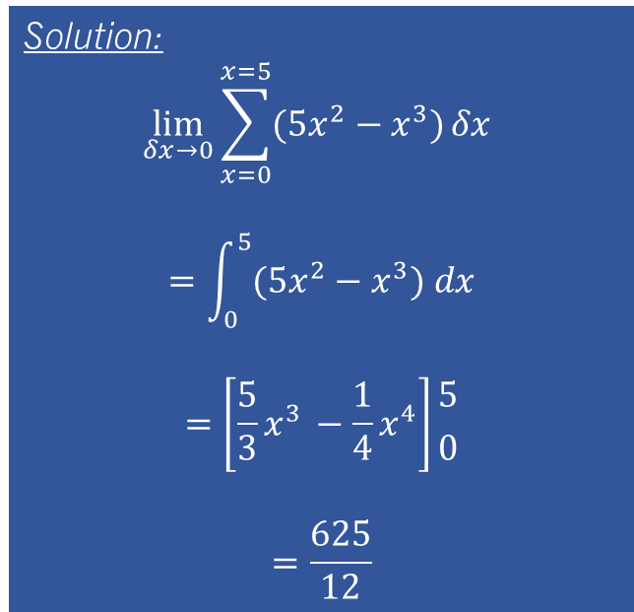
TASK 1:
Solution:
$$\lim_{δx→0}{\sum_{x=0}^{x=5}{(5x^{2}−x^{3})}}δx$$
$$=\int_{0}^{5}{(5x^{2}−x^{3}) dx}$$
$$=\left[\frac{5}{3}x^{3 }−\frac{1}{4}x^{4}\right]{5 \atop 0}$$
$$=\frac{625}{12}$$

Slide 10
Unit 12.2 – Integration using standard results
To be able to use the results learnt in Unit 3 for differentiation to be able to integrate a wider range of functions
To be able to solve basic problems using these integral results

Slide 11
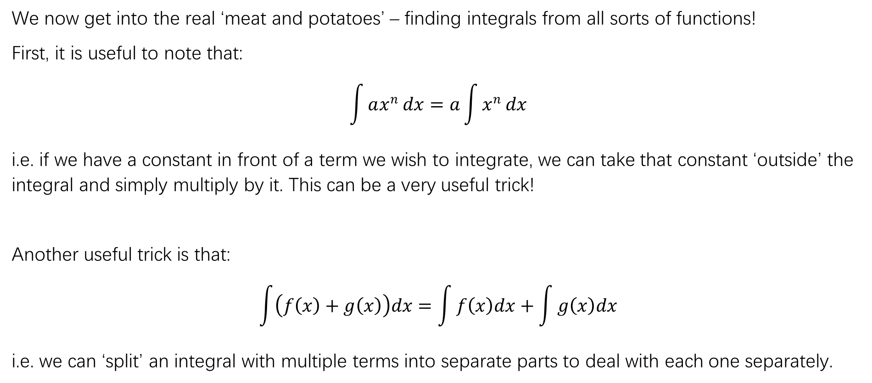
Integration using standard results
We now get into the real ‘meat and potatoes’ – finding integrals from all sorts of functions!
First, it is useful to note that:
$$\int{ax^{n}}dx=a\int{x^{n}}dx$$
i.e. if we have a constant in front of a term we wish to integrate, we can take that constant ‘outside’ the integral and simply multiply by it. This can be a very useful trick!
Another useful trick is that:
$$\int{\left(f\left(x\right)+g\left(x\right)\right)dx=\int{f\left(x\right)dx}+\int{g\left(x\right)dx}}$$
i.e. we can ‘split’ an integral with multiple terms into separate parts to deal with each one separately.

Slide 12
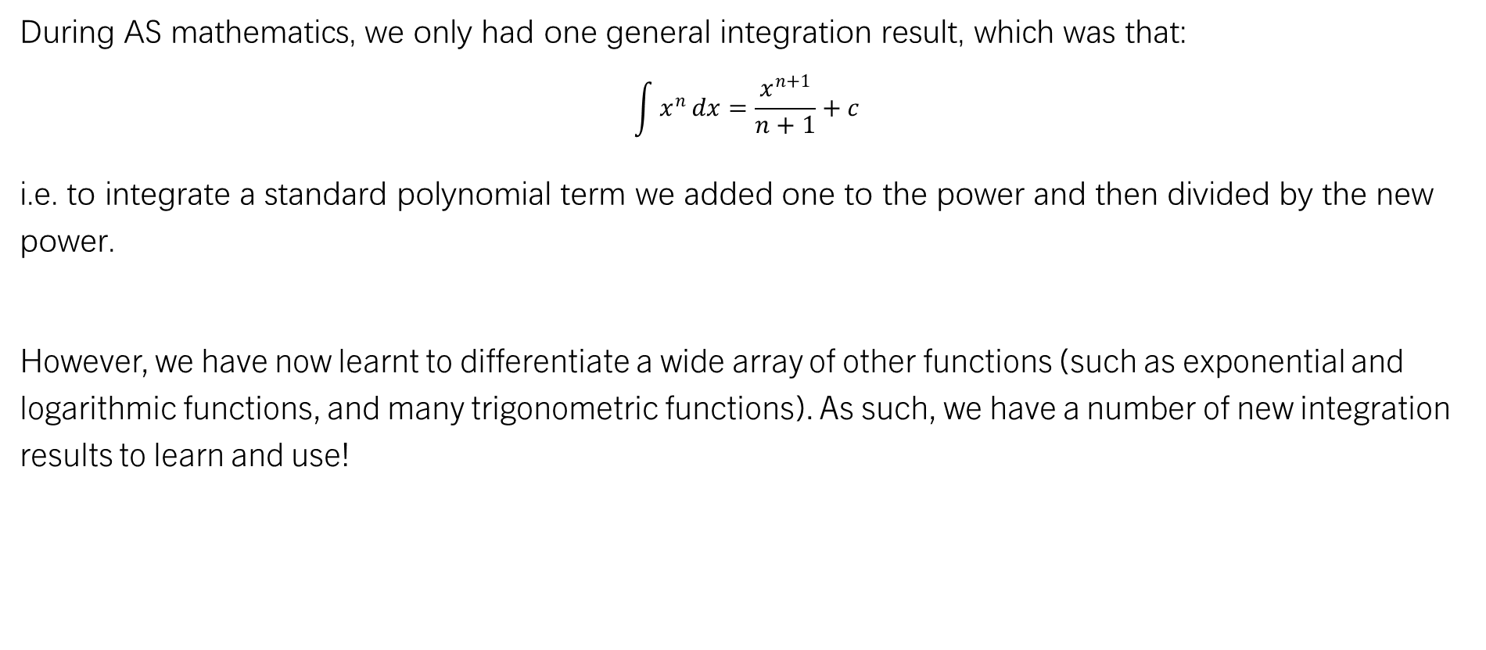
Integration using standard results
During AS mathematics, we only had one general integration result, which was that:
$$\int{x^{n}}dx=\frac{x^{n+1}}{n+1}+c$$
i.e. to integrate a standard polynomial term we added one to the power and then divided by the new power.
However, we have now learnt to differentiate a wide array of other functions (such as exponential and logarithmic functions, and many trigonometric functions). As such, we have a number of new integration results to learn and use!

Slide 13
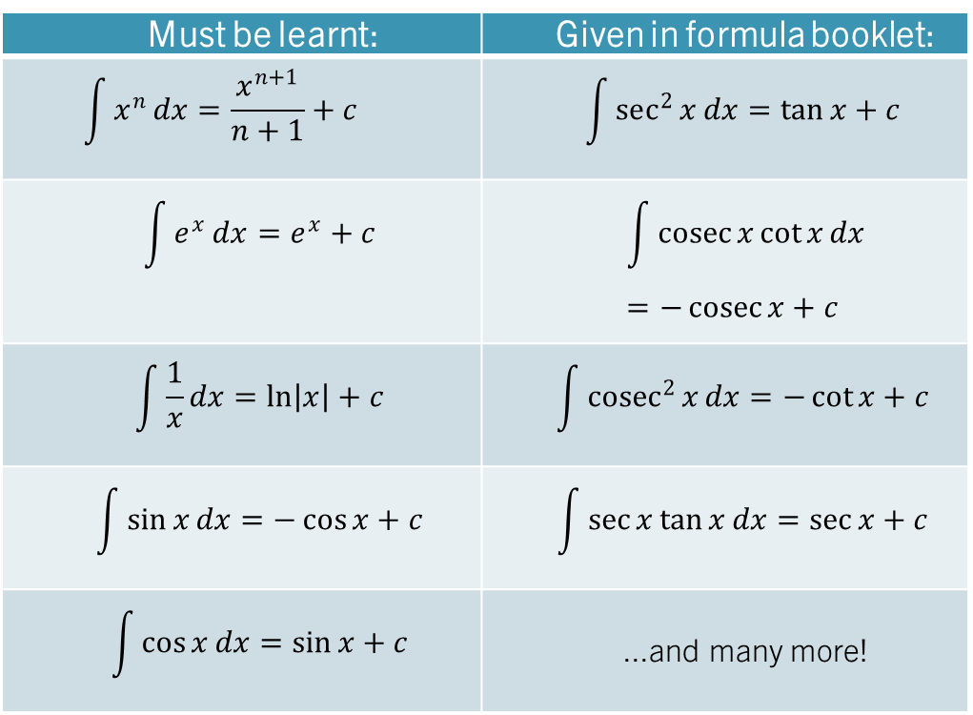
Integration using standard results
Must be learnt: | Given in formula booklet:
$$\int{x^{n}}dx=\frac{x^{n+1}}{n+1}+c$$ | $$\int{sec^{2}{x}}dx=\tan{x}+c$$
$$\int{e^{x}}dx=e^{x}+c$$ | $$\int{\operatorname{cosec}{x}\cot{x}}dx=−\operatorname{cosec}{x}+c$$
$$\int{\frac{1}{x}}dx=\ln\left|x\right|+c$$ | $$\int{cosec^{2}{x}}dx=−\cot{x}+c$$
$$\int{\sin{x}}dx=−\cos{x}+c$$ | $$\int{\sec{x}\tan{x}}dx=\sec{x}+c$$
$$\int{\cos{x}}dx=\sin{x}+c$$ | ...and many more!

Slide 14
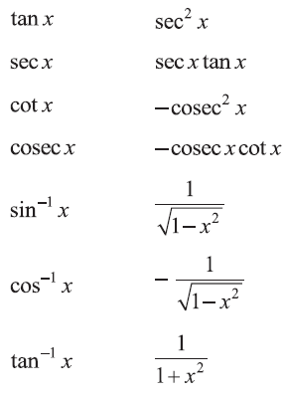
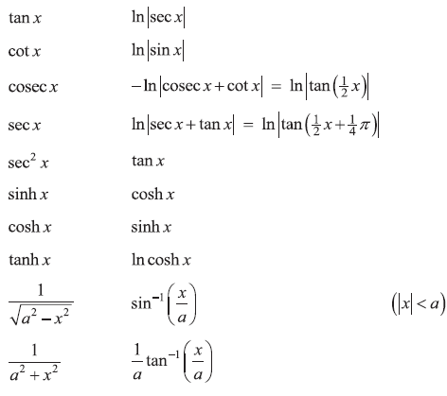
Integration using standard results
It’s really worth noting that many of the ones given in the formula booklet are actually listed in the differentiation results (i.e. they are the other way around from above), but we should be aware that we can use them as integration results also. Work smarter, not harder!
Overall, the formula booklet gives us the following usable results:
Differentiation Results: Integration Results

Slide 15


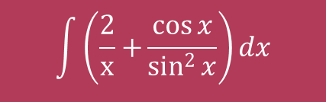
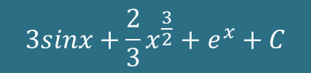
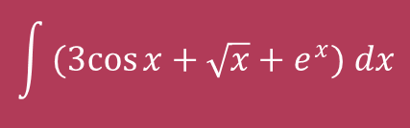
example 1:
Integrate the following with respect to $x$:
$$\int{(3cos{x}}+\sqrt{x}+e^{x}) dx$$
$$\int{\left(\frac{2}{x}+{\frac{\cos{x}}{sin^{2}{x}}}\right)}dx$$
$$3sinx+\frac{2}{3}x^{\frac{3}{2}}+e^{x}+C$$
$$2\ln\left|x\right|−cosec x+C$$

Slide 16

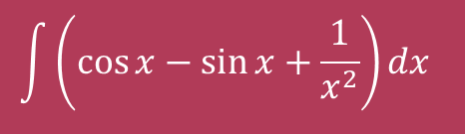

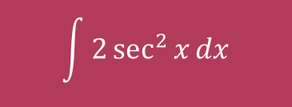


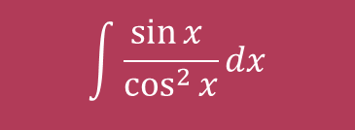

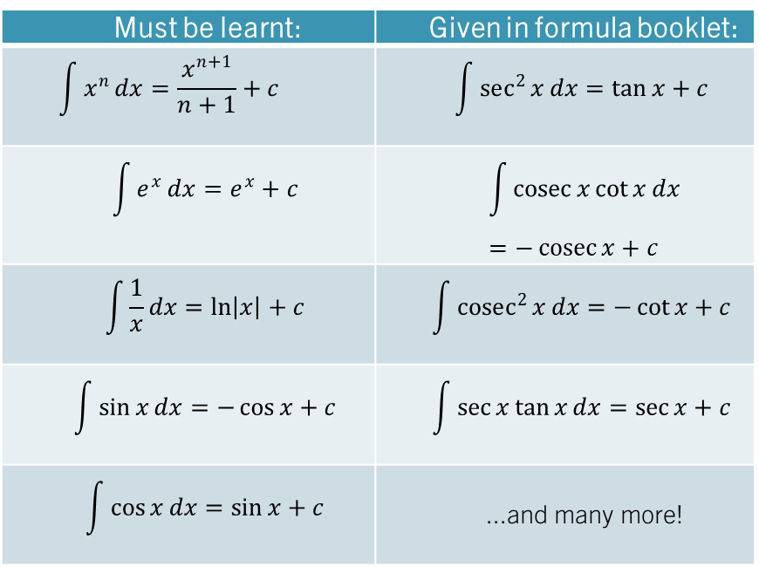
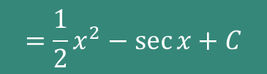

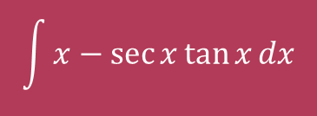
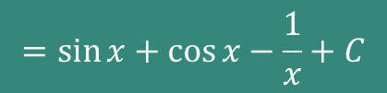
Quickfire Integrals - whiteboards
Find each of:
$$\int{{3e}^{x}}dx$$
Must be learnt: | Given in formula booklet:
$$\int{x^{n}}dx=\frac{x^{n+1}}{n+1}+c$$ | $$\int{sec^{2}{x}}dx=\tan{x}+c$$
$$\int{e^{x}}dx=e^{x}+c$$ | $$\int{\operatorname{cosec}{x}\cot{x}}dx=−\operatorname{cosec}{x}+c$$
$$\int{\frac{1}{x}}dx=\ln\left|x\right|+c$$ | $$\int{cosec^{2}{x}}dx=−\cot{x}+c$$
$$\int{\sin{x}}dx=−\cos{x}+c$$ | $$\int{\sec{x}\tan{x}}dx=\sec{x}+c$$
$$\int{\cos{x}}dx=\sin{x}+c$$ | ...and many more!
$${=3e}^{x}+C$$
$$\int{\frac{3}{x}dx}$$
$$=3\ln\left|x\right|+C$$
$$\int{2\sec^{2}{x}dx}$$
$$=2\tan{x}+C$$
$$\int{x−\sec{x}\tan{x}dx}$$
$$=\frac{1}{2}x^{2}−\sec{x}+C$$
$$\int{\frac{\sin{x} }{\cos^{2}{x}}dx}$$
$$=\sec{x}+C$$
$$\int{\left(\cos{x}−\sin{x}+\frac{1}{x^{2}}\right)dx }$$
$$=\sin{x}+\cos{x}−\frac{1}{x}+C$$

Slide 17
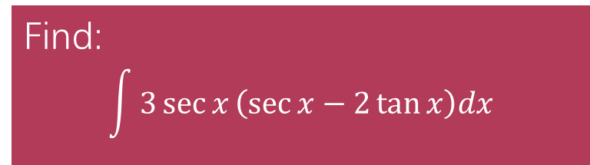
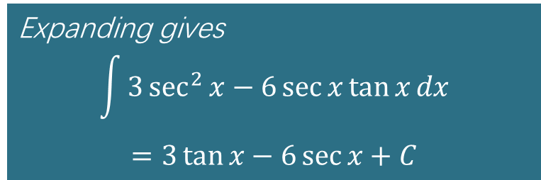
TASK 1:
Find:
$$\int{3\sec{x}\left(\sec{x}−2\tan{x}\right)dx}$$
Expanding gives
$$\int{3\sec^{2}{x}−6\sec{x}\tan{x}dx}$$
$$=3\tan{x}−6\sec{x}+C$$

Slide 18

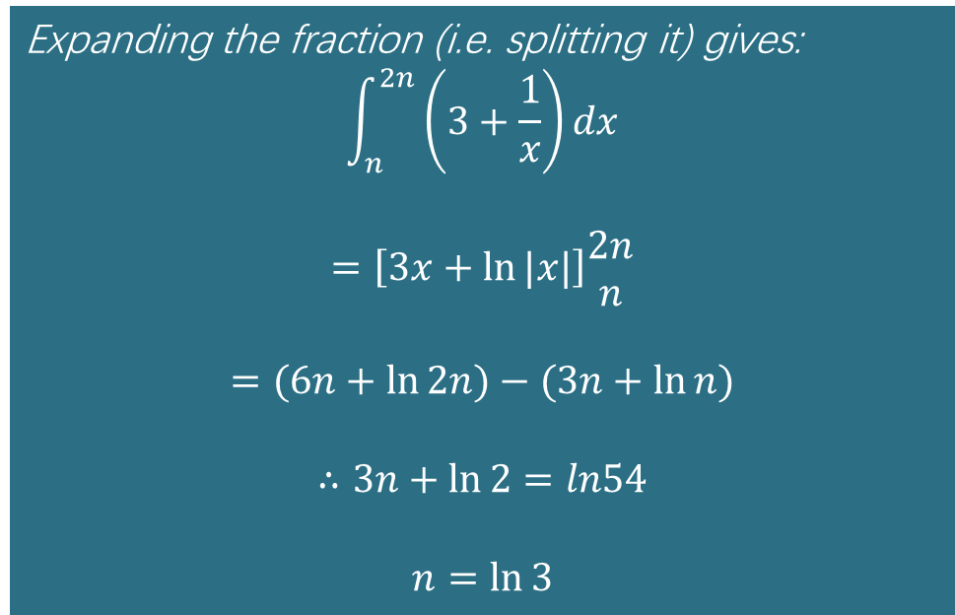
TASK 2:
Given that $n>0$and that
$$\int_{n}^{2n}{\frac{3x+1}{x}dx=\ln{54}}$$
find the exact value of 𝑛 giving your answer as simply as possible.
Expanding the fraction (i.e. splitting it) gives:
$$\int_{n}^{2n}{\left(3+\frac{1}{x}\right)dx}$$
$$=\left[3x+\ln{|x|}\right]\begin{matrix}2n \\ n\end{matrix}$$
$$=(6n+\ln{2n)}−(3n+\ln{n})$$
$$∴3n+\ln{2}=ln54$$
$$n=\ln{3}$$

Slide 19
Test your understanding 1
Complete TYU 1 from your pack.
Further questions available in student booklet.

Slide 20
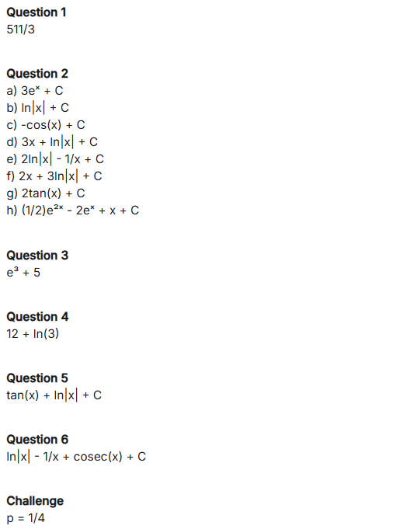
Test your understanding 1

Slide 21
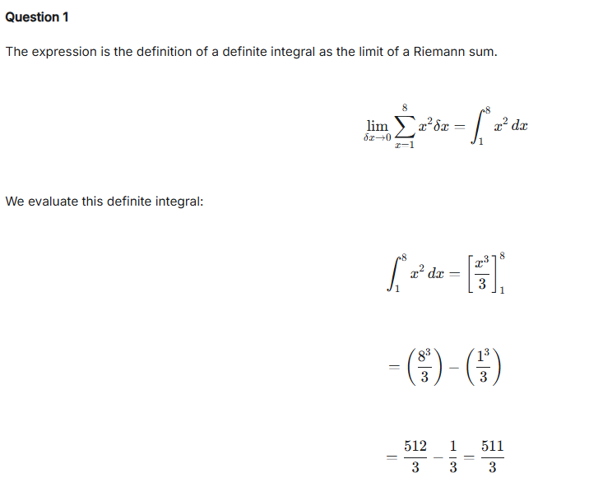
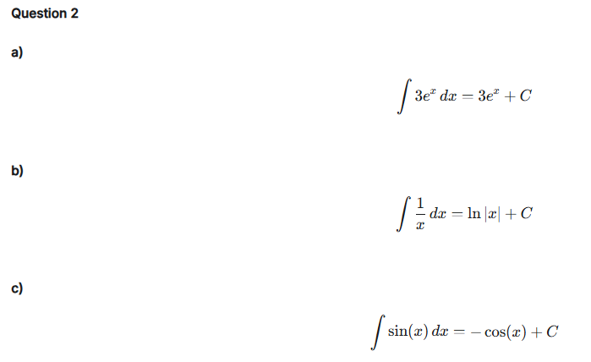
Test your understanding 1

Slide 22
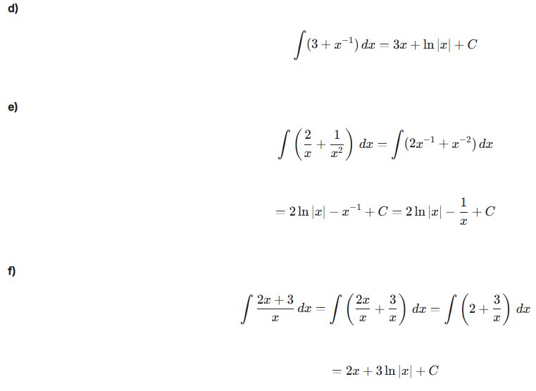
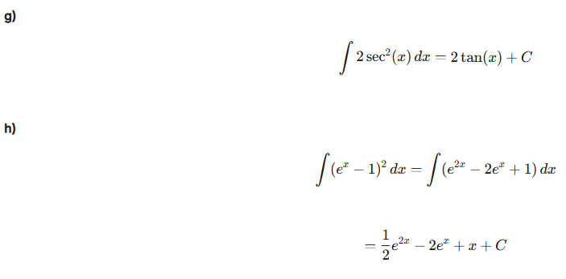
Test your understanding 1

Slide 23
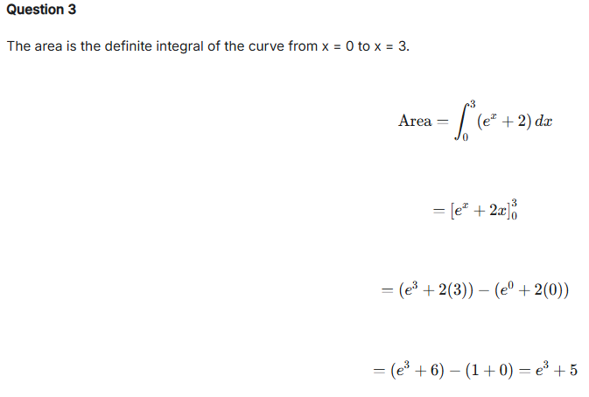
Test your understanding 1

Slide 24
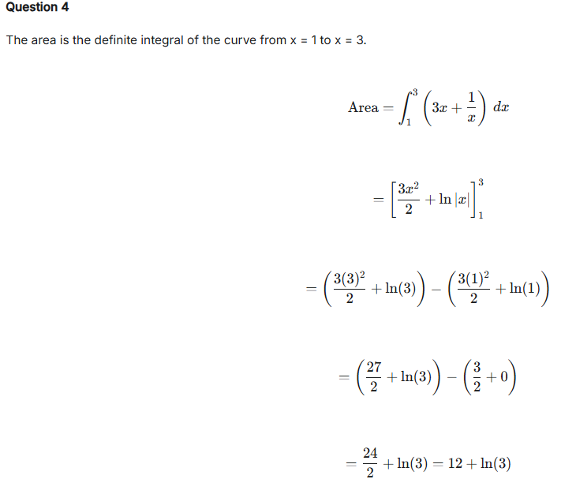
Test your understanding 1

Slide 25
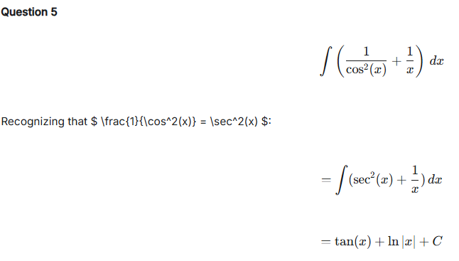
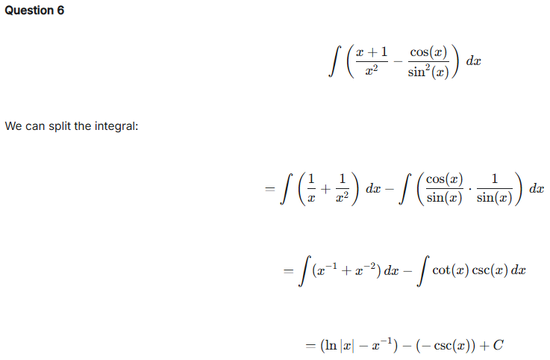
Test your understanding 1

Slide 26
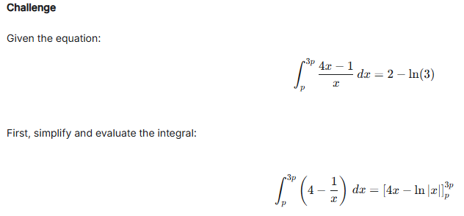
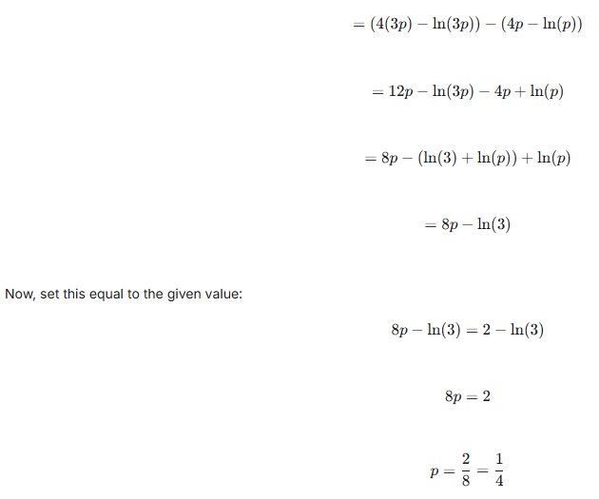
Test your understanding 1

