Slide 1
Precise Pulse integrator
December 2023
Halcyon Circuits/Bryan Nevins

Slide 2
Contents
Slide | topics
3 | Ideal integrator circuit
4 | Waveforms with ideal integrator
5 | Finite op-amp bandwidth
6 | R Parasitic circuit
7 | Waveforms with parasitic
8 | R divider fix
9-10 | Divider fix waveforms
11 | Divider parasitic circuit
12 | Tuning cap for divider parasitics
13 | Ctune waveforms
14 | references
contents

Slide 3
Ideal integrator circuit
The opamp has GBW = 1E9 Hz, so the output is nearly ideal.
contents

Slide 4
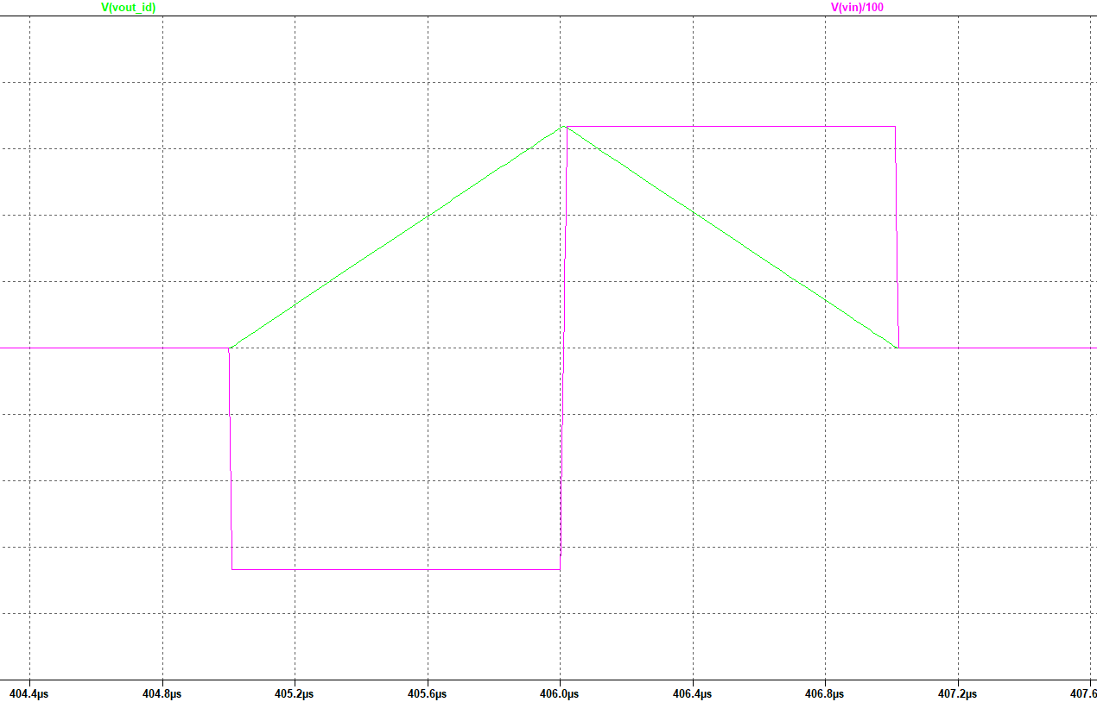
Ideal integrator with pulse input has ramp output
output
Red: integrator input (1:100)
Green: integrator output
input
contents

Slide 5
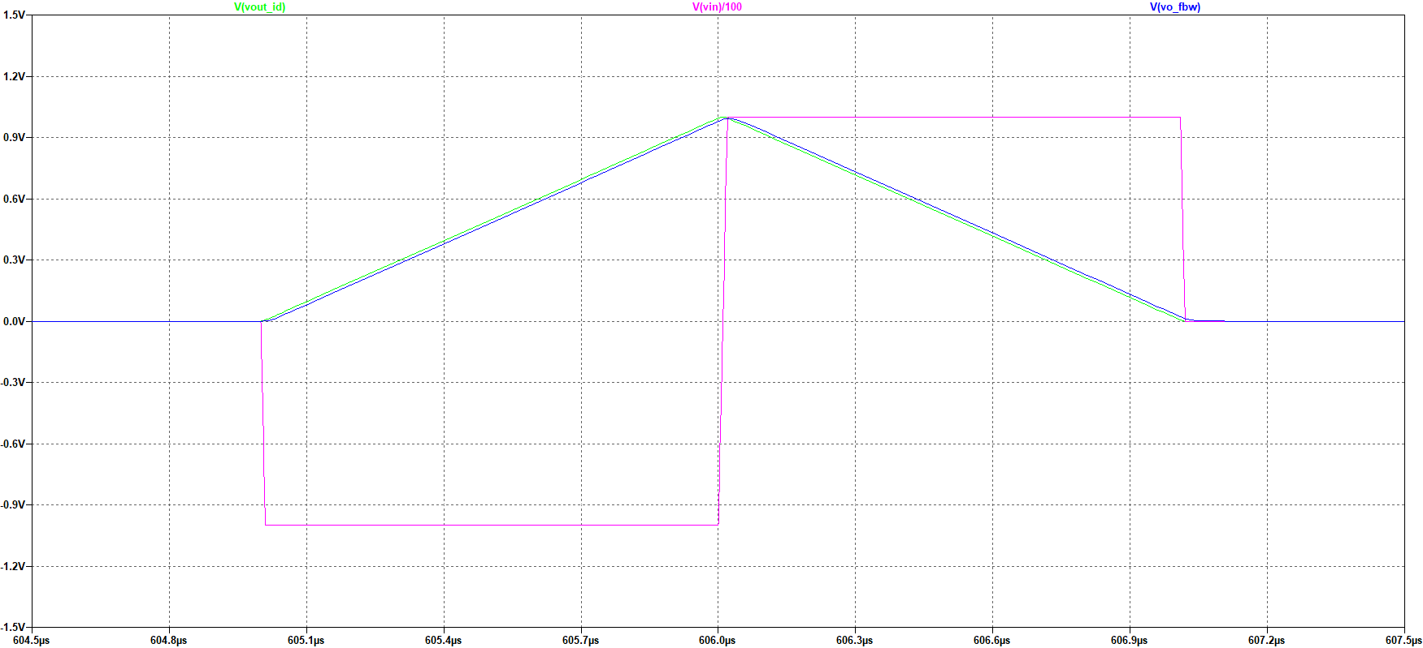
Finite op-amp bandwidth has minor effect
output
purple: integrator input (1:100)
Green: ideal integrator (1GHz GBW opamp)
Blue: 10 Mhz bandwidth opamp—15ns delay
input
contents

Slide 6
Chip R has parasitic Capacitance:
Cp3 = Ri3 parasitic capacitance
(pcb pads + resistor terminals)
contents

Slide 7
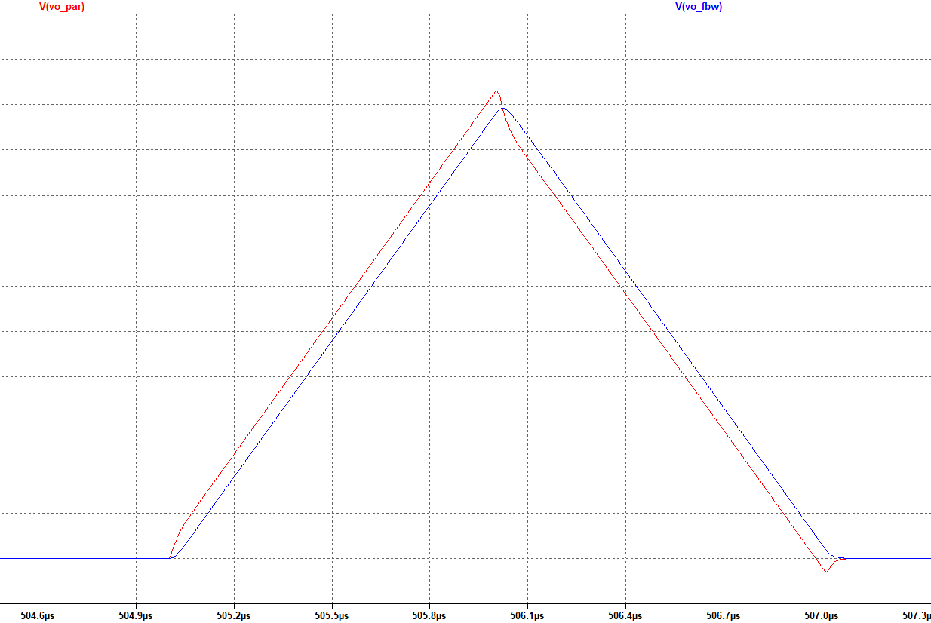
Parasitic advances integrator output
50ns error
With
parasitic
No parasitic
Blue: no parasitic, opamp has finite bandwidth
Red: parasitic, opamp has finite bandwidth
parasitic causes 50ns timing error (advance),
relative to no parasitic.
contents

Slide 8
R Divider fixes Parasitic
Ra4 and Rb4 cancel the effect of Cp4.
The signal due to Cp4 is now common mode
and has no effect on the output.
The divider mid-points (opamp inputs)
have equal signals at any frequency, because the dividers have the same impedance ratio at all frequencies.
Ra5/RB5 = 2000 = Ci5/Cp5
contents

Slide 9
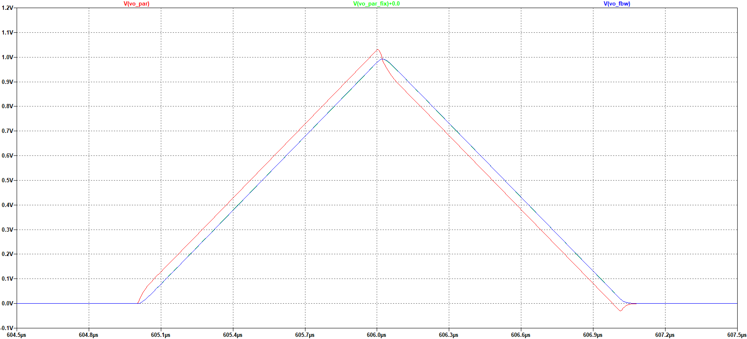
Waveforms with divider fix
Blue & Green are superimposed.
(cpar = 0 and divider fix)
Cpar=50fF
Red: Cpar=50fF
Blue: Cpar=0
Green: Cpar = 50fF with divider fix
The error of the divider fix circuit is ~0ns
relative to the Cpar = 0 circuit.
contents

Slide 10
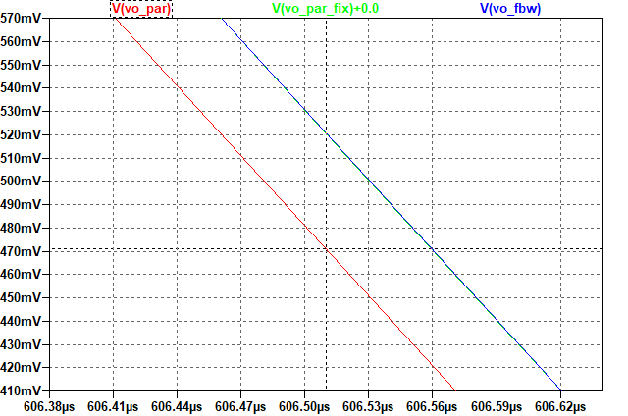
Waveforms with divider fix
Signal | Op amp bandwidth (Hz) | Cpar (fF) | Correction divider | Time Error (ns)
vo_fbw | 1E7 | 0 | No | 0
Vo_par | 1E7 | 50 | No | 49
vo_par_fix | 1E7 | 50 | Yes | ~0.2
Divider fix error ~ 0.2ns!
contents

Slide 11
Include all parasitics:
Divider resistors have their own parasitic capacitors, Cpa6 and Cpb6.
This means the divider impedance ratio is not constant over frequency.
This can be fixed with an additional capacitor (next slide)
contents

Slide 12
Tuning Capacitor for divider
Ctune7 causes the divider C ratio to
be 2000:1, the same as the R ratio.
All the parasitics are cancelled.
(waveforms next slide)
contents

Slide 13
Chip Implementation
On PCB
On chip
Trim Rb7 so that
Ra7/Rb7 = Cp7/Ci7
contents

Slide 14
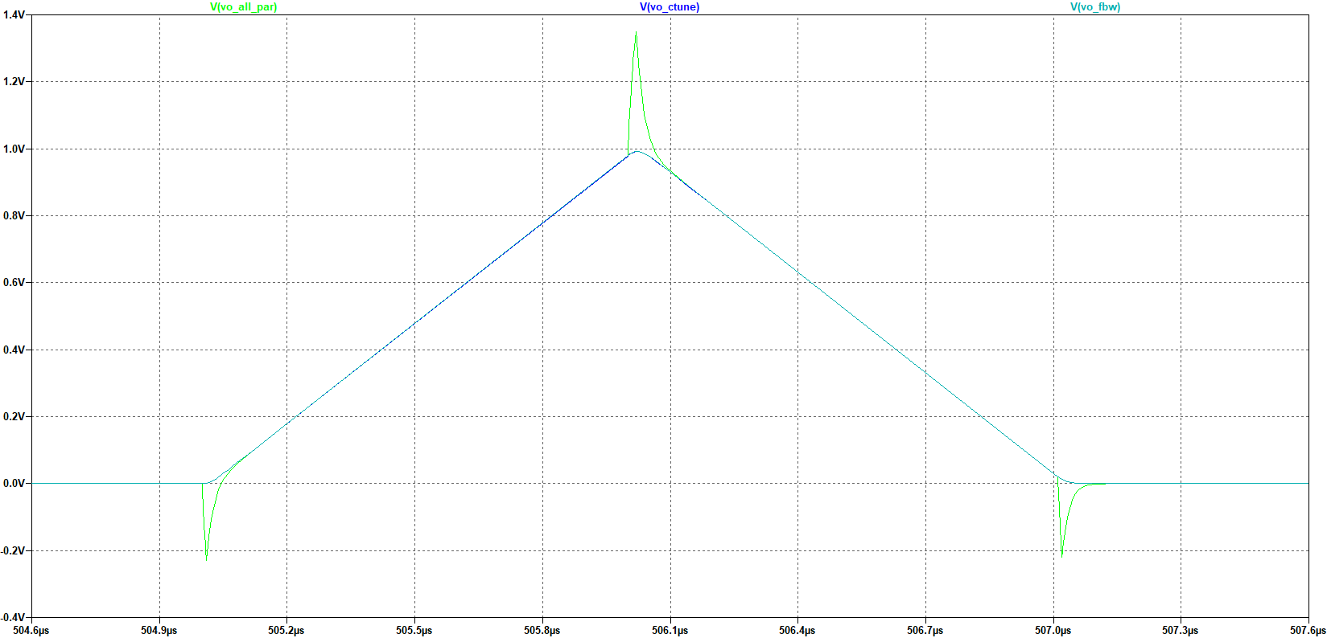
Waveforms for Ctune
Vo_all_par: Divider parasitics cause glitches
(Cpa6, Cpb6)
Vo_Ctune: All parasitics are cancelled. Integrator output same as no parasitic integrator (vo_fbw)
contents

Slide 15
references
C:\bdn\Career_t\github_website\integrator\ | integrator_latest.asc (local)
contents

