Slide 1
Contents
overview | Appendix: Reference info Behavioral ambient , behavioral NPN
Circuit representation of Thermal flow
Ambient flow,
1W analysis
NPN thermal runaway
Ballast circuit

Slide 2
Overview
Goals:
1) Graphical representation of thermal stability.
2) Use typical circuit simulators.
3) Include thermal effects which can be represented as
an electronic components.

Slide 3
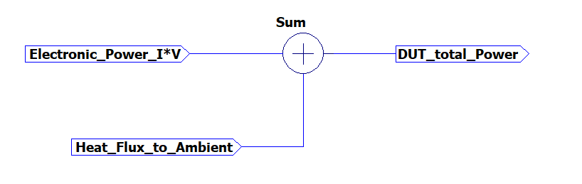
Circuit representation of Thermal flow
DUT_total_power = (Electronic power I*V) + (Heat flux to ambient)
Total Power > 0W system is heating up!
Total Power < 0W system is getting colder.
BJT_Thermal2.asc

Slide 4
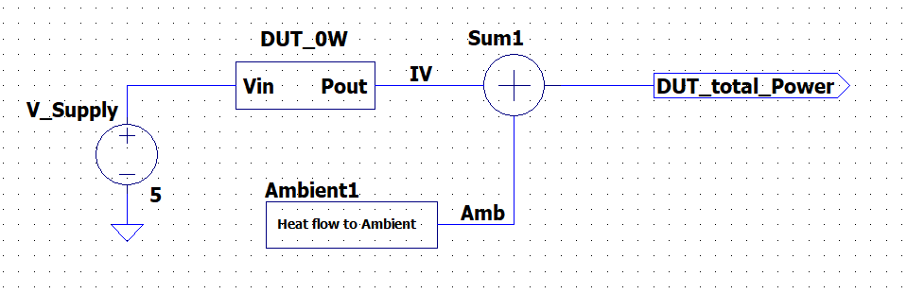
Thermal flow to Ambient: circuit
DUT_total_power = Electronic power (I*V) + Thermal flux to ambient.
I*V = 0W here.
This net is just +5V supply.
0V here represents 0 W. DUT I=0, so IV =0
This net represents heat flux to ambient. (linear with temperature)
BJT_Thermal2.asc

Slide 5
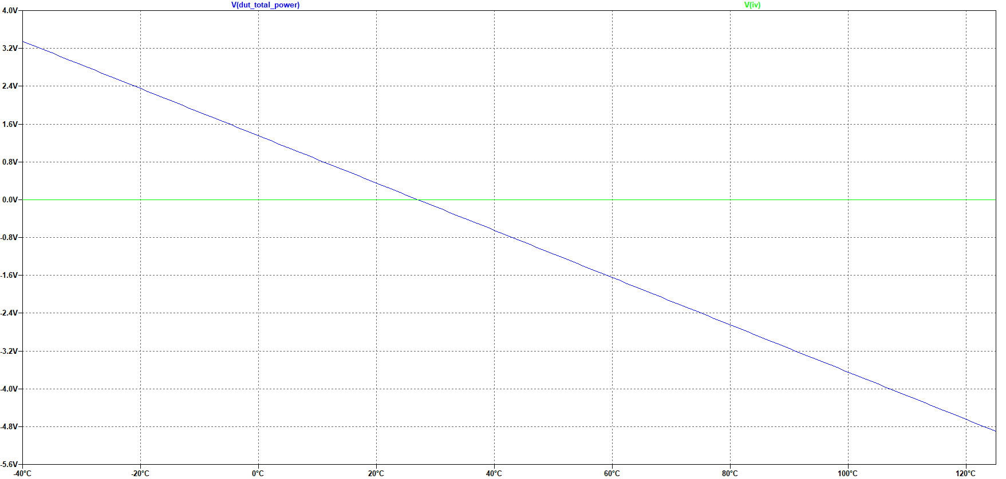
Thermal flow to Ambient: Temperature vs Power
Ambient temperature is 27C.
Since DUT electronic power is 0W,
DUT is in thermal equilibrium at 27C
Thermally stable: perturbation to higher temperature causes total power < 0 W (cooling).
Slope ~ 20C/Watt thermal resistance
Y-axis represents power
(1V = 1W)
X-axis represents DUT temperature.
Ambient temperature is always 27C
BJT_Thermal2.asc

Slide 6
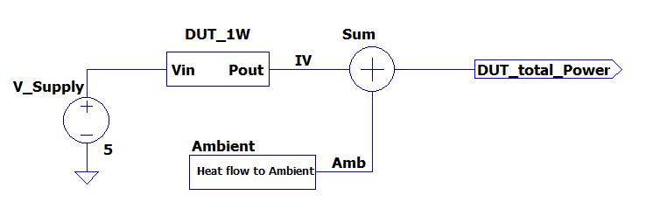
1W Schematic
DUT consuming 1W of electrical power, independent of temperature.
BJT_Thermal2.asc

Slide 7
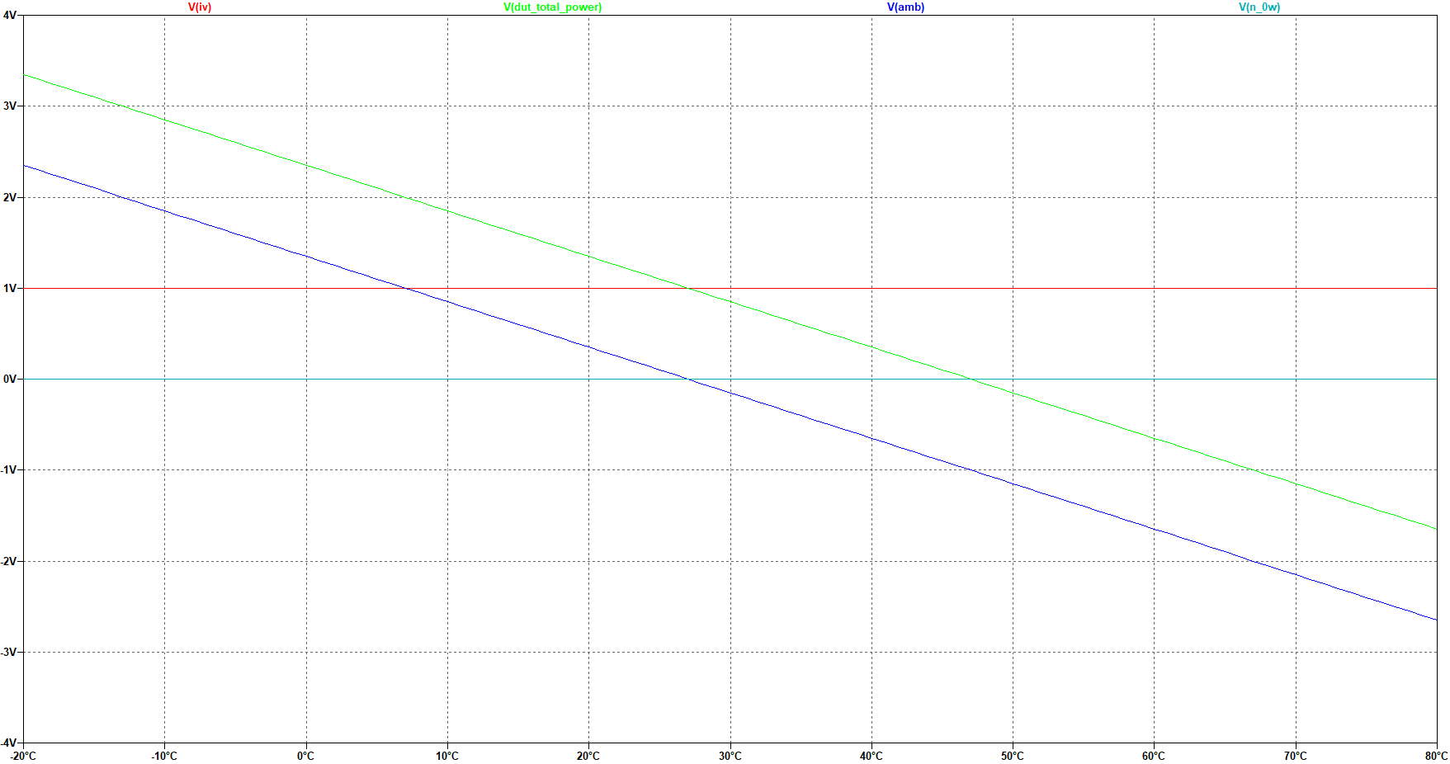
1W Thermal Simulation
Total Power
Total power 0W
At 47C. Thermally stable
DUT power 1W
Heat flow to ambient

Slide 8
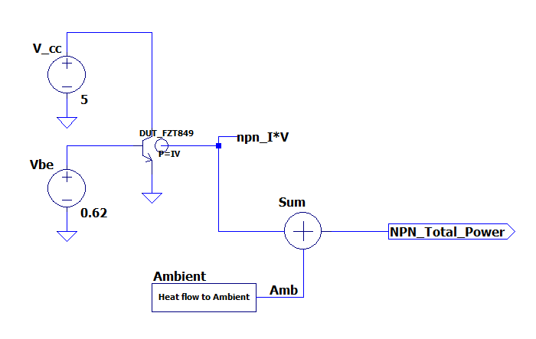
NPN thermal runaway circuit
collector voltage =5V, Vbe= 0.62V
NPN = FZT849 (big!)
Is this thermally stable?
Sweep temperature to find out!
Fourth terminal voltage is the NPN electrical power Ic * Vc.
(details here)

Slide 9
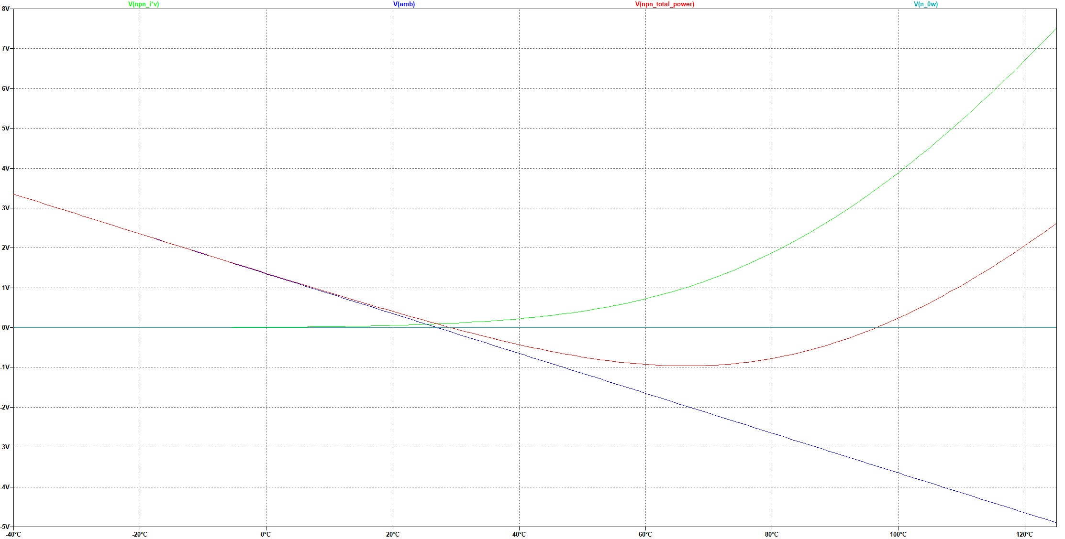
NPN simulation
T~29C
T~96C
Thermal Stability
Thermal Stability
Thermal Runaway
T=29C: total power = 0W
Thermally stable end point for initial condition T < 96C.
NPN I*V power
Total power
Thermal flux to ambient
96C: total power =0W Thermally Unstable
Perturbation to higher T causes positive
total power—more heating!

Slide 10
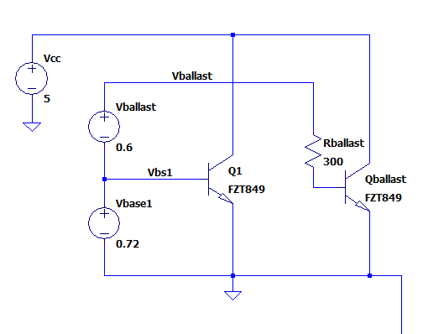
Runaway Solution: Ballast Resistors
“Base degeneration” brings thermal stability.
For fixed Vbase1 and Vballast:
Q1 current exponential with Temperature
Qballast current roughly constant with temperature

Slide 11
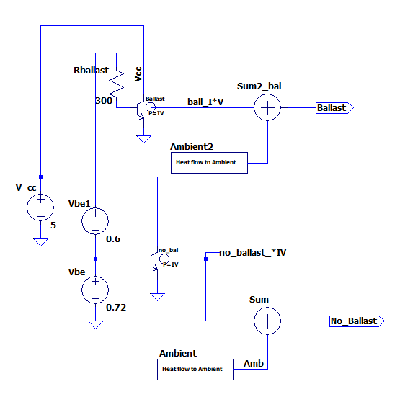
Ballast test circuit
Ballast and no ballast circuits have about the same current
at 27C. (see next slide).

Slide 12
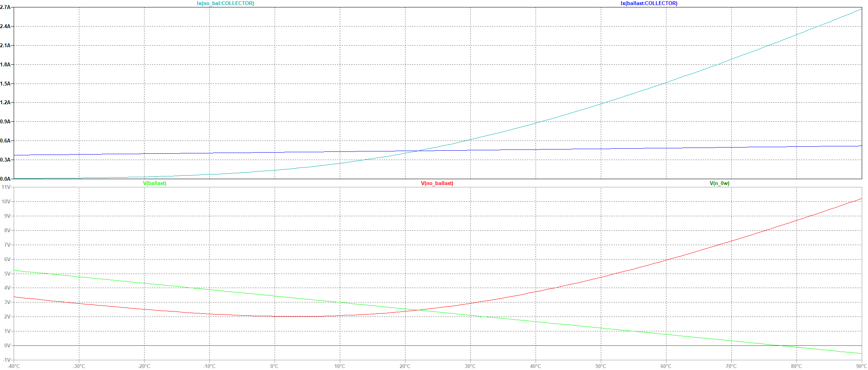
Ballast vs No Ballast
Collector currents
No Ballast: Ic increases with T.
Ballast: Ic~ 400mA over temperature
NPN power
No Ballast: Thermal runaway regardless of starting temperature.
Ballast: Temperature will be stable at 77C.

Slide 13
The End

Slide 14
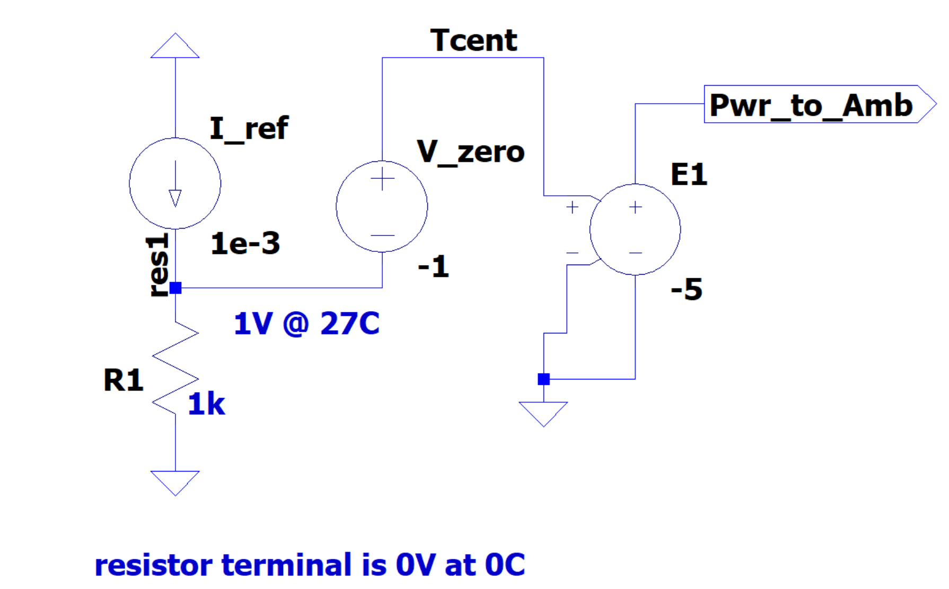
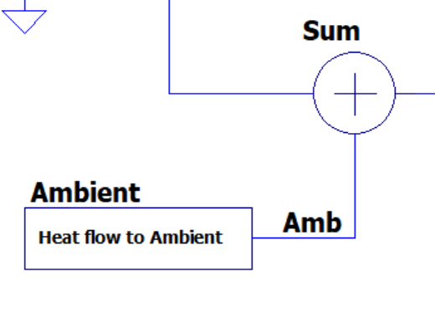
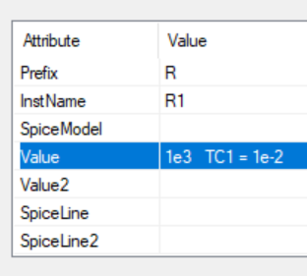
Ambient behavioral circuit
Power is linear with temperature,
0W at 27C.

Slide 15
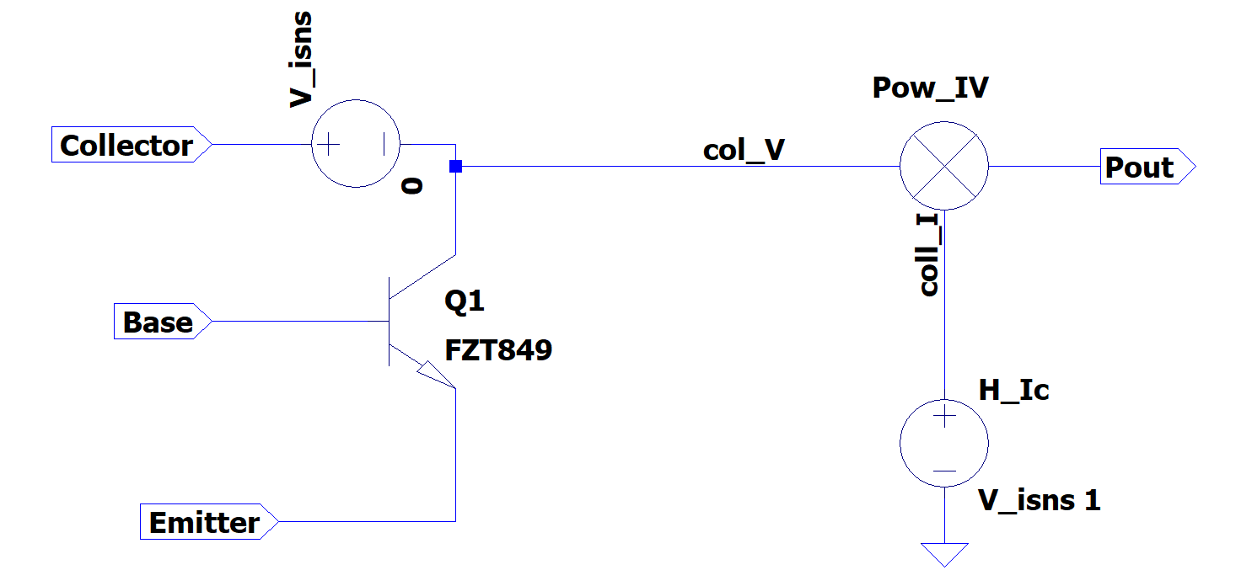
NPN behavioral circuit
The voltage at net Pout is the product of collector current
and collector voltage, Ic * Vc
H = current controlled voltage source

Slide 16
Ref info2
https://hogonext.com/how-to-analyze-thermal-effects-in-ltspice/
Thermal modeling:
https://www.analog.com/en/resources/technical-articles/ltspice-modeling-safe-operating-area-behavior-of-n-channel-mosfets.html

Slide 17
Shunt regulator
Shunt Regulator: Vout = Vref

Slide 18
BJT current

