Slide 1
Quadrature FM demodulator
April 6, 2025
Bryan Nevins

Slide 2
contents
Demodulator journal article
General theory
Resonant tank simulation
Demodulator output (lt spice)
BJT demodulator

Slide 3
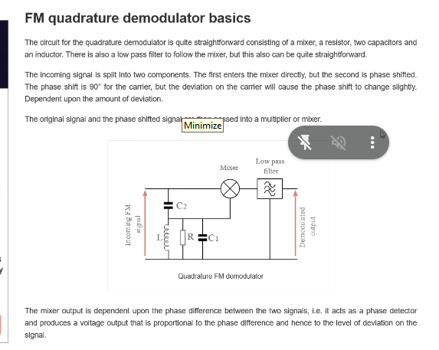
FM demodulator article
Basic: electronics notes
More technical: EE times

Slide 4
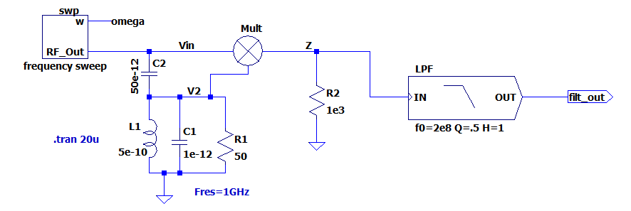
Circuit theory
2fc, f-fc
f-fc
The tank (L1, C1) resonates at the carrier frequency (fc=1GHz). For signals far from fc, the amplitude at V2 is small, and the output “z” is small.
For signals near fc, the amplitude at V2 is large. The mixer creates
signals at 2fc, and at low frequency |f-fc|. Only the low frequency signal is used. The low pass filter passes the useful signal at |f-fc|.
The circuit must be tested with a transient simulation with the input frequency swept through fc. The multiplier is NOT linear time invariant, and so cannot be simulated using an AC simulation.

Slide 5
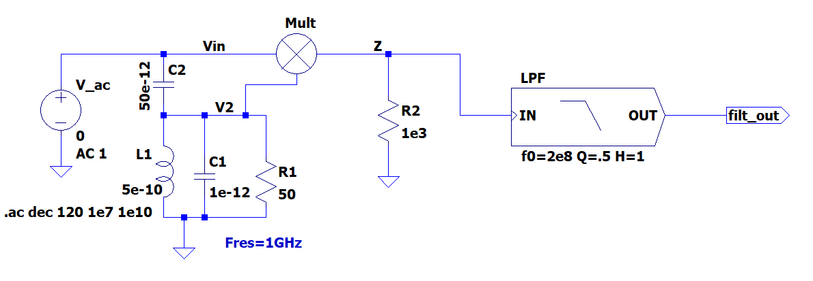
Phase vs frequency: AC test
FM_Demod.asc
AC simulation tests the resonant tank, not the multiplier.
We want V2 phase shift linear with f-fc

Slide 6
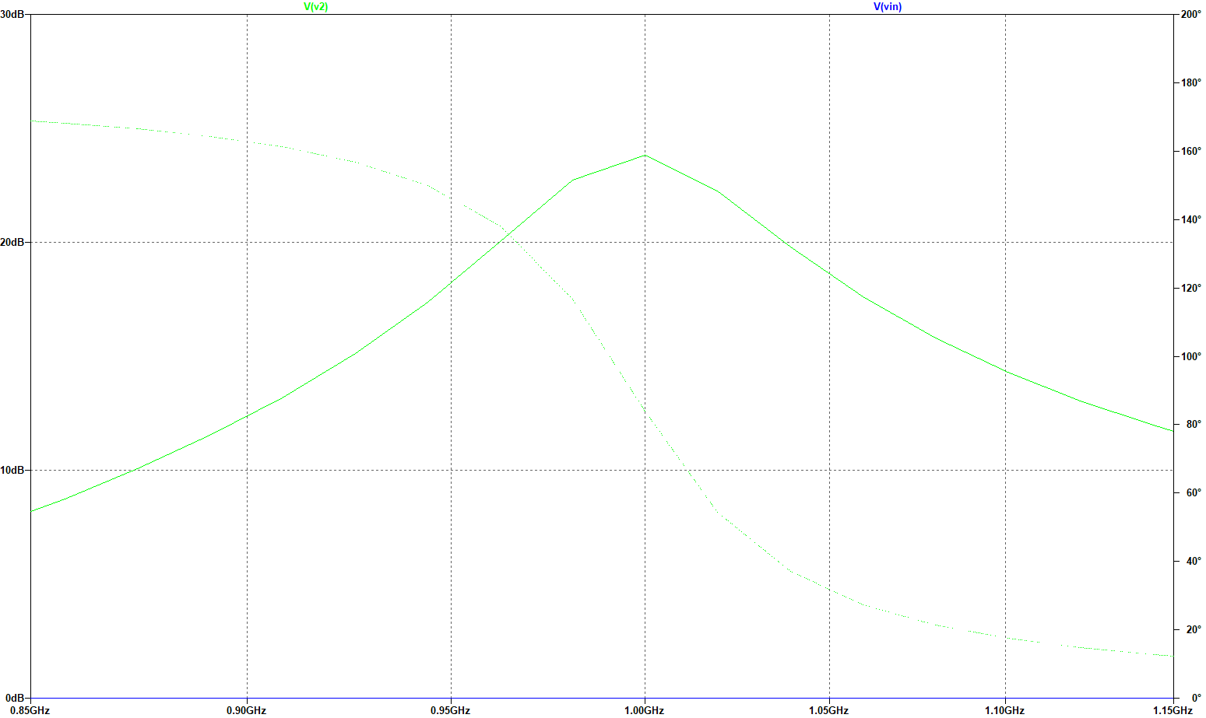
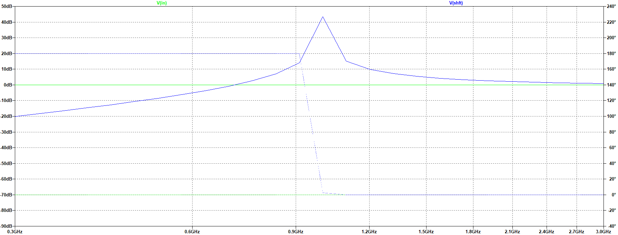
Tank AC response
Below fc : phase shift ~ 180º
Above fc : phase shift ~ 0º
Near fc : phase linear in (f - fc.)
fc
Phase(V2)
Phase shift linear
0.98GHz < f < 1.01GHz
amplitude(V2)
amplitude(Vin)=0db

Slide 7
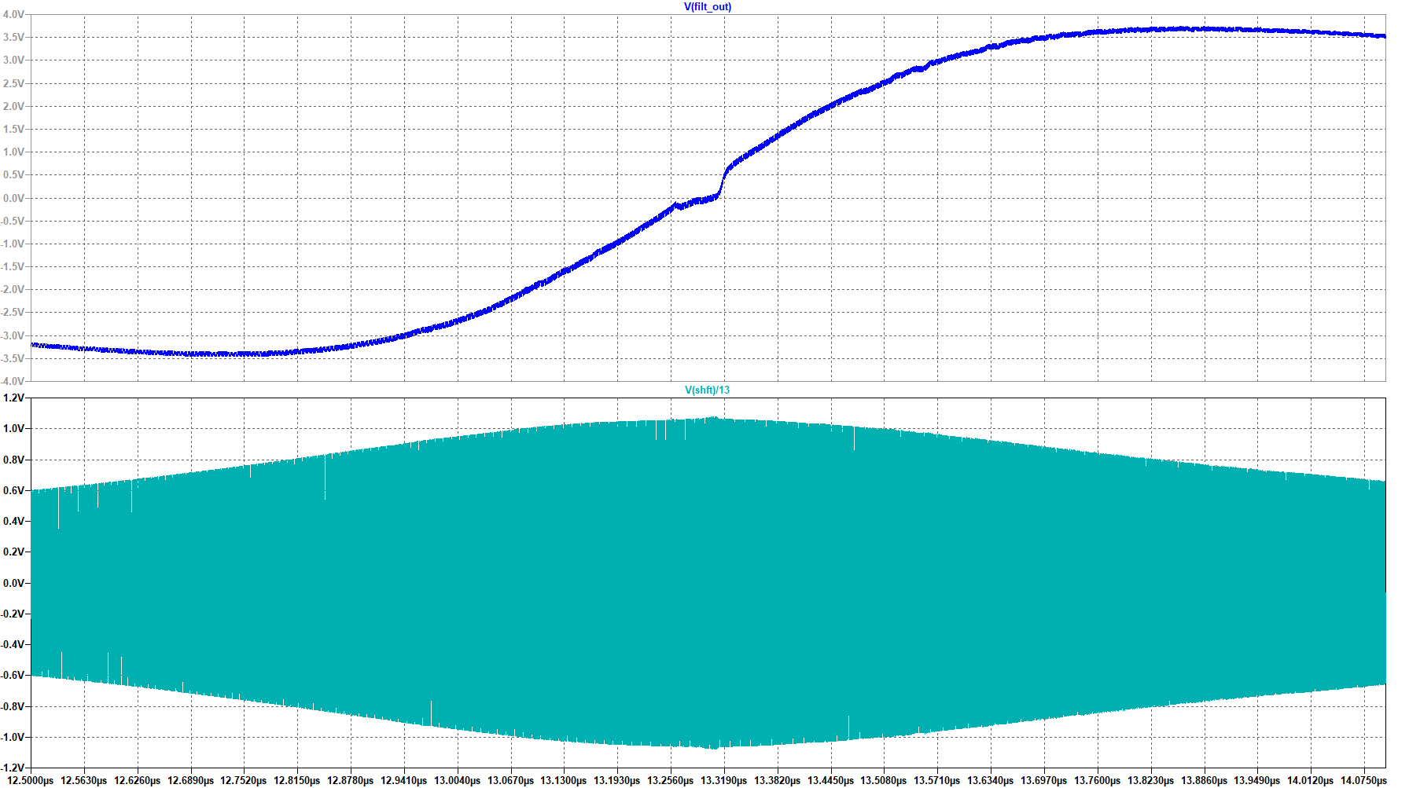
Demodulator output
Transient simulation, sweeping input frequency.
Low pass filter output <Vin *V2>
fc – f=50Mhz: 180º difference between Vin and V2
<Vin*V2> is negative
f-fc=50Mhz: phase shift ~ 0º,
<Vin*V2> is positive.
Output decreases at larger frequencies because V2 is decreasing above fc.
At f=fc phase shift ~ 90º,
<Vin*V2> ~ 0.
V2
V2 is largest at f= fc=1Ghz

Slide 8
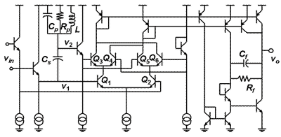
Circuit from EE times article
i~
Vin*V2
i~
-vin*V2
i ~ constant
resonator
multiplier
differential
Input V_{in}
Output
~V_{in}*V₂

