Slide 1
Z-Twist Consulting:
52 weeks of inclusion
April 2025
https://z-twist.com

Slide 2
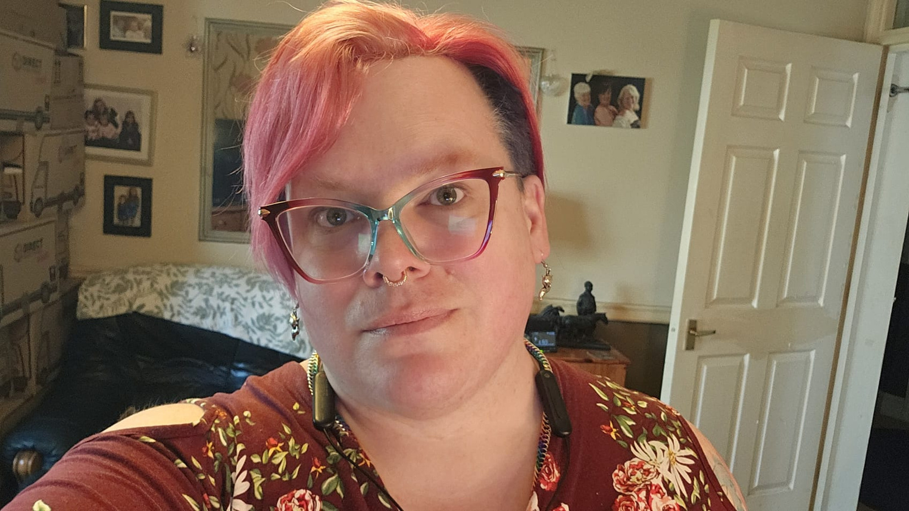

/02
Who We Are?
Z-Twist consulting is a boutique firm specialising in Product, Project and Programme management, and Equity, Diversity and Inclusion training. The founder, Morgan Grey (left), is a top 50 inclusive companies award winner and a passionate advocate for workplace inclusion, with 20 years of experience guiding organisations through transformational change.
Morgan’s background spans human resources, organisational development, and DEI strategy. This roadmap is the result of lessons learned from real-world experience helping teams become more inclusive, equitable, and sustainable.
z-twist.com
Z-Twist.com

Slide 3

/03
Why This Guide Exists
Inclusion isn't a one-time training — it's a continuous journey of learning, action, and accountability. Many companies want to do better but don’t know where to start. This guide offers a practical, weekly structure for building an inclusive culture without overwhelming your teams
Why You Should Care
Inclusive workplaces outperform others in innovation, employee retention, and customer satisfaction. But more importantly, creating a culture where everyone can thrive is the right thing to do. Your leadership can shape not only your organisation but ripple into your community and industry.
z-twist.com

Slide 4
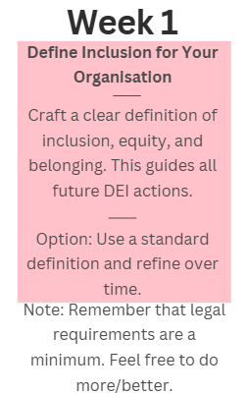
/04
How to Use This Presentation
This presentation is organised into 13 4-week months, each with a focused theme. Every week introduces one actionable task to build inclusion in your workplace.
These slides are separated by month so that they can be printed out as handouts on a month by month basis, to avoid overwhelm
Each task includes:
  A short goal
  A task to complete
  Alternatives if full implementation isn’t possible
  Sometimes there will be a note or resource beneath which will aid you.
You can move at your own pace, adapt ideas for your organisation, and revisit each section at any time. What matters is your commitment to progress.
Let’s build workplaces where everyone belongs.
z-twist.com

Slide 5
/05
📅 Month 1: Laying the Groundwork
Goal: Establish a foundational understanding of what inclusion means to your organisation and set the stage for long-term cultural change
Week 1
Week 2
Week 3
Week 4
Define Inclusion for Your Organisation
Launch a DEI Baseline Survey
Align Mission & Values with Inclusion
Host an Inclusion Kick-off Meeting
Craft a clear definition of inclusion, equity, and belonging. This guides all future DEI actions.
Gather anonymous employee input to understand current inclusion perceptions.
Update your mission and values to explicitly support inclusion.
Kick off your inclusion journey with a company-wide meeting.
z-twist.com
Option: Use a standard definition and refine over time.
Option: Hold informal focus groups instead.
Option: Add a supplemental inclusion statement.
Option: Share a video or email message instead.
Note: Remember that legal requirements are a minimum. Feel free to do more/better.

Slide 6
/06
🧭 Month 2: Leadership & Accountability
Goal: Ensure leadership ownership and establish clear accountability structures to drive inclusion efforts.
Week 5
Week 6
Week 7
Week 8
Executive DEI Commitments
Appoint a DEI Champion or Committee
Set & Share DEI Goals
Monthly DEI Updates
Ask senior leaders to share personal inclusion commitments and learning goals.
Designate responsible individuals to guide and track DEI work.
Define measurable goals (e.g., hiring targets, retention rates) and share them internally.
Share short monthly updates on DEI progress, learnings, and goals.
z-twist.com
Option: Have them support initiatives through small, visible actions.
Option: Start with a volunteer-led working group.
Option: Set one goal to focus on for the next quarter.
Option: Provide quarterly updates or short internal notes.
Note: It is important that actions are visible.
Note: It is important to pay people who are doing this work fairly.

Slide 7
/07
⚖️ Month 3: Policy & Structure
Goal: Create fair, transparent, and inclusive policies that remove structural barriers and promote equity.
Week 9
Week 10
Week 11
Week 12
Assess Pay Equity
Review Harassment & Discrimination Policies
Improve Caregiver Benefits
Audit Hiring Practices
Evaluate your recruiting process for bias, from job ads to interviews.
Analyse compensation data by gender, race, and role to identify disparities.
Ensure your policies are up to date, accessible, and cover all identities.
Evaluate how inclusive your policies are for parents and caregivers.
z-twist.com
Option: Start with one department or recent job posting.
Option: Conduct a sample review using anonymized data.
Option: Add a DEI addendum or checklist in the meantime.
Option: Start by allowing flexible work options.

Slide 8
/08
📚 Month 4: Awareness & Education
Goal: Increase awareness of bias, promote understanding, and build a culture of continuous learning.
Week 13
Week 14
Week 15
Week 16
Host Unconscious Bias Training
Create a DEI Resource Library
Culture & Heritage Spotlights
Bring in Guest Speakers
Offer a training session to help staff recognize and interrupt bias.
Build a shared library of books, podcasts, and videos about inclusion.
Celebrate diverse cultures or heritage events each week or month.
Invite thought leaders or employees to share lived experiences.
z-twist.com
Option: Use a recorded webinar or free resource.
Option: Share one resource per week via email or Slack.
Option: Feature highlights in company newsletters.
Option: Share relevant TED Talks or podcasts.
https://www.youtube.com/watch?v=dLAi78hluFc
https://www.inclusiveemployers.co.uk/diversity-calendar/

Slide 9
/09
💬 Month 5: Communication & Language
Goal: Foster respectful, clear, and inclusive communication across all channels and touchpoints.
Week 17
Week 18
Week 19
Week 20
Audit for Inclusive Language
Update Job Postings
Normalise Pronoun Sharing
Inclusive Language Guide
Review job ads, internal messages, and policies for inclusive wording.
Ensure job ads reflect inclusive tone and requirements.
Encourage employees to include pronouns in email signatures and profiles.
Create a guide for inclusive language in communication and documentation.
z-twist.com
Option: Update key documents first (e.g., onboarding, job ads).
Option: Start with high-priority or open roles.
Option: Introduce the concept gradually through examples.
Option: Link to an external resource as a temporary measure.
Note: Make sure you share the pay grade for jobs
Note: Encouragement is not the same as making it mandatory!

Slide 10
/10
🌱 Month 6: Culture & Belonging
Goal: Cultivate an environment where all employees feel seen, valued, and connected.
Week 21
Week 22
Week 23
Week 24
Start Employee Resource Groups (ERGs)
Host Belonging Circles
Share Stories of Belonging
Conduct Stay Interviews
Support voluntary, employee-led groups that promote shared identities or interests.
Create safe spaces for open discussion around identity, bias, or culture.
Feature employee stories about identity, culture, or inclusion.
Talk to current employees about what keeps them at the company — and what might push them away.
z-twist.com
Option: Start with one-time listening circles.
Option: Allow anonymous submissions to build comfort.
Option: Use a simple anonymous survey.
Option: Begin with one pilot ERG.

Slide 11
/11
🔍 Month 7: Evaluation & Feedback
Goal: Gather insights, reflect on progress, and adapt your approach to better support inclusion.
It’s been 6 months, time to check your progress. How do your employees feel you are doing? How do your DEI team feel you are doing? HR? Leadership? How do you feel you are doing?
Week 25
Week 26
Week 27
Week 28
Measure Inclusion Sentiment
Review DEI Progress So Far
Adjust Goals Based on Feedback
Celebrate Wins
Reflect on what’s working and what needs to change. Share your findings.
Acknowledge and reward inclusive behaviours, improvements, or milestones.
Ask employees how included they feel and where gaps exist.
Use insights to tweak your inclusion goals.
z-twist.com
Option: Use pulse surveys or informal check-ins.
Option: Conduct a brief internal review.
Option: Make small changes to scope or pacing.
Option: Use shout-outs or thank-you messages.

Slide 12
/12
🧠 Month 8: Learning & Unlearning
Goal: Challenge outdated assumptions, develop allyship, and embed inclusive thinking in daily behaviours.
Week 29
Week 30
Week 31
Week 32
Read a Company-Wide DEI Book
Host “Ask Me Anything” (AMA) Sessions
Mythbusting Inclusion
Allyship in Action
Choose a shared book and host an optional discussion group.
Create a respectful space for employees to ask DEI-related questions.
Debunk common DEI myths via internal posts or micro-learnings.
Educate employees on how to be effective allies across dimensions of identity.
z-twist.com
Option: Use anonymous submission forms and written answers.
Option: Post once a month rather than weekly.
Option: Share a short checklist or guide.
Option: Share a short article or podcast instead.

Slide 13
/13
🧩 Month 9: Hiring & Advancement
Goal: Make recruitment, advancement, and retention processes equitable and inclusive.
Week 33
Week 34
Week 35
Week 36
Inclusive Interview Training
Expand Job Board Reach
Promote Internal Mobility
Track Recruiting Metrics
Train hiring managers on bias-aware interviewing and evaluation.
Post jobs to sites that serve underrepresented communities.
Support equitable promotions and cross-functional opportunities.
Analyse applicant and hiring demographics to identify patterns.
z-twist.com
Option: Use just one new inclusive platform.
Option: Encourage mentorships to support growth.
Option: Track one role or department first.
Option: Create a hiring bias checklist.
https://lgbtjobs.co.uk

Slide 14
/14
🌍 Month 10: Community & Impact
Goal: Extend your inclusion values to external relationships, partnerships, and public presence.
Week 37
Week 38
Week 39
Week 40
Partner with Inclusive Organisations
Volunteer as a Team
Offer Pro Bono Services
Feature Social Impact in Marketing
Collaborate with nonprofits or groups supporting underrepresented communities.
Organise a group volunteer day supporting DEI-related causes.
Provide your company’s services to community organisations.
Highlight your company’s DEI and impact efforts publicly.
z-twist.com
Option: Begin with a donation or event sponsorship.
Option: Encourage individual volunteer days off.
Option: Offer free consultations or mentorship instead.
Option: Share one story on your website or LinkedIn..

Slide 15
/15
💼 Month 11: Systems & Sustainability
Goal: Embed DEI into business systems to ensure lasting change and continued progress.
Week 41
Week 42
Week 43
Week 44
Embed DEI in Performance Reviews
Evaluate Promotion Practices
Reward Inclusive Behaviors
Review Tech & Tools for Accessibility
Include inclusion behaviors and collaboration in review criteria.
Ensure promotions are fair and criteria are transparent.
Recognize employees who model inclusive values in daily work.
Check if your internal tools are inclusive to people with disabilities.
z-twist.com
Option: Ensure promotions are fair and criteria are transparent.
Option: If not possible: Start with a shout-out program.
Option: Start with your most-used platforms.
Option: Start with managers or leadership roles.

Slide 16
/16
💡 Month 12: Reflection & Momentum
Goal: Reflect on your journey, celebrate success, and set a sustainable course for the future.
Week 45
Week 46
Week 47
Week 48
Gather End-of-Year Feedback
Update DEI Strategy
Publish a Year-End Report
Celebrate Cultural Holidays Respectfully
Survey employees on how inclusion has evolved over the year.
Use the year’s insights to build a stronger strategy for next year.
Share wins, lessons, and next steps with your team.
Create a calendar of inclusive holiday acknowledgments.
z-twist.com
Option: Host small group reflection sessions.
Option: Identify 3 priorities for the next 6 months.
Option: Share a summary in an email or team meeting.
Option: Start with a quarterly spotlight.

Slide 17
/17
🔄 Month 13: Sustaining Inclusion
Goal: Set a lasting foundation to maintain inclusion work beyond the first year.
Week 49
Week 46
Week 47
Week 48
Encourage Ongoing Learning
Recognise Progress, Not Perfection
Renew Leadership Commitment
Set Next Year’s Roadmap
Create a learning path for continued DEI education in the company.
Acknowledge that DEI is a journey and celebrate the effort.
Ask leadership to recommit to DEI values for the year ahead.
Plan and communicate your DEI priorities for the coming year.
z-twist.com
Option: Have managers express appreciation directly.
Option: Share a message from the CEO or founder.
Option: Extend this current roadmap with refined goals.
Option: Share one resource monthly.

Slide 18




/18
It’s up to you now. You can hire an expert, or define your own goals based on employee feedback, but here’s some ideas that will help in the meantime:
Audit Your Supply Chain
Conduct an audit of your vendors, contractors, and suppliers to evaluate diversity, ethical sourcing, and alignment with your DEI values.
Build Equity into Product/Service Design
Ideas for year two goals
Examine whether your products or services meet the needs of diverse users — particularly those from marginalised communities.
Start or join a Cross-Industry Inclusion Alliance
z-twist.com
Collaborate with peer organisations to share resources, benchmark practices, and host joint learning opportunities that promote inclusion across your sector.

Slide 19
/19
Want Help Bringing This to Life?
What We Can Do
  Run your DEI programme end-to-end
  Deliver inclusive leadership training and workshops
  Facilitate listening sessions, audits, and strategy reviews
  Build or refresh your policies, comms, and accountability frameworks
  Provide fractional DEI leadership if you need long-term support
If you’re thinking, “This looks great, but who has the time?” — we’ve got you.
Z-twist offers hands-on support to turn your inclusive workplace strategy from a plan into real, measurable progress.
Whether you're looking for a partner to deliver the full 52-week roadmap, need help setting up systems, or want someone to guide your team through key moments — we're here to help.
📩 Ready to talk?
Why Work With Us?
Get in touch: enquiries@z-twist.com
Let’s make inclusion your organisation’s superpower.
z-twist.com
We're trusted by organisations that want to move beyond box-ticking and build cultures where everyone belongs. Practical, experienced, and rooted in equity — we meet you where you are and help you grow from there.

