Slide 1
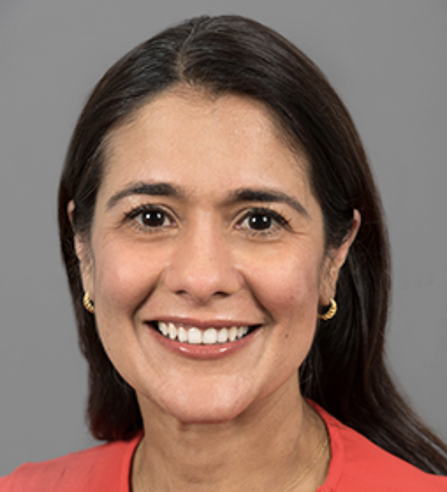
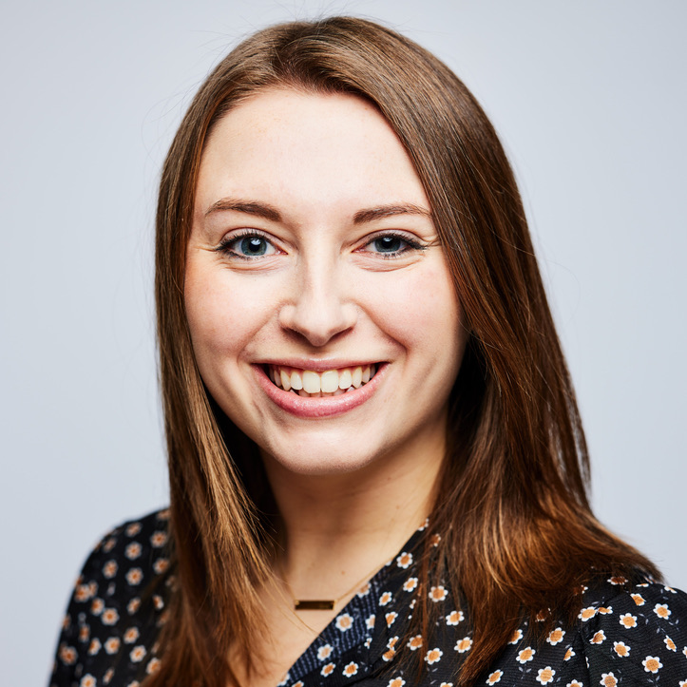

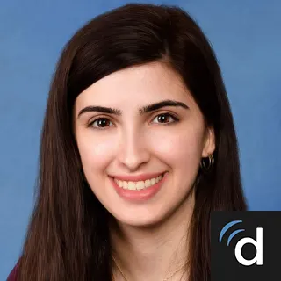
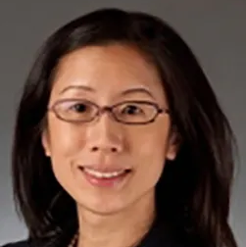
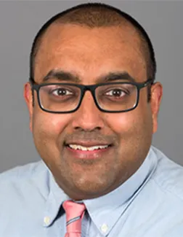

CAGS Clinic
Multidisciplinary clinic to provide expert care for those with confirmed and suspected diagnoses of CAGS
Neurogenetics
Neurology
Immunology
Nephrology
Maya Chopra
MBBS, FRACP
Clinical Geneticist
Abigail Sveden
MS, CGC
Genetic Counselor
Kellen Winden
MD, PhD
Sarah Chamseddine MD
Janet Chou
MD
Amar Majmundar
MD, PhD
Please contact Abigail at (617) 919-5214 or Abigail.Sveden@childrens.harvard.edu if you are interested in being seen in our CAGS Clinic

