Slide 1
Welcome To Modern Concepts & Fundamentals of Project Management

Slide 2
Project Management
Chapter 1 - Introduction to Project Management

Slide 3
Content
Certifying bodies and Important References
Introduction to Project Management
Project Selection Methods

Slide 4

Certifying Bodies
www.pmi.org

Slide 5
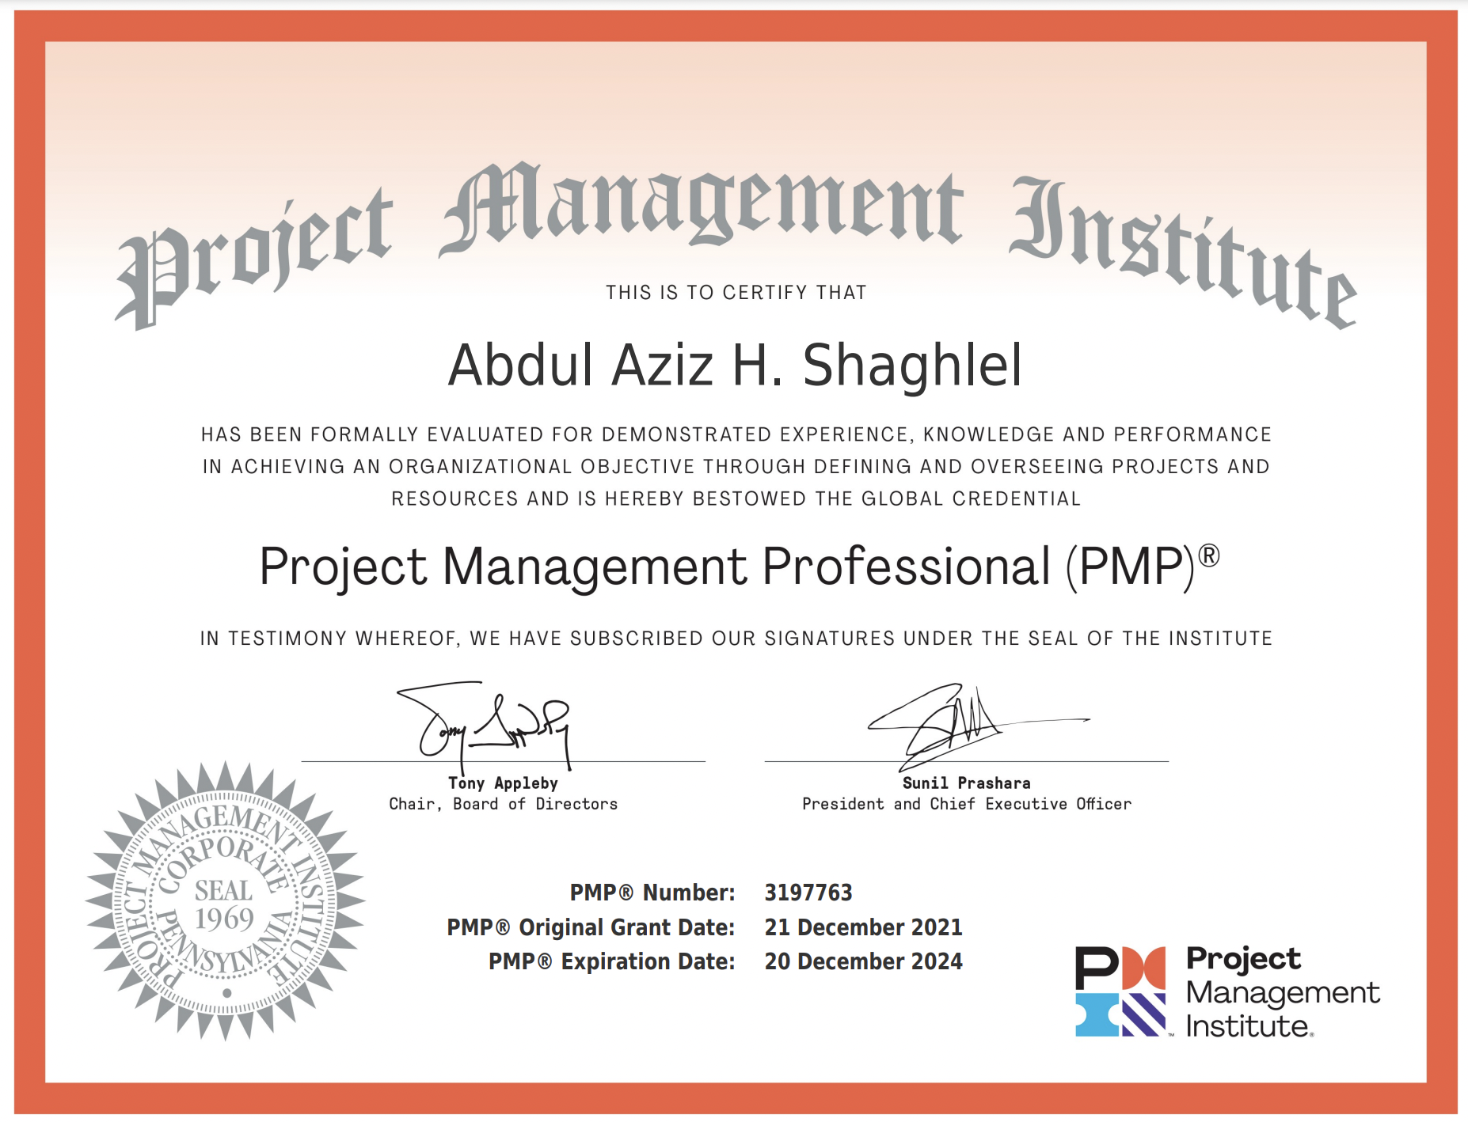
Certificate

Slide 6
Important References
Books:
A Guide to the Project Management Body of Knowledge (PMBOK® Guide) – Seventh Edition and The Standard for Project Management (ENGLISH)
Agile Practice Guide
PMP Project Management Professional Exam Certification Kit: 2021 Exam Update by Kim Heldman
Websites:
www.projectmanager.com
www.projectengineer.com

Slide 7
What is Project Management?
The tools and techniques applied by Professionals throughout the porject life cycle to design, manage, and monitor project work activities and meet project requirements.
Project Managers are responsible of applying the tools and techniques to perform project activities and fulfil project requirements.

Slide 8
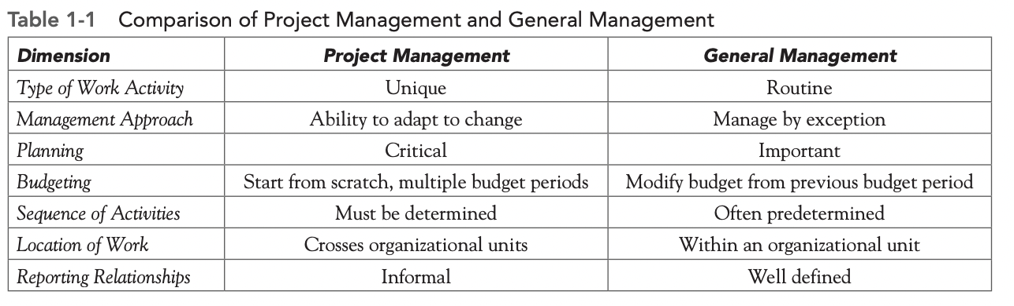
Projects vs Operations

Slide 9
Where do Projects come from?
Regulatory, Legal compliance
Social requirements
Stakeholders, Organizational needs
Market Demand
Customers Requests
Technology
Improvement

Slide 10
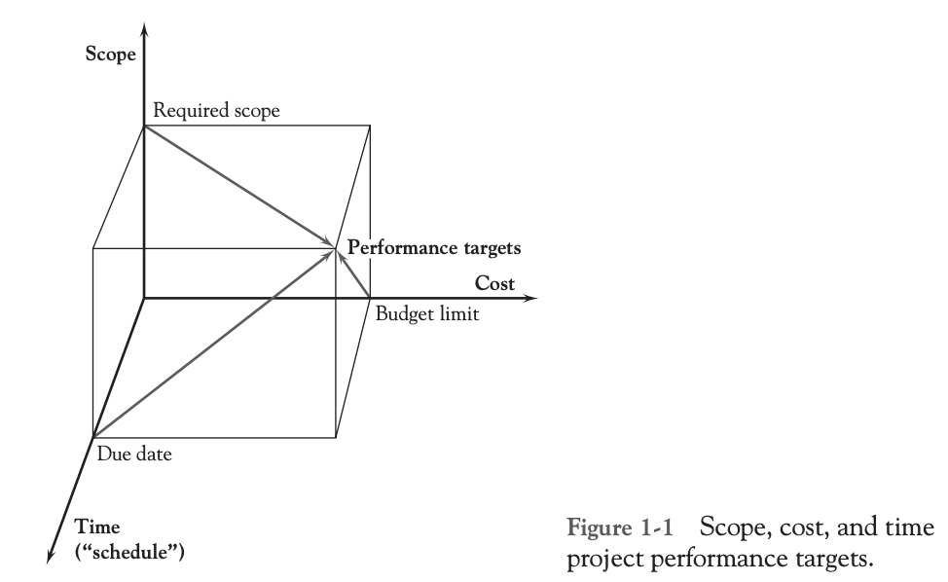
The three goals of a project

Slide 11
Projects, Programs and Portofolios
Projects: Projects are temporary in nature, has specific objective with start and end dates to produce a unique service, product our result.
Programs: Group of related projects, sub programs, and activities that if managed together using the same tools&techniques, wil yeild better results.
Portofolios: Manages a collection of programs, projects and otheractivities that may or may not be related to each other.
Mega Projects: Long-term projects (Multiple years), 1b$ value +, 1 million + impacted

Slide 12
OPM & PMO
Organizational Project Management (OPM): Methodology that Aligns and manage Projects, Programs and Portofolios according to the organization’s strategies and business objectives.
Project Management Office (PMO): Is a centralized Unit/Department that is incharge of project management across the entire organiation.
  Supportive: Consult, train and Support
  Controlling: Compliance, conformance, and governance to Project Management framework
  Directive: PMO Manages the project

Slide 13
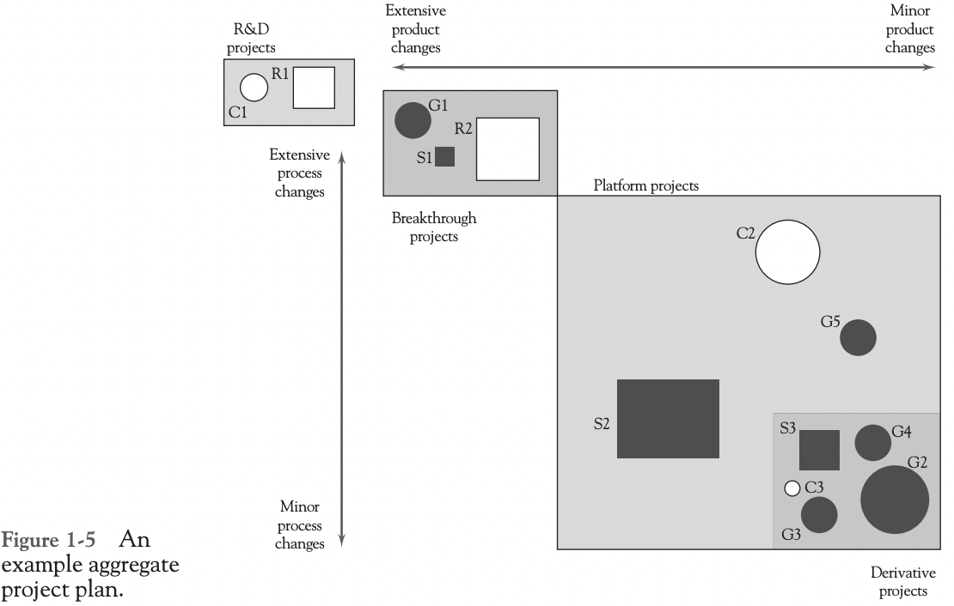
THE PROJECT PORTFOLIO PROCESS
The Project Portfolio Process (PPP) attempts to link the organization’s projects directly to the goals and strategy of the organization.
Notes:
Derivative projects These are projects with objectives or deliverables that are only incrementally different in both product and process from existing offerings. They are often meant to replace current offerings or add an extension to current offerings (lower priced version, upscale version). 2. Platform projects The planned outputs of these projects represent major departures from existing offerings in terms of either the product/service itself or the process used to make and deliver it, or both. As such, they become “platforms” for the next generation of organizational offerings, such as a new model of automobile or a new type of insurance plan. They form the basis for follow-on derivative projects that attempt to extend the platform in various dimensions. 3. Breakthrough projects Breakthrough projects typically involve a newer technology than platform projects. It may be a “disruptive” technology that is known to the industry or something proprietary that the organization has been developing over time. Examples here include the use of fiber-optic cables for data transmission, cashbalance pension plans, and hybrid gasoline-electric automobiles. 4. R&D projects These projects are “blue-sky,” visionary endeavors, oriented toward using newly developed technologies, or existing technologies in a new manner. They may also be for acquiring new knowledge, or developing new technologies themselves.

Slide 14
THE PROJECT PORTFOLIO PROCESS
Derivative projects: They are often meant to replace current offerings or add an extension to current offerings (lower priced version, upscale version).
Platform projects: A major departures from existing offerings in terms of either the product/service itself or the process used to make and deliver it, or both. a new model of automobile
Breakthrough projects: typically involve a newer technology than platform projects “disruptive”. hybrid gasoline-electric automobiles.
Research and Development (R&D) projects: These projects are “blue-sky,” visionary endeavors, oriented toward using newly developed technologies, or existing technologies in a new manner.
Notes:
Platform projects: As such, they become “platforms” for the next generation of organizational offerings, such as a new model of automobile or a new type of insurance plan. They form the basis for follow-on derivative projects that attempt to extend the platform in various dimensions.

Slide 15
PMP
Project Selection Methods

Slide 16
Non-numeric Selection Methods
The Sacred Cow: “You know, I was thinking that we might . . .” and concludes with “. . . Take a look at it and see if it looks sensible. If not, we’ll drop the whole thing.”
The Operating/Competitive Necessity: This method selects any project that is necessary for continued operation of a group, facility, or the firm itself.
Comparative Benefits: Many organizations have to select from a list of projects that are complex, difficult to assess, and often noncomparable

Slide 17
Numeric Selection Methods
Benefit-Cost Ratio Analysis
Scoring Model
Payback period
Discounted cash flow
Net present value
Internal Rate of Return

Slide 18
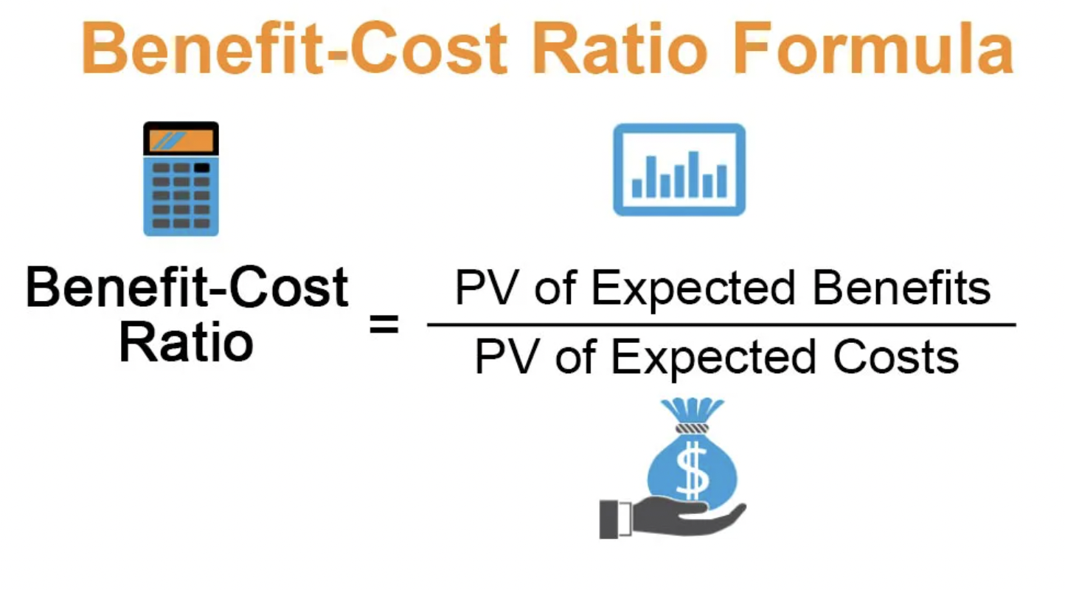
Benefit-Cost Ratio Analysis
It compares the cost of executing the project to the benefit/profit that the project generates.
Costs are everything spent from the time the project was initiated to closure.

Slide 19
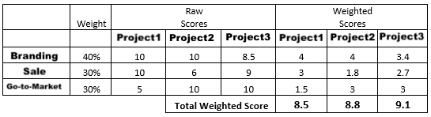
Scoring Model
Allow the team to rank potential projects based on criteria such as risk level, cost, and potential financial returns.

Slide 20

Payback period
How long does it take earn back the cost of the entire project.
Payback Period = Initial investment / Cash flow per year
For example, you have invested 1,00,000 $ with an annual payback of 20,000$. Payback Period = 1,00,000/20,000 = 5 years.

Slide 21
Discounted cash flow
The discounted cash flow method is based on the concept of the time value of money, which says that the money that an individual has now is worth more than the same amount in the future.

Slide 22
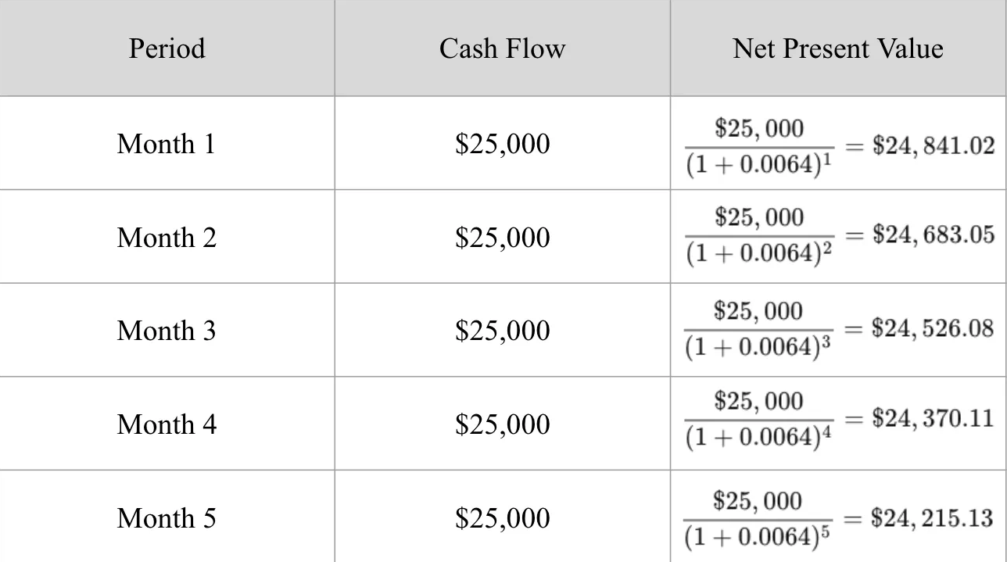
Discounted cash flow
It’s a method of calculating your return on investment (ROI) By looking at all of the money you expect to make from the investment and translating those returns into today’s dollars, you can decide whether the project is worthwhile.
Is it possible that the outcome of the investment is worth more than the investment.
If NPV is > 0, go ahead with the project
If NPV is < 0, Dot not go ahead
Notes:
Buy a house, you invest in it and then sell it after 5 years for better price

Slide 23
Internal Rate of Return
Rate of return that sets the net present value of all cash flows (both positive and negative) from the investment equal to zero.
For example, suppose an investor needs $100,000 for a project, and the project is estimated to generate $35,000 in cash flows each year for three years. The IRR is the rate at which those future cash flows can be discounted to equal $100,000.
Always choose the project with Highest IRR

Slide 24
Thank You

