Slide 1
SmartIcons
Click on the SmartIcon below and use the yellow balls 🟡 to adjust it
Great for ratings, milestones, and visual highlights
Superstar Sample
https://SmartIcons.net

Slide 2
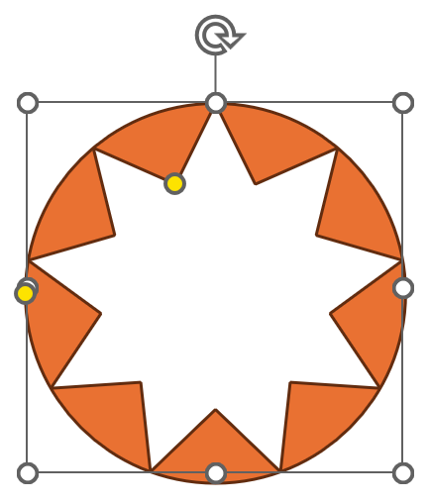
QUICK GUIDE: Superstars
THESE YELLOW BALL🟡 HANDLES ARE WHAT MAKES IT SMART!
Update your presentations in real-time during meetings. Change the story without changing slides.
Adjusts star inner points
Adjusts size of circle

Slide 3
SmartIcon Superstar Examples
PERFECT FOR DYNAMIC STORYTELLING
Copy/paste any of 9-pointed Superstar SmartIcons below into your slides and use the yellow balls 🟡 to adjust it
Software Feature Development
Vendor Strategic Partnership
Net Satisfaction Impact
Core Features
Platform Ready
Standard Vendor
Strategic Partner
FY Last
FY This
Planning Phase
Enterprise Impact
Department Level
Enterprise Partner
5.8/10 NSAT Score
8.1/10 NSAT Score
Progress from concept to full deployment with transformation
Evolve vendor relationships from tactical to strategic
Track satisfaction improvements over time
Your story evolves. Your icons should too.
https://SmartIcons.net

Slide 4
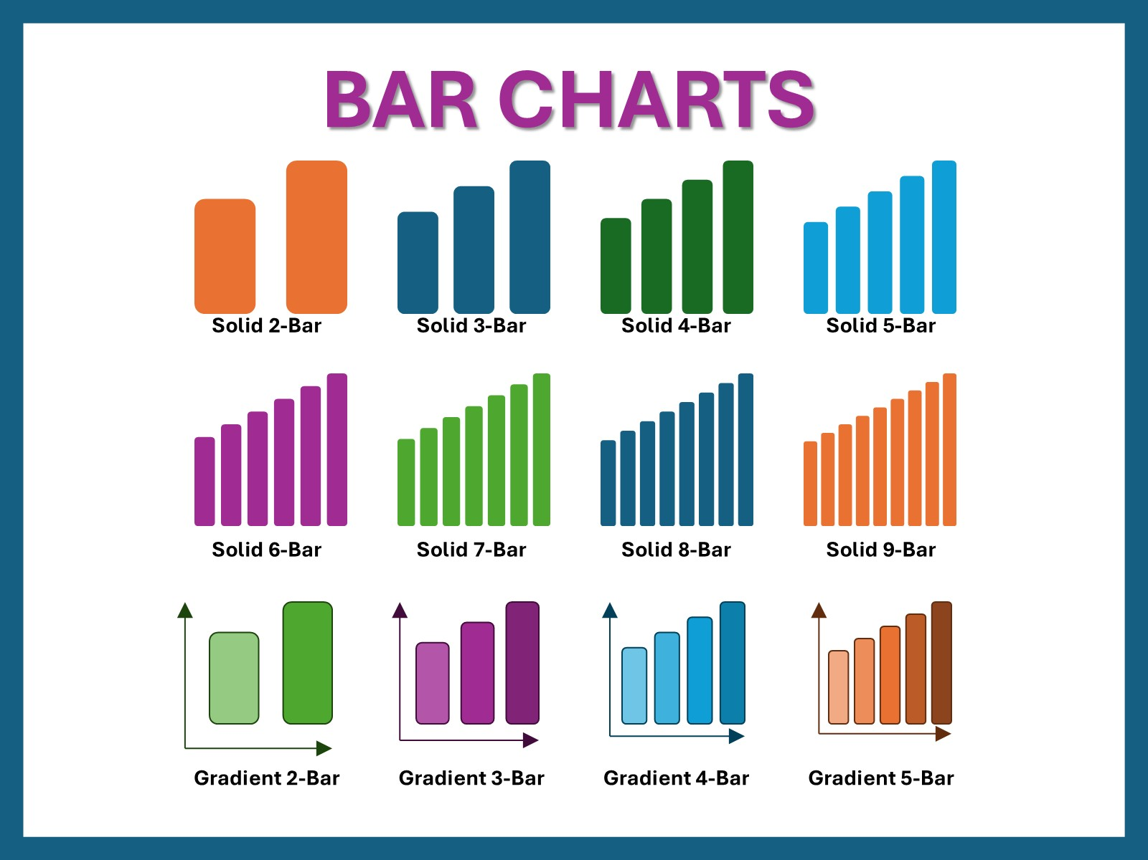
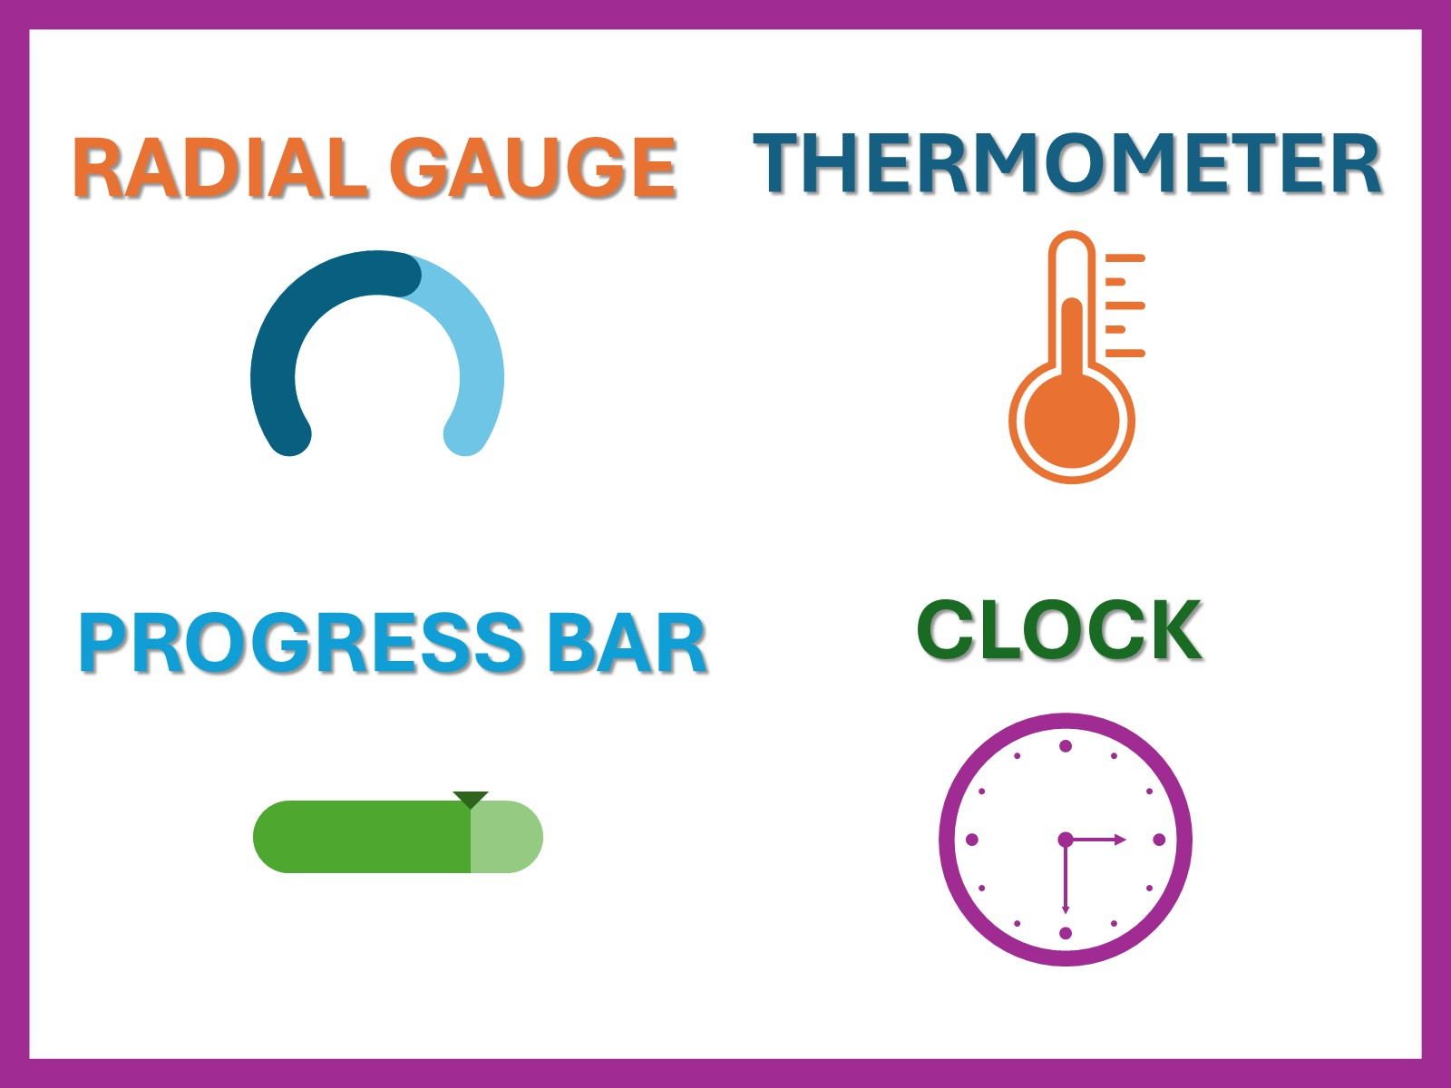
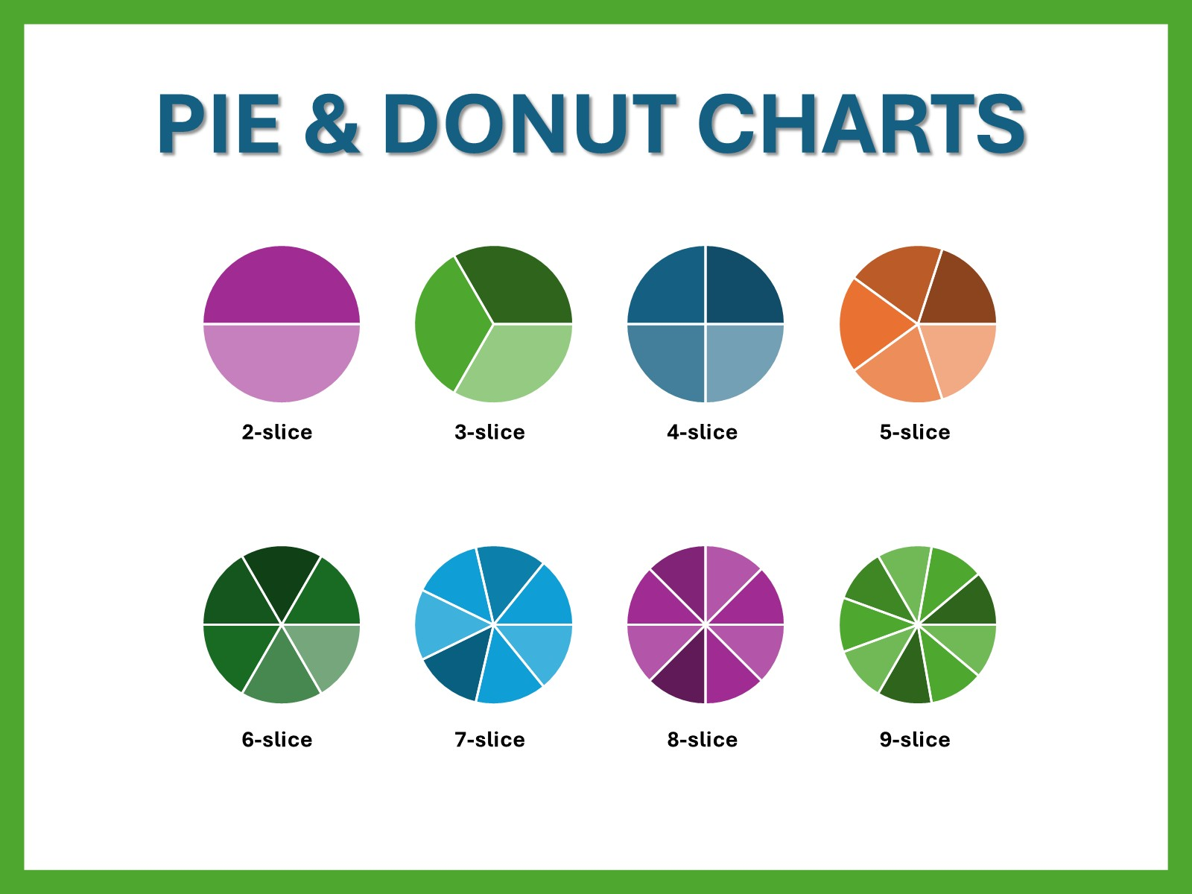
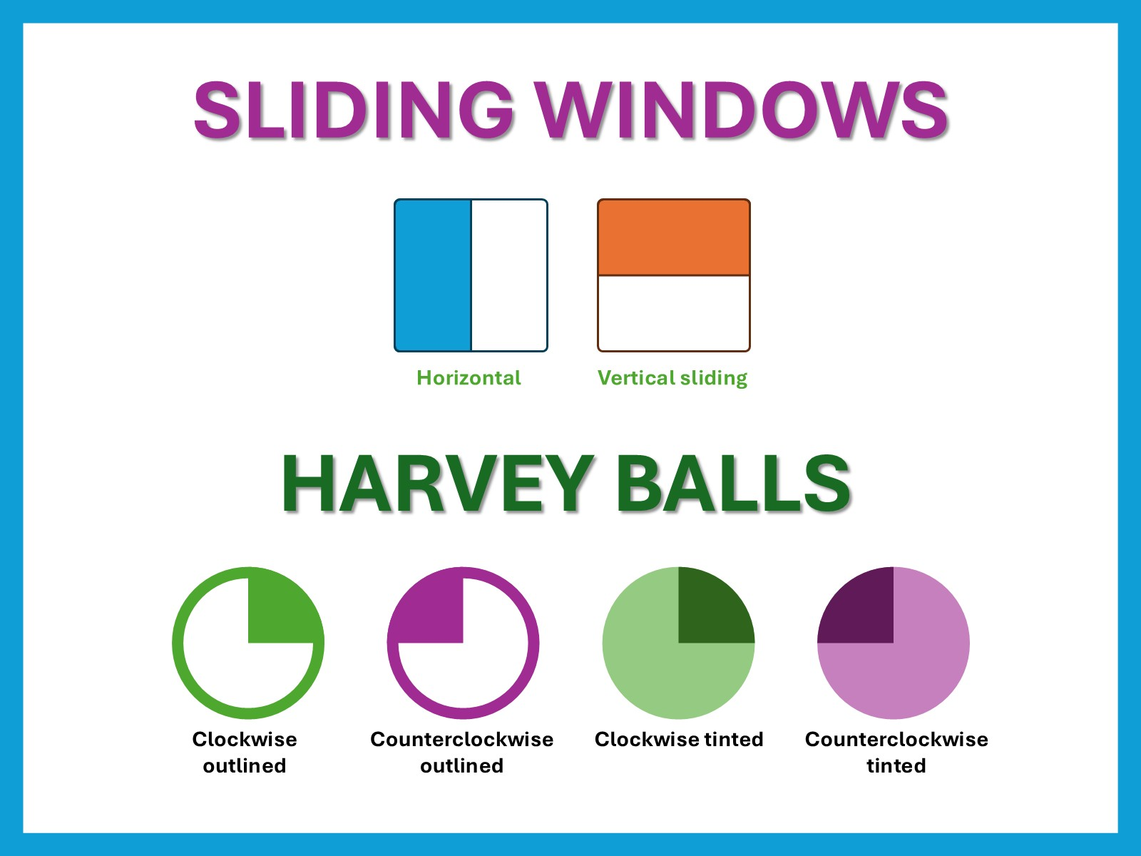
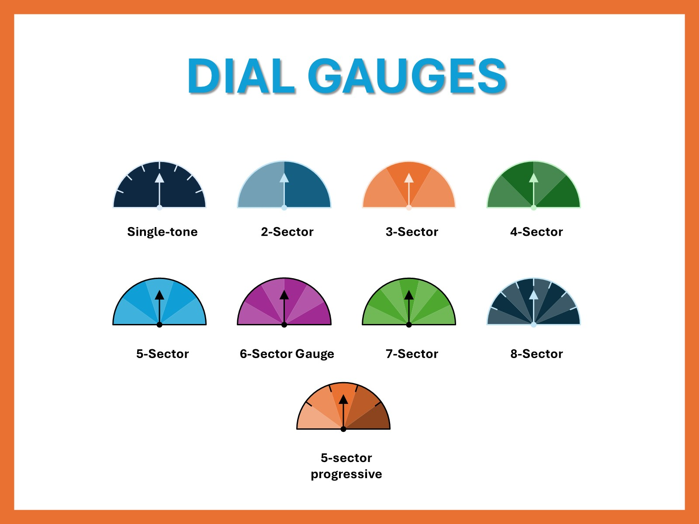
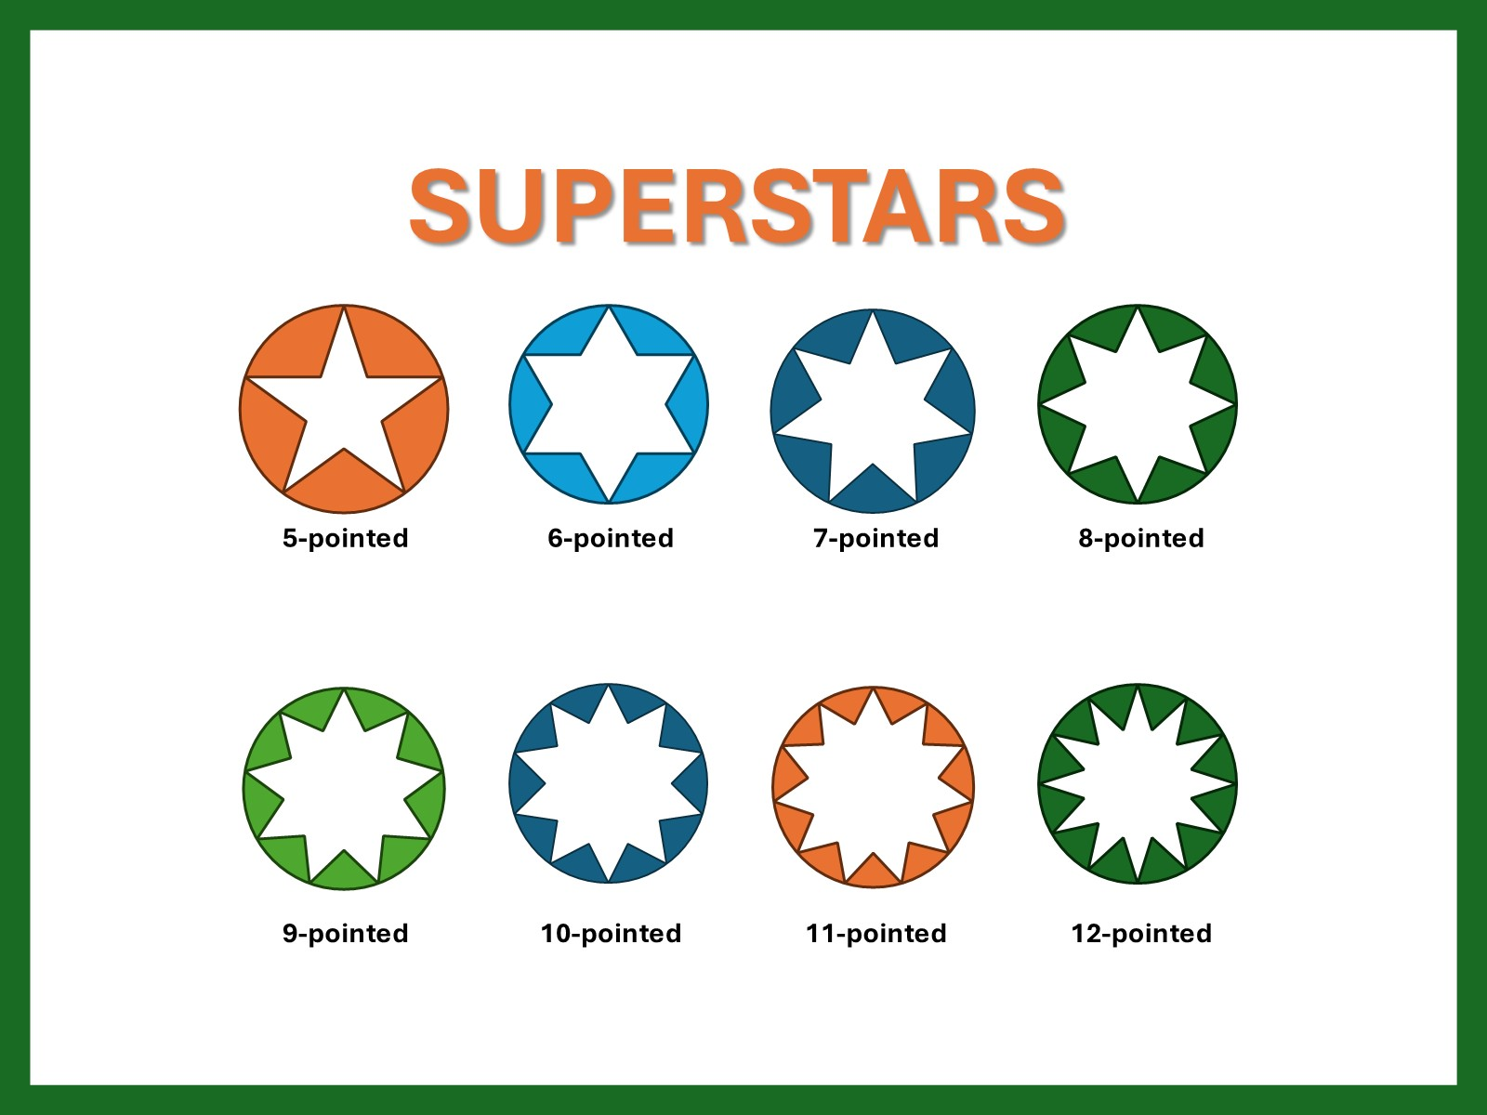
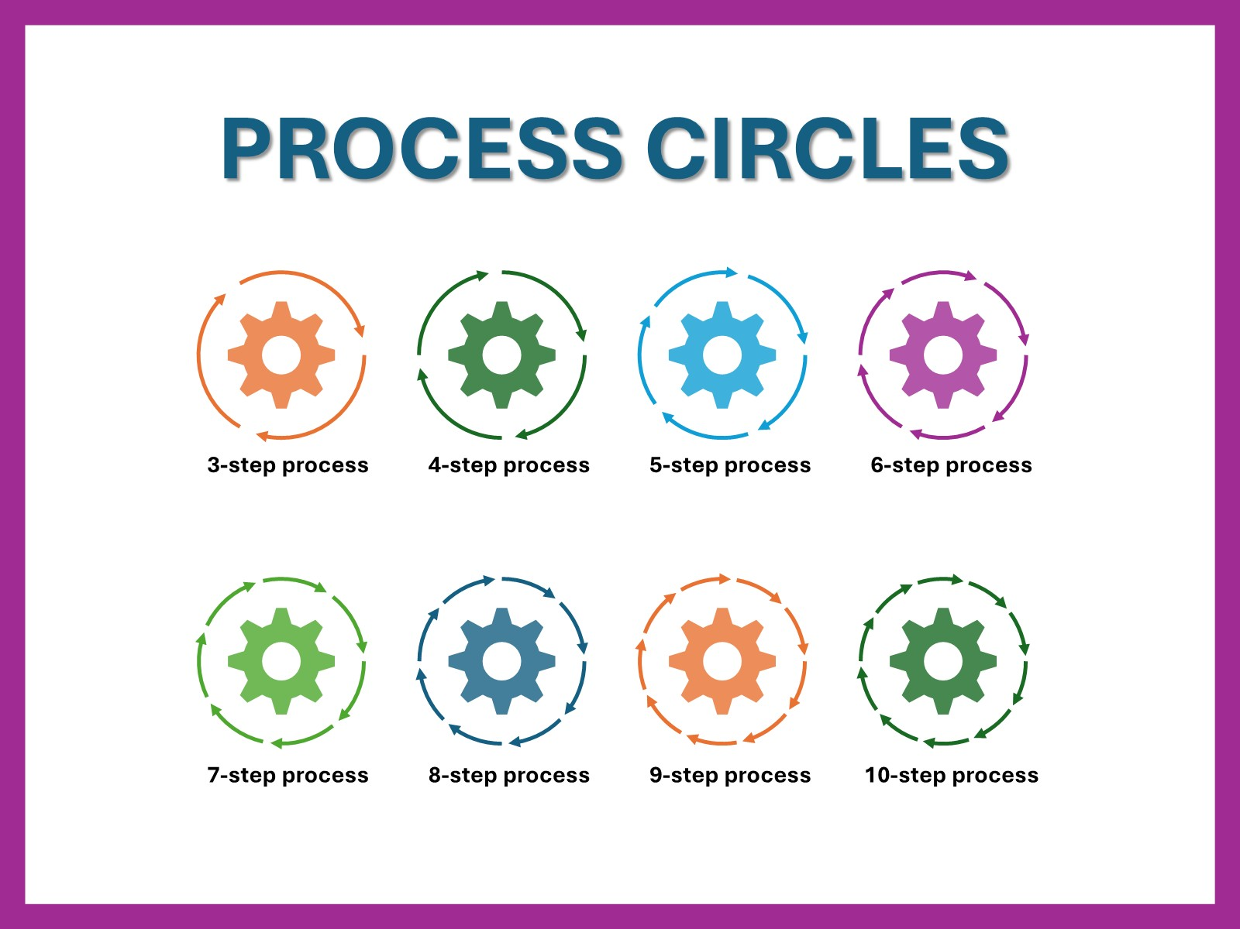
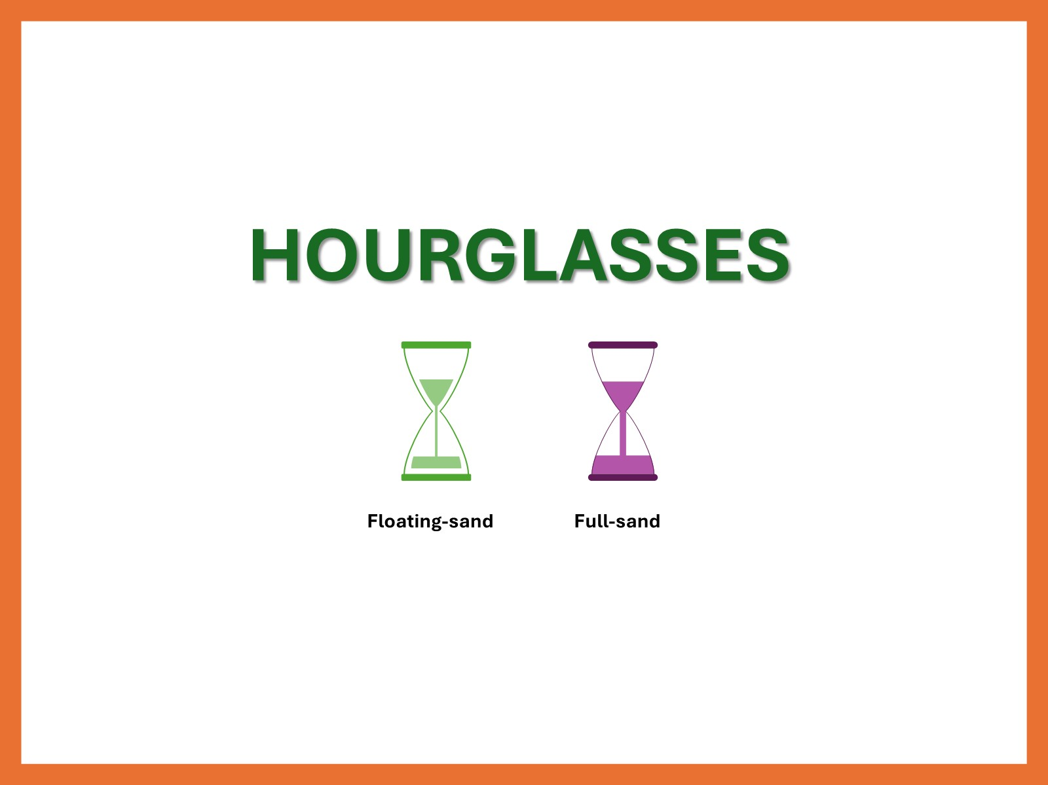
Ready for more?
https://SmartIcons.net/
Grab a full copy of SmartIcons SuperPack 1!
Find on: https://SmartIcons.net
Or go direct: https://shop.smarticons.net/buy/4e8ef65c-2a76-4c88-9f3d-ebaa610f3e05

Slide 5

Questions?
Visit us at:
https://SmartIcons.net/
Or reach out directly to:
smarticons@tendoors.com
SmartIcons © 2024-2025 Tendoors LLC

