Slide 1
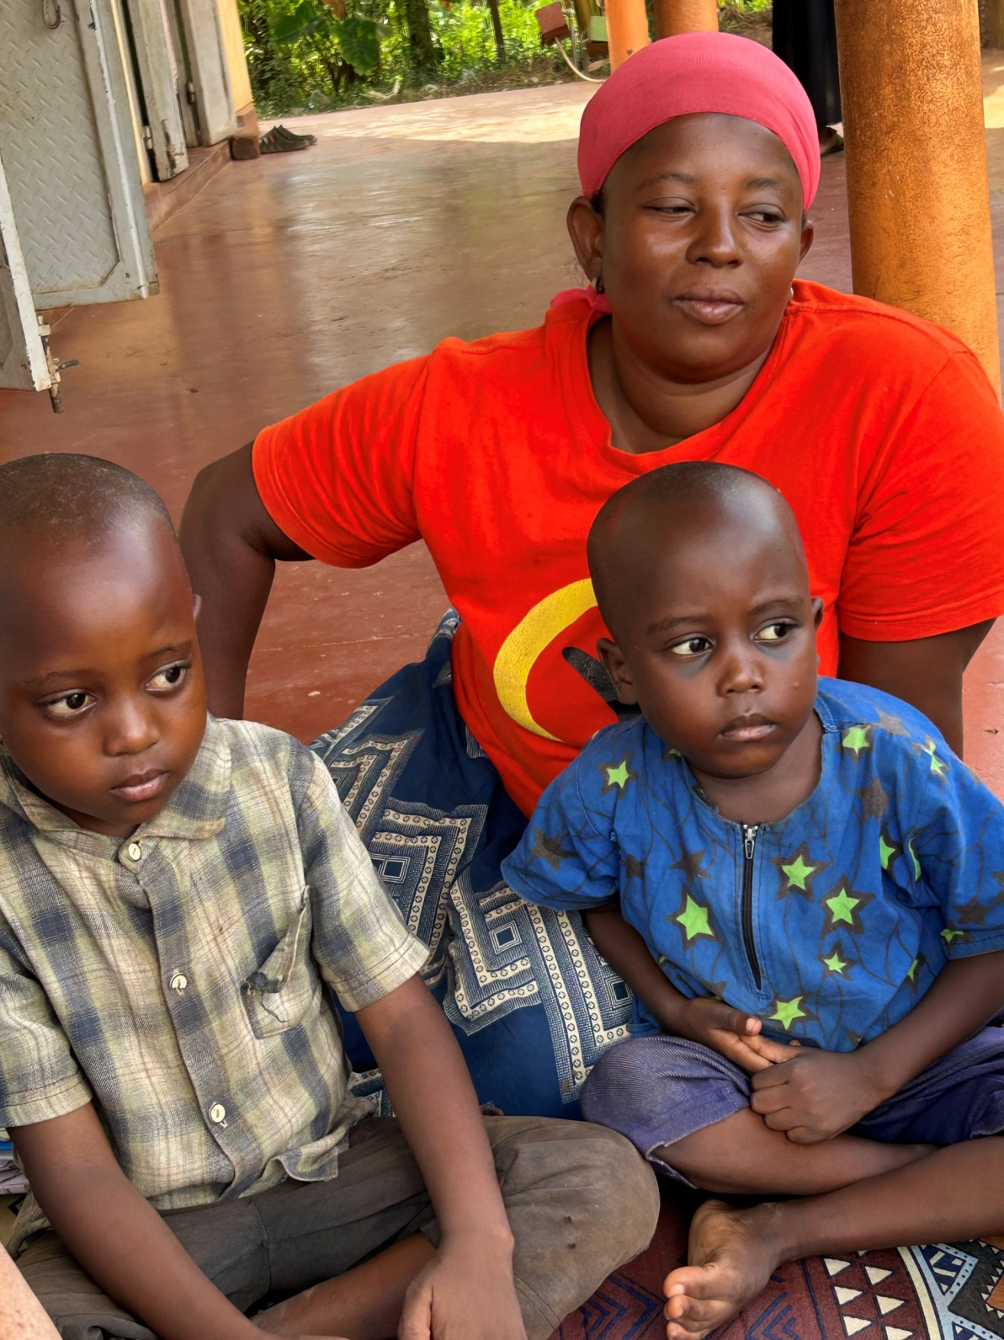

Slide 2


Moral dilemmas experienced by care-givers
of sickle-cell diseased (SCD) children:
Preliminary results of a qualitative research study
in Wakiso District, Uganda
By
FRIENDS OF SICKLERS FOUNDATION – UGANDA
In conjunction with
SALAMA SHIELD FOUNDATION

Slide 3
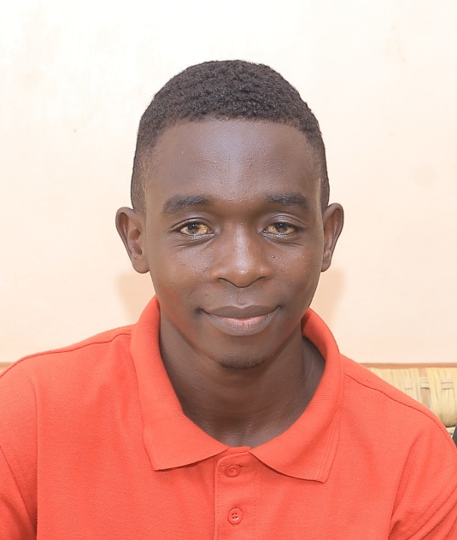
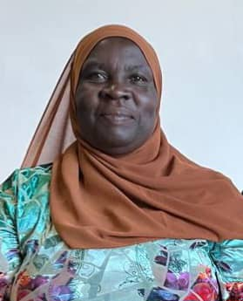


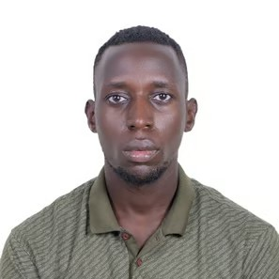
Our team
Nakalembe Sarah
social science researcher
Firoko Henry
Field Officer
Matovu Umar
Executive Director
Kintu Sharot
Social worker
Jjuuko Vicent
Social science researcher

Slide 4

Presentation Outline
Introduction
Objectives
Research
Results
Recommendations
Presentation Title

Slide 5
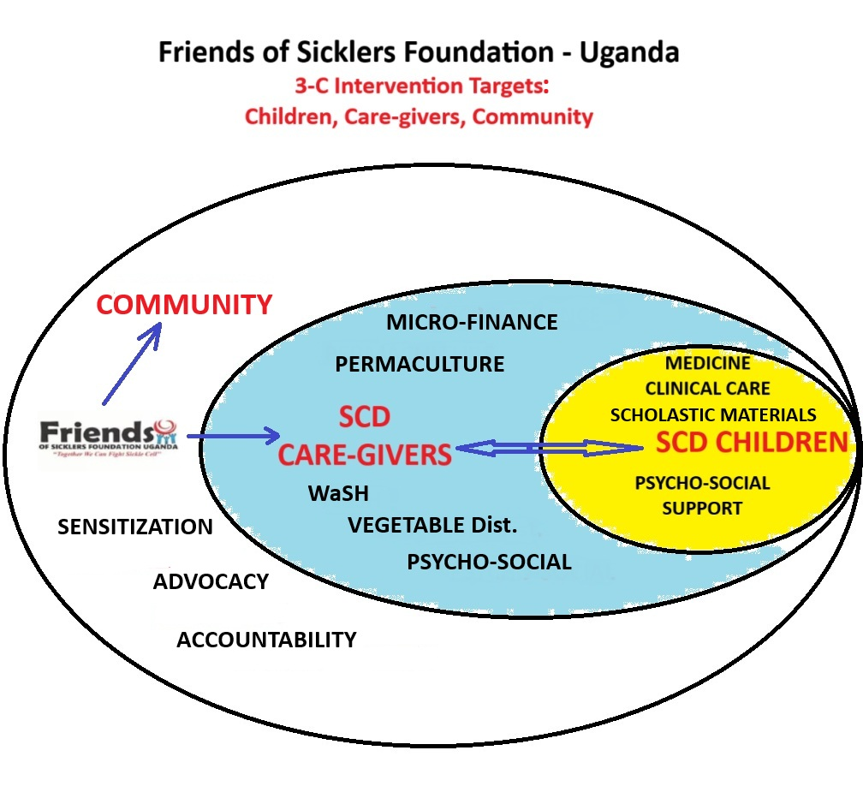
Introduction
Friends of Sicklers Foundation-Uganda founded in 2020, operates on the 3-C intervention targets. The Child, Care-giver and the Community.

Slide 6
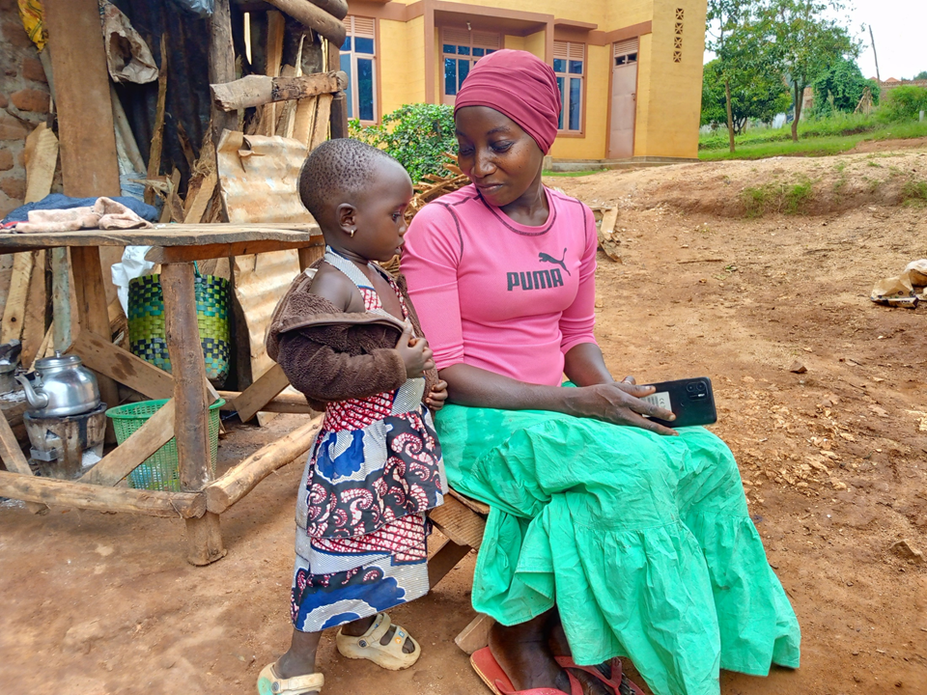
RESEARCH
RESEARCH ETHICS APPROVAL
was granted by:
Internal Research Board (IRB) at Makerere University
School of Social Science Ethics Review Committee
September 2024
Uganda National Council for Science and Technology (UNCST)
February 2025

Slide 7
What are we missing in our integrated suite of supportive programmes
for SCD care-givers?
We Conducted a qualitative / ethnographic research study
to elicit the experiential stories of SCD care-givers.
A quantitative study (e.g. survey format) would simply test a prior hypotheses:
Our ethnographic research permitted us to elicit problemes associated with SCD care-giver’s life-experience.

Slide 8
Study Objectives
Objective one
Objective two
Objective three
Objective four
To document the life experience of SCD care-givers.
To assess the social-cultural risks associated with this care.
To identify unrecognized needs of SCD care-givers.
To identify instances of gender-based violence (GBV) associated with SCD care-giver’s experiences.

Slide 9

Study population
Category of respondents | Method of data collection | No. of respondents
Parents/ care-takers of children with SCD. | In-depth interviews | 30
Health worker at HC-3 Village Health Team (VHT) Women at Local Council Executives Religious Leaders | Key informant interviews | 5
Parents/care-takers with other people in the community. | Focus Group Discussions | 30
Total |  | 65

Slide 10
Probe Questions
What social factors influence the role and the performance of care-giver in the home and the community?
Does having a child with SCD have any association with experiences of GBV in the household and/or the community?
How can SCD care-takers be assisted and supported?
What are the daily experiences of being a care-giver / parent of a SCD child?
What challenges exist in providing this care?
What are the common beliefs about SCD in the community?

Slide 11
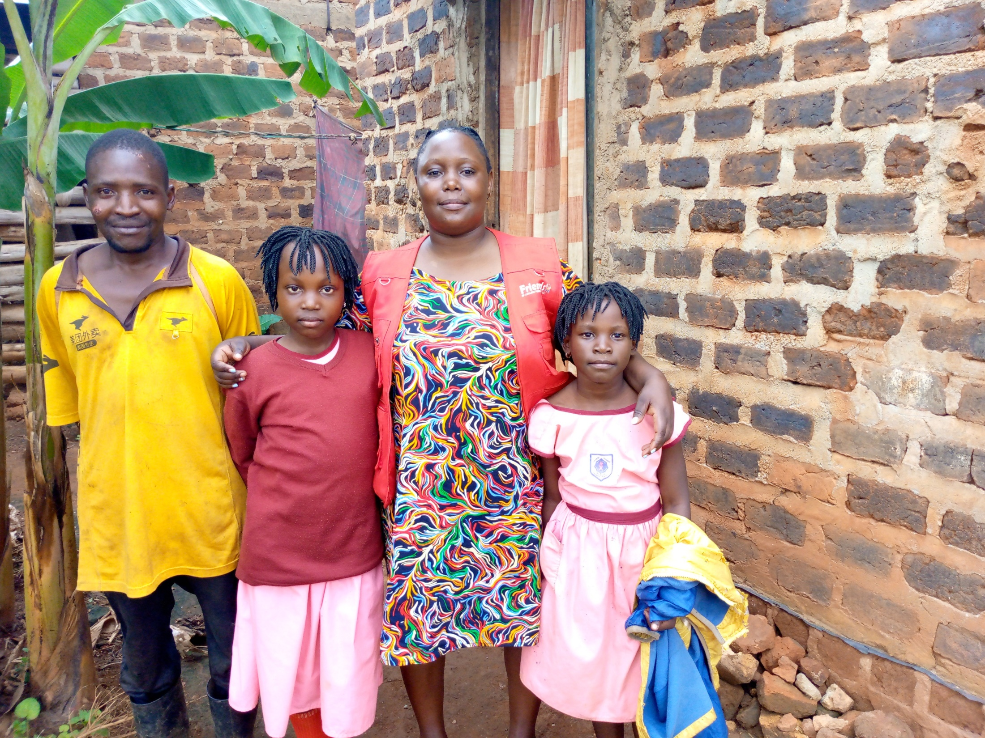

Slide 12
RESULTS
The research findings exposed troubling social-cultural misunderstandings, as well as moral dilemmas
experienced by SCD care-givers
High degree of social stigma attributed to SCD children
Mothers who bear SCD children are socially shamed
Biological fathers of SCD children accuse the mothers
for having a SCD child, which often results in:

Slide 13
Fathers abandoning the family and marrying another woman
Mothers of SCD children are left emotionally scarred
and financially deprived
Culturally-influenced masculinity norms and roles –
associated with GBV expression --
    are legitimized in the context of
    prescribed social-cultural norms
  The patronizing dominance of a male-centred and
  authoritarian mind-set, resulting in abusive behaviours is prevalent

Slide 14
Findings in relation to respondents

Slide 15
Moral Dilemmas
Is it food or medicines today – I cannot afford both?
Can one challenge male / father’s role responsibilities with respect to
caring for a SCD child -- a consequence of both the father and the mother?
If so, how would one entertain such a challenge / confrontation?
Will faith leaders, government officials, and/or community leaders
come alongside and help resolve these moral predicaments?

Slide 16
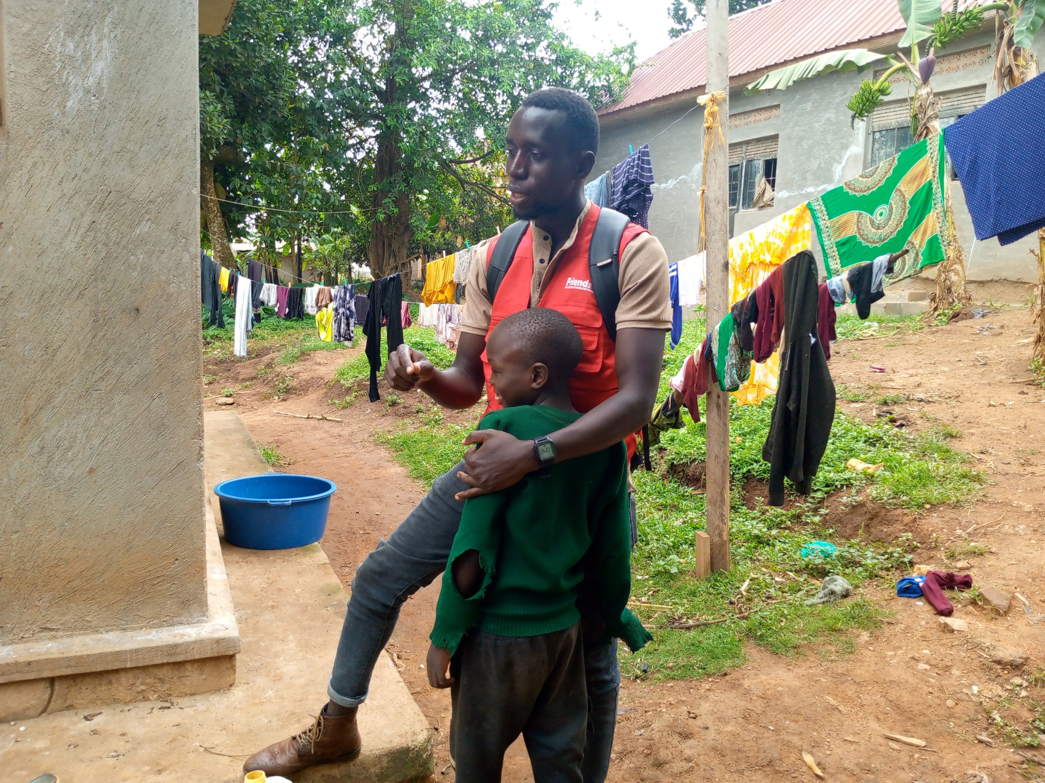

Slide 17
RECOMMENDATIONS
Food, nutrition and medicine
More studies
Entrepreneurial and vocational skills
Advocacy
Stigma is often associated with the appearance of a SCD child.
A nutritious diet provided, in addition to medication
would reduce concerns of stigma associated with
physical appearance of SCD child.
If ARV’s are free and accessible in all Government facilities,
why can’t Hydroxyurea be free?
More research is needed to:
elicit the social-cultural misunderstandings
associated with SCD disease
Ethnographic / qualitative research would generate grounded,
real-world evidence that could be translated into the
design, dissemination and evaluation of:
mind-set and behavioral change interventions
that would overcome existing barriers to
effective and meaningful support for SCD care-givers
Sickle-cell disease (SCD) Awareness
Community sensitization
Main-stream educational options are often out of reach and unattainable
for SCD children

Slide 18
Recommendations
Non-clinical care / psycho-social support
Early childhood development (ECD)
Marriage counseling and workshops
SCD children sessions
SCD care-givers / parents require more robust
psycho-social support, regardless of their financial circumstance
More ECD opportunities would enhance
cognitive growth and enhanced development for SCD children
Parents of SCD children
would benefit from marriage counseling to resolve
care-giving predicaments, challenges and unnecessary compromise
Special supportive care and educational sessions for SCD children
need to be organized
to enhance behavioral coping strategies in the community

Slide 19
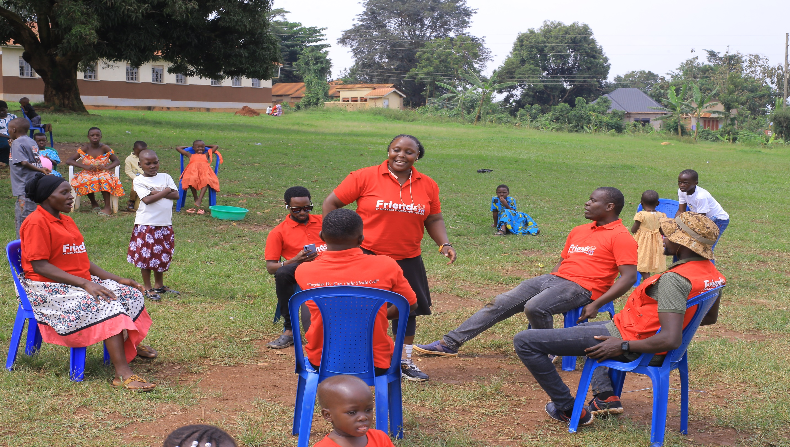

Slide 20
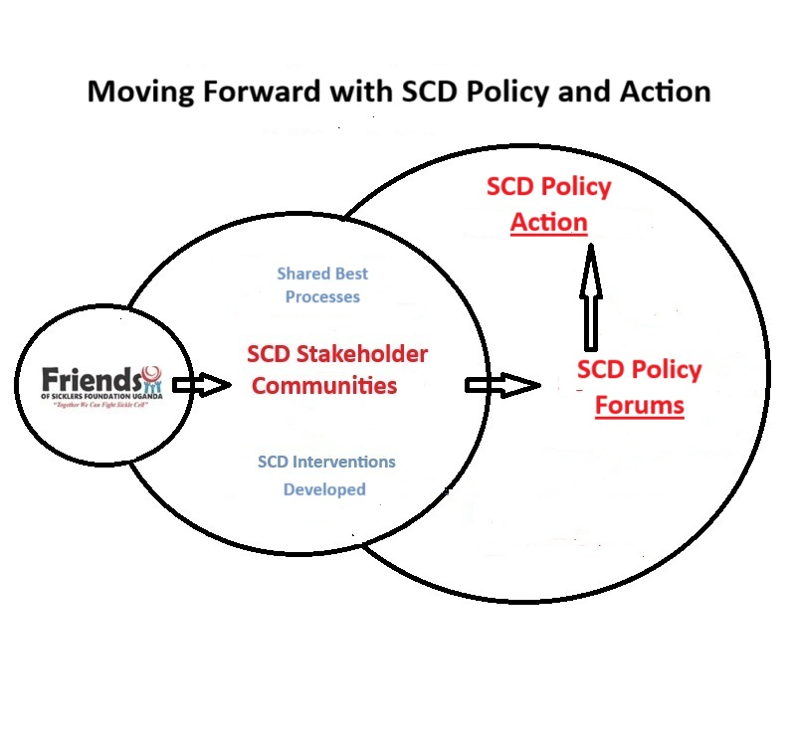

Slide 21
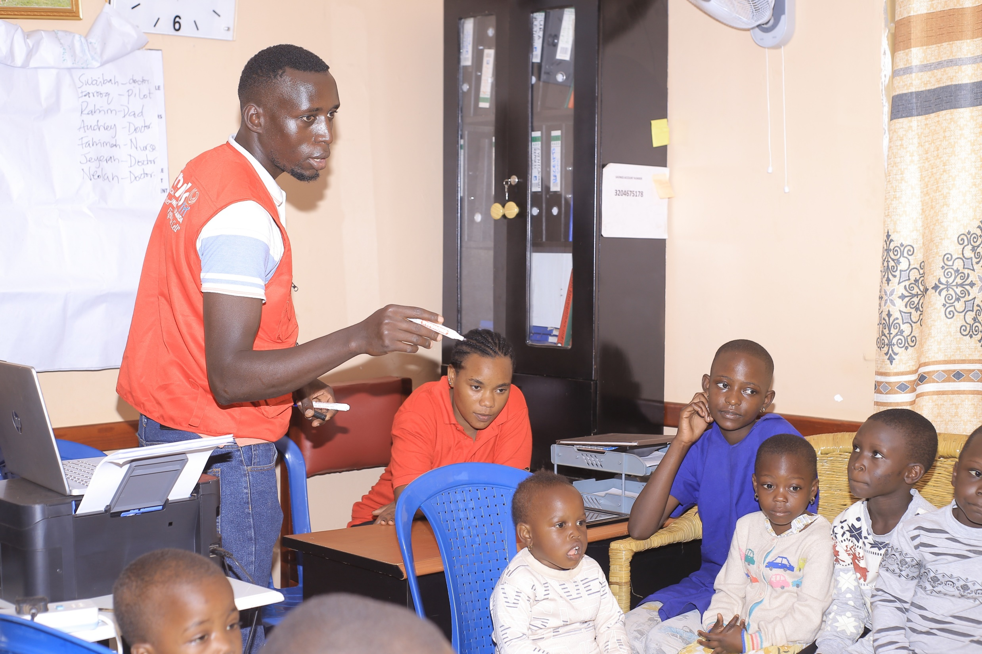

Slide 22






Contact us on
Email; friendsicklerfdnug@gmail.com
Website; friendsofsicklersfoundationuganda.org
Tel; 03931028816
+256 701974283 (WhatsApp)
Location; Kassegejje- Wakiso
Kampala Uganda.

