Slide 1

Presented by Dr. Ashish Mandlik Founder and Project Manager

Slide 2
Building Sustainable Nation
by converting Bio-Waste to Organic Fertilizer

Slide 3
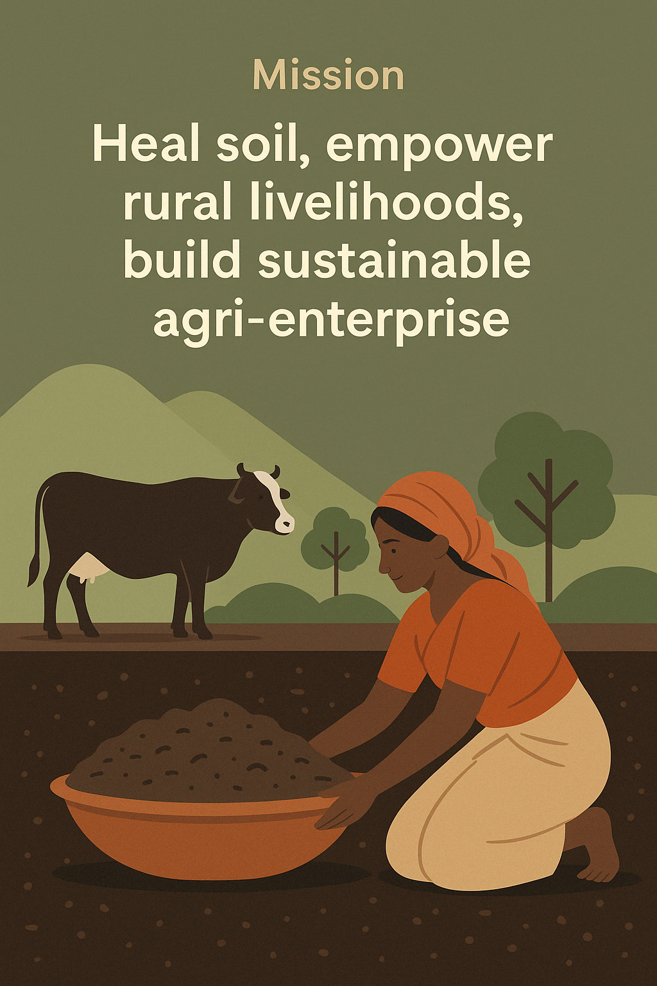
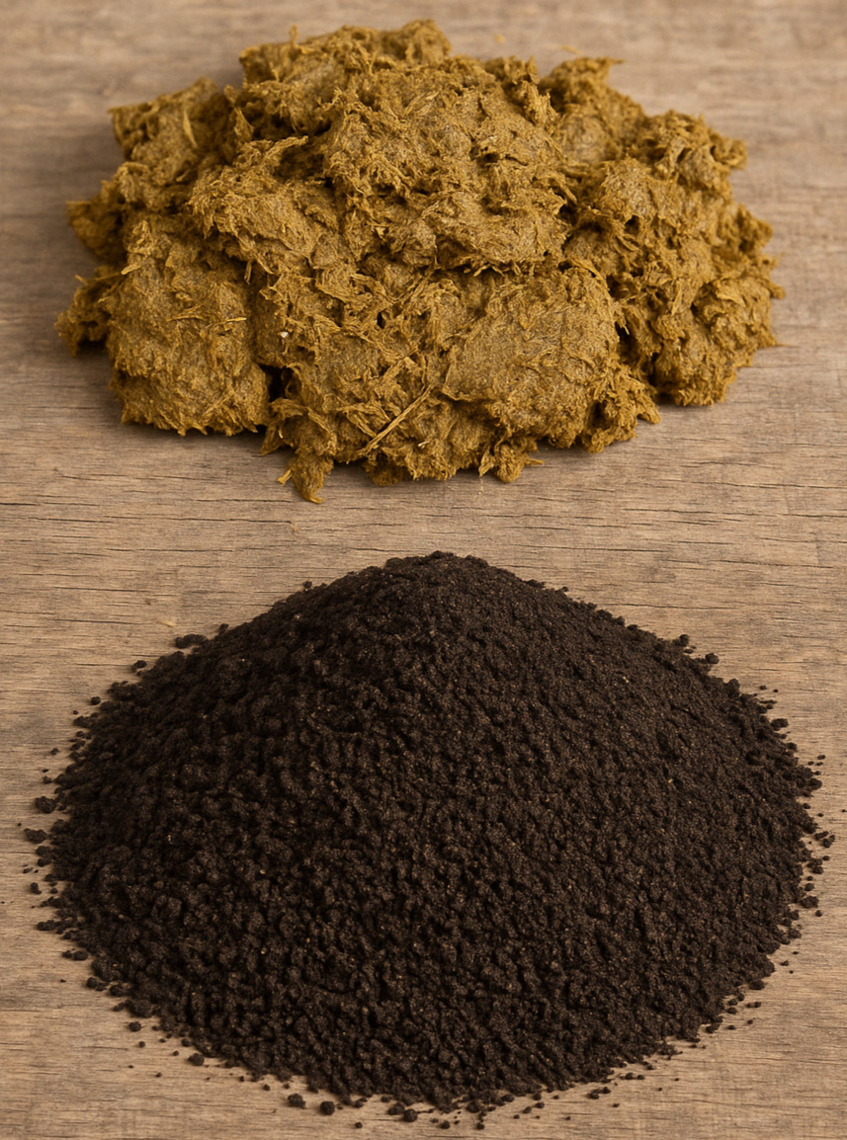
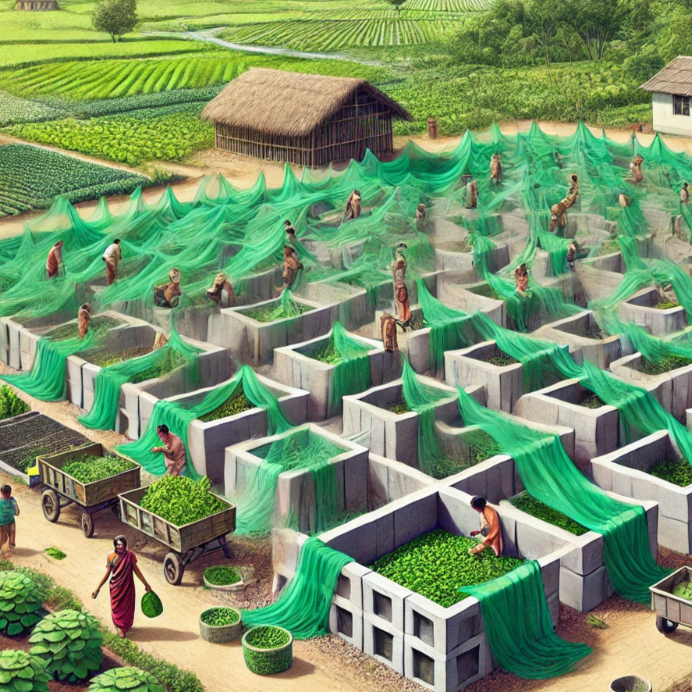

Introduction
Introducing "The Soil Generation Project"
Scalable, innovative vermicomposting system
Converts cow dung and organic waste into Organic Fertilizers

Slide 4
02
Problem – India’s Soil is Dying While Organic Waste is Wasted

Slide 5

Dual Crisis
30% of Indian land degraded (ISRO, Ministry of Agriculture)
Organic waste rotting in landfills, releasing methane, polluting rivers, harming health
Chemical fertilizers poisoning soils annually
Agricultural productivity crisis, public health challenge, missed billion- dollar opportunity
Unmanaged cow dung in villages

Slide 6
03
Solution – The Bhumikund Vermicomposting System: Engineered Regeneration

Slide 7
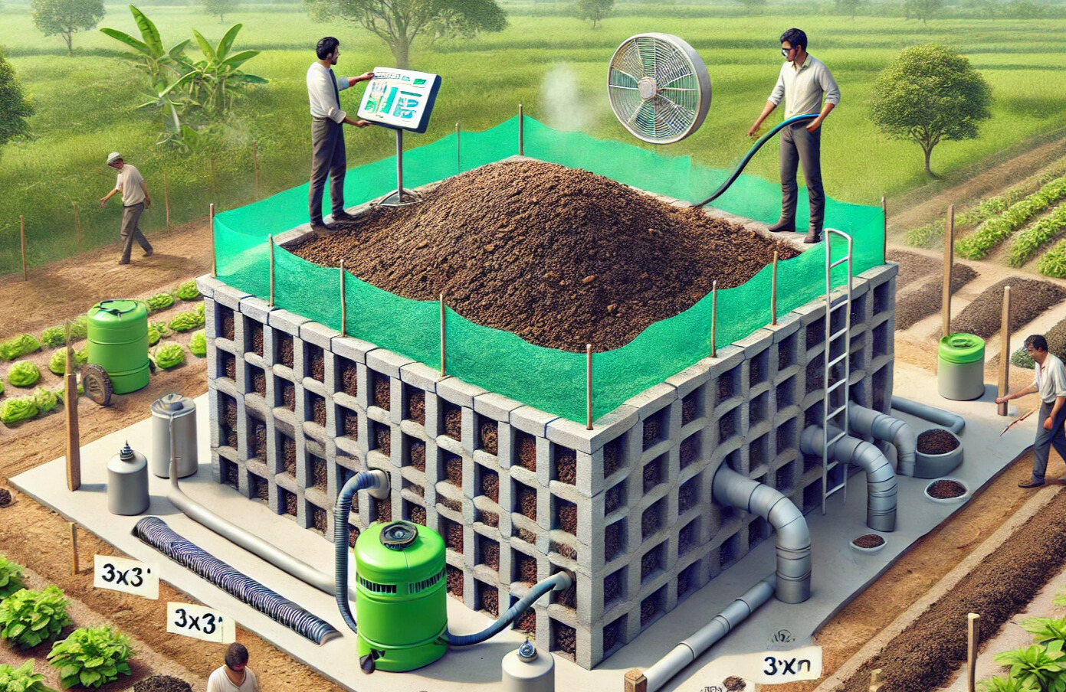
Bhumikund Vermicomposting System
Compact, climate controlled, 2- stage vermicomposting unit
Measures 3m x 3m, processes 7,700 kg organic waste
Integrates smart aeration, drainage, fogger, sensor- based monitoring (temperature, pH, humidity)
Built using Shivana 3D Interlocking Bricks (mortarless, reusable, eco- friendly)
Produces vermicompost and vermi- wash
Modular, scalable, replicable

Slide 8
04
Market Opportunity – Regenerative Agri is the Next Green Gold

Slide 9
Market Scope
Target Markets GLOBAL
INDIA
Initial target SOM ₹12 Cr via direct sales, FPOs, export channels in Gujarat and Rajasthan
India TAM ₹1200 Cr organic fertilizer market SAM ₹700 Cr from 10 high- agri states
Export demand UAE, EU, Southeast Asia, UK
Global TAM $360M vermicompost market (2025 est.), $12.5B+ organic food & input market

Slide 10
05
Product Demonstration – From Prototype to Production-Ready

Slide 11
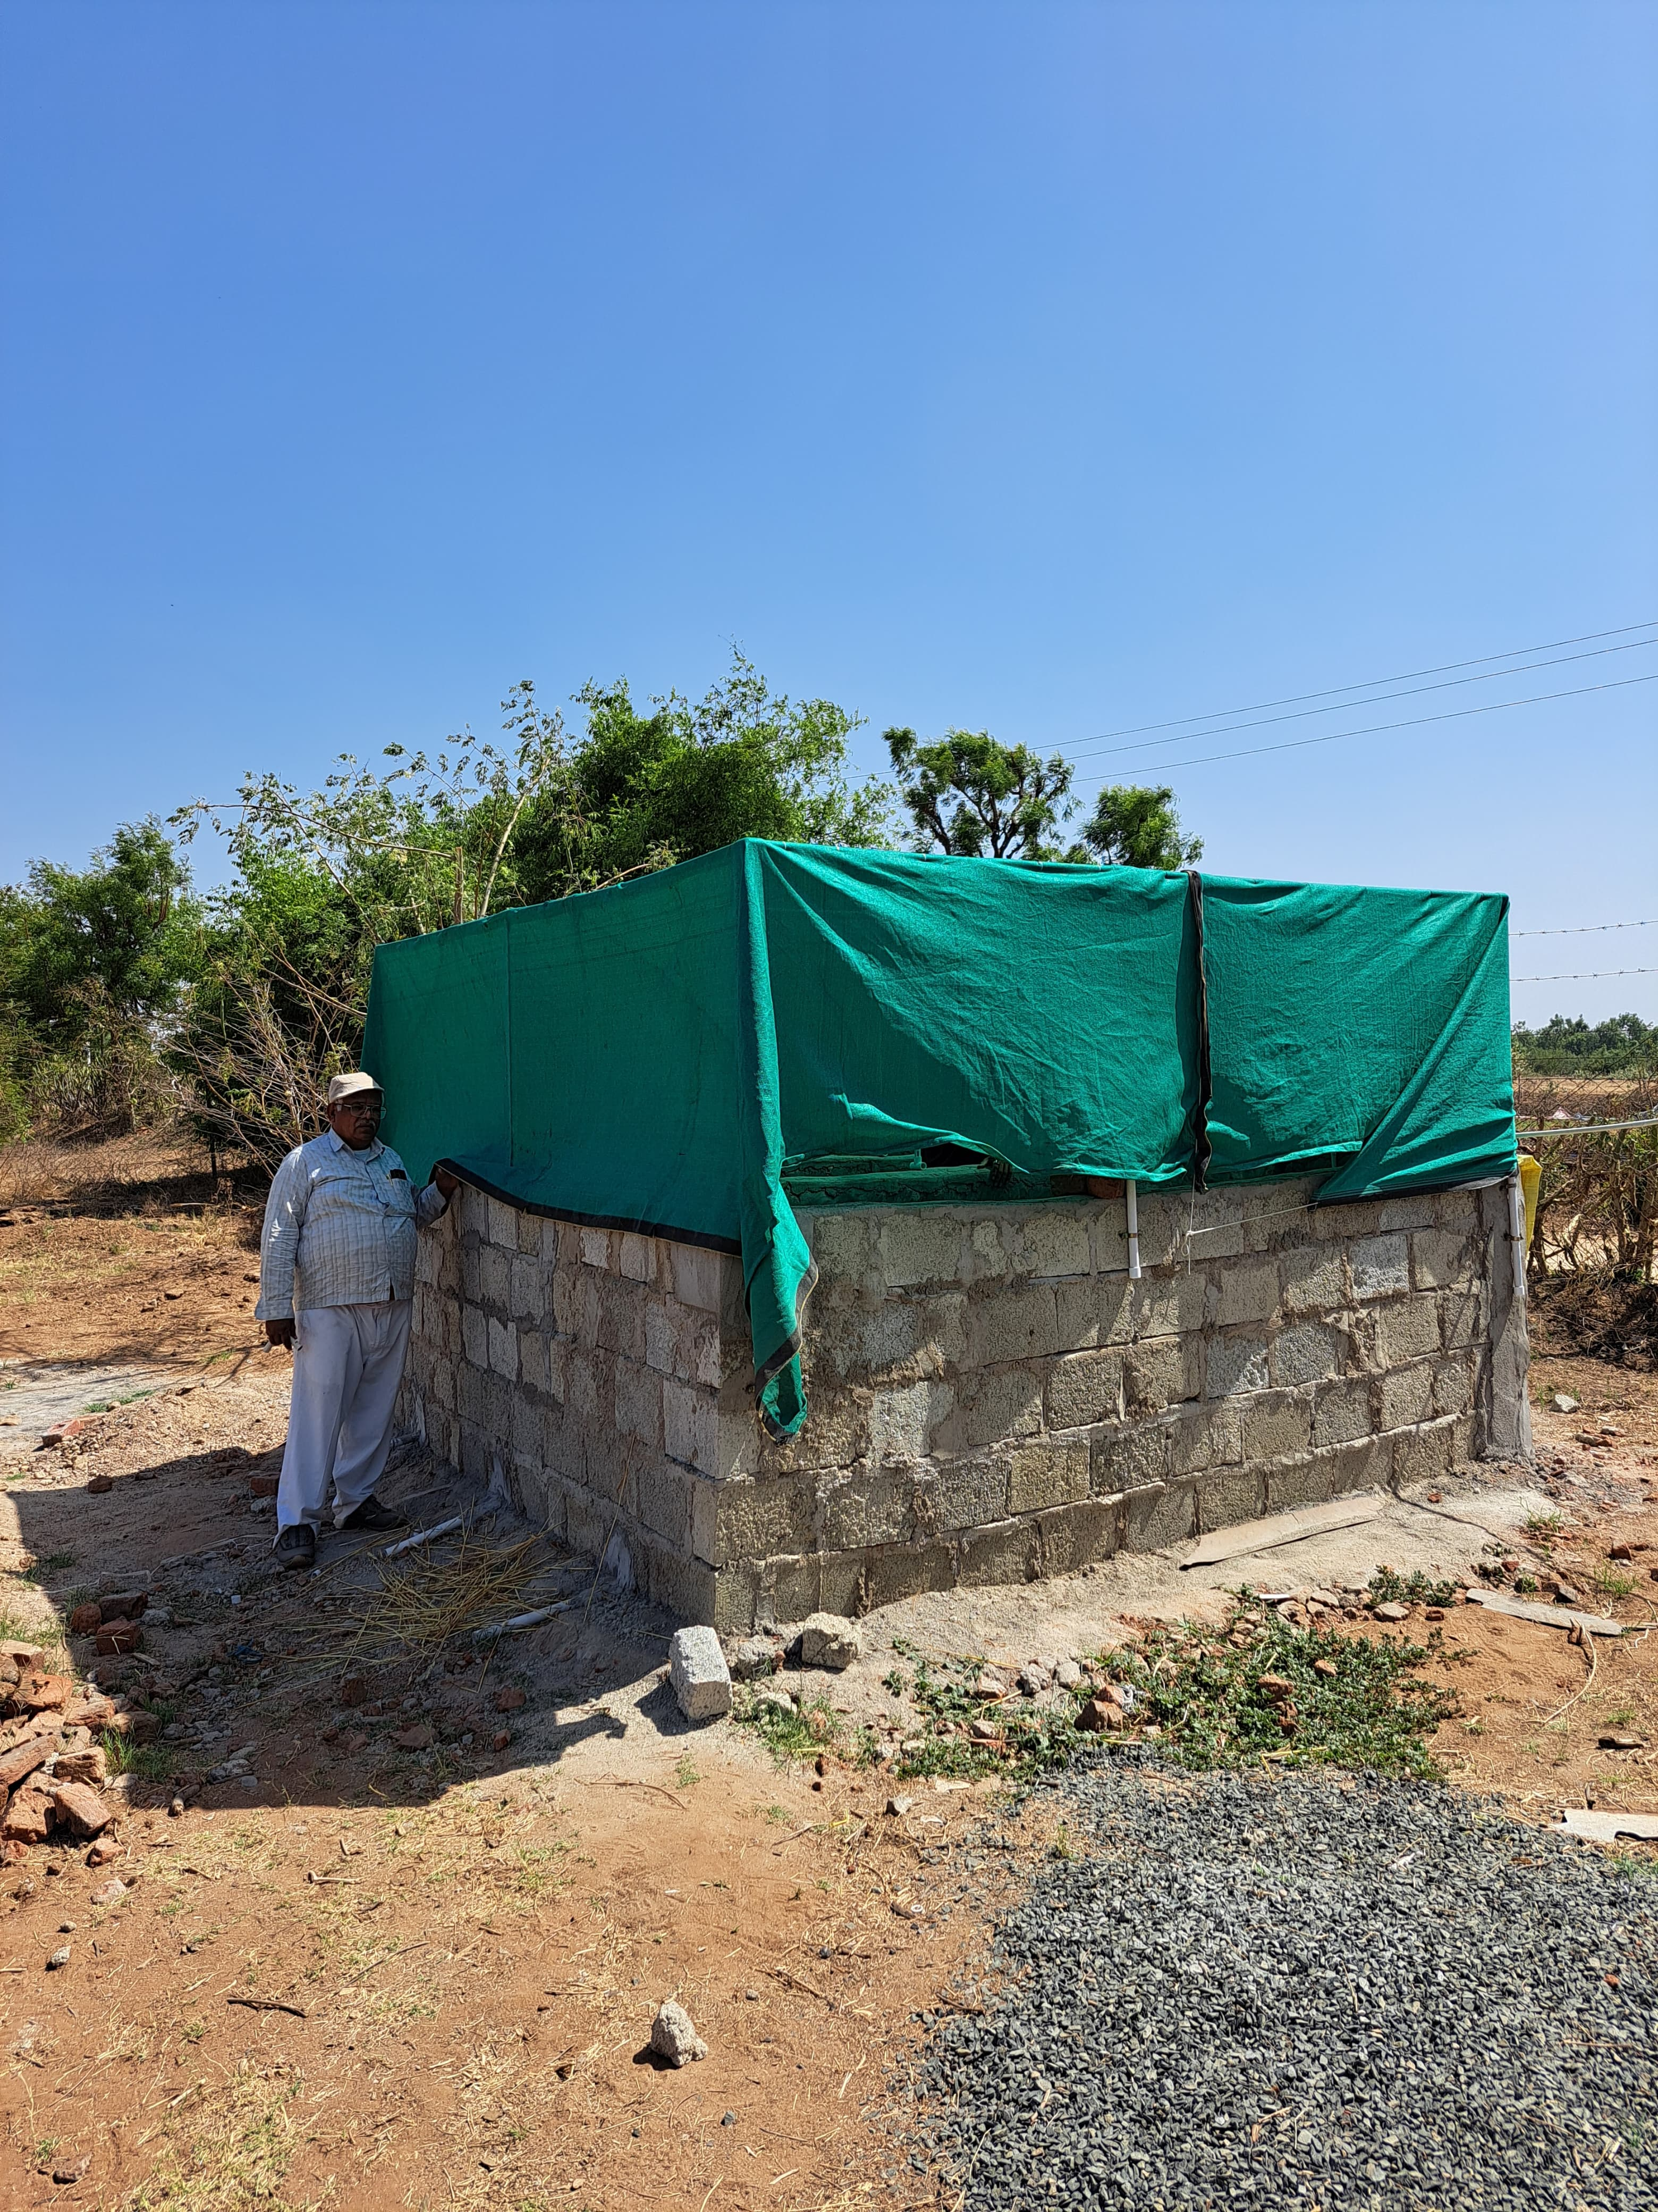
Bhumikund Vermicomposting system PROTOTYPE Testing
3x3x2 cu.m: 3 tonn in 1 cycle production capacity
First unit LIVE in Gandhinagar
Field- tested for strength, speed, yield
Open for investors to observe functionality
Efficient land area utilization, faster cycle turnaround, higher output quality

Slide 12
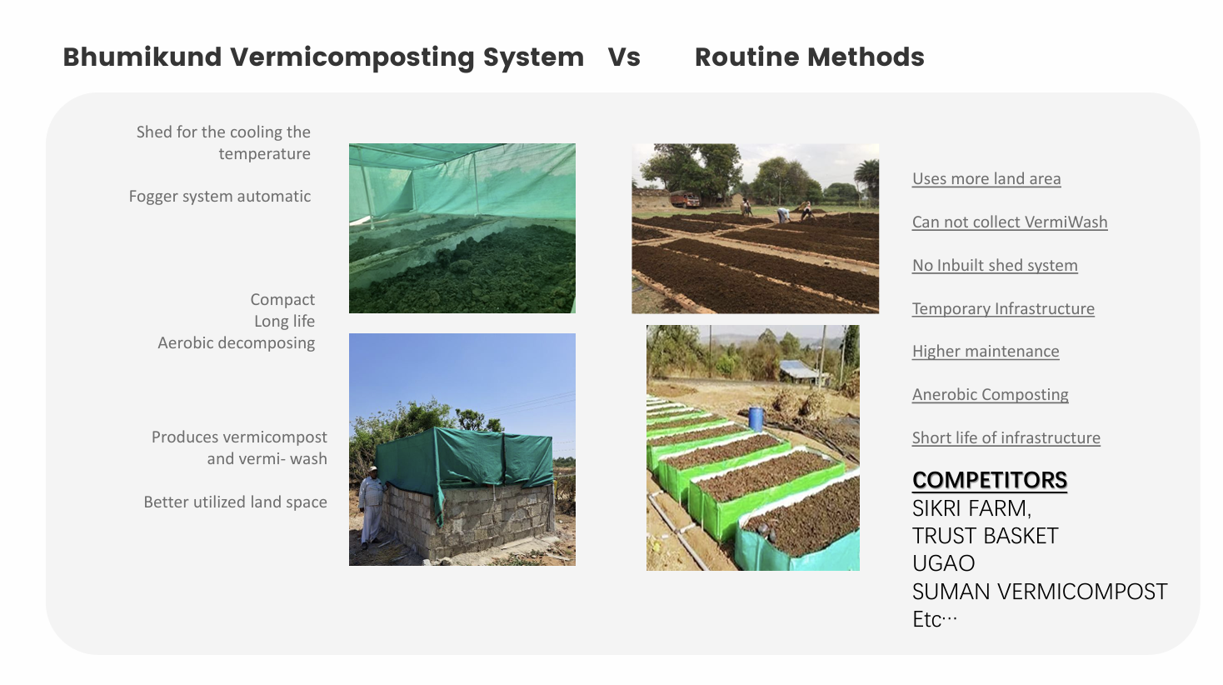

Slide 13
06
Traction & Milestones – Built to Scale

Slide 14
Achievements
100- unit layout mapped = ₹1.2 Cr annual revenue
Packaging, pricing, supply chains, SOPs in place
Export channels activated (Global Business for Sure, IndiaMart)
Prototype deployed and tested
Key Milestones

Slide 15
07
Business Model & Financials – Built for Speed

Slide 16
Revenue Model
Financial Snapshot (Year 1, 100 Bhumikunds)
01
Vermicompost @ ₹10/kg
05
Capex₹78.35 L
02
Vermi- wash @ ₹30/liter
06
OPEX (1st cycle only)₹21.65 L
03
Direct- to- farm, nursery sales, B2B bulk orders
07
Gross Margin~48%
04
Revenue (annual)₹1.21 Cr
08
Project Breakeven 18 months
09
Scaling Model Add units Replicate site

Slide 17
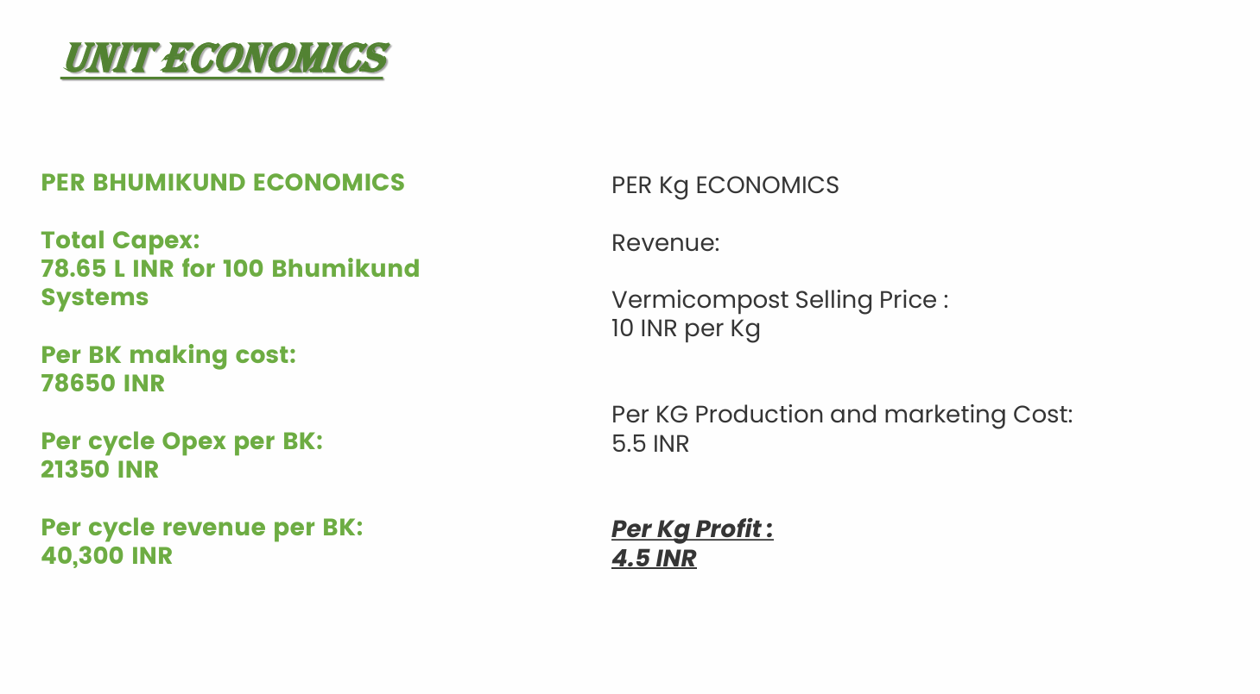

Slide 18
08
Go-to-Market Strategy – Deep Roots, Wide Reach

Slide 19


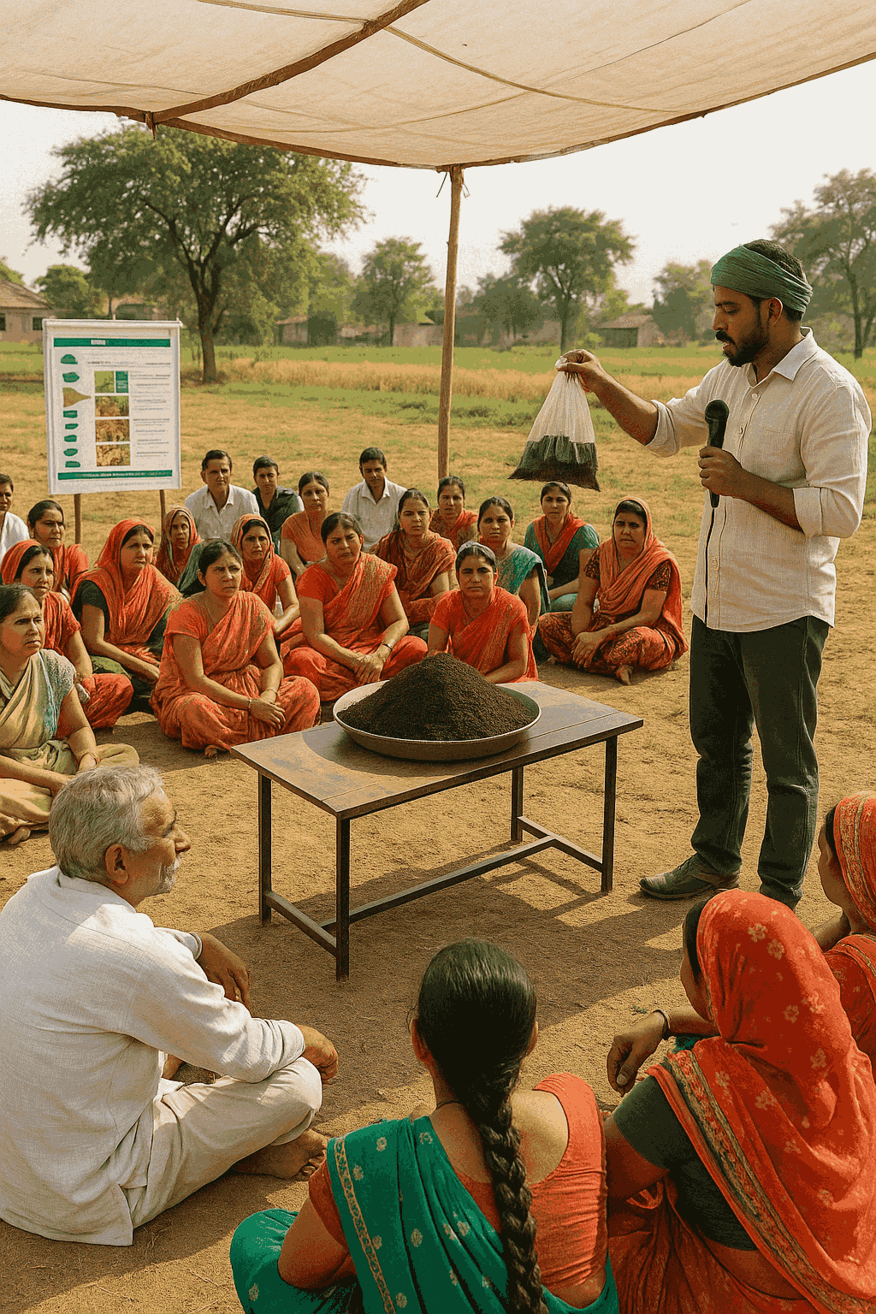

Outreach Strategies
Grassroots Outreach village events, live demos, samples, Q&A booths
Digital Marketing 3- month campaigns target organic farmers, nurseries, garden stores
Domestic & Global market Penetration by
Target global regions
Marketing Budget₹3.62 lakh for 1st cycle

Slide 20
09
Use of Funds – ₹1 Cr for Self-Sustaining Launch

Slide 21
Fund Allocation
Bhumikund Units (100)₹33.35 L
Infrastructure, Shredder, Containers ₹10.00 L
Total Ask is 1Cr
Type here...
Shivana Brick Machine 25.00 L
OPEX for Cycle 1₹21.65 L
Electric+CNG Vehicles: ₹10.00 L
Marketing cost for first cycle 3.62 lakh already added in opex

Slide 22
10
Team – Inventors with Execution Grit

Slide 23
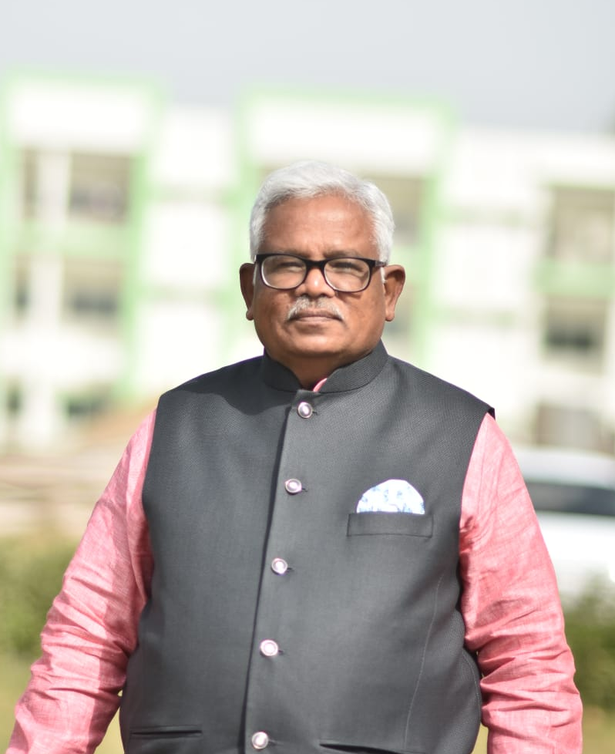
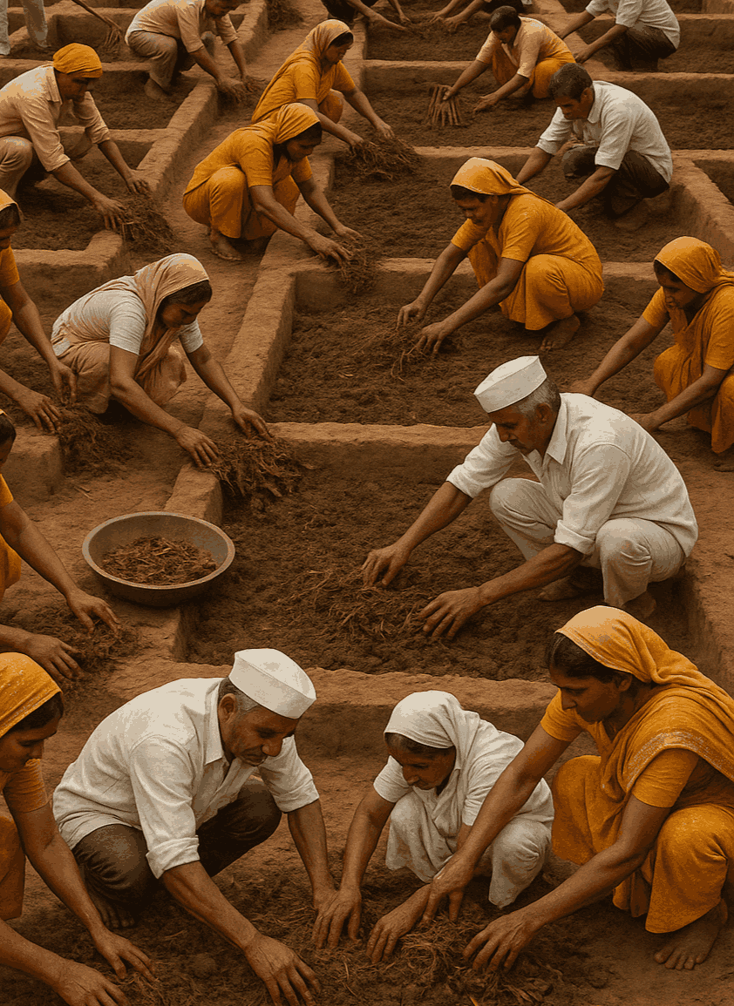

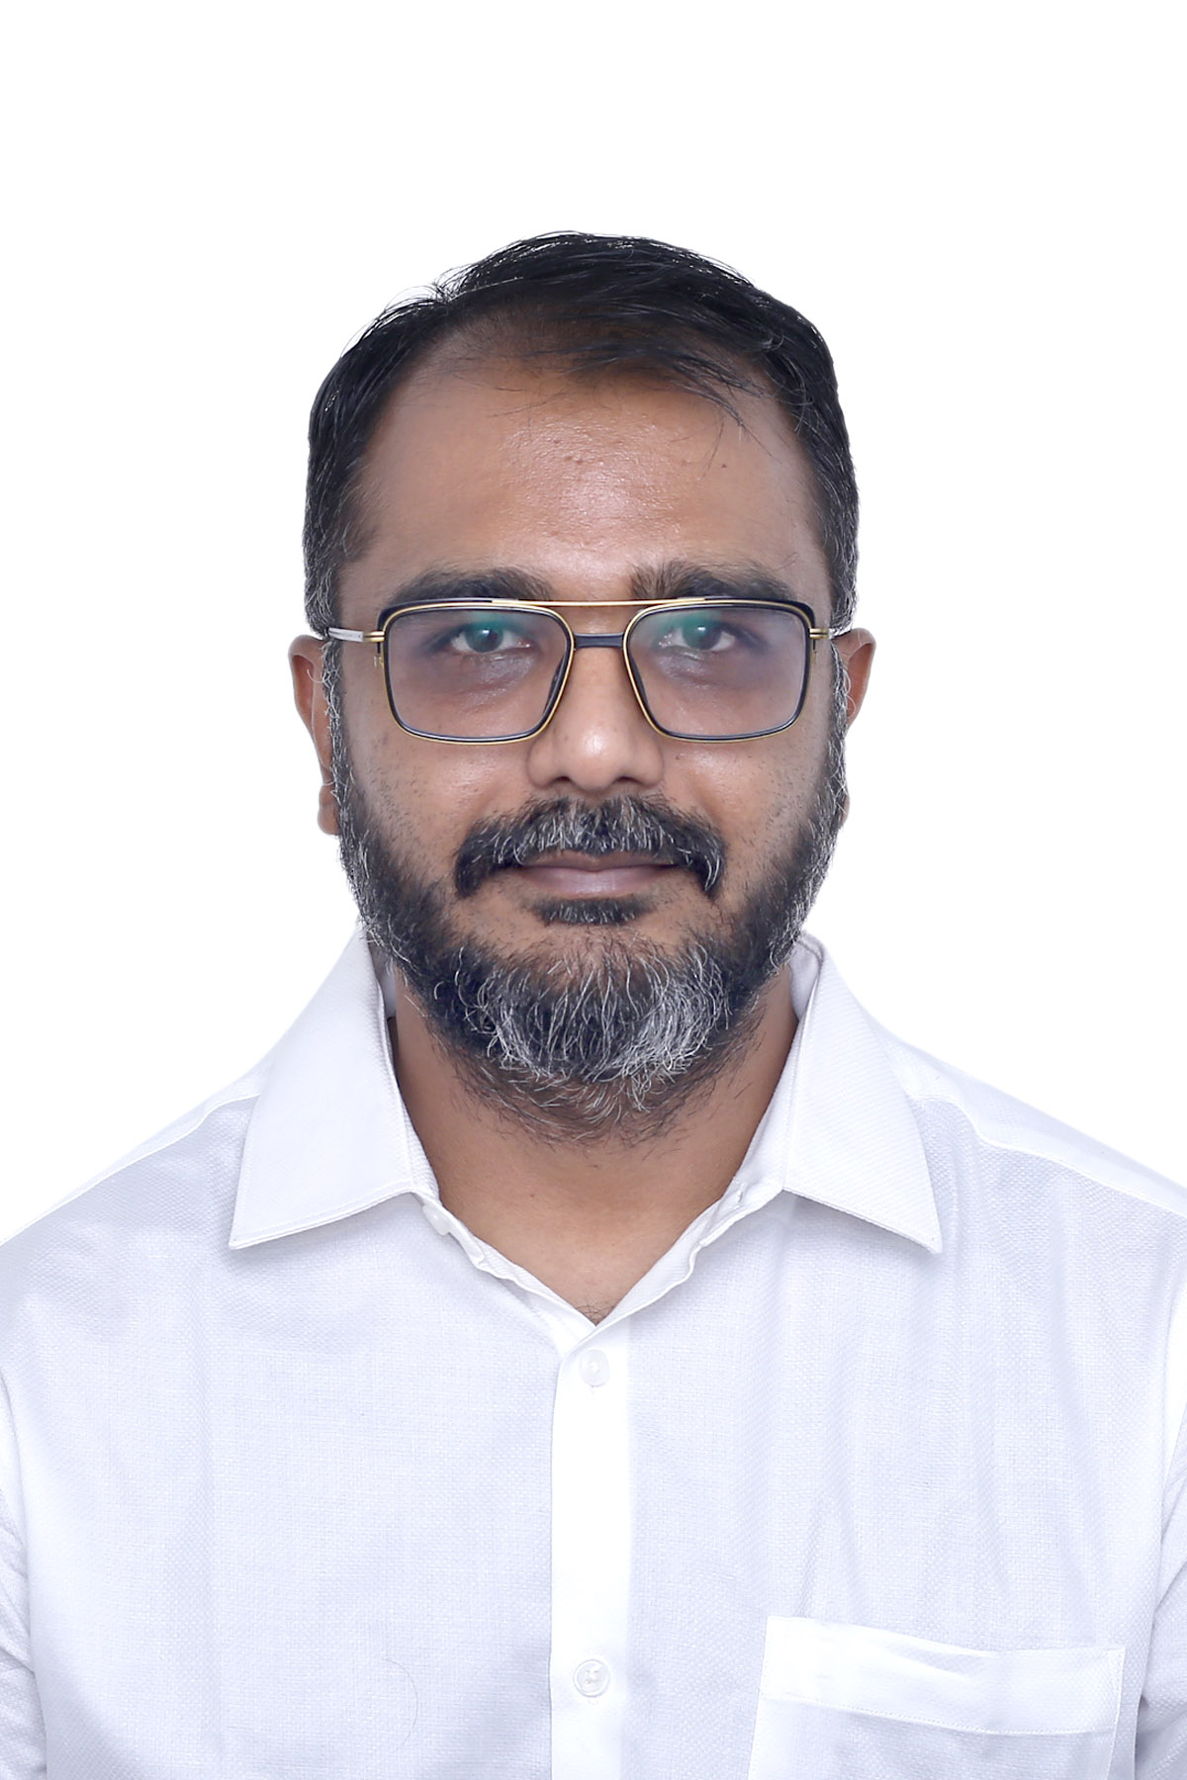
Dr. Dhaval Mandlik - Director, Advisor, Medical Director
Jayantibhai Mandlik – Chairman & Director
15+ Karmyogis per site
Dr. Ashish Mandlik – Innovator of Bhumikund, MD Pathology, MBA Innovation, Farmer
Supported by Mandlik Brotherhood of our Village Mandali

Slide 24
11
Impact – Regenerate Soil, Empower Farmers, Heal the Planet

Slide 25
Project Benefits
Jobs 15+ full- time per site + indirect opportunities
Organic Waste 7.7 tonns processed per BK
Key Impact Areas
Organic Farming Boost Supports FPOs, export- grade farms
Climate Reduces methane, improves soil carbon
Alignment with SDGs 2 (Zero Hunger) 12 (Responsible Consumption) 15 (Life on Land)

Slide 26

Movement Initiation
Convert waste into wealth, revive broken land
Empower rural youth as earth warriors
Build a regenerative India with ₹1 Cr
Project Vision

Slide 27
13
Growth Planning – Built to Replicate, Scale, and Lead

Slide 28
Trajectory Overview
2032 Integrate Carbon Credit markets +₹10 Cr/year
2031 Franchise Bhumikund model - ₹50 Cr+
2030 Launch global exports to UAE, Malaysia, UK - ₹25 Cr+
2026 Launch 1 unit (100 Bhumikunds) - ₹1.2 Cr
2029 Expand to 10 units in 5 districts - ₹12–15 Cr

Slide 29
Thanks
Edited by Simba King

