Slide 1
Remote Monitoring System (RMS) Draft Guidelines – 2025

Slide 2
Introduction
The Remote Monitoring System (RMS) is a smart data acquisition and communication system designed to monitor, record, and control the performance of grid-connected solar power plants in real time.
It connects inverters, meters, and data loggers to a Centralized IoT Platform, ensuring seamless and secure data exchange across the solar ecosystem.

Slide 3
Overview of RMS Guidelines
Defines communication, security, and interoperability standards for RMS devices.
Ensures seamless data exchange with the Centralized IoT Platform under PM Surya Ghar: Muft Bijli Yojana.
Covers inverter, energy meter, DAQ, and other field device data formats in JSON structure.
Applicable to vendors, system integrators, and DISCOM-linked monitoring portals.

Slide 4
Why RMS Matters
Enables centralized performance visibility
Detects faults remotely
Supports standardization across OEMs
Data-driven decision making

Slide 5
RMS Communication & Security Architecture

Slide 6
Security Architecture
Communication security architecture between RMS and CENTRALISED IoT Platform.
TLS(Transport Layer Security)/SSL(Secure Sockets Layer)-based encrypted communication for confidentiality and integrity.
AES-256 encryption with Private VPN for secure data transfer.
Two-factor validation using client certificate and OTP for each message.
Prevents data sniffing, unauthorized access, and MITM(Man in the middle) attacks.

Slide 7
RMS Registration Process
Vendors register RMS devices using IMEI via the Centralized IoT Platform API.
Platform issues client certificate, username, password, and connection details.
RMS authenticates and downloads configuration (FTP credentials, topic structure).
Automatic renewal of certificates via FTP post-expiry.

Slide 8
Message Queuing Telemetry Transport (MQTT)
Purpose: A lightweight messaging protocol designed for resource-constrained devices (IoT) and networks with low bandwidth.
Architecture: Publish/Subscribe
Publisher: Sends data (message) to a named Topic.
Subscriber: Receives messages by registering interest in a Topic.
Broker (Server): The central hub. Decouples the Publisher and Subscriber, handling message routing and filtering.
Key Advantage: Publishers and Subscribers never need to know each other's network addresses, offering massive scalability and flexibility.

Slide 9
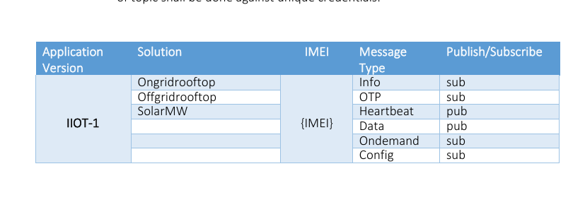
MQTT Topic Structure

Slide 10
Communication Modes
Push on Periodic Interval – Regular data transmission (e.g., inverter every 5 mins).
Push on Event – Sends alerts/faults in real time.
On Demand Read/Write– Remote command and feedback exchange.
Configuration Read/Write – Change RMS settings remotely (intervals, alarms).

Slide 11
Communication Protocol
RMS ↔ Field Devices
Devices: Inverter, MFT/MFM, Data Acquisition System
Protocol: MODBUS RTU
Widely supported by leading global manufacturers
RMS ↔ Energy Meters
Meters: Bidirectional (Revenue) Meter, Solar Generation (Audit) Meter
Protocol: DLMS / MODBUS
Supported by major Indian meter manufacturers

Slide 12
Communication Protocol(Cntd.)
RMS ↔ Server
Protocol: IEC 20922 (MQTT)
A globally accepted IoT protocol for
Smart Grid
Smart Renewable Energy (RE)
Smart City Applications
Supported by leading IT & OT companies

Slide 13
JSON
The Universal Data Structure JavaScript Object Notation (JSON)
Role in MQTT: While MQTT handles the transport, JSON handles the payload (the actual data).
Lightweight format to store and exchange data
Human-Readable: Simple key-value pairs make it easy to debug and read.
Language Agnostic: Easily parsed and generated by almost all modern programming languages.

Slide 14
MQTT + JSON Synergy in the IoT
The Perfect Partnership Efficiency: MQTT's 2-byte minimum header combined with JSON's compact data format ensures minimal network bandwidth consumption.
Interoperability: JSON provides a standardized format for complex data that can be immediately understood by any cloud platform, database, or analytics tool subscribing to the MQTT broker.
Real-World Application (RMS Guidelines):In a solar monitoring system, an Inverter's dongle uses MQTT to push lightweight telemetry messages. The payload is formatted in JSON (e.g., following the IS-10-2-3 field definitions from the guidelines) to ensure the Central Platform can correctly process the power and voltage readings.

Slide 15
Impact on Stakeholders
Stakeholder | Key Impacts
Inverter Manufactures | Must ensure compatibility with RMS using MODBUS RTU / MQTT protocols. • Need to include communication ports and firmware for data exchange. • Promote interoperability with multi-brand RMS platforms. • Require testing and certification to meet connectivity standards.
State DISCOMs | Gain real-time monitoring and control of distributed solar generation. • Enables data-driven grid management and accurate load forecasting. • Improves billing accuracy and fault detection. • Supports policy execution under schemes like PM Surya Ghar
Consumers | Access to real-time energy and solar generation data. • Improved service reliability through proactive monitoring. • Helps in optimizing inverter performance and maintenance. • Ensures regulatory compliance for solar system approval and incentives.

Slide 16
Before & After
Aspect | Before Implementation | After Implementation
Data Transmission Method | Inverters sent data through Wi-Fi or OEM dongles connected to manufacturer servers. | Data sent via M2M SIM-based communication units with secure mobile connectivity.
Data Storage Location | Data stored on OEM servers, many located outside India. | Data stored on India-based servers, managed under MNRE’s national platform.
Communication Protocols | Non-standard, brand-specific protocols used by different manufacturers. | Standardized protocols MQTT, Modbus, DLMS for all devices.
Data Security | Limited or inconsistent encryption; potential for data leakage via foreign servers. | Encrypted communication channels with strict cybersecurity controls.
System Integration | Fragmented, OEM-controlled systems without national coordination. | Unified national platform enabling interoperability across all inverter brands.
Cost Impact | Lower cost (simple Wi-Fi loggers, no SIM). | Slightly higher cost (M2M SIM devices, data plans) but more reliable and secure.
Cybersecurity Risk | High, due to foreign data routing and weak controls. | Low, with data localized and encrypted within India.

Slide 17
Scopes & Challenges
Scope | Challenges
1. Centralized national-level monitoring of rooftop solar systems through a unified IoT platform. | 1. Ensuring implementation and compliance from all vendors with new MQTT/JSON communication standards.
2. Secure data transfer using AES-256 encryption, TLS/SSL VPN, and OTP-based message authentication. | 2. Managing large-scale cybersecurity components like certificate renewals, OTP validation, and key security.
3. Standardized communication using MQTT and JSON ensures interoperability across all device types. | 3. Network connectivity issues in remote or rural areas affecting real-time data exchange.
4. Supports remote monitoring, over-the-air configuration updates, and on-demand control commands. | 4. High data volume from multiple sensors and devices requires scalable and efficient cloud infrastructure.
5. Unified data structure for inverters, meters, and weather sensors enables scalability and integration. | 5. Vendor coordination and interoperability testing required to prevent mismatched data formats.
6. Framework aligns with Smart Grid and AI-based future analytics applications. | 6. Maintenance challenges, data privacy, and ownership issues in centralized monitoring systems.

Slide 18
Thank You

