Slide 1
Critical media literacy – The role of media literacy in the struggle against fake news
Krisztina Nagy
Media in the Post-Truth World:
The New Marketplace of (Dis)information
November 2, 2017 – November 4, 2017 Prague

Slide 2
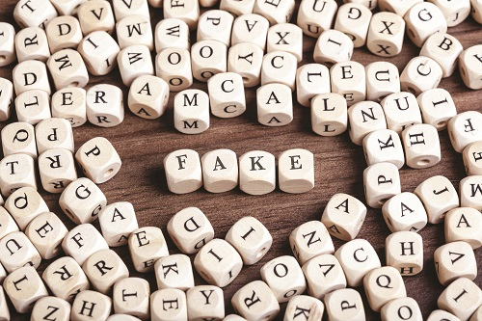
„When media regulation seems impossible, media literacy is often seen as the acceptable answer – and indeed a magical panacea – for all media-related social and psychological ills” (David Buckingham)

Slide 3
possibilities and boundaries of media education
contentual and methodological considerations
How does this work in practice?
„Dron”- teaching material

Slide 4
Media related reasons of the new dimension of the fake news phenomenon.
UGC
breakup of the previous gate keeper structure
rate of spreading

Slide 5
Pillars
need to be informed from multiple sources
Personal Locus
news literacy
„news factory”
operation of the digital media market
business models, algorithms, filter bubble
critical filtering skill
assess the credibility and reliability of the content
the standards of quality journalism
fake news

Slide 6
Boundaries
critical media literacy is embedded into the development of critical thinking
methodological challenges of teaching fact checking
shaping attitudes
danger of a blanket distrust – nihilism
propaganda

Slide 7
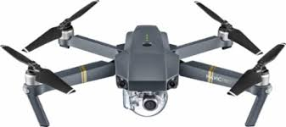
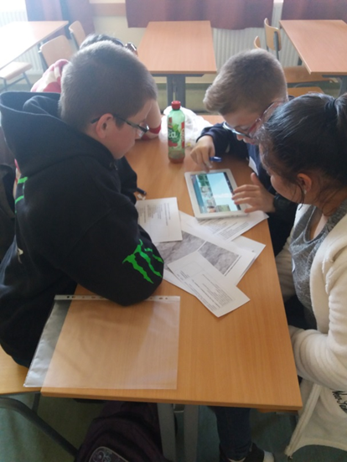
Drone program - teaching material for improving critical media literacy in middle and secondary school (11-18 years old students)
Televele Media Education Association
Open Society Foundations

Slide 8
Improving fact-checking skills
„Green woodpecker and the weasel”
Algorithms – filter bubble
role playing

Slide 9
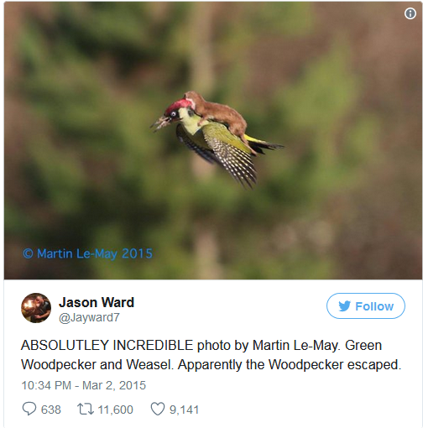
Fact-checking

Slide 10
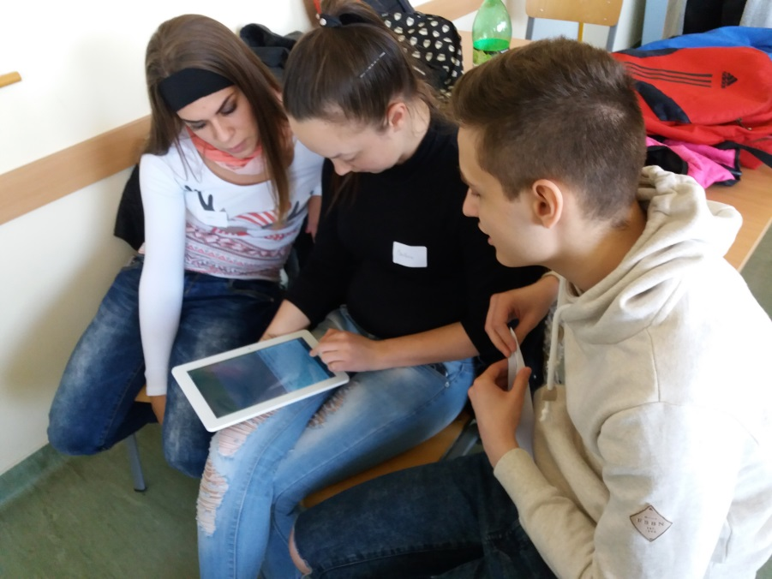
The goal of the exercise: Improving fact checking skills
Investigation in small groups : students work in groups and each group checks other aspects of the news story.
A group - habitat and physical qualities of the animals
B group – lifestyle of the animals
C group – credibility of the sources
and authors
D group – analyses the photo

Slide 11
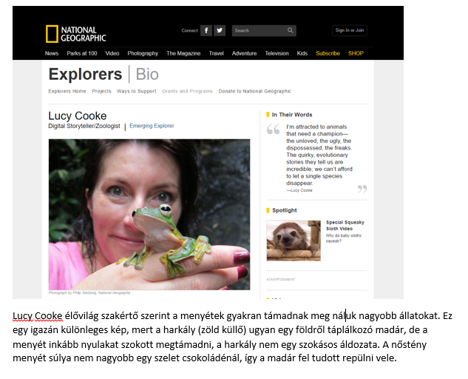
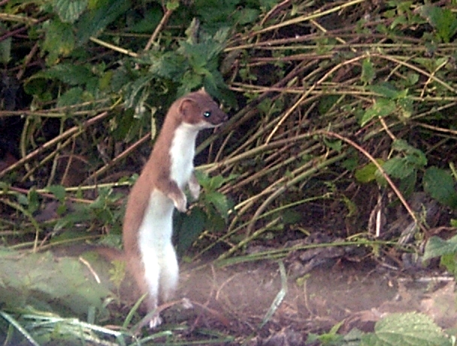
A menyét életmódja
A Wikipédiából, a szabad enciklopédiából
Az állat bátor és kíváncsi; túlnyomórészt éjjel vadászik és általában magányos. Tápláléka elsősorban pockok és egyéb egérfélék, madarak, tojások és üregi nyulak is. A nagy energiaveszteség kiegyenlítéséhez a menyétnek szinte állandóan vadásznia kell. Alapanyagcseréje igen magas.
A menyét tehát rengeteget portyázik. Ha lehetősége van arra, a menyét többet vadászik a kelleténél.
Ma már védett, bántalmazása törvénybe ütközik.

Slide 12
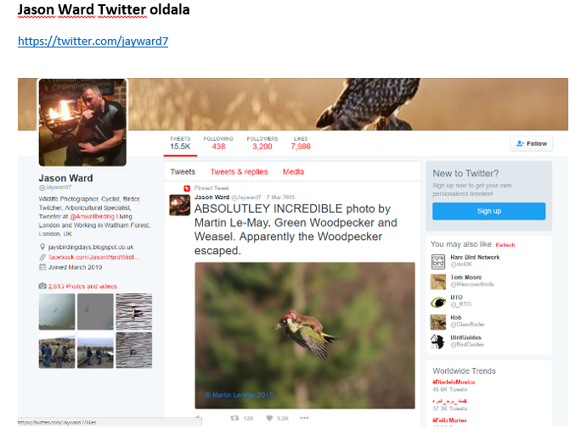

Slide 13
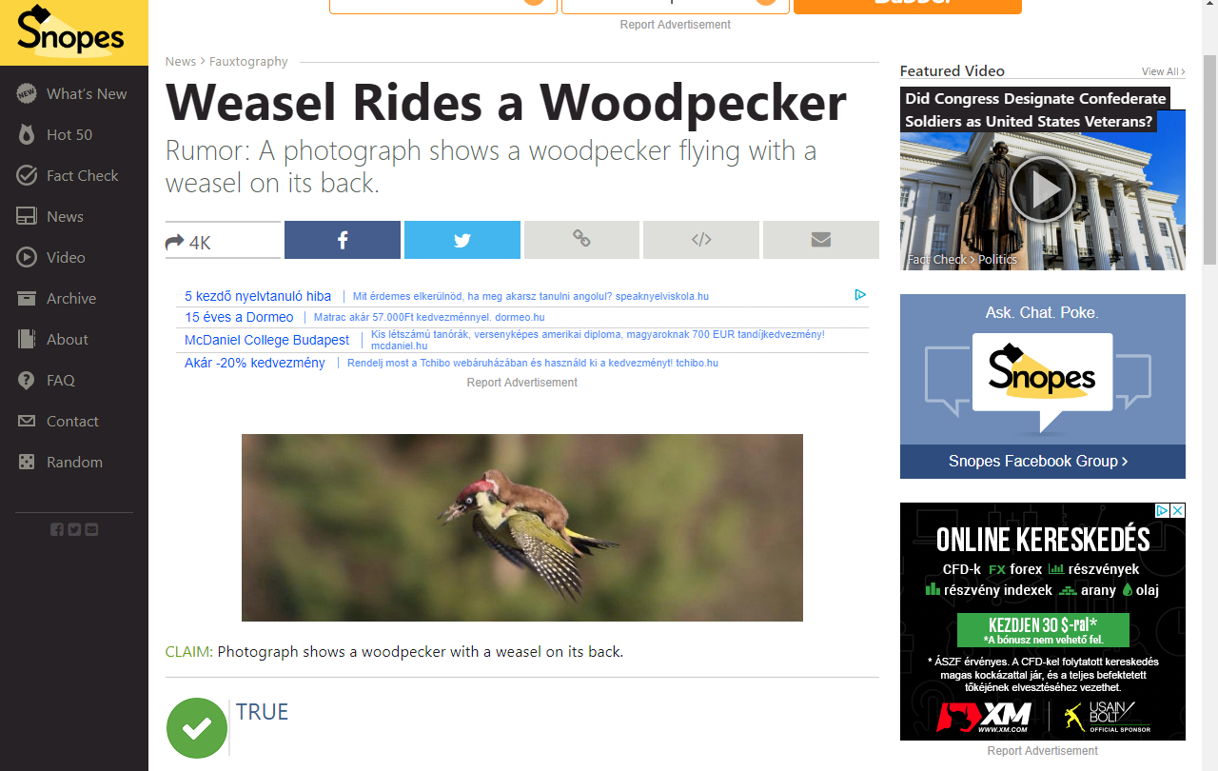

Slide 14
Algorithms - filter bubble
The goal of the exercise:
To demonstrate how an algorithm works and how it provides a personalised information flow.
Target group:
Students aged between 14-18 years
Method:
Roleplaying game with cards

Slide 15
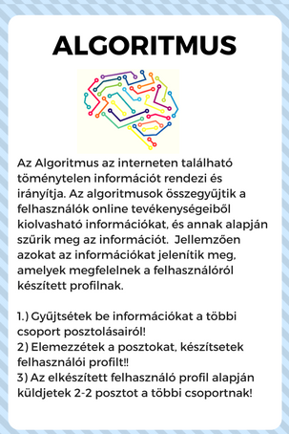
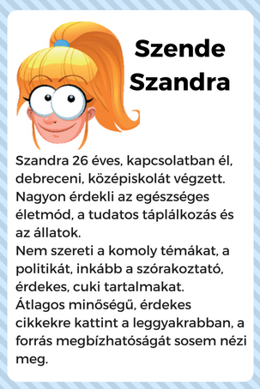
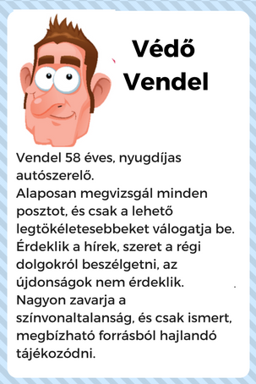
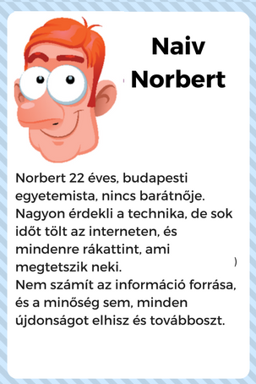
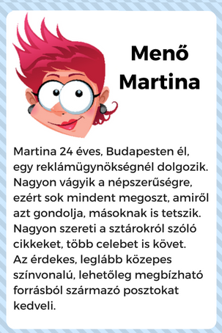
5 groups

Slide 16
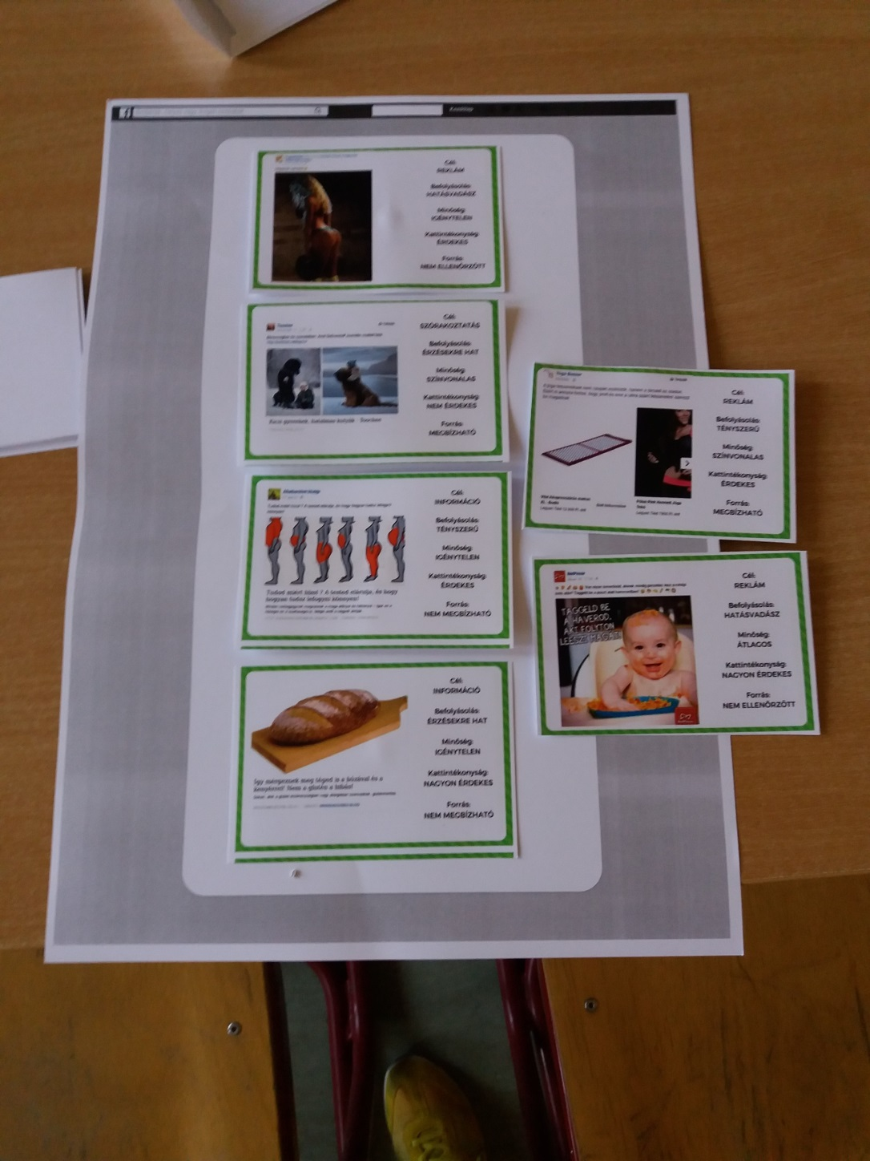
character
algorithm

Slide 17
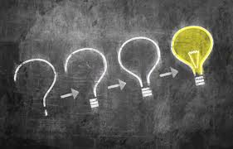
http://televele.hu/dron/
Many thanks for your attention!
nagy.krisztina@televele.hu

