Slide 1
Module 1 - Lecture 4:
Why Sustainable Finance
Is Contested

Slide 2
Learning Outcomes
explain why sustainable finance is contested, even when people use the same terms such as ESG or sustainability;
describe common sources of disagreement, including different objectives, time horizons, and views on externalities;
explain how different materiality perspectives lead to different priorities;
show why sustainable finance can be seen both as a tool for change and as a marketing label;
use a simple framework to separate objective, mechanism, and assumptions in debates.

Slide 3



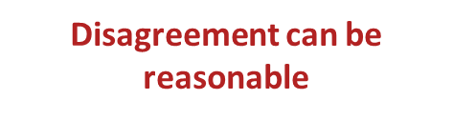
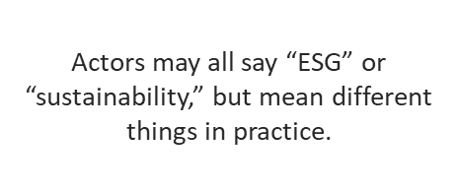
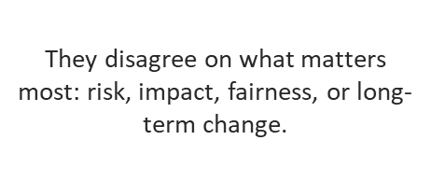
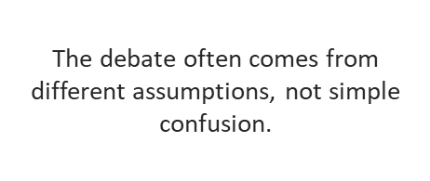
Why is Sustainable Finance contested?

Slide 4

Different Objectives lead to different Expectations
Shareholder-value lens
Stakeholder-oriented lens
• Focus on what is financially material to investors
• Sustainability matters when it changes risk, return, or valuation
• Typical question: does this affect firm performance?
• Focus on impacts on people and the environment
• Responsibility can matter even when effects are not fully priced
• Typical question: what harms or benefits are created?
Overlap is possible

Slide 5
Materiality shapes what gets prioritised
Financial materiality
How do sustainability issues affect the company and its financial performance?
Double materiality
How does the company affect people and the environment — and how do those issues also feed back financially?
VS
Same ESG language, different information priorities.

Slide 6
Two recurring tensions: time horizon and externalities
Time Horizon
Externalities
Many sustainability costs and benefits are not fully reflected in market prices.
That raises the question: should finance correct these failures on its own, or mainly complement public policy?
Short
term
Quarterly targets, bonus cycles, target pressure
Medium
term
Capital allocation,
Transition plans,
Credit conditions
Long
term
Climate risk,
Physical limits,
Societal impact

Slide 7
Credibility: tool for change or marketing label?
Tool for change
• re-orients capital
• improves transparency
• supports transition and stewardship
Marketing label
• sells products and reputations
• uses vague claims without evidence
• can mask greenwashing or weak incentives
Credibility depends on evidence, transparency,
governance, and alignment with incentives.

Slide 8
What makes a sustainable finance claim more credible?
1
Clear objective
What exactly is being claimed: lower risk, positive impact, transition support, or all three?
2
Transparent mechanism
How is change supposed to happen: screening, engagement, lending terms, disclosure, or incentives?
3
Evidence and metrics
Are the indicators decision-useful, comparable, and supported by data rather than slogans?
4
Governance and incentives
Do internal incentives, controls, and accountability support the stated objective?
5
Limits acknowledged
Does the claim admit trade-offs, uncertainty, and what it cannot prove?

Slide 9
A simple framework for analysing debate
Objective
What outcome is being pursued?
Mechanism
How is it supposed to work?
Assumptions
What must be true for the claim to hold?
Separate the claim from the route and the hidden assumptions behind it.

Slide 10
Mini case: the same company can look different from different lenses
A company improves its climate strategy but faces criticism over labour conditions in its supply chain.
Investor-focused lens
• What is financially material?
• Does labour controversy affect cash flows, risk, or valuation?
• Which risks are immediate?
Double materiality lens
• What are the real-world impacts?
• Who bears the harm in the supply chain?
• How credible is improvement if major social issues remain?

Slide 11
Discussion
1
When people argue about sustainable finance, are they disagreeing mainly about goals or methods?
2
Where is the sharpest tension between short-term performance and long-term sustainability?
3
What extra questions become central under double materiality?
4
What features make you trust a sustainable finance claim more?

Slide 12
Cross-Faculty Perspective Module 1
Using disagreement productively across disciplines
Different faculties ask different questions, but they can share one analytical language.
Finance & Business
Risk, return, valuation,
capital allocation, trade-offs
Law & Public Policy
Externalities, regulation,
guardrails, enforcement
Environment
& Engineering
Physical limits, climate risk,
resource constraints, transition
Social Sciences
& Humanities
Legitimacy, fairness,
stakeholders, distributional impacts
Shared analytical habit:
name the objective → clarify materiality → examine mechanisms → test assumptions
Key idea: sustainable finance is not only about tools — it is also about what each discipline considers credible, material, responsible, and successful.

Slide 13
Takeaways
Sustainable finance is contested because actors can share the same language while pursuing different objectives.
Materiality matters: investor-focused and double materiality perspectives prioritise different information.
Time horizon and externalities make sustainability debates especially difficult.
Credibility depends on clear objectives, transparent mechanisms, evidence, and aligned incentives.
A good habit is to ask: objective, mechanism, assumptions.
Thanks for listening!
Any questions?

