Slide 1
Module 1 – Lecture 2:
ESG and the Sustainable Development Goal

Slide 2
Learning Outcomes
explain the difference between primary and secondary markets using simple examples (shares, corporate bonds, fund units);
describe where cash flows in each market and why this matters for sustainability narratives;
describe several mechanisms through which financial products can influence real economic activities (financing conditions, capital allocation, ownership influence, information and incentives);
explain why these mechanisms are often indirect and conditional, and name typical overstatements in product communication.

Slide 3
From Sustainable Finance to ESG
Lecture 1 clarified what sustainable finance is.
Lecture 2 asks: How are sustainability considerations commonly organised in practice?
The most common practical structure is ESG.
ESG gives a shared vocabulary for discussing what is considered, measured, and debated.

Slide 4
ESG: A Practical Structuring Framework
ESG stands for Environmental, Social, and Governance.
ESG is a widely used structure for asking questions, not a single universal checklist.
The specific indicators vary by sector, region, and purpose.
ESG helps structure information used in:
  screening,
  analysis,
  target-setting,
  engagement,
  product design,
  reporting.
ESG structures attention — it does not automatically decide objectives or resolve trade-offs.

Slide 5
The Three ESG Dimensions
E – Environment
S – Social
G – Governance
climate
pollution
resource use
biodiversity
circularity
working conditions
health and safety
diversity and inclusion
supply-chain human rights
customer and community impacts
board oversight
business ethics
transparency
remuneration
risk management and internal controls

Slide 6
Environmental Topics in Practice
climate-related issues are central, but not the whole story
environmental topics also include:
  pollution,
  energy and resource use,
  water,
  biodiversity,
  circularity
relevance depends on sector and business model
Which environmental issue would matter most for an airline? For a food company? For a software firm?

Slide 7
Social Topics in Practice
social criteria concern how organisations affect people
typical topics:
  labour standards,
  health and safety,
  diversity and inclusion,
  human rights in supply chains,
  product responsibility,
  community impacts
some social effects are hard to observe directly and unfold over time
What could a company report on — and what might still remain invisible?

Slide 8
Governance Topics in Practice
governance concerns how an organisation is directed and controlled
common examples:
  board independence and oversight,
  executive remuneration,
  business ethics and anti-corruption,
  internal controls,
  transparency,
  risk management
governance often shapes whether environmental and social commitments are taken seriously
Why can a company have a strong climate narrative but weak governance credibility?

Slide 9
What ESG Is — and What It Is Not
ESG
Structures factors used in decision-making
Sustainability
Broader societal concept and objective horizon
Ethics / values
Asks what ought to be acceptable or unacceptable
Impact
Focuses on contribution to real-world outcomes
ESG integration describes a process, not a guaranteed outcome.
People can agree on ESG language and still disagree about priorities and evidence.

Slide 10
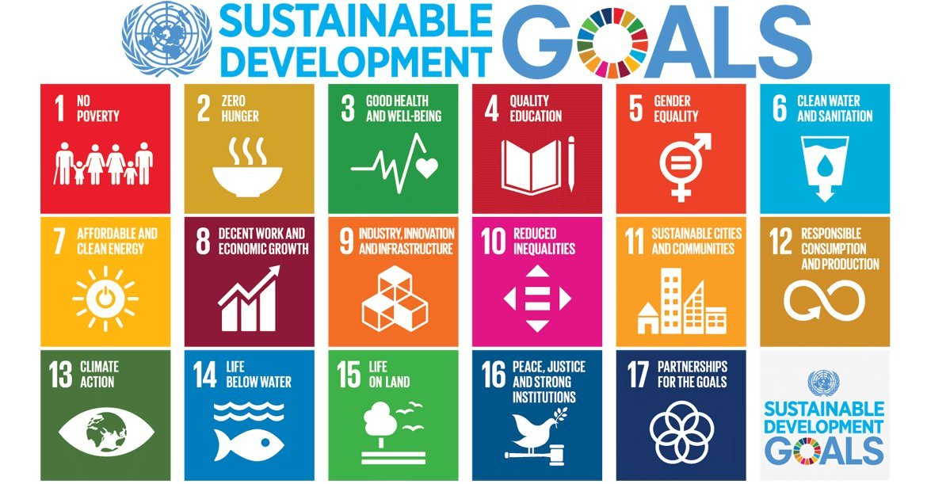
SDGs
Since 2015, the United Nations' Sustainable Development Goals (SDGs) have represented the most comprehensive global framework for sustainable development.
The SDGs comprise 17 goals and 169 targets – ranging from poverty reduction and quality education to climate action and responsible consumption.
For the financial sector, the SDGs are increasingly used as a reference for impact measurement, product design, and reporting.

Slide 11
The SDGs: Global Goals, Not an Investment Scoring System
The Sustainable Development Goals are global goals and targets.
They were designed to guide collective action and policy.
They are useful as a broader societal frame and communication tool.
But they are not a ready-made scoring system for investments.
ESG–SDG relation = translation, not equivalence.

Slide 12
How to Map an ESG Topic to the SDGs
Choose one ESG topic
  e.g. water use, labour standards, board oversight, product safety
Identify the most relevant SDG
Add a second SDG if clearly connected
Ask:
  What does this mapping show?
  What does it miss?
  What trade-off or blind spot remains?
Water use → SDG 6, SDG 12
Possible blind spot: improved water efficiency may say little about biodiversity or local justice issues

Slide 13
Group Work
Please think of 5 environmental, 5 social, and 5 governance factors that are for you most important (rank them) for sustainability assessment of a potential investee company of your choice.
How do you weight these factors to produce an overall ESG Rating (i.e., sustainability assessment)?
Rank​ | Environmental​ | Social​ | Governance​
1​ | …​ ​ | …​ | …​
2​ | …​ | …​ | …​
3​ | …​ | …​ | …​
4​ | …​ | …​ | …​
5​ | …​ | …​ | …​

Slide 14
Key Takeaways
ESG is a practical framework, not a universal checklist
ESG is not the same as sustainability, ethics, or impact
SDGs provide a broader societal frame, not a ready-made investment score
Good mapping requires judgement, evidence, and awareness of trade-offs

