Slide 1
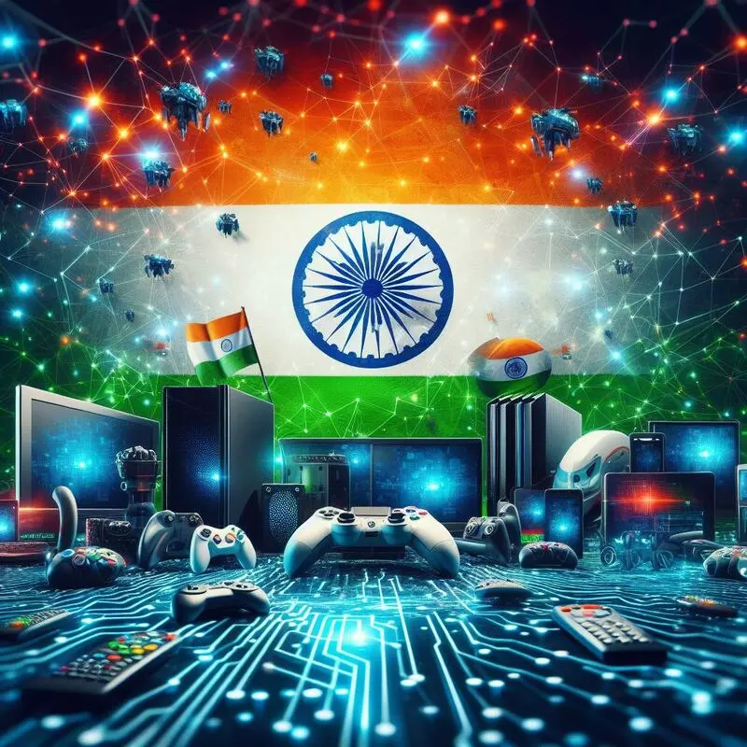
GAMING INDUSTRY REORT

Slide 2
History of online gaming
Key Drivers of the Online Gaming Market in India
Widespread Smartphone and Internet Access
Over 500 million smartphone users by 2024.
Affordable 4G and emerging 5G enable smooth, low-latency gameplay.
Youth-Centric Digital Engagement
Median age of 28 fuels demand for digital entertainment.
Social media integration promotes gaming communities and engagement.
Growth of Digital Payments
UPI and other platforms simplify in-game purchases and subscriptions.
Monetization through microtransactions becomes seamless.
Evolving Cultural Perception of Gaming
Gaming seen as a social and mainstream activity.
Popularity of gaming influencers boosts cultural acceptance.
Localized Game Content
Indian developers create culturally resonant games (e.g., Teen Patti, Rummy).
Demand for familiar themes drives domestic game innovation.
Online gaming involves playing video games over the internet using high-speed connections and compatible devices. It began evolving in the late 1960s with the Magnavox Odyssey and introduced multiplayer gaming in the 1970s.
The 1990s saw a major shift with the rise of the internet and LANs, leading to iconic games like Doom and Quake, and internet-ready consoles like the Sega Dreamcast. In the 2000s, games like RuneScape and World of Warcraft connected millions of players. Today, smartphones and virtual reality continue to reshape the industry, driven by the growing demand for interactive, connected experiences.

Slide 3
Regulation of Online Gaming in India
Central law- Government should enact a separate law to regulate online gaming in the country.
Regulation- It has recommended creating a regulatory body for the online gaming industry.
It will determine what qualifies as a game of skill or chance, and accordingly certify different gaming formats, seek compliance and enforcement.
India's IT ministry would act as the central ministry for online gaming but they will be not monitoring esports (electronic sports) and games of chance.
Legalisation- Any online gaming platform (domestic or foreign) offering real money online games to Indian users will need to be a legal entity incorporated under Indian law.
These platforms will be treated as ‘reporting entities’ under the Prevention of Money Laundering Act, 2002, and will be required to report suspicious transactions to the Financial Intelligence Unit-India.
Applicability- The legal framework should apply to both real money and free games of skill including online fantasy sports, casual games and card games that may impose significant impact.
The rules would also be applicable to gaming companies operating outside India but do target users in India.
Dispute resolution- A three-tier dispute re solution mechanism, similar to that prescribed under the Information Technology Rules, 2021 for online streaming services, should be put in place for online gaming.
It must consist of a grievance redressal system at the gaming platform level, self regulatory body of the industry, and an oversight committee led by the government.
Sector | Nodal agency for regulation
Online gaming (games of skill) except e-sports category | Ministry of Electronics and Information Technology
e-sports category | Department of Sports
Advertisements, code of ethics relating to content classification | Ministry of Information and Broadcasting
Sector for unfair trade practices | Ministry of Consumer Affairs

Slide 4
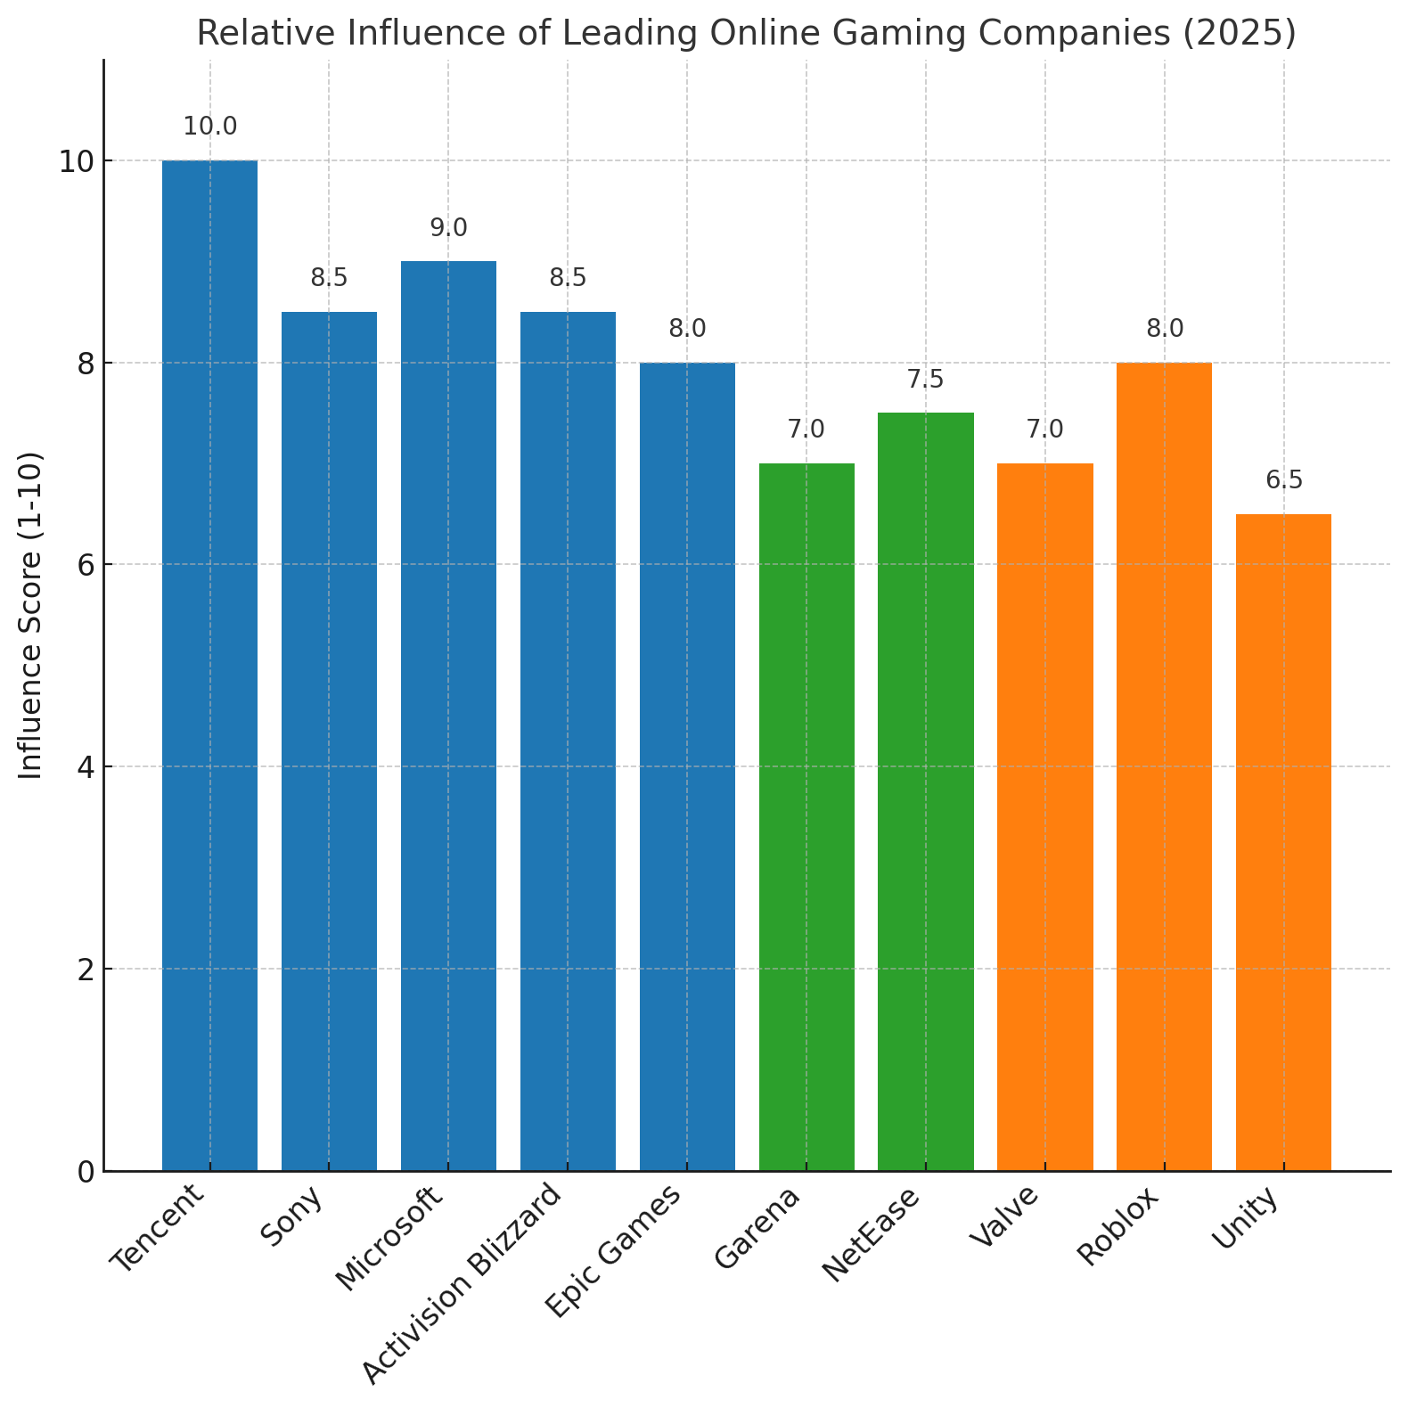
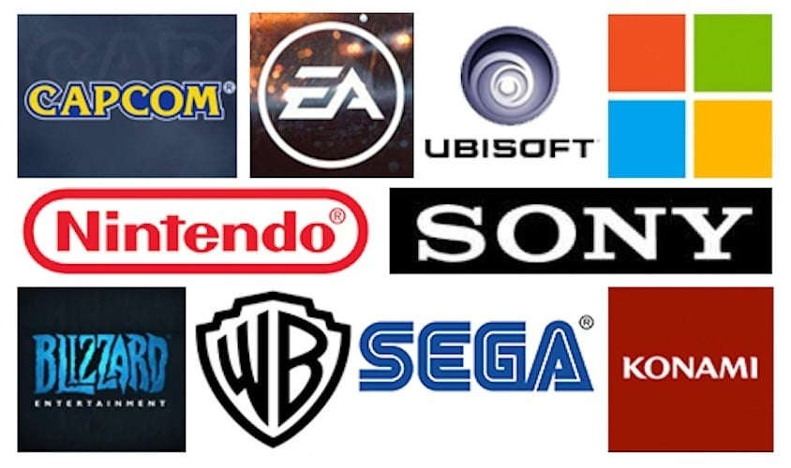
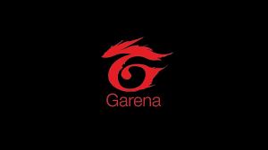
Global Leaders (Game Developers & Publishers)
Tencent (China) – World's largest gaming firm; owns Riot, Supercell, stakes in Epic.
Sony Interactive Entertainment (Japan) – PlayStation Network and online exclusives.
Microsoft (USA) – Owns Xbox Live, Game Pass, and Activision Blizzard.
Activision Blizzard (USA) – Creator of Call of Duty, Overwatch, World of Warcraft.
Epic Games (USA) – Developer of Fortnite and Unreal Engine.
Mobile Gaming Giants
Garena (Singapore) – Publisher of Free Fire, strong in emerging markets.
NetEase (China) – Major mobile/PC publisher expanding globally.

Slide 5
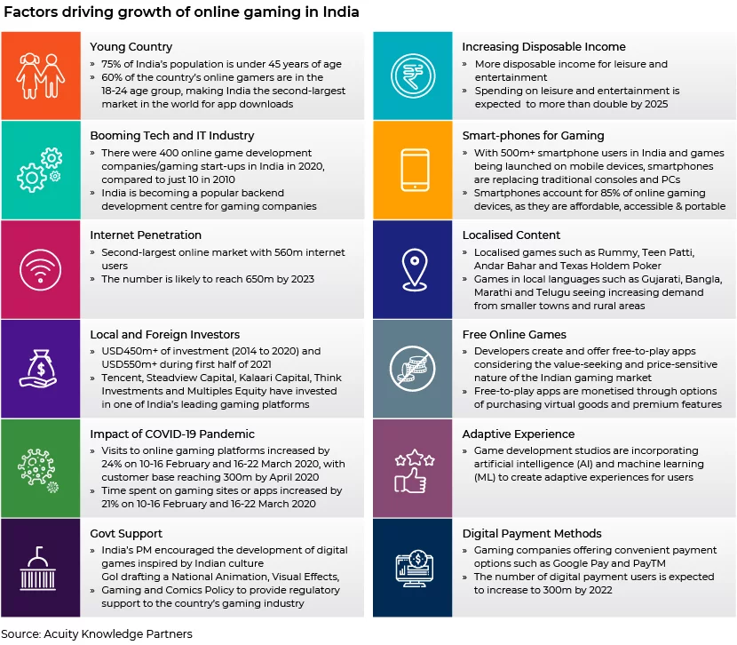
Growth of India’s Online Gaming Industry
Rapid Expansion: The online gaming sector in India is growing rapidly and emerging as a key contributor to economic development.
Sectoral Integration: It intersects with two major creative industries:
Media & Entertainment (M&E)
Animation, Visual Effects, Gaming, and Comics (AVGC)
GDP Contribution:
Recorded a 27.5% CAGR in its share of GDP from 2019 to 2022.
Market Size:
Expected to reach USD 2.4 billion by FY2029.
Reflects a 20% CAGR from 2017 to 2029.
Regulatory Developments
GST Council Discussions:
Significant deliberations over the past 12–18 months on taxation policy for the online gaming sector.
Key Policy Update (August 2023):
In the 51st GST Council meeting, amendments were recommended regarding GST on ‘actionable claims’ in Real Money Gaming (RMG) platforms.
Tax Implications:
A 28% GST is now levied on the entire deposit amount, not just the platform fee or net winnings.
Industry Response:
Gaming platforms are actively re-evaluating their business models and operational strategies to adapt to the new tax framework.

Slide 6
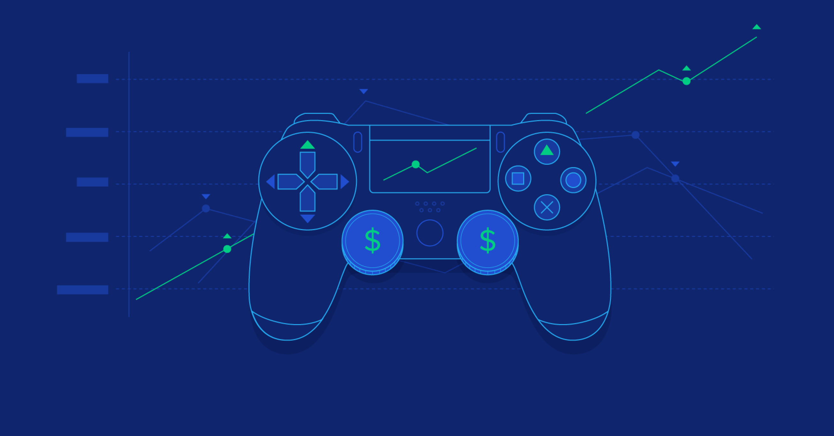
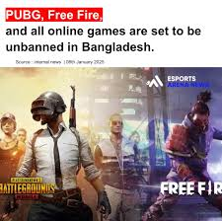
News - 2025
Market Growth
India’s online gaming market to reach $9.1B by 2029 (from $3.7B in 2024).
Real Money Gaming makes up 86% of the market.
$3B in FDI so far; 85% in pay-to-play games.
Regulatory Developments (India)
Industry pushing for GST cut from 28% to 18% on skill-based games.
Demand for clear policy separating skill vs. chance-based games.
Global Trends
Cloud Gaming is expanding access—no need for high-end hardware.
User-Generated Content (UGC) rising—players create & monetize game content.
AI in Gaming: Used for smarter NPCs, faster development, and procedural design.
Mobile Gaming
New hardware like GameSir X5 Lite offers console-like gameplay on phones.
Platforms like GameHub centralize mobile gaming access.
Esports Recognition
Olympic Esports Games confirmed for 2027 in Riyadh—boosts esports legitimacy.

Slide 7
Innovations in Online Gaming
Cloud Gaming – Play high-end games via streaming on any device.
Cross-Platform Play – Seamless multiplayer across devices.
AI Integration – Smarter NPCs and dynamic game design.
Metaverse & Virtual Worlds – Persistent, social, immersive environments.
Blockchain/NFTs – Digital asset ownership and play-to-earn models.
Personalized Gameplay – Tailored experiences using real-time data.
AR/VR Gaming – Immersive experiences with advanced tech.
Esports & Streaming – Built-in tools for spectators and content creators.
Haptic Tech – Realistic touch feedback in controllers.
Voice & Gesture Control – Hands-free, intuitive gameplay.

Slide 8
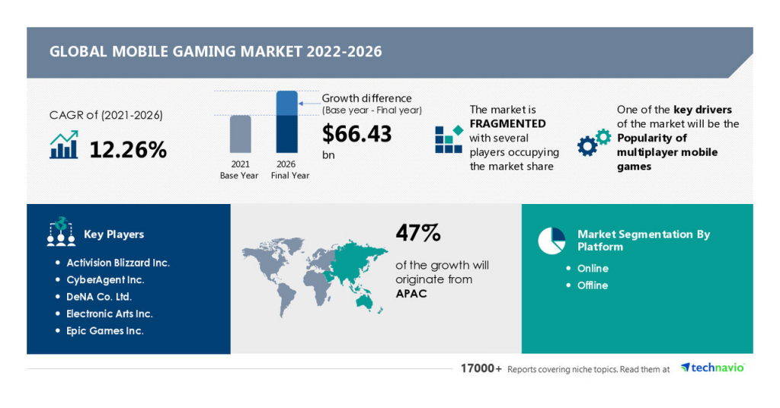
Consumer Market Data
Revenue in the Online Games market in the world is projected to reach US$29.48bn in 2025.
Revenue is expected to demonstrate an annual growth rate (CAGR 2025-2029) of 4.87%, resulting in a projected market volume of US$35.66bn by 2029.
In the Online Games market in the world, the number of users is expected to amount to 1.3bn users by 2029.
User penetration will be 15.3% in 2025 and is anticipated to increase to 16.2% by 2029.
In a global comparison, the majority of revenue will be generated China, with an expected revenue of US$6.90bn in 2025.
The average revenue per user (ARPU) in the Online Games market in the world is projected to be US$24.59 in 2025.
The worldwide online games market is increasingly prioritizing immersive experiences and social connectivity, reflecting a shift towards community-driven gaming platforms.
The global mobile gaming market is expected to grow at a 12.26% CAGR (2021–2026), adding $66.43 billion in value.
The market is fragmented, driven by the popularity of multiplayer mobile games.
Key players include Activision Blizzard, CyberAgent, DeNA, Electronic Arts, and Epic Games.
47% of growth will come from the APAC region.
Platforms: Online and Offline.

Slide 9
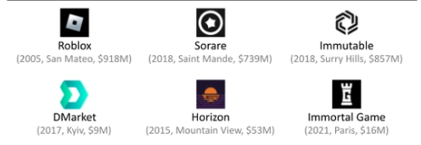
Competitor Information
The gaming industry has always been highly competitive, and this has intensified with growing global popularity.
The competitive landscape includes both multibillion-dollar giants and smaller players with breakout successes.
Non-gaming companies, including tech and streaming giants, are actively entering the gaming sector.
72% of gaming executives view increased competition as a moderate or significant opportunity, regardless of company size.
Stuart (executive quote): Competition signals that gaming is a valuable, high-potential industry.
Competing effectively requires a blend of technical, artistic, business, and operational excellence.
Rising customer expectations are driving the need for continuous innovation and product differentiation.
83% of executives agree the industry is under constant pressure to innovate and create new experiences.
Top Competitors

Slide 10
About Uniform Capital
At Uniform Capital, our purpose is to empower businesses by delivering robust financial insights and solutions. We are a specialized corporate finance firm that partners with startups, SMEs, and large enterprises to unlock growth and strategic value. Our expertise spans valuation, financial modelling, market research, fundraising, accounting outsourcing, transaction advisory, due diligence, and strategic consulting. We are committed to excellence, data-driven decision-making, and transparency. Discover more about what we do and how we can support your financial journey at www.uniformcapital.com. © 2025 Uniform Capital. All rights reserved.
Prepared by
Akash Tiwari(Financial Analyst)
uniformcapital.com
Data Classification: Public
This document is for informational purposes only and does not constitute professional advice. The content herein has been developed using publicly available and internal data sources considered reliable, but no warranty is given as to its accuracy or completeness. Readers are advised to consult financial professionals before making any decisions based on this material. Uniform Capital does not assume responsibility or liability for any decisions made based on the information contained herein. May 2025 • UC-01

