Slide 1
REPORT

Slide 2
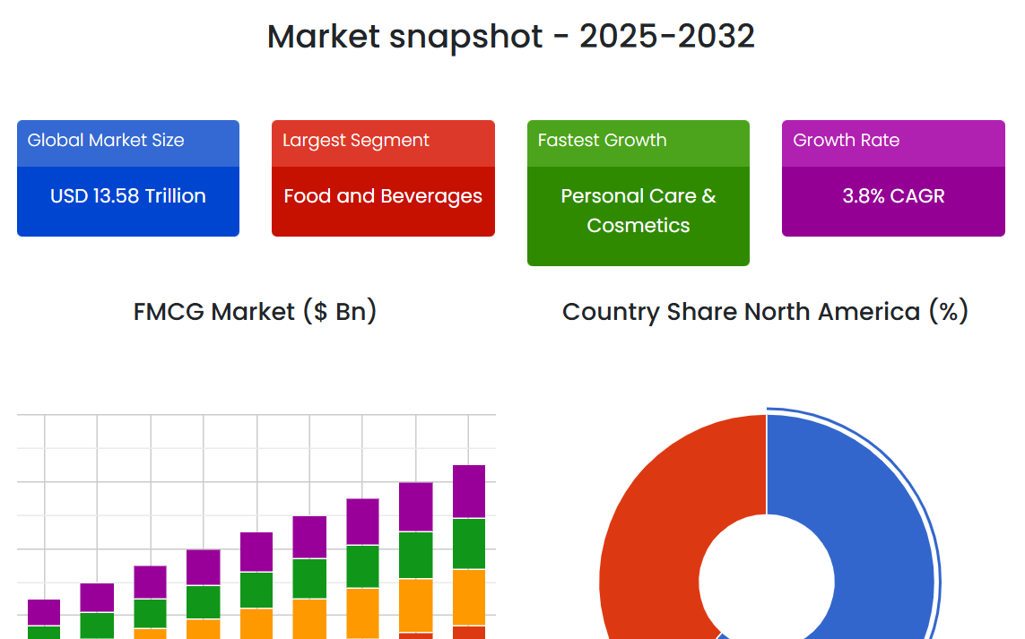
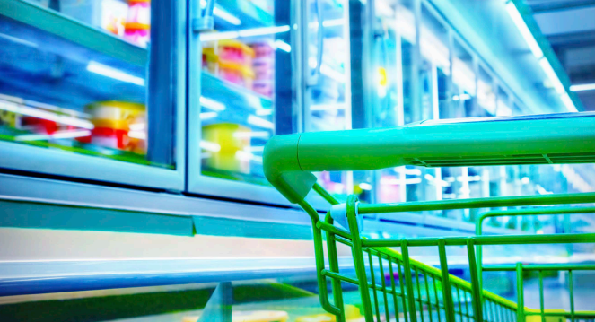
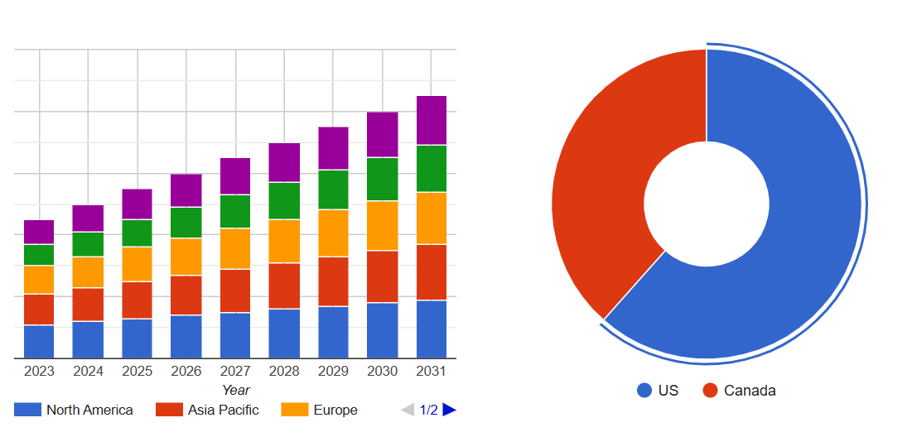
FMCG Market Insights
FMCG Market Drivers
Changing Consumer Preferences Consumers are increasingly prioritizing health and sustainability, driving demand for organic, natural, and eco-friendly FMCG products. In response, companies are offering cleaner ingredients, natural personal care items, and sustainable packaging to meet these evolving expectations.
E-commerce Growth The growth of e-commerce has made FMCG products more accessible and convenient to purchase. This trend, accelerated by the COVID-19 pandemic, has led companies to enhance their digital presence and streamline online shopping experiences to cater to rising consumer demand.
The global FMCG market was valued at USD 13.58 trillion in 2023 and is projected to grow to USD 18.96 trillion by 2032, at a CAGR of 3.8% from 2025 to 2032. Driven by population growth, urbanization, and shifting lifestyles such as dual-income households, the demand for essential daily products remains strong. Digital transformation through e-commerce, mobile apps, and subscription services has enhanced consumer access and convenience.
Additionally, data analytics is enabling more personalized marketing. Growing emphasis on health and sustainability is pushing FMCG firms toward eco-friendly packaging, organic products, and plant-based offerings.

Slide 3
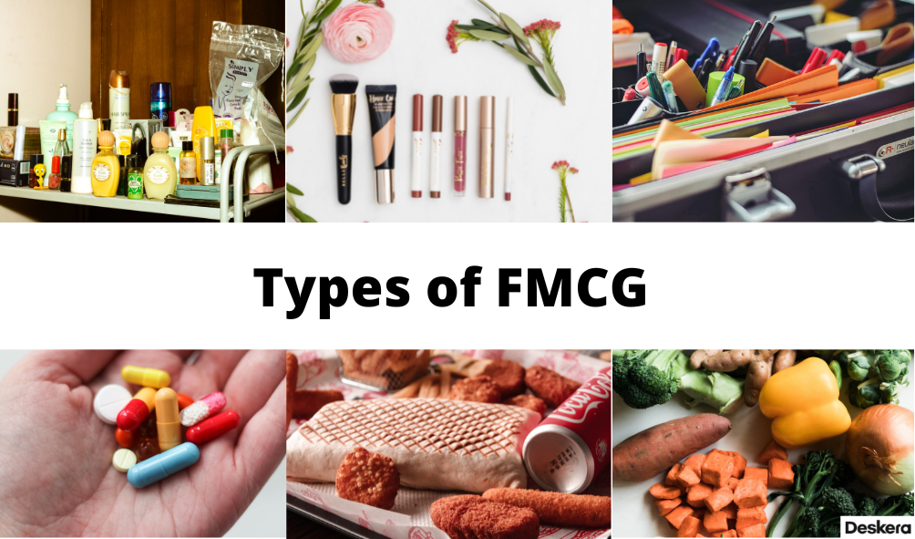
Types of Fast-Moving Consumer Goods
FMCGs include several subcategories:
Processed foods: Cheese products, cereals, and boxed pasta
Prepared meals: Ready-to-eat meals
Beverages: Bottled water, energy drinks, and juices
Baked goods: Cookies, croissants, and bagels
Fresh foods, frozen foods, and dry goods: Fruits, vegetables, and nuts
Medicines: Aspirin, pain relievers, and other medications that can be purchased without a prescription
Cleaning products: Baking soda, oven cleaner, and window and glass cleaner
Cosmetics and toiletries: Hair care products, concealers, toothpaste, and soap
Office supplies: Pens, pencils, and markers

Slide 4
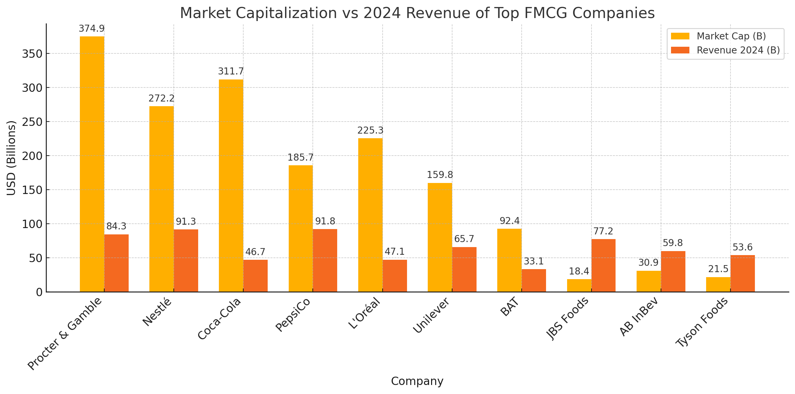
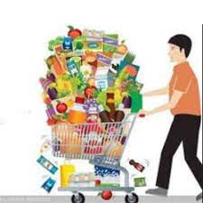
10 Largest FMCG Companies by Revenue
The 10 largest FMCG companies in the world are the following (all figures in U.S. dollars, as of mid-2024):
Nestlé: Swiss multinational focused on food and beverages—candy, infant formula, bottled water, dairy, cereals. Market cap: $272.2B, 2024 revenue: $91.35B.
PepsiCo (PEP): U.S. company producing soft drinks and snacks. Market cap: $185.66B, 2024 revenue: $91.85B.
Procter & Gamble (PG): U.S. consumer goods giant making hygiene, personal care, and cleaning products. Market cap: $374.85B, 2024 revenue: $84.35B.
JBS Foods (JBSAY): Brazilian meat processor offering beef, pork, poultry, and byproducts. Market cap: $18.37B, 2024 revenue: $77.22B.
Unilever plc (UL): British FMCG firm making beauty, food, and healthcare products. Market cap: $159.76B, 2024 revenue: $65.72B.
Anheuser-Busch InBev (BUD): Belgian brewing company, known for Budweiser and other beers. Market cap: $30.95B, 2024 revenue: $59.75B.
Tyson Foods (TSN): U.S. meat producer behind brands like Jimmy Dean and Hillshire Farm. Market cap: $21.51B, 2024 revenue: $53.61B.
Coca-Cola Co. (KO): U.S. beverage leader making sodas, juices, and sports drinks. Market cap: $311.74B, 2024 revenue: $46.7B.
L'Oréal Co. (LRLCY): French cosmetics giant—makeup, skincare, fragrance, and haircare. Market cap: $225.29B, 2024 revenue: $47.07B.
British American Tobacco (BTI): British tobacco company offering cigarettes and nicotine products. Market cap: $92.39B, 2024 revenue: $33.07B.

Slide 5
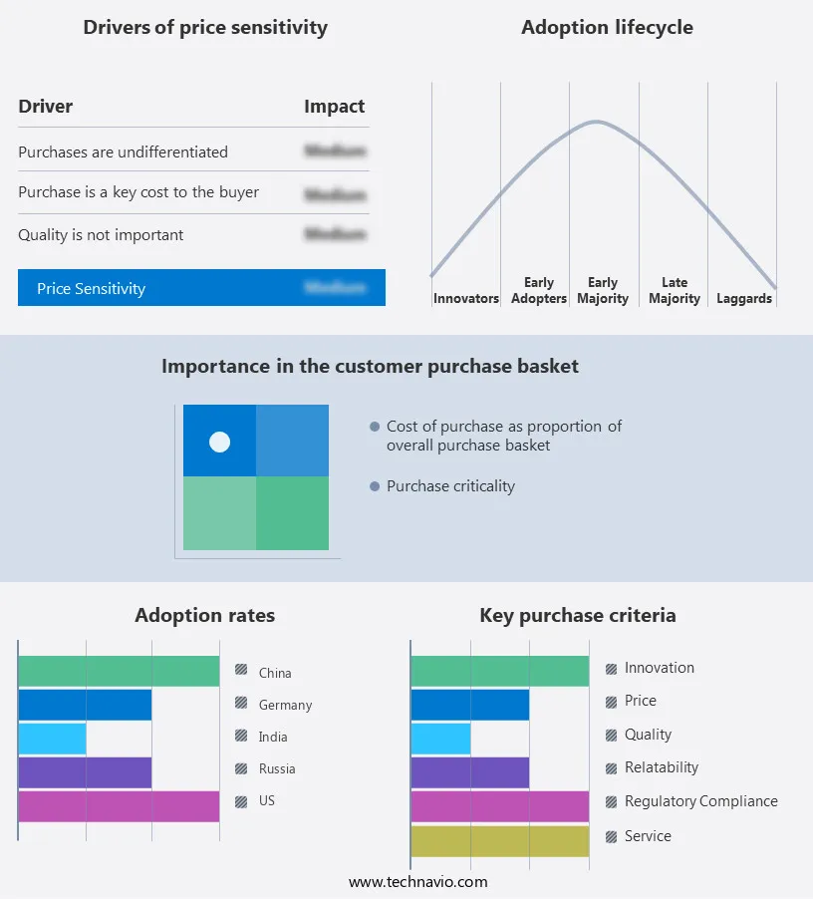
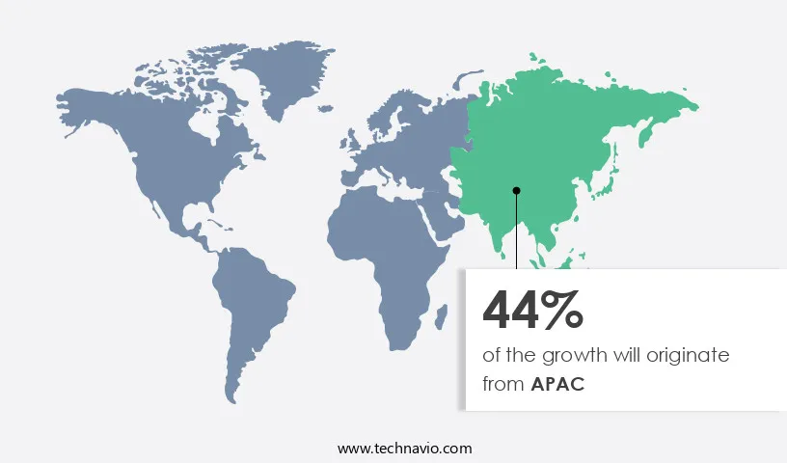
Regional Analysis
Exclusive Customer Landscape
The Asia Pacific (APAC) region is expected to contribute 44% to the growth of the global FMCG market during the forecast period, driven by factors such as population growth, rising disposable incomes, and urbanization.
Countries like China, India, Japan, South Korea, Indonesia, Singapore, and Australia are experiencing changing lifestyles due to economic development, with more dual-income households and a growing preference for natural, sustainable, and plant-based products. The expansion of modern retail formats, including supermarkets, hypermarkets, specialty stores, and convenience stores, along with the increasing adoption of e-commerce and mobile shopping, is further boosting market growth across urban, semi-urban, and rural areas. While online platforms are gaining popularity for a wide range of products, from consumer electronics to beauty and health care items, counterfeiting remains a concern, underlining the need for enhanced security and consumer awareness.
The FMCG market forecasting report includes the adoption lifecycle of the market, covering from the innovator's stage to the laggard's stage. It focuses on adoption rates in different regions based on penetration. Furthermore, the FMCG market report also includes key purchase criteria and drivers of price sensitivity to help companies evaluate and develop their market growth analysis strategies.

Slide 6
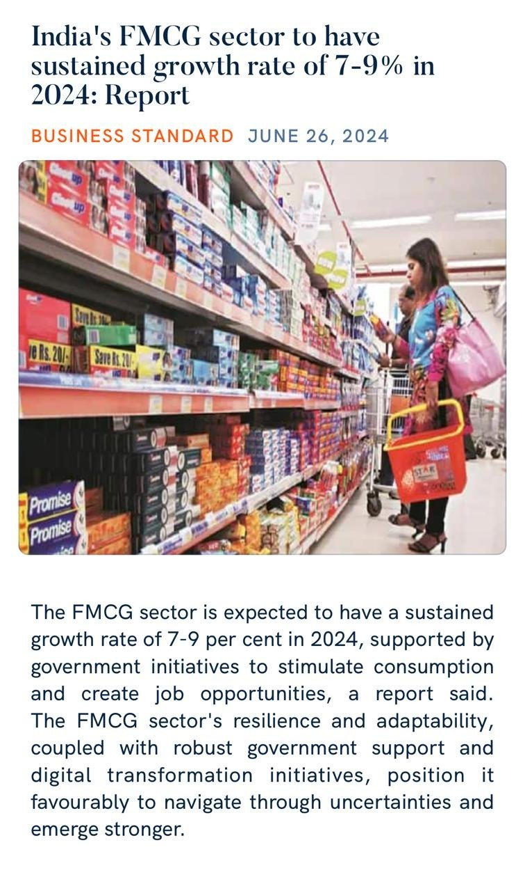
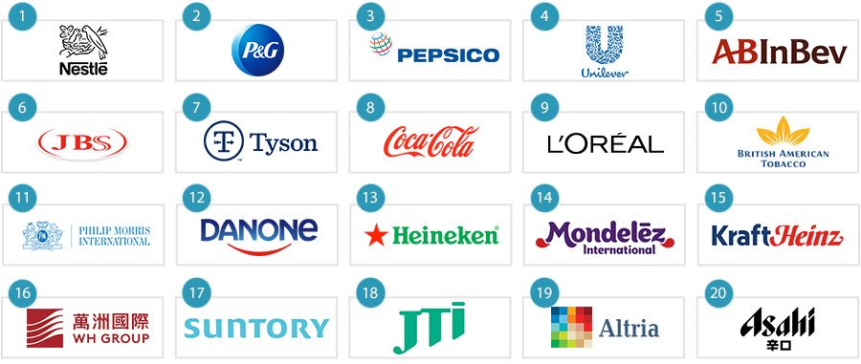
FMCG Market News
In January 2023, Unilever released a new line of private care products that are crafted from ninety five% herbal components and are packaged in recyclable substances.
In February 2023, Nestlé announced that it is going to be investing $1 billion within the improvement of recent plant-based meals and beverage merchandise.
In March 2023, PepsiCo released a brand new line of practical drinks which can be designed to enhance sleep, temper, and cognitive characteristics.
In April 2023, Procter & Gamble announced that it is going to be launching a new line of laundry detergent that is crafted from recycled plastic.
In May 2023, Kimberly-Clark announced that it is going to be launching a new line of diapers which are made from sustainable materials and are packaged in recyclable packaging.

Slide 7
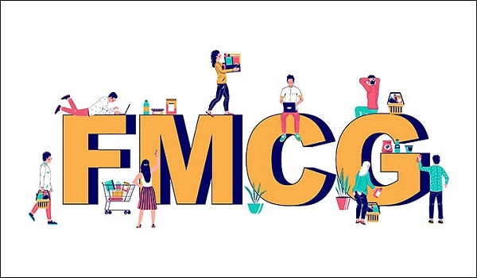
Challenges
Distribution Channel Analysis
Lack of proper infrastructure in emerging economies is a key challenge affecting the industry growth. The market in emerging economies, particularly in the Asia Pacific region, is experiencing significant growth due to improving economic conditions, urbanization, and increasing health consciousness. This expansion is particularly notable in the food processing industries, which in turn drives demand for FMCG products. However, challenges persist in ensuring proper infrastructure for storing and manufacturing essential food processing ingredients such as preservatives, emulsifiers, and enzymes.
Proper handling and care, including maintaining specific temperatures and preventing contamination, are crucial to preserve their chemical compositions. Despite these challenges, the market in APAC continues to show promising growth prospects.
Distribution channels are key to the FMCG market, shaping how products reach consumers. Supermarkets and hypermarkets remain dominant due to their wide product range, competitive pricing, and one-stop convenience, though they face growing competition from online retail.
Convenience stores thrive in urban areas, offering quick access to daily essentials and catering to impulse buys. Online platforms have rapidly gained ground, driven by smartphone usage and demand for contactless shopping, especially post-COVID. Specialty stores serve niche markets with curated, high-quality products, appealing to health-conscious and eco-aware consumers. Alternative channels like direct selling and vending machines further support market reach by providing personalized service and instant access in high-traffic areas.

Slide 8
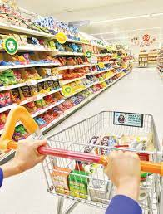
Sustainability and ESG Focus
Those in the business of fast‑moving consumer goods (“FMCGs”) are likely aware of the plethora of environmental and product stewardship regulations applicable to the FMCG sector. These laws are set to increase and expand in application. What FMCG companies also need to get to grips with are a range of broader (and also fast‑moving!) environmental, social and governance (“ESG”) developments and consequent risks and opportunities. Companies need to understand how the new world of ESG impacts their supply chains, key ingredients and components, consumer choice and confidence, competitive advantage, market accessibility, and marketing.
Designed as a ‘primer’ for FMCG companies, in this piece, we cover a range of key trends in the emerging UK and EU ESG legal landscape as relevant for the FMCG sector, from farmers to Food Business Operators (“FBOs”) and from manufacturers to retailers. We also discuss some key legal and reputational risks; as well as pointers to help companies decipher and prepare for the ESG storm.
We focus on the UK and the EU (first movers on many ESG issues), but the landscape in other jurisdictions (including, for example, the US) is also evolving and becoming more complex.

Slide 9
About Uniform Capital
At Uniform Capital, our purpose is to empower businesses by delivering robust financial insights and solutions. We are a specialized corporate finance firm that partners with startups, SMEs, and large enterprises to unlock growth and strategic value. Our expertise spans valuation, financial modelling, market research, fundraising, accounting outsourcing, transaction advisory, due diligence, and strategic consulting. We are committed to excellence, data-driven decision-making, and transparency. Discover more about what we do and how we can support your financial journey at www.uniformcapital.com. © 2025 Uniform Capital. All rights reserved.
Prepared by
Uniform Capital
uniformcapital.in
Data Classification: Public
This document is for informational purposes only and does not constitute professional advice. The content herein has been developed using publicly available and internal data sources considered reliable, but no warranty is given as to its accuracy or completeness. Readers are advised to consult financial professionals before making any decisions based on this material. Uniform Capital does not assume responsibility or liability for any decisions made based on the information contained herein. May 2025 • UC-02

