Slide 1
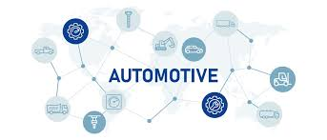
Global Automotive report

Slide 2
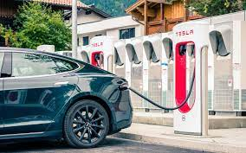
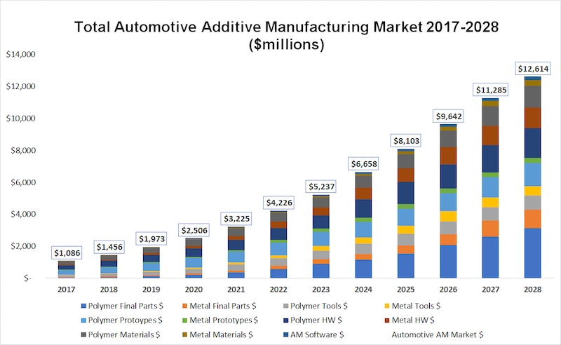
Introduction
Manufacturing & Technology
The automobile industry is rapidly evolving with the rise of electric and hybrid vehicles, autonomous technology, and semiconductor advancements.
Manufacturing involves materials like steel, glass, plastics, and electronics, along with expertise in robotics, logistics, and assembly. Cars are mainly gas-powered, hybrid (HEV), or electric (EV). Gas vehicles use internal combustion engines and gasoline, with fuel prices influenced by oil markets. Hybrids combine gas engines with electric motors, while EVs run solely on batteries, reducing fuel costs and emissions. Both HEVs and EVs require battery charging, with three charging levels based on the vehicle type.
Automakers are increasingly shifting toward electric mobility.
The automotive industry is a cornerstone of the global economy, spanning manufacturing, sales, and services across major regions like North America, Europe, and Asia. Leading automakers such as Toyota, Volkswagen, Hyundai, and Stellantis contribute significantly to GDP and employment worldwide.
The sector supports vast supply chains involving steel, oil, rubber, and electronics, while also fostering infrastructure development. As the industry shifts toward sustainability, innovations in electric and autonomous vehicles are reshaping its future. Global classification systems, such as NAICS, help track its economic impact and evolving trends.

Slide 3
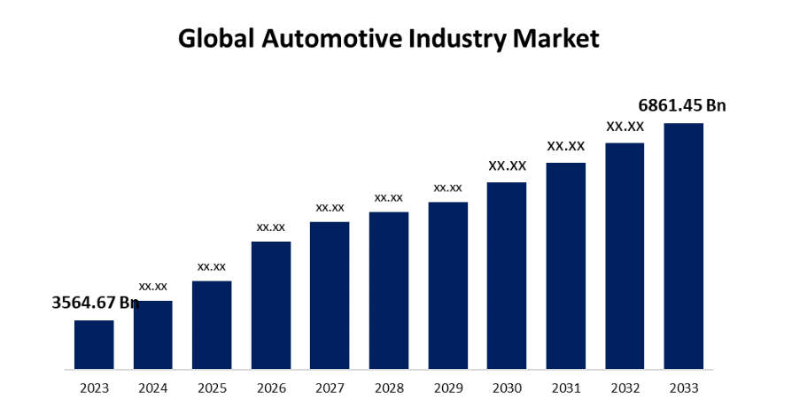
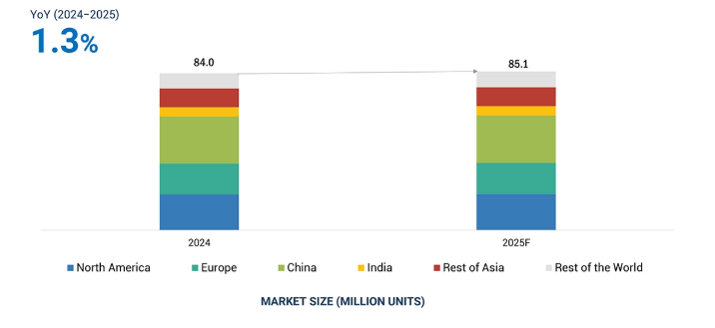
Market Size
Global Automotive Outlook
The Global Automotive Industry Market Size is expected to reach USD 6,861.45 Billion by 2033, at a CAGR of 6.77% during the forecast period 2023 to 2033.
The industry includes businesses involved in designing, manufacturing, and selling various vehicles like electric cars, SUVs, trucks, and vans. Automakers are heavily investing in battery production, charging infrastructure, software for EVs, and digitalization, including features like autonomous driving and over-the-air updates. Growth is further fueled by e-commerce-driven logistics, industrialization, shared mobility, telematics, and increasing demand for connected commercial vehicles with features like accident alerts and traffic updates.
The Global Automotive Outlook indicates that global light vehicle sales were 84.0 million units in 2024 and are projected to reach 85.1 million units in 2025, witnessing a YoY growth of 1.3% from 2024 to 2025. Further, within the regional market, the Asia-Pacific region accounted for almost half of the market share. While Internal Combustion Engine (ICE) Vehicles held the major share, the Hybrid Electric Vehicles (HEV) segment is expected to grow at a high rate of 20-25% over 2024-2025.
Dedicated to achieving zero emission targets, the OEMs have planned to invest over USD 500 Billion by 2030 for EV production facilities. In 2025, at least 10 new manufacturing plants of various OEMs are expected to commence. Similarly, Hyundai, Kia, Toyota, Tesla, Maruti, Tata Motors and others have invested in new manufacturing facilities especially focussed on producing their upcoming electric vehicles (EV) models. Further, the price of Lithium-ion batteries is expected to fall below USD 100/KWh in 2025. Moreover, OEMs have attempted to diversify the EV battery supply chain to de-risk from any possible supply chain disruption of raw material.

Slide 4
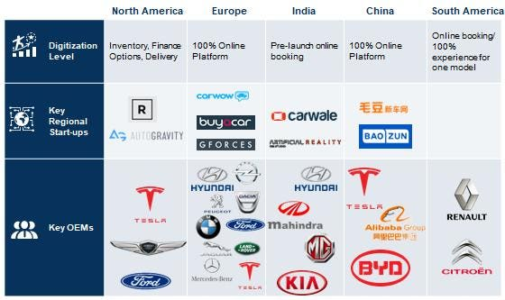
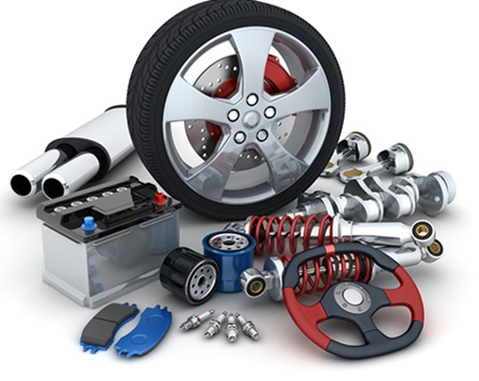
Key Players in the Automotive Market
The top performing OEMs in 2023 were Toyota Motor Corporation, Volkswagen AG, Hyundai Motor Group, General Motors, Renault-Nissan-Mitsubishi, Stellantis N.V. accounting over 50% of the market share. By 2030, 3 automotive groups will contribute over 10 million units in light vehicle sales. By 2035, market will be led by companies with robust EV portfolios with more Chinese manufacturers in the top 10. Wherein BYD Auto, Tesla and Volkswagen group will lead the EV segment. By 2035, Chinese players such as Geely, Chery, SAIC and Changan will join BYD in top 10.
These companies adopted new product launches, acquisitions, partnerships, collaborations, and other key strategies to gain traction in the automotive market.

Slide 5
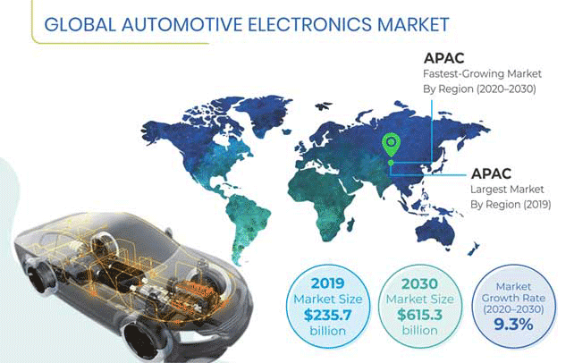
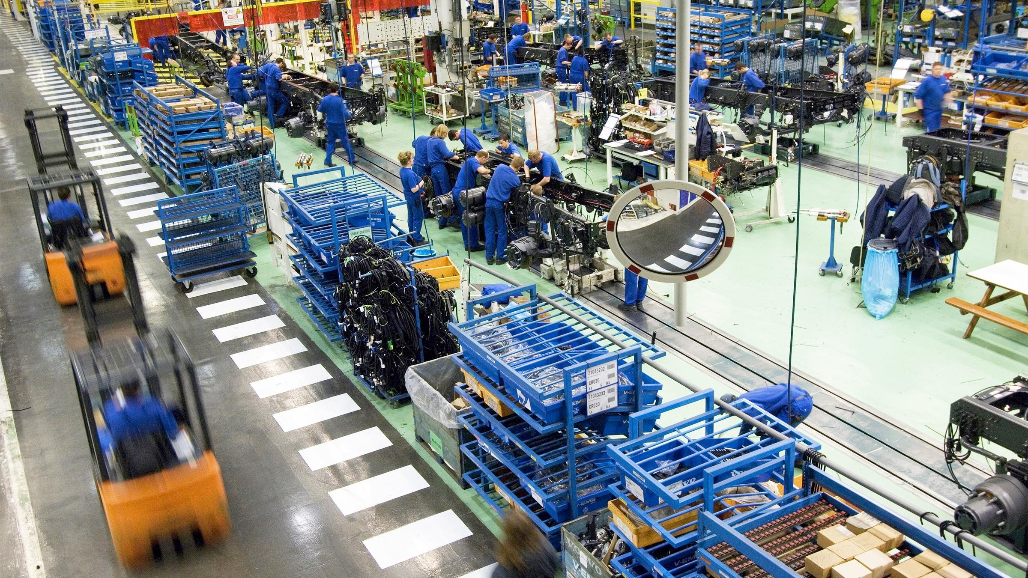
Regional Insights
Supply Chain
Asia Pacific holds the largest market share and is expected to continue dominating the automotive market during the forecast period, driven by government safety mandates and strong demand in countries like China, India, and Japan.
China leads in market share, while India shows the fastest growth, particularly in EV adoption. Japan's established auto industry further supports regional growth. Meanwhile, North America is projected to grow rapidly due to evolving engine technologies, stricter emission norms, and government support for EVs, with the U.S. leading the regional market followed by Canada and Mexico.
Post pandemic, automotive markets in Europe and Asia are experiencing steady growth, while progress in the Americas has been variable, amid prevailing geopolitical crises and resulting supply chain bottlenecks.
Global automakers are building supply chain resilience by vertically integrating into essential raw materials, and diversifying their supplier base.
Automotive companies are also focusing on ESG, including vehicle electrification, sustainable supply chains, and computer-aided software engineering (CASE) technologies to drive the next growth wave.
While supply chain bottlenecks, and scarcity of electronic chips and other raw materials should gradually ease in the near-term, the next phase of growth will depend upon reducing or removing volatility from complex supply chains.
The global automotive industry is seeing a resurgence following a downturn between 2020 and late 2021, primarily due to COVID-19. As we step into 2024, the sector is enjoying a notable uptick in sales across various regions, indicating a promising recovery. Despite this renewed optimism, industry stakeholders should remain vigilant and proactive in addressing emerging supply chain concerns, while also adapting to fast technological disruption without being held back by legacy infrastructure.

Slide 6
Consumer Trends and Preferences
The automotive industry is experiencing a dynamic transformation driven by evolving consumer preferences and technological advancements. Understanding consumer trends for the automotive industry is crucial for automakers and industry stakeholders to stay ahead in this competitive market. From electric vehicles to autonomous driving and smart features, the future of the automotive industry is being reshaped by these trends.
Electric Vehicles (EVs): Rapidly gaining popularity due to government incentives and increased accessibility from companies like Tesla, Nissan, and Chevrolet.
Autonomous Driving Technology: Advancing steadily with companies like Waymo and Uber leading development; ADAS features are common, but full autonomy is still evolving.
Connectivity and Smart Features: In-vehicle tech like GPS, Wi-Fi, and mobile integration are standard; automakers are prioritizing innovation in connected features.
Sustainability and Eco-Friendly Options: Growing consumer demand for green vehicles is pushing automakers to adopt recyclable materials and low-emission technologies.
Subscription and Shared Mobility Services: Alternatives to ownership such as Zipcar and Turo are popular among urban and younger users for their flexibility and cost-efficiency.
Luxury and Customization Trends: High demand for premium vehicles with bespoke customization; brands like Mercedes-Benz and Audi are focusing on personalized experiences.
Digital Retail and Online Sales: Online car buying is increasing with virtual showrooms and contactless delivery, prompting dealerships to enhance digital capabilities.
Health and Wellness Features: Features like air purifiers and ergonomic seats are being integrated to meet growing consumer interest in health-conscious vehicle design.
Consumer Focus on Safety Features: Strong emphasis on safety technologies like emergency braking and lane assist; consumers seek advanced, reliable safety systems.
Financing and Leasing Trends: Flexible financing and leasing options are rising in popularity due to economic uncertainties and changing consumer habits.
Influence of Social Media and Online Reviews: Platforms like YouTube and Instagram significantly impact purchasing decisions; automakers use digital channels for engagement and branding.
Emerging Markets and Global Trends: Markets like China, India, and Brazil are driving growth with distinct preferences; global trends like EVs and smart tech are influencing these regions.

Slide 7
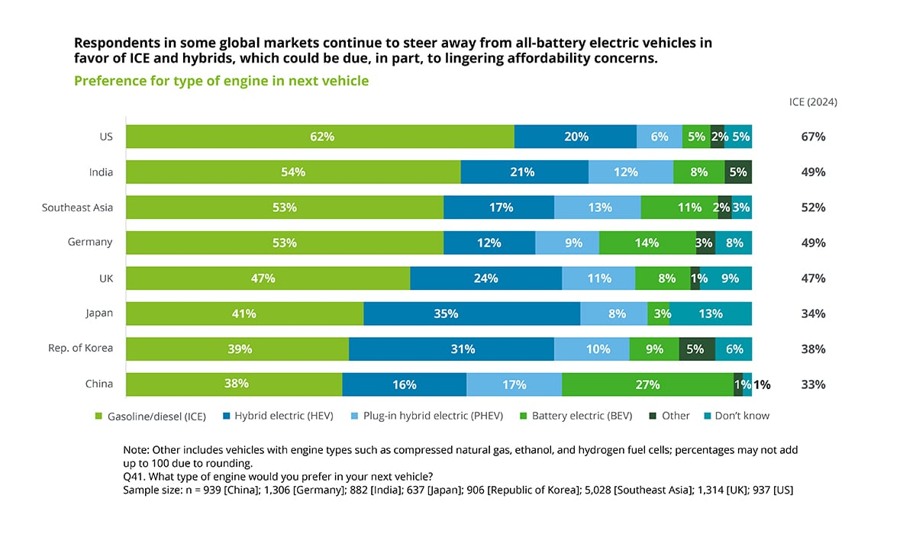

Slide 8
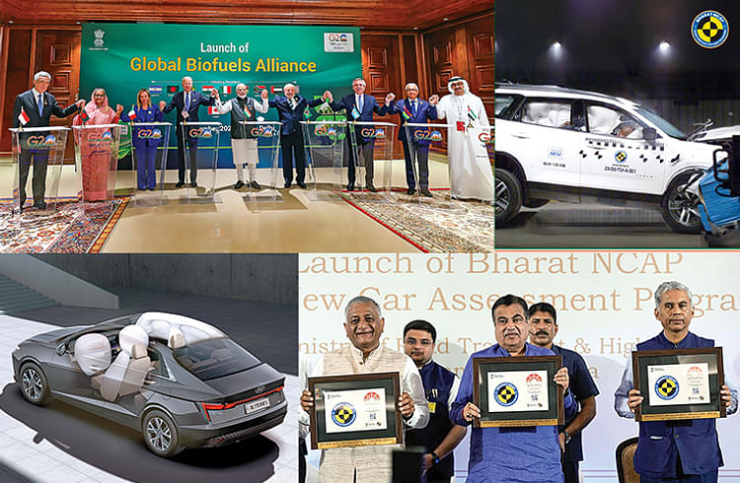
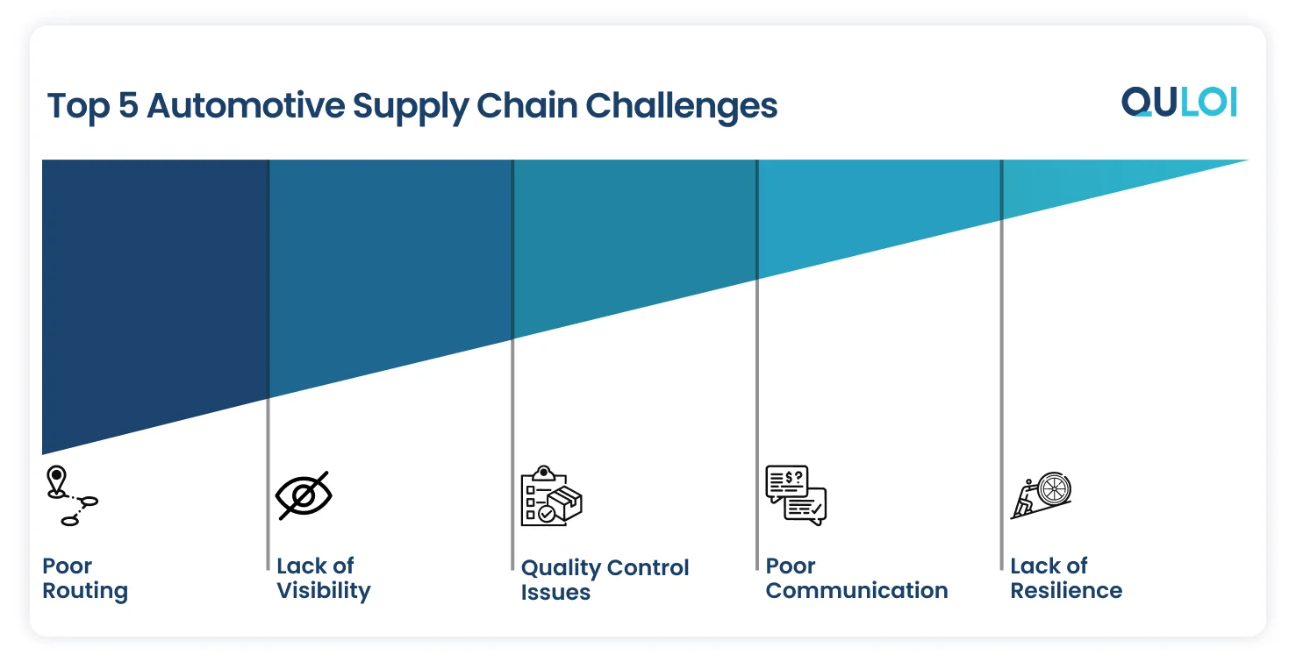
Influence of Government Policies
Supply Chain Challenges
Government policies play a critical role in shaping the automotive industry by influencing its growth, innovation, and sustainability. Emission and safety regulations push automakers to develop cleaner, safer, and more efficient vehicles through advanced technologies and materials.
Fuel efficiency standards like CAFE encourage the use of hybrid systems, lightweight designs, and electric drivetrains. Incentives for electric vehicles, such as tax breaks and infrastructure support, accelerate the transition to sustainable mobility. Trade policies impact global market access, manufacturing strategies, and supply chains, while government funding for research and development fosters innovation in areas like automation, connectivity, and green energy. Together, these policies drive transformation across the industry.
The automotive manufacturing industry relies on complex, global supply chains involving thousands of components sourced worldwide. While globalization brings cost and technology advantages, it also increases vulnerability to disruptions.
Geopolitical tensions, trade disputes, and natural disasters can halt production and raise costs. The COVID-19 pandemic exposed severe weaknesses, including factory shutdowns, labor shortages, and logistic delays. Limited supply chain visibility and reliance on just-in-time systems further heighten risk. Raw material shortages, driven by rising demand and geopolitical issues, also impact production. The shift toward electric and autonomous vehicles introduces new supply chain needs and integration challenges. Additionally, labor shortages and regulatory pressures around sustainability and compliance add complexity. Addressing these challenges requires greater transparency, technological adoption, and strategic resilience.

Slide 9
About Uniform Capital
At Uniform Capital, our purpose is to empower businesses by delivering robust financial insights and solutions. We are a specialized corporate finance firm that partners with startups, SMEs, and large enterprises to unlock growth and strategic value. Our expertise spans valuation, financial modelling, market research, fundraising, accounting outsourcing, transaction advisory, due diligence, and strategic consulting. We are committed to excellence, data-driven decision-making, and transparency. Discover more about what we do and how we can support your financial journey at www.uniformcapital.com. © 2025 Uniform Capital. All rights reserved.
Prepared by
Uniform Capital
uniformcapital.in
Data Classification: Public
This document is for informational purposes only and does not constitute professional advice. The content herein has been developed using publicly available and internal data sources considered reliable, but no warranty is given as to its accuracy or completeness. Readers are advised to consult financial professionals before making any decisions based on this material. Uniform Capital does not assume responsibility or liability for any decisions made based on the information contained herein. May 2025 • UC-04

